Slide 1
FIORI Log-in Quick Reference Guide
FMMI Intelligent Enterprise Transformation (FIET) Project

Slide 2
Contents
Logging In
Navigating the Fiori Launchpad
Understanding the Mapping of Process Areas and Transactions
Navigating to a Transaction
Customizing the Fiori Launchpad
For more information, please review the Fiori Log-In & Navigation course on FMMI Online Help

Slide 3
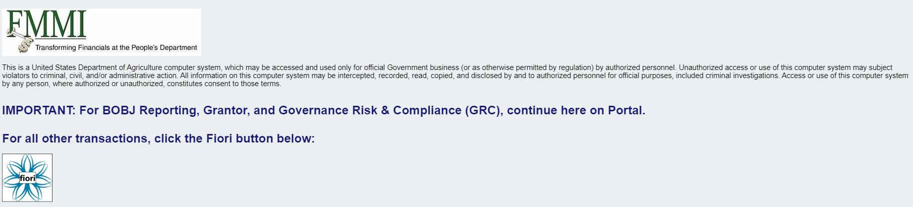
LOGGING IN
Navigate to Portal
Select the Fiori button to be taken to Fiori
You will be automatically logged in thanks to SSO

Slide 4
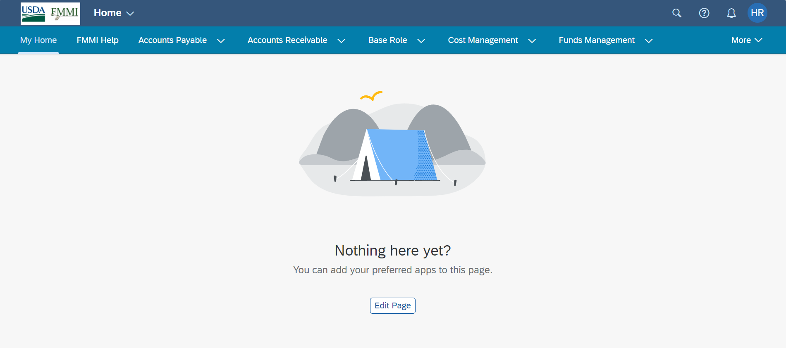
Navigating the Fiori Launchpad
Welcome to the Fiori Launchpad!
The launchpad is the landing page; the first screen you will see when you log in from Portal
Note: The FMMI Help tab is the first tab you will see; you can go there at any time to access training materials

Slide 5
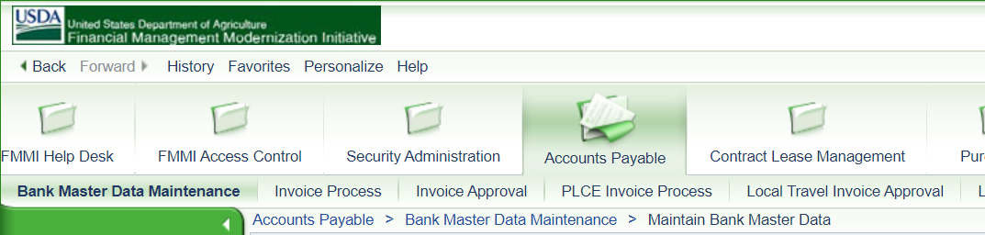
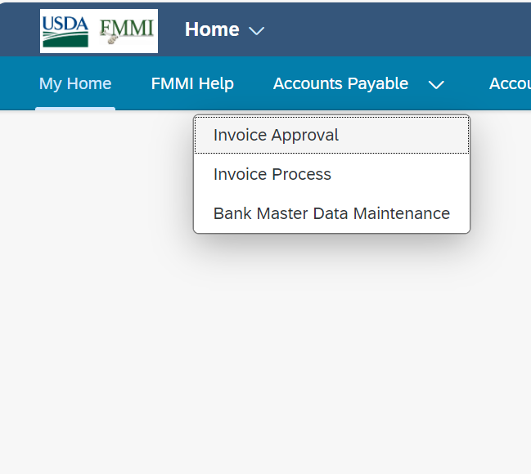
Understanding the Mapping
The process areas and transactions under each are extremely similar to what was seen in Portal
Just as a user would go to Accounts Payable > Invoice Approval to approve invoices in the Portal, they will do the same in Fiori
The process areas and transactions that each user can access will be determined by their individual role profile; the role(s) they have in Portal will inform the role(s) that they have in Fiori

Slide 6
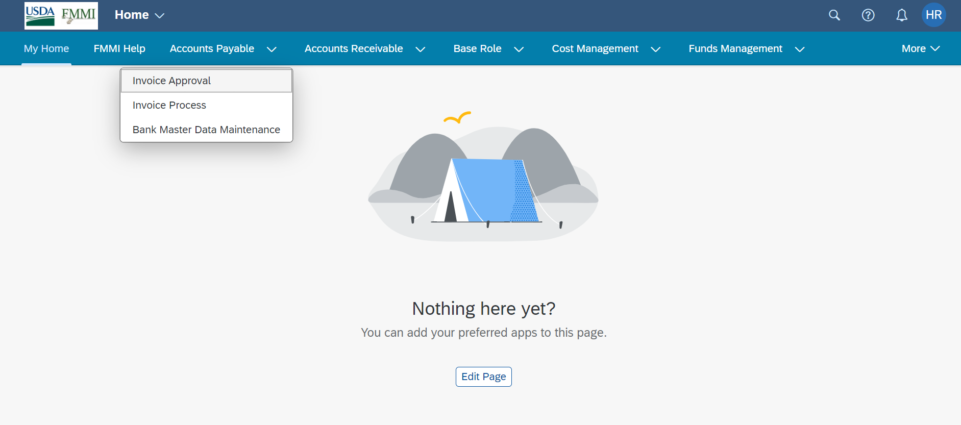
Navigating to a Transaction
To find a transaction, users have multiple options
Option 1 is to select the relevant process area, and then select the transaction you want to complete

Slide 7
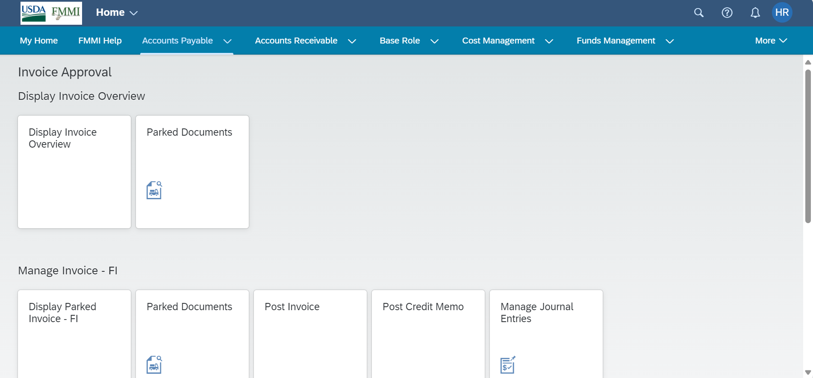
Navigating to a Transaction – Option 2
Option 2 is to select the relevant process area. This will take users to a page that shows all transactions available to them in that process area. The user can then select the desired transaction tile.

Slide 8
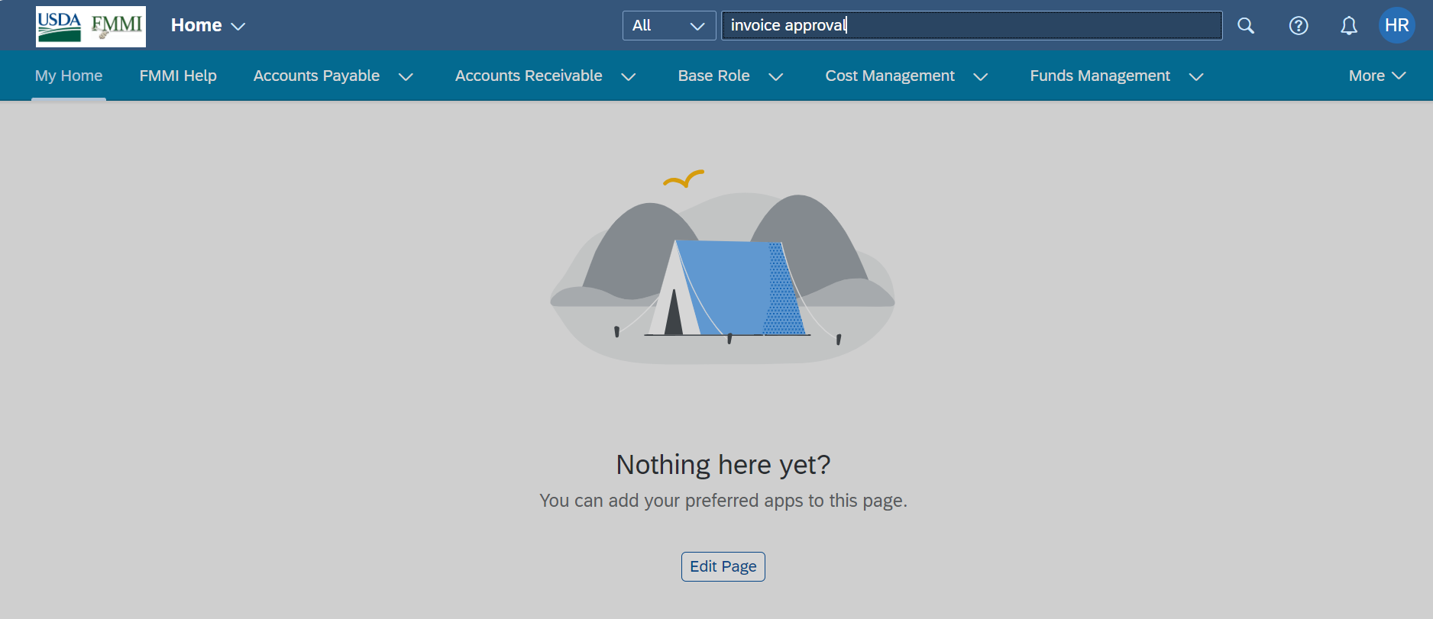
Navigating to a Transaction – option 3
Option 3 is to utilize the search function: Select the magnifying glass, then type in the name of the transaction
Note: “App,” “tile,” and “transaction” are used interchangeably in Fiori

Slide 9
Successful Navigation
Once the user successfully navigates to the transaction and selects the tile, 90% of transactions will operate exactly the same as they did in Portal.

Slide 10
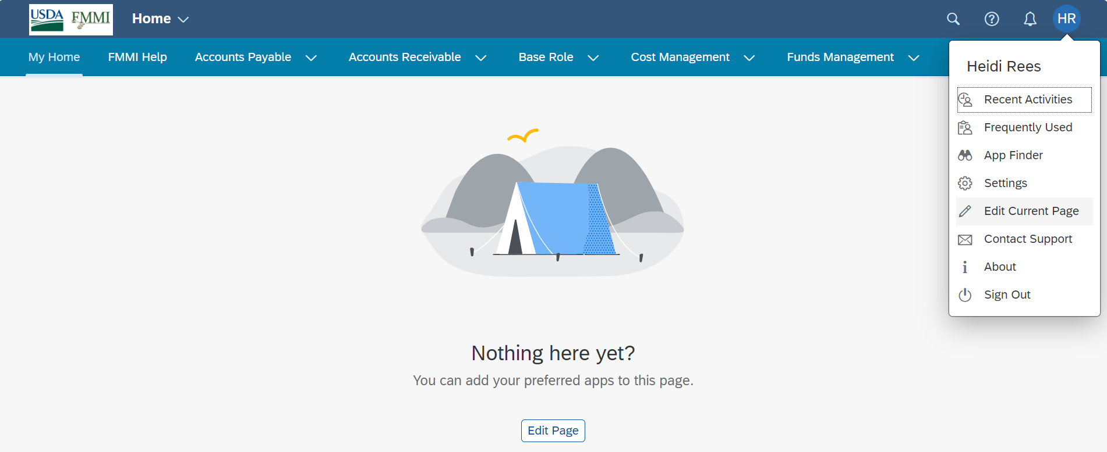
Customizing the Fiori Launchpad
Users can customize which apps they want to display on their launchpad
If a user has not already added tiles to their launchpad, they can select Edit Page in the center of the screen
Or users can select User Profile at the top right of the screen, then select Edit Current Page

Slide 11
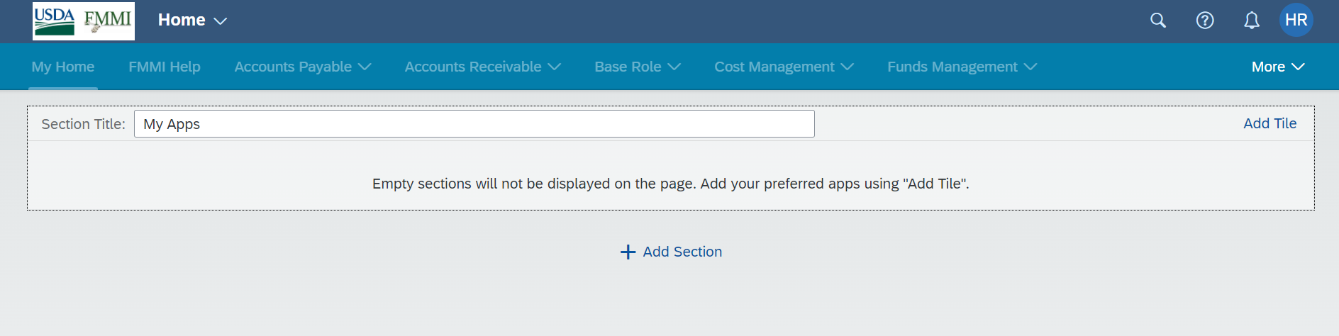
Customizing the Fiori Launchpad, Cont’d
Users have the option to add or remove a tile, rename a section, or add a section; detailed instructions on how to do this can be found in the Fiori Log-In & Navigation course on FMMI Online Help
Selecting Add Tile will take users to a catalog where they can select tiles to add to their launchpad home page

Slide 12
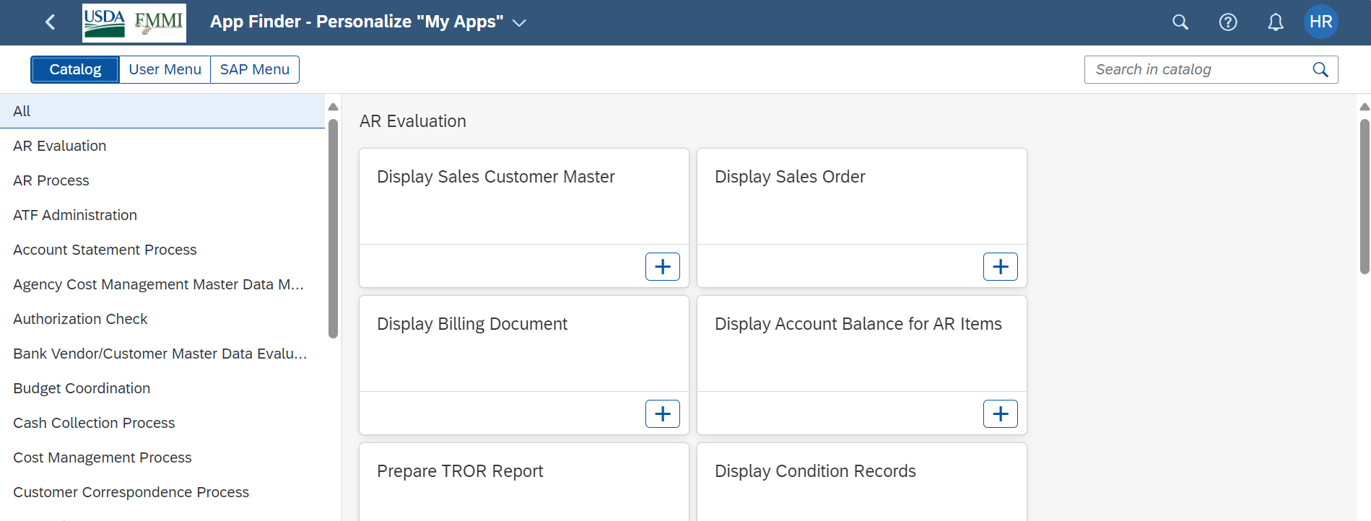
Customizing using the app finder
Users can select tiles within the App Finder to add to their launchpad home page

Slide 13
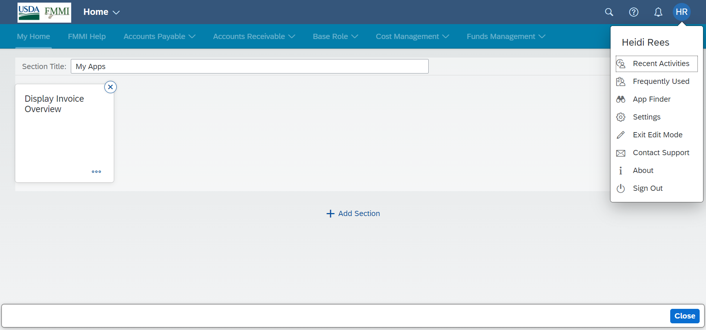
Successful customization
Once finished customizing the launchpad, select Close or Exit Edit Mode

