Slide 1

USDA 2016 Financial Management Training Transforming Shared Services
Reconciliation of IPAC Transactions for Agriculture (RITA) User Training
Presented by Eddie Reso

Slide 2
Overview
RITA Login – eAuthentication
URL https://www.ocfo.usda.gov/rita
Application is available 24/7
Stores 6 previous years and the current-year’s IPAC Bills
View all IPAC bills: Initiated and Received
View GL transactions and unprocessed bill balances
View research Notes entered by FMS staff
Generate reports
Enter notes and staff assignments to bills
Load backup attachments: xls, doc, pdf, or csv

Slide 3
RITA Modules
Reconcile Module – Quick search for IPAC Treasury Bills and Processing GL entries
Add and view notes
Add and view attachments: xls, doc, pdf, or csv
Modify and view bill assignee
Print and view bills
Report Module – Summary Information for Treasury IPAC Bills
Print Received IPAC Bills
View:
Agency Unprocessed Details
Agency Unprocessed Summary
Agency Unprocessed Spreadsheet

Slide 4
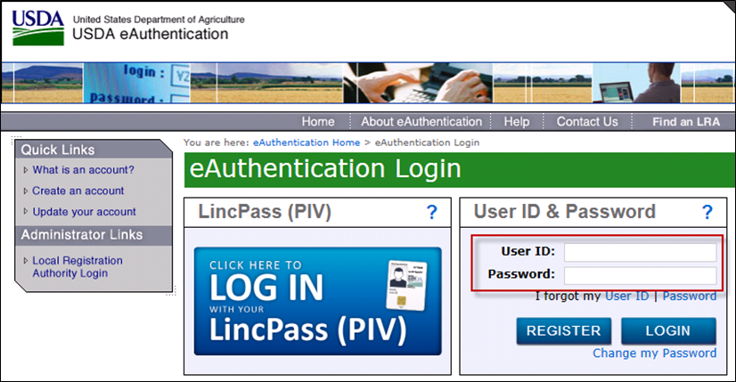
RITA Login
Sign in with your eAuthentication credentials

Slide 5
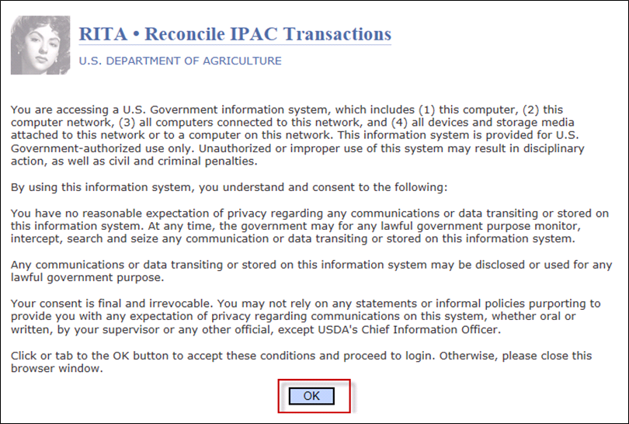
RITA Splash Page
Select the OK button to continue.

Slide 6
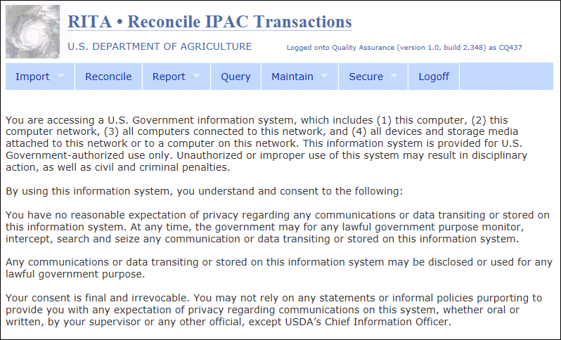
RITA Home Page
All users will see the Module Bar
Submenus visible based on security access
Access Reconcile and Report modules

Slide 7
Reconcile Module
Overview

Slide 8
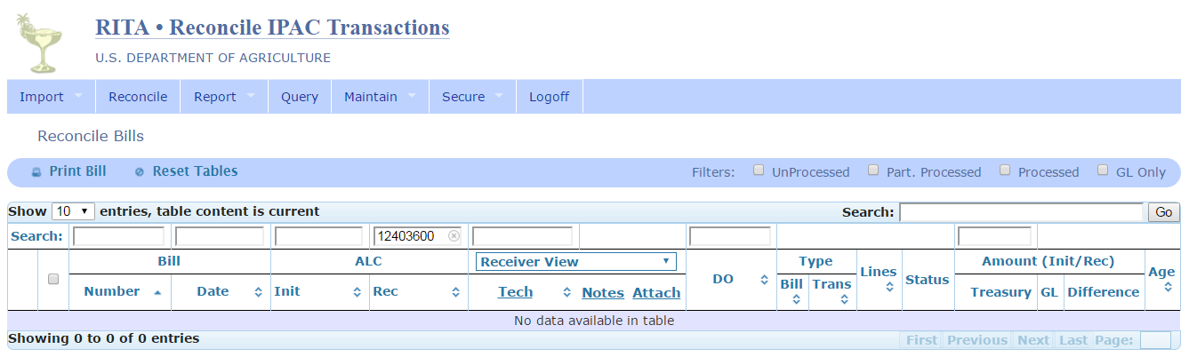
Reconcile – Display Defaults
Receiver View
Receiver ALC – defaults based on user access (Agency)
See GIPSA user example

Slide 9
Reconcile – Views
There are two sides to every IPAC Bill: Initiator and Receiver
One side of the bill is a payment
The other side is a collection
Depending on the view selected, some information – notes, attachments, and assignments – will pertain only to that particular side of the bill
A third view (Agency view) is provided to display any notes, attachments, and assignments made by USDA Customer Agency staff
Points of View summary
Initiating View – info input by FMS staff pertaining to Initiating side of bill
Receiver View – info input by FMS staff pertaining to Receiving side of bill
Agency View – info input by agency staff

Slide 10
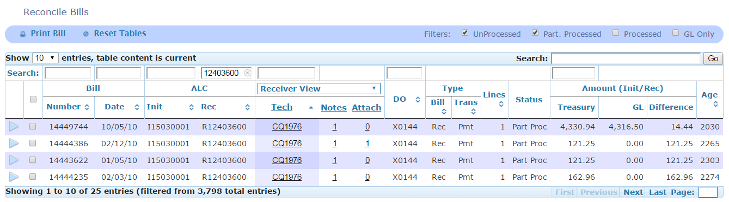
Reconcile – Views (continued)
Received bills only
Technician assignment among FMS staff
Notes added by FMS staff
Attachments added by FMS staff
All agency bills: Initiated and Received
Technician assignment among Agency staff
Notes added by Agency staff
Attachments added by Agency staff
Receiver View
Agency View

Slide 11

Reconcile – Filters
Select “Bill Status” Filters
and the GO Button
If select Unprocessed filter, the application will automatically check the Part. Processed filter. Same scenario if Part. Processed were selected.
Unprocessed
Partially Processed
Processed
GL Only

Slide 12
Reconcile – Field Definitions
Bill Number: IPAC Document Reference Number
Bill Date: Accomplished Date on the IPAC Bill
Init ALC: Originating ALC on the IPAC Bill
Rec ALC: Customer ALC on the IPAC Bill
Tech: FMS or Agency user assigned to the IPAC Bill and responsible for processing the bill
Notes: Information added by FMS or Agency user to the IPAC Bill
Attach: Documents added by FMS or Agency user to the IPAC bill (e.g. backup info)
DO:
Init ALC’s Disbursing Office (DO) Symbol
Sender DO Symbol on the IPAC Bill
Bill Type: Three types based on view
Rec – Receiver
Init – Initiator
Intra – Intragovernmental (IPAC between two USDA Agencies)
Trans Type: Transaction Type on the IPAC Bill – Payment, Collection, or Adjustment
Lines: Total number of details
Status:
UnProcess – no matching GL transactions with 0.00 in GL Amount column
Part Proc – matching GL transaction(s) and balance in Difference column
Process – matching GL transaction(s) with 0.00 balance in Difference column
Treasury Amount: Summary Amount on the IPAC Bill
GL Amount: Sum of all GL cash processing transactions with the sign (+/-) as recorded in the FMMI clearing document
Difference Amount: Amount that remains unprocessed
Age: Number of days bill is unprocessed (Current Date – Bill Date = Age)

Slide 13
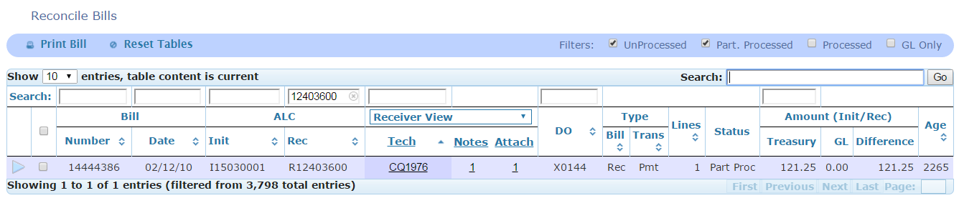
Reconcile – Search
There are two search areas:
Search by column field headings
Requires exact match of search criteria input
Enter search criteria in one or more fields
Do not use asterisks **
Global search bar
Scans all data containing search criteria input
Note: This will scan Treasury IPAC Bills (primary fields only, listed on this screen) and GL processing records (all fields).

Slide 14
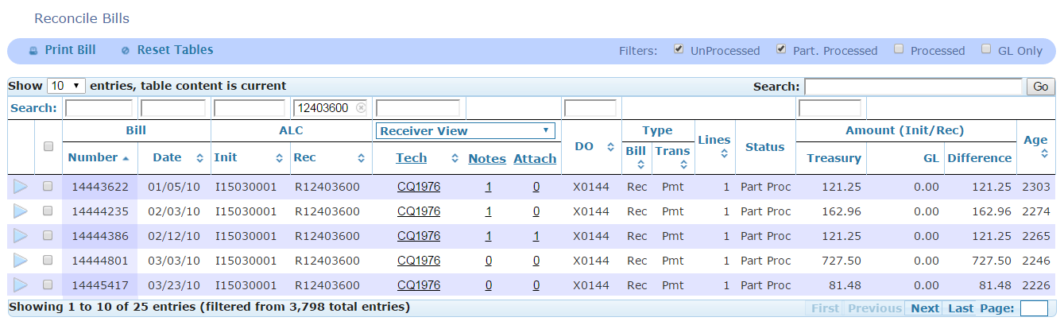
Reconcile – Sort
Default sort: ascending order to Bill Number column
Select the column arrows to sort in ascending order
Select the column arrows again to sort in descending order

Slide 15
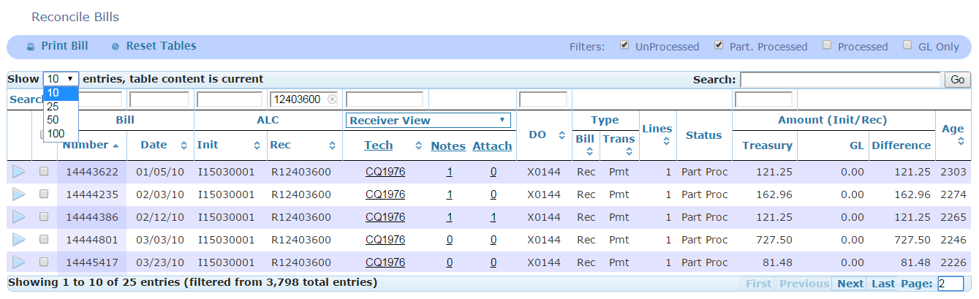
Reconcile – Navigate
There are various ways to navigate from page to page
Select entries to display per page: 10, 25, 50, or 100
Select the exact page to be displayed
First, Last, or Specific page number
CAUTION: The default is first page. Use the Reset Tables button before performing a new search to assure results display properly
If you choose a page number, RITA stays at that page for future searches. This could lead to the appearance of no results displayed if not reset. For example, no data would return when currently displaying page 10 and next query has only 6 page results

Slide 16
Drill Down To View Treasury and General Ledger Details
Reconcile Module

Slide 17
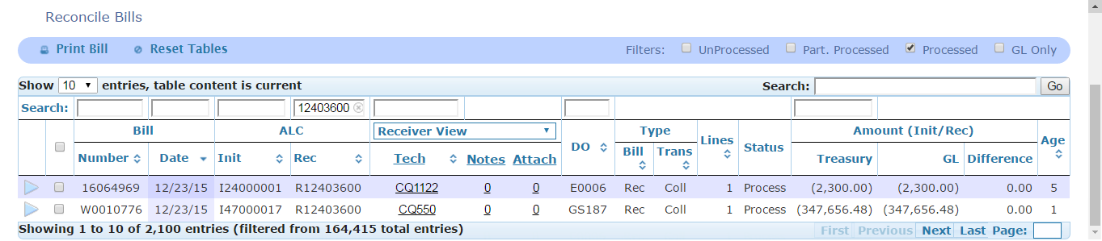


Drill Down – Summary
There are two processed bills shown at the summary level
Drill-Down Indicators
Indicates more data available; click to drill down
Indicates lowest detail-level record
Note: As you drill down, scroll to see additional data including
Detail line records, and/or GL records

Slide 18
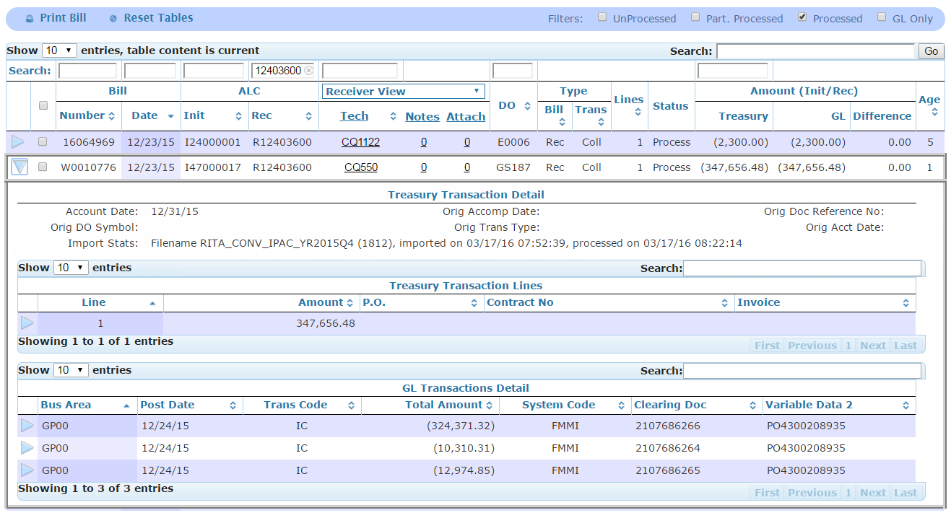
Drill Down – Treasury and GL Details
Select the arrow to drill down to the
Treasury Details
and GL Details
Note: GL records pertain to a bill as a whole, not the individual detail lines.
Processed Bill

Slide 19
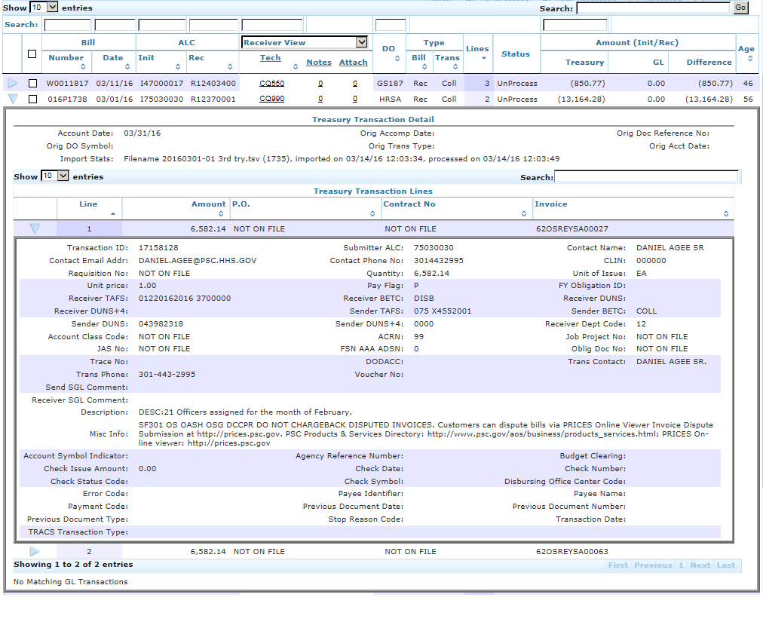
Drill Down – Treasury Detail Lines
Select the arrow to drill down to see
IPAC Bill detail line(s)
This example is an unprocessed bill; thus, no matching GL transactions
Note: For Conversion bills (dated prior to June 1, 2016), the only Treasury Detail information is the Description.

Slide 20
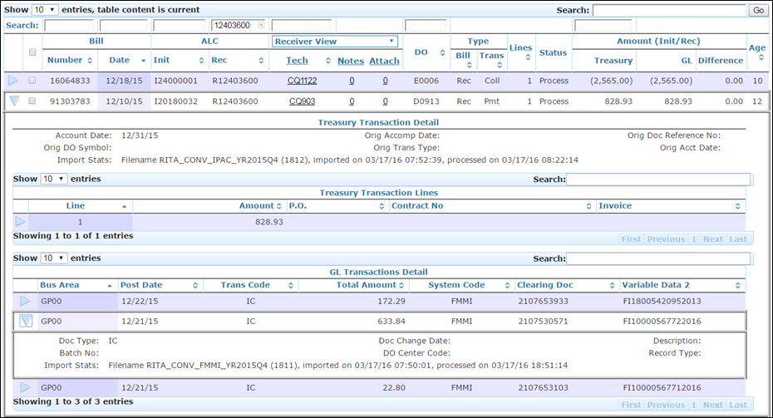
Drill Down – GL Details
Processed Bill
Select the arrow to drill down to the
GL Details

Slide 21
Drill Down – GL Field Definitions
Bus Area: FMMI business area
Post Date: Posting date in accounting system
Trans Code: FMMI document type
Total Amount: Total amount on document
System Code: Accounting system (FMMI)
Clearing Doc: FMMI clearing or cash document number
Variable Data 2: FMMI PO or FI accounting document
Doc Type: FMMI document type
Batch No: Not applicable for FMMI
Import Stats: File name and import date
Doc Change Date: Change date in accounting system
DO Center Code: Not applicable for FMMI
Description: Not applicable for FMMI
Record Type: Not applicable for FMMI

Slide 22
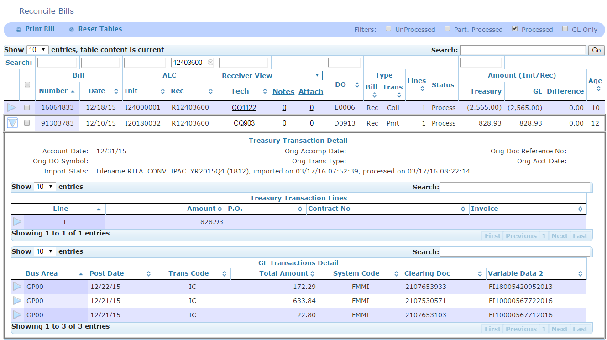
Reconcile – GL Sign (+/-)
GL cash processing entries are displayed with the debit and credit signs as recorded on the FMMI clearing document.
Below example is a “received” payment, “money coming in”.

Slide 23
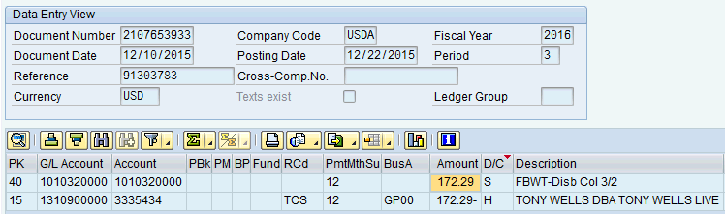
Reconcile – GL Sign (continued)
Identified GL Transactions can be displayed in FMMI – See previous page example IPAC Bill 91303783 dated 12/10/2015 in the amount of $828.23
Below is first document 2107653933 identified in RITA, partially processing this bill. (see previous page)

Slide 24
Reconcile Module (continued)
View FMS Assignee
View FMS Notes
View FMS Attachments

Slide 25
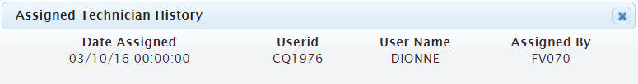
Reconcile – View FMS Assignee
Click on the Tech ID to view more information
If multiple assignments have been made, these will be displayed in chronological order

Slide 26
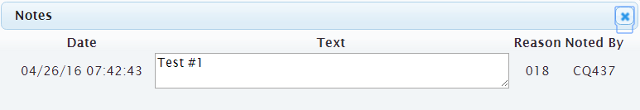
Reconcile – View FMS Notes
Click on the note to view contents

Slide 27
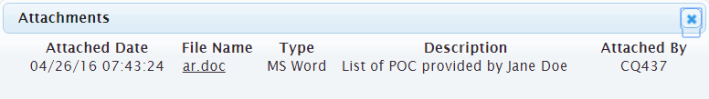
Reconcile – View FMS Attachments
Click on the attachment to view contents

Slide 28
Agency View
Allows user to:
Assign responsible Agency staff
Add Agency notes
Add Agency attachments

Slide 29
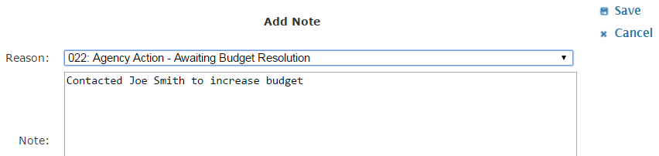
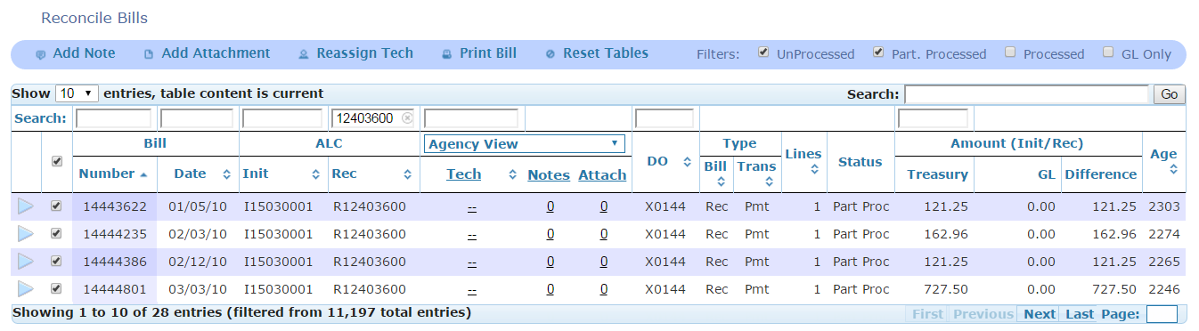
Agency View – Add Notes
Select IPAC Bill(s)
….then click “Add Note” button
Select a Reason Code and Enter Notes, click Save

Slide 30
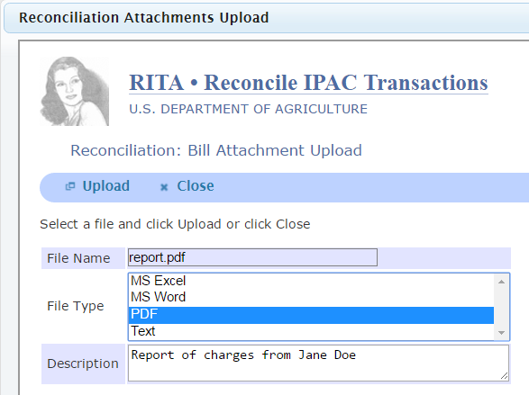

Agency View – Add Attachments
Select: IPAC Bill(s)
Add Attachment button
File Name
File Type
Click Upload
Close the pop-up window

Slide 31

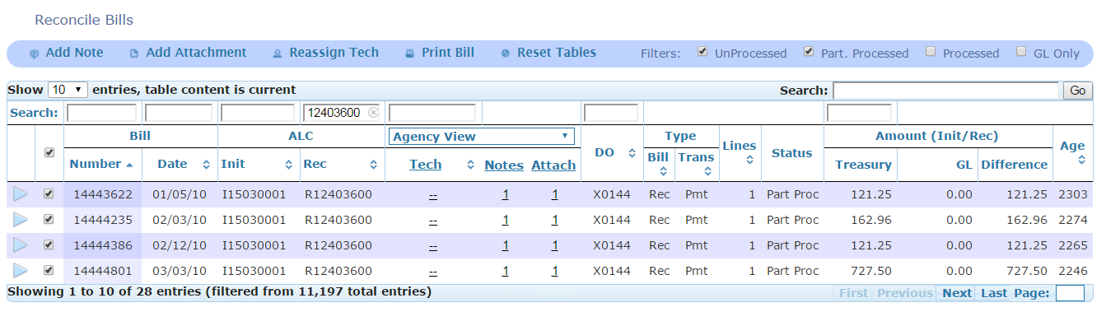
Agency View – Reassign Tech
Select IPAC Bill(s)
, then click Reassign Tech button
Select a new Tech ID
and the Save button

Slide 32
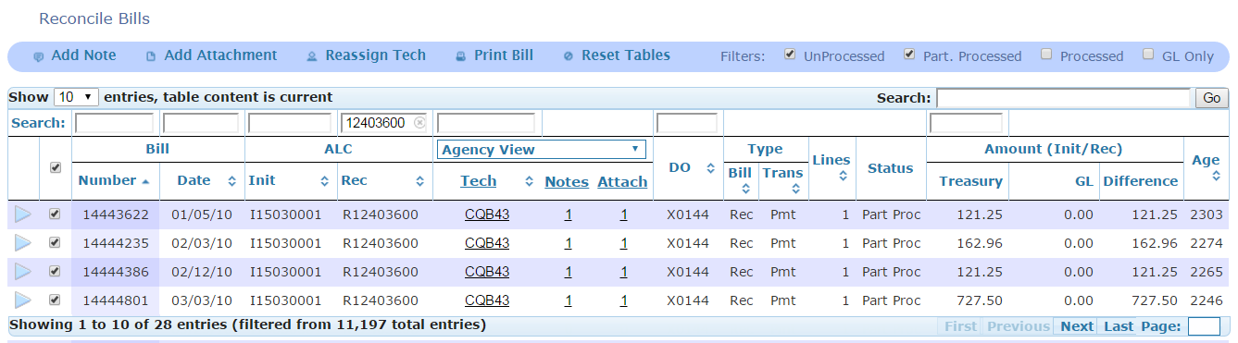
Agency View – Print Bill
Reconcile Module is the best place to print bills in RITA
Any IPAC bill can be printed
Select single or multiple bills
– then, click Print Bill
A PDF will open containing all bills selected with all detail lines

Slide 33
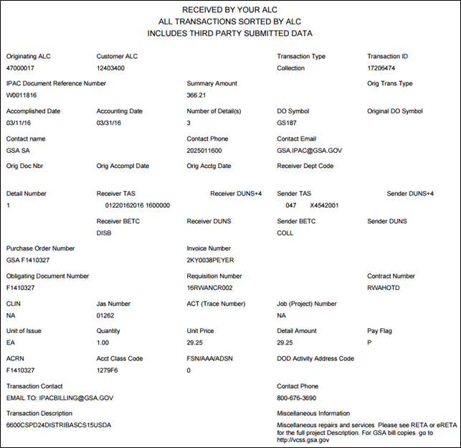
Agency View – Print Bill (continued)
This is an exact replica of the IPAC Bill generated by Treasury.
For Conversion bills (dated prior to June 1, 2016), the only Treasury Detail information is the Description.

Slide 34
Report Module
Overview

Slide 35
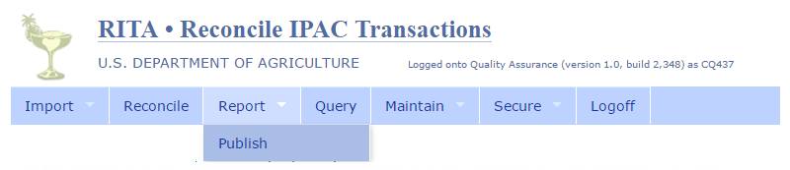
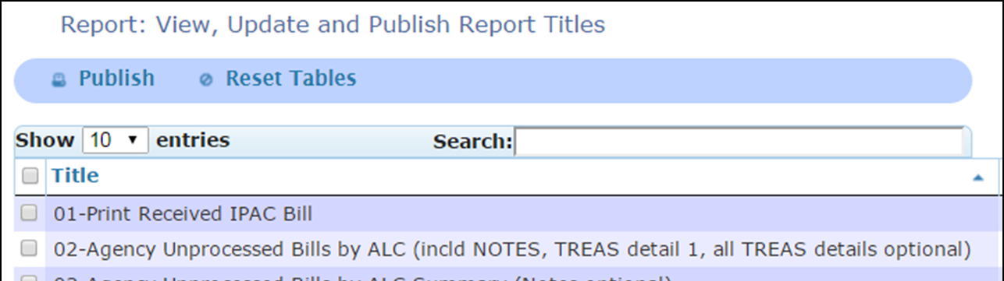
Report Module – Publish Submenu
Select the Report Module and Publish Submenu to view available reports
Note: There are multiple pages of available reports

Slide 36
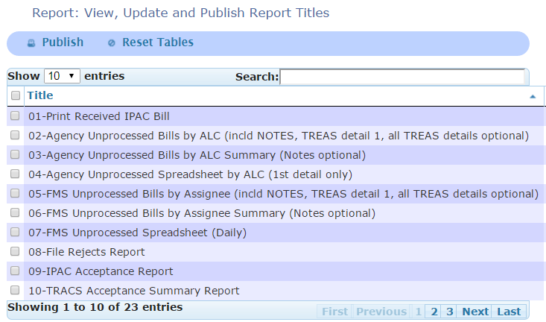
Report Module (continued)
The most commonly used reports
The Weekly Reports

Slide 37
Report Module (continued)
RReport Module (continued)
eport Module (continued)
01 – Print Received IPAC Bill
Excludes Initiated Bills
Excludes Sender DO Symbols: GS116 , GS127, and GS157
(GSA FEDS, TOPS, and MPOL)
02 – Agency Unprocessed Details
Includes information from IPAC Bill
Includes current FMS assignee
Includes notes from all views: Initiating, Receiving, and Agency
Option to select all or first Treasury detail lines
The Weekly Reports EMAILED TO AGENCY
03 – Agency Unprocessed Summary
No Treasury IPAC Bill information
Includes current FMS and Agency assignee
With or without notes
04 – Agency Unprocessed Spreadsheet
First Treasury detail line only
No notes

Slide 38
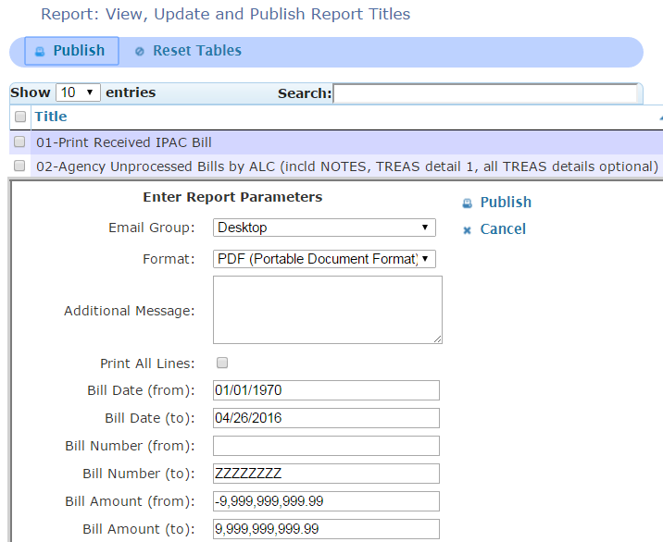
Report Module Publish (continued)
Select one report
and then click the Publish
Parameters will appear
Select the Publish button (to the right) to generate the report

Slide 39
Report Modules
Parameter Definitions

Slide 40
Report Module – Parameters
There are various elements in the Report Parameters
Allows for easier search
Not required to enter parameters
Most of the fields have default information
Note: Tabbing from field to field changes the defaulted info
Use the mouse to select specific parameters
Click the white space outside the fields after entering search criteria
The parameters will print on the last page of the report

Slide 41
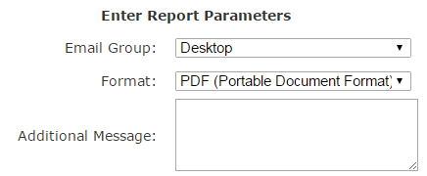
Report Module – Parameters (continued)
Email Group: two options for report
Desktop (default) – report generated in new browser tab and not emailed
Other selection – report emailed to RITA User(s) in a predefined group
Additional Message – the email body sent to RITA Users in the predefined group
Formats available:
CSV
HTML
PDF
XLS

Slide 42

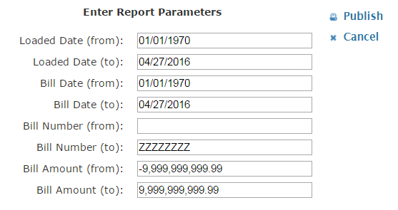

Report Module – Enter Parameters
Date Ranges default from the beginning of time to current date
Load Date: the date the bill was imported to RITA
Bill Date: the Accomplished Date of the IPAC Treasury Bill
Select dates from calendar or enter in MM/DD/YYYY format
Be a mouse person. NO TABBING
Bill Number
FROM defaults with a leading space to account for 7-digit bill
Remove the space when searching for 8-digit bill number
TO defaults with “ZZZZZZ” which encompasses everything
Bill Amount
Enter amounts in absolute values
Defaults with 9,999,999,999.99 which encompasses everything

Slide 43
Report Module – Parameters II
Print First Line Only:
Default to print all Treasury IPAC Bill detail lines if there are multiple lines
Select to populate only the first detail line
Print All Lines:
Default to print only first Treasury IPAC Bill detail line
Select to populate all detail lines if there are multiple lines
Print Note Details:
Select to populate Assignee notes on the report
Otherwise, the report will display without assignee notes
Agency Location Code(s): USDA agencies
Sender Treasury Symbol: Sender Treasury Account Symbol (TAS) or Treasury Account Fund Symbol (TAFS) on IPAC Bill
Receiver Treasury Symbol: Receiver TAS or TAFS on IPAC Bill
Assignee(s): FMS user assigned to IPAC Bill
Reason Code(s): Code selected by FMS user when entering notes
DO Symbol(s): Sender Disbursing Office (DO) Symbol on IPAC Bill
Bill State(s): Two options
Unprocessed includes both UnProc and Partially Process
Processed
Defaults to return all bill states if no selection is made
Information as stated on the Treasury IPAC Bill
Exact Match fields: Contract Number, PO Number, and Invoice Number
Wild Card field: Description and Misc. Info
Trans Type(s): Transaction Type on Treasury IPAC Bill
C – Collection and P – Payment
RITA looks at the Original Transaction Type for Adjustment Bills

Slide 44
Report Module Examples
Report Examples

Slide 45
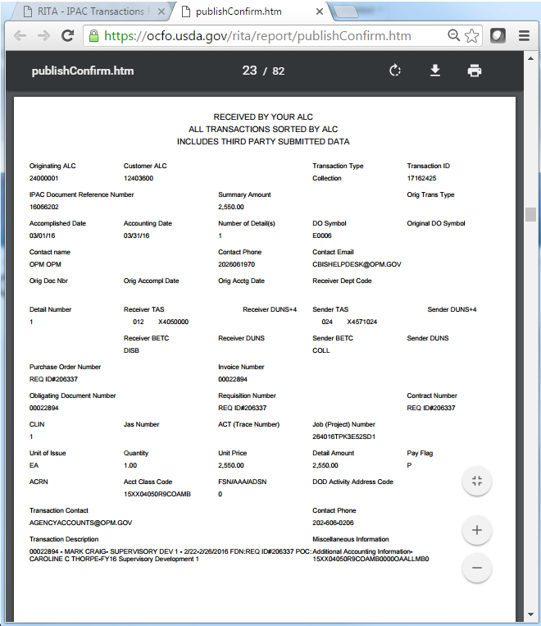
Examples
01-Print Received IPAC Bill
New tab opens with report
Download and save
Print
Excludes
Initiated bills
Sender DO Symbols
GS116 GSA FEDS
GS127 GSA TOPS
GS157 GSA MPOL

Slide 46
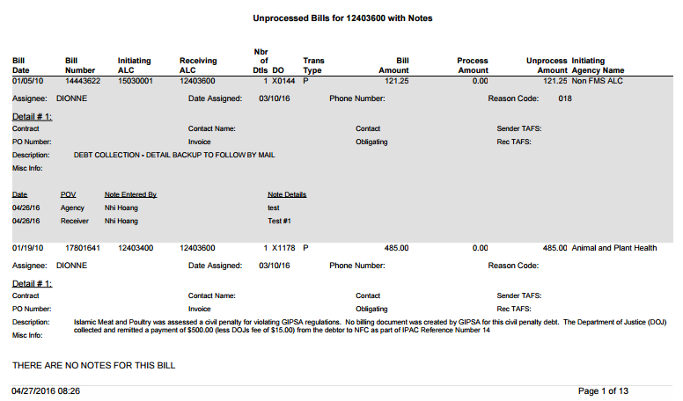
Examples (continued)
02-Agency Unprocessed Bills by ALC
TREAS Header
TREAS Detail 1 (all details –optional)
Notes from all points of view

Slide 47
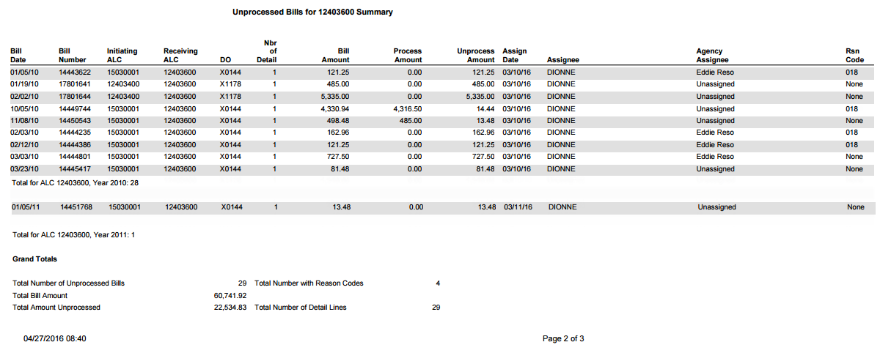
Examples Unprocessed Bills
03-Agency Unprocessed Bills by ALC Summary
No Treasury IPAC Bill detail information
Notes are optional
Example shows report without notes
Statistics
Current FMS Assignee
Current Agency Assignee

Slide 48
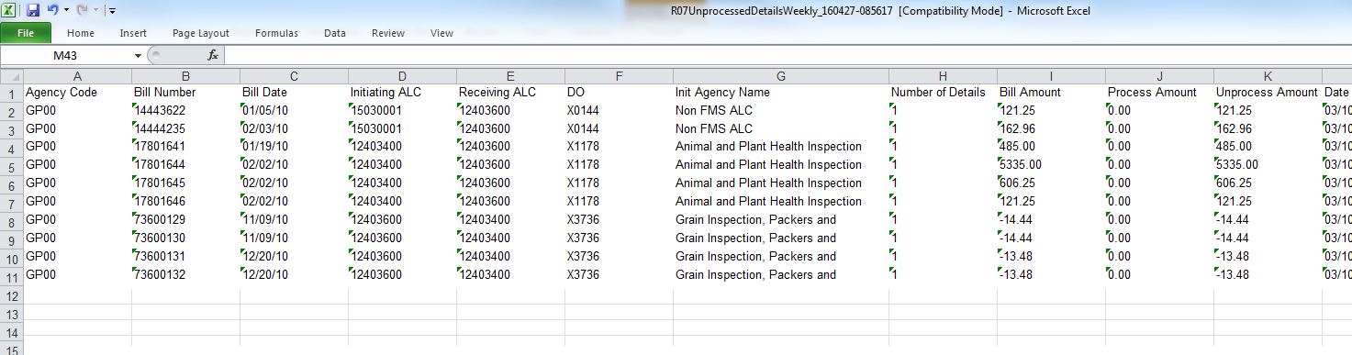
Examples Unprocessed Spreadsheet
04-Agency Unprocessed Spreadsheet by ALC
Default format: Excel Spreadsheet
Data available up to Column AB
Includes select Treasury IPAC Bill information for Detail Line 1
Columns Q-T: PO, Obligating Doc, Invoice Number, and Contract Number
Columns U-V: Sender and Receiver TAS
Columns W-Y: Description, Miscellaneous Information, and Transaction Contact
Column AB: Accounting Classification Code
Column AA: Agency Assigned

Slide 49
Contacts
Eddie Reso, Cash Processing Branch Chief
eddie.reso@nfc.usda.gov
504-426-5064
Tam Nguyen, Program Analyst
tam.nguyen@nfc.usda.gov
504-426-5057
Nhi Hoang, Systems Accountant
nhi.hoang@nfc.usda.gov
504-426-5042

Slide 50
RITA Implementation 2016
Questions ?

