Slide 1

Reporting of IPAC Transactions
(RITA)
User Training
Presented by: Eddie Reso

Slide 2
Overview
RITA Login – eAuthentication
  URL https://www.ocfo.usda.gov/rita
  Application is available 24/7
  Stores 6 previous years and the current year’s IPAC Bills
View all IPAC bills: Initiated and Received
View GL transactions and unprocessed bill balances
View research Notes entered by FMS staff
Generate reports
Enter “agency” notes and staff assignments to bills
Load backup attachments: xls, doc, pdf, or csv

Slide 3
RITA Modules
Reconcile Module – Quick search for IPAC Treasury Bills and Processing GL entries
  Add and view notes
  Add and view attachments: xls, doc, pdf, or csv
  Modify and view bill assignee
  Print and view bills
Report Module – Summary Information for Treasury IPAC Bills
  Print Received IPAC Bills
  View:
    Agency Unprocessed Details
    Agency Unprocessed Summary
    Agency Unprocessed Spreadsheet

Slide 4
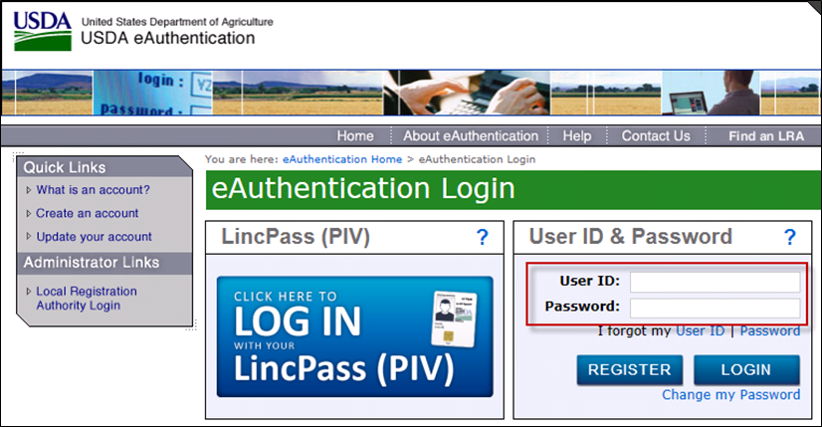
RITA Login
Sign in with your eAuthentication credentials

Slide 5
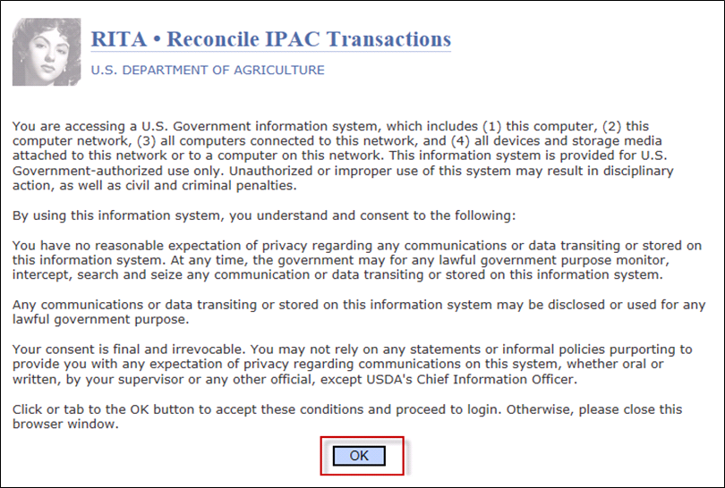
RITA Splash Page
Select the OK button to continue.
Notes:
RITA icon picture changes frequently.

Slide 6
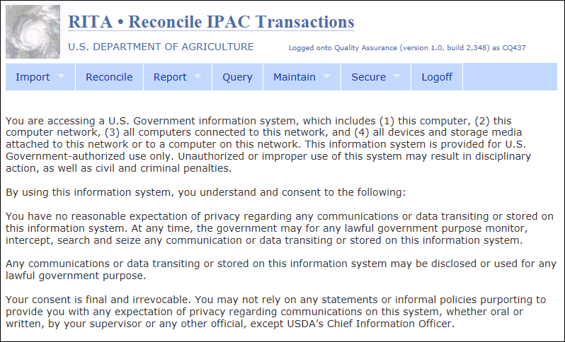
RITA Home Page
All users will see the Module Bar
  Submenus visible based on security access
  Access Reconcile and Report modules

Slide 7
Reconcile Module
Overview

Slide 8
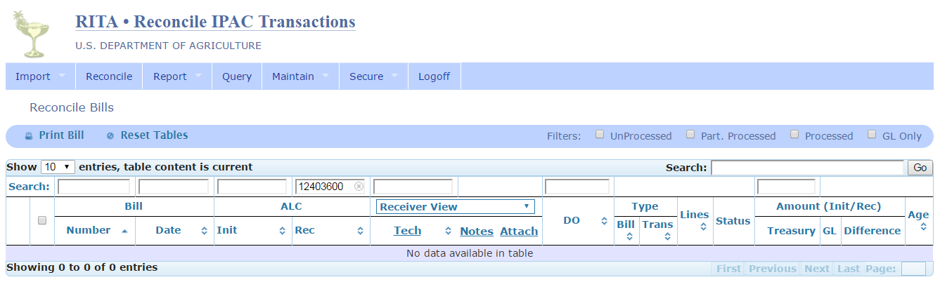
Reconcile – Display Defaults
Receiver View
Receiver ALC – defaults based on user access (Agency)
See GIPSA user example

Slide 9
Reconcile – Views
There are two sides to every IPAC Bill: Initiator and Receiver
  One side of the bill is a payment
  The other side is a collection
Depending on the view selected, some information – notes, attachments, and assignments – will pertain only to that particular side of the bill
A third view (Agency view) is provided to display any notes, attachments, and assignments made by USDA Customer Agency staff
Points of View summary
Initiating View – info input by FMS staff pertaining to Initiating side of bill
Receiver View – info input by FMS staff pertaining to Receiving side of bill
Agency View – info input by agency staff

Slide 10
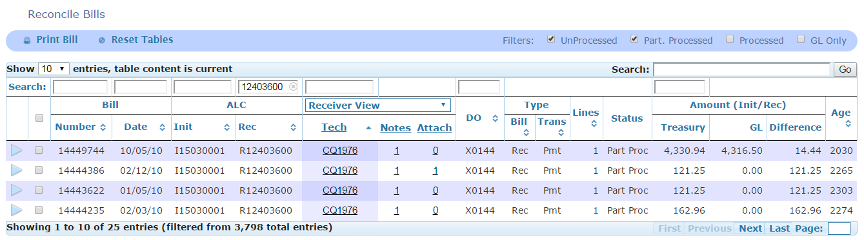
Reconcile – Views (continued)
  Received bills only
  Technician assignment among FMS staff
  Notes added by FMS staff
  Attachments added by FMS staff
  All agency bills: Initiated and Received
  Technician assignment among Agency staff
  Notes added by Agency staff
  Attachments added by Agency staff
Receiver View
Agency View

Slide 11

Reconcile – Filters
Select “Bill Status” Filters
and the GO Button
  If select Unprocessed filter, the application will automatically check the Part. Processed filter. Same scenario if Part. Processed were selected.
  Unprocessed
  Partially Processed
  Processed
  GL Only

Slide 12
Reconcile – Field Definitions
Bill Number: IPAC Document Reference Number
Bill Date: Accomplished Date on the IPAC Bill
Init ALC: Originating ALC on the IPAC Bill
Rec ALC: Customer ALC on the IPAC Bill
Tech: FMS or Agency user assigned to the IPAC Bill and responsible for processing the bill
Notes: information added by FMS or Agency user to the IPAC Bill
Attach: documents added by FMS or Agency user to the IPAC bill (e.g. backup info)
DO:
  Init ALC’s Disbursing Office (DO) Symbol
  Sender DO Symbol on the IPAC Bill
Bill Type: three types based on view
  Rec – Receiver
  Init – Initiator
  Intra – Intragovernmental (IPAC between two USDA Agencies)
Trans Type: Transaction Type on the IPAC Bill – Payment, Collection, or Adjustment
Lines: Total number of details
Status:
  UnProcess – no matching GL transactions with 0.00 in GL Amount column
  Part Proc – matching GL transaction(s) and balance in Difference column
  Process – matching GL transaction(s) with 0.00 balance in Difference column
Treasury Amount: Summary Amount on the IPAC Bill
GL Amount: Sum of all GL cash processing transactions with the sign (+/-) as recorded in the FMMI clearing document
Difference Amount: Amount that remains unprocessed
Age: Number of days bill is unprocessed (Current Date – Bill Date = Age)

Slide 13
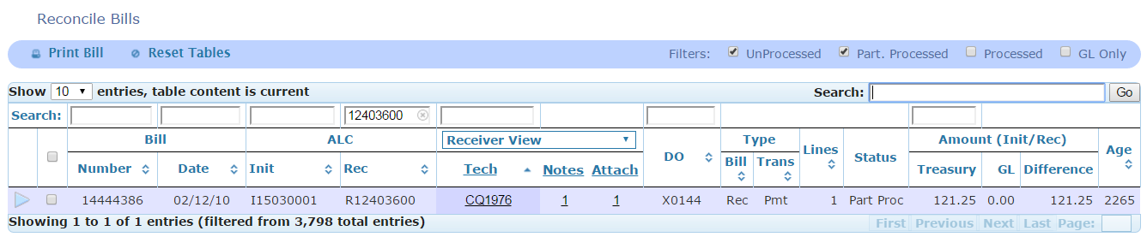
Reconcile – Search
There are two search areas:
  Search by column field headings
    Requires exact match of search criteria input
    Enter search criteria in one or more fields
    Do not use asterisks **
  Global search bar
    scans all data containing search criteria input
    Note: this will scan the Treasury IPAC Bills (primary fields only – when drill down) and GL processing records (primary fields only – when drill down)

Slide 14
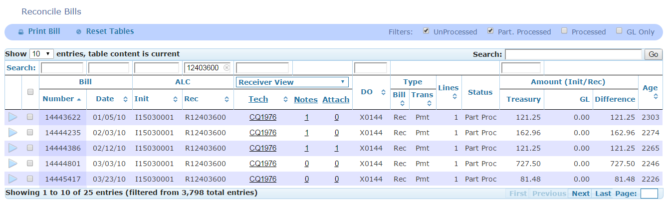
Reconcile – Sort
Default sort: ascending order to Bill Number column
  Select the column arrows to sort in ascending order
  Select the column arrows again to sort in descending order

Slide 15
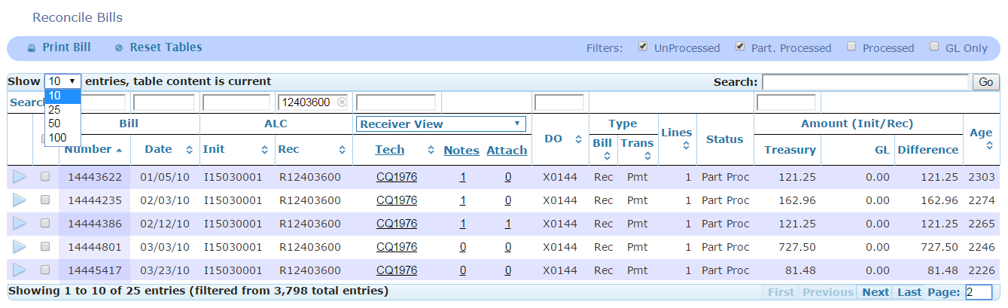
Reconcile – Navigate
There are various ways to navigate from page to page
  Select entries to display per page: 10, 25, 50, or 100
  Select the exact page to be displayed
    First, Last, or Specific page number
    CAUTION: the default is first page. Use the Reset Tables button before performing new search to assure results display properly
If you choose a page number, RITA stays at that page for future searches. This could lead to the appearance of no results displayed if not reset. For example, no data would return when currently displaying page 10 and next query has only 6 page results

Slide 16
Drill Down To View Treasury and General Ledger Details
Reconcile Module

Slide 17
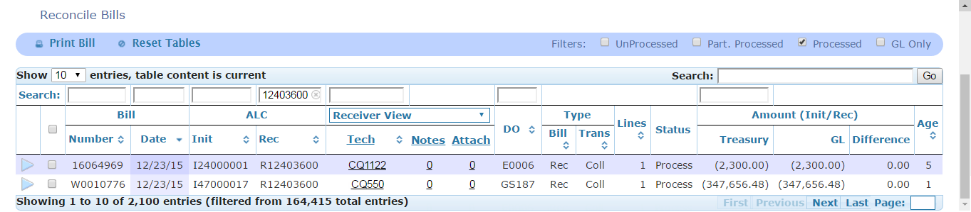


Drill Down – Summary
There are two processed bills shown at the summary level
Drill-Down Indicators
Indicates more data available; click to drill down
Indicates lowest detail-level record
Note: As you drill down, scroll to see additional data including
Detail line records, and/or GL records

Slide 18
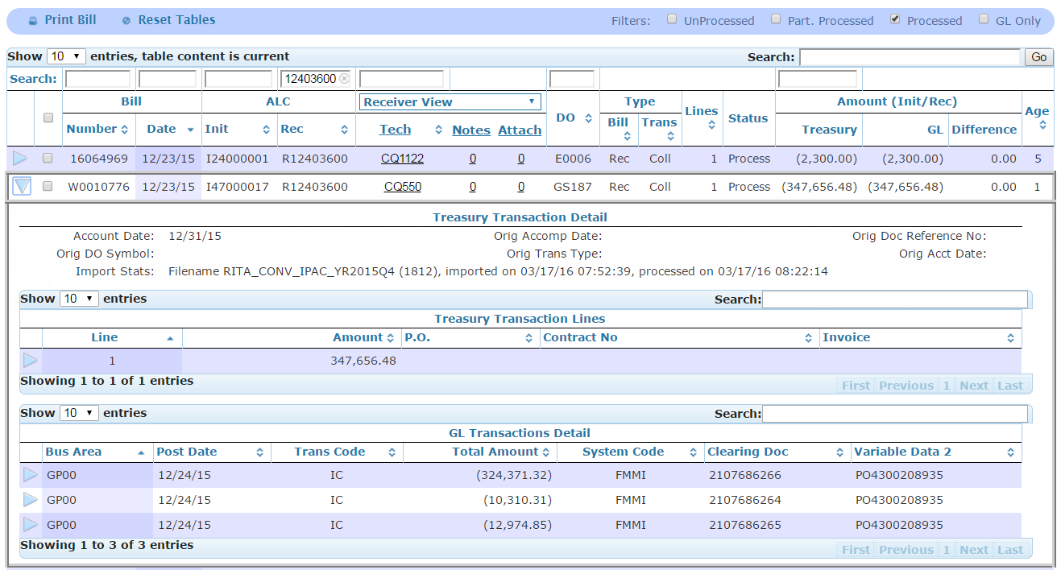
Drill Down – Treasury and GL Details
Select the arrow to drill down to the
Treasury Details
and GL Details
Note: GL records pertain to a bill as a whole, not the individual detail lines.
Processed Bill

Slide 19
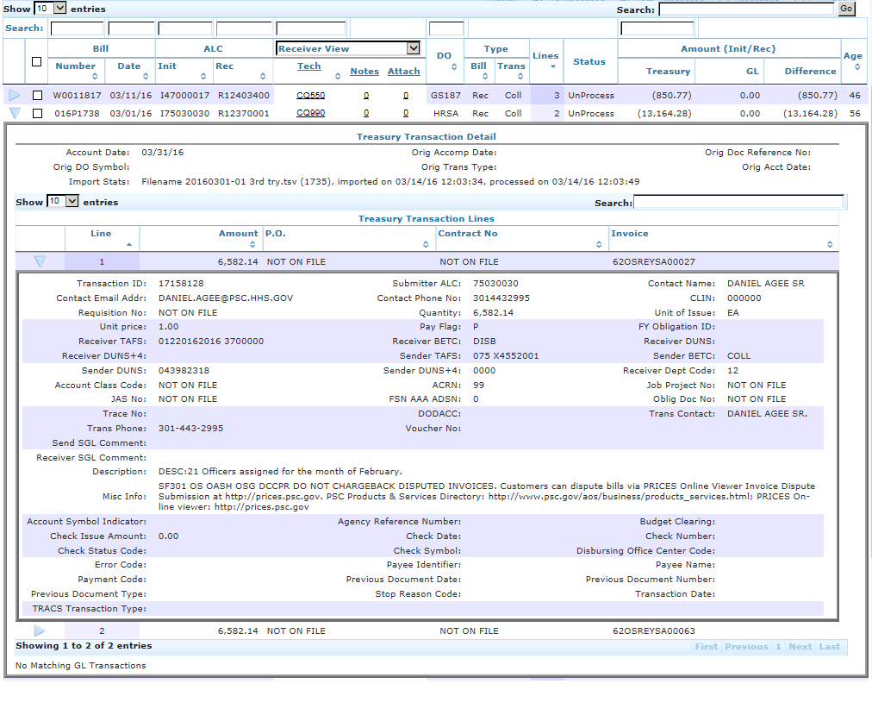
Drill Down – Treasury Detail Lines
Select the arrow to drill down to see
IPAC Bill detail line(s)
This example is an unprocessed bill; thus, no matching GL transactions
Note:
For Conversion bills (those bills dated prior to 08/01/16, the RITA production date), only Treasury Detail information is the Description.

Slide 20
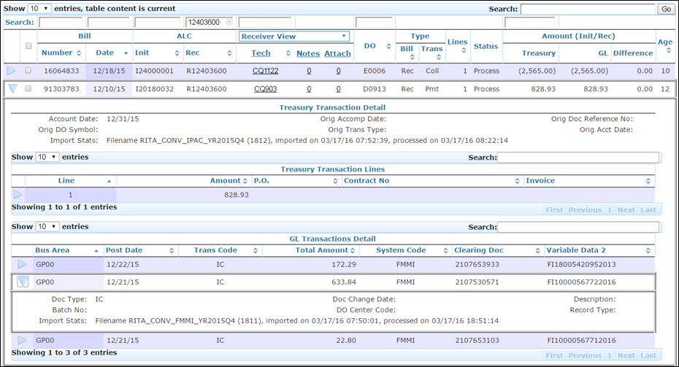
Drill Down – GL Details
Processed Bill
Select the arrow to drill down to the
GL Details

Slide 21
Drill Down – GL Field Definitions
Bus Area: FMMI business area
Post Date: Posting date in accounting system
Trans Code: FMMI document type
Total Amount: Total amount on document
System Code: Accounting system (FMMI)
Clearing Doc: FMMI clearing or cash document number
Variable Data 2: FMMI PO or FI accounting document
Doc Type: FMMI document type
Batch No: not applicable for FMMI
Import Stats: file name and import date
Doc Change Date: Change date in accounting system
DO Center Code: not applicable for FMMI
Description: not applicable for FMMI
Record Type: not applicable for FMMI

Slide 22
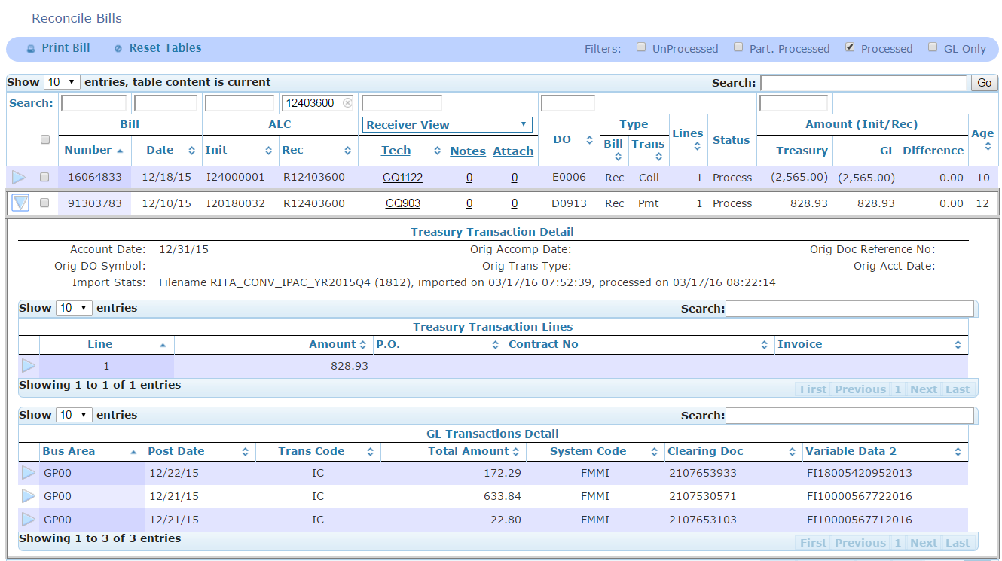
Reconcile – GL Sign (+/-)
GL cash processing entries are displayed with the debit and credit signs as recorded on the FMMI clearing document.
Below example is a “received” payment, “money coming in”.

Slide 23
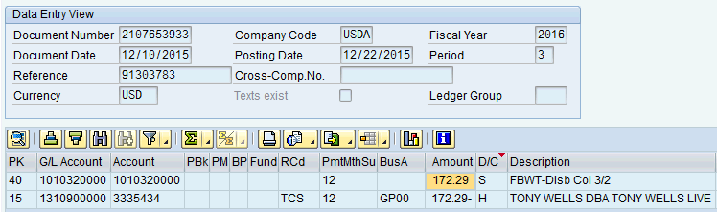
Reconcile – GL Sign (continued)
Identified GL Transactions can be displayed in FMMI – See previous page example IPAC Bill 91303783 dated 12/10/2015 in the amount of $828.23
Below is first document 2107653933 identified in RITA, partially processing this bill. (see previous page)

Slide 24
Reconcile Module
(continued)
View FMS Assignee
View FMS Notes
View FMS Attachments

Slide 25
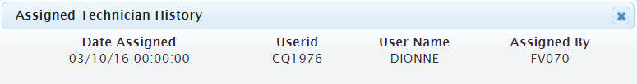
Reconcile – View FMS Assignee
Click on the Tech ID to view more information
  If multiple assignments have been made, these will displayed in chronological order

Slide 26
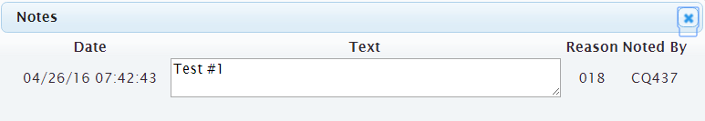
Reconcile – View FMS Notes
Click on the note to view contents

Slide 27
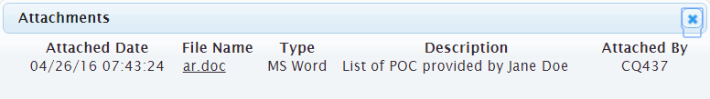
Reconcile – View FMS Attachments
Click on the attachment to view contents

Slide 28
Agency View
Allows user to:
Assign responsible Agency staff
Add agency notes
Add agency attachments

Slide 29
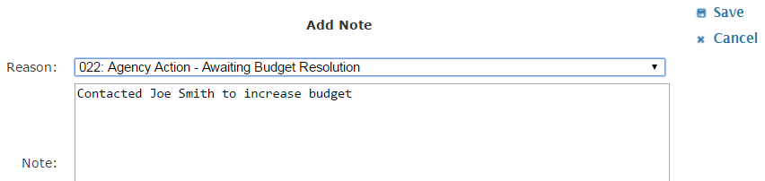
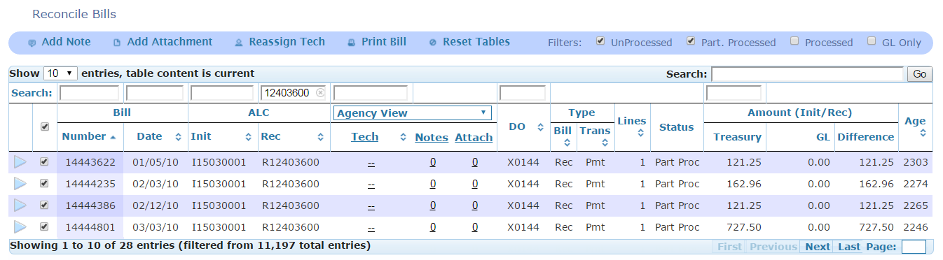
Agency View – Add Notes
Select IPAC Bill(s)
….then click “Add Note” button
Select a Reason Code and Enter Notes, click Save

Slide 30
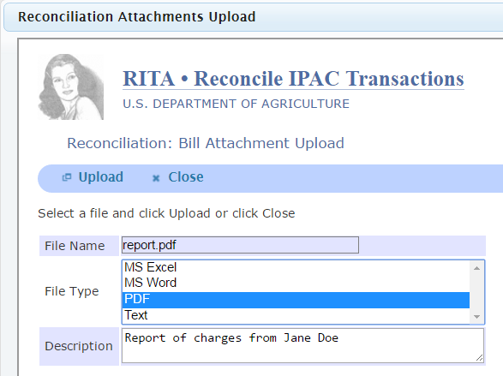

Agency View – Add Attachments
Select: IPAC Bill(s)
Add Attachment button
File Name
File Type
Click Upload
Close the pop-up window

Slide 31

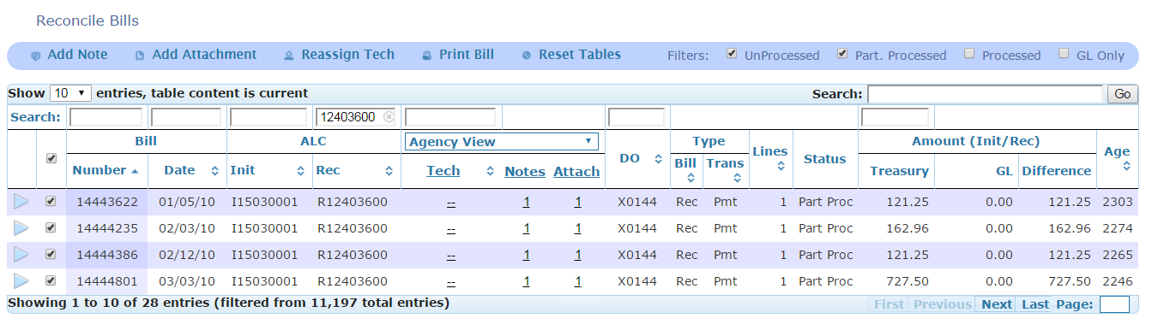
Agency View – Reassign Tech
Select IPAC Bill(s)
, then click Reassign Tech button
Select a new Tech ID
and the Save button

Slide 32
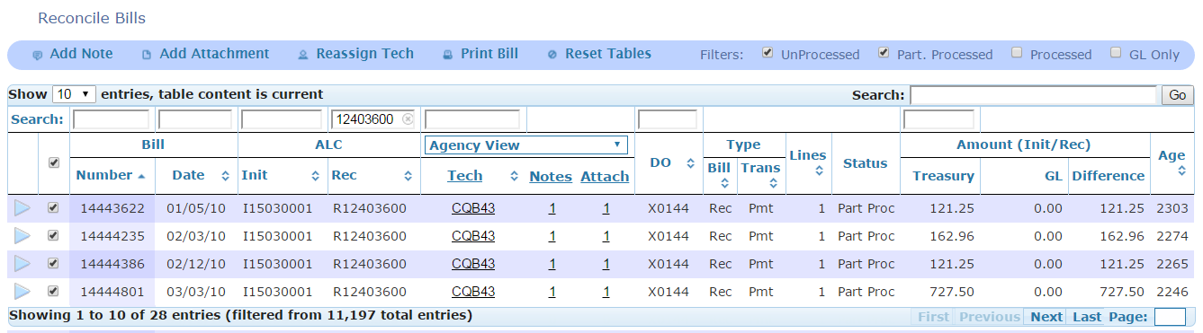
Agency View – Print Bill
Reconcile Module is the best place to print bills in RITA
  Any IPAC bill can be printed
  Select single or multiple bills
  – then, click Print Bill
  A PDF will open containing all bills selected with all detail lines

Slide 33
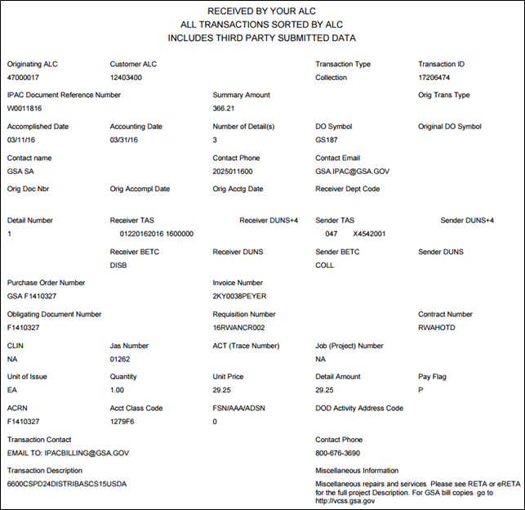
Agency View – Print Bill (continued)
This is an exact replica
of the IPAC Bill generated
by Treasury.
For Conversion bills (dated prior to August 1, 2016), the only Treasury Detail information is the Description.

Slide 34
Report Module
Overview

Slide 35
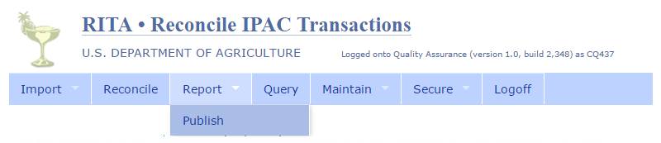
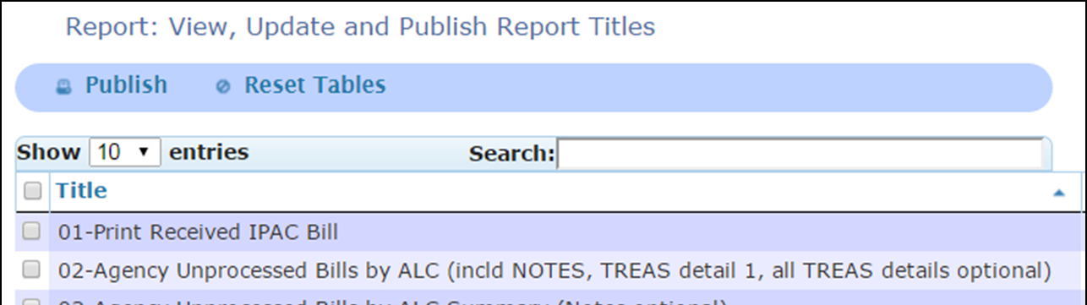
Report Module – Publish Submenu
Select the Report Module and Publish Submenu to view available reports
Note: there are multiple pages of available reports

Slide 36
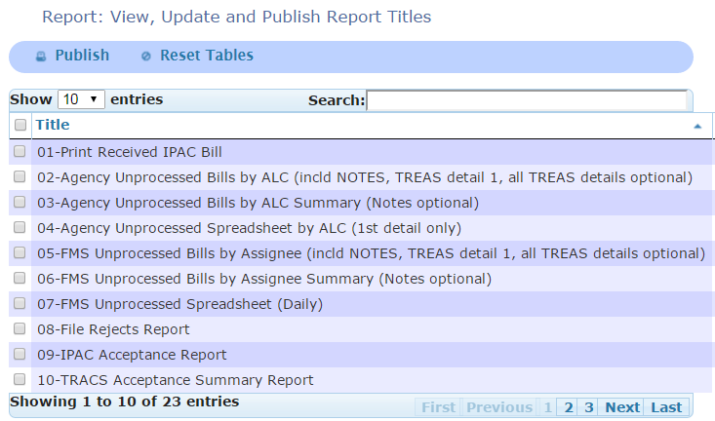
Report Module (continued)
The most commonly used reports
The Weekly Reports

Slide 37
Report Module (continued)
01 – Print Received IPAC Bill
  Excludes Initiated Bills
  Excludes Sender DO Symbols: GS116 , GS127, and GS157
  (GSA FEDS, TOPS, and MPOL)
02 – Agency Unprocessed Details
  Includes information from IPAC Bill
  Includes current FMS assignee
  Includes notes from all views: Initiating, Receiving, and Agency
  Option to select all or first Treasury detail lines
REPORTS 2,3, & 4 are E-MAILED WEEKLY to agency IPAC contacts.
03 – Agency Unprocessed Summary
  No Treasury IPAC Bill information
  Includes current FMS and Agency assignee
  With or without notes
04 – Agency Unprocessed Spreadsheet
  First Treasury detail line only
  No notes

Slide 38
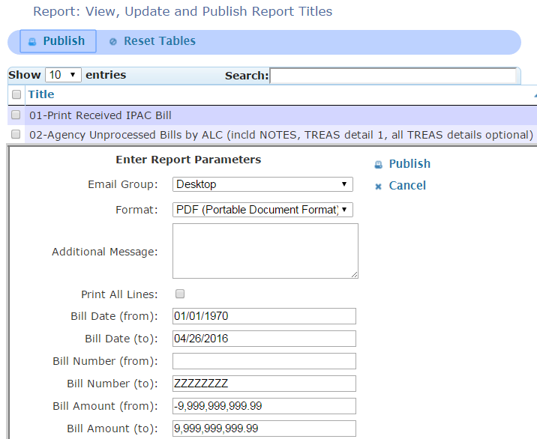
Report Module Publish(continued)
Select one report
and then click the Publish
Parameters
will appear
Select the
Publish
button
(to the right)
to generate
the report

Slide 39
Report Modules
Parameter Definitions

Slide 40
Report Module – Parameters
There are various elements in the Report Parameters
  Allows for easier search
  Not required to enter parameters
  Most of the fields have default information
Note: Tabbing from field to field changes the defaulted info
  Use the mouse to select specific parameters
  Click the white space outside the fields after entering search criteria
The parameters will print on the last page of the report

Slide 41
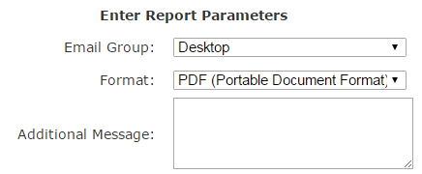
Report Module – Parameters (continued)
Email Group: two options for report
  Desktop (default) – report generated in new browser tab and not emailed
  Other selection – report emailed to RITA User(s) in a predefined group
    Additional Message – the email body sent to RITA Users in the predefined group
Formats
available:
  CSV
  HTML
  PDF
  XLS

Slide 42

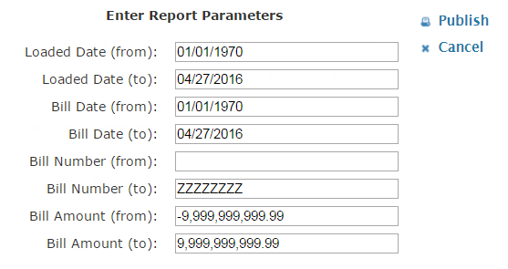

Report Modules – Parameters (continued)
Date Ranges default from the beginning of time to current date
  Load Date: the date the bill was imported to RITA
  Bill Date: the Accomplished Date of the IPAC Treasury Bill
  Select dates from calendar or enter in MM/DD/YYYY format
Be a mouse person. NO TABBING
Bill Number
  FROM defaults with a leading space to account for 7-digit bill
    Remove the space when searching for 8-digit bill number
  TO defaults with
  “ZZZZZZ” which
  encompasses
  everything
Bill Amount
  Enter amounts in absolute values
  defaults with 9,999,999,999.99 which encompasses everything

Slide 43
Report Modules – Parameters
Print First Line Only:
  Default to print all Treasury IPAC Bill detail lines if there are multiple lines
  Select to populate only the first detail line
Print All Lines:
  Default to print only first Treasury IPAC Bill detail line
  Select to populate all detail lines if there are multiple lines
Print Note Details:
  Select to populate Assignee notes on the report
  Otherwise, the report will display without assignee notes
Agency Location Code(s): USDA agencies
Sender Treasury Symbol: Sender Treasury Account Symbol (TAS) or Treasury Account Fund Symbol (TAFS) on IPAC Bill
Receiver Treasury Symbol: Receiver TAS or TAFS on IPAC Bill
Assignee(s): FMS user assigned to IPAC Bill
Reason Code(s): code selected by FMS user when entering notes
DO Symbol(s): Sender Disbursing Office (DO) Symbol on IPAC Bill
Bill State(s): two options
  Unprocessed includes both UnProc and Partially Process
  Processed
  Defaults to return all bill states if no selection is made
Information as stated on the Treasury IPAC Bill
  Exact Match fields: Contract Number, PO Number, and Invoice Number
  Wild Card field: Description and Misc. Info
Trans Type(s): Transaction Type on Treasury IPAC Bill
  C – Collection and P – Payment
  RITA looks at the Original Transaction Type for Adjustment Bills

Slide 44
Report Module II
Report Examples

Slide 45
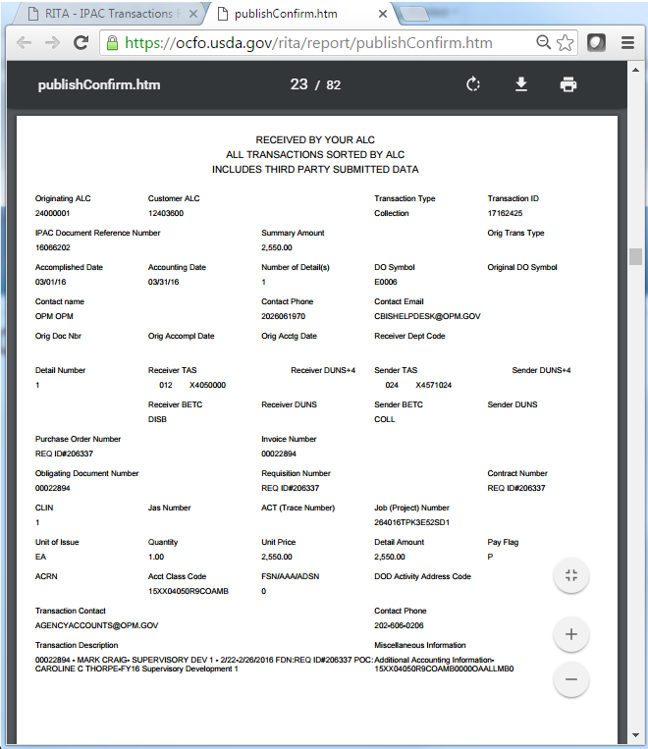
Examples
01-Print
Received IPAC
Bill
New tab opens
with report
  Download
  and save
  Print
Excludes
  Initiated bills
  Sender DO Symbols
    GS116 GSA FEDS
    GS127 GSA TOPS
    GS157 GSA MPOL

Slide 46
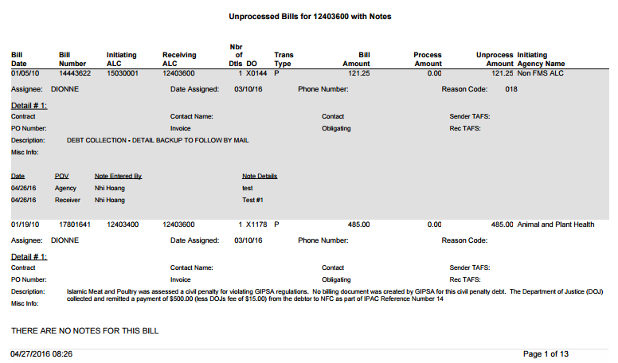
Examples (continued)
02-Agency Unprocessed Bills by ALC
TREAS Header
TREAS Detail 1 (all details –optional)
Notes
from all
points of view

Slide 47
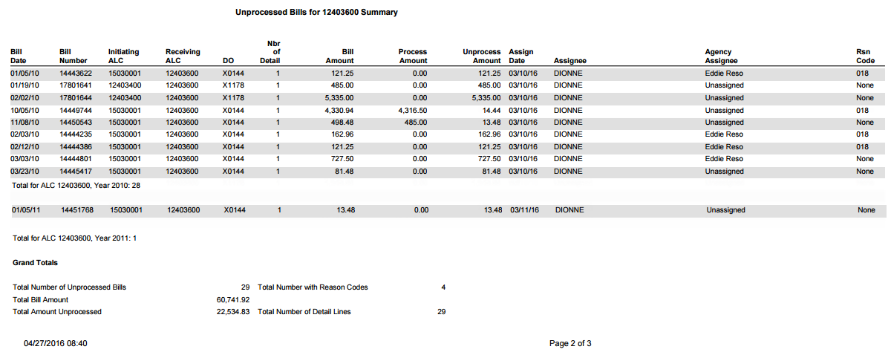
Examples Unprocessed Bills
03-Agency Unprocessed Bills by ALC Summary
  No Treasury IPAC Bill detail information
  Notes are optional
  Example shows report without notes
Statistics
Current FMS Assignee
Current Agency Assignee

Slide 48
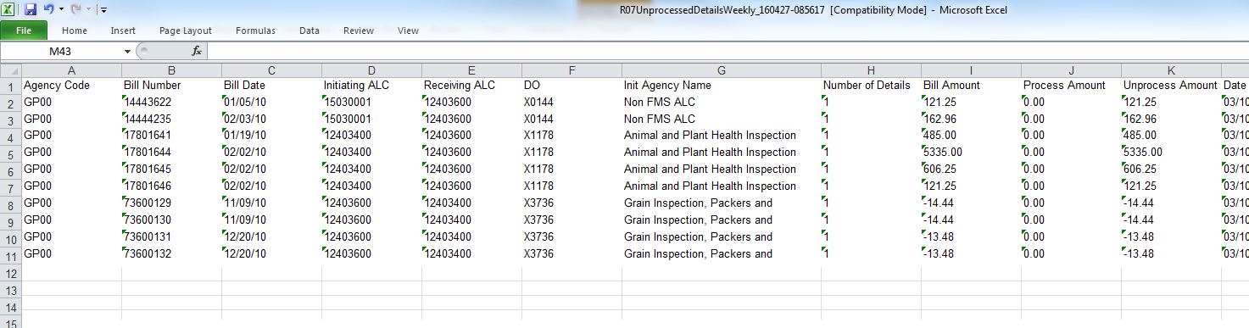
Examples Unprocessed Spreadsheet
04-Agency Unprocessed Spreadsheet by ALC
  Default format: Excel Spreadsheet
  Data available up to Column AB
    Includes select Treasury IPAC Bill information for Detail Line 1
      Columns Q-T: PO, Obligating Doc, Invoice Number, and Contract Number
      Columns U-V: Sender and Receiver TAS
      Columns W-Y: Description, Miscellaneous Information, and Transaction Contact
      Column AB: Accounting Classification Code
    Column AA: Agency Assigned

Slide 49
Contacts
Eddie Reso, Acting Director, Financial Services Division eddie.reso@usda.gov
  (mobile) 817-542-2839
Angele James, Supervisor, IPAC Control Section angele.james@usda.gov
  1-877-243-3072 (Option 3)
Patricia Barrere, Supervisor, IPAC Processing Section patricia.barrere@usda.gov
  1-877-243-3072 (Option 3)
Tam Nguyen, Program Analyst
  tam.nguyen@usda.gov
  1-877-243-3072 (Option 3)

Slide 50
QUESTIONS ?

Slide 51
Additional Information
Advanced Search
Reconcile Module

Slide 52
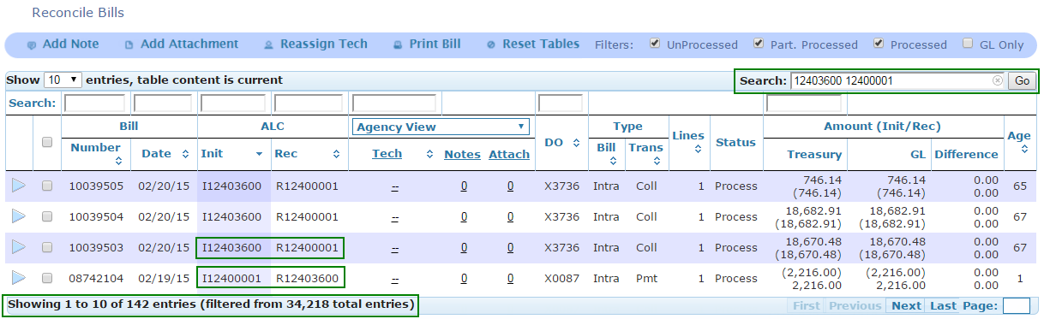
Advanced Search – AND Expression
Global Search Bar: search “AND” conditions with space
  Regular billings
  Chargeback history
For example, search “12403600 12400001” to return all bills between these ALCs
Notes:
** DO NOT USE ASTERISKS **

Slide 53
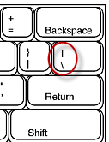
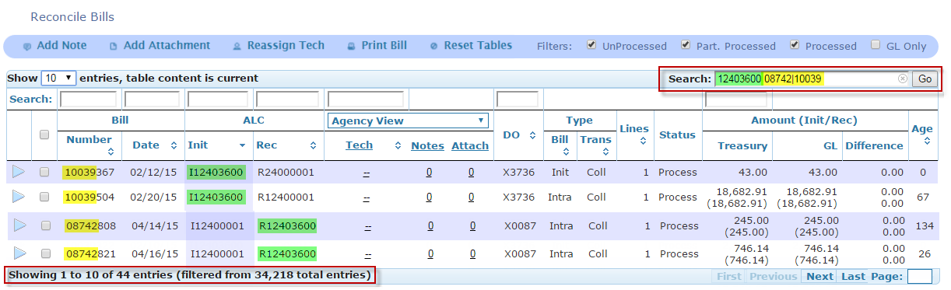
Advanced Search – OR Expression
Global Search Bar: search “OR” conditions with vertical bar
  Bill types
  Billing history
For example, search “12403600 08742|10039”
to return all bills for ALC 12403600 AND
bills containing 08742 OR 10039
Notes:
** DO NOT USE ASTERISKS **

