Slide 1
Agency Spotlight
Commodity Credit Corporation/Farm Service Agency

Slide 2
Commodity Credit Corporation
The Commodity Credit Corporation (CCC) is a Government-owned and operated entity that was created to stabilize, support, and protect farm income and prices. CCC also helps maintain balanced and adequate supplies of agricultural commodities and aids in their orderly distribution.
CCC was incorporated October 17, 1933, under a Delaware charter with a capitalization of $3 million.
On July 1, 1939, CCC was transferred to the United States Department of Agriculture (USDA). It was reincorporated on July 1, 1948, as a Federal corporation within USDA by the Commodity Credit Corporation Charter Act (62 Stat.1070; 15 U.S.C. 714). As amended through the Presidential Appointment Efficiency and Streamlining Act of 2011, P.L. 112-166, Enacted August 10, 2012.

Slide 3
CCC Mission
Do Right
Stabilize, support, and protect farm income and prices
Conserve soil, air, and water resources and protect and improve wildlife habitats
Feed Everyone
Maintain balances and adequate supplies of agricultural commodities and aid in their orderly distribution
Develop new domestic and foreign markets and marketing facilities for agricultural commodities

Slide 4
Organization
CCC is managed by a Board of Directors
Secretary of Agriculture is the Chairman
CCC has no operating personnel – its domestic activities are carried out by the personnel and facilities of the Farm Service Agency (FSA)
International Programs are carried out by the Foreign Agricultural Service (FAS) and the US Agency for International Development (USAID)
Has the authority to borrow up to $30 Billion from the Treasury at any one time

Slide 5
Organizationa
FSA Administrator
DAFO
DAM
DAFP
DAFLP
The Deputy Administrator for Field Operations (DAFO) is responsible for the supervision and oversight of Farm Service Agency State and County Offices, and is the primary liaison between field and headquarters offices on agency-wide issues.
The Deputy Administrator for Farm Programs (DAFP) is responsible for overseeing and implementing policies and procedures that regulate the delivery of federal farm programs.
FSA makes direct and guaranteed farm ownership (FO) and operating loans (OL) to family-size farmers and ranchers who cannot obtain commercial credit from a bank, Farm Credit System institution, or other lender. FSA loans can be used to purchase land, livestock, equipment, feed, seed, and supplies
The Deputy Administrator for Management (DAM) organization is an operational support office within the USDA Farm Production and Conservation (FPAC) mission area.
51 state offices and 2,124 county offices

Slide 6
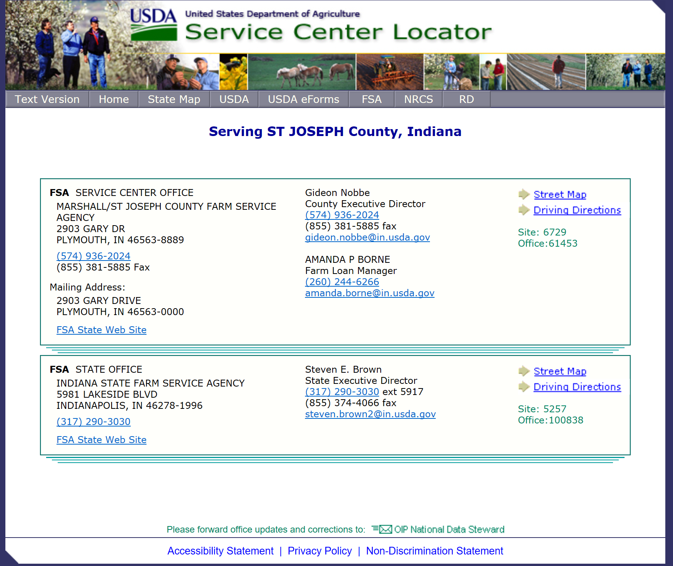
State and County
Offices

Slide 7

What is the Farm Service Agency?
The Farm Service Agency is part of the U.S. Department of Agriculture and provides programs and loans to help farmers, ranchers and agricultural partner organizations provide food, fuel and fiber to millions of people worldwide.

Slide 8

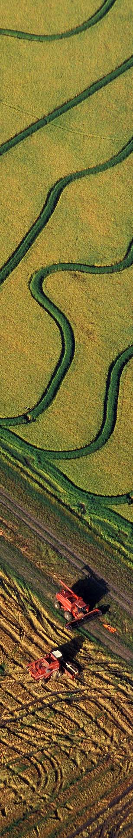
Farm Programs
Agriculture Risk Coverage (ARC) & Price Loss Coverage (PLC)
  County ARC
  Individual ARC
  PLC
Notes:
ARC/PLC
County ARC: Payments are issued when the actual county crop revenue of the covered commodity is less than the ARC county guarantee for that covered commodity. County ARC payments are based on county data not the farm data.
Individual ARC: Payments are issued when the actual individual crop revenues (which are summed across all covered commodities on the farm) are less than ARC individual guarantees (which are summed across those covered commodities on the farm).
PLC: payments are issued when the effective price of a covered commodity is less than the respective reference price for that commodity established in the statute. The payment is equal to 85 percent of the base acres of the covered commodity times the difference, between the reference price and the effective prices times the program payment yield for the covered commodity.

Slide 9

Farm Programsa
Disaster Assistance Programs
  Livestock Forage Disaster Program (LFP)
  Livestock Indemnity Program (LIP)
  Emergency Assistance for Livestock, Honeybees and Farm-Raised Fish Program (ELAP)
  Tree Assistance Program (TAP)
  Noninsured Crop Disaster Assistance Program (NAP)
  2017 Wildfires and Hurricanes Indemnity Program (WHIP)
Notes:
Livestock Forage Disaster Program
LFP provides compensation to eligible livestock producers who have suffered grazing losses for covered livestock on land that is native or improved pastureland with permanent vegetative cover or is planted specifically for grazing. The grazing losses must be due to a qualifying drought condition during the normal grazing period of the county. LFP also provides compensation to eligible livestock producers that have suffered grazing losses on rangeland managed by a federal agency, if the eligible livestock producer is prohibited by the Federal agency from grazing the normal permitted livestock on the managed rangeland due to a qualifying fire.
Livestock Indemnity Program (LIP)
LIP provides benefits to livestock producers for livestock deaths in excess of normal mortality caused by adverse weather, including livestock disease, resulting from a weather disaster. In addition, LIP covers attacks by animals reintroduced into the wild by the federal government or protected by federal Law, including wolves and avian predators. LIP payments are equal to 75 percent of the market value of the applicable livestock on the day before the date of death of the livestock as determined by the Secretary.
Emergency Assistance for Livestock, Honeybees and Farm-Raised Fish Program (ELAP)
ELAP provides emergency assistance to eligible producers of livestock, honeybees, and farm-raised fish. ELAP covers losses due to an eligible adverse weather condition or an eligible loss condition, including blizzards, disease (including cattle tick fever), water shortages and wildfires, as determined by the Secretary, which occurs on or after Oct. 1, 2011. ELAP covers losses that are not covered under other supplemental Agricultural Disaster Assistance Payment programs established by the 2014 Farm Bill, specifically LFP and LIP programs. The ELAP program year begins Oct. 1 of the fiscal year and ends Sept. 30 of the fiscal year.
Tree Assistance Program (TAP)
TAP program provides financial assistance to qualifying orchardists and nursery tree growers to replant or rehabilitate eligible trees, bushes and vines damaged by natural disasters.
Non-Insured Crop Disaster Assistance Program
NAP provides financial assistance to producers of noninsurable crops when a low yield, loss of inventory or prevented planting occur due to a natural disaster. To be eligible for NAP assistance, crops must be noninsurable crops and agricultural commodities, for which the catastrophic risk protection level of crop insurance is not available.
Higher levels of coverage are available and enhanced access is available to beginning, limited resource and targeted underserved farmers and ranchers.

Slide 10
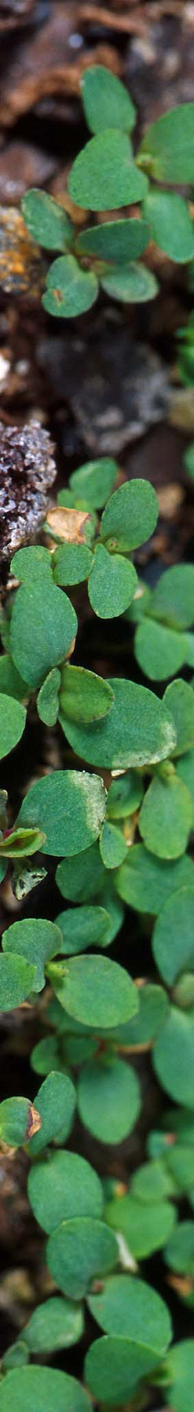
Farm Programsb
Margin Protection Program (MPP) – Dairy
Marketing Assistance Loans (MALs)
Loan Deficiency Payments (LDPs)
Farm Storage Facility Loan Program (FSFL)
Sugar Storage Facility Loan Program (SSFL)
Cotton Ginning Cost Share (CGCS)
Notes:
MPP-Dairy
The Margin Protection Program - Dairy (MPP–D) replaces MILC and is effective through December 31, 2018. The Margin Protection Program offers dairy producers: (1) catastrophic coverage, at no cost to the producer, other than an annual $100 administrative fee, which can be waived for limited resource, beginning, veteran and disadvantaged producers, a change made with the Bipartisan Budget Act of 2018; and (2) various levels of buy-up coverage. Catastrophic coverage provides payments to participating producers when the national dairy production margin is less than $4.00 per hundredweight (cwt). The national dairy production margin is the difference between the all-milk price and average feed costs. Producers may purchase buy-up coverage that provides payments when margins are between $4.00 and $8.00 per cwt. To participate in buy-up coverage, a producer must pay a premium that varies with the level of protection the producer elects.
2018 registration and re-enrollment continues through June 1, 2018. If a dairy operation previously elected coverage for 2018, a new coverage election for 2018 must be made during the re-enrollment period.
Marketing Assistance Loans (MAL)
MALs provide producers interim financing at harvest time to meet cash flow needs without having to sell their commodities when market prices are typically at harvest-time lows, allowing the producers to delay the sale of the commodity until more favorable market conditions. Marketing assistance loans for covered commodities are non-recourse because the commodity is pledged as loan collateral and producers have the option of delivering the pledged collateral to the Commodity Credit Corporation (CCC) in satisfaction of the repayment of the outstanding loan for the loan at maturity. A settlement value is determined and applied to the outstanding loan principal and interest.
Certain situations and conditions may warrant use of recourse loans. These loans must be repaid at principal plus interest and the loan commodity cannot be delivered or forfeited in satisfaction of the outstanding loan.
Loan Deficiency Payments (LDP)
A producer who is eligible to obtain a loan, but who agrees to forgo the loan, may obtain an LDP. The LDP rate equals the amount by which the applicable loan rate where the commodity is stored exceeds the alternative loan repayment rate for the respective commodity. The LDP equals the LDP rate times the quantity of the commodity for which the LDP is requested.
Farm Storage Facility Loan Program (FSFL)
Under the Commodity Credit Corporation (CCC) Charter Act, USDA may make loans to producers to build or upgrade farm storage and handling facilities. The 2008 act extends FSFL to increase loan term, loan amount and storage needs for new commodities. Eligible facility types include grain bins, hay barns, bulk tanks, and facilities for cold storage. Drying and handling and storage equipment is also eligible, including storage and handling trucks. Eligible facilities and equipment may be new or used, permanently affixed or portable. Loan terms vary from 3 to 12 years. The maximum loan amount for storage facilities is $500,000. The maximum loan amount for storage and handling trucks is $100,000.
Sugar Storage Facility Loan Program (SSFL)
The 2014 Farm Bill authorized loans to processors of domestically produced sugarcane and sugar beets for the construction or upgrading of storage and handling facilities for raw sugars and refined sugars.
Cotton Ginning Cost Share
This program provides cost share assistance payments to cotton producers with a share in the 2016 cotton crop. Eligible producers can receive a one-time cost share payment, which is based on a producer’s 2016 cotton acres reported to FSA multiplied by 20 percent of the average ginning cost for each production region.

Slide 11

Conservation
Conservation Reserve Program (CRP)
  General Sign-Up
  Continuous Sign-Up
CRP Grasslands
Farmable Wetlands Program (FWP)
Conservation Reserve Enhancement Program (CREP)
Notes:
Conservation Reserve Program General Sign-Up
CRP is a voluntary program for agricultural landowners. Through CRP, individuals can receive annual rental payments and cost-share assistance to establish long-term, resource conserving covers on eligible farmland. The Commodity Credit Corporation (CCC) makes annual rental payments based on the agriculture rental value of the land, and it provides cost-share assistance for up to 50 percent of the participant's costs in establishing approved conservation practices. Participants enroll in CRP contracts for 10 to 15 years. When new initiatives are announced, additional sign-up opportunities or practices may be added under either the General or Continuous Sign-up program types. Producers can offer land for CRP general sign-up only during designated sign-up periods.
Continuous Sign-Up Programs
Environmentally desirable land devoted to certain conservation practices may be enrolled at any time under CRP continuous sign-up.
CRP Grasslands
CRP Grasslands helps landowners and operators protect grassland, including rangeland, pastureland, and certain other lands, while maintaining the areas as grazing lands. The program emphasizes support for grazing operations, plant and animal biodiversity, and grassland and land containing shrubs and forbs under the greatest threat of conversion.
Farmable Wetlands Program (FWP)
Reduces downstream flood damage, improves surface and groundwater quality, and recharges groundwater supplies by restoring wetlands.
Conservation Reserve Enhancement Program (CREP) Continuous Sign-Up Programs
a voluntary land retirement program that helps agricultural producers protect environmentally sensitive land, decrease erosion, restore wildlife habitat, and safeguard ground and surface water. The program is a partnership among producers, tribal, state, and federal governments and in some cases, private groups.
is an offshoot of the country's largest private-lands environmental improvement program. Like CRP, CREP is administered by USDA-FSA. By combining CRP resources with state, tribal and private programs, CREP provides farmers and ranchers with a sound financial package for conserving and enhancing the natural resources of farms.

Slide 12

Conservationb
Emergency Conservation Program (ECP)
Grassroots Source Water Protection Program
Emergency Forest Restoration Program (EFRP)
State Acres for Wildlife Enhancement (SAFE)
Notes:
Emergency Conservation Program (ECP)
ECP provides emergency funding and technical assistance for farmers and ranchers to rehabilitate farmland damaged by natural disasters and for carrying out emergency water conservation measures in periods of severe drought. Funding for ECP is appropriated by Congress. FSA county committees determine land eligibility based on on-site inspections of damage, taking into account the type and extent of damage. For land to be eligible, the natural disaster must create new conservation problems that:
If untreated, will impair or endanger the land;
Materially affect the land's productive capacity;
Represent unusual damage which, except for wind erosion, is not the type likely to recur frequently in the same area;
Would be so costly to repair that federal assistance is or will be required to return the land to productive agricultural use.
Grassroots Source Water Protection Program
Source water is surface and ground water that is consumed by rural residents. The Source Water Protection Program is designed to help prevent source water pollution through voluntary practices installed by producers at local levels.
Emergency Forest Restoration Program (EFRP)
The 2008 Farm Bill authorized EFRP for an owner of non-industrial private forest land to carry out emergency measures to restore the land after being damaged by an approved natural disaster. Funding for EFRP is appropriated by Congress.
State Acres for Wildlife Enhancement (SAFE)
SAFE is a flexible, results-oriented, locally led initiative that creates a continuous CRP enrollment opportunity for producers to address wildlife habit resource concerns for specific species in a targeted region.

Slide 13
Farm Loans Program
FSA’s loan program is designed to help family farmers to start, purchase or expand their farming operation.
Farm Ownership Loans (Direct & Guaranteed)
Farm Operating Loans (Direct & Guaranteed)
  EZ Guarantee Loans
  Youth Loans
Notes:
You may be able to get a loan or loan guarantee through FSA’s Farm Loan Programs if you are a farmer or rancher who is unable to get credit elsewhere to start, purchase, sustain, or expand your family farm. Unlike loans from a commercial lender, FSA loans are temporary, and our goal is to help you graduate to commercial credit. Once you are able to get credit from a commercial lender, our mission of providing temporary, supervised credit is complete.
Farm Ownership Loan-Direct and Guaranteed
Eligible applicants may obtain direct loans up to a maximum indebtedness of $300,000. Maximum indebtedness for guaranteed loans is $1,399,000 (amount adjusted annually for inflation). The maximum repayment term is 40 years for both direct and guaranteed farm ownership loans. In general, loan funds may be used to purchase a farm, enlarge an existing farm, construct new farm buildings and/or improve structures, pay closing costs, and promote soil and water conservation and protection.
Farm Operating Loan-Direct and Guaranteed
Eligible applicants may obtain direct loans for up to a maximum indebtedness of $300,000 and a direct operating Microloan for up to a maximum indebtedness of $50,000. Maximum indebtedness for a guaranteed loan is $1,399,000 (amount adjusted annually for inflation). The repayment term may vary, but typically it will not exceed seven years for intermediate-term purposes. Annual operating loans are generally repaid within 12 months or when the commodities produced are sold. In general, loan funds may be used for normal operating expenses, machinery and equipment, minor real estate repairs or improvements, and refinancing debt.
EZ Guarantee Loans
These loans better serve the unique financial operating needs of new, niche, family, underserved or small farm operations by offering faster and simplified application and submission requirements. USDA-approved lenders can apply to FSA on behalf of their applicants to obtain a guarantee of up to 95 percent for the EZ Guarantee Loan. The maximum loan amount is $100,000.
Youth Loans
These are available as direct loans only and have a maximum loan amount of $5,000. Youth loans may be made to individuals who are sponsored by a project advisor, such as a 4-H Club, FFA or local vocational instructor. Individuals must be at least 10 but not more than 20 years old to be eligible.

Slide 14
Farm Loans Programc
Microloans
Targeted Funds to Underserved and Beginning Farmers and Ranchers
Down Payment Program
Emergency Loans
Conservation Loans
Land Contract Guarantees
Notes:
Microloans
The focus of Microloans is on the financing needs of small, beginning farmer, niche and non-traditional farm operations, such as truck farms, farms participating in direct marketing and sales such as farmers’ markets, CSA’s (Community Supported Agriculture), restaurants and grocery stores, or those using hydroponic, aquaponic, organic and vertical growing methods. There is no minimum loan amount. The maximum loan amount for a Microloan is $50,000.
Targeted Funds to Underrepresented and Beginning Farmers
Each year Congress targets a percentage of farm ownership and farm operating loan funds to socially disadvantaged (SDA) and beginning farmers.
Down Payment Program
Retiring farmers may use this program to transfer their land to future generations. Being a beginning farmer is one of the requirements to be eligible for the Direct Farm Ownership Down Payment Loan. Down Payment loan funds may be used only to partially finance the purchase of a family farm. Loan applicants must contribute a minimum down payment of 5 percent of the purchase price of the farm and the Agency will finance 45 percent to a maximum loan amount of $300,000. The balance of the purchase price not covered by the down payment loan and the loan applicant's down payment may be financed by a commercial lender, private lender, a cooperative, or the seller.
Emergency Loans
These loans are available only as direct loans from FSA. Emergency Loans assist farmers who have suffered physical or production losses in areas declared by the President as disaster areas or designated by the Secretary of Agriculture as disaster or quarantine areas (for physical losses only, the FSA Administrator may authorize Emergency Loan assistance). For production loss loans, applicants must demonstrate a 30-percent loss.
Conservation Loans
Conservation loans are available as guaranteed loans only. Eligible applicants may use Conservation Loan funds to complete any conservation activity included in a conservation plan or Forestry Management Plan and refinance debts related to implementing any conservation activity if refinancing will result in additional conservation benefits. Maximum indebtedness is $1,399,000 (amount adjusted annually for inflation) and the maximum repayment term is 30 years.
Land Contract Guarantees
These provide certain financial guarantees to the seller of a farm through a land contract sale to a beginning or underrepresented farmer.

Slide 15
Bipartisan Budget Act of 2018
Provided funding for 2017 Wildfires and Hurricanes Indemnity Program (WHIP)
Increased eligible TAP acreage; removes $125,000 payment limitation
Expanded LIP eligible losses; removes $125,000 payment limitation
Removed annual $20 million national cap on ELAP
LFP and ELAP now have combined payment limitation
of $125,000
Notes:
Wildfires and Hurricanes Indemnity Program (WHIP)
As part of the Bipartisan Budget Act of 2018, FSA will deploy up to $2.36 billion to help producers with recovery of agricultural operations impacted by hurricane damage and wildfire. USDA will hold a sign-up for the new program beginning no later than July 16, 2018.
Tree Assistance Program Changes
The acreage eligible for TAP is doubled from 500 to 1,000 acres annually and the $125,000 payment limitation is removed.
Livestock Indemnity Program Changes
LIP is expanded to cover losses incurred by selling livestock at a reduced price and the $125,000 payment limitation is removed.
Emergency Assistance for Livestock, Honeybees, and Farm-raised Fish Program (ELAP)
The $20 million cap on ELAP is lifted.
Payment Limitation Changes
LFP and ELAP have a combined payment limitation of $125,000.

Slide 16
Bipartisan Budget Act of 2018a
Changed provisions under the Margin Protection Program for Dairy based on feedback from dairy producers
Added seed cotton as a covered commodity with start of 2018 crop year
Provided additional funding for ECP
Notes:
MPP-Dairy
Based on feedback from dairy producers, Congress made several changes to MPP-Dairy in the Bipartisan Budget Act of 2018, including:
Calculations of the margin period is monthly rather than bi-monthly.
Covered production is increased to 5 million pounds on the Tier 1 premium schedule, and premium rates for Tier 1 are substantially lowered.
An exemption from paying an administrative fee for limited resource, beginning, veteran, and disadvantaged producers. Dairy operators enrolled in the previous 2018 enrollment period that qualify for this exemption under the new provisions may request a refund.
Seed Cotton
Seed cotton will be a covered commodity for the Agriculture Risk Coverage (ARC) and Price Loss Coverage (PLC) programs beginning with the 2018 crop year.
The procedure to establish seed cotton base, or reallocate base is anticipated to be similar to what we did with initial elections in 2014.
Producers with seed cotton base will be able to elect to participate in ARC or PLC and then sign a contract to enroll in the program.
For 2018, a producer who already purchased STAX may also participate in ARC or PLC. A restriction is imposed beginning 2019.
Emergency Conservation Program
Provided $400 million for ECP to address consequences of Hurricanes Harvey, Irma and Maria, wildfires and other natural disasters.

Slide 17

Farm Service Agency
For More Information Contact:
www.fsa.usda.gov

