Slide 1
Budget Status and Forecasting (BSF)
David Plessy
IT Specialist
FMS New Orleans

Slide 2
Budget Execution of the Past
Localized, Excel-based
  Not suited for large amounts of data
Manual downloads of Spending and Payroll data
Time-consuming to generate, less time for analysis
Distribution via e-mail or shared folders
Security (if applied) at cursory level
Variance explanations oftentimes lacking

Slide 3
Today’s BSF
Need for a single application to monitor and report on the status of funds
  Anticipated spending
  Projected salaries and benefits at the employee level
Daily Updates
  Reflects the daily status of obligations and commitments
  Payroll will be available the night it is posted in FMMI Business Warehouse
  Plan data available for reporting in real-time
Enterprise foundation within the FMMI landscape
  Centralized application with Scalability and agency-wide availability
  Consistent reporting and measurement across the department
  Leverages BEX (Integrated Planning) & Business Objects reporting

Slide 4
BSF Application Overview
Access-based prototype developed and used by DM from
June 2013 thru October 2016
  Became basis for FMMI model
FMMI-based version began development in February 2014
  Platformed in BI and accessed through the FMMI portal
  Agile project methodology applied
  Several agencies participating in Sprint reviews
  GRC security protocols applied
Agency deployments coincided with new feature releases
  Latest release (Release 3) in May 2016
  Supported by FMS and Accenture O&M
  Feedback from agency community will drive future development.

Slide 5
BSF Application Overviewa
Feedback from agency community will drive future development.
In addition to responding to feedback of current users, FMS is also facilitating pilot implementations for prospective agency users
  The flexibility and scalability of BSF allows these pilot implementations to happen in production with real production data.
  Because we leverage existing FMMI security, agencies are restricted only to their data.
  Changes to agency data can later be removed, or retained upon full implementation
  During the pilot, agency-specific tailoring can be developed

Slide 6



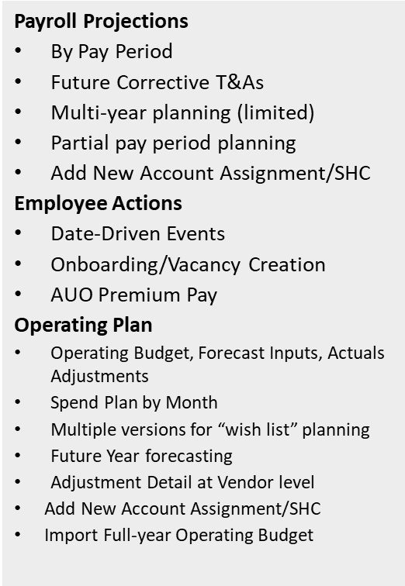
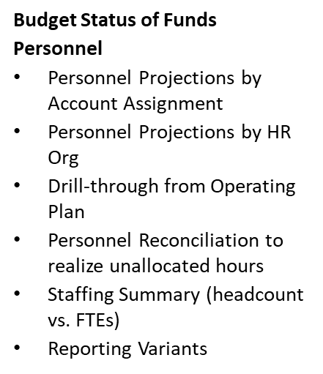
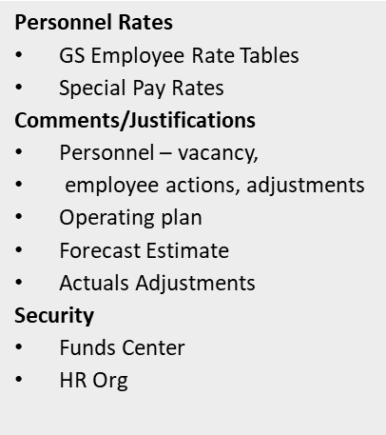
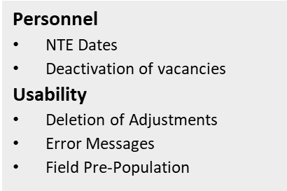
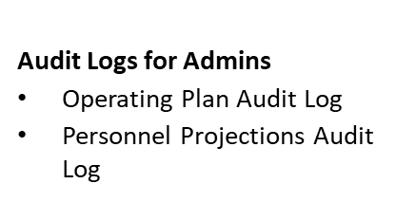
FMMI BSF Application: features summary

Slide 7



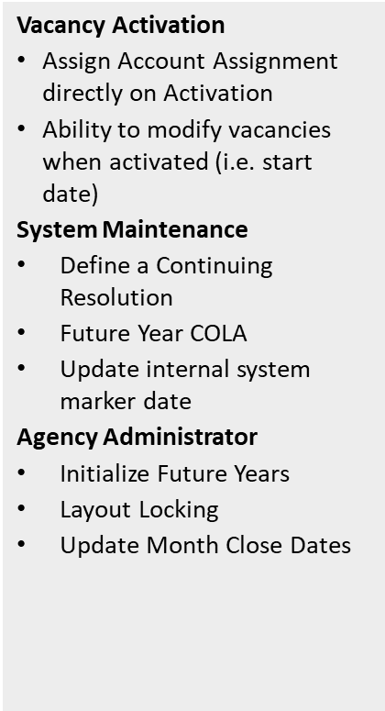
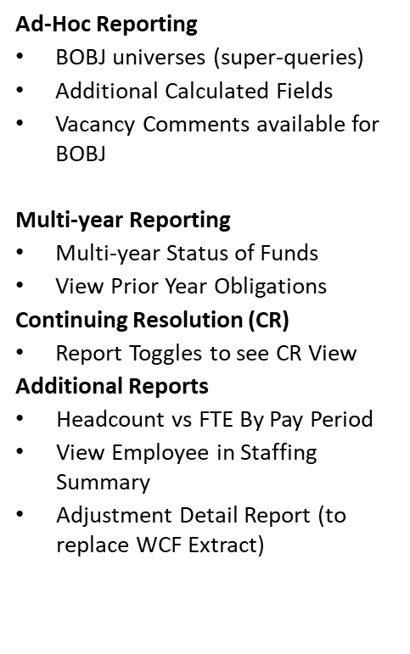
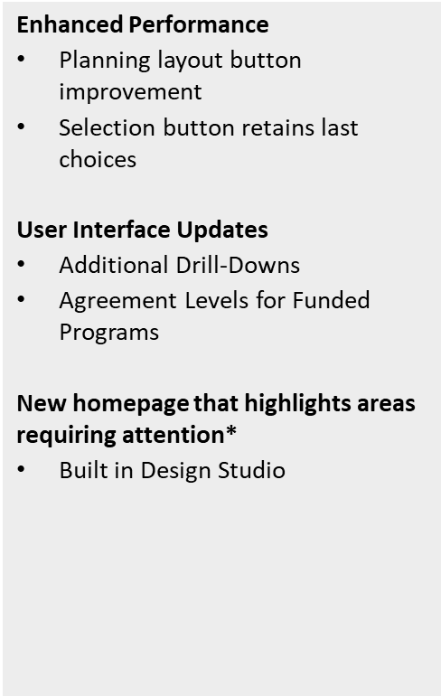
FMMI BSF Application: features summary (cont’d)

Slide 8
BSF Deployment Highlights
Agency Deployments
  Department Management agencies:
    Office of the Secretary
    OCFO
    OCIO
    Off of Ops
    HR
  General Counsel
  Foreign Ag Service (FAS)
  Food & Nutrition Services (FNS)
  Rural Development (RD)
  Natural Resources Conservation Svc (NRCS)
  Risk Management (RMA)
  Evaluating via pilot: Forest Service (FS)
Future Development
  Primarily user-driven

Slide 9
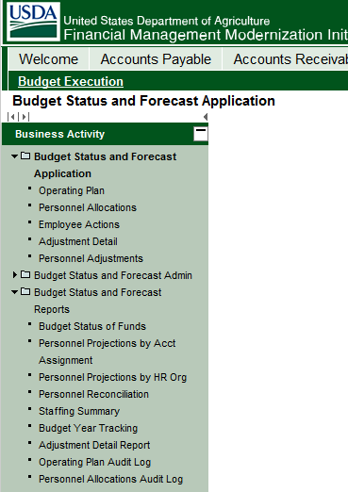
BSF Main Menu

Slide 10
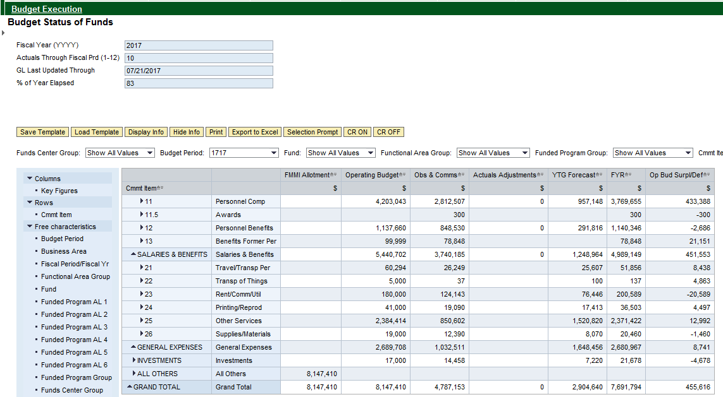
BSF Primary Report

Slide 11
BSF Staffing Summary Report

Slide 12
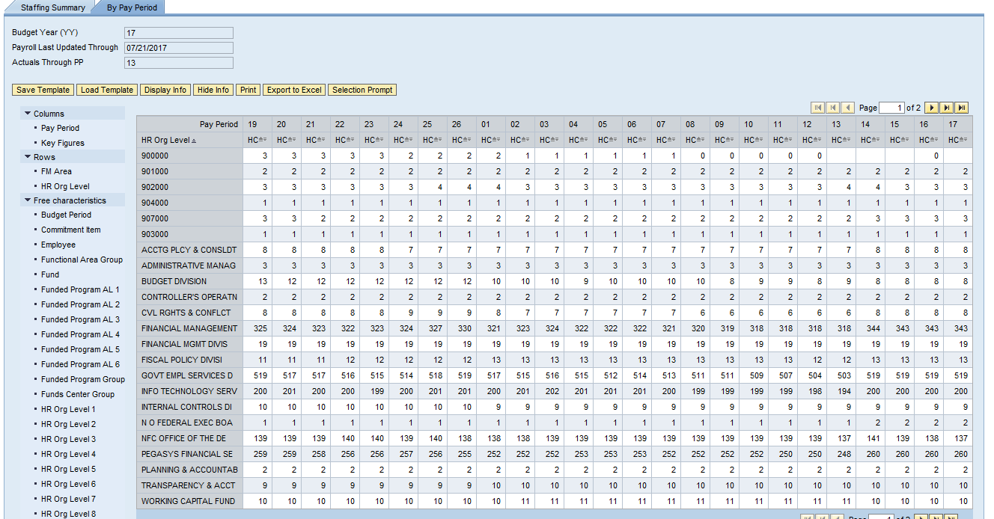
BSF Staffing Summary Reporta

Slide 13
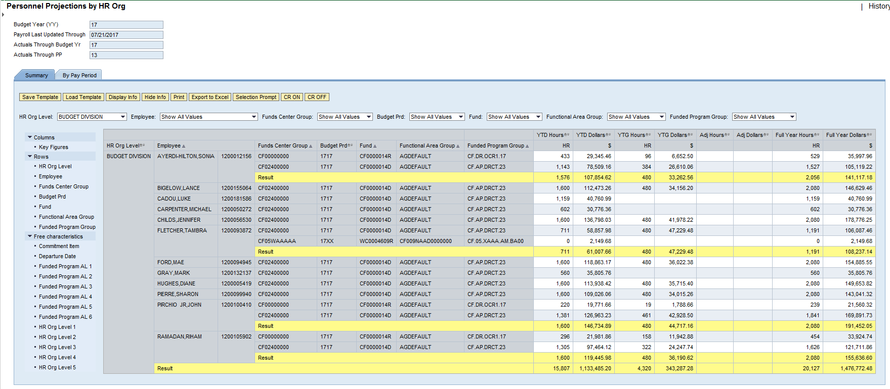
BSF Personnel Projections by
HR Organization Report

Slide 14
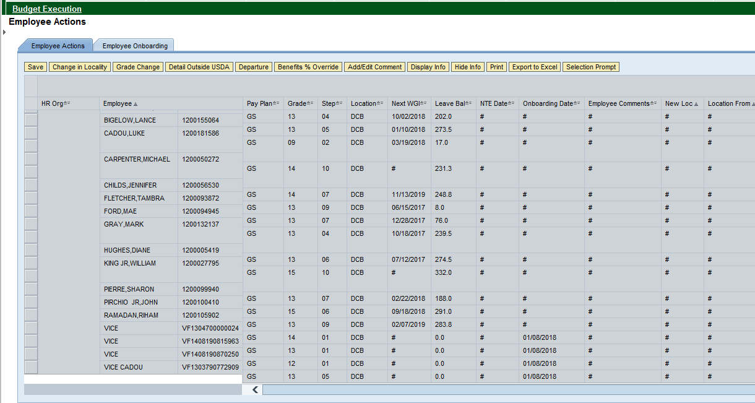
BSF Employee Actions

Slide 15
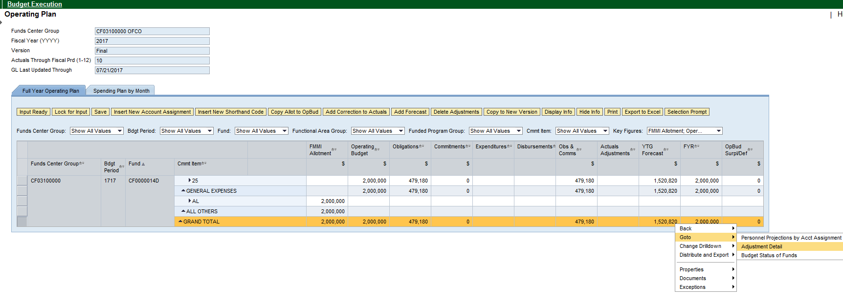
BSF Operating Plan
(with Adjustment drill-down)

Slide 16
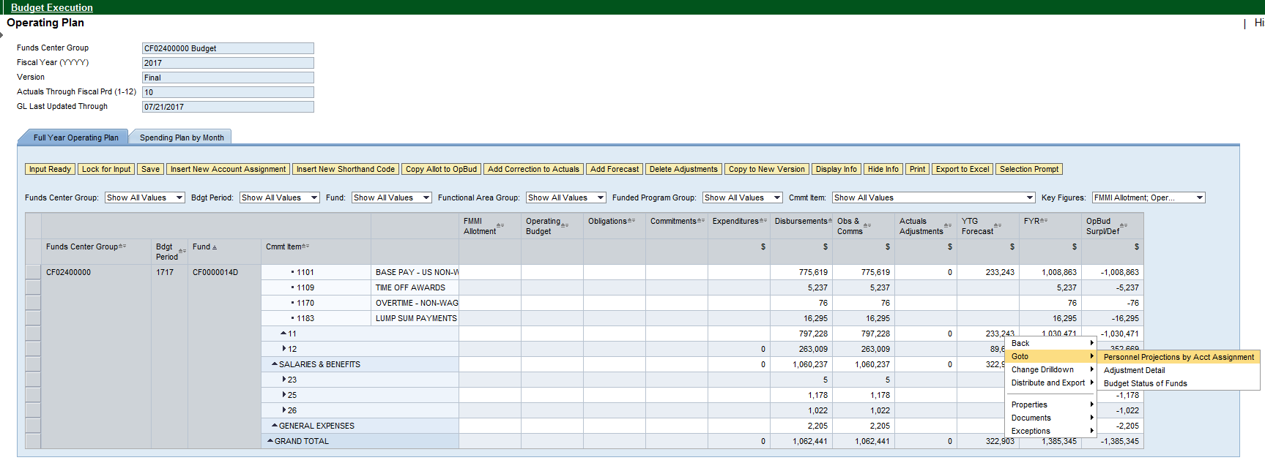
BSF Operating Plan
(with Adjustment drill-down)a

Slide 17
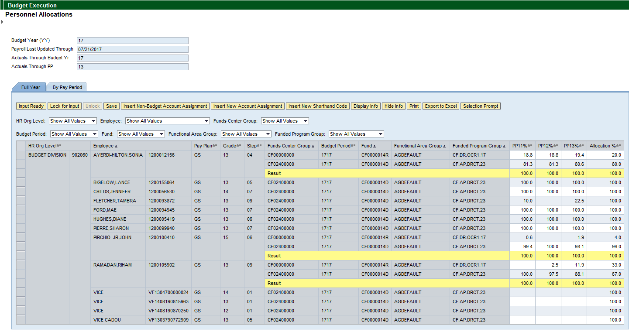
BSF Personnel Allocations

Slide 18

BSF

