Slide 1
CXO DASHBOARDS
ENABLING DATA-DRIVEN DECISION-MAKING

Slide 2

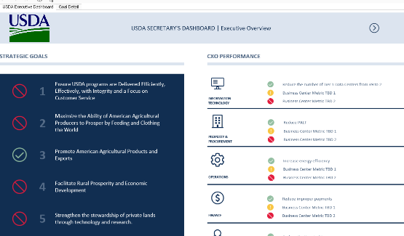
INTRODUCTION
PURPOSE
WHY DO WE CARE?
As part of the Agency Priority Goals (APG), CXO Dashboards will enable USDA leaders with instant access to key administrative data to enable data-driven decisions.
FY18 DASHBOARD CONCEPT
Agency Priority Goal: Modernize information technology and data analytics capabilities across the Department
CXO Dashboards will help:
‘Secretary's Dashboard’:
Executive Summary Dashboard
      Facilitate Communication
      Improve Data Quality
      Increase Data Access and Timeliness
      Optimize Performance
OHRM
OPF
OO
OCP
OCIO
OCFO
OHS

Slide 3

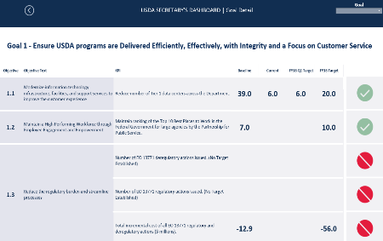
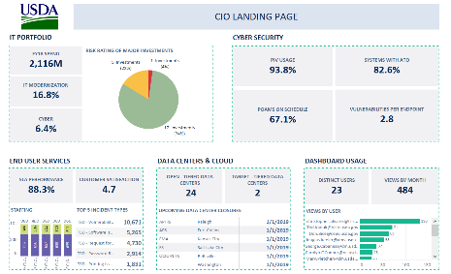

ACCOMPLISHMENTS
  Delivered Pilot executive dashboard
  This dashboard tracks progress across the 7 enterprise-wide strategic goals as well as CXO performance in their respective business areas.
  Delivered Pilot OCIO dashboard
  This dashboard now includes key information across all key domains of USDA IT – spanning IT Portfolio, Cybersecurity, Data Center & Cloud, End User Services, and Dashboard Adoption.
  Submitted Technical architecture assessment
  After a comprehensive assessment, a cloud-based data lake was selected to support back-end automation and data consolidation across administrative offices.

Slide 4
CURRENT STATUS
DASHBOARD DEVELOPMENT
Development of OCFO and OHRM dashboards are set for completion at the end of Q3. Data collection and data manipulation for initial views are underway.
300 Tableau Licenses will also be procured in the coming weeks to grant viewing access to groups such as -- CXO Leadership Teams, ASA, COOs and Leadership Teams, Undersecretaries, etc.
DATA LAKE IMPLEMENTATION
The project team is currently engaging with the owners of 12 identified systems to begin data ingestion.
A partnership with Security and Privacy team has been established to navigate the RMF process and secure an ATT/ATO by the end of the fiscal year.
DATA
GOVERNANCE
A user management workflow has been established to grant appropriate access to dashboards containing PII.
A Departmental Administration Data Governance Charter has been drafted.

Slide 5
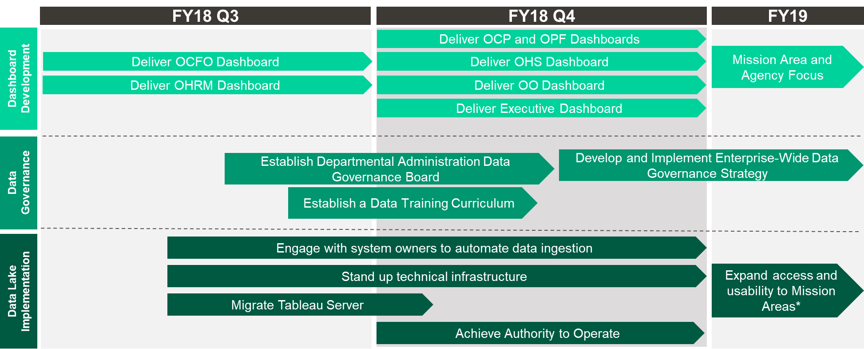
TIMELINE
*Timeline dependent on availability of system owners to answer questions, provide data, enable ports/connections where necessary, etc.

Slide 6
RISK ASSESSMENT
RISKS
MITIGATIONS
Breaking new ground with rapid ATO development in support of cloud implementation |  | Collaborating with ISC and Cloud Adoption COE to use the IPT model and conduct an agile ATT/ATO pilot Integrating with privacy team to revise and submit required documentation
Limited capacity of business owners to identify priorities, provide sample data, answer questions about data, etc. |  | Identified Dashboard Champions for each administrative office Implementing IPT model into dashboard development; establishing a daily stand-up with business owners during 10-week development cycle to facilitate communication and data sharing
Some unknowns about some CXO function data quality exist |  | Conducting reviews with CXO and leadership teams to validate metrics and ensure data quality and governance

Slide 7
FY18: WHERE DO WE GO FROM HERE?
What do you need from us?
Data Validation
Dashboard User Acceptance Testing
Services Model Requirements and Feedback

Slide 8
FY18 AND BEYOND
OCIO is focused on six initiatives to enable data-driven decision-making
Visibility/ inspiration
CXO Dashboards
Analytics Community of Practice
Technology/
services
3. Data lake infrastructure and analytics software stack provided as a service to agencies
4. Enterprise licensing arrangements to minimize licensing costs across analytics tools
Standards/ guidelines
5. Establish Data governance
6. Provide standard tools and analytics playbooks

Slide 9
FY18 AND BEYONDa
Phase 3 (FY’20 and beyond)
Phase 2 (FY’19)
Phase 1 (FY’18)
Expanded Communities of Practice
Analytics showcases
CXO Dashboards 2.0
Expanded Communities of Practice
Visibility/ inspiration
CXO Dashboards
Communities of Practice
Technology/
services
Analytics Infrastructure
Enterprise Licensing
Launch analytics services
Enterprise licensing
Standards/ guidelines
CXO data governance
Analytics playbook
Departmental Data governance
Tools guidance
9

