Slide 1
CERTIFICATION PROCESS
Notes:
CERTIFICATION PROCESS

Slide 2
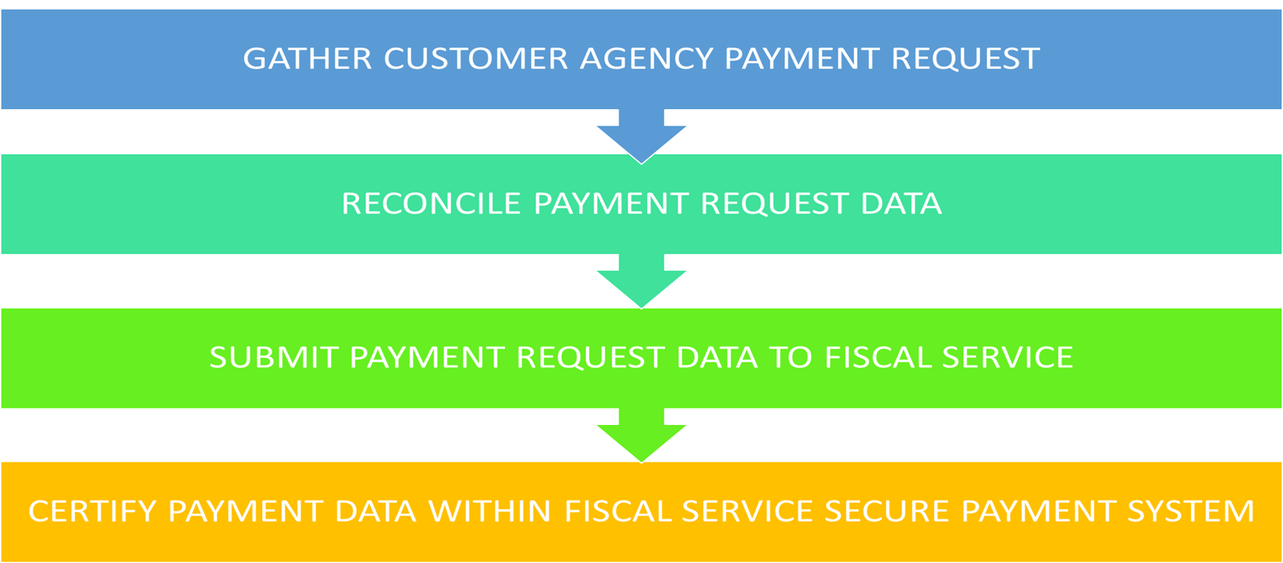
Certification Process a

Slide 3
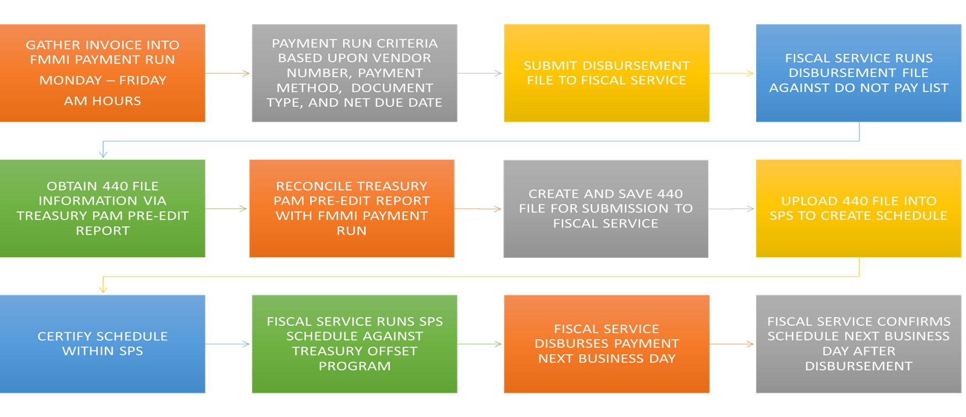
Certification Process b

Slide 4
FMMI Automated Confirmation

Slide 5
Confirmation Processing
Underlying Objective:
Compare Treasury records to USDA records utilizing Agency Location Code, schedule number and Treasury Account Symbol-BETC
Goals of Process:
Record paid FMMI schedules
Reconcile paid schedules
Work rejects from the automated confirmation process
Retrieve paid schedules from Fiscal Service Central Accounting Reporting System
Load Fiscal Service disbursement file to FMMI cloud drop box
Reconcile Fiscal Service paid schedules to FMMI recorded paid schedules

Slide 6
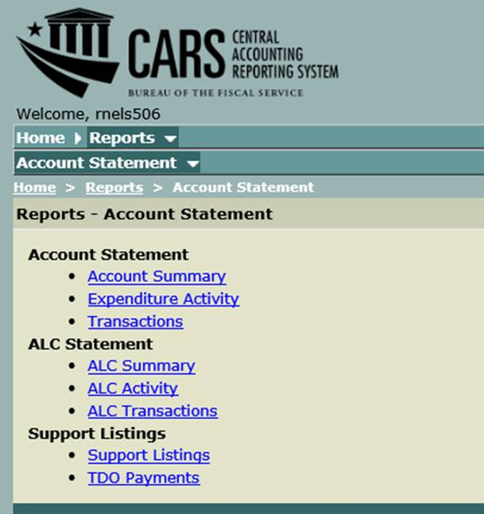
Central Accounting Reporting System

Slide 7
FISCAL SERVICE CONFIRMATION FILE
**** Treasury Confirmation File Data ****
Treasury Confirmation File: FMMI.TREAS.CONF.12401240.D180417.T104000.txt
On Cloud Drop Box
Treasury Schedule: 0A128041701
Schedule Type: A
Number of Payments: 527
Treasury Schedule: 0C128041701
Schedule Type: C
Number of Payments: 12
**** Treasury Confirmation File Totals ****
Total NBR Schedules: 16
Total NBR Payments: 4,520
Total Payment Amount: $19,664,252.70
Total RFC Count: 14
Total RFC Amount: $19,664,252.70
Total ALC Amount: $19,664,252.70

Slide 8
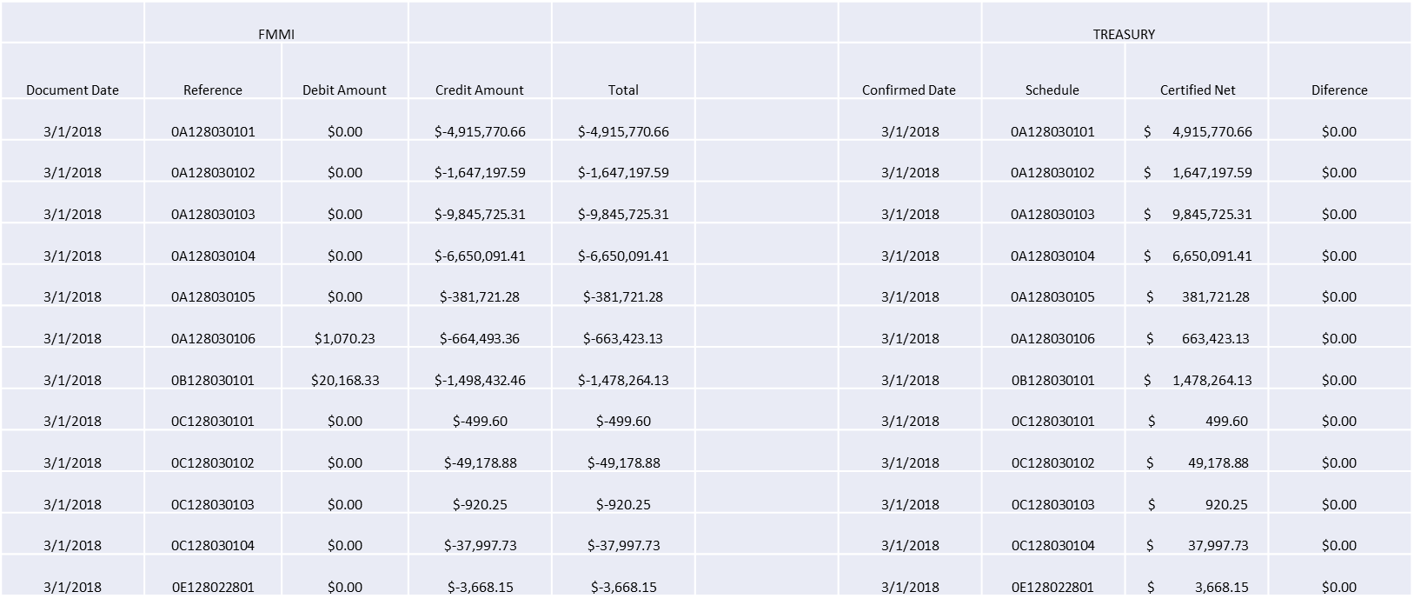
Cash Reconciliation Data

Slide 9
Payment Cancellation

Slide 10
Cancellation Overview
Underlying Objective:
Compare Treasury records to USDA records utilizing Agency Location Code, schedule number and Treasury Account Symbol-BETC
Transaction Flow:
USDA submits pay request to Fiscal Service
Fiscal Service attempts to pay
Fiscal Service notifies USDA of cancellation
USDA locates In-Transit document associated with the original payment and records cancellation via
TR document type
Goals of Process:
Record cancellation
Inform customer agency

Slide 11
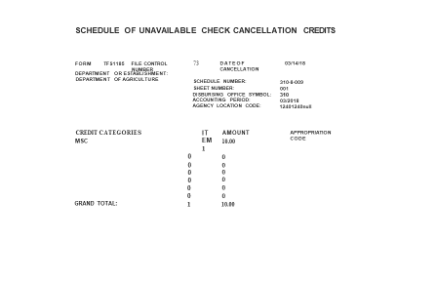
Fiscal Service Cancellation Report

Slide 12
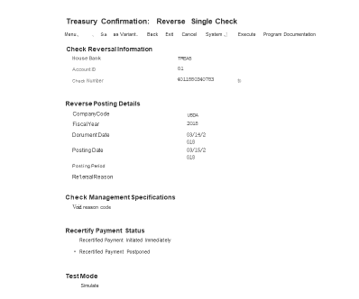
Reverse Single Check display

Slide 13
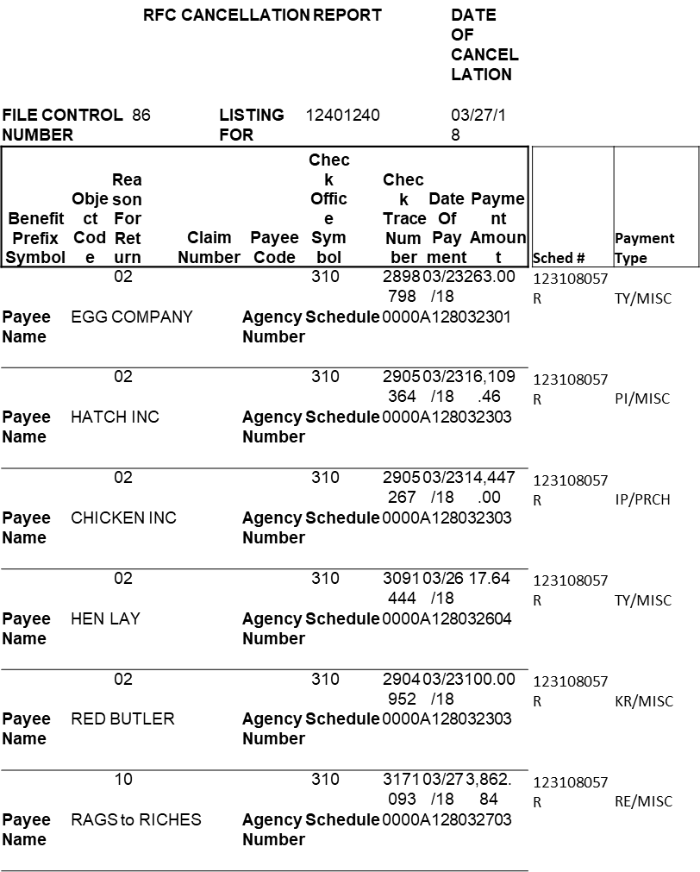
RFC Cancellation Report

Slide 14
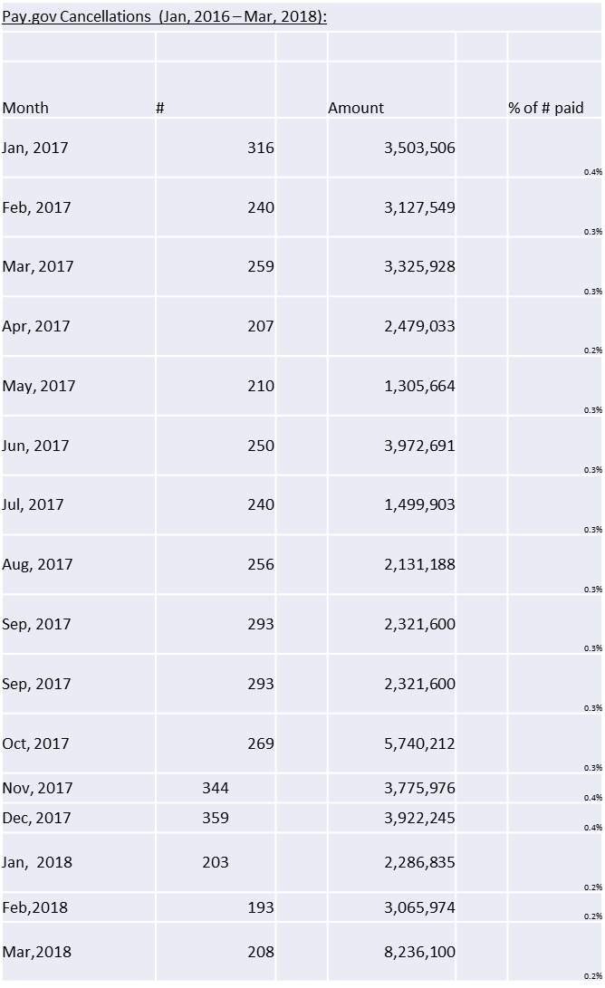
Pay.gov Cancellation Report

Slide 15
ASSIGNMENT OF CLAIMS
Submission Instructions

Slide 16
AGENCY SUBMISSION
Upon receipt by the agency of an Assignment of Claim (Assignment), the following actions are required:
Confirm that a complete copy of the assignment, signed by all parties, has been received and notarized.
Execute the Receipt of Acknowledgement as contained within the Assignment. This is done by the Contracting Officer.
Provide the assignee’s banking information (routing and account numbers), mailing address, and email address.
Provide contracted vendor’s email address.
Provide agency email address.
Confirm the contract number, as provided within the Assignment, is contained within the FMMI application.
Provide the FMMI purchase order number and vendor code and/or contract number.
Submit complete acknowledged copy of the Assignment, as well as coversheet and/or letterhead providing requested information, to Administrative Certification Section fax number 303-205-3435 or email to Tammy.Alphonse@cfo.usda.gov, Ann.Gaten@cfo.usda.gov and Susan.Lauga@cfo.usda.gov.

Slide 17
CFO/FMS/ACS ACTIONS
Upon receipt by ACS of an Assignment, the following actions are required:
Confirm and/or establish vendor record for assignee.
Confirm availability of funds within the FMMI purchase order.
Email IAS Help Desk to establish partner function under the IAS contract number utilizing the assignee’s vendor record number.
Confirm partner function established under the FMMI purchase order number linked to the IAS contract number upon notification of completion from IAS Help Desk.
Advise the agency, vendor, and assignee via email that the partner function is established and that payments may be processed under the contracted vendor number.
Note: Sample Assignment of Claims form is available upon request.

Slide 18
ASSIGNMENT OF CLAIMS
Points of Contact
Tammy Alphonse – Tammy.Alphonse@cfo.usda.gov
Ann Gaten – Ann.Gaten@cfo.usda.gov
Susan Lauga – Susan.Lauga@cfo.usda.gov
Lloyd Davis – Lloyd.Davis@cfo.usda.gov

