Slide 1
Compassionate Leadership
Cultivating a Culture of ”All-in” When and Where You Need it Most.
Jennifer Lynne Croneberger
www.thefivewords.com

Slide 2
Compassion: What is it?
Dictionary.com: A feeling of deep sympathy and sorrow for another who is stricken by misfortune, accompanied by a strong desire to alleviate the suffering.
Compassionate Leadership-Forbes: “Leadership that transcends the traditional measures of organizational performance, to take care of the human condition at the heart level.”

Slide 3
67.

Slide 4
The Three Core Principles:
Empathy: Feeling how someone else is feeling.
Cognitive: Seeking to understand what someone else is thinking and why they came to this certain opinion.
Motivation: Seeking to take care of the concerns of others and reduce their suffering.

Slide 5
Apathy, Sympathy, Empathy
I don’t care, get it done.
Oh, that’s a shame. Here’s a piece of chocolate. At least you have…
I hear you, I see you, I feel you and I’m sorry. I’m not sure what to say, but I am here.
The Story of Giovanni di Pietro di Bernadone

Slide 6
Cognitive-Listening is a skill
Aggressive - Listening to respond, interrupts you while you are still talking and is thinking about what they are going to say.
Passive - The one that believes they can multi-task while you are talking to them, responding to a text message or email.
Active - Listens thoroughly to what you said and can mirror back what you said with phrases like, “What I hear you saying is…” “TELL ME MORE” YOU CAN’T BE A COMPASSIONATE LEADER WITHOUT LISTENING TO WHAT YOUR FOLLOWERS ARE TRULY SAYING AND WHY THEY ARE SAYING IT.

Slide 7
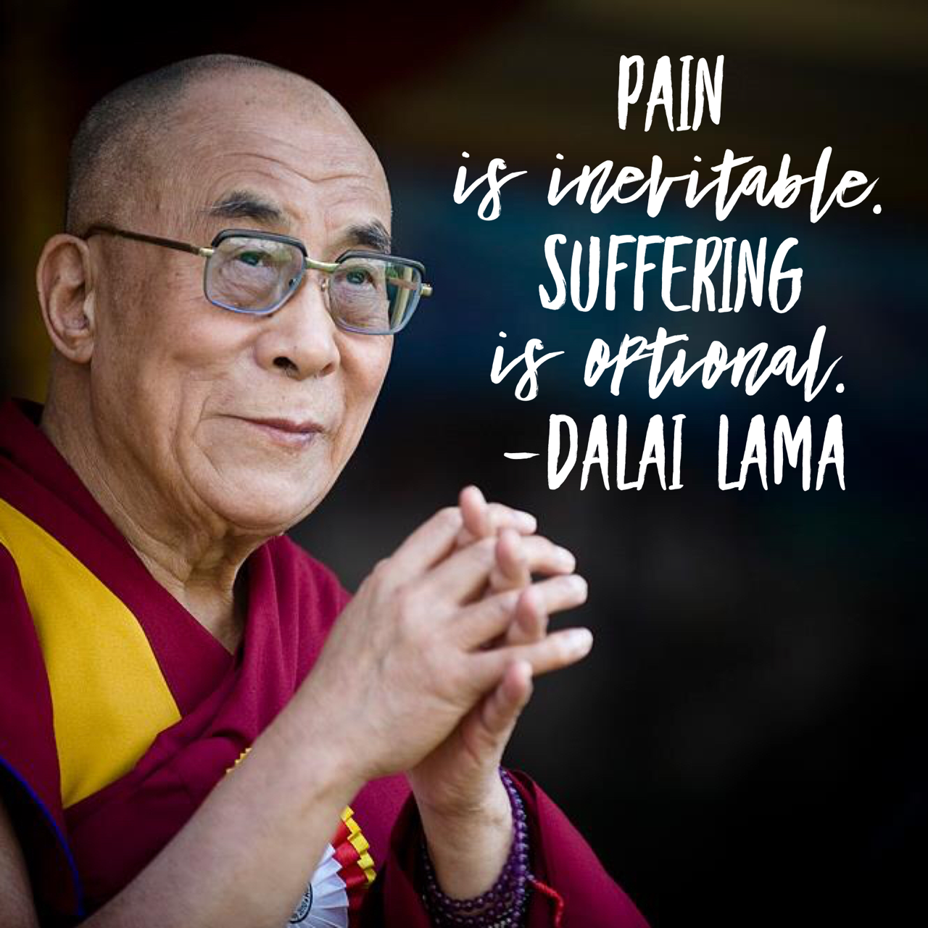
Motivation/Action
Asking questions like “How can I serve? What can I do to help you with this situation?”
There will be pain, but help take away the suffering. Remember the human being isn’t different when they walk in and out of the door at work
Your motivation as well as the other person’s will be deeply rooted in their core values, personal non-negotiables and your WHY.

Slide 8
Compassionate Leadership Skills and Traits

Slide 9
So what is the outcome?
How does being a compassionate leader increase your bottom line as a company?
Higher productivity, less call-outs, less turnover, stronger employee engagement, decrease in stress, stronger social interaction and connection. All leading to the most critical elements of what the greatest employee desires are:

Slide 10
Taking a Poll

Slide 11
TRUST
Leigh Branham, Author of 7 Hidden Reasons Employees Leave:
Analyzed over 20,000 anonymous surveys asking employees why they left their last job. Most managers believe pay was the reason people quit. Branham discovered that the number one reason actually is:
LOSS OF TRUST AND CONFIDENCE IN THEIR SENIOR LEADERS.

Slide 12
LOVE
Whole Foods, PepsiCo, Zappos and Cisco Systems all list management principles that begin with love and caring.
Harvard Business Review studied compassion and love in the workplace. (Warmth, affection, connection)
Findings: of 3,201 employees in 7 different industries - Those who worked in a culture where they felt free to express affection, compassion and caring for one another were more satisfied with their jobs, committed to the organization and accountable for their performance. =Happiness.

Slide 13
Conclusion
“There is little doubt that employee engagement can be strengthened by fairness and its related elements, just as employee engagement can be weakened by unfairness and the like. As both the workforce and the workplace evolve, organizations may find that in order to win the ’war for talent’, they must first win the battle for employees’ hearts.” -The Center for Advanced Human Resource Studies, 2011

Slide 14
A Compassionate Leader:
Shows EMPATHY
LISTENS ACTIVELY
Knows the WHY
Builds TRUST
Creates a culture of LOVE

