Slide 1

USDA FINANCIAL MANAGEMENT TRAINING

Slide 2
What’s What?
Mission Area DASO | Not under Mission Area DASO
Office of Chief Information Officer (OCIO) | Office of Chief Financial Officer (OCFO)
Office of Executive Secretariat (OES) | Office of Inspector General (OIG)
Office of Homeland Security (OHS) | Office of General Counsel (OGC)
Office of Operations (OO) | Office of Budget and Program Analysis (OBPA)
Office of Contracting and Procurement (OCP) | Office of Partnerships and Public Engagement (OPPE)
Office of Property and Fleet Management (OPFM) | Office of Chief Scientist (OCS)
Office of Small and Disadvantage Business Utilization (OSDBU) | Office of Hearings and Appeals (OHA)
 | Office of Assistant Secretary of Civil Rights (OASCR)
 | Office of Communications (OC)
 | Office of Chief Economist (OCE)

Slide 3
Departmental Administration
Office of the Assistant Secretary for Administration
Office of the Chief Information Officer
Office of Contracts and Procurement
Office of Property and Fleet Management
Office of Human Resources Management
Office of Homeland Security
Office of Operations
Office of Executive Secretariat
Office of Small and Disadvantaged Business Utilization
Secretary’s Customer Experience Office
Feb 2018 Reorganization
Created Secretary’s Customer Experience Office
Split OPPM into an Office of Contracts and Procurement and Office of Property and Fleet Management
OCIO shifted Directives and Records to OES
OCIO shifted classified national security program branch and controlled unclassified to Office of Homeland Security
OPPM shifted workers compensation and safety to OHRM
Renamed Departmental Administration from Departmental Management
Renamed the Office Homeland Security

Slide 4
Leadership
ASA’s Office
Don Bice Deputy Assistant Secretary
Jeleen Briscoe Chief of Staff
Joe Doyle Office of Customer Experience
Office of the Chief Information Officer
Gary Washington Chief Information Officer
Office of Contracts and Procurement
George Cabaniss
Office of Property and Fleet Management
Ginger Murphy (Acting)
Office of Human Resources Management
Mary Pletcher Chief Human Capital Officer
Office of Homeland Security
Josh Bornstein (Acting)
Office of Operations
Duane Williams
Office of Executive Secretariat
Jean Daniels (Acting)
Office of Small and Disadvantaged Business Utilization
Michelle Warren (Acting)

Slide 5
A sample of other DASO activities
Service Now Reporting HACU Interns Program TMCF Interns Program 2501 Grant Program COOP planning Program Bio Preferred Program Human Resources CIO CFO Ag Buildings and Facilities | Integrated Acquisition System Secretary Security Detail Support for the CXO’s ULO daily reporting A-123 compliance, testing and remediation Travel Internal Agency Agreements Forecasting current and future years Since 2015, Shared Cost Program support (billing, obligations, payments, payroll, etc.)

Slide 6
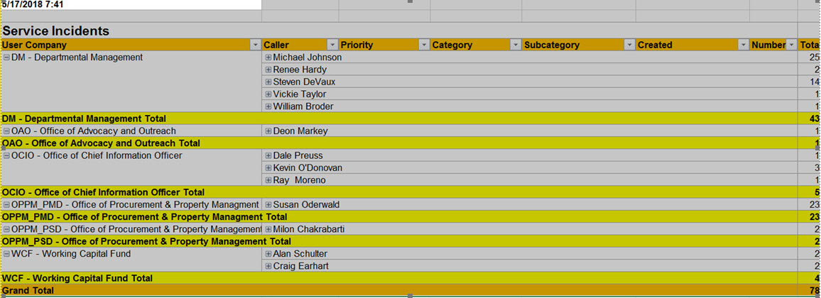
Service Now

Slide 7
A sample of other DASO activitiesb
Service Now Reporting HACU Interns Program TMCF Interns Program 2501 Grant Program COOP planning Program Bio Preferred Program Human Resources CIO CFO Ag Buildings and Facilities | Integrated Acquisition System Secretary Security Detail Support for the CXO’s ULO daily reporting A-123 compliance, testing and remediation Travel Internal Agency Agreements Forecasting current and future years Since 2015, Shared Cost Program support (billing, obligations, payments, payroll, etc.)

Slide 8
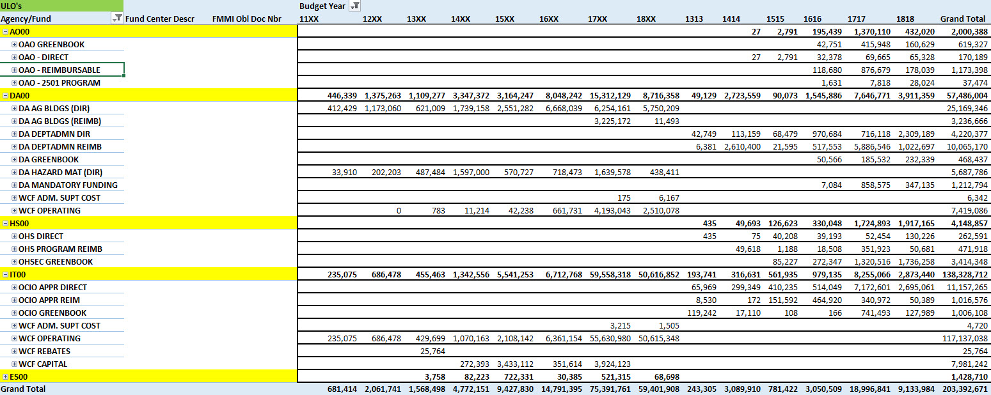
ULO’s at a glance…

Slide 9
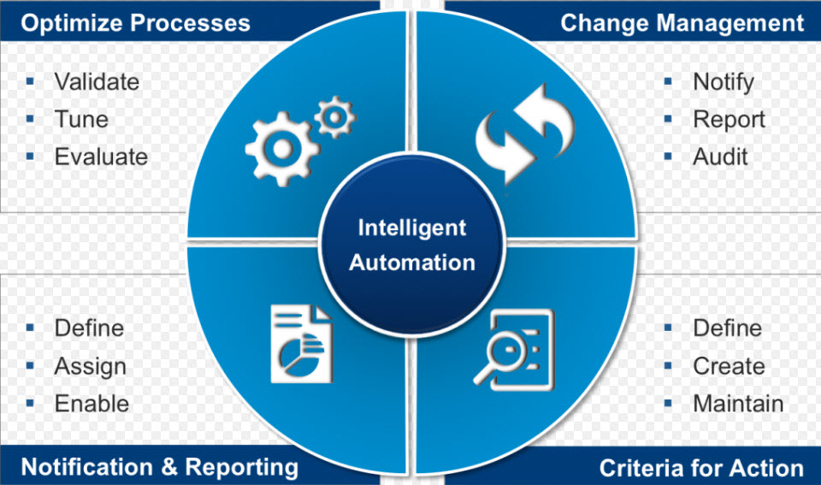
Intelligent Automation…

Slide 10


Slide 11
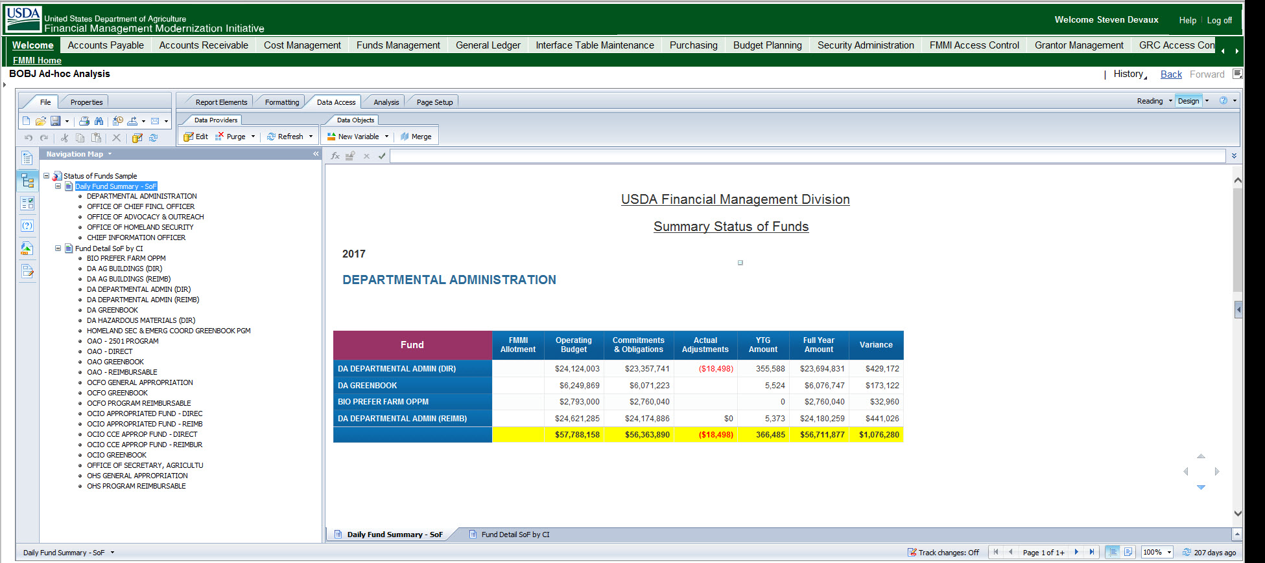
Status of Funds Summary

Slide 12
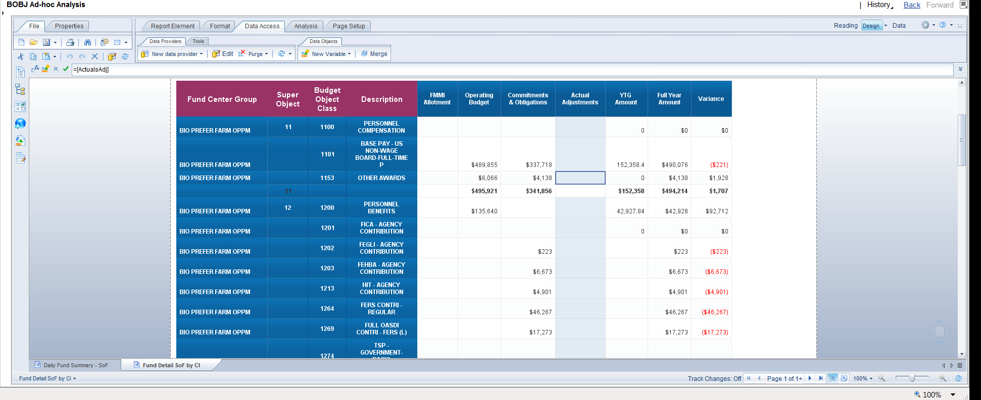
Detail by Super and Budget Object by Fund

Slide 13
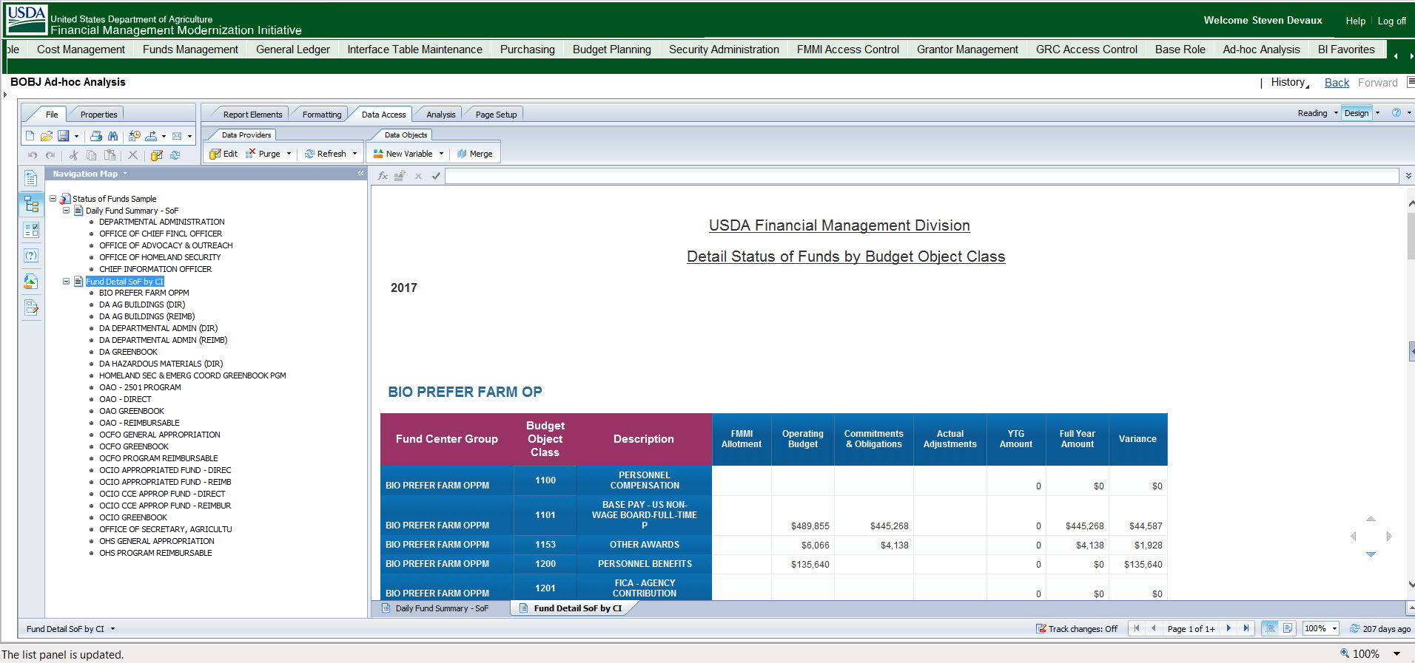
…for all

Slide 14
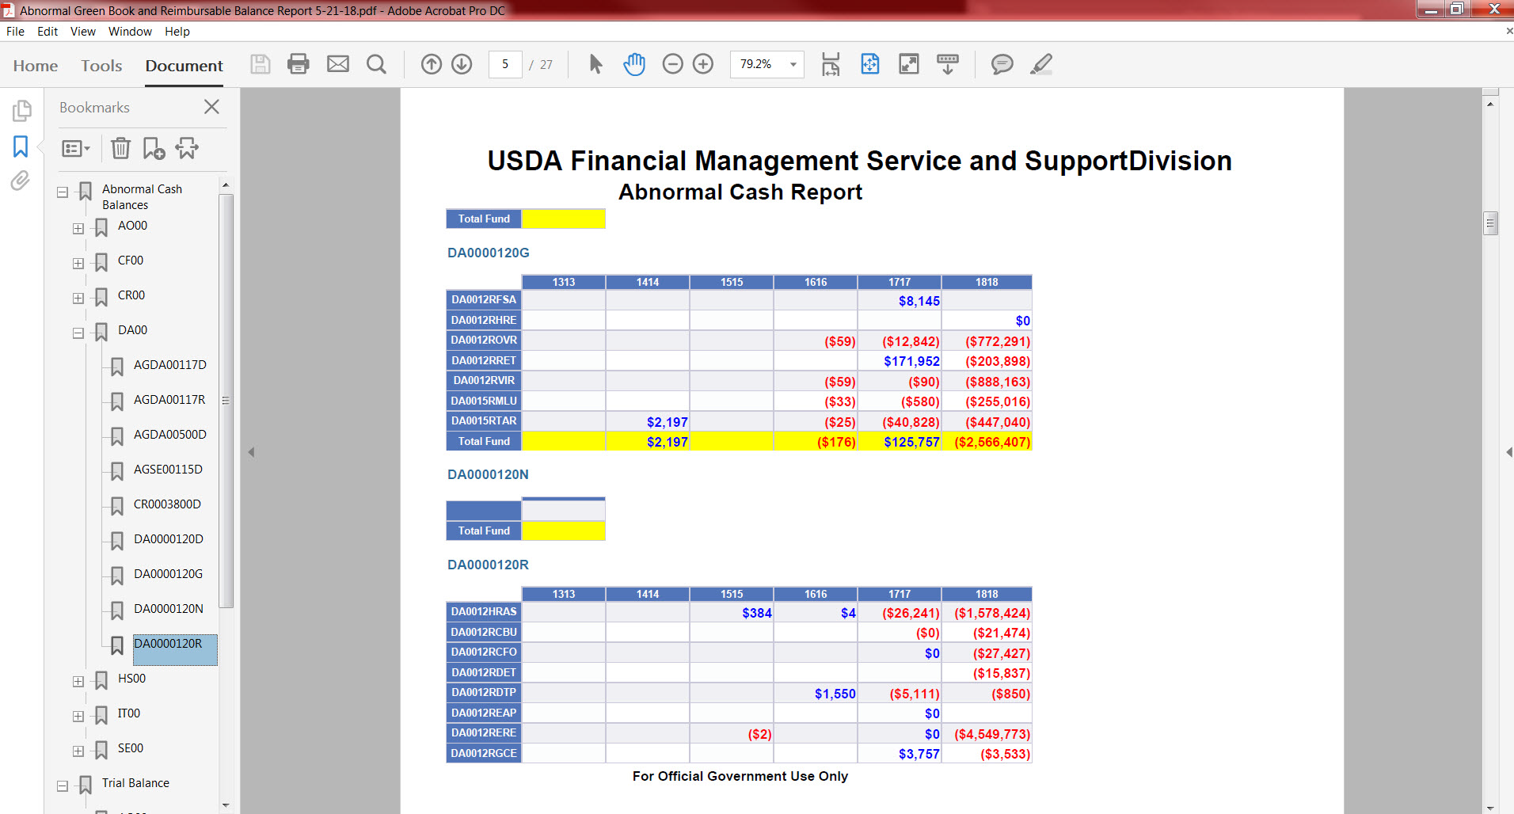
Abnormal Balances

Slide 15
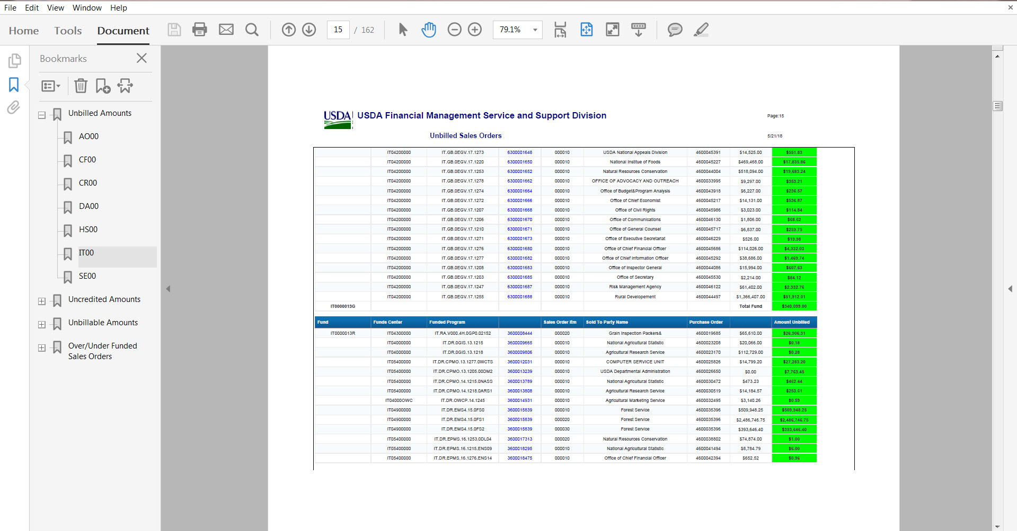
Comprehensive Sales Order Report

Slide 16

The exceptions…

Slide 17
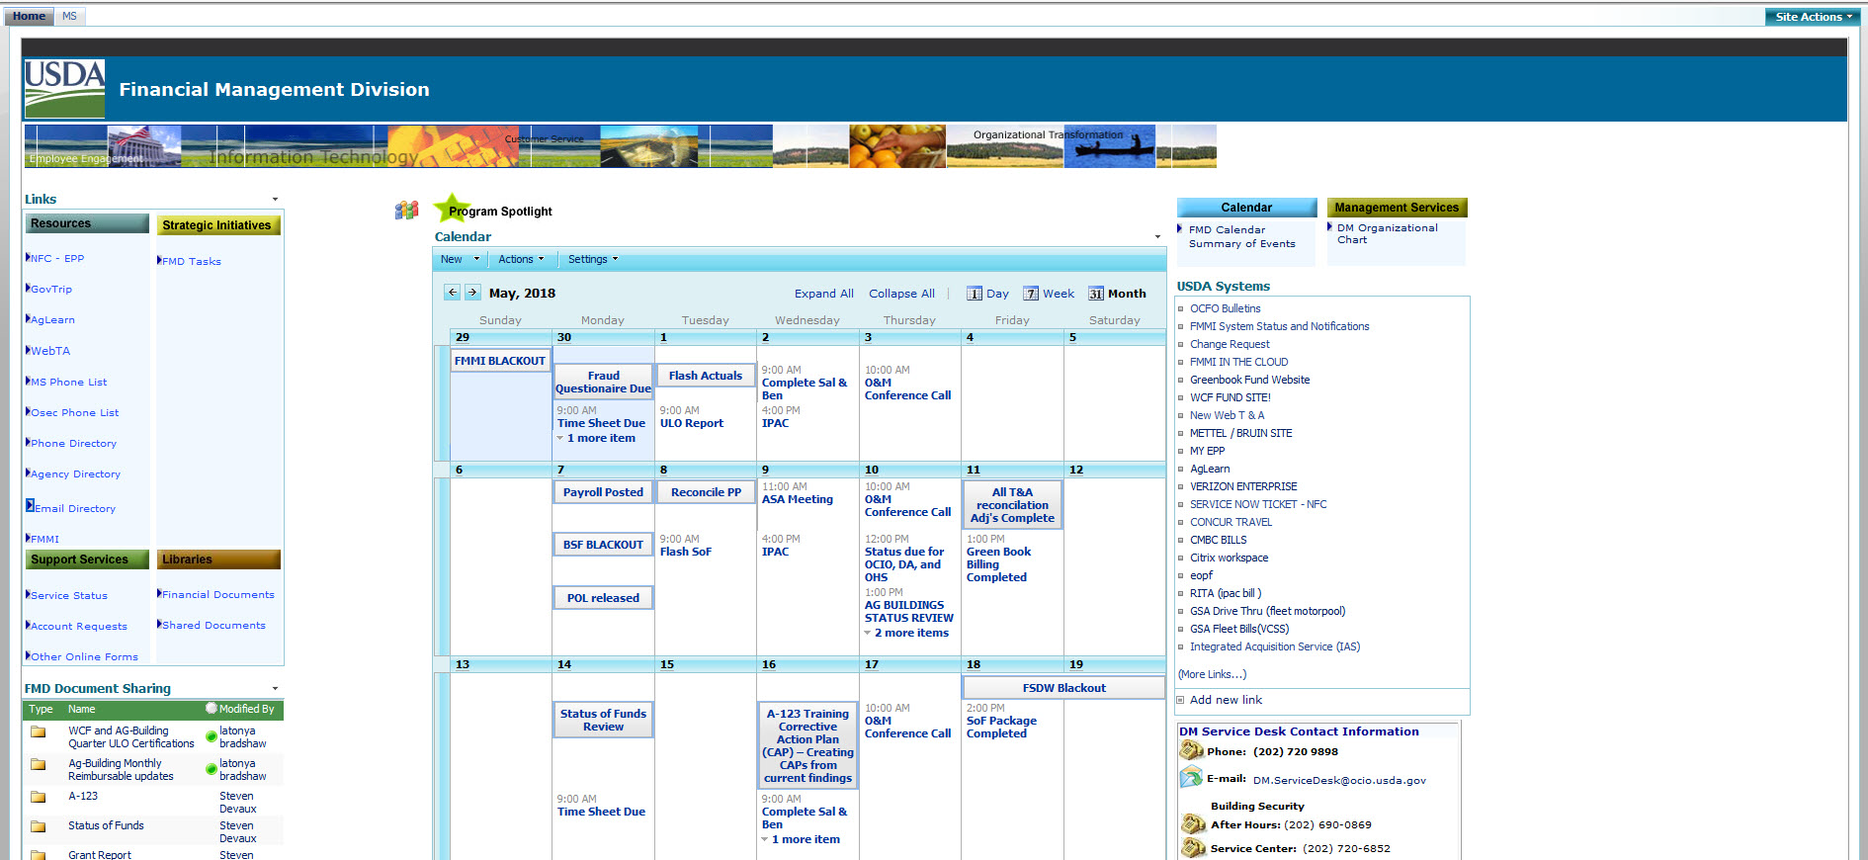
Share Point

Slide 18
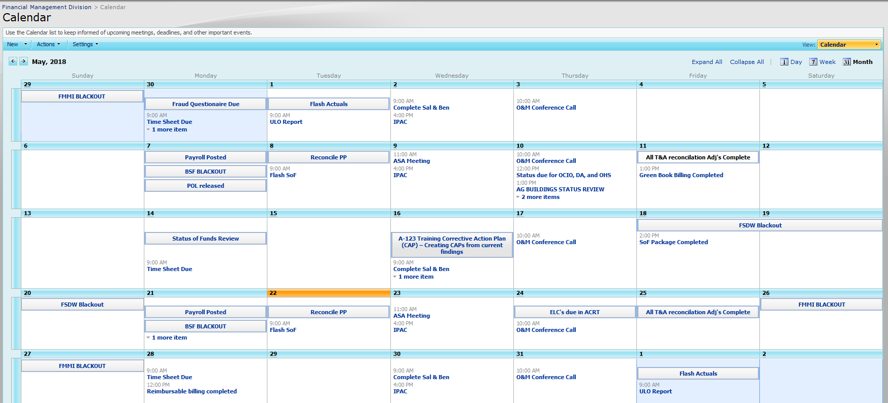
Share Point Calendar

Slide 19
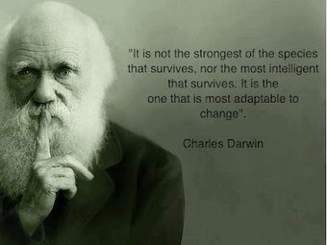
Adaptation

Slide 20

The invisible second shift…

Slide 21

We’re all about building bridges helping our customers to bridge the divide between plans and actions and measuring the results

Slide 22

Thanks for listening!

