Slide 1

Financial Management Service Center (FMSC)
Help Desk Tier 1
ETS2/FMMI Support
Presenter: Wade Edwards

Slide 2
AGENDA
FMSC Help Desk
Who
What
Why
How
OUR GOAL
The goal of the Financial Management Services
Center (FMSC) Help Desk is to provide excellent customer service to both internal and external customers.

Slide 3
FMSC Help Desk
Tier 1
ETS2/FMMI Support
Who We Are?
A highly trained and dedicated Tier 1 Help Desk providing customer-focused assistance and solutions on multiple levels for the ETS2 (ConcurGov) Travel System/FMMI support.
Analyst - Triage and ticket assignment. Instant resolution.
Sr. Analyst – Research, Analysis and Resolution for complex issues.
Lead Analyst – Escalated complex issues and reporting. Deep Dive Analysis, Resolution and Vendor Escalation.

Slide 4
FMSC Help Desk
Tier 1
ETS2/FMMI Support
Address and resolve most ETS2/ConcurGov documents and any related accounting system issues, both user and systemic.
Proactively monitors ConcurGov document processing, reports and email notifications to remain ahead of systems problems, while working with dedicated resources to resolve issues before they are reported by an agency.
Provide agency support for internal errors received when traveler documents are entered and rejected.
Perform analysis of Concur Support cases entered both by agencies and the FMSC Help Desk, to determine trends in document and/or system failure.
Act as advocate for agencies in Concur Account Manager meetings and User groups.
What We Do?

Slide 5

FMSC Help Desk
Tier 1
ETS2/FMMI Supporta
                Automated systems are implemented by USDA to accurately process, record, store and report financial data. Systems are linked via interfaces and often perform as designed. However, the best systems still require user and application support.
  FMSC Help Desk Tier1, USDA’s best choice for first line support for our customers.
Why We

Slide 6

FMSC Help Desk
Tier 1
ETS2/FMMI Support
t
How We
Support You?
Proactively
by
Monitoring
Monitor ETS2 FMMI Interface (ISD)
Reactively
to
Service Tickets
Triage & Assign Service Tickets Expeditiously
Research & Resolve Tickets Timely
Customer Advocacy
through
Issue Escalation
Advocate & Submit cases for Escalation to ConcurGov on behalf of USDA agencies
ETS2 & ConcurGov User Group Participants
Daily Coordination w/ConcurGov interface Dedicated Support
Report Analysis Support
Manual FMMI De-Obligation & Commitment Adjustments
Reject Resolution Assistance - FMMI Manual Entry Support
Monitor Document Statuses (Daily Reports)

Slide 7
FMSC Help Desk
Tier 1
ETS2/FMMI Supportb
ETS2/FMMI
Travel Documents
and
How They Flow

Slide 8
FMSC Help Desk
Tier 1
ETS2/FMMI Supportc
Travel Authorization (AUTH)
Foundational document sent from ETS2 to FMMI used to authorize and obligate estimated funds to cover travel expenses for federal and non-federal travelers
Base document from which advance payment of travel expenses is calculated and disbursed
Does not have an accounting impact in FMMI until it is approved and posted in FMMI

Slide 9
FMSC Help Desk
Tier 1
ETS2/FMMI Supportd
TRAVEL ADVANCE
Request for payment of travel expenses in advance of the trip
Includes 80% of Lodging, M&IE, and MISC expenses
Does not have an accounting impact in FMMI until the auth is approved and posted in FMMI
Can be disbursed immediately upon request or 3 days prior to the travel date

Slide 10
FMSC Help Desk
Tier 1
ETS2/FMMI Supporte
Authorization Changes
Upward/downward adjustments of travel expenses
can occur three ways:
Direct change to the authorization (AUTH Amendment)
Systemic change triggered by the entry of a voucher (Offsetting Obligation)
Manual adjustment(s) in FMMI

Slide 11
FMSC Help Desk
Tier 1
ETS2/FMMI Supportf
TRAVEL VOUCHER
A request for payment of the actual expenses incurred by the traveler
Will automatically trigger an upward/downward adjustment of the commitment in FMMI if the voucher total is greater than or less than the original AUTH total or when there is a change in payment method
Does not have an accounting impact in FMMI until it is approved and posted in FMMI

Slide 12
FMSC Help Desk
Tier 1
ETS2/FMMI Supportg
TRAVEL VOUCHER TYPES
There are four vouchers types processed in ETS2:
Pre-trip voucher – filed to pay airfare expenses prior to the trip
Interim voucher – short-term vouchers filed during extended travel (usually every two weeks)
Final voucher – filed at the end of the travel period (most common)
Supplemental/Amended voucher – filed after the final voucher is processed to pay an expense that was not paid on the final voucher

Slide 13
FMSC Help Desk
Tier 1
ETS2/FMMI Supporth
BASIC DOCUMENT LIFECYCLE
Created (AUTH/Voucher)
Signed (AUTH/Voucher)
Approved (AUTH/Voucher)
Pending (awaiting response from FMMI)
Posack Obligation (positive acknowledgement of AUTH posting in FMMI)
Offsetting Obligated (positive acknowledgement of offsetting obligation posting in FMMI)
Voucher Received (positive acknowledgement of voucher posting in FMMI)
Paid (confirmation of payment of voucher by Treasury)

Slide 14
FMSC Help Desk
Tier 1
ETS2/FMMI Supporti
Near-Real Time Interface Processing
An approved document in ETS2 will post or reject in FMMI in a matter of seconds or minutes

Slide 15
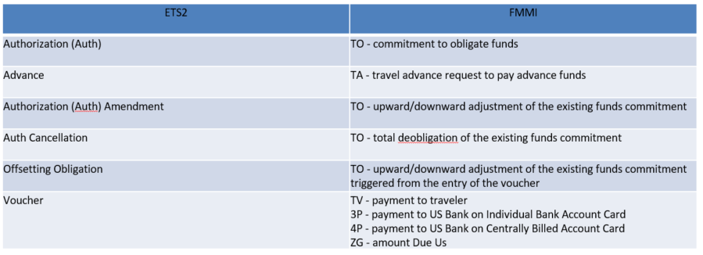
FMSC Help Desk
Tier 1
ETS2/FMMI Supportj
ETS2/FMMI DOCUMENT COMPARISON
CREATES
POST

Slide 16
FMSC Help Desk
Tier 1
ETS2/FMMI Supportk
ETS2/FMMI
Travel Document
Interface Support

Slide 17
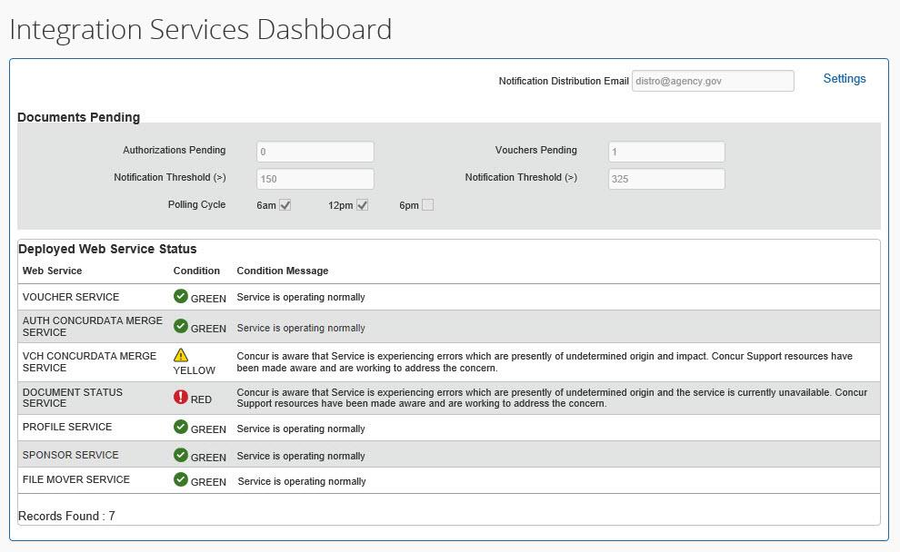
FMSC Help Desk
Tier 1
ETS2/FMMI Supportl
Monitoring: ConcurGov Integration Services Dashboard (ISD)
Real-time state of integration services
Notices of outages and service suspensions
Status information of document processing

Slide 18
FMSC Help Desk
Tier 1
ETS2/FMMI Supportm
Monitoring Document Status (Reports)
FMSC Help Desk Tier 1 provides support for the interface documents by daily running and analyzing five different status reports from ConcurGov
  Obligation Pending
  Voucher Pending
  Voucher Received
  Advance Submitted
  Advance Received

Slide 19
FMSC Help Desk
Tier 1
ETS2/FMMI Supportn
Direct Document Interface Monitoring with Concur Support
FMSC Help Desk Tier 1 works daily with a dedicated resource from Concur’s Support Integration Team. This allows us to:
Request detailed real-time status reports that can only be run by the Concur Integration Team
Gain detailed information regarding the status and condition of their middleware
Address rejects that are a result of interface sequencing
Request manual actions to be taken by Concur to fix document rejects/failures

Slide 20
FMSC Help Desk
Tier 1
ETS2/FMMI Supporto
ETS2/FMMI
Service Now Support
Tickets

Slide 21
FMSC Help Desk
Tier 1
ETS2/FMMI Supportp
Requesting Support Services
Telephone Calls
Written Inquiries (emails)
Service Now Tickets
Concur Support Cases
Reject Report Support
Agency Report Support (ULO)

Slide 22
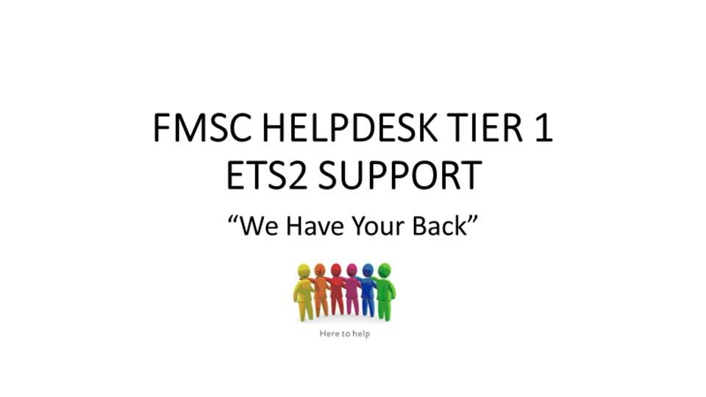
FMSC Help Desk
ETS2/FMMI Support
Hours of Operation:7:45am to 4:00pm CST
Contact Us: 1-800-421-0323; FMSC.help@ USDA.gov

