Slide 1
FMS Collection Processing and Initiatives
Presented by: Eddie Reso & Donna Cornella
May 2018

Slide 2
Overview
Treasury Collection Systems
Collection Processing at USDA
Current Improvements
Implementation of Treasury’s CRS System
Future Initiatives

Slide 3
Introduction
Various types of collections are processed in FMMI.
Treasury has many different collection systems to which payments are remitted.
All collections come through a Treasury system.
Various USDA agencies utilize some or all of these Treasury systems.
Having data passed from these systems, that identify the debtor and/or applicable receivable, is necessary for posting collections.

Slide 4
Treasury Collection Mechanisms
Electronic Check Processing (ECP)
General Lockbox Network (GLN)
OCTnet
Credit Card Acquiring Services (CAS)
Credit Gate Way (Fedwire/ACH/Online Bill Pay)
Pay.gov
Electronic Federal Tax Payment System (EFTPS)
Treasury General Account (TGA)

Slide 5
GLN & ECP
GLN facilitates the capture of Federal Agencies check deposit and remittance (forms, coupons, and correspondence) information.
GLN is currently comprised of three Financial Agents that form the Lockbox Network:
  Citibank
  US Bank
  Bank of America
ECP is a system used to convert paper checks into Automated Clearing House (ACH) or Check 21 via a lockbox network.
The ECP system is widely used by Federal Agencies and their Financial Agents to view and research transactions.
In order to use ECP, the agencies must have a lockbox. ECP and GLN work together.

Slide 6
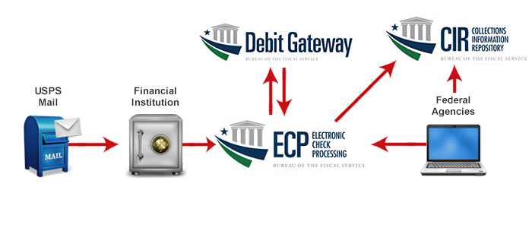
GLN and ECP Process Flow
5) Bank of
Deposit
Processes payments
Settlement via Check 21 or ACH
Sends settlement and return info back to ECP
6) Settlement and Return Data available in voucher reports
1) Incoming USPS and overnight delivery
2) GLN Lockbox picks up mail
Verifies items according to specification
Data Capture
Scan checks and remittance images
3) Payment and Remittance data and images are transmitted to ECP
4) Deposit preparation
Stores images and data
Generates reports
Logs into the ECP system to retrieve reports/images
Log into CIR to view reports and deposit information

Slide 7
ECP System
Receives files from Financial Agents containing:
  Payment Information
  Remittance Information
  Check Images
  Remittance Images
Acts as a data and image repository
Transmits data for settlement to FRB Cleveland
Enables users to query and view elements associated with a transaction
Download balancing and other reporting information

Slide 8
OTCnet
OTCnet is a Web-based system that enables federal agencies to integrate check conversion and deposit reporting activities, so that all check and cash deposits to Treasury General Accounts are handled by one Web-based application
Deposits come from an over-the-counter environment, which are required to make weekly deposits to a Treasury General Account (TGA) Bank
Two Components: The Check Capture component and the Deposit Reporting component
The Check Capture component allows agencies to electronically convert paper checks to digital images for presentment in an online (internet connectivity) or offline (no internet connectivity) mode.
The Deposit Reporting component allows agencies to deposit check, cash and coins to a TGA bank

Slide 9
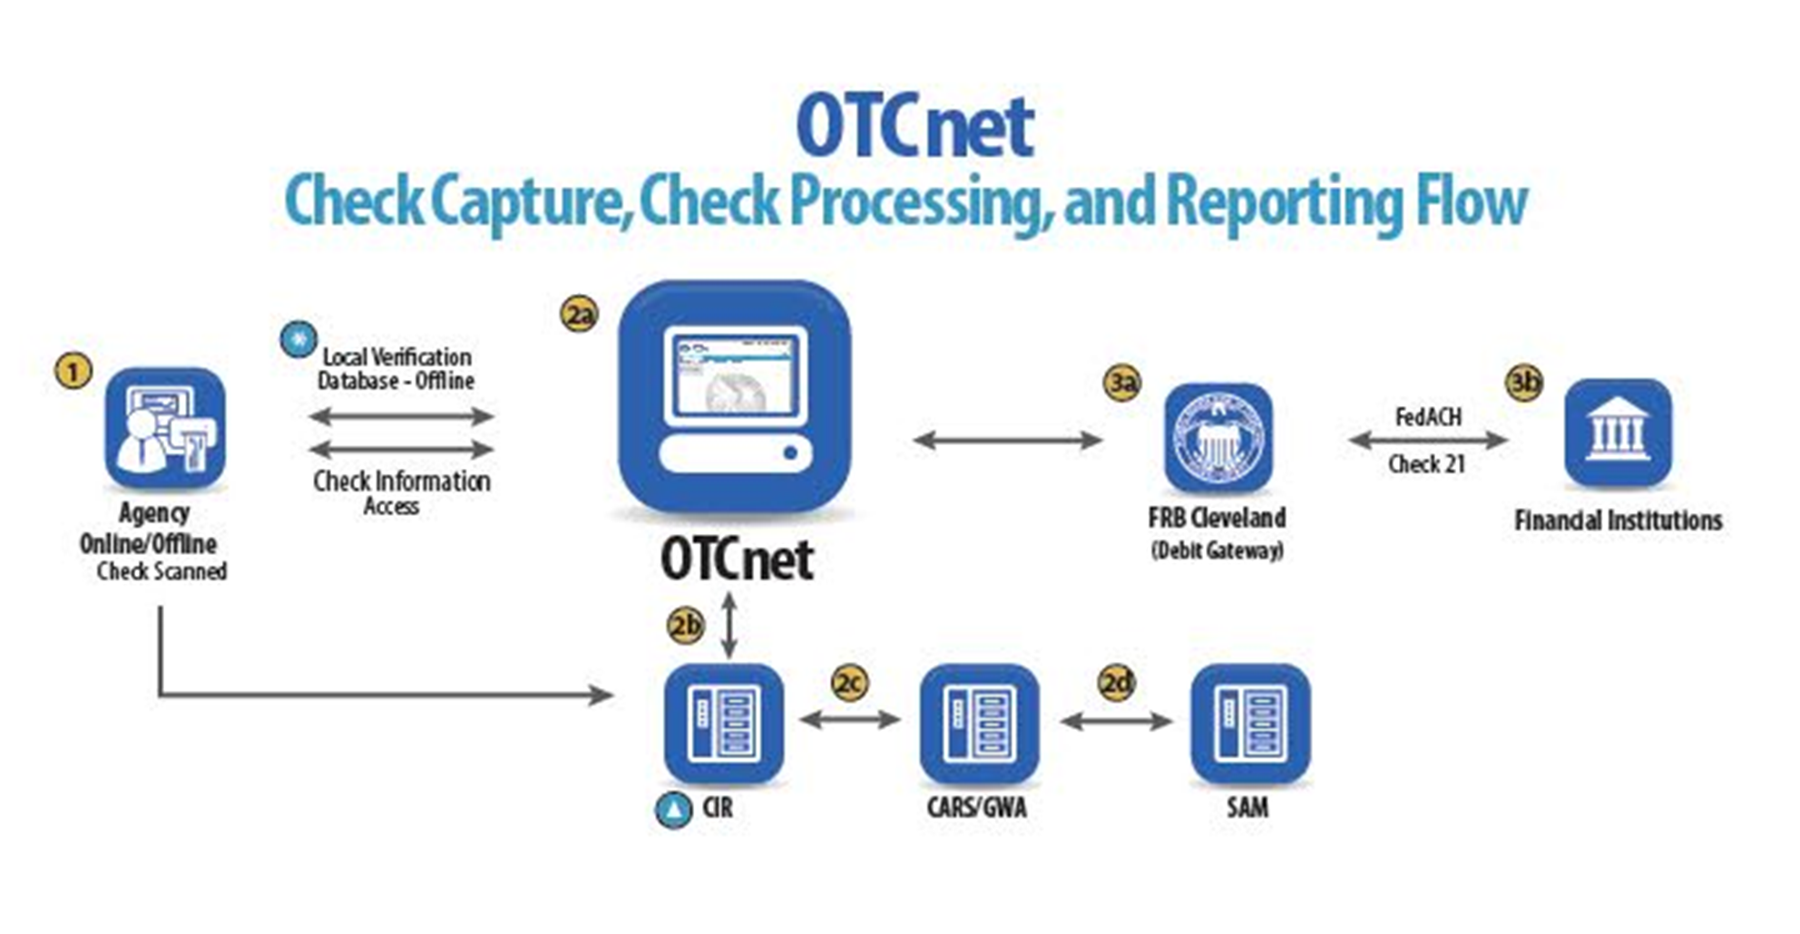
OTCnet

Slide 10
Card Acquiring Services
(CAS)
Formerly known as the Plastic Card Network
Treasury system which provides Federal Agencies with merchant services, credit, debit, electronic benefit transaction and stored value (e.g. gift, etc.) cards
Acceptance Points:
  Traditional stand-alone terminals
  Integrated point of sale solutions (e.g. electronic cash registers)
  Vantiv Accept (mobile)
  Kiosks
  Internet-based software applications (e.g., pay.gov)
Vendor for Merchant processing: VANTIV

Slide 11
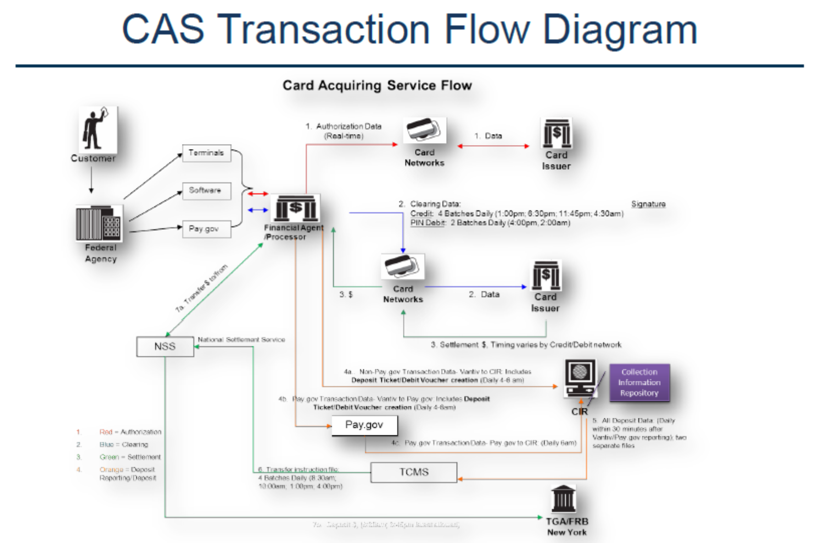
CAS transaction Flow Diagram

Slide 12
Three Electronic Payment Options
Treasury programs for collecting funds electronically
  Online Bill Payment (OLBP)
  Fedwire
  ACH Credit (aka: Same day ACH)
Key factors such as payment size, time sensitivity of receipt, type of customer, and customer costs drive which collection option is most appropriate for agencies
These systems utilize the Credit Gateway to settle transactions through the
FRB (operated by US Bank)
Transactions feed via Credit Gateway by ALC to the CIR

Slide 13
Pay.Gov
Allows Federal Agencies to collect money online
ACH Debits
Credit & Branded Debit Cards
Digital Wallet - PayPal & Amazon Payments
Pay.gov is the 2nd largest collection engine (only to taxes) in the
United States
Agency Specific forms
Funds collected go through designated ALC to the CIR

Slide 14
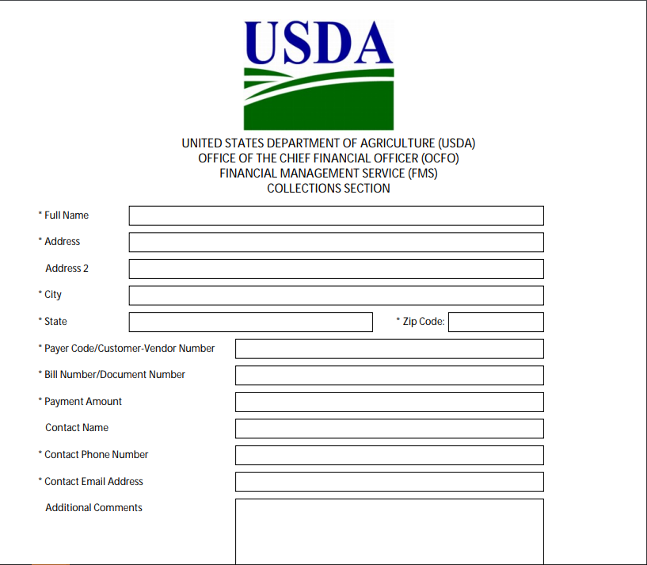
Pay.gov – USDA FMS Form
Example

Slide 15
Pay.Gov – E-billing
E-billing option – Debtor views actual bill in Pay.gov
Greatly reduces if not eliminate unapplied collections
Features | Benefits
Notifications are sent to user by email | Reduced agency expense (postage) and enhanced efficiency and record keeping
A link is included in the notification directing client to the Pay.gov Billing page | Clear call to action; positive user experience that can be immediately fulfilled
Provides an electronic and efficient way for agencies to proactively seek collections | May reduce agency resources needed to manage billing process
To be used by the Central Receivables Service (CRS) | Agencies leveraging CRS support may benefit by redundancy of use
Security methods include requiring payer to use Access Code, security questions/answers the submission of codes to payer in separate communication from notification | Enhanced security for all stakeholders

Slide 16
The CIR
Standard Reports
ACH Reports
Financial Transaction Reports
Plastic Card Reports
Voucher Reports
Fedwire Reports
CIR: Collection Information Repository
Central source for all settled collections
Web-based - Accessible on-line
Over 20 standard online-viewed agency reports
Source for USDA Cash Reconciliation for collections

Slide 17
The CIR
“Single Data Source”
CIR
EFTPS
CAS
GLN/ECP
Pay.gov
Credit Gateway
OCTnet
TGA

Slide 18
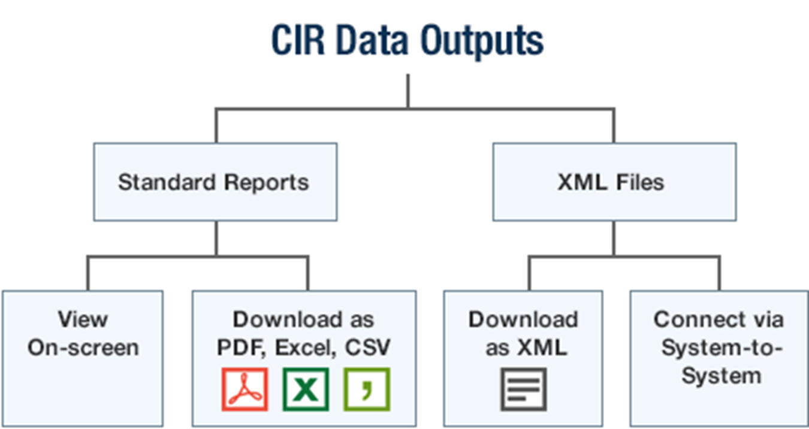

CIR Standard Reports & XML Files

Slide 19
USDA Collection Processing
Collections are processed at five different USDA locations
Five different versions of the FMMI Lockbox Programs are utilized to process collections
Some offices use special programs or feeders in conjunction with the standard lockbox program

Slide 20
USDA Primary Collection
Processing Areas
Forest Service (FS) – Albuquerque, NM
Food Safety Inspection Service (FSIS) – Urbandale , IA
Marketing and Regulatory Program Agencies (MRP) (APHIS, AMS, GIPSA, and servicing FAS) – Minneapolis, MN
Food and Nutrition Service (FNS) - Washington, DC
“Corporate” - New Orleans, LA

Slide 21
Current Corporate Collections
Current Corporate Collection process:
FMS-TSB, Collection Processing Section (CPS)
Responsible for processing USDA’s Corporate Collections related to:
  Employee TDY travel
  Employee Travel relocations
  Refund of Expenditures (i.e. IPERA, Telecommunications, and Utilities)
  Various other types of collections
  Most collections for NRCS and ARS
  Not Payroll Debts (Payroll debts are processed by NFC/ABCO)

Slide 22
Current Corporate Collections
Current Corporate Collection process:
  Lockbox - US Bank File and CIR
    US Bank provides bank file that is automatically submitted into FMMI Corporate Lockbox processor:
    automatic processing, or
    recording to Suspense.
  Non-Lockbox – CIR only data source
    CPS creates a file to upload Suspense (S2) documents into FMMI for non-lockbox items (i.e. Fedwire, Pay.gov). This allows staff to work the collection via re-processor.

Slide 23
Corporate Lockbox
Lockbox Remittance information included on US Bank lockbox file:
  Schedule Date
  Schedule Number
  Customer Number
  Customer Name
  Account Receivable Number (a.k.a. Invoice Number)
  Check Number
  Amount

Slide 24
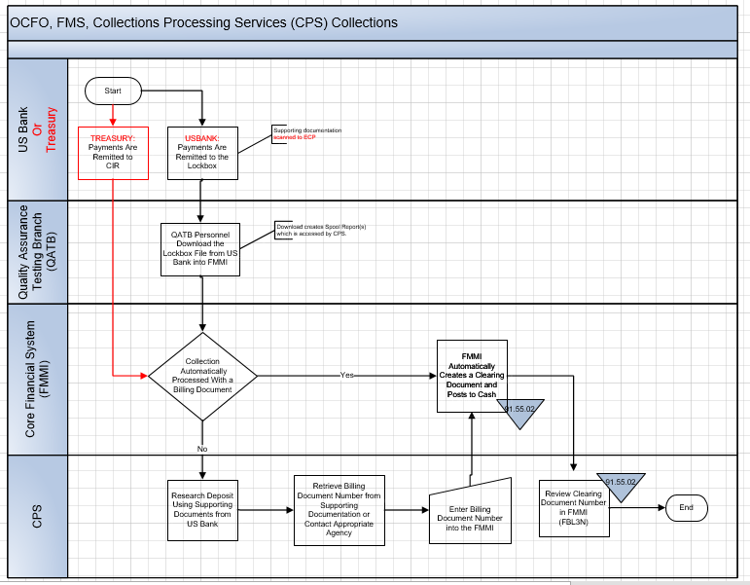
Corporate Lockboxa

Slide 25
Corporate Non-Lockbox
Manual Processes
Manually process other collection data from CIR:
  Non-Lockbox – not read automatically into Lockbox processor
    Upload S2 to process against cash, and then use Re-processor
    Manually process directly to cash without suspense
Manually process items with unique accounting:
    Cash back to Purchase Order
    Cash back to Fund Commitment Item
    Cash applied to Advance (ZG and VG)

Slide 26
Reconciliation
Collections Must be Reconciled!
Cash Reconciliation
Suspense Reconciliation – process within 30 days (most within 5 days)
Reconcile by Schedule Number and Schedule Date
Total collections recorded in FMMI GL must equal collections reported on the CIR – monthly reconciliation

Slide 27
Refunds
  Agencies can now initiate refunds on-line in FMMI
    FMS assistance no longer necessary
    Change payment method on AR invoice (“E” or “F”)
    FMS automated payment run picks up invoice
  Refund Limitations
    Non-federal customers only
    Only the following customer number
      3000000-3999999 (Commercial)
      4000000-4999999 (Employee)
      6000000-6999999 (State and Local)

Slide 28
Efficient Collections
Efficient collections processing requires agency assistance. CPS needs:
    Existing Accounting Document in FMMI
    Completed Coversheet
    Point of Contact
If this occurs, CPS will be able to:
    Process more quickly
    Process more accurately

Slide 29
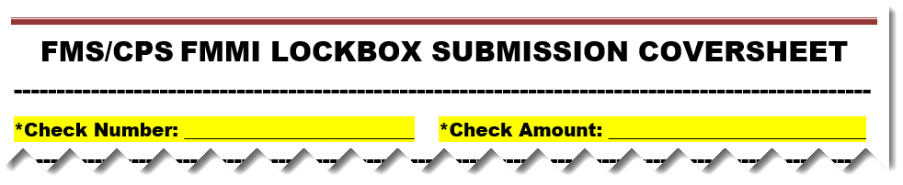
Efficient Collections
CPS Responsibility:
  CPS applies cash only - separation of duties.
Agency Responsibility:
  Create the accounting document prior to submitting check to lockbox.
  Reference that document number and customer/vendor number on coversheet….UPDATED Coversheet:

Slide 30
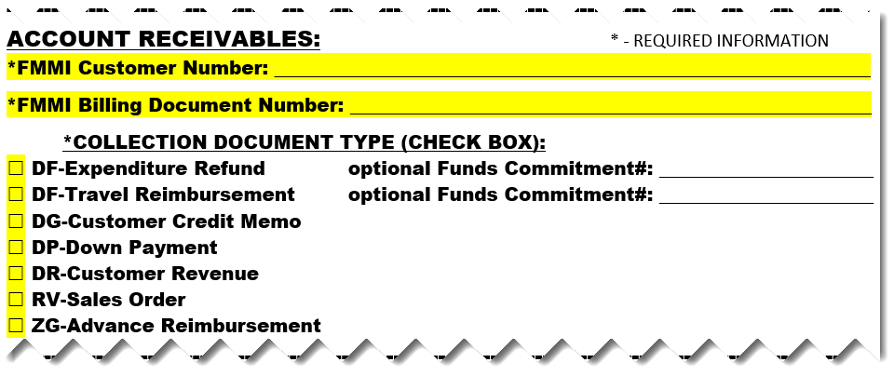
Efficient Collections

Slide 31
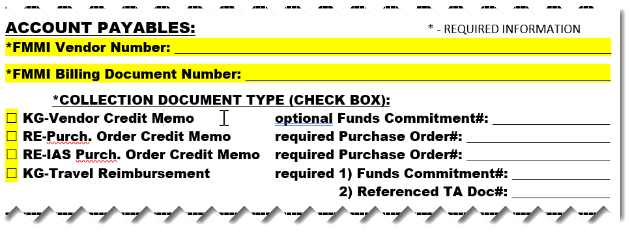
Efficient Collections

Slide 32

Efficient Collections
Returning Funds to Treasury:
  Restitutions
  Jury Duty payments
  Record to Treasury’s miscellaneous receipt account 3220

Slide 33
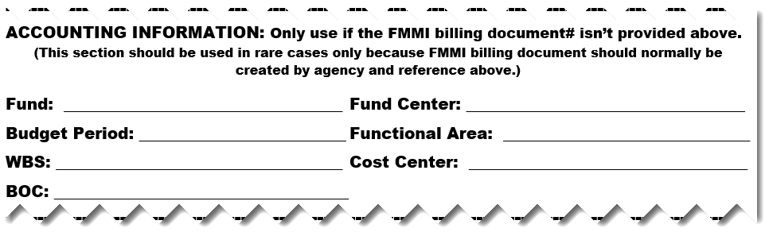
Efficient Collections

Slide 34
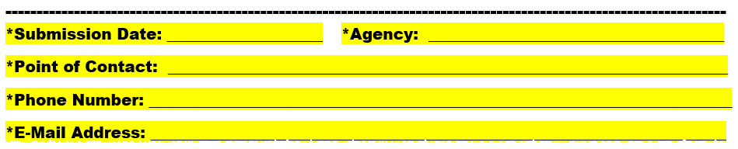
Efficient Collections

Slide 35
FMS Initiatives
Utilizing full benefits of the CIR
Building a CIR-FMMI interface
Implementing Treasury’s Central Receivable System
Utilizing eBill option to virtually eliminate unapplied collections
CRS Implementation
Using eBill in Pay.gov

Slide 36
Future USDA Initiatives
Processing Collections
Interfacing Data from the CIR to FMIMI
Automated Processing of Collections from Single Source – CIR
CIR is official source of collections received
Eliminate need to obtain files from bank
Assure all remittance data obtained from bank is contained on CIR
Leverage current FMMI Lockbox Processor and Re-processor programs for processing - ALL Collections
Begin with Corporate Lockbox

Slide 37


Collections Processing Vision
CIR
EFTPS
CAS
GLN/ECP
Pay.gov
Credit Gateway
OCTnet
TGA
Rejects worked “Collection” Re-Processor
Lockbox “Collection” Processor
Extract File
Collection Details
Post in FMMI to
AR Invoice or as
Straight Cash deposit

Slide 38
Implementing Treasury’s
Central Receivable Service (CRS)
CRS is a service provided by Treasury, at no charge to federal agencies to assist in the management of current, non-tax receivables
Agencies send receivables to CRS
CRS issues bills and handles debt management
CRS is operated by US Bank
US Bank call center handles inquires and follow up on delinquent debt
Collections go directly to Agency – Both CRS and agency receive collection data from the CIR.
CRS performs no accounting services, but handles debt management services

Slide 39
CRS Services Provided
Invoice automation including demand letter and due process notice
Offers electronic and conventional remittance options
Active debtor location through skip tracing and outbound calls
Call center servicing
Installment agreements
Automated referral (transfer of debt) to Treasury for delinquent servicing (TOPS, CSNG)
Standardization and DATA Act compliance
On-line system – agencies can query on debts, upload proof of debt documents, and modify if necessary

Slide 40
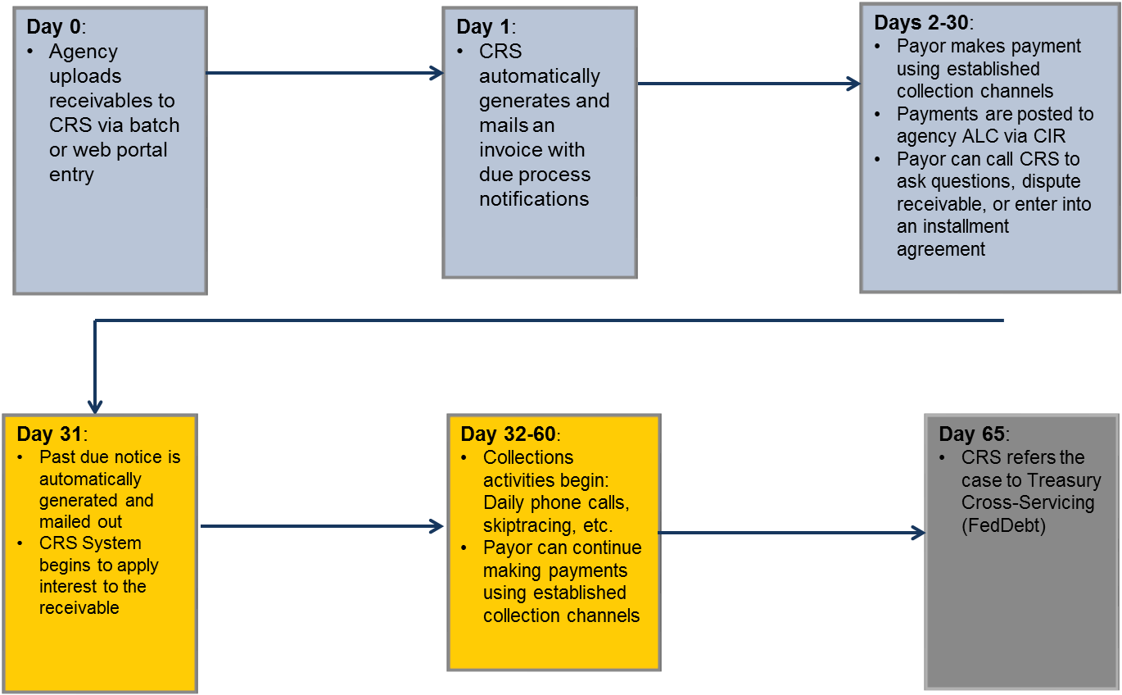
CRS Receivable Life Cycle

Slide 41
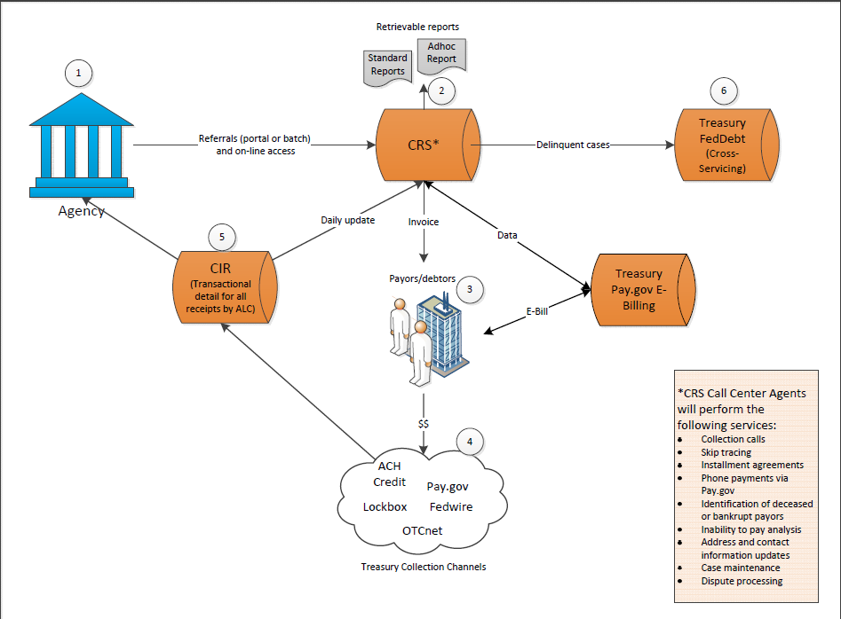
CRS Process Flow

Slide 42
USDA-FMS CRS Implementation
Phase 1
Travel Relocation Receivables
New moveLINQ system for Travel Relocation sends receivables to FMMI
New FMMI-CRS Interface:
  Extract invoices created by moveLINQ-FMMI Interface
  Create file for CRS with receivable information
  Flags Invoices in FMMI as “Sent to CRS”
CRS will issue bills and perform follow-up debt management actions
Collections come into the FMMI ALC 12-40-1240 established collection accounts at Treasury, with all other collections.

Slide 43
USDA-FMS CRS Implementation
Phase 1 (cont.)
CRS will use FMMI Accounts Receivable invoice number
CRS will use FMMI Customer Number
If necessary, CRS will perform the following actions:
  Follow up calls
  Delinquent notices
  Transfer of to TOPS/CSNG
  CRS will send files with current receivable status and activity to FMS
  CRS will record cash collection activity in CRS, and provide on-line reports and queries available for inquiry, research and reconciliation activities.

Slide 44
USDA-FMS CRS Implementation
Phase 1 (cont.)
FMS will run FMMI-CRS interface routinely to send new “Travel Relocation” related receivable records to CRS.
FMS will receive cash collections, with all other collections, and post to receivables using current cash collection processing procedures.
FMS will reconcile FMMI and CRS receivable balances.
FMS will input documents in FMMI for any interest, penalty and fees applied to a receivable by CRS.
FMS will modify receivables in FMMI as appropriate when CRS transfers a debt to TOPS or CSNG (change reason code).

Slide 45
USDA-FMS CRS Implementation
Phase 1 (cont.)a
USDA Travel Relocation related debt, is considered a program in CRS
Agencies can establish multiple programs within CRS.
Agencies submit standard narratives, to be included on bills issued for a specific program.
Agencies can choose Treasury Collections mechanisms that are will be used for each program
  OCTnet. Lockbox, Fedwire, CAS, Pay.gov, etc.
FMS has chosen exclusive use of eBill option in Pay.gov for payment of the travel relocation related debt program

Slide 46
CRS Implementation
Using eBill Option
Review of e-billing
  eBill created through Pay.gov
  A notice sent to customer that a payment is due and instructions that the eBill can be found on Pay.gov
  An access code, if provided, that customer must enter on Pay.gov to access their eBill
  The online eBill contains the details of the payment request
  Customer can enter the financial information to pay the eBill
  Notification of bill can be sent e-mail or paper notice
  Customer calls USBank for assistance if needed with retrieving eBill
USDA benefit – FMMI Document number included on 100% of collections

Slide 47
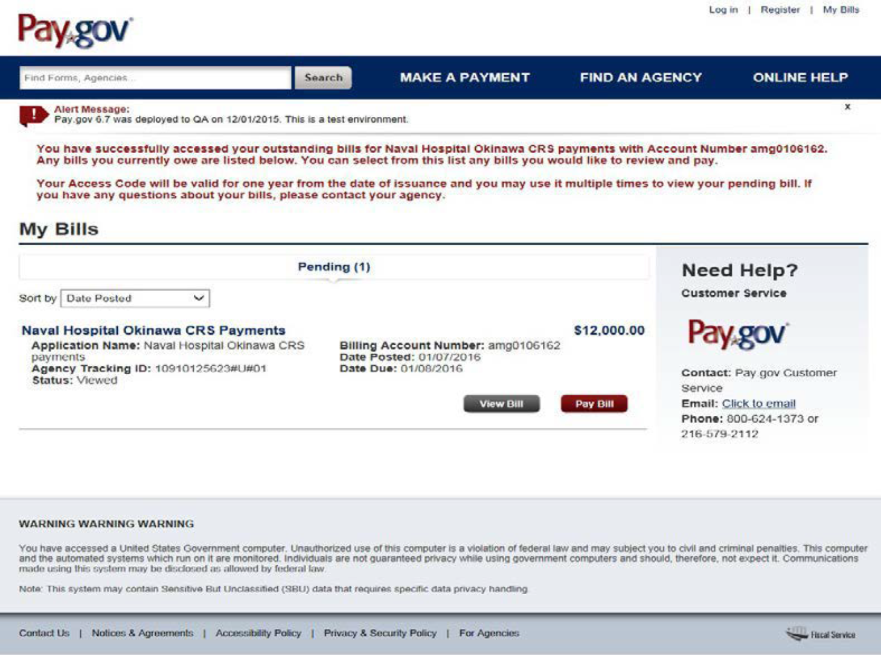




eBill Example
eBill Example

Slide 48

FMMI – CRS Billing through Collection
CRS issues Bill
(using FMM AR Invoice Doc No.)
Debtor goes to Pay.gov
Pays (eBill)
FMMI Doc No. Referenced
FMMI AR Invoice
Debtor Receives eBill Notice
FMMI-CRS Interface
CRS
Collection Posted in the CIR
FMMI AR Invoice match
FMMI Collection
Re-processor
CIR
Extract File

Slide 49
Future USDA Initiatives
What’s next? - Phase 2,3 . . .
NRCS programs to CRS
FNS currently utilizes CRS, but manually inputs bills both into CRS
and FMMI
FMMI-CRS Interface
  Built with selection parameters to easily implement additional programs without minimum or no programming changes necessary.
  Develop back feed program from CRS-FMMI
    Automatic creation of Penalty, Interest and Administrative fee documents
    Automatic update to FMMI receivables transferred to TOPS & CSNG

Slide 50
FMS Collection Processing and Initiatives
Questions ?

Slide 51
Contacts
Donna Cornella, Supervisor
Collections Processing Section
donna.cornella@cfo.usda.gov
877-242-3072 (Opt 3)
Ashley Horton
CRS Project Manager
ashley.horton@cfo.usda.gov
Eddie Reso, Chief
Treasury Services Branch (TSB)
eddie.reso@cfo.usda.gov
817-542-2839
877-242-3072 (Opt 3)

