Slide 1
Financial Information Repository (FIR)
Building a Better User Experience for Operational Efficiency and Transparency

Slide 2
Agenda
FIR Overview
Using the FIR
Data Summary

Slide 3
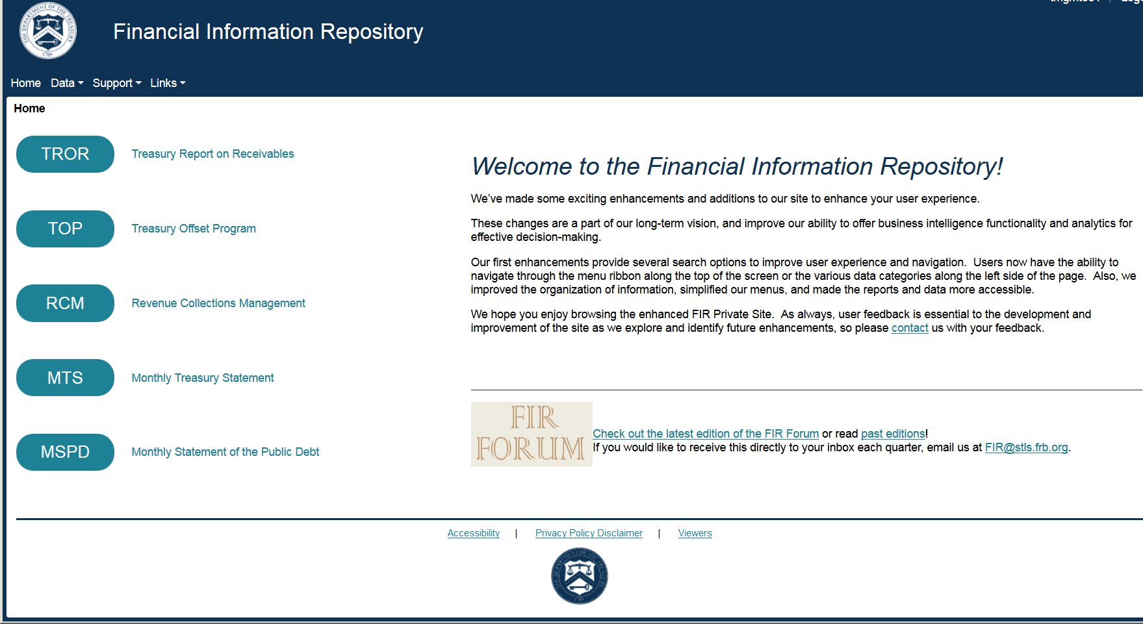
What is the FIR?
Evaluate. Analyze. Deliver.
Access at fir.fms.treas.gov

Slide 4
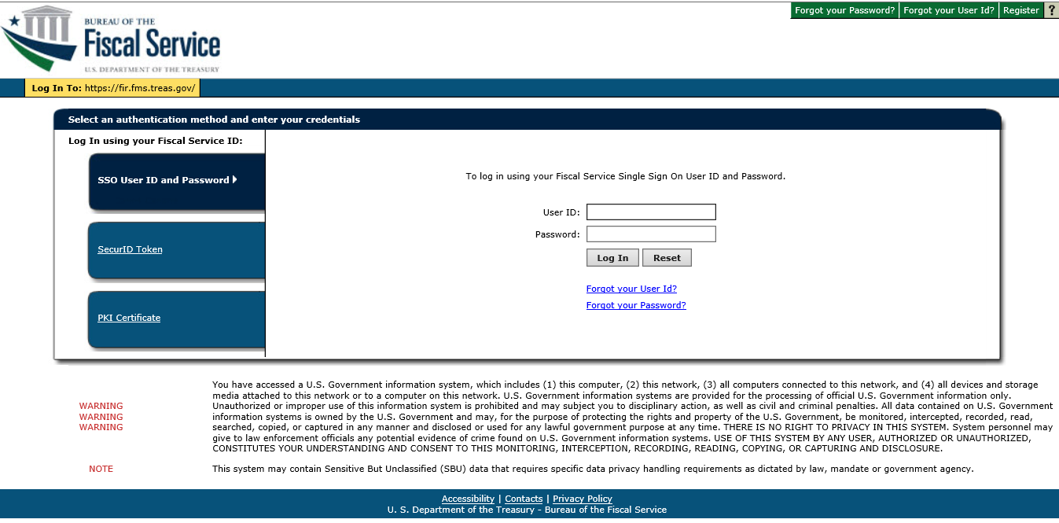
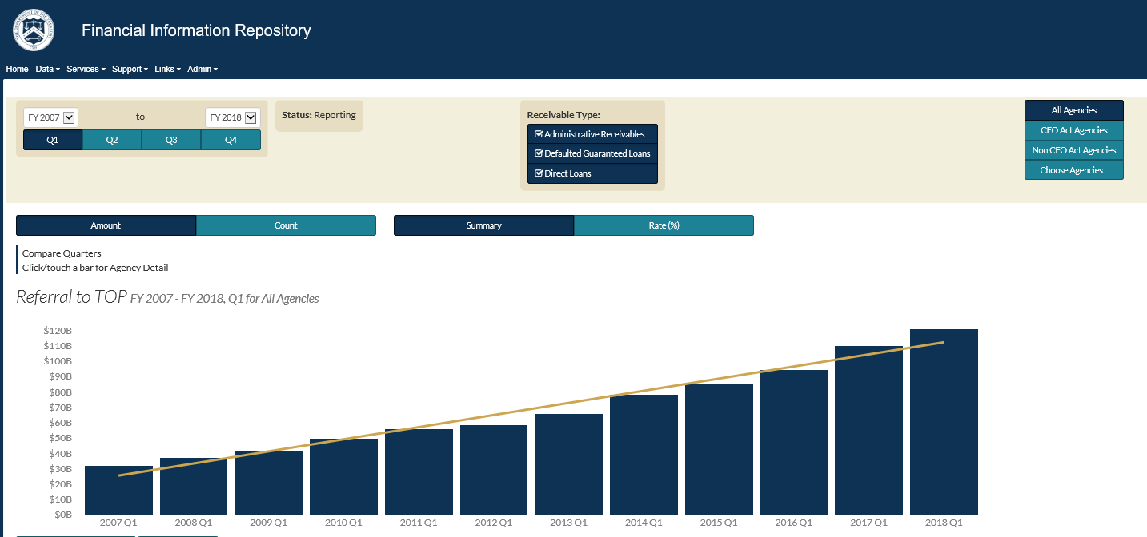
How can the FIR help you?
Single point of entry
Easy navigation
Interactive reports
Drill down functionality
Trending/Outlier analysis
Outreach/Training/Support
Self service capabilities
Cross business line reporting

Slide 5

Site Review

Slide 6
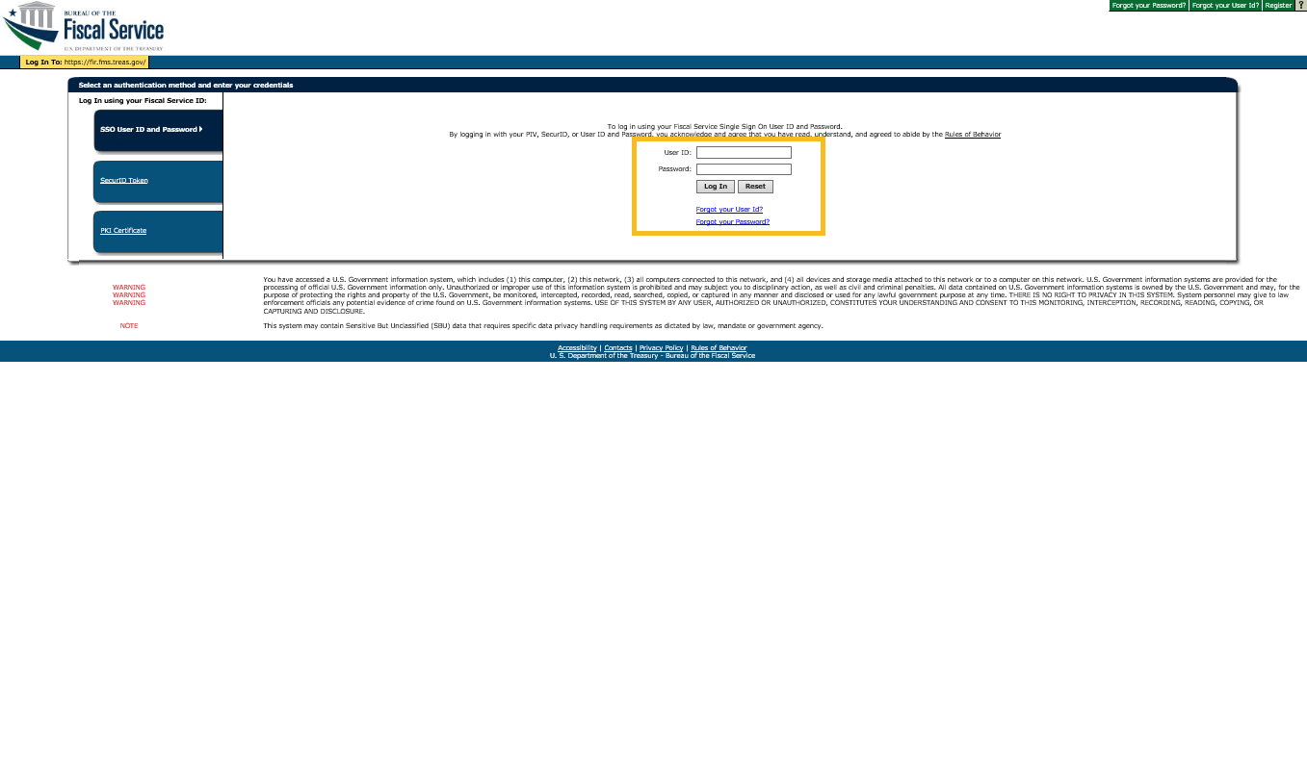
FIR

Slide 7
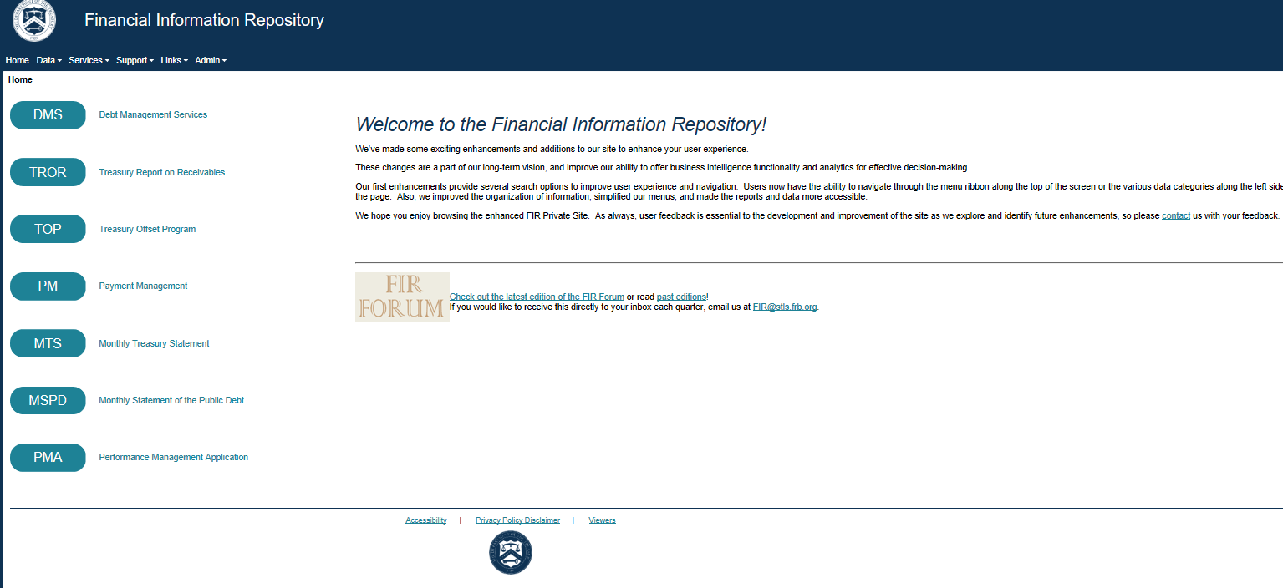
FIRa

Slide 8
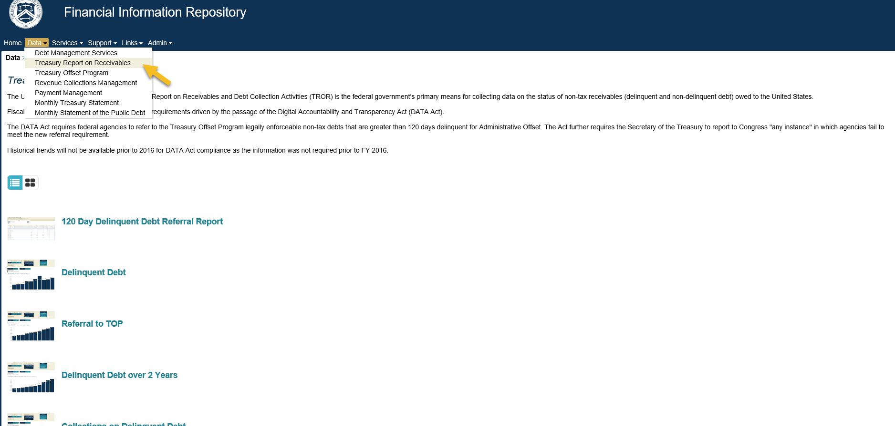
FIR b

Slide 9
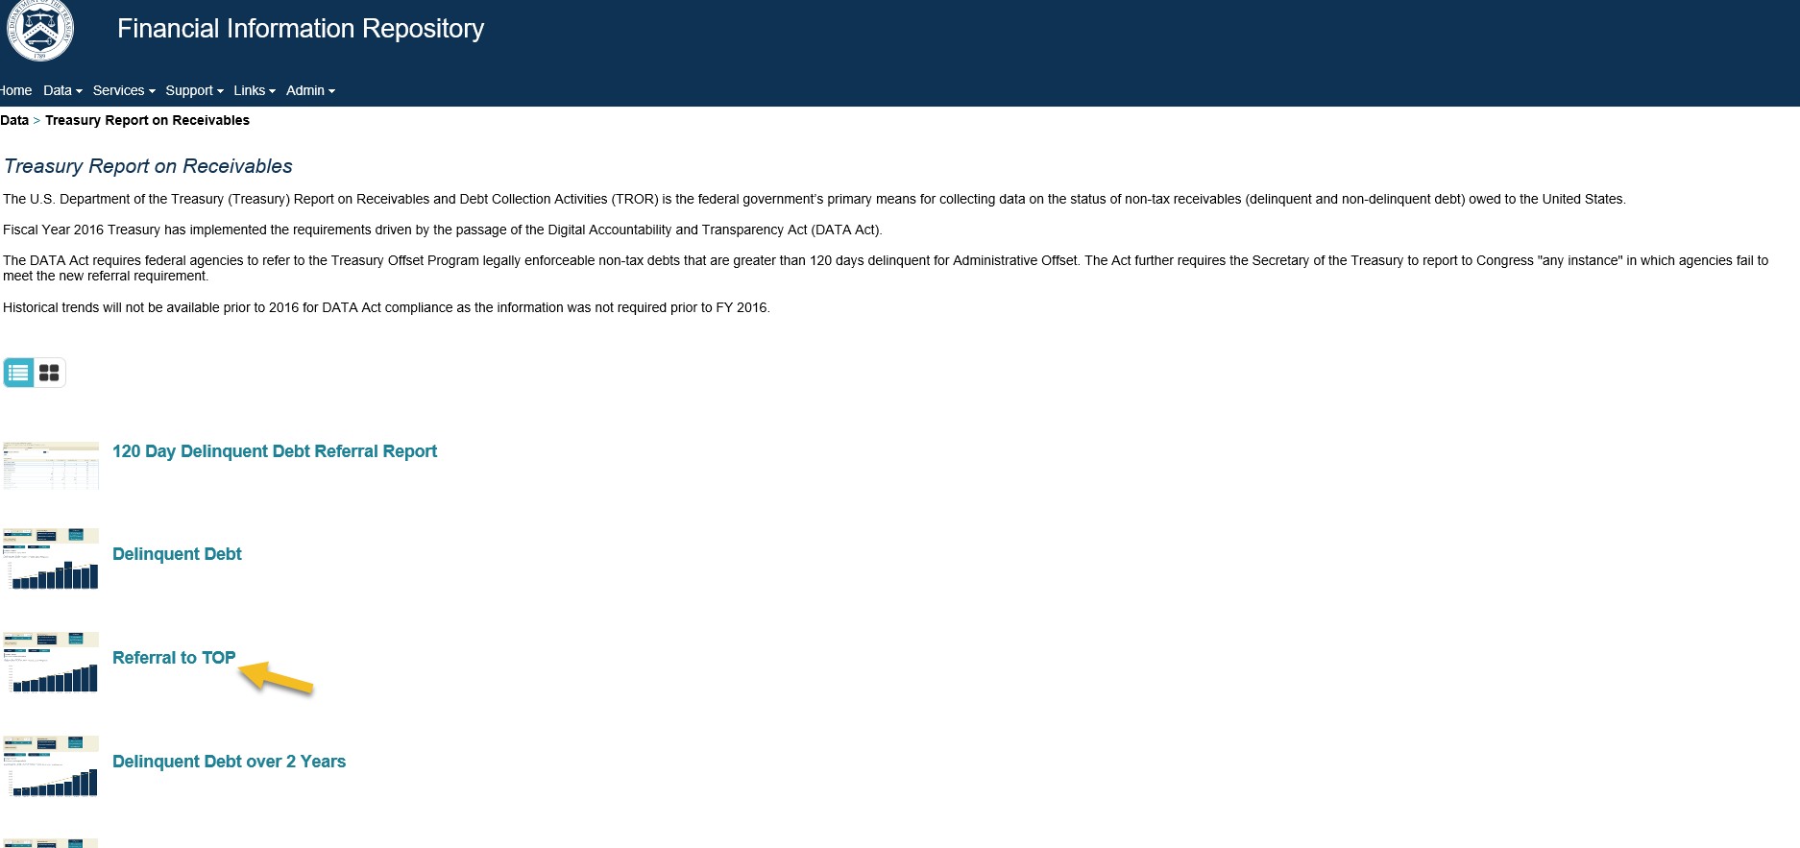
FIRc

Slide 10
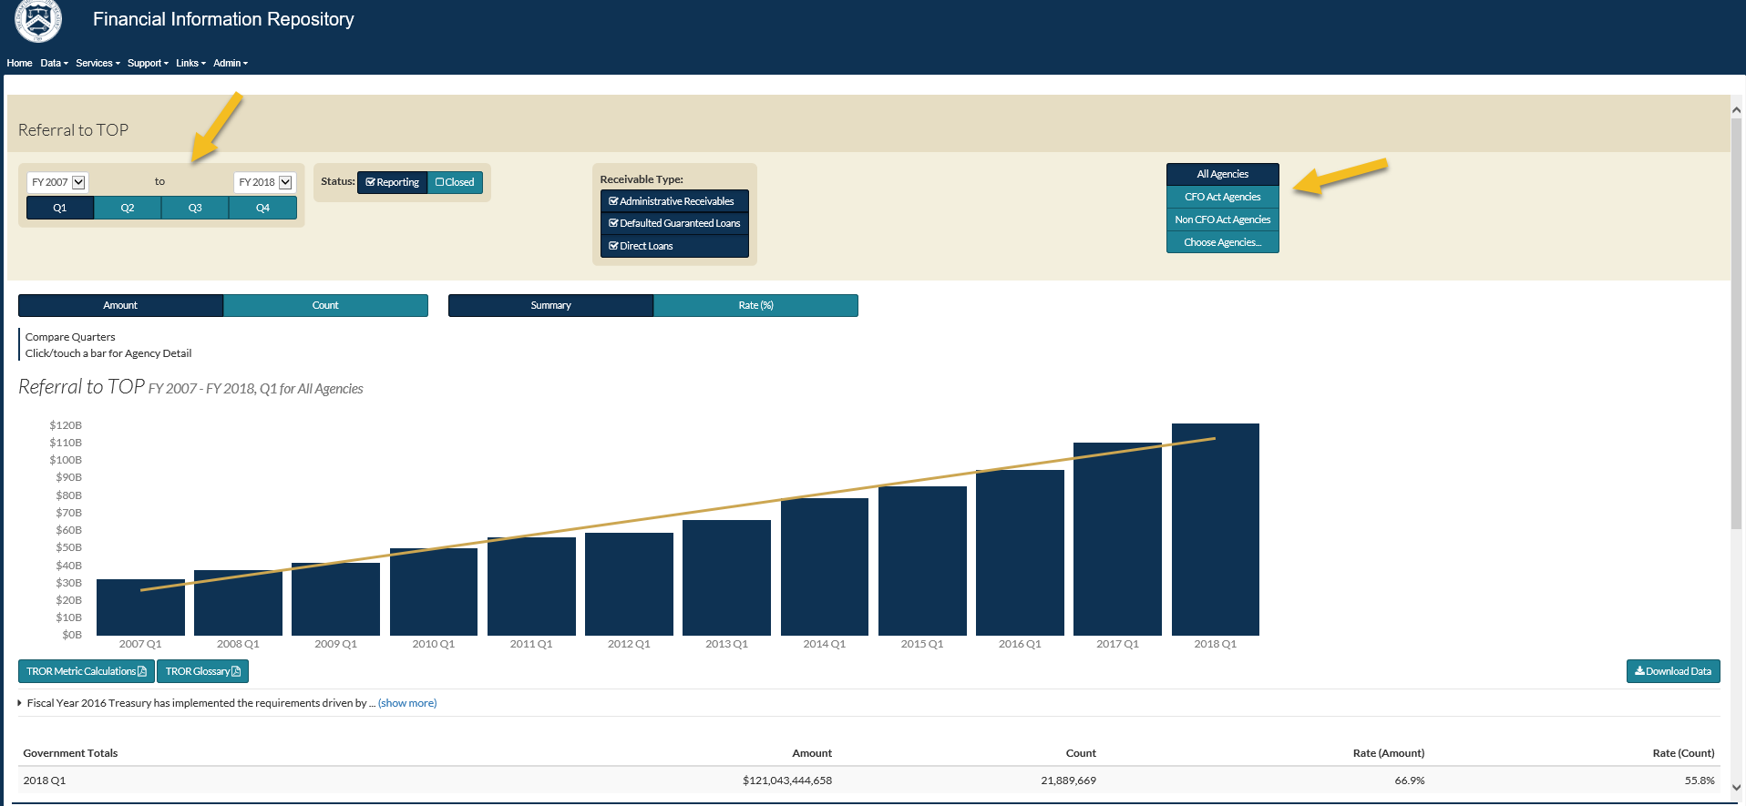
FIRd

Slide 11
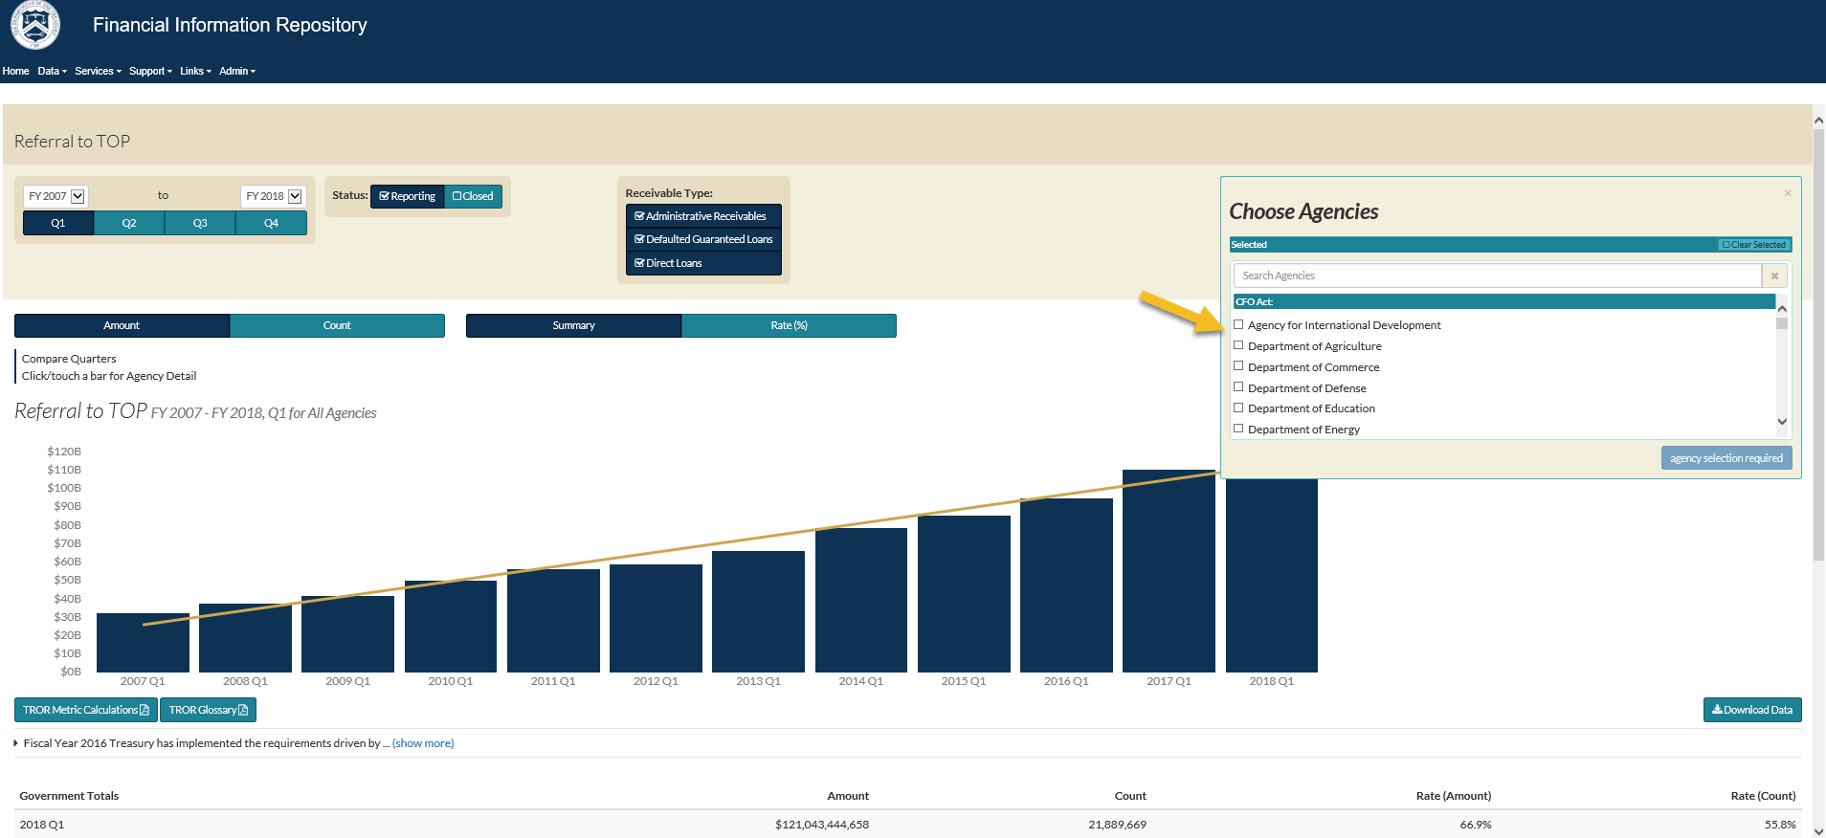
FIRe

Slide 12
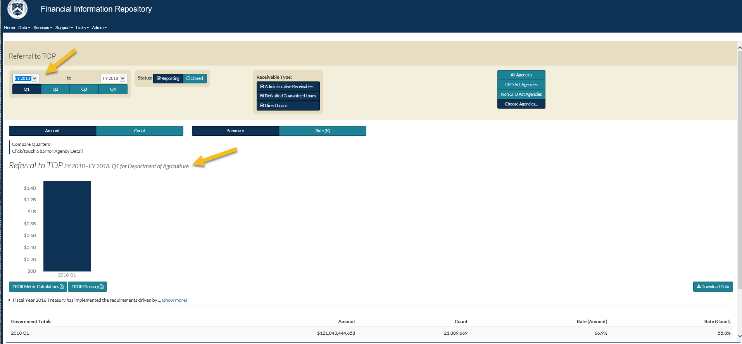
FIR f

Slide 13
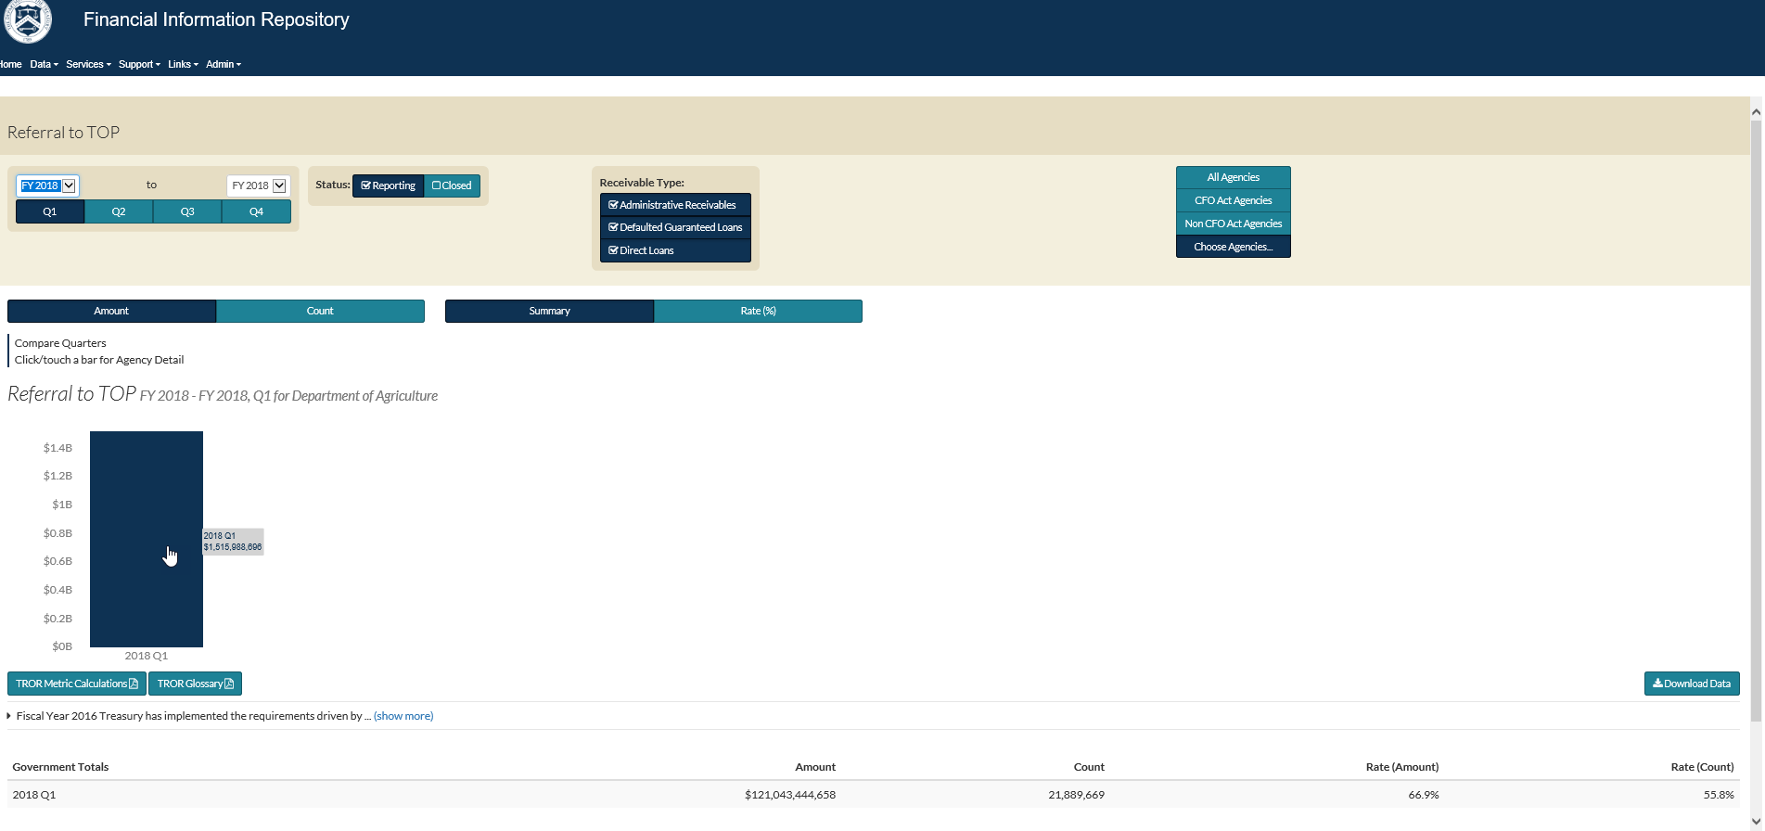
FIRg

Slide 14
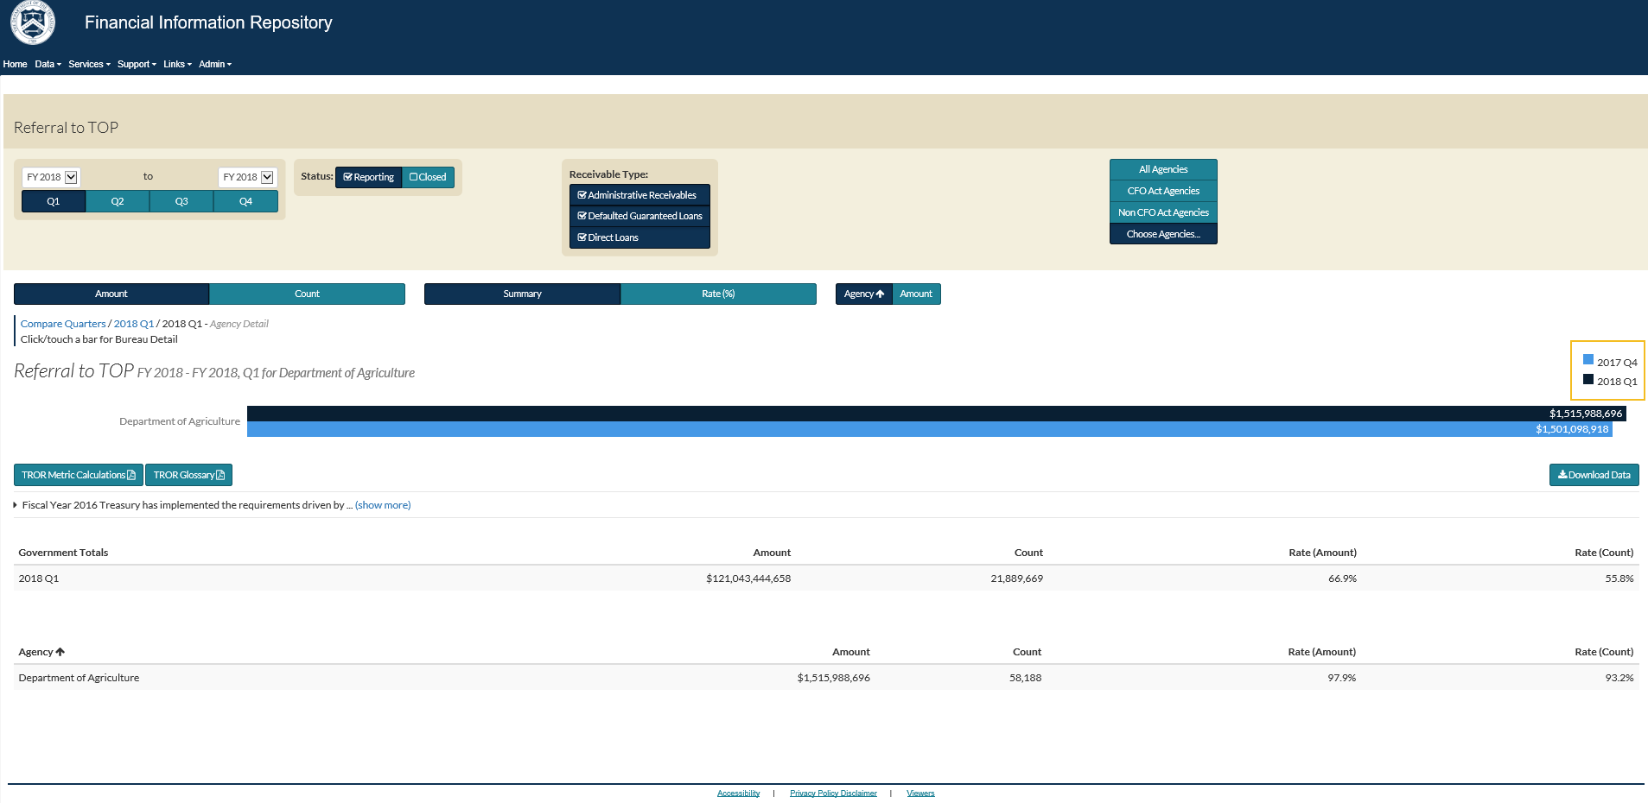
FIR h

Slide 15
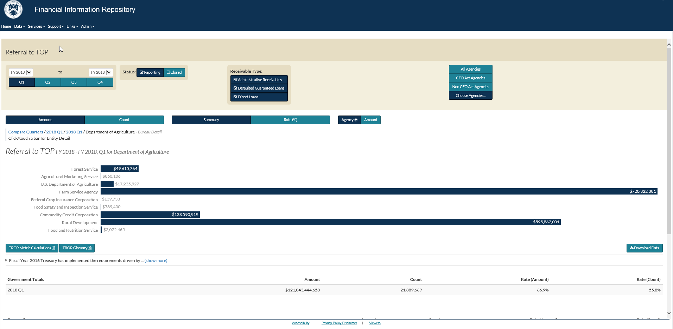
FIRZ

Slide 16
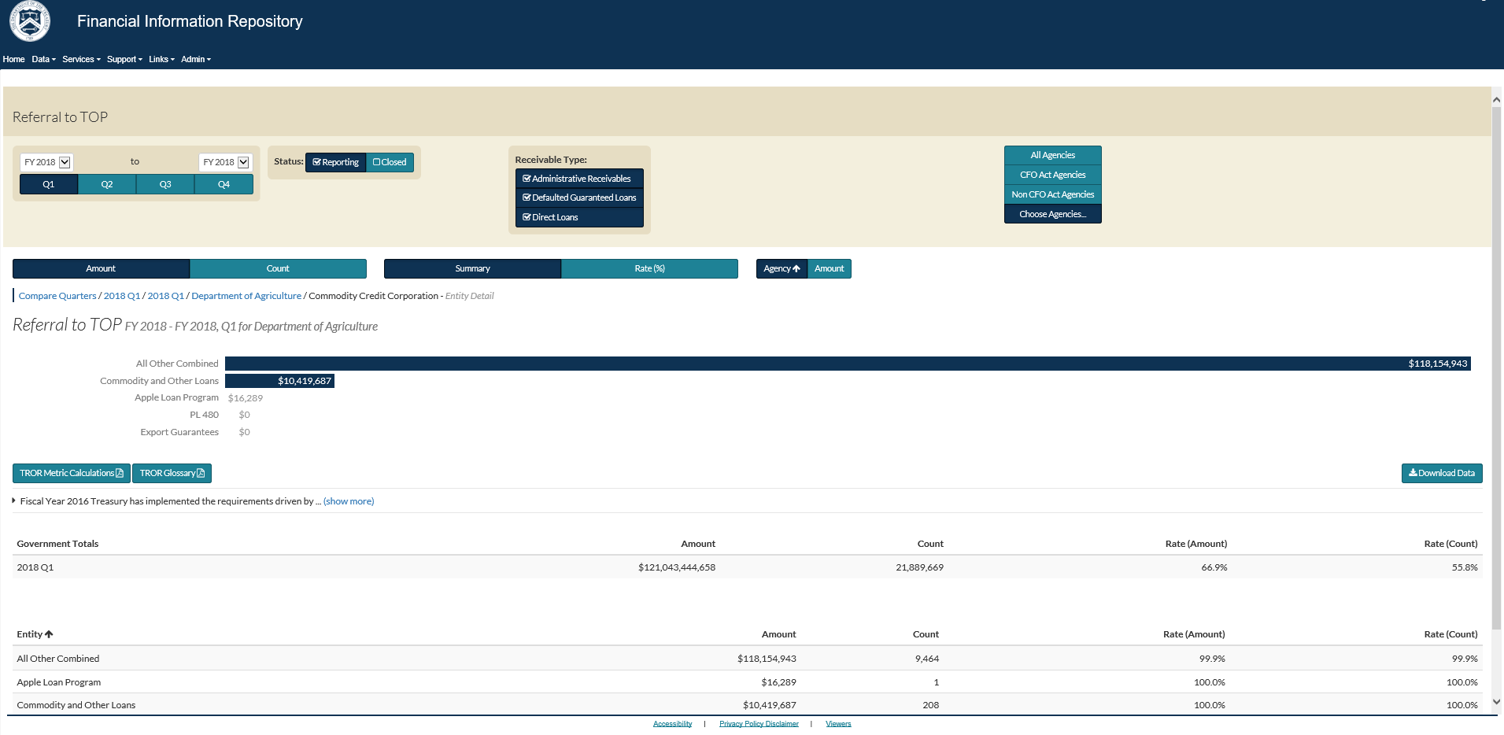
FIRj

Slide 17
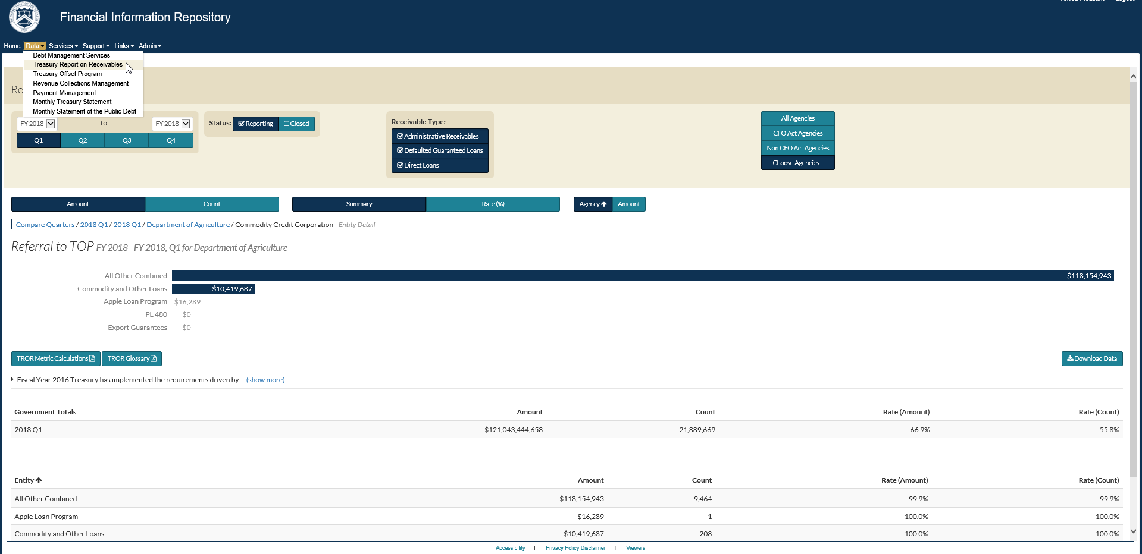
FIR k

Slide 18
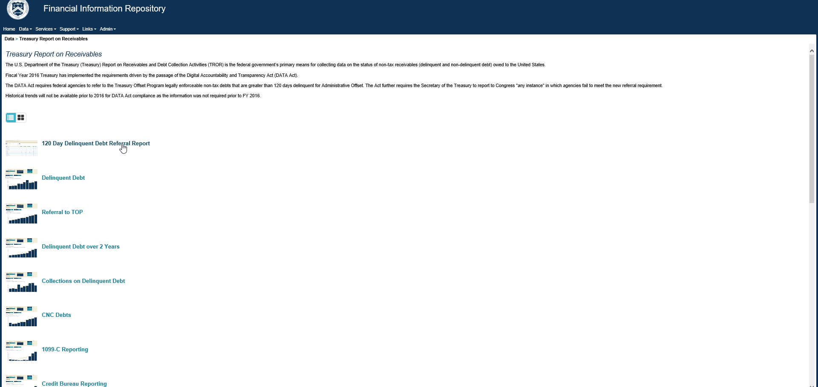
FIRI

Slide 19
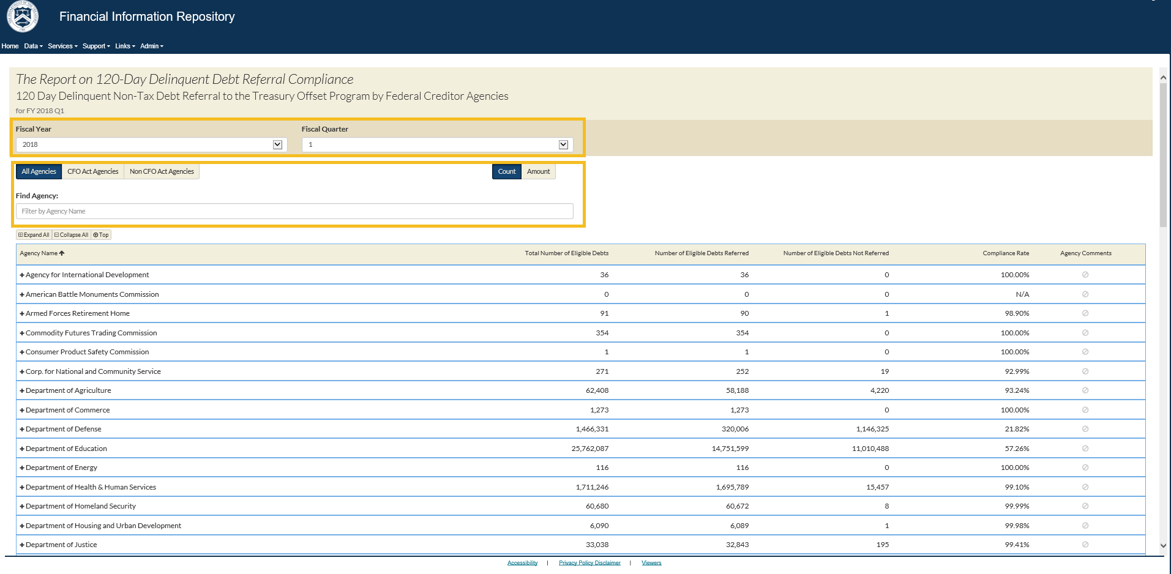
FIRm

Slide 20
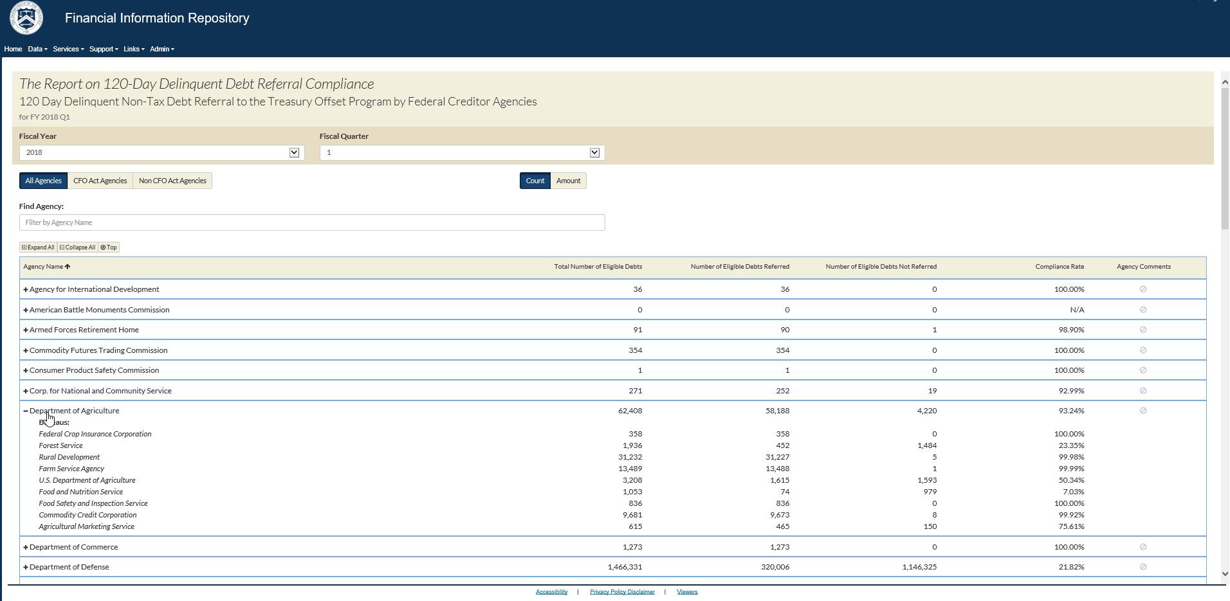
FIRn

Slide 21
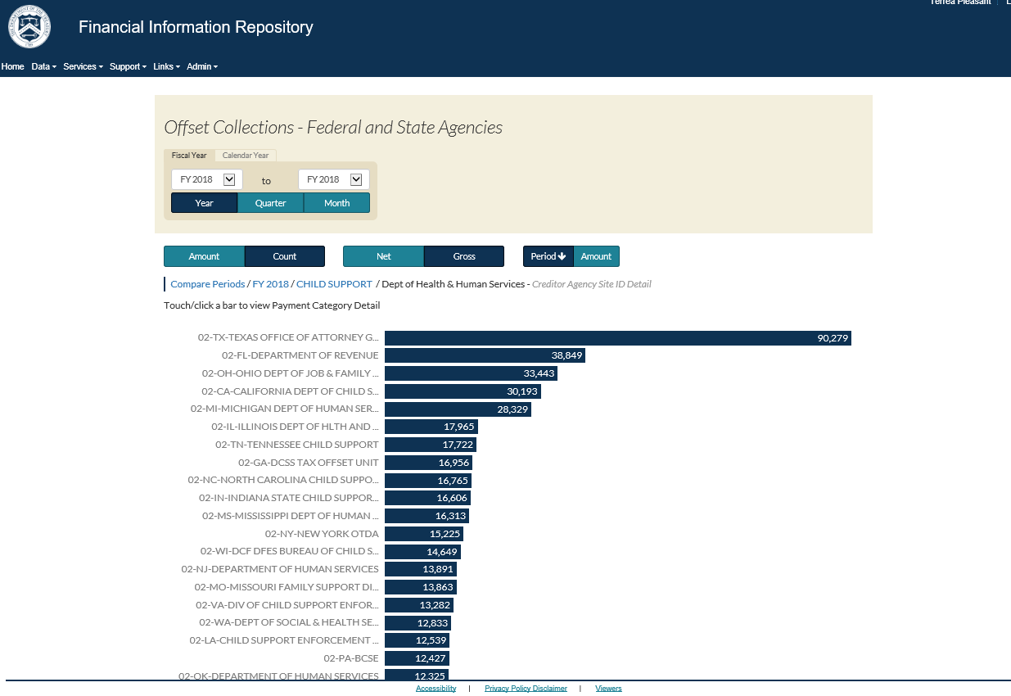
Treasury Report on Receivables
Offset Collections

Slide 22
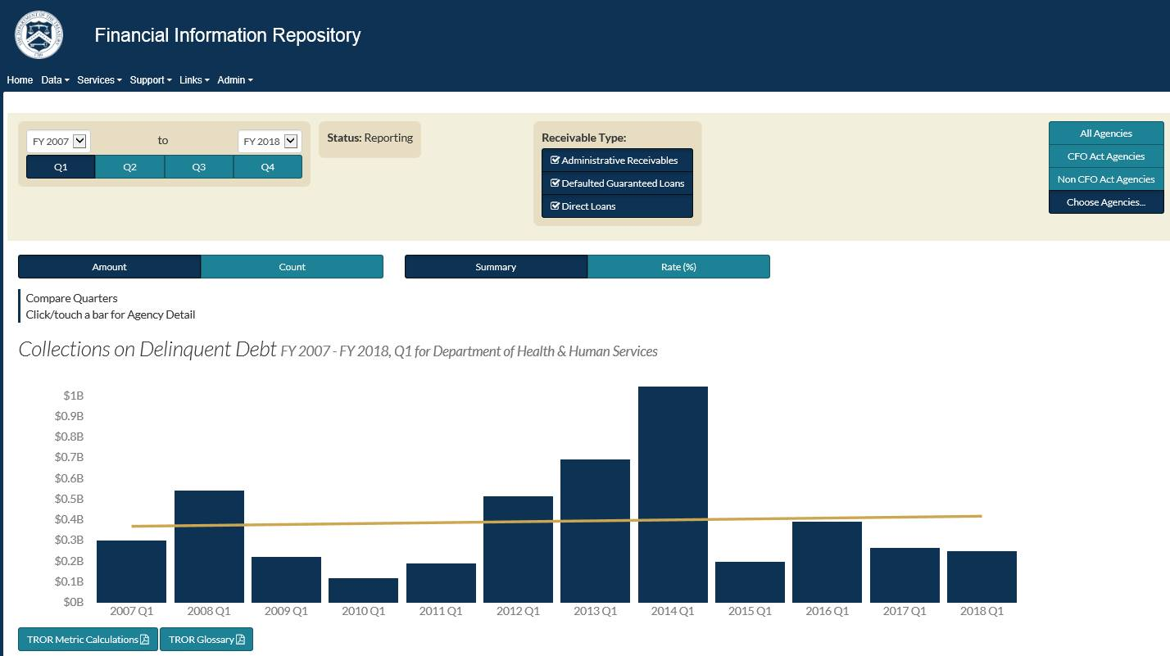
Treasury Report on Receivables
Collections on Delinquent Debt

Slide 23
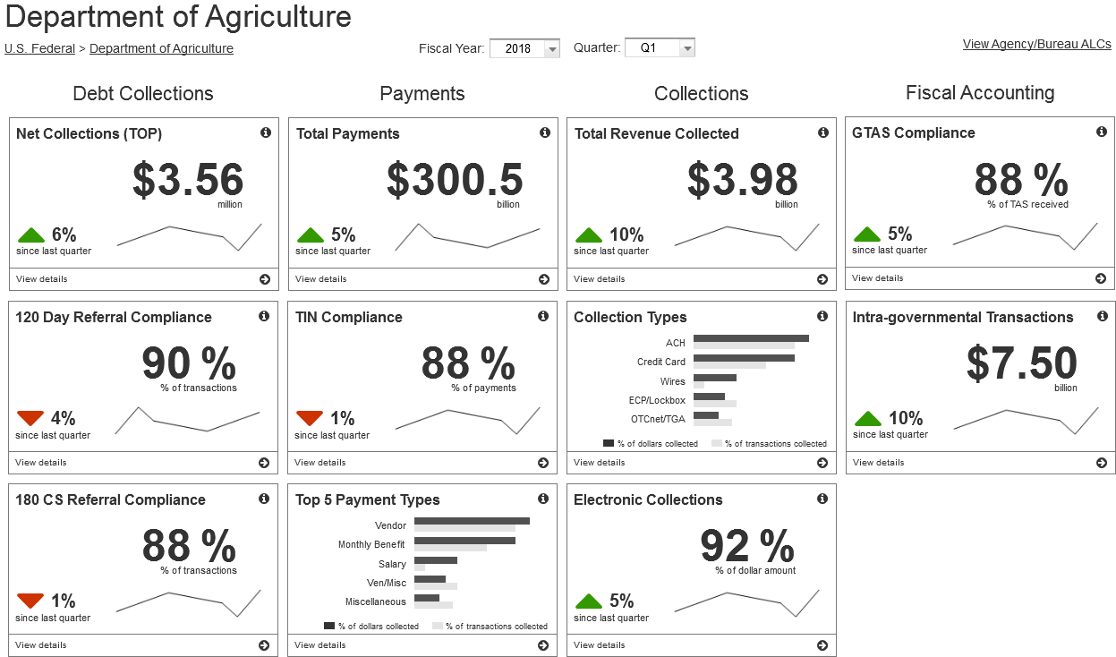
Your impact on the future of FIR
This mock visual does not contain actual USDA data.

Slide 24

Contact Information
Primary Contact
Monica Shelton
Project Manager
202.874.6601
monica.shelton@fiscal.treasury.gov
Secondary Contact
Financial Information Repository Outreach Team
855.464.4191
fir@stls.frb.org

