Slide 1

Linking US Agriculture to the World

Slide 2
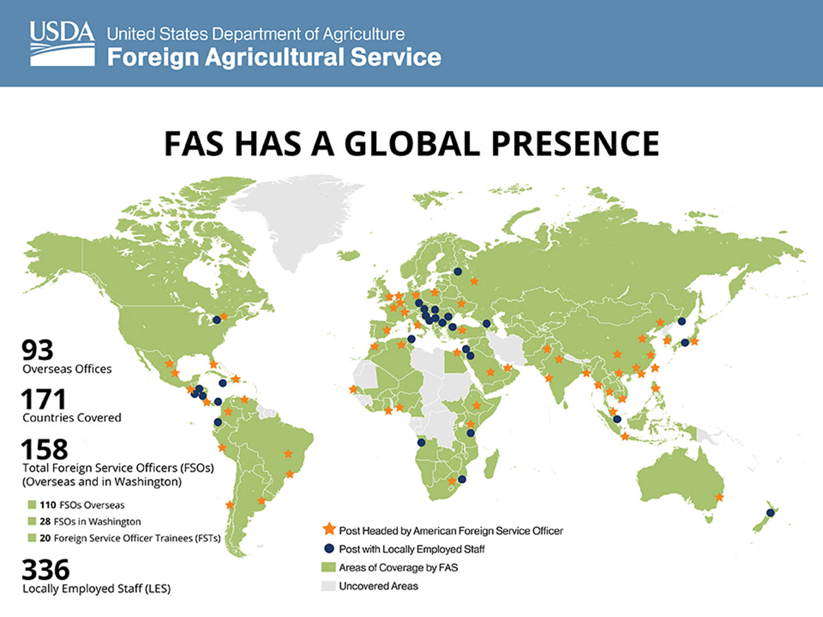
FAS

Slide 3
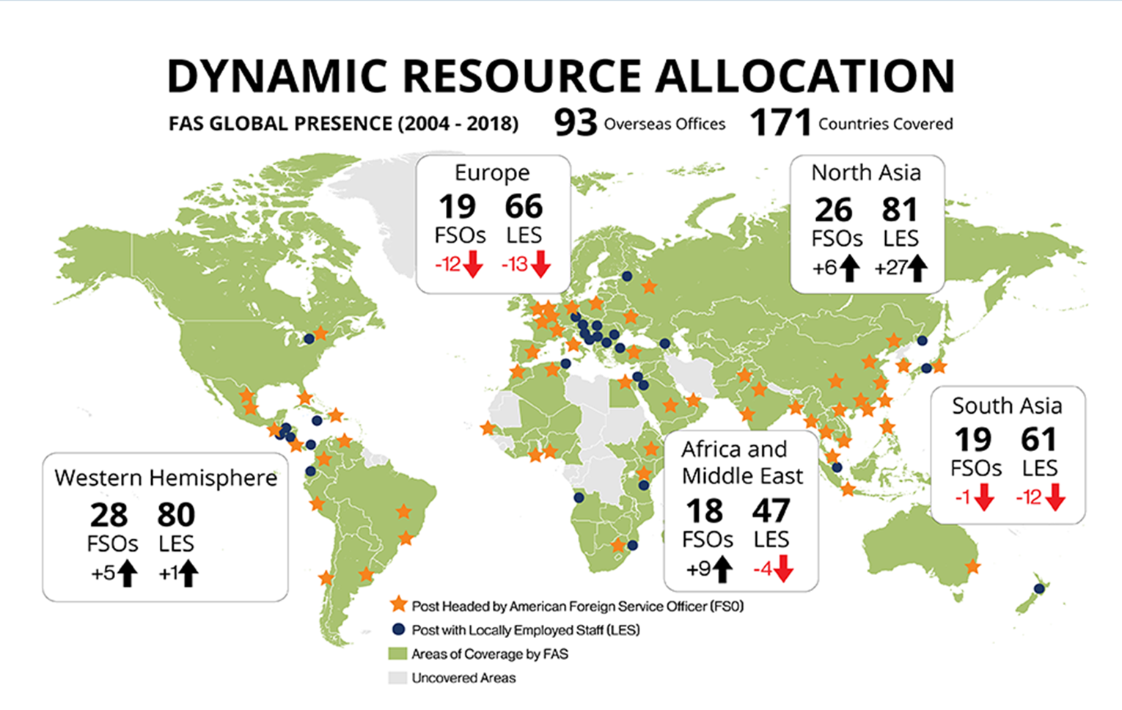
Foreign Agricultural Service
Overview

Slide 4
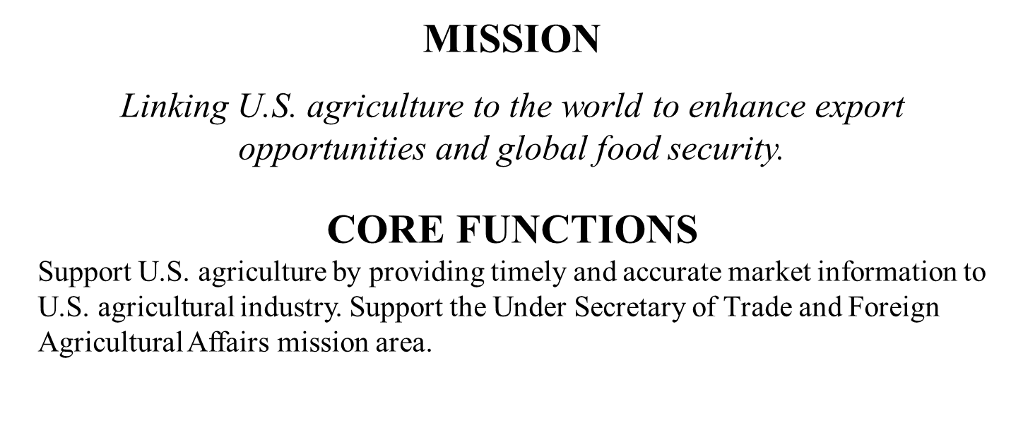
Foreign Agricultural Service
Overview

Slide 5
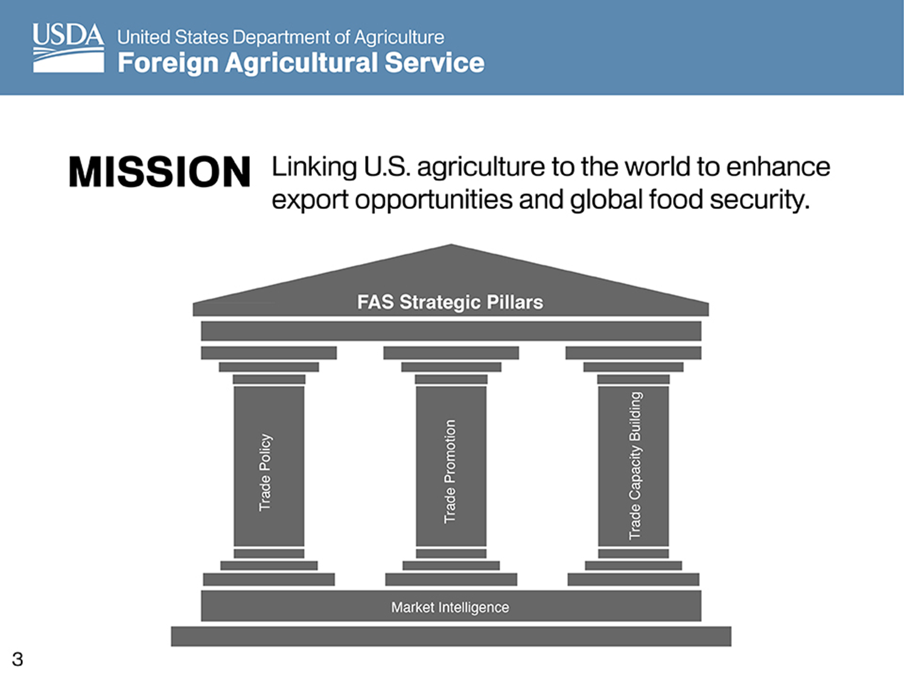
FASa

Slide 6
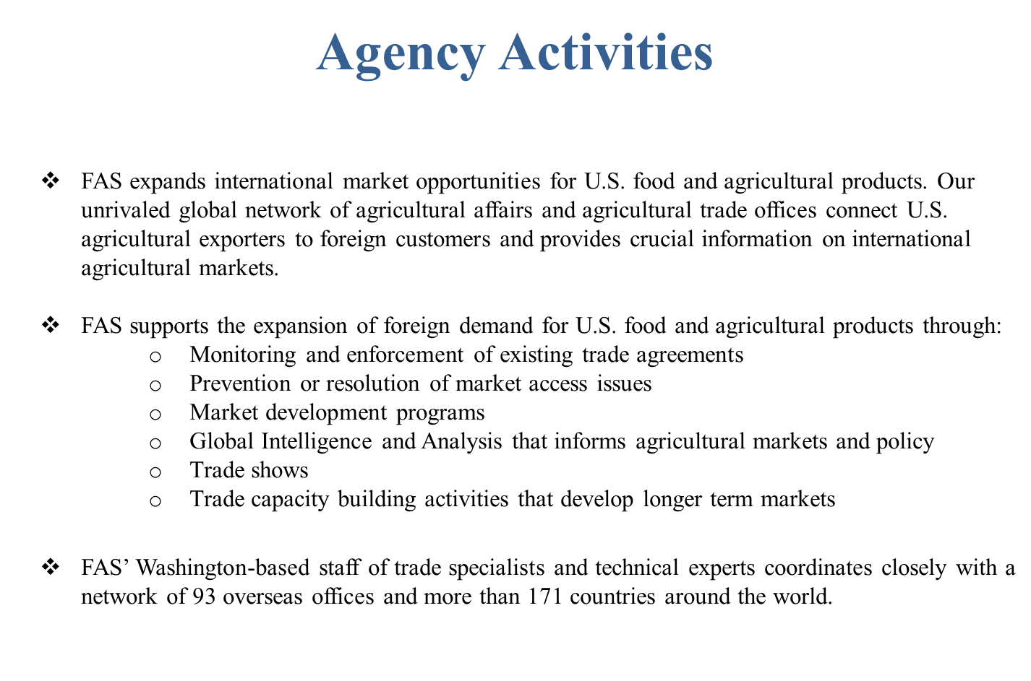
Agency Activities

Slide 7
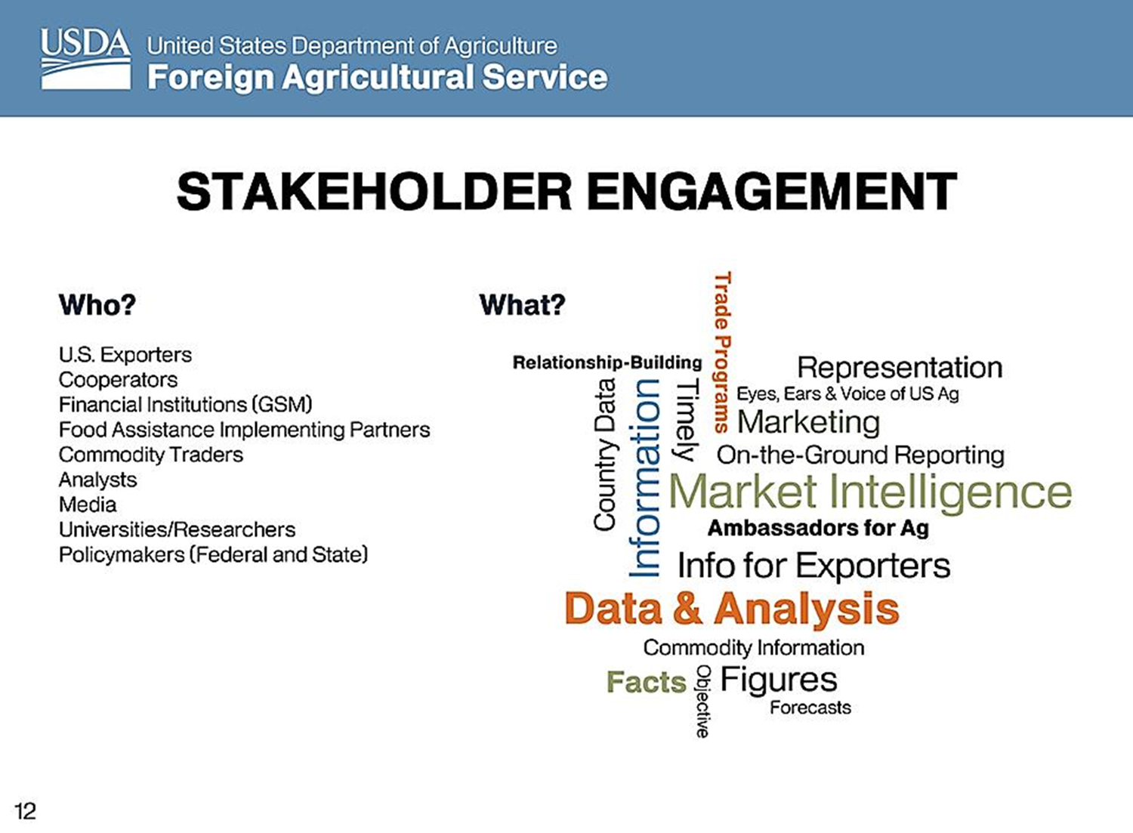
FASb

Slide 8
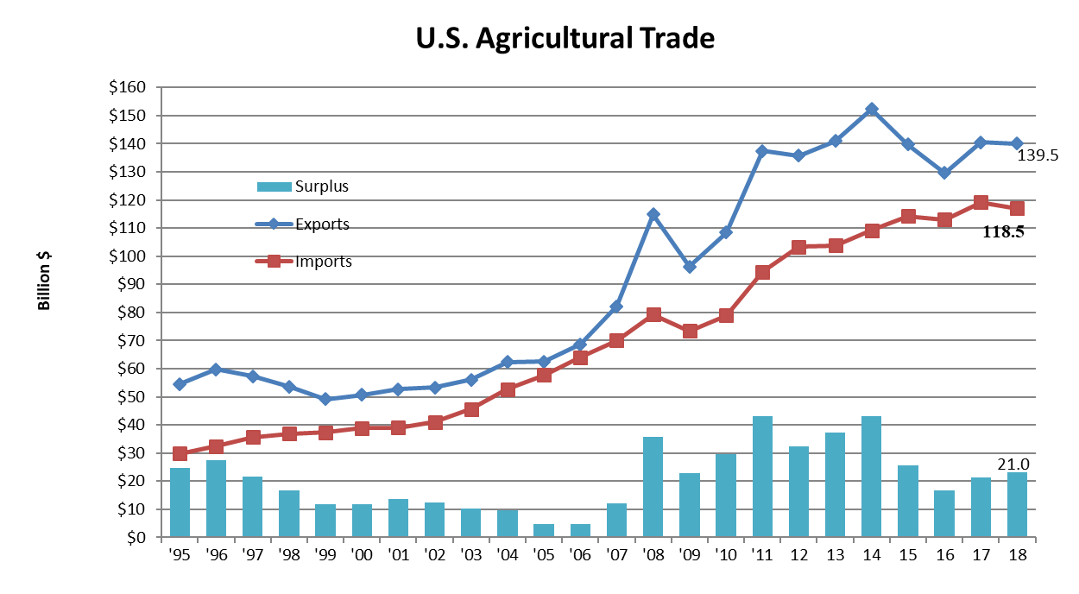
Foreign Agricultural Service
Agricultural Trade Forecast

Slide 9
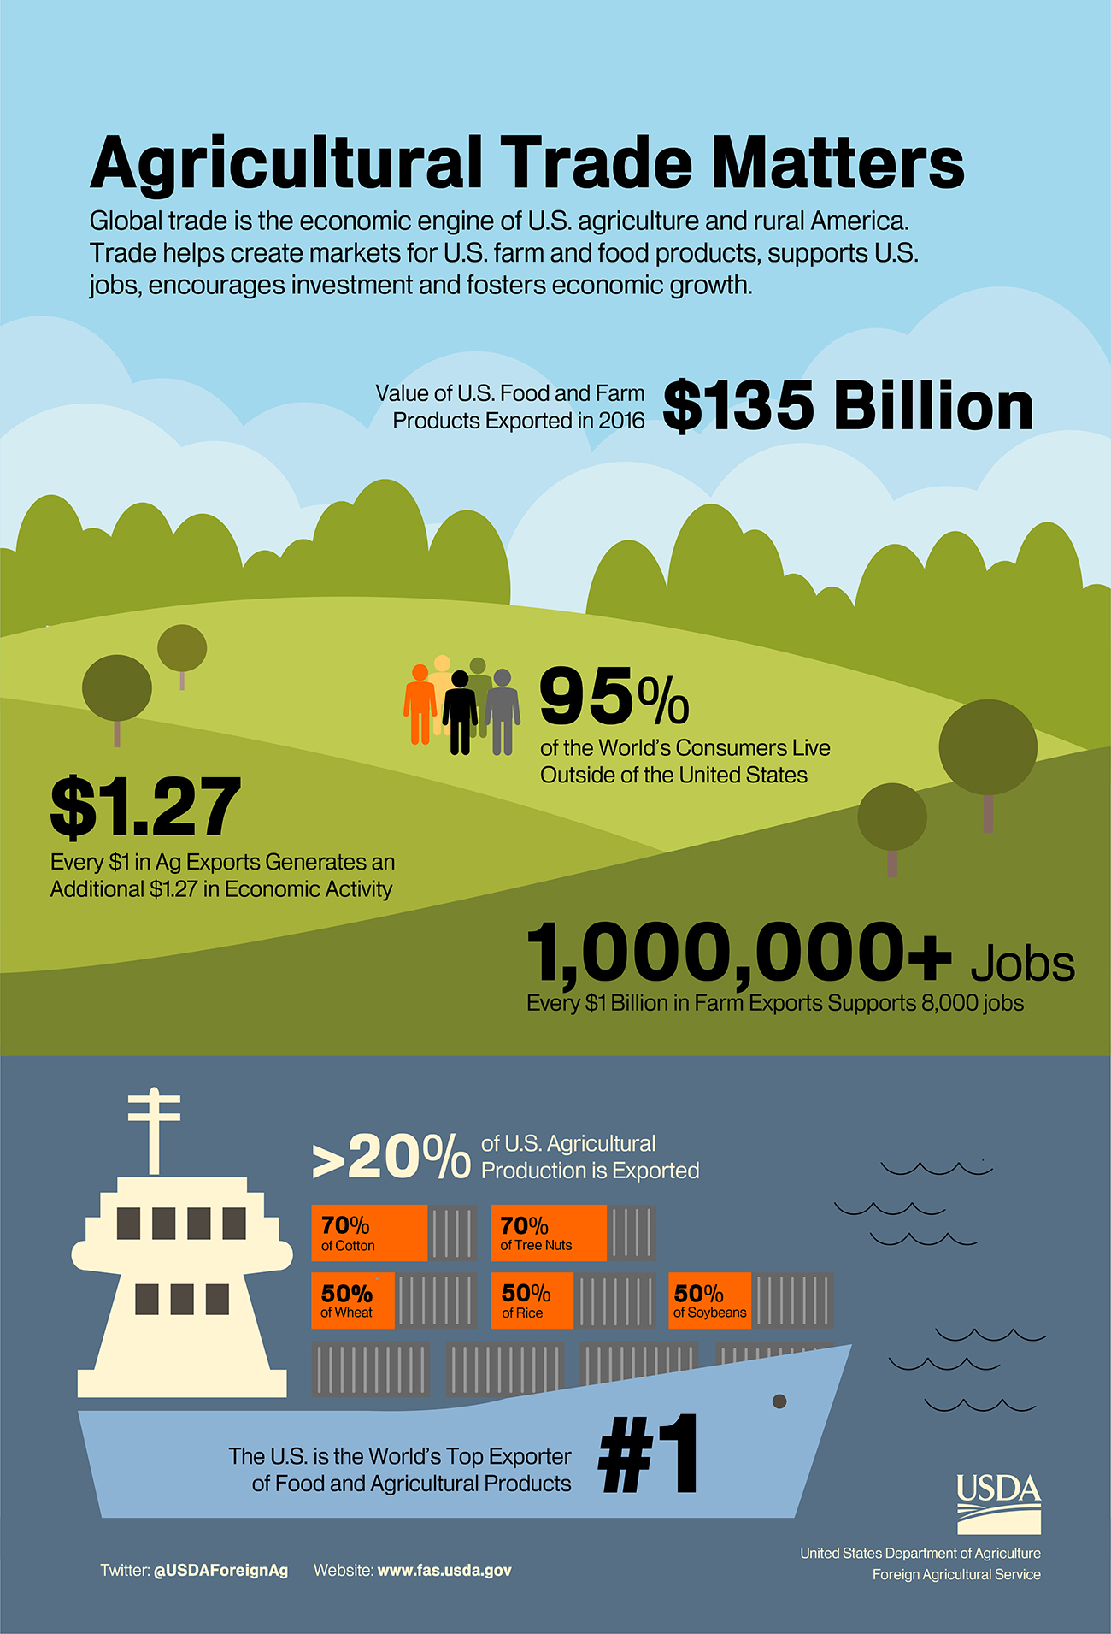
Benefits of Trade

Slide 10


QUESTIONS

