Slide 1
CARS Overview & Related Changes
Presented by: Eddie Reso
Notes:
CERTIFICATION PROCESS

Slide 2



GWA vs. CARS
GWA – Governmentwide Accounting Project: Treasury’s Assistant Commissioner’s area responsible for the maintenance of the Federal Government’s set of accounts and accounting data.
CARS – Central Accounting and Reporting System: New system of record for the government’s financial data. Replaces Treasury’s old STAR system.
GTAS – Governmentwide Treasury Account Symbol Adjusted Trial Balance System: Replaces functionality of FACTS I, FACTS II, IFCS, IRAS, and SID reporting systems as the primary means of reporting agency trial balance data.
This Photo by Unknown Author is licensed under CC BY-SA

Slide 3
Purpose
Standardize
  Component TAS: Developed one standard Treasury Account Symbol (TAS) format. Replaces the old “string TAS format”.
  BETC: Business Event Type Code (BETC), used to identify the classification of each cash transaction. Used only for reporting Cash Transactions.
Streamline processes
  Agencies classify payments, collections, and intra-governmental transactions at the TAS level upon origination.
  Real-time classification of transactions and reporting on Fund Balance with Treasury (FBWT) - No Statement of Differences.
  GTAS – Replaces FACTS I and FACTS II reporting.

Slide 4
SF-224 vs. CARS Comparison
SF-224 (Old) World
CARS World
Collections, Disbursements & IPAC submitted to Treasury at ALC level – NO TAS or BETC
Collections, Disbursements & IPAC submitted to Treasury by each ALC, at the TAS/BETC level.
ALC is an identifier of an entity submitting a cash transaction, but the cash transaction is at the TAS & BETC level upon submission.
SF-6653 / GWA Account Statement Reconciliation for each TAS, with transaction/Treasury Schedule number detail contained on-line, and is produced daily.
Treasury has appropriate TAS/BETC chargeable upon submission; no monthly report needed.
SF-6653 / GWA Account Statement Reconciliation for each TAS
SF-6652 Reconciliation for SoD’s. - Reconcile differences in cash as whole by ALC
Cash transactions are created at the ALC level upon transaction submission
Report to Treasury the appropriate TAS chargeable for each transaction at month end via the SF-224 process

Slide 5
Reporting in CARS
    All cash transactions, disbursements, collections, and IPAC still originate in and are controlled by one of Treasury’s systems.
    No month end reporting (SF-224).
    Every disbursement sent to Treasury has the chargeable TAS/BETC on the record. The fund balance at Treasury is immediately affected vs. under the
    SF-224 method of reporting, where the actual account submission of the SF-224 at month end affects the Treasury Account (TAS) balance.
    Every non-IPAC collection (i.e., collections reported on the CIR) is recorded at Treasury to a stored TAS (C-key), and affects the account balance for that TAS immediately.
    Every IPAC transaction contains both Trading Partners’ TASs, and affects both accounts at Treasury immediately.
    Reclassification between TAS/BETC’s can be made at Treasury, and must net to zero. Files may be sent to Treasury daily, or as desired by the agency.

Slide 6



CARS Overview
Collections
GWA
CARS
C-Key or TAS/BETC
Transactions
With TAS/BETC’s
IPAC
C-Key or TAS/BETC – both sides
Valid
TAS/BETC
TAS/BETC
Payments
C-Key or TAS/BETC
SAM

Slide 7
Component TAS Format
TAS - Treasury Account Symbol
  Known as: string TAS, TAFS, fund symbols, appropriation accounts, receipt accounts, etc.
New Standard Term: “Component TAS”
  Composed of 8 component elements
  Expansion of Departmental Agency Codes from 2 to 3 digits
  Expansion of Fiscal Year into 3 separate fields
  Elimination of Standard Subclasses – replaced by BETC

Slide 8
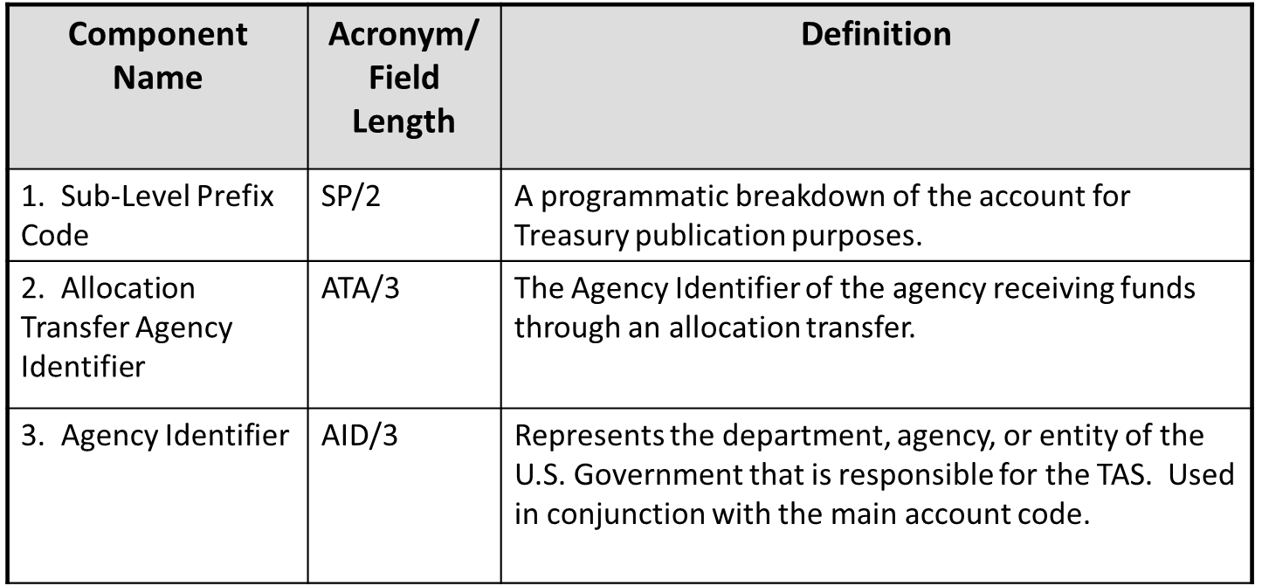
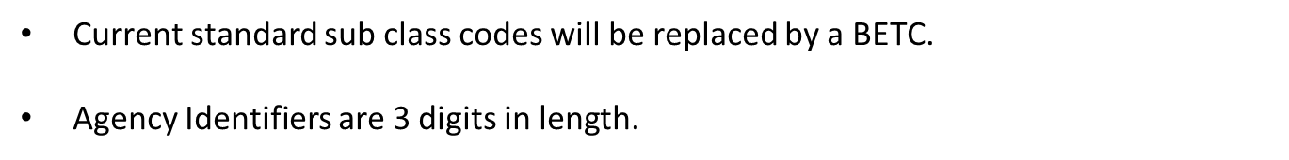
Component TAS Structure

Slide 9
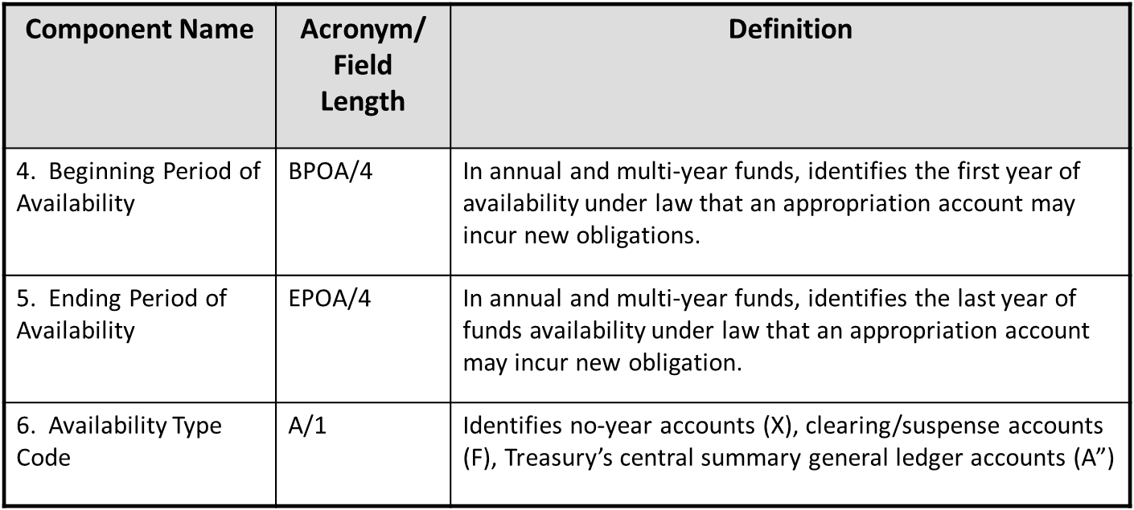
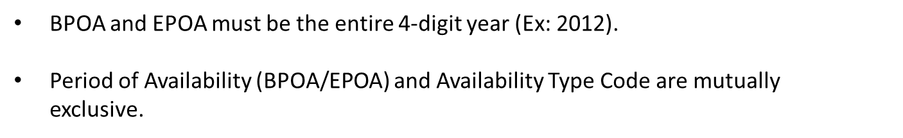
Component TAS Structure (cont’d)

Slide 10
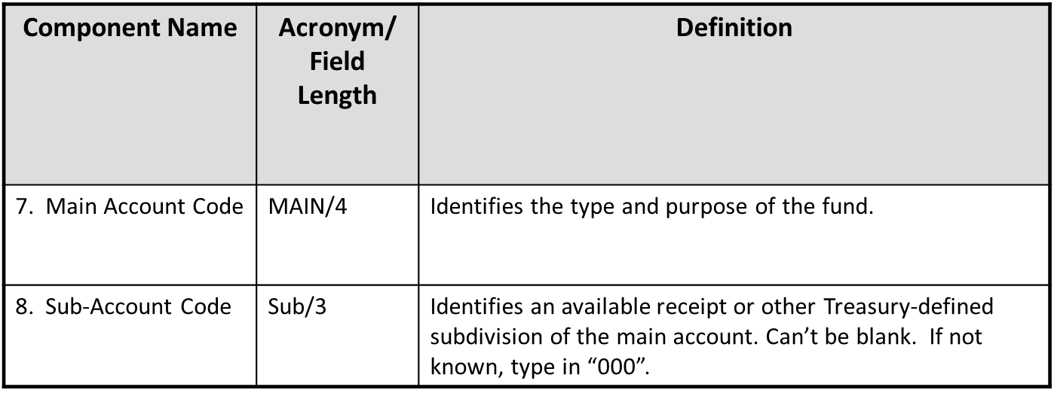
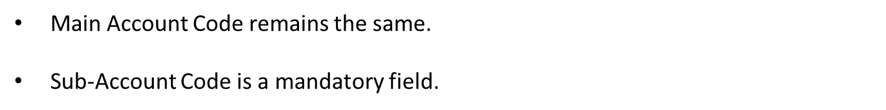
Component TAS Structure (cont’d)A

Slide 11
Component TAS Example
Component
Example: SP ATA AID BPOA EPOA A MAIN SUB BETC
012 X 5010 011 COLL
12X5010.1
String

Slide 12


Component TAS ExampleA
Example: SP ATA AID BPOA EPOA A MAIN SUB BETC
075 070 2009 2014 0714 000 DISB
75-7009/140714
Name of agency

Slide 13
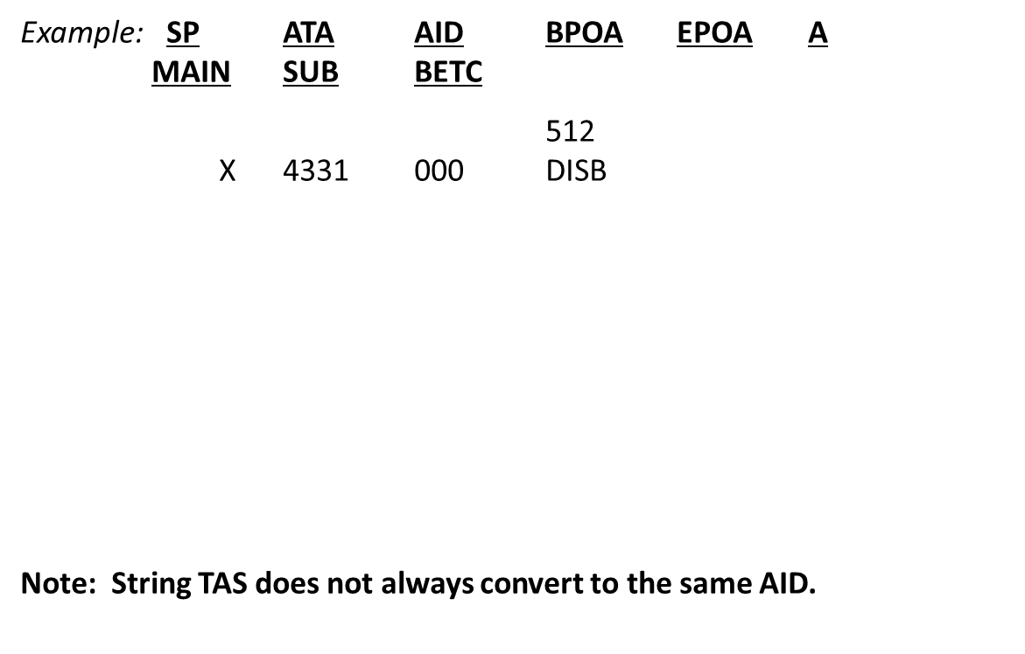



Component TAS ExampleB

Slide 14
Business Event Type Code (BETC)
Definition
BETC
  Refers to an “up to” 8-character code that indicates the type of activity being reported (e.g. receipt, disbursement, etc.).
  Determines the transaction classification on the Treasury Account Symbol’s Fund Balance with Treasury.
  Replaces transaction codes and standard sub-classes but at a more intuitive level of detail.
  Used when reporting Cash Transactions.
  Derived by FMMI. Users will not need to input.

Slide 15
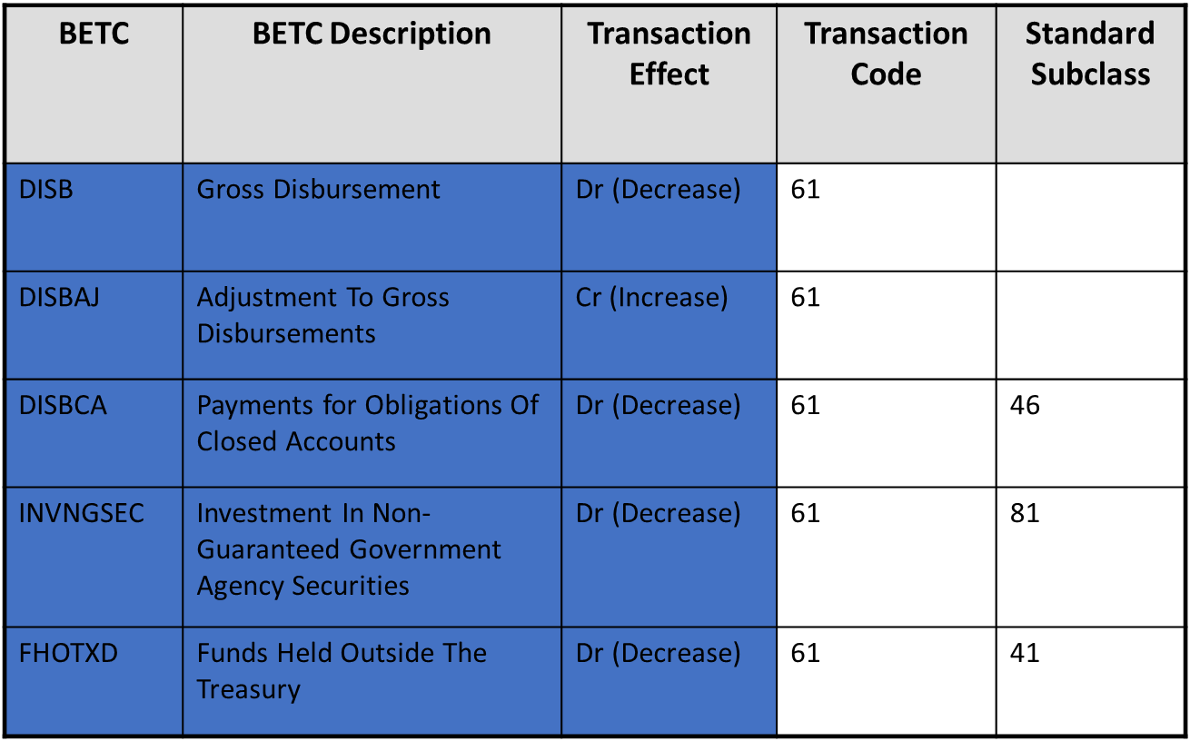
BETC Examples

Slide 16
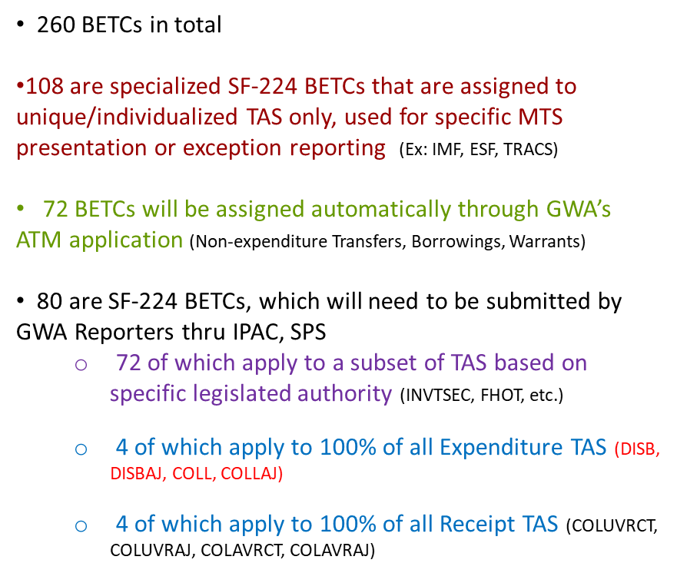
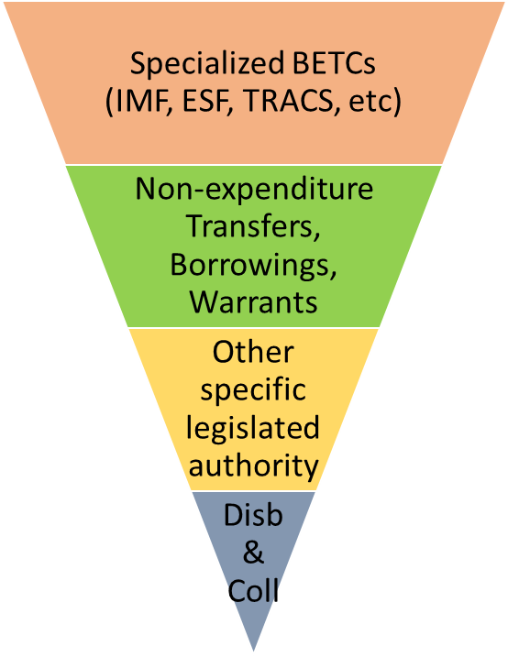

Breaking Down BETC

Slide 17
Transaction Volumes for each BETC
Category - Governmentwide
Specialized BETCs (IMF, ESF, TRACS, etc)
Non-expenditure Transfers, Borrowings, Warrants
Other specific legislated authority
Disb
&
Coll

Slide 18
GWA Account Statement
Provides a daily refreshed view of a Federal Program Agency’s Fund Balance With Treasury (FBWT) – by TAS/BETC.
Is available on-line.
Generates user customized reports.
Provides a central source for retrieving a near real‐time picture of account balance, providing a GWA Account Statement for each TAS.
Is reconciled by the FMS Asset Reconciliation Branch (ARB) in New Orleans. ARB reconciles the GWA Account Statement for many USDA TASs to FMMI.

Slide 19
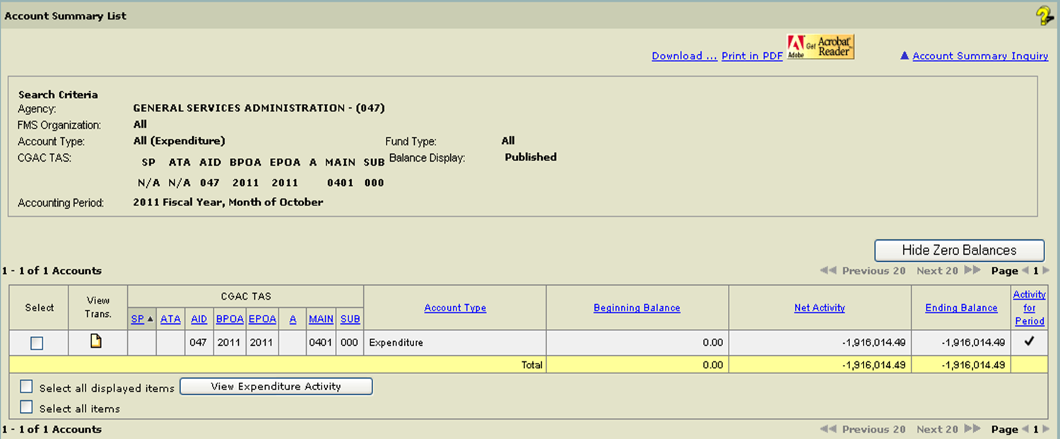


CARS Account Statement
Example
View account summary level information

Slide 20
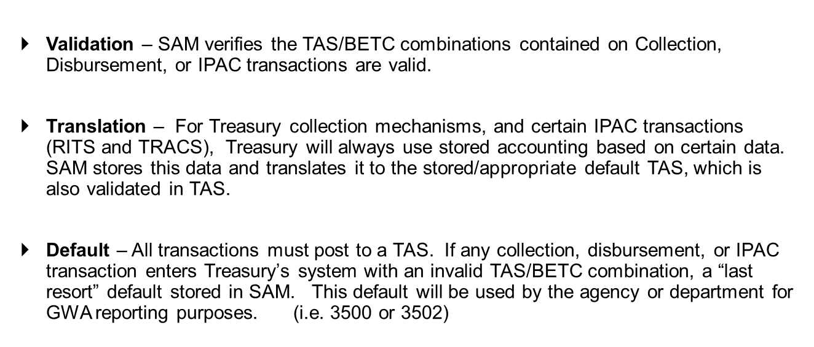
Shared Accounting Modules
(SAMs)
Three Functions of SAM

Slide 21
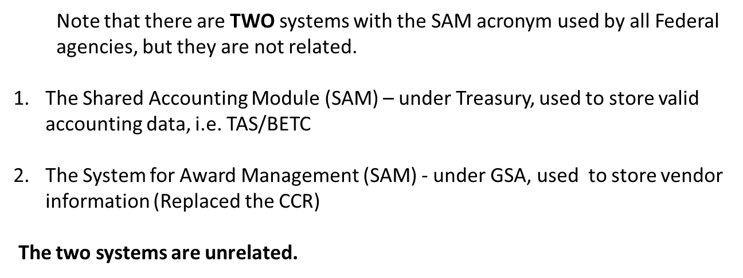
Let’s Not Confuse SAMs!

Slide 22
SAM Public Website
All valid component TAS/BETC combinations are included.
Crosswalk from the String TAS to the Component TAS is provided.
Variety of downloadable file formats to choose from, including EXCEL.
Username/password is not required
Daily updates (available 6 a.m. EST)
https://sam.for.fiscal.treasury.gov/sampublic/
Note: This data is also downloaded routinely and stored in a FMMI table for inquiry purposes.

Slide 23
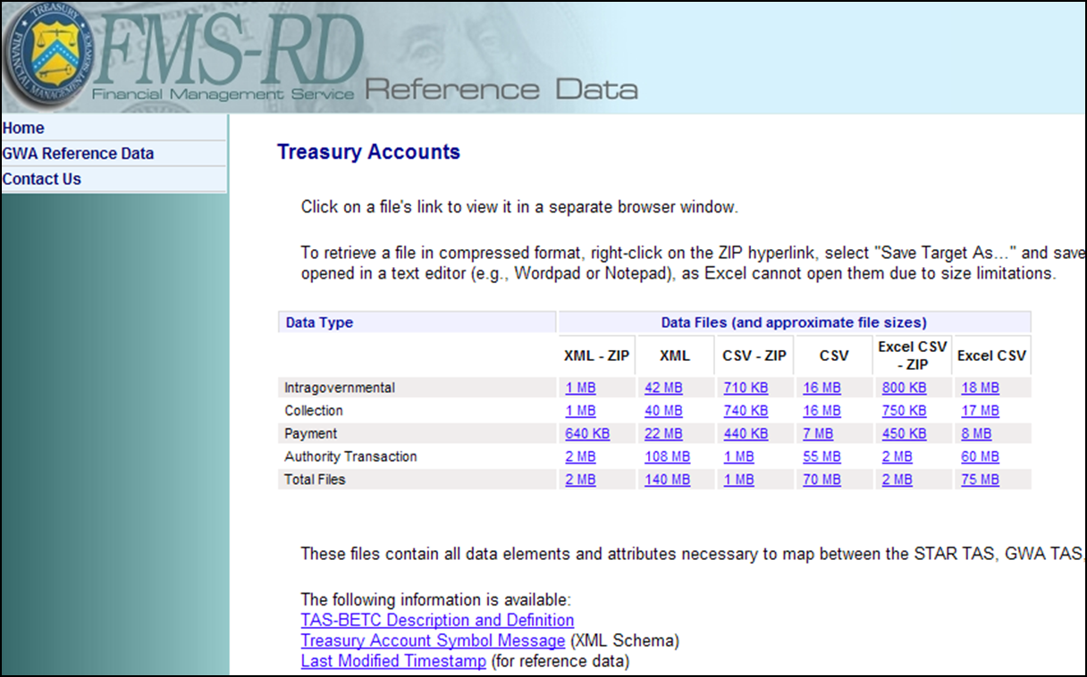
SAM Public WebsiteC
Valid TAS/BETC combinations are on the SAM public website:
https://www.sam.fms.treas.gov/sampublic/tasbetc.htm

Slide 24
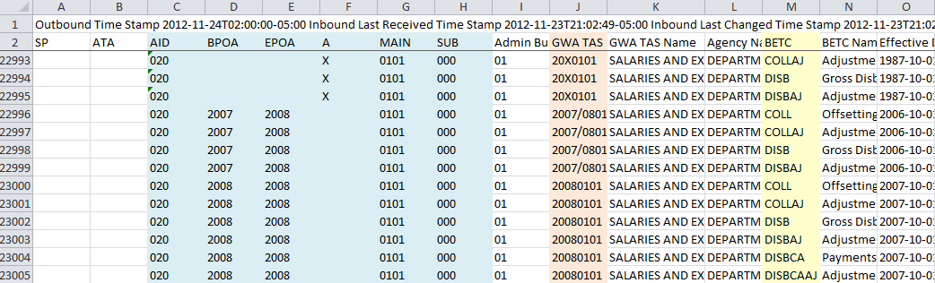
SAM Public Website
(Example of data download)
Component TAS
String TAS
BETC
Note: The String TAS, is listed in the GWA column, but with a two-digit year, instead of a single digit year. For example, 1261600 will be listed as 12161600.

Slide 25
FMMI Table with SAM Data
A list of all Federal Agency valid Component TAS/BETC combinations is downloaded from SAM and stored in FMMI for viewing by users.
Access to the table of combinations is granted to users with the following Evaluator roles in FMMI.
  Funds Management Evaluator
  Purchase Order Evaluator
  Accounts Payable Evaluator
  Accounts Receivable Evaluator
  General Ledger Management Evaluator
The portal path to view the combinations for any of the above roles is:
    View TAS / BETC Data > View TAS / BETC Data Records or
The transaction code used to access the table for any of the above roles is :
    ZFIX_TAS_BETC_VIEW
You can query this table based on several different selection criteria, most commonly by Agency ID, Main Account or GWA string TAS.

Slide 26
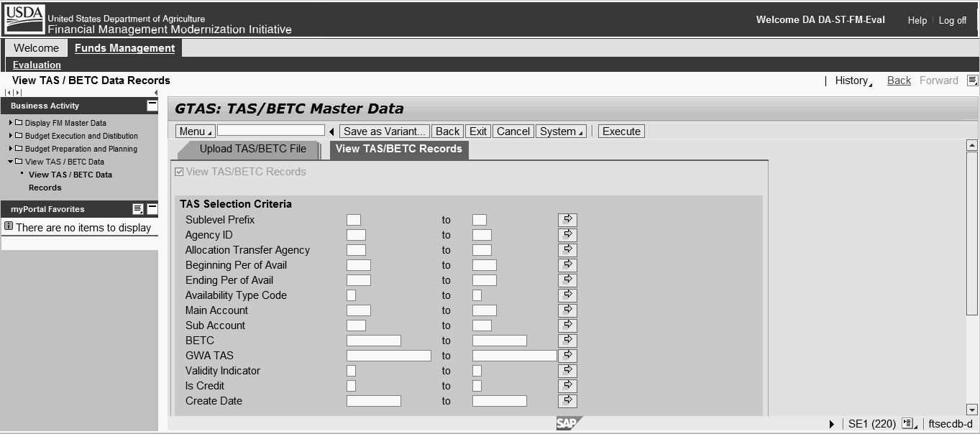
FMMI Table with SAM Data
(cont’d)
AKA:
String TAS
The data values in this table are also used to validate your entries in the required Trading Partner TAS fields. Users will receive an error message if the unique combination of Trading Partner TAS component data entered on the transaction document line item does not match a valid record in this table.
Reminder: Enter traditional string TAS with a two digit year.

Slide 27
Why Both the USDA TAS and the Trading Partner TAS are Needed
October 1, 2014, Treasury mandated that agencies report Federal Trading Partner TAS information on all transactions involving Federal Trading Partners for GTAS Reporting (beginning with FY15 activity).
For IPAC bills initiated by USDA Agencies via FMMI, the Trading Partners TAS is now required.
Agencies billing USDA-FMMI agencies will be required to input a receiver TAS on IPAC bills once FMMI ALC’s we become a CARS reporters.
FMMI has been modified to require users to input the Federal Trading Partner TAS on all documents with a Federal Customer, Vendor, or Trading Partner, regardless of whether the customer is a CARS reporter or not.

Slide 28
Trading Partner TAS in FMMI
A new box titled “US Government Fields” has been created for input of the Federal Trading Partner’s component TAS.
A valid TAS for the specific trading partner must be entered on all documents that reference a Federal Vendor, Customer, or Trading Partner code.
Affected documents:
  FI AP Invoice
  FI AR Invoice
  FI GL Accounting Document
  Purchase Orders
  Sales Orders
  Earmarked Funds documents
  FMS 7600B – Page 2 (new FMMI Document coming in Feb 15)

Slide 29
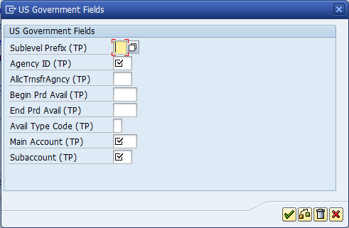
Trading Partner TAS in FMMID
Below is an illustration of the box where FMMI users must input the Trading Partner Component TAS.
  Select the US Gov’t button to display and input the component elements.
Note that the AgencyID and AlcTrnsAgncy fields are displayed in the wrong order. A request for SAP to correct

Slide 30
Trading Partner TAS in FMMI
(cont’d)
Ensure that the USDA TAS and the Federal Trading Partner TAS are contained on all agreements and orders (and on the FMS 7600B – page 2).
Contact your trading partner to obtain the Trading Partner’s CORRECT TAS for input on FMMI documents.
Once the Federal Trading Partner TAS is input on Sales Orders and Purchase Orders, it can not be changed after the first invoice is recorded against it.
Input of an incorrect Trading Partner TAS on Sales Orders and AR Invoice documents will result in chargebacks of IPAC collections.
Continue to Input your Trading Partner’s Accounting in the line text for AR invoices, and the “Sold To Party - Purchase Order” field for Sales Orders. Without this information, a chargeback bill will most likely result.

Slide 31
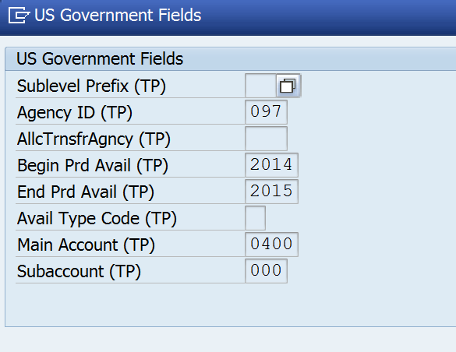
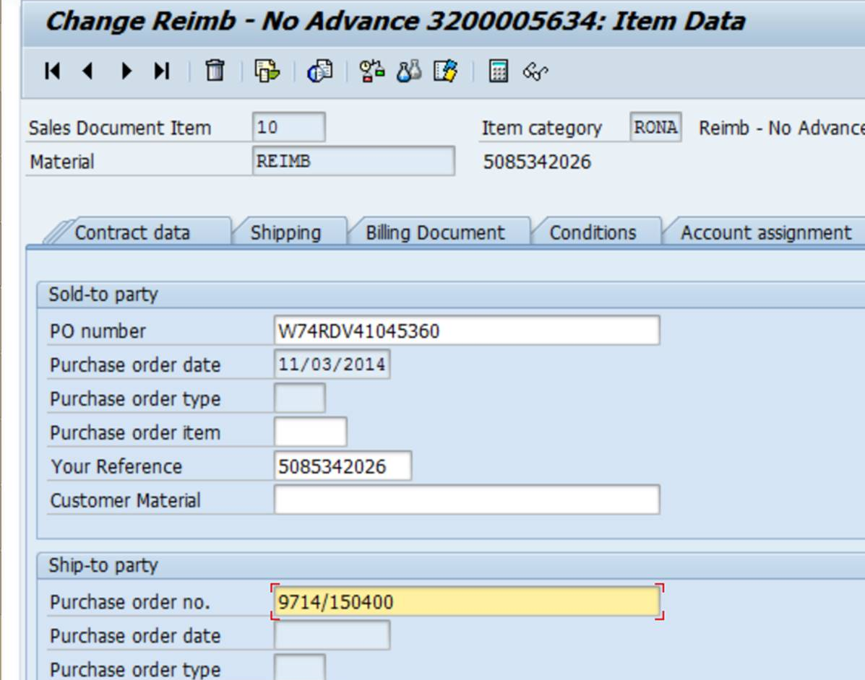
Trading Partner TAS in FMMI
(cont’d)E
New Sales Order – Input TP TAS Component Format.
Existing/Old Sales Orders – In the Ship-to Party PO number field, input TAS using the single digit year string format.
A conversion program will currently use this TAS and convert component format for billing if US Gov’t Fields Box is blank. (Note: You cannot populate this if there are invoices against a sales order)
GTAS reporting will use the Component format input in the Government Fields Box.

Slide 32
USDA Component TAS Format
USDA TASs are still contained in the Application of Funds table in FMMI.
The 8 component fields of the component TAS format have been added.
The old string TAS is still used in FMMI to look-up the Component TAS elements.
The Portal Path to this table is as follows:
  Funds Management > Display FM Master Data > Display Application of Funds

Slide 33

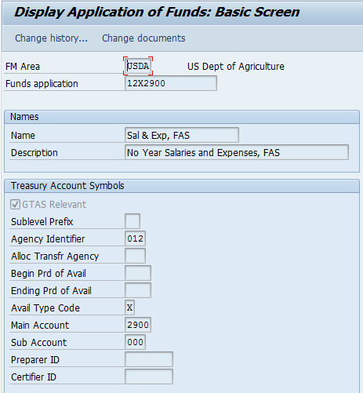
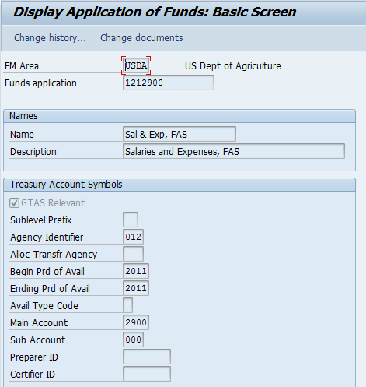
Display Application of Funds
Display Application of Funds
Note that the old String TAS now serves as a “label” (Funds Application Field)
Example of No-Year Fund
Example of Single Year Fund
The Sub Account field (suffix), is displayed here as zeroes, and will derived by FMMI where applicable for reporting.

Slide 34
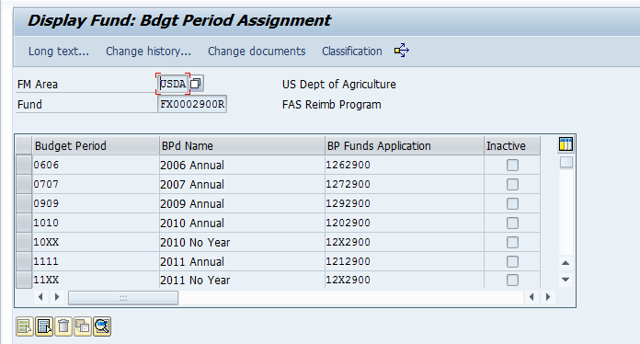
Component TAS in FMMI
TASs are still linked to the Fund/Budget Period Combination, and still displayed in the String TAS Format.
The Component TAS format is visible in Application of Funds Screen, shown on the previous slide, using the String TAS to call up the record.

Slide 35
Identifying a TAS for a FMMI Document
FMMI users usually begin with functional document, and must obtain the Fund and Budget Period contained on the accounting line of document in order to locate the TAS.
Once the Fund and Budget Period are obtained, display the fund to obtain the string TAS.
Portal Navigation: Funds Management > Evaluation > Display FM Master Data > Display Fund > Budget Period Assignment (BP Assignment may be hidden, so you may need to hit Shift F4)

Slide 36
Identifying a TAS for a FMMI Document
(cont’d)
Example: For a document with BP=10XX and Fund=FX0002900R, the String TAS is displayed from the Path: Display Fund > Budget Period Assignment as below.
In this example, the String TAS is 12X2900, and when entered into the Display Application Funds Screen, the Component TAS format is displayed.
Path: Funds Management > Evaluation > Display FM Master Data > Display Application of Funds

Slide 37
Necessity to Identify the Underlying
TAS on a Purchase Order
    The trading partner will require the TAS to IPAC the USDA agency.
    USDA must continue to provide the PO to Federal Trading Partners when purchasing goods or services, in addition to the TAS. USDA agencies must require the trading partner to include the PO on every IPAC bill.
    The Receiver TAS contained on the IPAC bill should agree with the underlying TAS of the referenced Purchase Order number or invoice.
    In the case of multiple TASs resulting from multiple account assignments, provide the Trading Partner with one TAS, and FMMI will accept and adjust it upon receipt in the GWA/CARS system during the monthly cash reconciliation process.
    Find the TAS for a PO through FMMI Funds Management.
    Trading Partners are modifying their forms to include a Receiver TAS field.

Slide 38
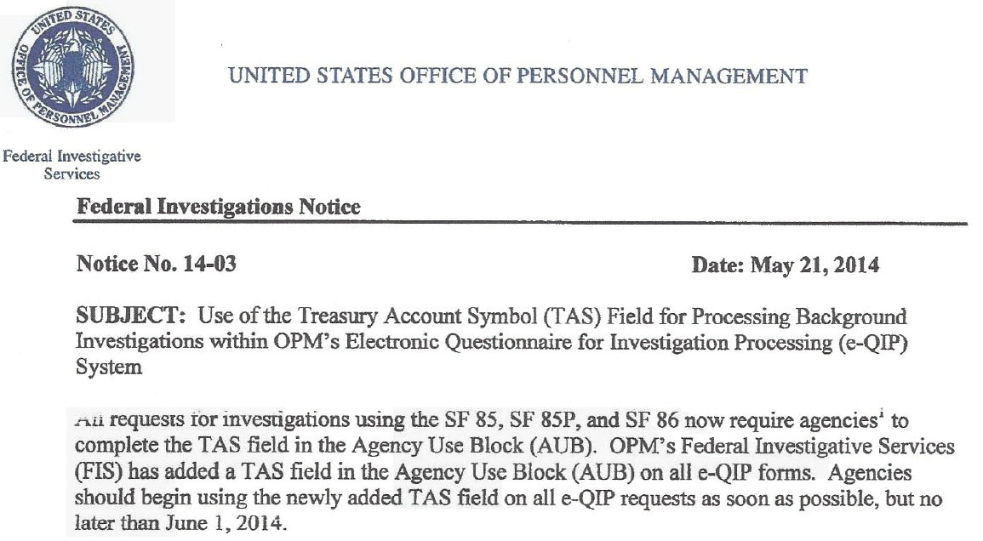
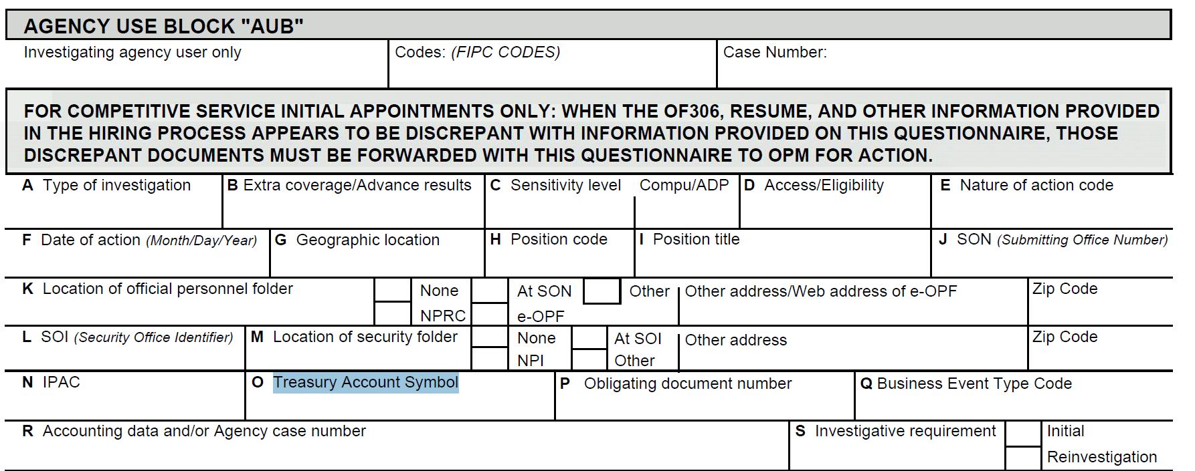
Input TAS for the
Purchase Order on all Order
    Example
    from OPM:
    SF86:
    Questionnaire for
    National Security Positions
You must still provide the USDA PO!

Slide 39
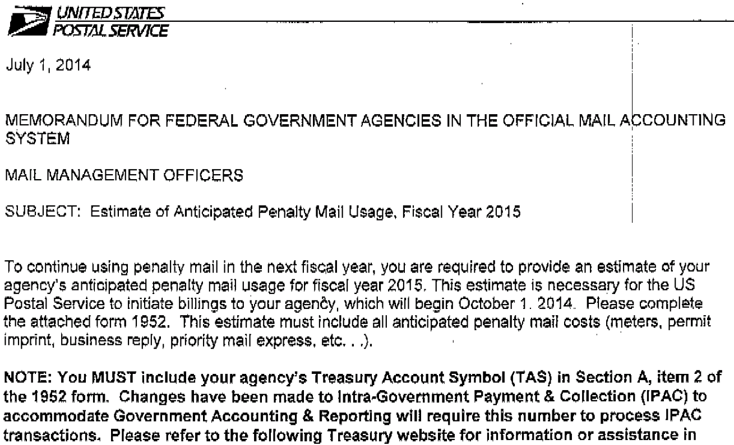
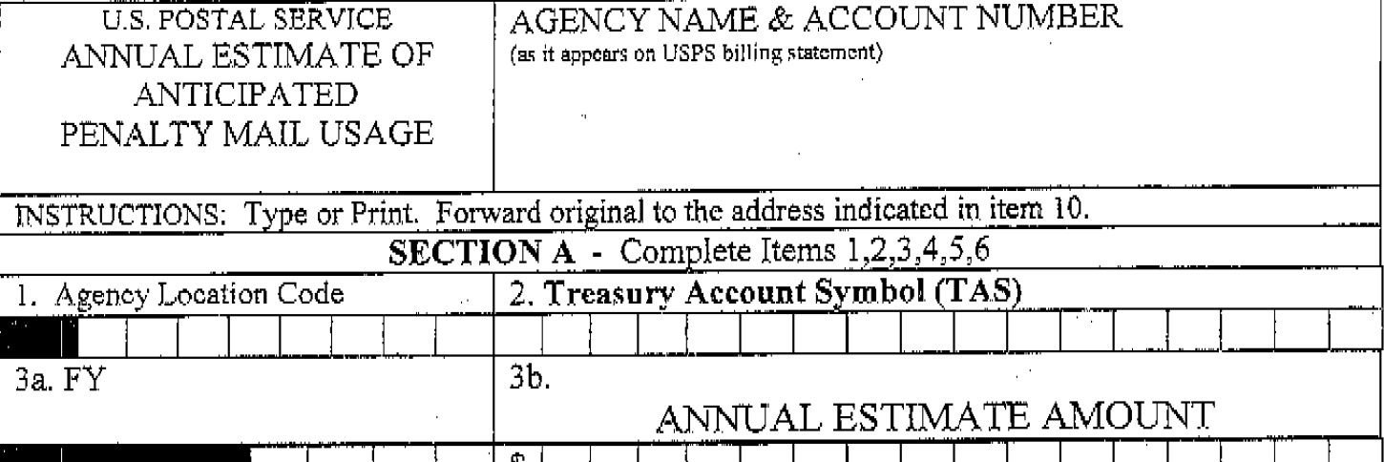
Input Both TAS and PO on Orders
    Example from
    US Postal Service:
    Form 1952:
    Annual Estimate of
    Anticipated
    Penalty Mail Usage
You must still provide the USDA PO!

Slide 40
Recap of Key Points
Each Payment, Collection, and IPAC transaction will need to be classified when received or initiated, to a valid TAS/BETC.
The TAS structure is changing to Component TAS format.
Do not confuse GTAS with Component TAS.
Use the table from the SAM website or the FMMI table to obtain the Component TAS for any string TAS.
Payments: USDA will put the USDA TAS on all disbursement files sent to Treasury.
Collections: All non-IPAC collections will be recorded to a default
C-key/TAS, i.e. 12F3875.
IPAC: The initiator of the IPAC transaction must report both the initiator and receiver TAS/BETC’s.

Slide 41
Recap of Key Points
(cont’d)
When entering Sales Orders or AR invoice documents, the accounting for the other agency will be required, and should be input in the same fields as previously required.
  For example, on a sales order to a Department of Defense (DOD) Customer, the DOD Line of Accounting (LOA) must still be input in the Order Data TAB, Billing Party Purchase Order number field. This must be done to avoid chargebacks.
To obtain a Component TAS for a FMMI document: obtain the Fund and Budget FY on the document, look up this information on the Fund table to obtain the string TAS, and then look up the string TAS on “Display Funds Application”.
For 99% of USDA transactions, the BETC code will be COLL, DISB, or one of their related BETC’s, COLLBCA, COLLADJ, DISBBCA, or DISBADJ. The system will derive the appropriate BETC.
In FMMI, a Trading partner component TAS is required on each document line. (The system will allow input of a different TAS on each line if applicable.)

Slide 42
Frequently Used Acronym
GWA – Government Wide Accounting
CARS- Central Accounting Reporting System
SAM – Shared Accounting Module
TAS/BETC - Treasury Account Symbol / Business Transaction Code Combination
Component TAS
SoD – Statement of Difference
Treasury Payment Systems
SPS - Secure Payment System
ITS - International Treasury Services
ASAP - Automated Standard Application for Payments
PAM - Payment Application Modernization

Slide 43
Trading Partner’s TAS Helpful Tips
    For all Federal business agreements, agencies should obtain TAS numbers from their trading partners.
    FMS representatives have contacted certain large Federal Vendor agencies to determine if a single TAS is always used.
    The following slides contain Trading Partner TAS information that should be helpful when creating Purchase Orders in FMMI, and alleviate the need to contact those trading partners for a TAS.

Slide 44
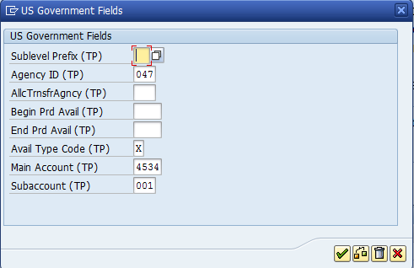
Trading Partner’s TAS - Example
GSA TOPS, MPOL, and FEDS Orders – the below TAS on PO’s
Component TAS Fields:
Sublevel Prefix: blank
Agency ID: 047
ALC Trnsfr Agncy: blank
Begin Prd Avail: blank
End Prd Avail: blank
Avail Type Code: X
Main Account: 4534
Subaccount: 001
Old String TAS Format = 47X4534.1

Slide 45
Trading Partner Default TAS’s
Use AR and AP Transactions (i.e., Sales Orders, Purchase Orders, AR & AP Invoices)

Slide 46
Agency TAS to Trading Partners
    When entering an agreement with any Trading Partner, give them your correct TAS that will match the TAS on your PO. Your Trading Partner, the Vendor on the future IPAC bills, will use this TAS as the “Receiver Treasury Account Symbol” when creating the IPAC bill to collect from the USDA agency.
    Note: If the Trading Partner’s system is not yet ready to hold multiple TASs per customer ALC, they will use a suspense TAS (12F3885.xx) for your agency until their system is modified to hold a specific TAS for each order.
    When USDA becomes a CARS reporter, if an agency creates an IPAC bill referencing the wrong USDA TAS, or a suspense TAS, or a single TAS in a situation where the PO line has multiple TAS’s, this should not be a problem. The current plan is to modify USDA systems to reclassify transactions to the appropriate TAS at Treasury when any of these situations occur.

Slide 47
FMMI Documents
Inputting TP TAS
    When entering any of the below FMMI Documents, the TP TAS must be entered.
      FI AP Invoice
      FI AR Invoice
      FI GL Accounting Document
      Purchase Orders
      Sales Orders
      Earmarked Funds documents
    B2 Document
    The following slides contain examples of where to input and view on each of these FMMI documents.

Slide 48
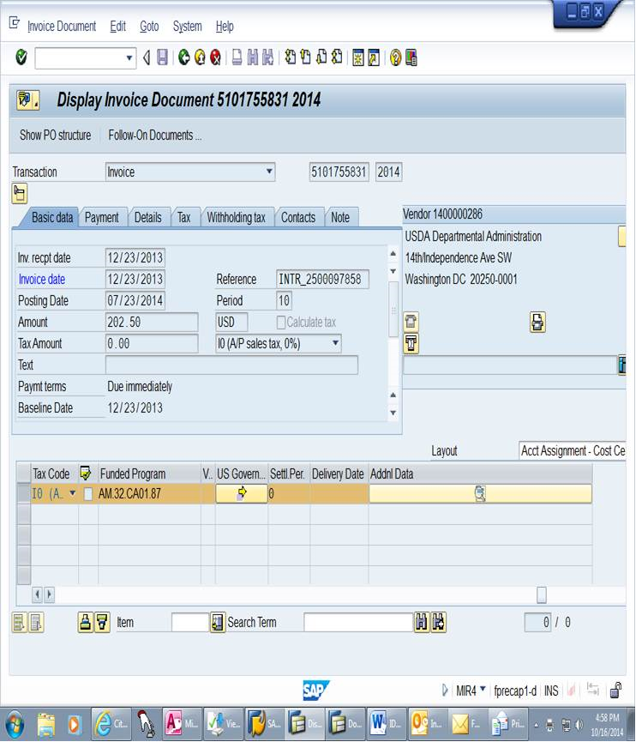
FI AP Invoice
Scroll to the right to see the US Govt Field key

Slide 49
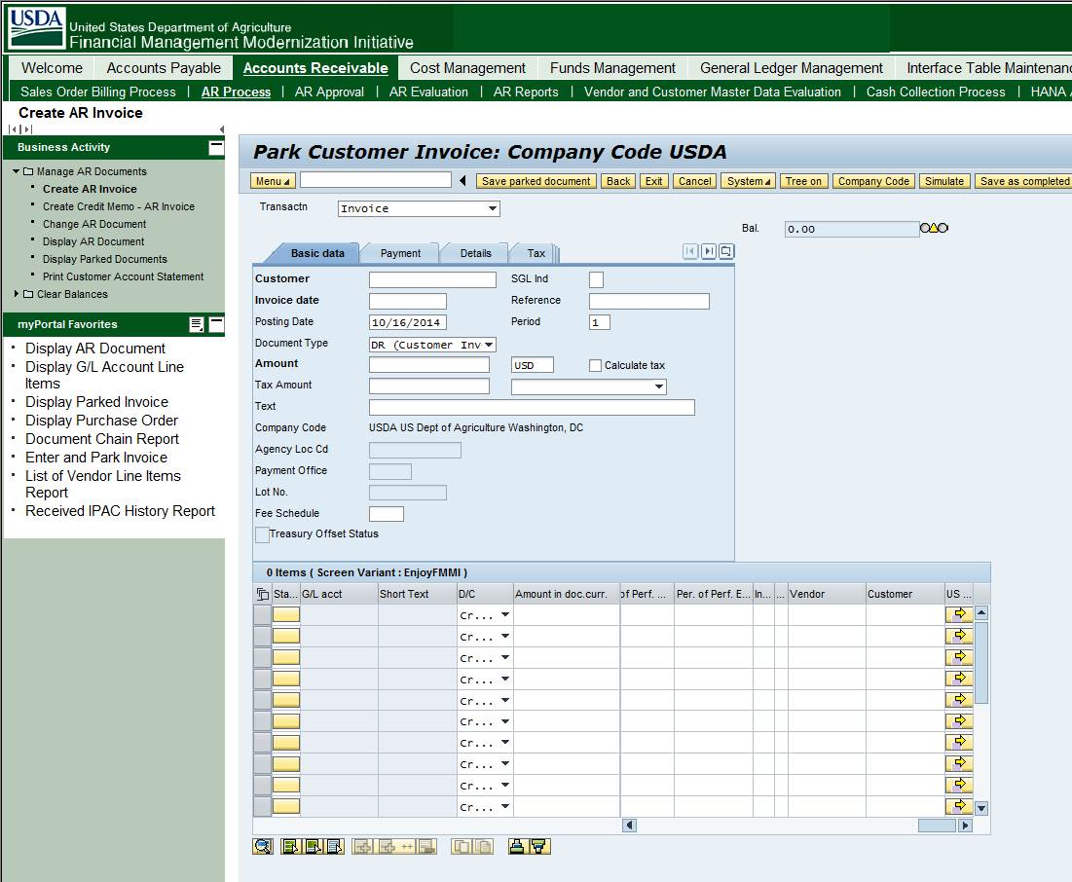
FI AR Invoice – FV70
The US Government Field is located under the Basic Data tab. At the below screen, use the bottom scroll to see the US Govt Field button.

Slide 50
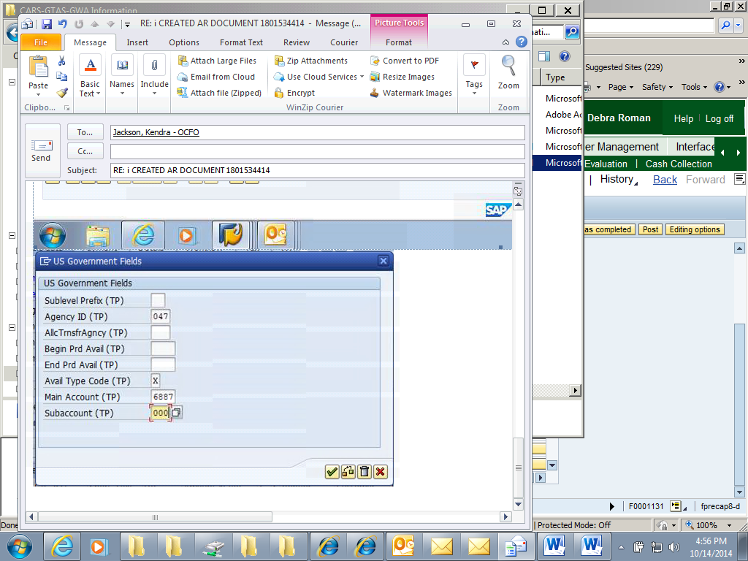
FI AR Invoice – FV70
(cont’d)
Enter necessary TAS data elements from trading partner, then click on green check mark. Proceed as normal to process document.

Slide 51
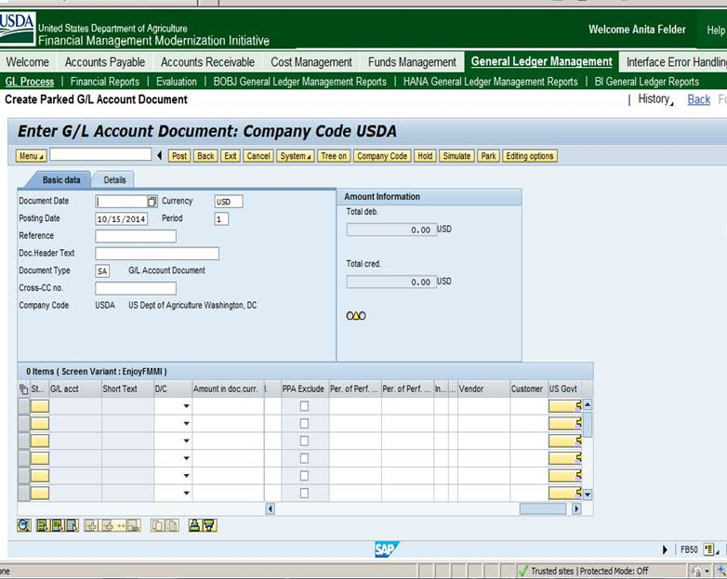
FI GL Accounting Document – FB50
Click on Basic Data Tab. Scroll to the right to see the US Govt Field key.

Slide 52
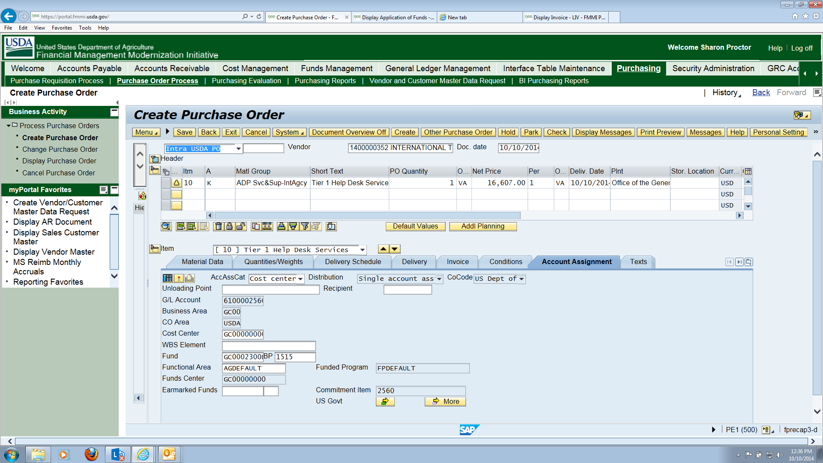
Purchase Order – ME23N
The US Government Field is located under the Account Assignment tab. To enter TAS, click on the yellow arrow next to the US Govt field.
Purchase order

Slide 53
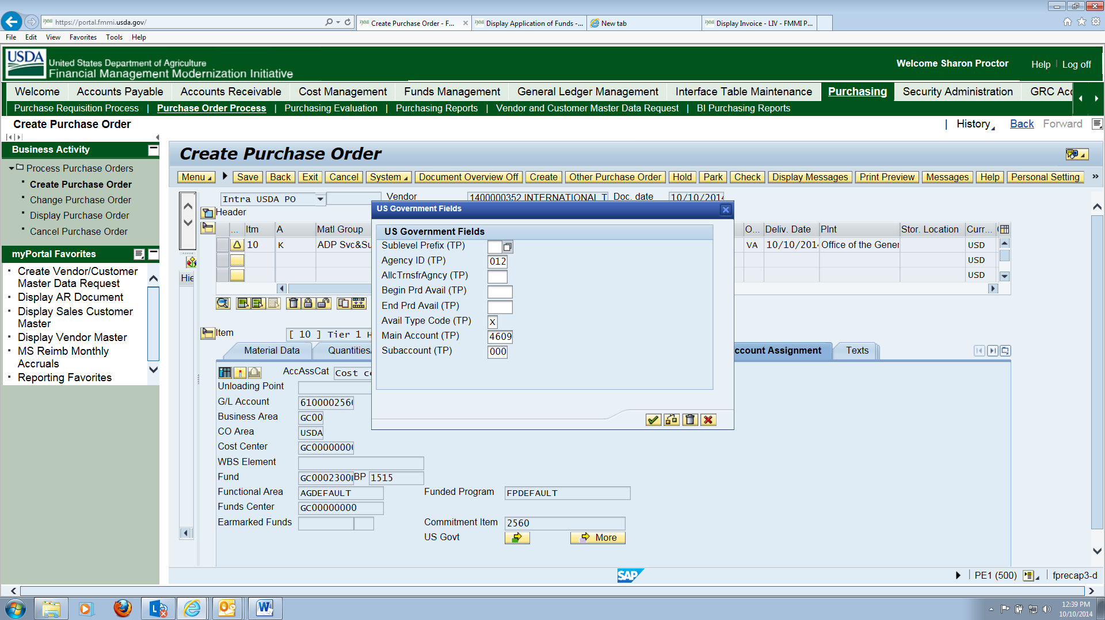
Purchase Order ME23N
(cont’d)
Enter necessary Trading Partner’s TAS data elements, then click on the green check mark.

Slide 54
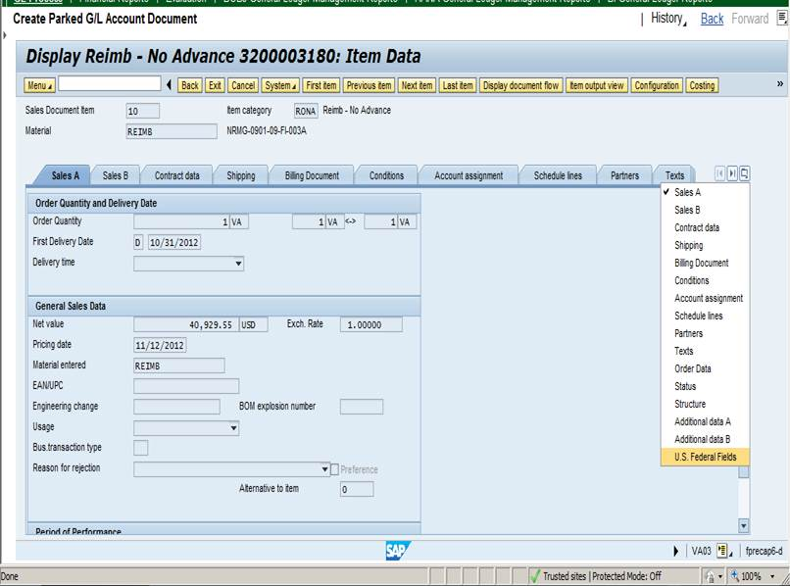
Sales Orders – VA03
Click on the Navigation Menu Box to see additional fields and then choose U.S. Federal Fields.

Slide 55
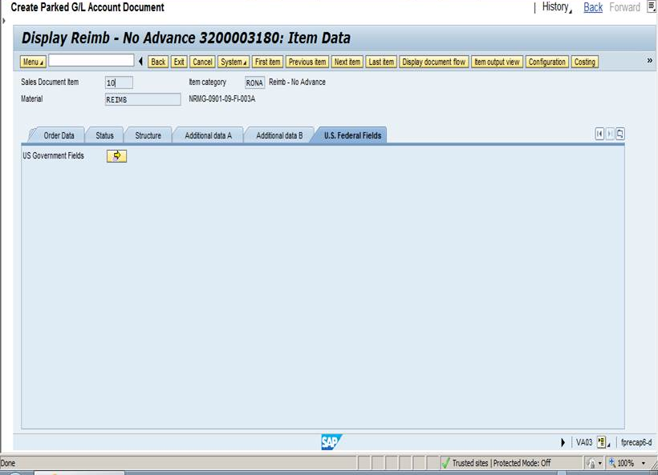
Sales Orders – VA03
(cont’d)
The below screen will show. Click on Yellow box for the TAS Element box to open. Then complete applicable fields with appropriate elements.

Slide 56
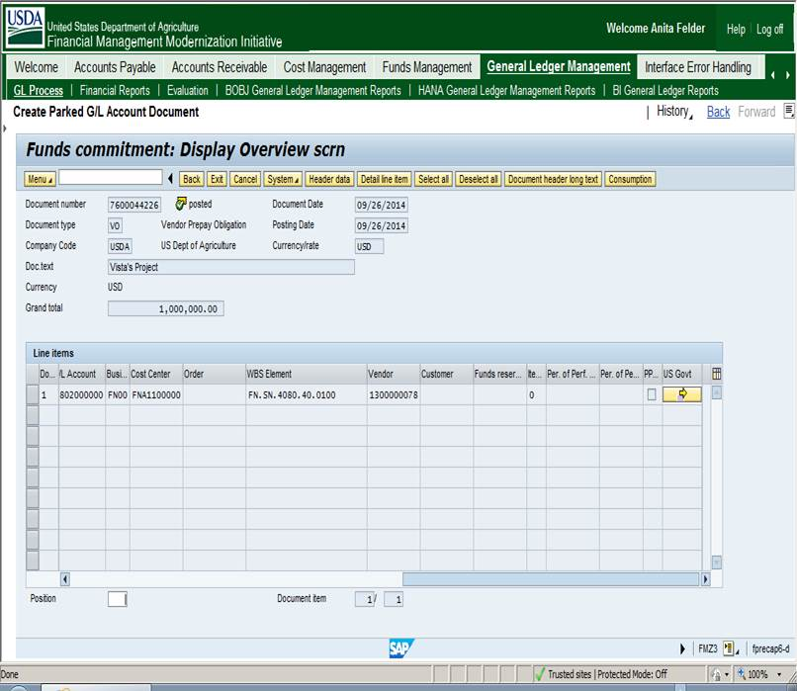
Earmarked Funds – FM23
Scroll to the right to see the US Govt Field key

Slide 57
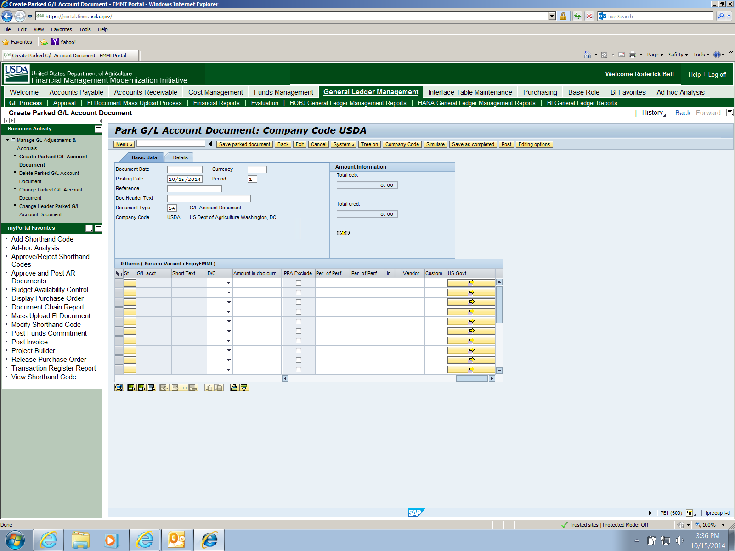
B2 Document
Scroll to the right to find US Govt Field Key – Click on yellow arrow.

Slide 58
B2 Document
(cont’d)
Enter necessary TAS data elements from trading partner, then click on green check mark. Proceed as normal to process document.

Slide 59
Contacts
Eddie Reso, Chief
Treasury Services Branch
eddie.reso@cfo.usda.gov
(817) 542-2839
Debra Roman, Program Analyst
Treasury Services Branch, IPAC Control Section
debra.roman@cfo.usda.gov
(800) 421-0323 opt. 3

Slide 60

Questions

