Slide 1
Integrated Acquisition System (IAS) and Treasury's
Invoice Processing Platform (IPP)
Rick Toothman
Procurement Systems Division (PSD)
Rick.Toothman@dm.usda.gov

Slide 2
Purpose
The purpose of this presentation is to provide an understanding of how the Integrated Acquisition System (IAS), Invoice Processing Platform (IPP), and Federal Financial Management Modernization Initiative (FMMI) interact to process an acquisition from the initial procurement request, through funding, award, billing, and invoice payment.
This presentation has the following sections:
  Overview
  Document Flow and Interfaces
  Reporting
  IAS Support

Slide 3
Overview
Procurement Systems Division (PSD)
PSD is part of the Office of Contracting and Procurement (OCP) – formerly the Office of Procurement and Property Management (OPPM) – within Department Administration (DA)
The mission of the Procurement Systems Division (PSD) is to provide dynamic and integrated solutions, products, and services in support of USDA’s leadership and acquisition community
PSD owns and operates IAS
For Treasury’s IPP, PSD handles all configuration, user provisioning (in conjunction with Treasury), help desk support, and interfaces with IAS
Notes:
6/19/2018
3

Slide 4
Overview
IAS within USDA Procurement
Overview
IAS within USDA
Three Primary USDA Procurement Systems per Procurement Advisory 105C
Integrated Acquisition System (IAS)
All Agencies
Virtual Incident Procurement (VIPR)
FS
Web Based Supply Chain Management (WBSCM)
AMS and FSA
Broad range of dept. purchases
$2.5B annual avg.
Incident management
$750M annual avg.
Food commodity-based procurements
$3B annual avg.
Financial Management Modernization Initiative (FMMI)
All Agencies
USDA’s financial system handles some procurement exclusions noted in Procurement Advisory 105C such as:
  Acquisitions from other Federal Agencies
  Acquisitions supporting risk incidents
  Telecom & utilities paid through third-party billing services
  GSA Capital Leasing transactions
  Program Loan Cost Expense (PLCE)

Slide 5
Overview
IAS Basics
Integrated e-procurement system that documents the full spending cycle chain including:
  Requisition (Oracle)
  Solicitation, Award (PRISM)
  Receipt, Invoice (IPP and Oracle)
Integrated with FMMI, IPP, and Federal Procurement Data System – Next Generation (FPDS-NG)
Serves approximately 4,000 requisitioners and 1,000 contracting personnel throughout USDA

Slide 6
Overview
Benefits
Data accuracy, integrity, and consistency
Federal mandate compliance (FAR, AGAR, OMB)
Approval workflow, warrant checks, electronic document storage, USDA-specific fields and validations, FPDS-NG reporting
Linking IAS to IPP provides improved invoice management/oversight of vendor invoice payments
Customizable reporting tool for data reporting/analysis
Supports non-traditional contracting programs where award is not interfaced to FMMI:
    Purchase Card (PCARD)
    Program Loan Cost Expense
    APHIS foreign vendor program

Slide 7
Document Flow and Interfaces
FMMI Interface
FMMI sends IAS the following through batch processes:
  Accounting: Shorthand Codes and Budget Object Classification codes (BOCs)
  Vendors: Via SAM with DUNS. Some vendor types filtered out (e.g., Permitees, Employees)
  Payment Feedback: Invoice scheduled date, disbursement amount, disbursement date, and other fields
A “real-time” interface exists for IAS to send FMMI requisitions, awards, receipts, and invoices
  FMMI provides immediate response on their acceptance or rejection along with FMMI Document Number
An IAS requisition that commits funds utilizes these three accounting elements: FMMI Business Area, FMMI Shorthand Code, and BOC
When IAS sends over a document, FMMI performs validation such as: (a) funds check, (b) tolerance between requisition and award, (c) deobligation does not reduce amount below $0, and (d) vendor status
Additionally, there is a nightly batch interface between IAS and FMMI to support reporting:
  IAS provides FMMI with award information not sent through the transaction interface. FMMI has this available in their BI tool
  FMMI provides all transactions from Material Management (MM) which IAS uses for troubleshooting, consistency checks, and source for outstanding financial balances (e.g., ULO)

Slide 8
Document Flow and Interfaces
FMMI Transaction Types
Transaction | FMMI Doc Type | Notes
Requisition | ZIQ | Called “Purchase Request” in FMMI Produces a commitment of funds
Award | ZIO, ZIN | Called “Purchase Order” in FMMI Produces an obligation of funds ZIO references a requisition, ZIN does not and is not used often
Receipt | ZIC | Receipts are only created on awards created prior to March 2016 Automatically created by IAS once invoice reaches IAS from IPP
Invoice | ZIP, ZIM | ZIM was used for all invoices prior to IPP ZIP used for all invoiced processed by IPP ZIM still seen for recurring invoices which do not use IPP Automatically created by IAS once invoice reaches IAS from IPP
Non-obligating contract vehicles (e.g., Blanket Purchase Agreement) are not sent to FMMI
IAS supports transactions subject to availability of funds which are not sent to FMMI until funding is added

Slide 9
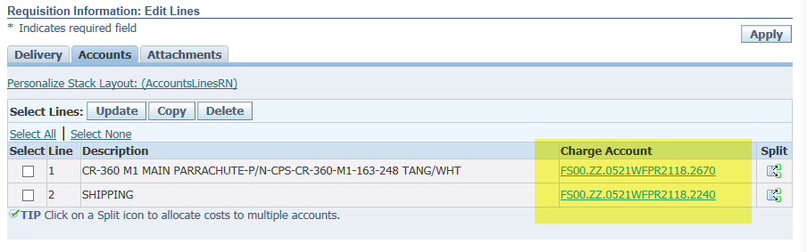
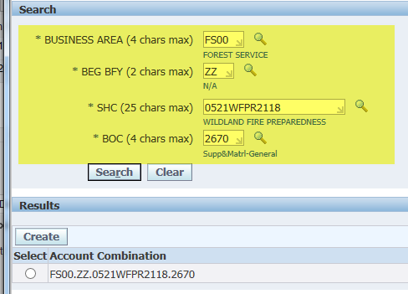
Document Flow and Interfaces
IAS Requisition
Funding specified on IAS requisition

Slide 10
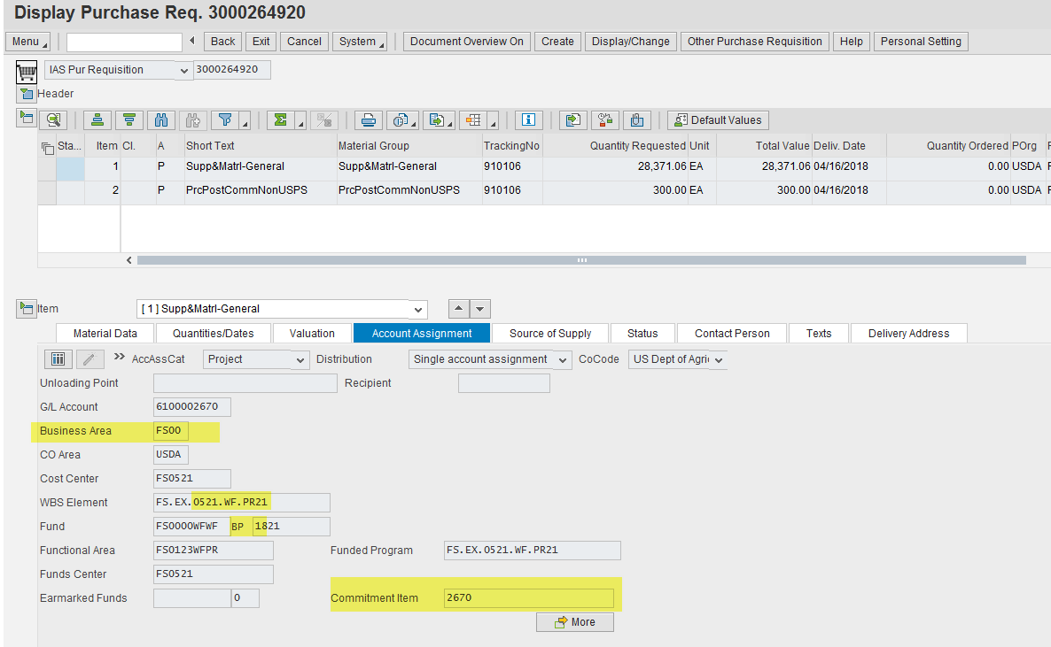
Document Flow and Interfaces
FMMI Purchase Request
Corresponding Purchase Request built in FMMI with funding set based on SHC

Slide 11
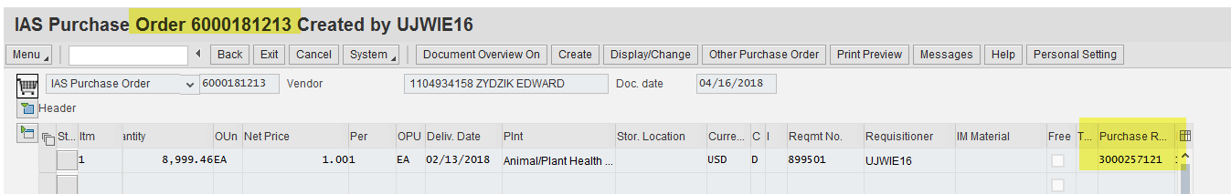
Document Flow and Interfaces
FMMI Purchase Order
Example FMMI Purchase Order screenshot showing relationship between Purchase Request and Purchase Order

Slide 12

Document Flow and Interfaces
Invoice
IPP is a secure, web-based centralized service that more efficiently manages USDA invoicing from the start of the award through confirmation of payment by Treasury
The IPP application provides many different capabilities:
  Approval workflow, queues, escalations, delegations, and notifications
  Reporting on outstanding approvals needed
Other benefits:
  Provides vendor visibility into invoice status
  Elimination of improper invoices because all necessary elements are required and invoice must be created from award
  Lower interest paid due to reduced number of late invoices
  Elimination of many manual processes conducted prior to IPP
  Complete transparency of approval routing and status
  Ability to set approvers from IAS award

Slide 13
Document Flow and Interfaces
Invoice Process Flow
Entry
Vendor enters invoice in IPP against PO sent from IAS (within 30 mins of approval in IAS)
Review
Approvers identified on IAS award (e.g., COR) approves invoice in IPP
If applicable, approver adjusts accounting distribution if multiple accounting lines are tied to one line item
Export
Invoice data exported out of IPP (within 30 mins of all requisite IPP approvals being completed) into IAS where an invoice (and receipt, if applicable) is created automatically
Status update
IPP monitors payments issued by Treasury. Invoice status updated to PAID by FMMI program
2-way (award-invoice) or 3-way (award-receipt-invoice) match automated in IAS and transaction sent to FMMI
If vendor cannot access IPP, there is an option to self-service an invoice on their behalf

Slide 14
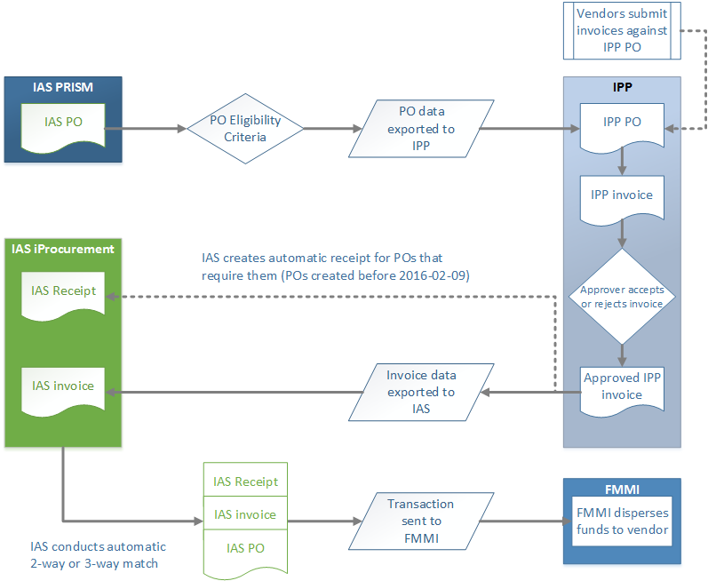
Document Flow and Interfaces
Invoice Process Flow – System View

Slide 15
Document Flow and Interfaces
Invoice – Prompt Pay
Under the Prompt Payment Act, an agency that fails to pay within the required time will be liable for interest on the delinquent payment.
Many invoices have a Prompt Pay Type of ‘O’ for Other which requires payment within 30 days.
  Meat, fish, agricultural commodities, and dairy have varying Prompt Pay Types – 7 to 10 days
OMB M-17-26 recommended paying small businesses within 15 days.
Prior to this memo, FMMI held the invoice until the last possible day to maximize interest earned.
Prompt Payment should not be confused with discounts, which are terms a vendor negotiates to receive a reduced amount in return for early payment.
  Not often used because invoices are paid within 15 days

Slide 16
Document Flow and Interfaces
Invoice – Prompt Paya
Prompt Pay type is established on IAS award and carried forward to invoice
Prompt Pay is based on the Baseline date of the invoice in FMMI
3 fields from the IPP invoice determine the Baseline:
  Receipt Date – System timestamp; Date in which the invoice was entered into IPP
  Goods/Services Received Date – Entered by the agency approver during invoice approval
  Goods/Services Accepted Date – Entered by the agency approver during invoice approval
FMMI calculates the Baseline Date, based on the later of the Receipt Date and the Goods/Services Received Date entered into IPP
  Baseline Date = Goods/Services Accepted date in the event that all the following conditions are met:
    Goods/Services Accepted Date later than Receipt Date and Date Goods/Services Received
    Goods/Services Accepted is within 7 days of the Receipt Date and Goods/Services Received
If invoice is late, FMMI will send to Treasury on the earliest possible payment run
Payment runs occur Monday – Friday (excludes Federal Holidays / exceptions exist.)

Slide 17
Document Flow and Interfaces
FPDS-NG
FPDS-NG is a source for US Governmentwide procurement data
  Managed by Integrated Acquisition Environment (IAE) within GSA
Real-time interface between PRISM (the acquisition module) and FPDS-NG
Contracting Officers (COs) must submit complete reports on all contract actions above the micro purchase threshold, as required by the Federal Acquisition Regulation (FAR) and USDA Procurement Advisory 132
IAS has controls in place to prevent the release of an award until FPDS-NG indicates a valid FPDS-NG record has been created
FPDS-NG data utilized for DATA Act reporting
FPDS-NG data imported into IAS for use in the FPDS-NG Dashboard within IAS (see Reporting section)

Slide 18
Reporting
Reporting Tool
In addition to reports within PRISM, PSD developed the IAS Reporting Tool which pools from all IAS, FMMI, and FPDS-NG data
Standard reports have been developed to meet the needs of the IAS user community including: COs, program offices, and procurement executives. It also includes financial management personnel within agencies.
  All communities have access to the same reports
Most IAS users receive access to the IAS Reporting Tool by default in addition to their requested role
The reports can be filtered by available fields and data can be exported to Excel

Slide 19
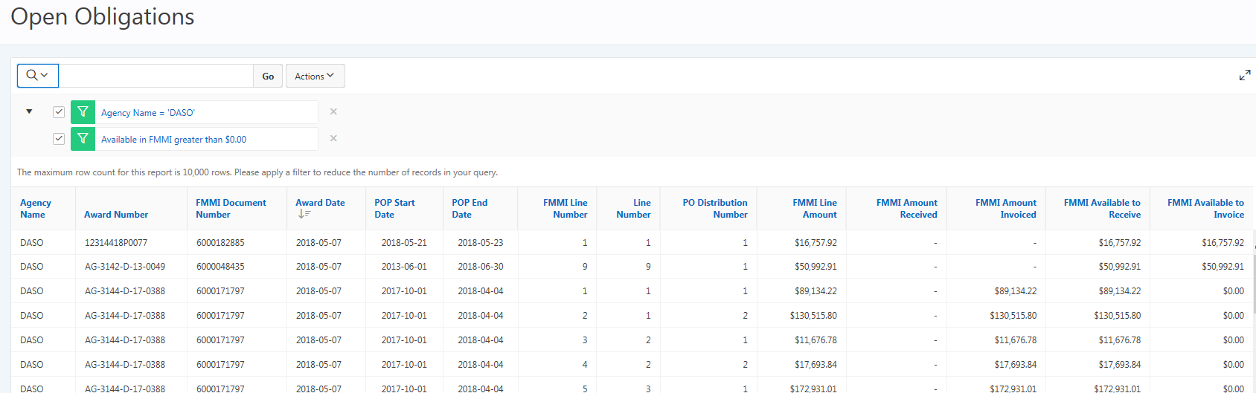
Reporting
Example Report
Open Obligation Report
  Based on data from the FMMI BI, this report displays all IAS award lines that have an open balance in FMMI
  Report also includes IAS line item data such as line item description that facilitates the de-obligation process in IAS for Contracting Specialists

Slide 20
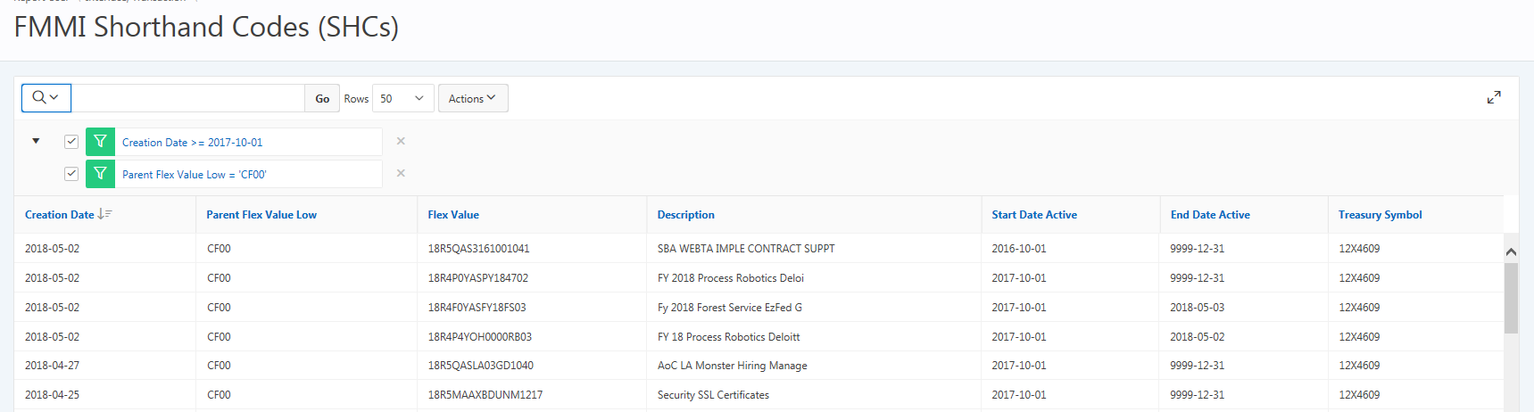
Reporting
Example Reporta
FMMI Shorthand Code Report
  Report of all SHCs that have been received by IAS from FMMI
  Allows for validation that SHCs created in FMMI are available for use in IAS

Slide 21
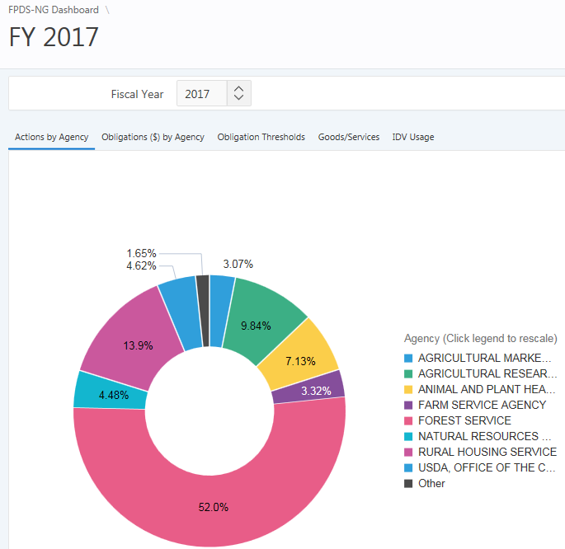
Reporting
FPDS-NG Dashboard
Interactive dashboard utilizing USDA procurement data publicly available in FPDS-NG with potential to be supplemented with other procurement data
Charts/tables drillable by fiscal year, agency, office, preparer
Reports by dollar threshold and procurement type
Top 10 vendor and small business reports
Search capability
Data export capability

Slide 22
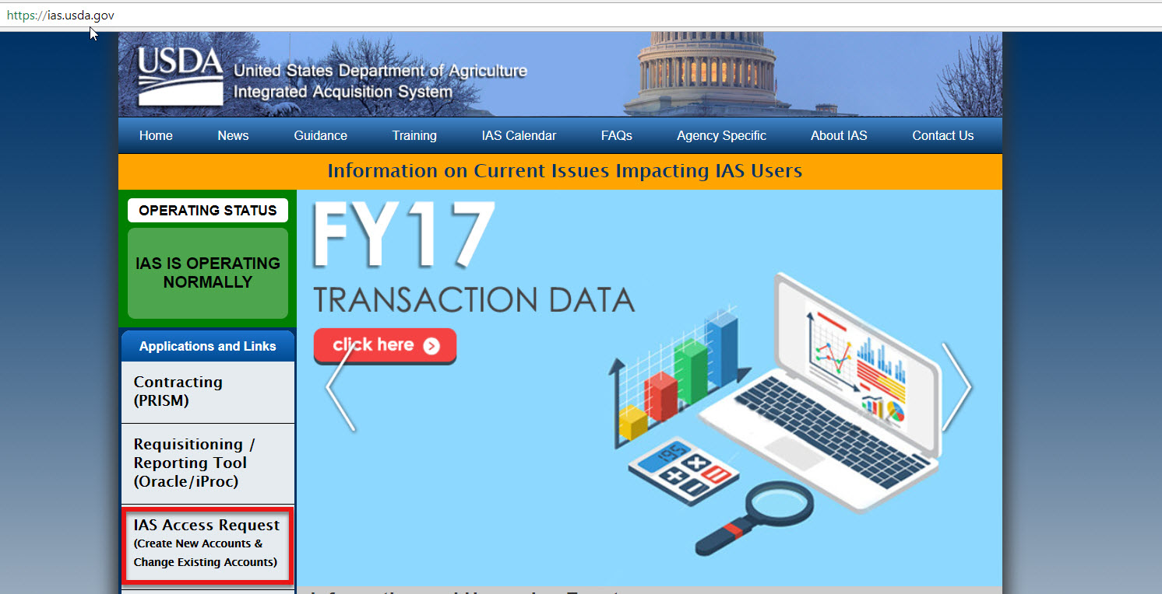
IAS Support
How to Get Access to IAS
Website: https://ias.usda.gov
  Link located on the left-hand side under Applications and Links on home page for easy access

Slide 23
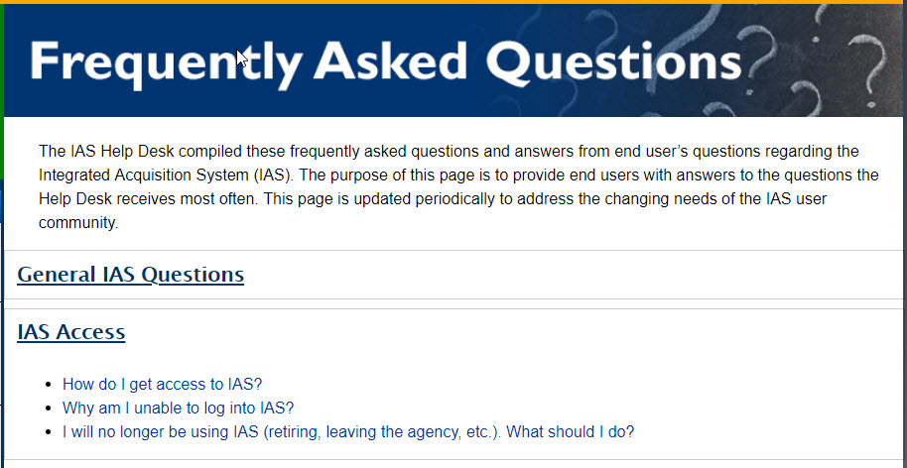
IAS Support
How to get Access to IASa
IAS Request
  On Website go to FAQ -> IAS Access
  How to Video and Guide available
  This is an automated process – all approvals are done within the system

Slide 24
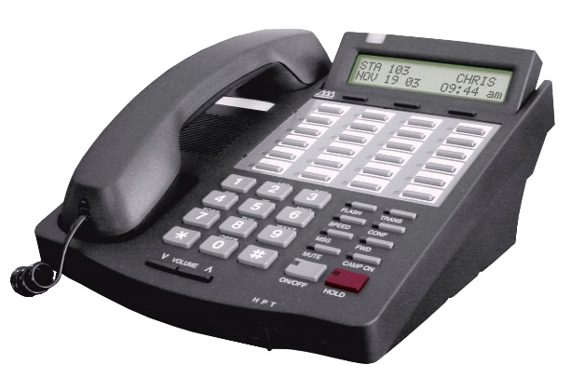

IAS Support
How to Contact the Help Desk
Hours
  Monday-Friday 8AM-8PM EST
Phone or email
  Telephone: 1.888.IAS.1631 (1.888.427.1631) Voicemail after hours
  Email: IAS-HelpDesk@dm.usda.gov
  Link located on the bottom left-hand side on the website on the home page under Need Assistance?

Slide 25

IAS Support
Training
PSD offers instructor-led, hands-on courses conducted using the IAS Training Environment
Two different courses available for:
  Requisitioners
  Contracting Officers
IAS Overview and Reporting courses coming in future
Cost
  IAS Training is free (there are no per students fees)
  If you need to travel to attend an IAS training class, all transportation, lodging, and per diem must be funded by your agency

Slide 26
IAS Support
Trainingb
Credit
  CLP's awarded for both classes are classified as "Formal Training" for FAITAS purposes
  Students completing the 1-Day iProcurement Training class receive 7 CLP's
  Students completing the 3-Day PRISM class receive 21 CLP's
Information on how to register is on the IAS Website
AgLearn registration
  Seats are limited, it is strongly recommended that you initiate the registration process as soon as possible
Training Team Contact Information
  Email: iastraining@dm.usda.gov
  Phone: (202)-690-1048

Slide 27

Questions

