Slide 1
Interface Management
and
Process Orchestration

Slide 2

Who Attended the
FMT
Interface Management Overview Session
August 2017

Slide 3

Presentation Overview
Interface Management Overview
Interface Landscape
Types of Interfaces
  Batch
  Real-Time
  Hybrid
Middle Ware What is it?
Monitoring Tools
Error Handling/System Monitoring
SAP Process Orchestration (PO)
Summary/Conclusion
Questions/Comments

Slide 4

Interface Management Overview
POINT
A
POINT
B
Interface
Perception

Slide 5

Interface Management Overviewa
Interface
Program
POINT
A
POINT
B

Slide 6

Interface Management Overviewb
POINT
A
INTERFACE
PROGRAM
POINT
B
* Multiple Programs
* Multiple Interfaces
* Multiple Platforms

Slide 7
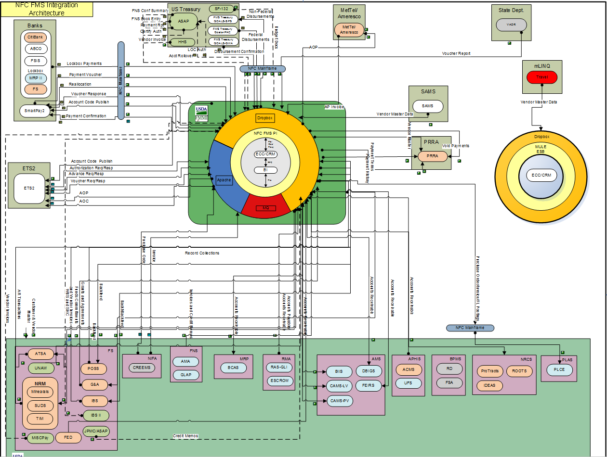
Interface Landscape Overview

Slide 8
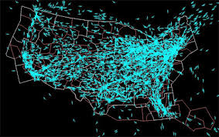
Interface Landscape Overviewc

Slide 9
Interface Management Overviewd
POINT
A
INTERFACE
PROGRAM
POINT
B

Slide 10
Interface Management Overviewe
Multiple
INTERFACE
PROGRAM
POINT
B
POINT
A
Multiple Programs for
One Interface

Slide 11
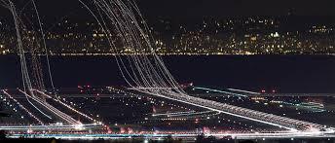
Interface Landscape Overviewf
* Successfully processed over 15.2 million messages for FY2017
* Disbursed over 6.6 Billion Dollars for FY2017
* Have over 175 interfaces controlled through 390 various PI Channels

Slide 12
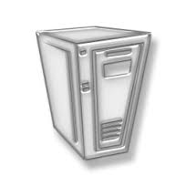

Types of Interfaces
Batch Processing (Batch Jobs/Files/Multiple Transactions)
  Components of Batch Jobs
    SAP ABAP Programs
    UNIX/Windows Scripting
    Batch Job Schedules
    Dependent Schedules
    Multiple File Transfer Platforms
      SFTP
      FTP
      Connect Direct

Slide 13

Types of Interfacesa
Real Time (Transactional)
  Components of Real Time Interfaces
    Web Services
    Proxy
    JMS
    SOAP
    HTTP
    AXIS
    MQ

Slide 14
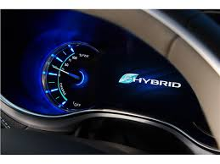

Types of Interfacesb
Hybrid (Combination of Batch and Online)
  SFTP Batch File to IDOC’s Connections
  SFTP Batch File to Proxy Connections
Endpoint Applications
  Interface Partners
  Accounting Systems (FMMI)
  Data Warehouse

Slide 15
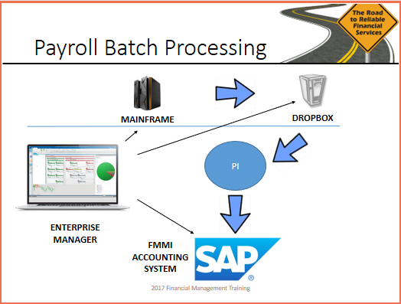
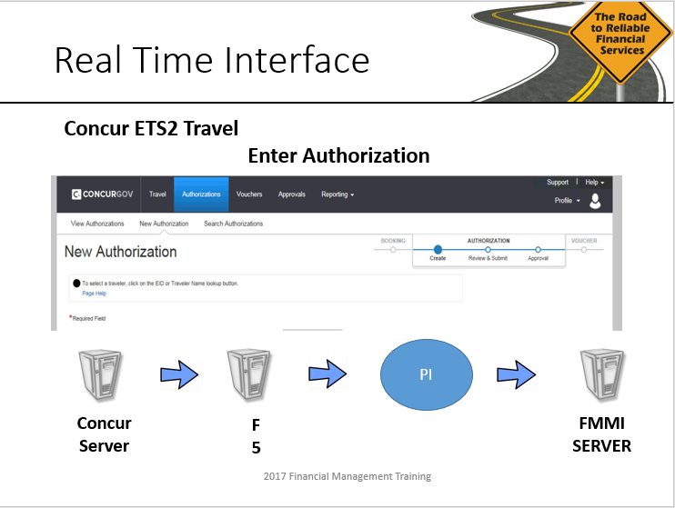
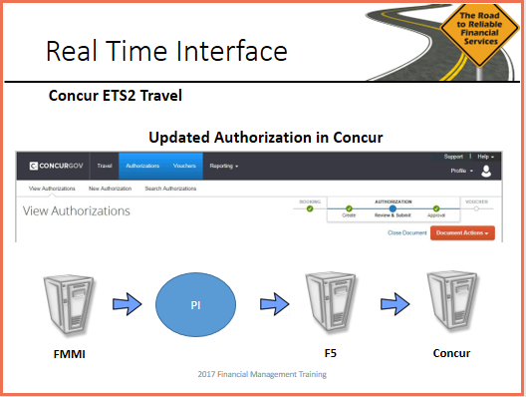
Types of Interfacesc
  Examples:

Slide 16
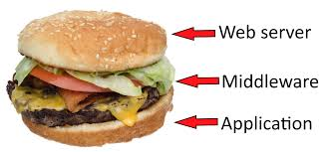
Middleware/Monitoring Tools
What is Middleware?
  Middleware is software that lies between an operating system and the applications running on it.
  Middleware is software that lies between two or more application software systems.
  Middleware monitoring tool is software that monitors and controls software from a central location.

Slide 17
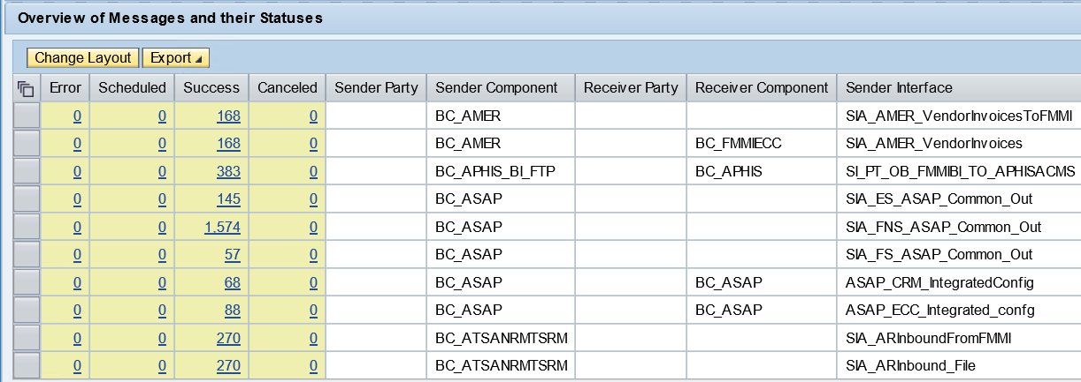
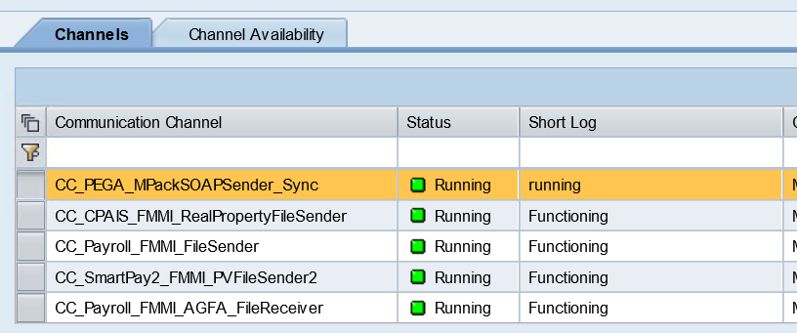
Middleware/Monitoring Toolsa
ECC
Drop Box
Interface Partner
BI
PI
CRM
Third Party software
  SAP Process Integration (PI) V7.3-Enterprise Server Bus
    * Central Point for Incoming and Outgoing Interface
    * Directs Interfaces to their Proper Destination
    * Monitors Interface Traffic (Online and Batch)

Slide 18
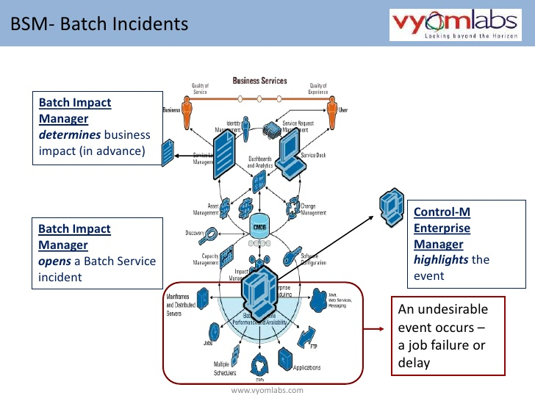
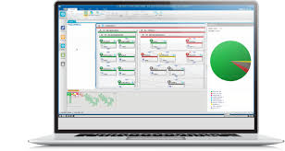
Middleware/Monitoring Toolsb
  Enterprise Manager
    Manages, Submits and Monitors Batch Jobs
    Communicates Across Multiple Platforms
    Notifies PI when Data is Ready to Process

Slide 19




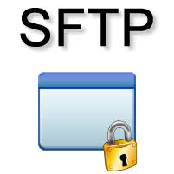
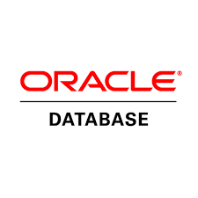
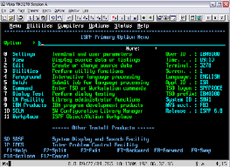

Middleware/Monitoring Toolsc
  Operating System Monitoring Tools
    Unix
    Windows
    SAP Tools/Oracle/Hana/Mainframe/SQL
    SFTP/Connect Direct

Slide 20


Middleware/Monitoring Toolsd
End Point Applications
  SAP FMMI Accounting System
  Interface Partners
  Financial Reporting Systems

Slide 21
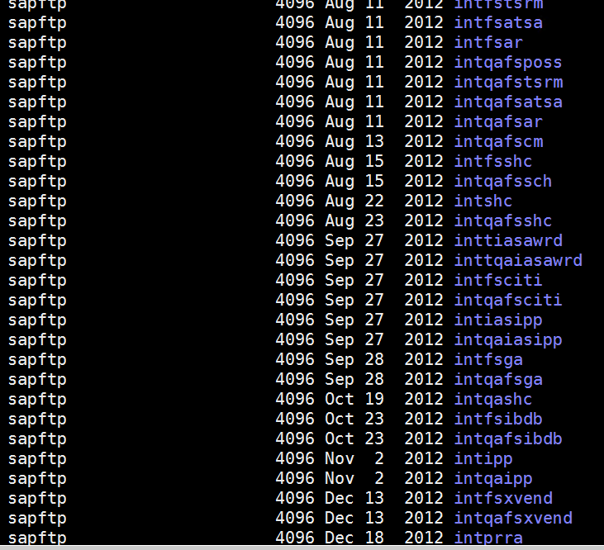

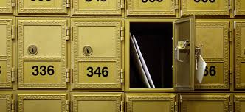
Middleware/Monitoring Toolse
What is the Drop Box?
  Just a server (Unix/Windows/Etc.)
  Like the mail box on your curb or a PO Box
  Sits in the DMZ (De-militarized Zone) for Security Reasons

Slide 22
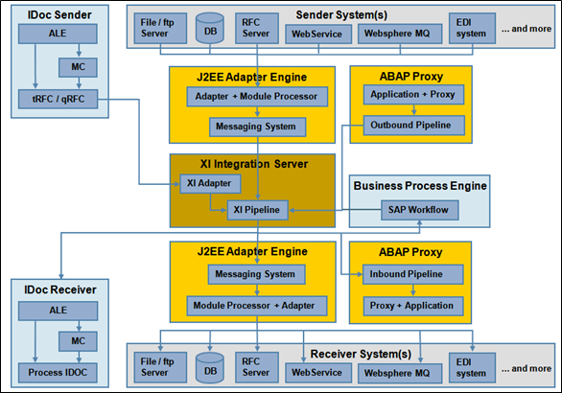
FMS Interface Landscape

Slide 23
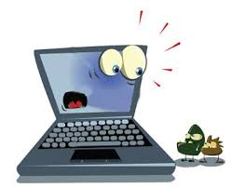
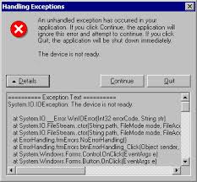
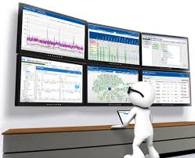
Error Handling/System Validation
Types of Errors
Finding and Addressing These Errors
System Monitoring

Slide 24
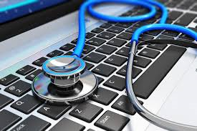
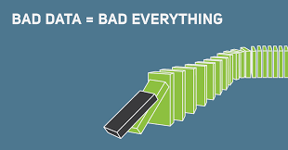
Error Handling/System Validationa
Type Errors
Technical Errors (Batch/Online)
* Job Failures
* Network Errors
* System Errors
* System Assurance Edit Check
Functional Errors
* Bad Data
* Out of Balance Conditions
* System Assurance Edit Check

Slide 25

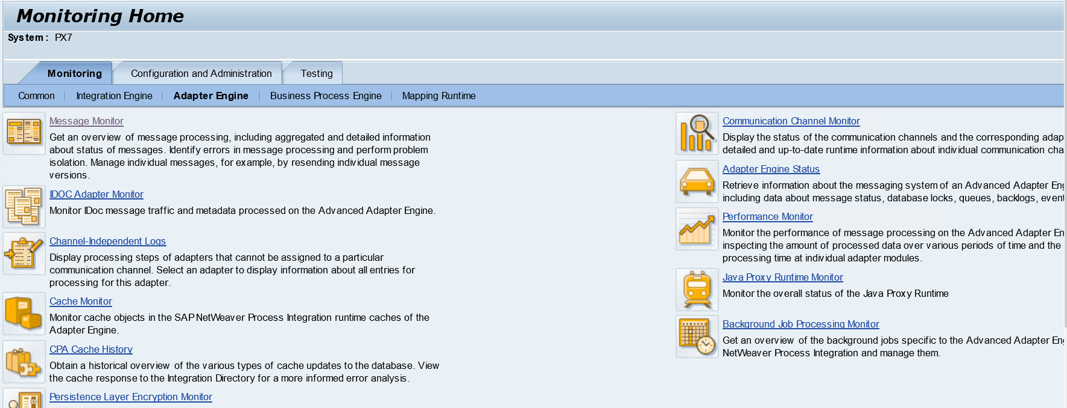
Error Handling/System Validationb
Daily Monitoring
Email Notification
* PI Notifications (Batch/Online)
* Enterprise Manager
* Batch Job
* System Notifications
Monitoring
* Enterprise Manager
* SAP Alerts/RFC Inbound Queues
Process Integration (PI)
ECC
CRM

Slide 26

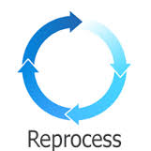

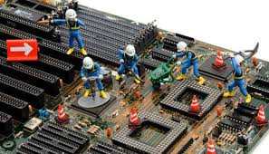
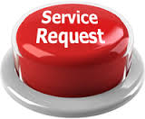
Error Handling/System Validationc
Special Processing
* User Request
* Interface Partner Request
* Special File Processing
* Special Job Processing
* Reprocess Corrected Data
* Year End Request
* Down for Maintenance

Slide 27



Cross Landscape Processing
Cross Landscape Processing
* Program in SAP applications needs data from from various SAP and non SAP Applications
* Example: PE1 needs data from PC1 (CRM)
* As Opposed To: In and Out of SAP
* Will need programs in each application
* Will need batch jobs in each applications

Slide 28
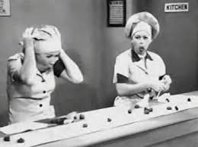
Let Her Roll!!!

Slide 29
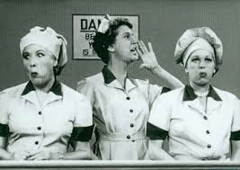
Let Her Roll!!!a

Slide 30
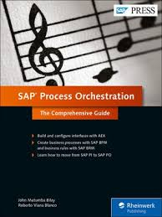
SAP PO To The Rescue
SAP Process Orchestration

Slide 31
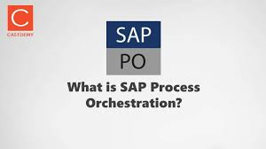
Process Orchestration

Slide 32
Process Orchestrationb
SAP PI/PO (Process Integration/Process Orchestration) is a tool that allows you to integrate solutions. It makes it easy to synchronize data between different systems. Let's say you are using the SAP ERP system, and you wish to integrate with the CRM system.
Work becomes easier and more hassle-free if developers and organizations have one tool that can be used for a variety of different integrations, as opposed to several divergent tools being used for smaller tasks.

Slide 33

Process Orchestrationc
PE1
PC1
PJ1
PB7
ERP
PX7
Drop Box
Non SAP
Data Directed To A Particular Server
Driven By Multiple Programs and Jobs

Slide 34
Process Orchestrationd
PC1
PJ1
PE1
PB7
Inbound
ERP
PX7
DB
Non SAP
Outbound
Data Transfer Between Servers
Internal and External
One Program

Slide 35

Process Orchestratione
ECC
CRM
  PE1 to CRM to PE1 Interface
    File created by CRM for PE1
    File created by PE1 for CRM
    Develop separate programs in PE1 and CRM
    Develop PI channels for each
    Develop separate batch jobs in PE1 and CRM
    Proper timing for each step in this process

Slide 36

Process Orchestrationf
ECC
CRM
  PE1 to CRM to PE1 Interface
    File created by CRM for PE1
    File created by PE1 for CRM
    Develop separate programs in PE1 and CRM
    Develop PI channels for each
    Develop separate batch jobs in PE1 and CRM
    Proper timing for each step in this process

Slide 37
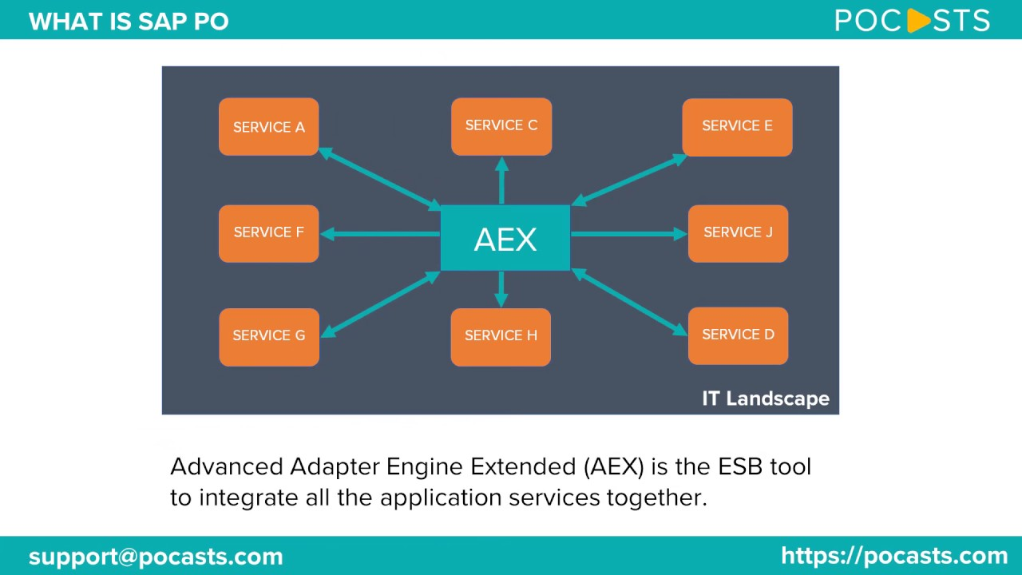
Process Orchestrationg
ECC
CRM
  PE1 to CRM to PE1 Interface
    One program written in PE1
    PO using API’s will access the necessary data in CRM
    One program developed along with PI channels
    Streamline development and production process

Slide 38
Process Orchestration/API’s
  API’s - What are They?
    Application Programmer Interface
    Been around since the 1960’s
    In computer programming, an application programming interface (API) is a set of subroutine definitions, protocols, and tools for building application software
    IBM Assembler Class “Assembler Programming Language”
      by Kevin Mudd copyrighted 1977

Slide 39
Process Orchestration/API’sh
How Does PO Use API’s?
    API libraries in each SAP Application
    PO uses the API libraries tied to a function to setup the connection for the application program
    A PO Function called by a Application Program will gather the pre-defined data in the AP for the pre-defined application.
    PO can control the application process and pass data defined by the API tied to that process.

Slide 40
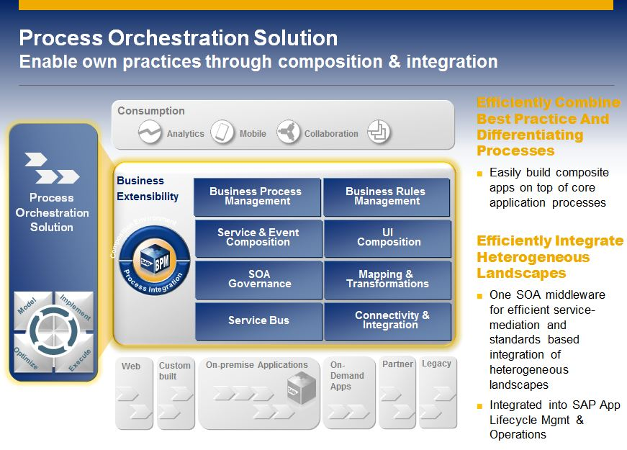
Process Orchestrationi

Slide 41
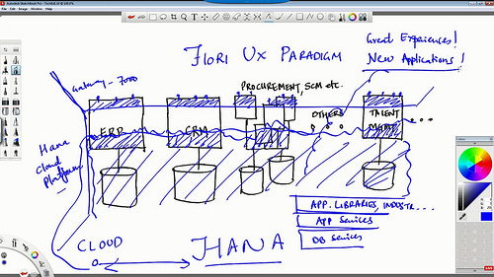
Process Orchestrationj

Slide 42
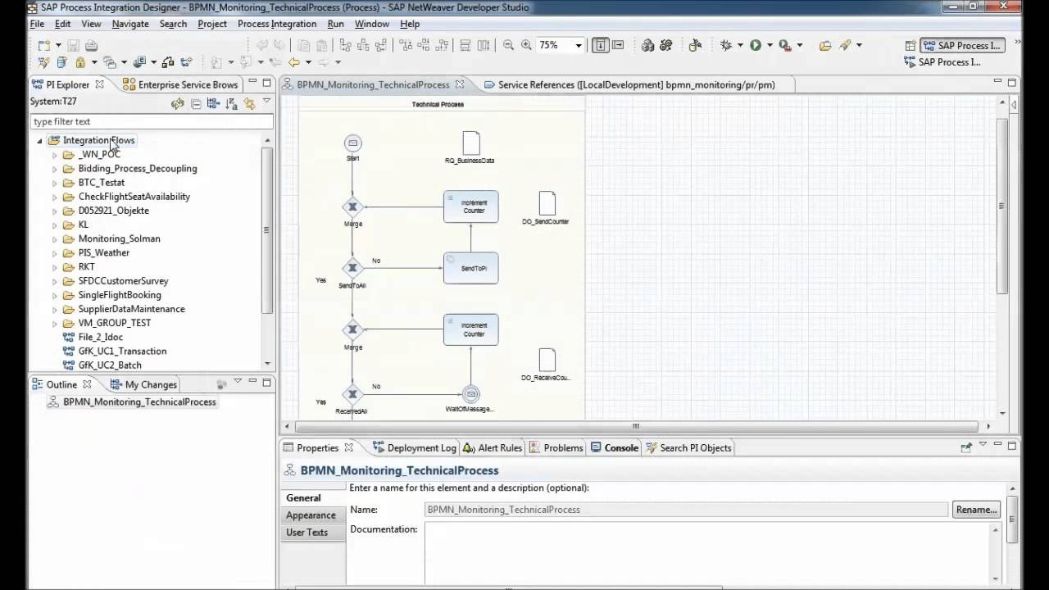
Process Orchestrationk
SAP Process Orchestration
Proces Control
Data Flow

Slide 43
Process Orchestrationl
SAP Process Orchestration
Process Control
Data Flow
SAP Process Orchestration
Process Control
Data Flow

Slide 44

PO/PI Release 7.5
New Features
  Process Orchestration
    SAP’s new concept of integrating their applications under one umbrella
    Streamlining communications across the enterprise SAP landscape
  Runs on HANA along with other SAP applications
  Improved Java performance
  Develop iFlows/Interface Configuration on Eclipse tools
  Supported Eclipse 4.4
  Dual Stack support is obsolete for SAP PI
  ESR mapping improvements
  ESR Drag and Drop Features
  Error Handling improved
  PI Monitoring Enhancements
  Improved CTS Object exporting
  Additional Attachment Capabilities
  On-premise and HANA Cloud Deployment (HCI) available

Slide 45
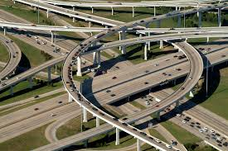
Summary
Interface Management team has processes in place to handle today’s most complex landscape spreading across multiple platforms and systems.
Compatible to connect with any system platform not just SAP

Slide 46
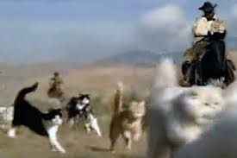
Summary

Slide 47
Acronyms
API - Application Programmer Interface
AXIS - Security Framework feature of SOAP
BI - Business Intelligence
CRM - Customer Relations Management
ECC - Enterprise Resource Planning (ERP) Central Component
ETS2 - Concur Travel System
FMMI - Financial Management Modernization Initiative
F5 - Network Security Configuration
HTTP - Hypertext Transfer Protocol
IAS - Integrated Acquisition System
JMS - JAVA Message Service
MQ - IBM’s Message Oriented Middleware
PI - SAP Process Integration
PO - Process Orchestration (SAP)
SAP - Software Vendor
SFTP/FTP - Secure File Transfer Protocol /File Transfer Protocol
SOAP - Simple Object Access Protocol
RFC - Remote Function Call
XML - eXtensible Markup Language

Slide 48


Questions/Comments

