Slide 1
OCFO Process Robotics
Automating transactional work to empower valuable labor and improve operational efficiency
USDA FMMI Demo

Slide 2
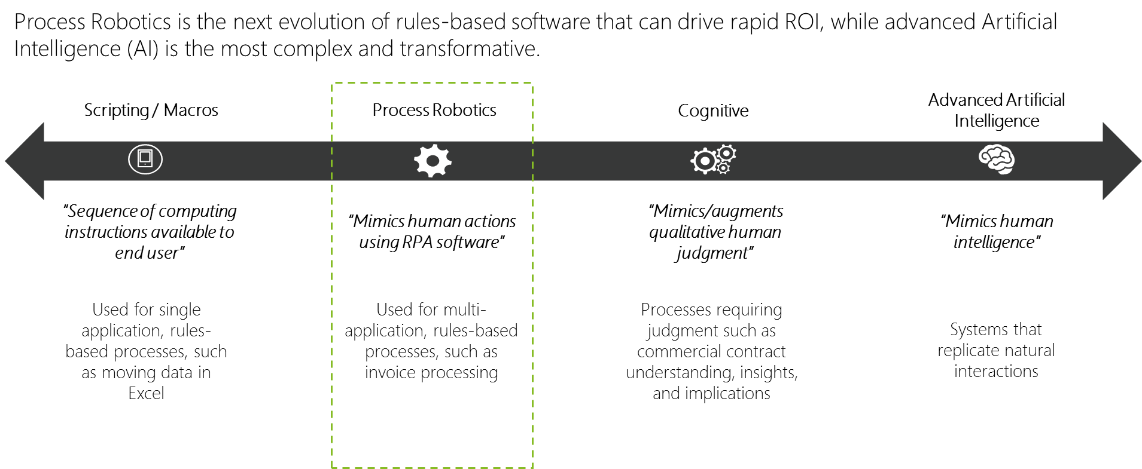
Process Robotics is one point on the AI spectrum

Slide 3
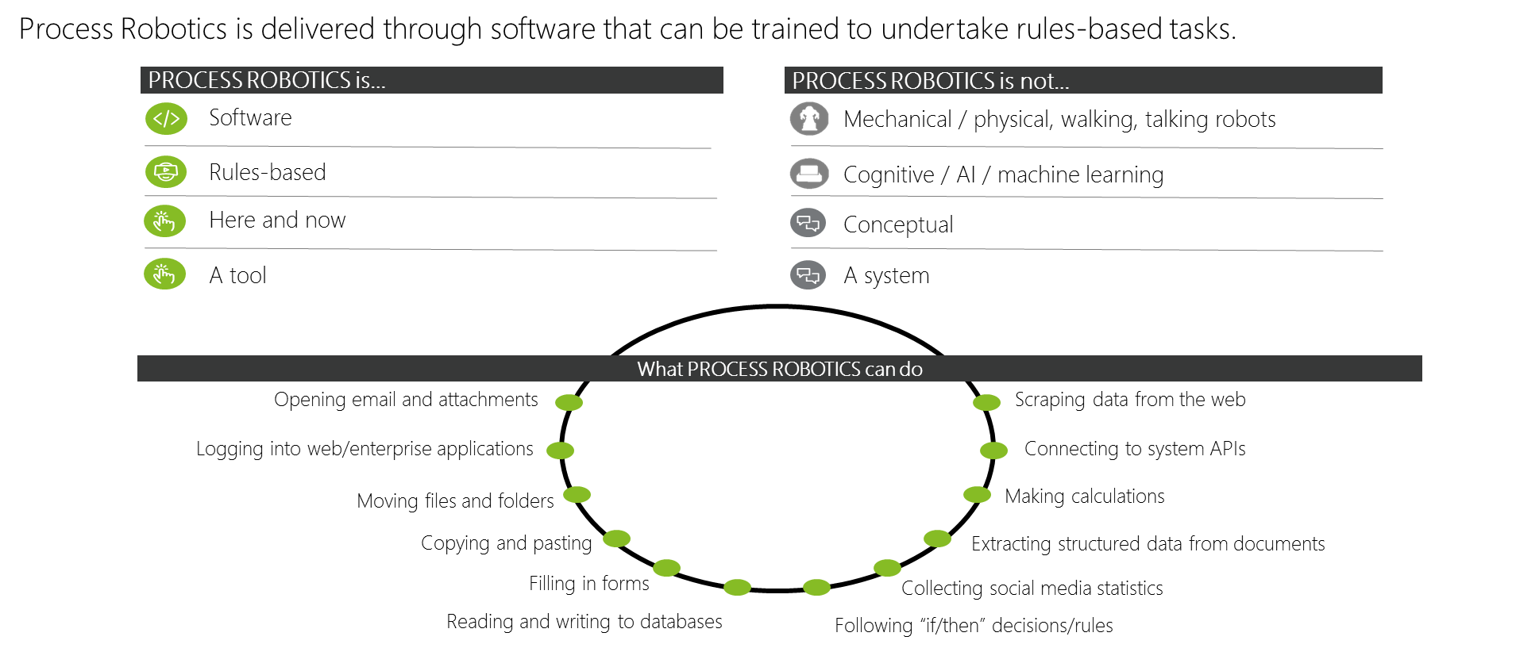
Process Robotics…what it is & isn’t

Slide 4
The ‘Total Workforce’ of today…
We want to focus on high value work…
…but there is so much low value ‘data collection’ work that needs to take place before we can get to the higher value ‘data user’ activities.
The amount time spent on low value work limits the amount of time available for analysis and innovation…
Agency Leadership
Mounting issues… compliance, backlog, not enough staff, overtime, excessive contractor spend…
Contract Support
Government Staff
Time spent on work
Represents ‘human workforce’
Transactional / Low Value
Value of work
Judgement / High Value

Slide 5
The ‘Total Workforce’ of tomorrow…
As the newest member of the ‘Total Workforce’ I can handle all rules-based computer tasks (low value work)
Freed from low-value work, we can spend more time analyzing data, making informed decisions, and innovating!
Agency Leadership
No Collar
‘Digital Employee’
Government Staff
Contract Support
Shifting workforce to higher value work
Time spent on work
Represents RPA ‘digital workforce’
Represents reallocation
of human workforce
Transactional / Low Value
Value of work
Judgement / High Value

Slide 6

Bots in Action
Bots in Action

Slide 7
Evaluation Criteria
Processes are evaluated against eight criteria for Process Robotics automation potential:
Criteria | Description
Number of Systems Used | Process should typically require employees to access multiple independent systems to complete the process.
Transaction Volume | Process has high-volume transactions, but candidates for automation are not limited by this. Any process that is labor intensive, time-consuming, or has high-cost error impacts qualifies.
Prone to Errors or Rework | Process involves manual activities which may result in errors due to human operator mistakes (e.g. complexity of work).
Process Predictability | Process needs to be defined by a set of unambiguous business rules.
Rules Based Exception Handling | Processes with few exceptions in delivery are excellent candidates in the beginning. With experience, there is potential to expand to processes that are more complex or error prone.
Manual Work Involved | Process should have little automation support today and large amounts of manual work.
System Upgrade Timing | Process should be avoided if it interacts with a system scheduled for a major planned upgrade within 6 months. Major upgrades beyond minor enhancements need to be planned for in order to prevent rework.
Controls Importance | Process is high-risk or has sensitive data that requires strong oversight and set of internal controls.

Slide 8
OCFO Process Robotics Overview
The project kicked off at the end of September 2017 and key USDA stakeholders were identified: OCFO Budget and OCFO Pegasys
Initial meetings were conducted with each stakeholder group.
  OCFO Budget – Two processes were identified for automation (Direct Authority and Reimbursable Authority Funds Distribution)
  OCFO Pegasys – The four processes were identified for automation (Treasury Daily Cash Files, User Separations, Cost Transfers, RWA Surcharge Adjustments)
Meetings with process owners for each of the six automations were conducted and the Process Design Documents (PDDs) were completed incrementally, from October – January.
UiPath was selected as USDA’s tool in January 2018 and development has begun in the FMMI pre-production environment.
Currently, UiPath is in the software approval process to obtain authority to test (ATT) and authority to
operate (ATO).

Slide 9
Process Robotics Next Steps
Complete the initial Budget and Pegasys automations
Support full ATO of the UiPath software
Begin to identify additional processes to be automated
Identify the path forward for USDA, and the potential for robotics at the Agency level

Slide 10
Questions?
Q & A

