Slide 1
ezFedGrants: The OneUSDA Grant Solution
Presented by Chris Coppenbarger

Slide 2
Overview
Background
  Evolution
Grants Strategic Plan
  Mission
  Vision
  Goals
Grants Management Services (LoB)
  Description of Services
  Operational Plan
Major Projects
  IAA
  FS

Slide 3
How Did ezFedGrants Begin?
ezFedGrants (eFG) is an outgrowth of the e-Government initiative and the Lean Six Sigma Grants Process (LSGP) Project
OCFO and FAS embarked on a pilot called Grantor
Gradually, from a grass-roots beginning, Agencies began to use eFG
eFG has evolved into a Line of Business and is offered internally through OCFO/FMS

Slide 4
USDA Grants Mission
The USDA Grants Management Program mission is to provide guidance and leadership in the areas of program management, governance, grants and agreements policy, and information technology
eFG encompasses OneUSDA agencies and includes Catalog of Federal Domestic Assistance (CFDA) and non-CFDA programs, and transforms USDA’s grants and agreements processes
The program supports myriad federal initiatives, such as school lunch programs, homeownership opportunities to low and moderate income rural Americans, Organic Agriculture, and other grant and agreement making programs to better serve the American public

Slide 5
USDA Grants Vision and Goals
Vision:
To have all USDA grants and other agreements administered within the ezFedGrants (eFG) system, which would include:
  Approximately 253 CFDA programs across 17 grant making agencies
  All Interagency Agreements (buy/sell transactions) across 29 agencies
  Over $125 billion per year transaction volume
    Goals:
  Meet stakeholder expectations
  Ensure all financial data is reliable, complete, and timely
  Compliance with applicable laws/regulations
  Operate in a secure environment for maximum integrity
  Bolster internal controls and efficient program activities/operations
  Add new transaction types as more agencies come into the system
  Continuous process improvements and enhancements

Slide 6
What is ezFedGrants?
Pre-Award
Award
Post-Award
Closeout
Financial Audit
ezFedGrants (eFG) - A comprehensive grants and agreements management solution that gives agencies within OneUSDA and recipients, such as farmers and ranchers, the ability to manage their awards throughout the entire lifecycle of the award.
Solicitation
Application
Evaluation
Commit Funds
Electronic Signature
NOAs
Obligate Funds
Payments
Financial Reports
Performance Reports
Amendments
Deobligate Remaining Funds
A-123 Audit
Reporting

Slide 7
Benefits of ezFedGrants
  Improved Customer Focus, 24/7 Access
  Improved Operational Visibility
  Increased Efficiency
  Lower Complexity
  Enhanced Program Compliance
  Improved Accountability & Transparency
  Integrates with SAM.gov, Grants.gov, ASAP, and ITS

Slide 8

ezFedGrants Capabilities
Single Enterprise System Offering:
  Streamlined workflow that increases speed of transactions
  Scalability
  Ensured compliance with rules and regulations
  Financial integrity
Multiple Transaction Types
  Grants
  Repayments
  SF-270 Advance and Reimbursement Payments
  Memorandums of Understanding (MOUs)
  Collection Agreements
End-to-End Support to Recipients and Awarding Agencies

Slide 9

OneUSDA Strategic Goal #1
Ensuring USDA programs are delivered efficiently, effectively, with integrity, and a focus on the Customer.
ezFedGrants Contributions:
Efficient
Comprehensive Solution
Complex process is streamlined and automated
Effective
Standard business processes across USDA
Reduces Unliquidated Obligations
Increases Visibility
Integrity
A-123 Audit
Reporting, including DATA Act
Enforce compliance of regulations
Customer Service
Recipients can securely and timely manage their OneUSDA portfolios
Payments made quickly
Deputy Secretary Censky IT Goal: Improve the USDA customer experience by delivering all new Farm Bill programs online and creating online service portals that are easy-to-use, include additional self-service capabilities, and integrate data for common customers.

Slide 10
Customer Support Services
OCFO Provides End-to-End Customer Support to ezFedGrants Users
★ Both Recipients and Awarding Agencies 
Tier 0 Help Desk Support
WikiGrants Self Service Center
On-Demand and Scheduled
Training
Train-the-Trainer
Change Request Management
Project Management
Knowledge Management
Governance Board Coordination
Customer
Outreach

Slide 11
ezFedGrants Tier 0 Help Desk
Services both internal and external users
Receives, troubleshoots, responds to end-user questions
Log, track, and determine the best course of action for service requests
WikiGrants - www.tinyurl.com/Wikigrants
The Help Desk business hours are 8:00 am – 6:00 pm EST, Monday through Friday: ezFedGrants@cfo.usda.gov email address

Slide 12








Current eFG Customers
Current ezFedGrants Agencies:
Next Up:
Inter-Agency Agreements
&
CRM only

Slide 13
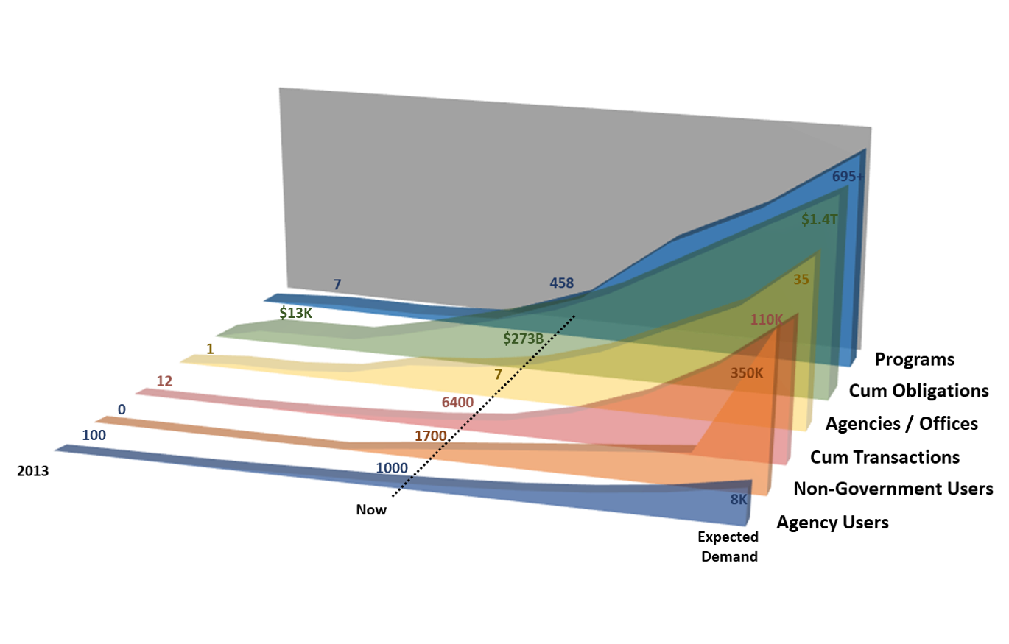
Where Is OneUSDA Headed?

Slide 14
Major Projects:
Interagency Agreement (IAA)
Interagency Agreements (IAA)
  An IAA is a written agreement entered into between two Federal agencies for buy/sell transactions (e.g., Economy Act)
  Includes both IPAC and INTR transactions
Forest Service Grants and Agreements
  Start with Pilot during release 1

Slide 15
IAA Implementation Strategy
Two major project phases:
  Capture requirements (currently finalizing)
  Design, build, test, deploy
Leverage the eFG Community and Grants Governance Board

Slide 16
Benefits of IAA in ezFedGrants
Prevent Audit Findings
  Many audit findings are a result of the lack of documentation and process controls throughout the IAA life-cycle.
    eFG is repository for key documents
    IAA residing within ezFedGrants allows for all steps in the process to be recorded providing an audit trail that is accessible 24 hours a day 7 days a week to both the servicing agency and customer agency
Improves Transparency
    Same data access to buyer and seller
    System audit roles
    Comprehensive reports covering transactions, statuses, performance, etc.

Slide 17
Benefits of IAA in ezFedGrantsa
Maximizes System Integration
  FMMI ECC, Treasury IPAC, Grantor CRM, and Pega Portal
  IAAs can be tied to other instruments: Grants and Agreements, MOUs, IPAC, INTR
Manages Full Agreement Life Cycle including flexible workflow
Utilizes 7600 A and B Forms, including amendments
Allows Electronic Signature

Slide 18
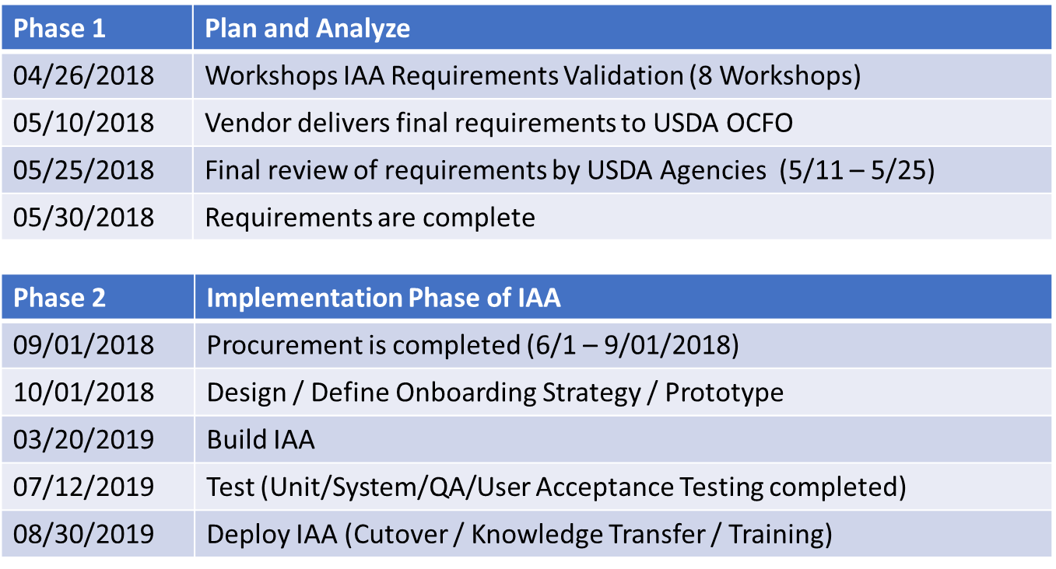
IAA Notional Timeline

Slide 19

Questions?

Slide 20
Backup Data
Category | Past (2013) | Present (end of 2017) | Future (2022+)
Agencies | 0 | 7 | 35 in USDA w/IAAs, 17 Grant Making
Programs | 6 | 458 (73+ CFDAs) | 695 +
Transaction Volume (Agreements/Awards) | 230 | Over 6,000 (cumulative from 2013) | 40,000
Obligation Amounts | $31,000 | $275 billion (cumulative from 2013) | $200 billion transactional funds processed annually
USDA Users | 100 | 1,058 | 8,000 – 10,000
Recipient Users | 0 | 1,700 adding 28/week | 350,000 (70k vendors x 5 POCs)
Help Desk Tickets | 0 | 200 per month/10 per day | 1,286 per day/ 1 ticket per 280 Users
Transaction Type Portfolio | 4 | 7 | 30+
Staffing | 0 | 5 | 40-70

