Slide 1
Federal Acquisition Service
GSA SmartPay® Charge Card and Related Payment Services Update and Transition Overview
USDA Financial Management Training
David J. Shea, CPCM, PMP
Director, Center for Charge Card Management (CCCM)
May 21, 2018

Slide 2
Meeting Agenda
GSA SmartPay Program Overview
GSA SmartPay Card Usage
Spend & Refunds Since Inception
FY17 Spend and Transaction Trends
FY18 YTD Spend and Transaction Trends
GSA SmartPay 3 Transition
Micro-Purchase Increase
Procurement through e-Commerce Portals
Recent Issues Wrap-Up
2018 SmartPay Forum
Mobile App
Questions

Slide 3
GSA SmartPay Program Overview
CCCM leads and manages the overall GSA SmartPay Program, the world’s largest government charge card and related payment services program, serving more than 560 customer agencies and organizations around the globe.
GSA SmartPay payment solutions were unanimously nominated and are designated by OMB as Best-in-Class, helping agencies achieve the following:
Streamlining procurement, travel, fleet management, and related payments
Use of strong, modern controls and commercial transaction data
Agility in supporting mission support needs
Obtaining commercial payment solutions at no up-front cost
Earning refunds based on use and speed of payment

Slide 4
GSA SmartPay Card Usage
GSA Schedule contractors are required to accept the GSA SmartPay purchase cards within the Micro-Purchase Threshold (MPT).
If a contractor already accepts credit cards for commercial business, there are no additional steps to take to accept GSA SmartPay payment solutions.
GSA SmartPay account holders may use the following brands: VISA, MasterCard, Voyager, and Wright Express. Voyager and Wright Express cards may only be used for fleet related purchases. (Branding is agency task order dependent.)
Traditional card payments ecosystem
Networks
Issuing Bank
Acquiring Bank
Processors
Consumer
Merchant

Slide 5
Spend & Refunds Since Inception
Since inception, GSA SmartPay has enabled over $489B in total spend through 1.68B transactions, generating over $3.7B in agency refunds.
GSA SmartPay 1 Begins
GSA SmartPay 2 Begins
Fleet: $26B
Travel: $137B
Purchase: $325B
Agency Refunds

Slide 6
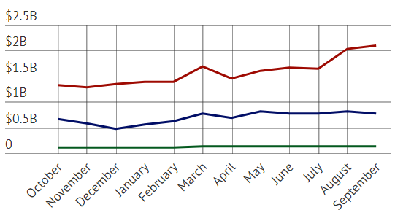
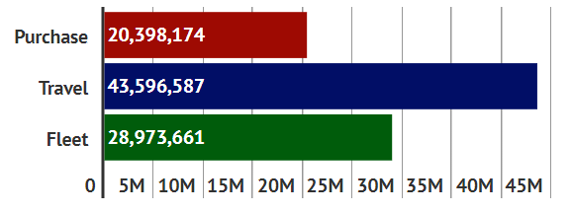
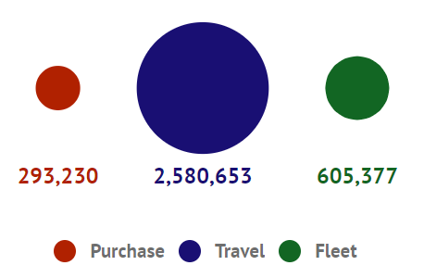
FY17 Government-Wide Spend & Transaction Trends
Spend
Total Spend:
$28.6B
▲0.29% vs. FY16.
Total Transactions:
93M
▲1.4% vs. FY16.
Transactions
Accounts

Slide 7
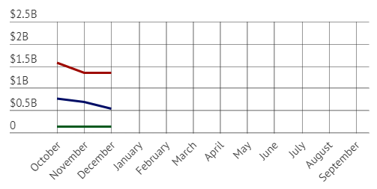
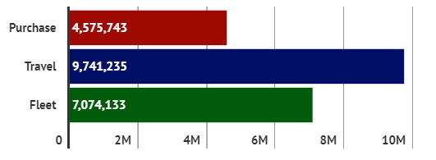
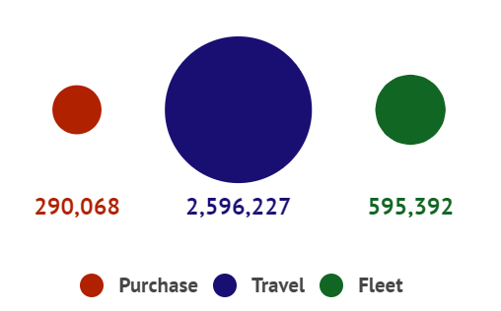
FY18 Q1 Government-Wide Spend & Transactions
Spend
Total Spend:
$6.56B
▲9.5% vs. FY17 YTD.
Total Transactions:
21M
▲4.2% vs. FY17 YTD.
Transactions
Accounts

Slide 8
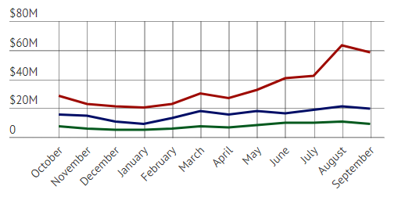
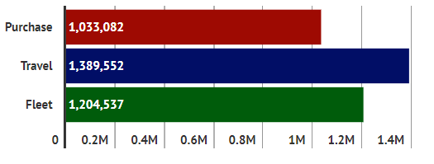
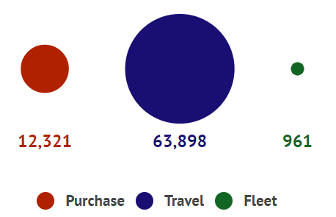
FY17 USDA Spend & Transaction Trends
Spend
Total Spend:
$685M
▲2.6% vs. FY16.
Total Transactions:
3.6M
▼0.5% vs. FY16.
Transactions
Accounts

Slide 9
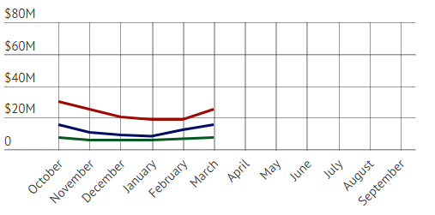
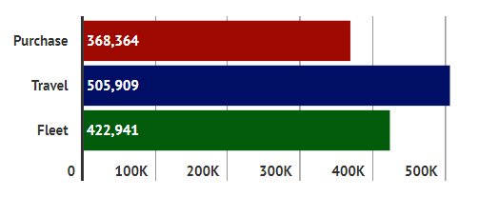
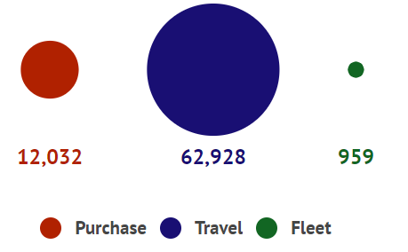
FY18 Q2 USDA Spend & Transaction Trends
Spend
Total Spend:
$245M
▼5.8% vs. FY17 YTD.
Total Transactions:
1.3M
▼10% vs. FY17 YTD.
Transactions
Accounts

Slide 10
Agency SP3 Notional Transition Timeline
FY18
FY19
Transactional Period of Performance Begins
Nov 30, 2018
Agency TO Post-Award Implementation
Apr 2018 thru Nov 29, 2018
Q1 FY18
Q2 FY18
Q3 FY18
Q4 FY18
Q1 FY19
Agencies identify program needs & write Task Order (TO) Requirements
Through Dec 2017
Continuous updating of CCCM Transition Tracking Tool
Notes:
*Note: agencies should not wait for these dates, can (and should) begin processes early.

Slide 11
GSA SmartPay 3 Basics
The GSA SmartPay 3 Master Contract is a Multiple Award, Indefinite Quantity, Indefinite Delivery (ID/IQ) task order type contract.
Awarded to Citibank and US Bank
Transactional period of performance begins November 30, 2018
Base period from November 30, 2018 to November 29, 2022
Option period 1 from November 30, 2022 to November 29, 2025
Option period 2 from November 30, 2025 to November 29, 2028
Option period 3 from November 30, 2028 to November 29, 2031
Different types of Task Orders/”access lanes”, depending on agency needs -- USDA using tailored task order approach

Slide 12
GSA SmartPay 3 vs. GSA SmartPay 2
The GSA SmartPay 3 Master Contract contains significant new opportunities for customer agencies to improve their programs and maximize card and cardless payment solutions.
GSA SmartPay 3 includes Tier 1 (Required) and Tier 2 (Optional) products and services as outlined in Sections C.3.1.1 and C.3.1.2 of the master contract.
Significant new/revised Tier 1 required offerings include: large ticket, ePayables - Supplier-Initiated Payments (SIP), GSA SmartPay Tax Advantage Travel Card Accounts, Mobile Payments, and Non-Interchange Based Government-to-Government transactions.
More information on the differences between the GSA SmartPay 2 and GSA SmartPay 3 Master Contracts can be found in the Master Contract Updates Quick Sheet, Frequently Asked Questions, and ePayables and Tax Advantage Card handouts at: https://smartpay.gsa.gov/content/resources#sa797

Slide 13
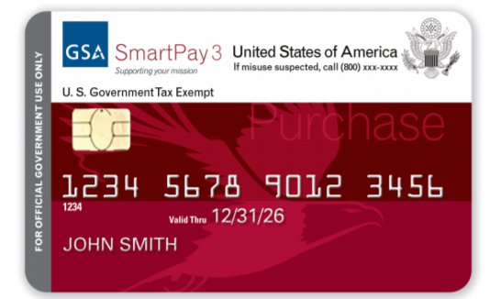
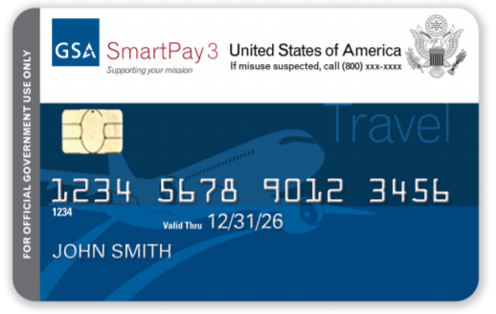
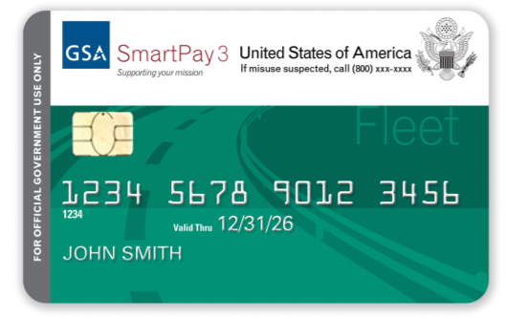
GSA SmartPay 3 Tier 1 Products and Features
All Business Lines | Purchase | Travel | Fleet
24-hour EAS Customer Service Accounts Payable File Review Association Program Management Tools Chip & PIN / Signature Cards Email / SMS Alert Service ePayables - Supplier-Initiated Payments (SIP) Ghost Card Interchange-Based Government-to- Government (G2G) Transactions Mobile Applications Mobile Payments Net Billing Non-Interchange based Government-to- Government (G2G) Transactions Real-Time Web Assistance Single Use Account (SUA) Tokenization Virtual Cards | Convenience Checks Declining Balance Cards Foreign Currency Cards | ATM Access Declining Balance Cards Foreign Currency Cards GSA SmartPay Tax Advantage Travel Card Account | No additional business line-specific Tier 1 products or services

Slide 14
Micro-Purchase Increase
In accordance with the Federal Acquisition Regulation (FAR), the GSA SmartPay Purchase payment solution is the preferred method to purchase and pay for micro-purchases (FAR Part 13.201). For purchases above the micro-purchase threshold, the purchase solution may be used as an ordering and payment mechanism. Last year, over half of government-wide spend was above the micro-purchase limit at the time of $3,500. On December 12, 2017, the FY18 NDAA was signed into law, increasing the micro-purchase threshold to $10,000.
FY18 National Defense Authorization Act (NDAA)*:
SEC. 806. REQUIREMENTS RELATED TO THE MICRO-PURCHASE THRESHOLD.
(a) Increase In Threshold.—Section 1902(a)(1) of title 41, United States Code, is amended by striking “$3,000” and inserting “$10,000.”
FAR Part 13.301 - Governmentwide commercial purchase card:
(c) The Governmentwide commercial purchase card may be used to—
(1) Make micro-purchases;
(2) Place a task or delivery order (if authorized in the basic contract, basic ordering agreement, or blanket purchase agreement); or
(3) Make payments, when the contractor agrees to accept payment by the card.

Slide 15
Evolution of Increased Flexibility
The first MPT was established in 1994 through the Federal Acquisition Streamlining Act (FASA)
Since that time, the “routine” MPT has been adjusted four times
Additionally, multiple MPTs were created to address specific purchasing activities or conditions
FAR 13.301(b) also states that agencies may not limit card use to micro-purchases
Authority (Note: Lower thresholds apply to acquisitions subject to the Service Contract Act ($2,500) and Davis Bacon Act ($2,000)) | Agency Threshold
FY 1994 - FASA | $2,500
FY 1998 – Stafford Act; Contingency Prep and/or Response Except Construction | $20,000 w/in U.S. $30,000 outside U.S.
FY 2010 – FAR Economic Threshold Adjustment | $3,000
FY 2015 – FAR Economic Threshold Adjustment | $3,500
FY 2017 – NDAA; Increase in DoD MPT (DoD Only) | $5,000
FY 2017 – NDAA; Institutions of Higher Education (DoD & Civ) | $10,000 or as determined by head of institution
FY 2018 – NDAA Section 806 (Civ only) | $10,000
Proposed for e-commerce portal (approved commodities only) | $25,000

Slide 16
Procurement Through e-commerce Portals
Section 846 of the FY 2018 NDAA requires the GSA to establish a program to enable procurement through commercial e-commerce portals.
The NDAA specifies the program will be carried out through multiple contracts with multiple commercial e-commerce portal providers.
The program will be implemented in phases with the objective of enabling Government-wide use of portals.
In January 2018, GSA held an industry and stakeholder town hall style meeting with representatives from Amazon Business, Overstock.com, Staples, Ability One, and more.
In March, GSA released its “Procurement Through E-Commerce Portals Implementation Plan.” This plan proposes increasing the MPT to $25,000 for commodities acquired through the approved marketplace.

Slide 17
Recent Issues Wrap-up
Transition Best Practices (selected)
A/OPC keeps transition tracker up-to-date – even post TO award
Ensure master file is updated – not a one-time shot
Interfaces – complete requirements & testing (incumbent?)
Consider new payment solutions
A/P File review – no added bank cost to perform
DODIG purchase and travel card metrics and confirmed violation reporting (refer to the GSA SmartPay Audit Repository for a link to the audit at: GSA Smart Pay Link .
Data Management Group – Agency HQ participation
OMB A-123, Appendix B Revision – In OMB clearance process
Kaspersky Labs “Use” prohibition – FY18 NDAA Section 1634 - Effective October 1, 2018
Industry trends – Goodbye to signatures? (Merchant dependent)

Slide 18
Recent Issues Wrap-Up (Continued)
NDAA Title XVIII required agency reports:
(b) AGENCY REPORTS AND CONSOLIDATED REPORT TO CONGRESS — Not later than one year after the date of the enactment of this Act, the head of each Federal agency described in section 2 of the Government Charge Card Abuse Prevention Act of 2012 (Public Law 112–194) shall submit a report to the Director of the Office of Management and Budget on that agency’s activities to implement this title. (Emphasis added)

Slide 19
GSA SmartPay
Visit the GSA SmartPay Training Forum’s website at
www.gsasmartpayforum.org.
What: 2018 GSA SmartPay Training Forum
When: August 7 – 9, 2018 8 a.m. to 4:40 p.m. (CT)
Where: New Orleans Ernest N. Morial Convention Center 900 Convention Center Blvd. New Orleans, LA
Go to www.gsasmartpayforum.org for helpful information about the GSA SmartPay Training Forum, such as the upcoming training schedule (which includes a special focus on GSA SmartPay 3), Charge Card Manager Certification (CCMC) requirements, and Frequently Asked Questions about the event. Who should attend the training forum?
Agency/Organization Program Coordinators (A/OPCs)
Financial managers
Approving officials
Billing officials
Other agency personnel who help manage their agency’s GSA SmartPay charge card program
Note: This event is not intended for cardholders. In May, we will email you when online registration opens. Please note that no fee is required to register for this valuable event. It is highly recommended that anyone registering for this training forum have agency approval to attend prior to registering online. Follow GSA SmartPay on social media for event updates (clicking the links below will take you to non-GSA, non-government websites):
Twitter
Facebook
LinkedIn
For GSA SmartPay program information, visit the website. GSA is here to help! If you have questions about this event, contact the GSA SmartPay Program Support Team at (703) 605-2808 or gsa_smartpay@gsa.gov. We hope to see you in New Orleans!

Slide 20
CCCM has already obtained approval from the GSA Administrator to hold the 2019 Forum – location and date(s) TBD.

Slide 21
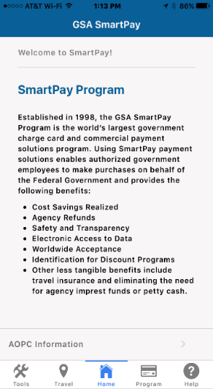
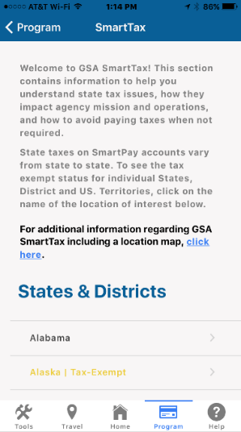
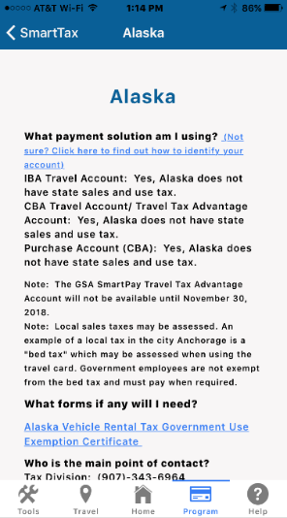
GSA SmartPay Travel Card Mobile App
The new GSA SmartPay Mobile App for cardholders and A/OPCs is available in the Apple App store as well as Google Play. Resources available through the app include A/OPC contact information, state-specific tax information, and more.

Slide 22
Questions?

Slide 23
GSA Starmark logo

