Slide 1
CHANGE MANAGEMENT
Ashlie Horton
Patrice Kunzli

Slide 2
What You Can Expect:
Change Management
Configuration Management
Release Management
Process Improvements
    Service Now
    ChaRM

Slide 3
Change Management
What is Change Management?
Follows a standard operating procedure to eliminate any unintended interruptions and includes change assessment, planning, and approval.
Operates as a gatekeeper to ensure minimum risk and impact to the ongoing infrastructure and operations.
Serves to protect the production environment via effective change planning, optimized resources, and communication.

Slide 4

Configuration Management

Slide 5
Configuration Management
Configuration Management is……
A process that encompasses all other processes and services in the lifecycle phases.
A practice designed to handle changes systematically so that a system maintains its integrity over time.
A more disciplined process that is flexible and responsive:
  Provides better control over changes into production.
  Improves communication across teams.
  Enhances cross team integration and promotes early detection of issues and cross team requirements.

Slide 6
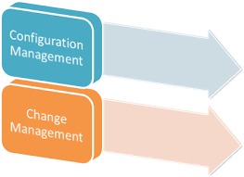
Configuration Management versus
Change Management

Slide 7
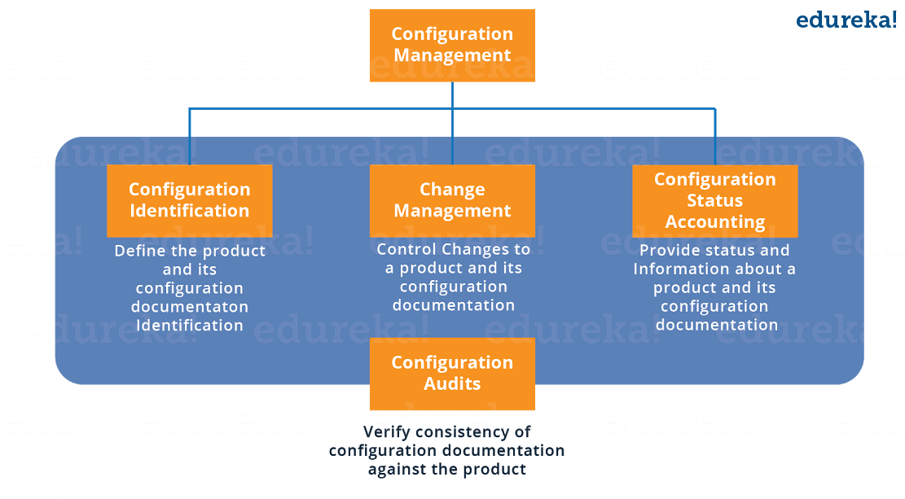
Configuration Management versus
Change Management

Slide 8
Configuration Management Branch
What does the Configuration Management Branch do?
  Maintains the configuration management procedures and configuration rationale documents.
  Facilitates the change management governance boards.
  Serves as the Release Manager for all changes to the O&M environments.
  Serves as control owner and remediator for daily CCM Process Controls.
  Provides oversight for FMS’ Annual Internal Controls Review Process.

Slide 9

Changes

Slide 10
Change Management
Reasons for Change:
  Improve existing functionality
  Add new functionality
  Address statutory requirements
  Correct defects
  Incorporate system upgrades
Notes:
There are several reasons why Change Management would occur. [Read some or all of bullet points on slide]

Slide 11
Enhancement vs. Defect
Enhancement
Defect
  Represents a new requirement or clarification of an existing requirement.
  Any change that is not a defect and not part of the original design.
  Any item that is within the designed process that is not working as intended (commonly referred to as a Break-Fix).
  A table update, derivation/substitution rule, data change within the existing requirement that requires a transport.
Notes:
There are two types of changes that occur; an enhancement which can include XYZ or a defect such as ABC.

Slide 12
Enhancement vs. Defect con’t
Enhancement
Defect
  Requires ERB Review
  Requires CCB approval
  Requires release assignment prior to development
  Requires ERB Review
  Requires Design Lead approval (with an information copy to the CCB for cross-team communication)
  Requires release assignment prior to development
Notes:
Enhancements and Defects go through a similar process but with some important differences. Enhancements require ABC. Defects require A & C but also include B [elaborate on this bullet point].

Slide 13
Enhancement vs. Defect con’t
Enhancement
Defect
  Examples:
  Requirements change:
    - Software change request
    - Engineering change proposal
  Infrastructure change request
    - New batch processes in schedule
    - Upgrades
  Role Change Request
  New configuration required to address new functions
  Government Approved Projects
  Examples:
  Modification to data in custom rules or tables
  Master data updates
  OSS Notes to repair a system defect
  Development that does not require change to the functional design
  Configuration changes to meet original functional requirements
Notes:
What do these enhancements look like? Here we have outlined what types of changes fall into each category. For enhancements we have changes such as XYZ. Defects will encompass changes that are ABC.

Slide 14
Governance Boards
What do they do?
Governance refers to oversight and decision-making related to strategic direction and financial planning with regard to the core policies that outline the organization's purpose and structure.
A group of functional and technical subject matter experts who work on behalf of the system users to ensure a business need is achieved.
Avoid any unacceptable situations or outcomes.

Slide 15
Governance Boards ERB
Engineering Review Board (ERB):
The ERB serves as the governance body to review and determine the feasibility of a proposed change to the Financial Management Services (FMS) Shared Service Offerings. FMS Shared Service Offerings are comprised of applications, components, configuration controlled items, functional configuration settings, and/or interfaces that support the financial management infrastructure of USDA.

Slide 16
Governance Boards CCB
Configuration Control Board (CCB):
The CCB is the governing entity that meets weekly to review and discuss all incoming and outstanding Enhancements. The CCB consists of SMEs that are representative of each branch and group concerned with the system from both a business process and technical perspective, including customer support. The purpose of the CCB meeting is to review and discuss the change at a high level, understand the release strategy, and approve or disapprove the change.

Slide 17
Governance Boards TCCB
Technical Configuration Control Board (TCCB):
The TCCB is a board that manages the risk of introducing changes to the production solution, reviewing and approving all transports and all changes planned for the production environment. It is the last board to review the changes for production in the configuration management process.

Slide 18


Change Process Flow
End User Submits Request
Validation
Moved to Production
TCCB
via ServiceNow
3.0 Development &
SDLC
Testing
Close/Resolve
Incident/CR
User is Notified
Tier 1 / 2 Review Incident
QA Test
System Test
Development
/ Create Documentation
1.0 Validation
No
Disapproved
2.0 Planning
ERB Reviews Incident
Deferred
Approved
/Request
Release Manager /
Prioritization
Yes
Subject Matter
Expert / POC Prepares
(Enhancement)
and Submits for
Approval
Yes
CCB Reviews
(Defect)
Notes:
Here is an overview of the Change Management Process. [click] [click] ERB Reviews Incident is part of our Validation process which we will detail in the next slide. [click] [click] Release Manager is part of our Planning process which you will see in depth shortly. [click] [click] The SDLC process that includes Development, Systems Testing, and QA testing is part of our Development & Testing process which you will see outlined in more detail in the coming slides.

Slide 19
1.0 Request Validation
Notes:
As you saw in the Overview Change Management Process the first step involves requesting validation. As you can see here the process begins with entering a change request into ServiceNow. From there it goes to XYZABC………

Slide 20
2.0 Planning
Notes:
You can see that after CCB has reviewed and approved the change request it moves onto the next stage of the process which is Planning. The Release Manager will review it for scheduling and from there XYZABC…

Slide 21
3.0 Development and Testing
Notes:
After the change request has gone through Development it is then assigned to the Development Branch where our Developers will review the change, conduct peer reviews, and do unit testing. From there XYZABC……

Slide 22
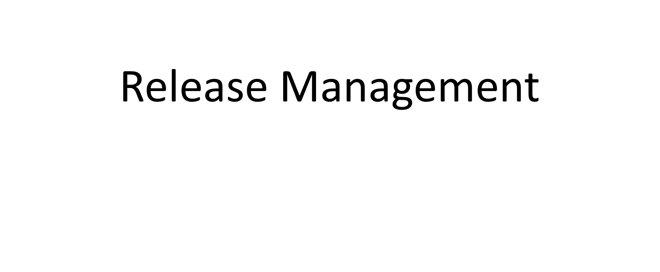
Release Management

Slide 23
Release Management
Release Management encompasses the planning, design, build, configuration, and testing of hardware and software changes.
Creates a defined set of related components.

Slide 24
Release Management Goals
Goals of Release Management include……….
Ensuring the integrity of the production environment is protected and the correct components are released in such a way to deliver valued products and services to the customer.
Delivering change faster and at optimum cost and minimized risk.
Providing traceability.
Additional information can be found on the FMS Website. (FMS Release Information)

Slide 25
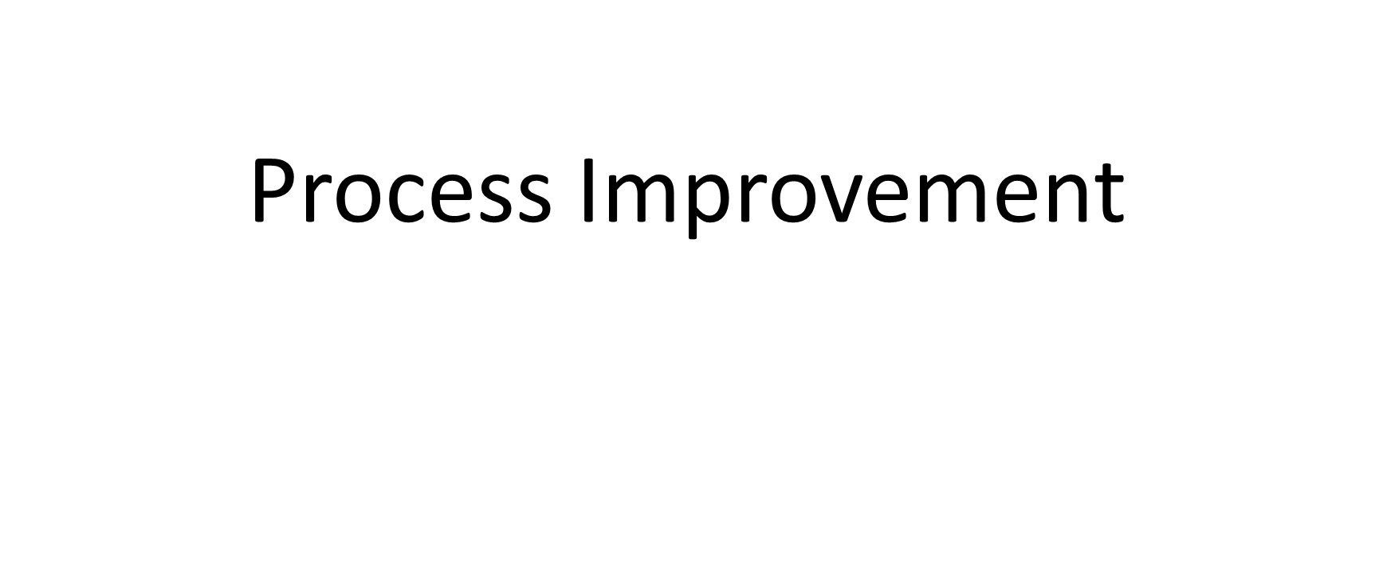
Process Improvement

Slide 26
Process Improvement
ServiceNow
Aligned to our Change Management process by:
    Providing more statuses.
    Revised Email notifications.
    Automated Workflow.

Slide 27
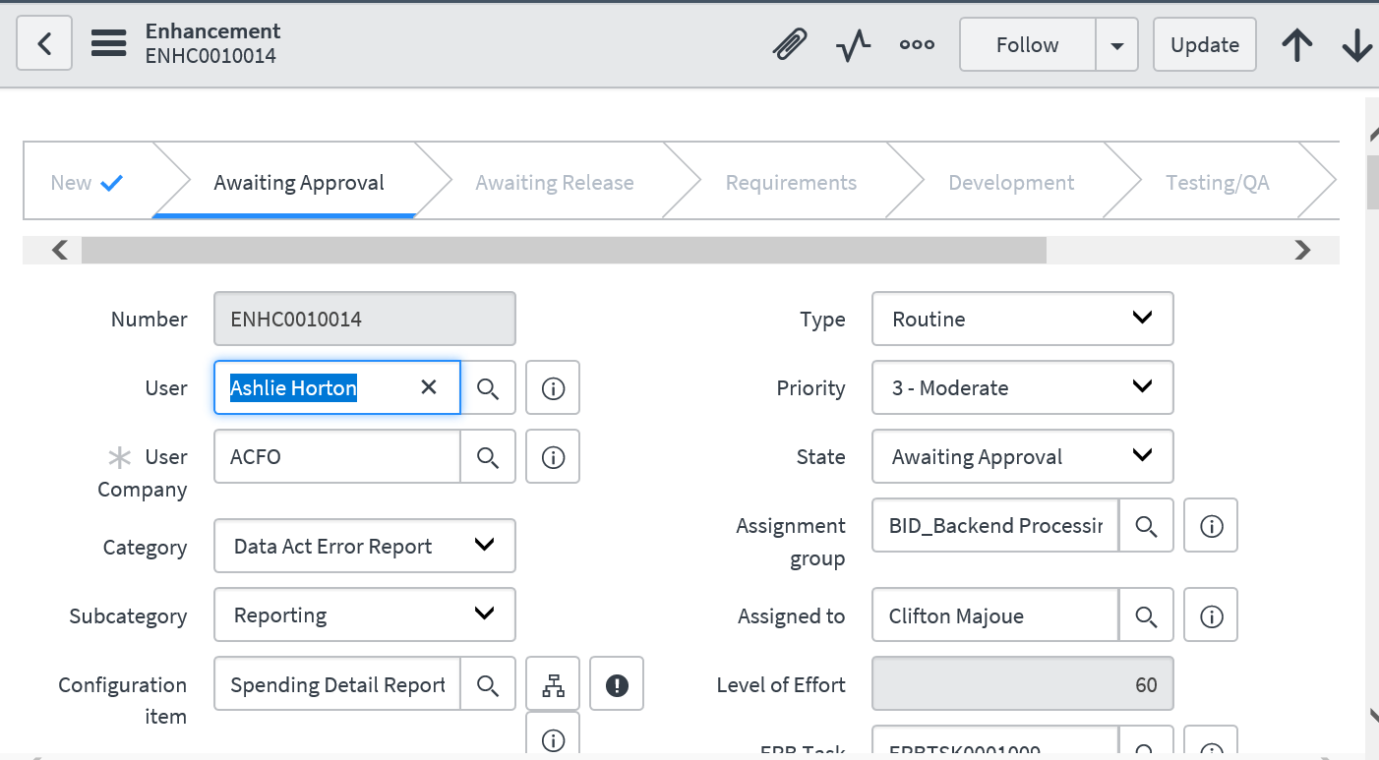
Service Now

Slide 28
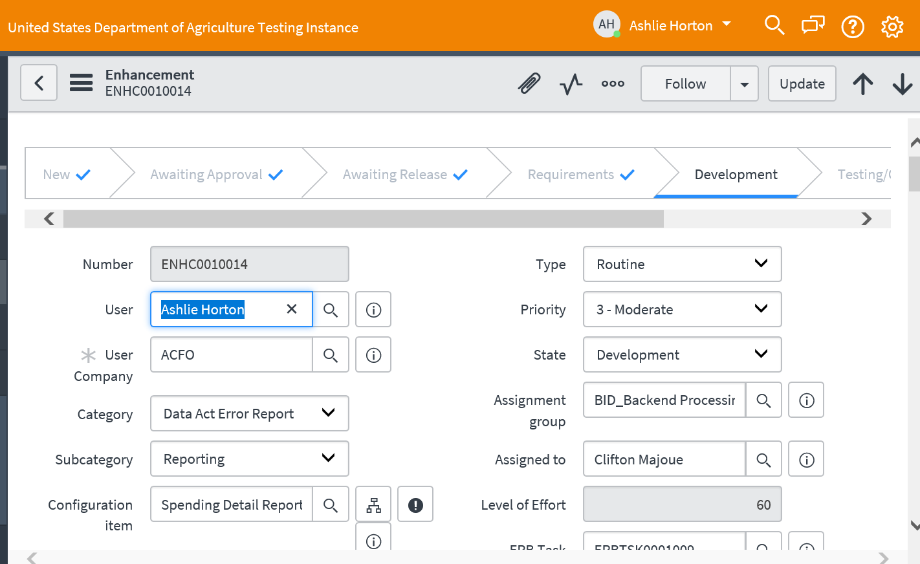
Service Now

Slide 29
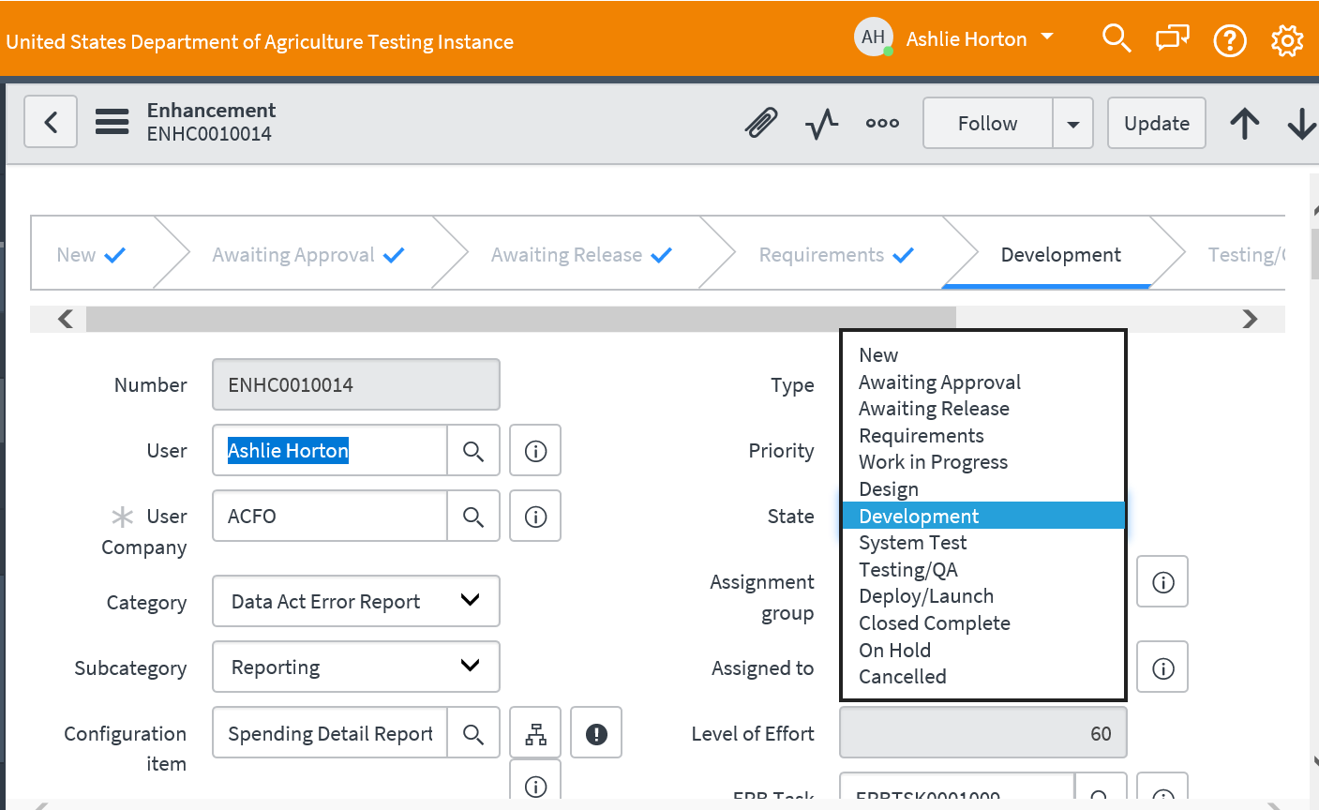
Service Now con’t

Slide 30
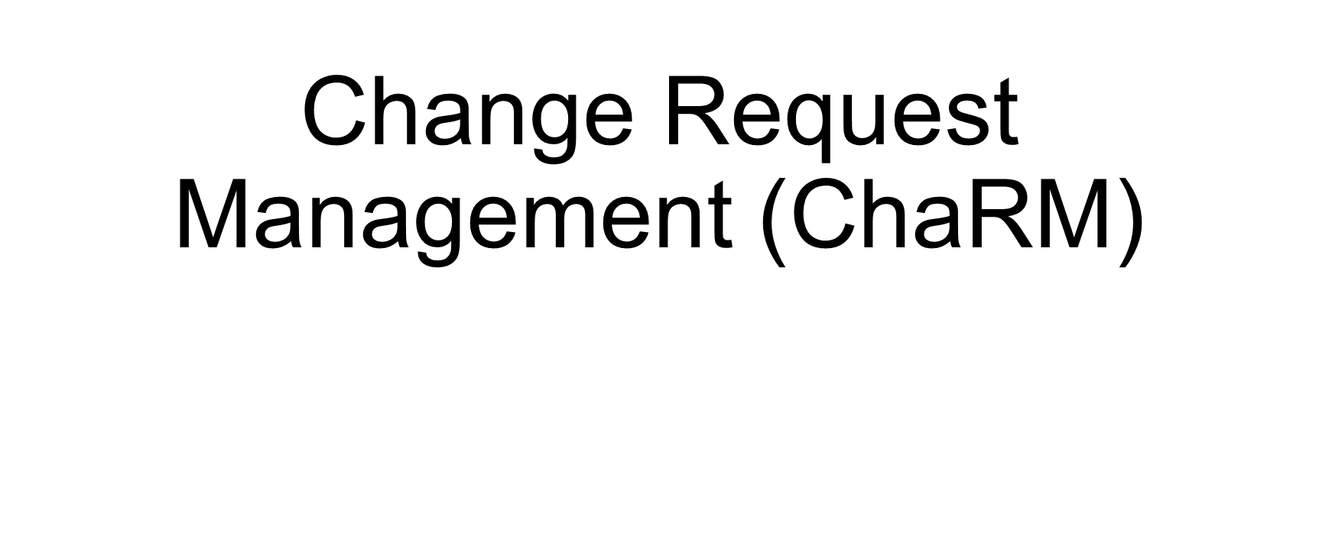
ChaRM

Slide 31
ChaRM
Three objectives of ChaRM:
Consolidate SAP Change Management into a common toolset
2. Reduce Change Management administrative overhead
3. Leverage workflow with technical action

Slide 32
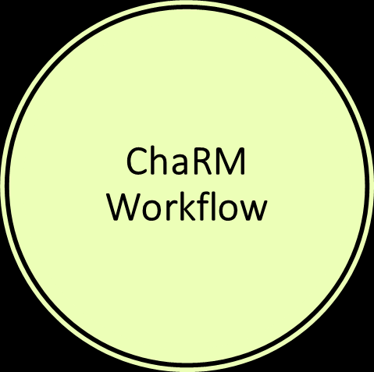
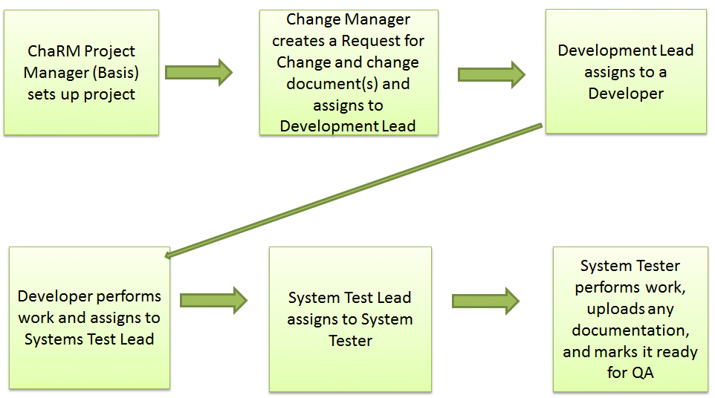
Charm Workflow

Slide 33
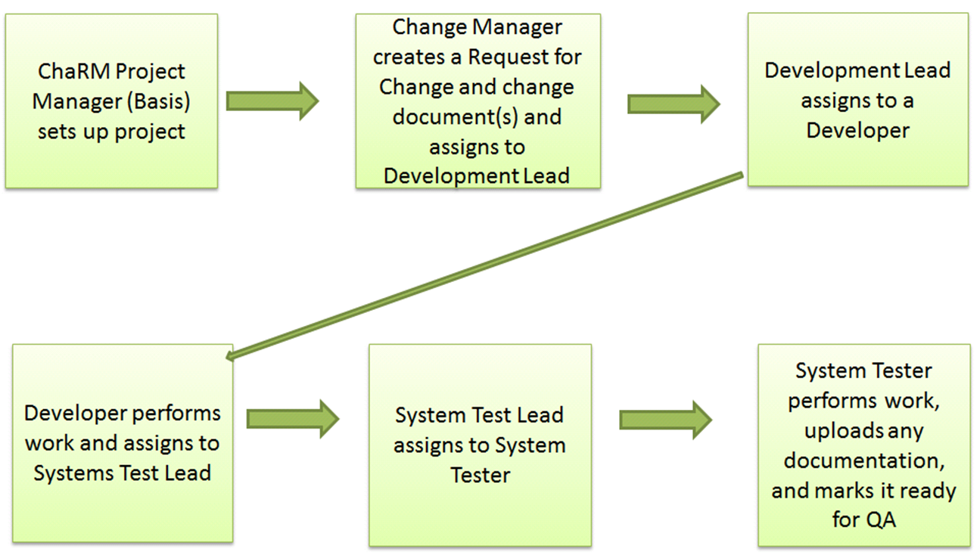
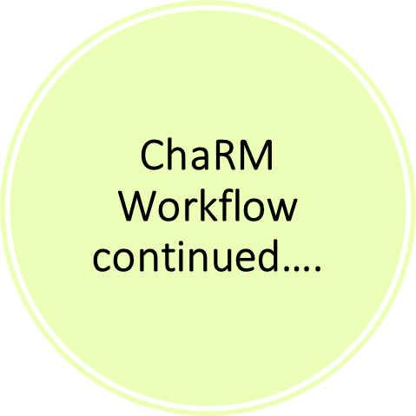
Charm Workflow

Slide 34

Questions
Any Questions?

