Slide 1

USDA Farm production and conservation (FPAC)
FSA/CCC Financial Improvement Program (FFIP)

Slide 2


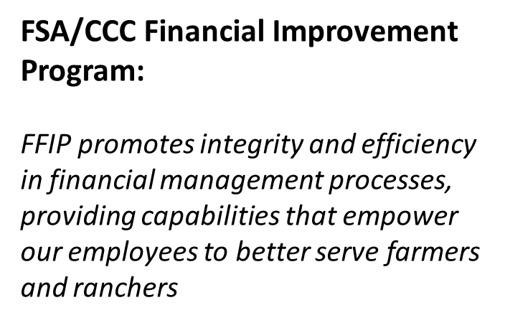
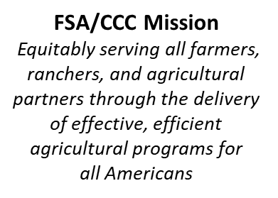

Project Vision
FFIP
Promoting FSA/CCC’s mission through efficient, transparent financial management

Slide 3
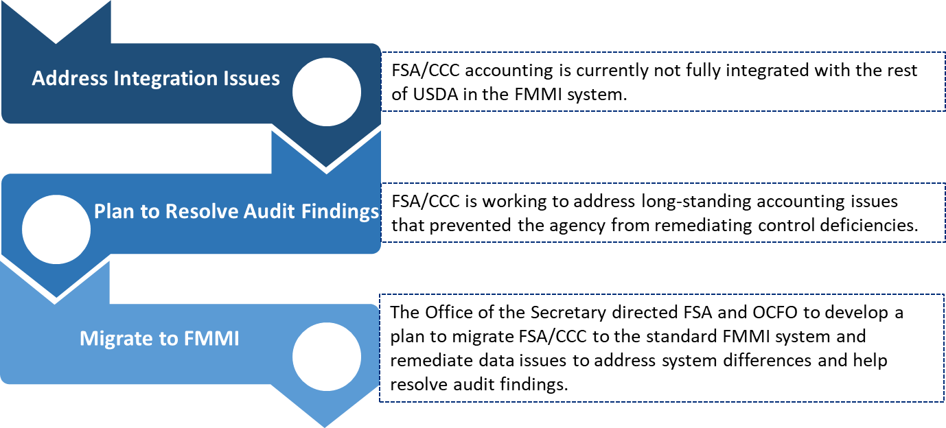
Background
FSA/CCC
Financial Improvement Program

Slide 4
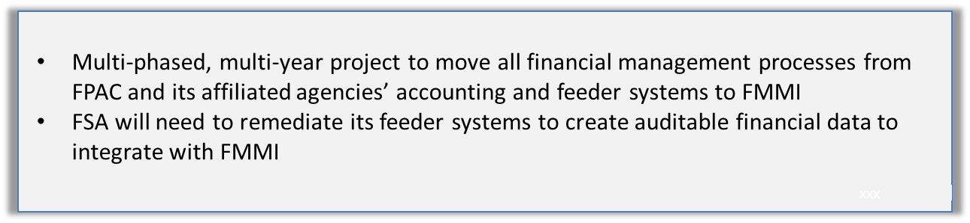
Scope and Impacted Stakeholders
Beyond FSA/CCC employees, FMMI implementation will likely affect partner agencies such as:
RD
FAS
USAID
AMS
NRCS

Slide 5







What is FMMI?
The FMMI software solution is is a commercial off-the-shelf enterprise resource planning system
The system supports general accounting, financial management, and funds management
FMMI is used in most USDA agencies, including the following:

Slide 6
Implementation Phase Activity Flow
Each phase includes defined programs and will follow the activity flow described below:
Phase Definition
(Plan Part 1)
Development
(Do)
Test
(Check)
Migrate
(Act)
BPR
(Plan Part 2)
Phase Definition - documents what is going to be accomplished during the phase.
Migrate - executes all activities necessary to realize the phase goals.
BPR and Data Remediation - details specifications on which processes and programs will need to be modified, inclusive of data remediation.
Test - validates that the development phase successfully achieved changes outlined in the BPR phase, and that changes operate efficiently.
Development - builds the systems, processes, and policy changes necessary to realize the phase goals.

Slide 7
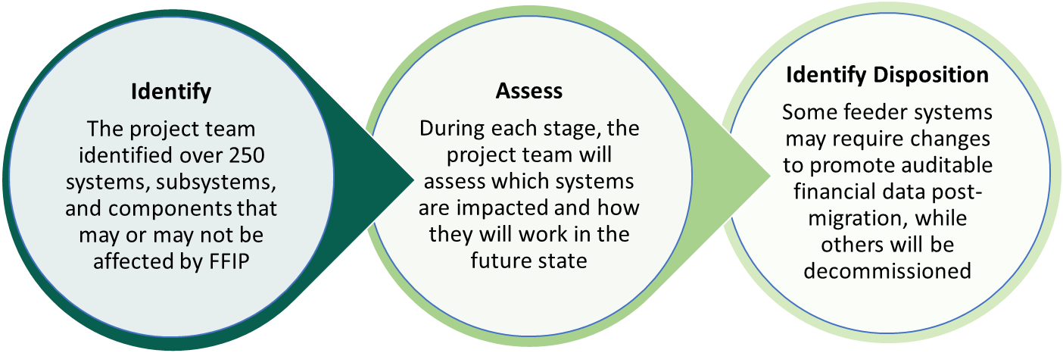
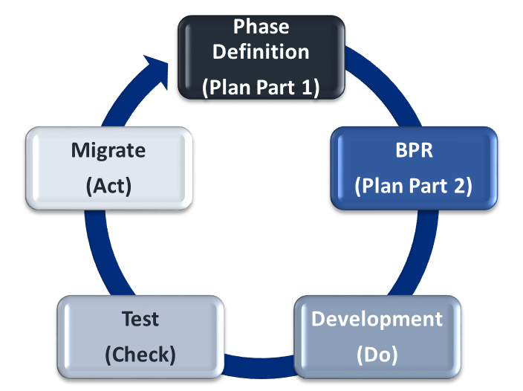
Feeder Systems
FFIP is incorporating considerations around feeder systems through each stage of the implementation process

Slide 8
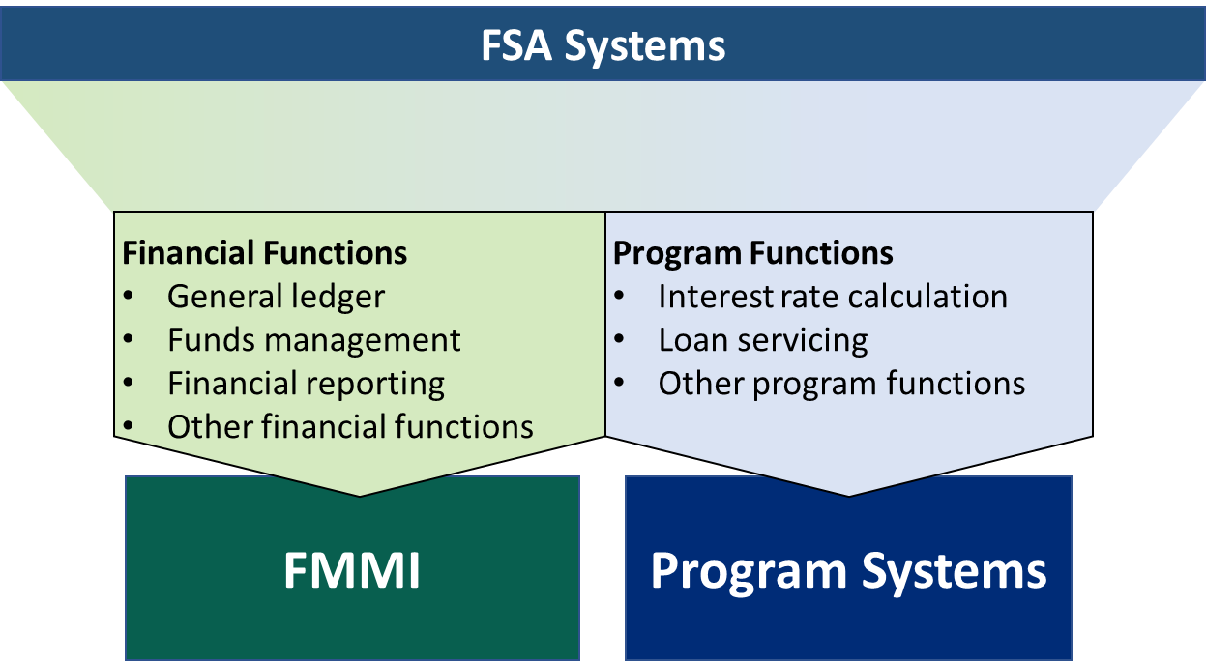
System Disposition
The system disposition process is designed to facilitate the transfer of financial functions to FMMI, while program functions remain in program systems.

Slide 9
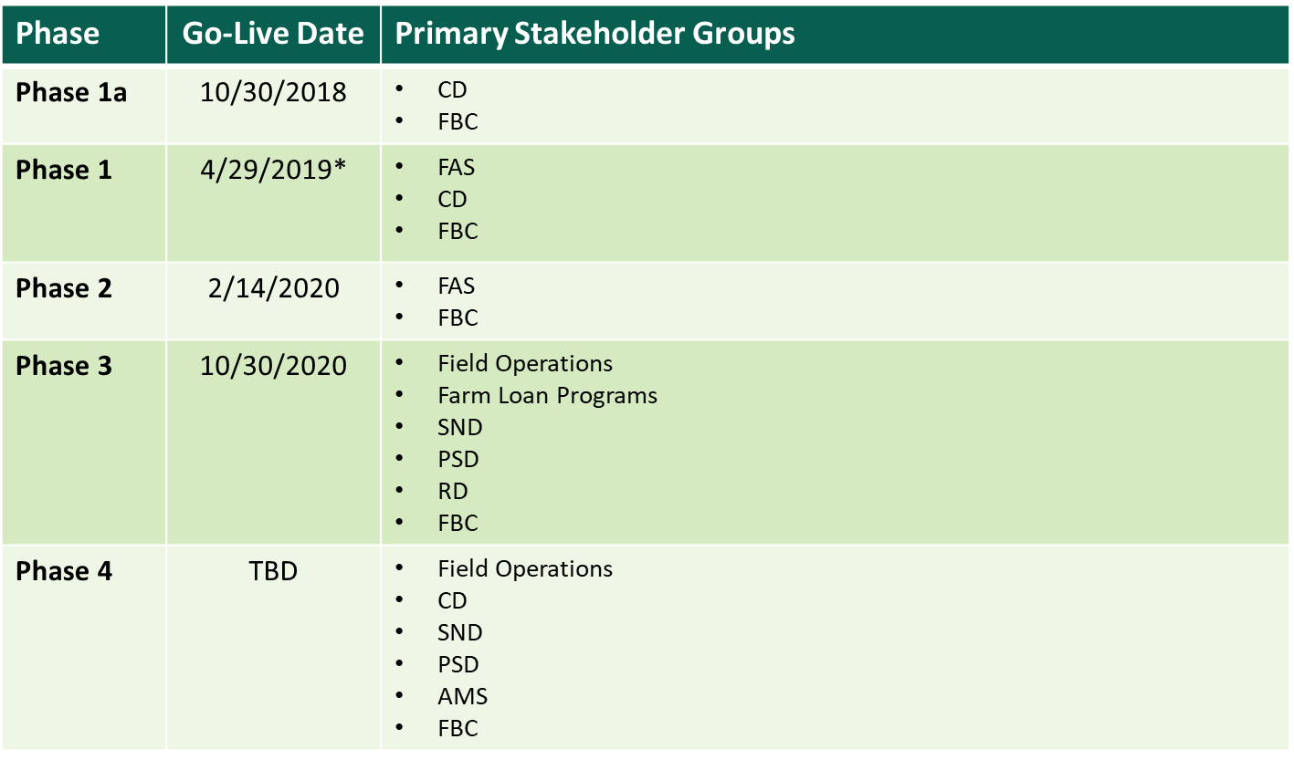
Key Dates (Current as of 6/28/19)
*Phase 1.2: Agriculture Wool Apparel Manufacturer Trust Fund Program went live June 17, 2019.
Pima Cotton Agricultural Trust Fund is currently under review

Slide 10
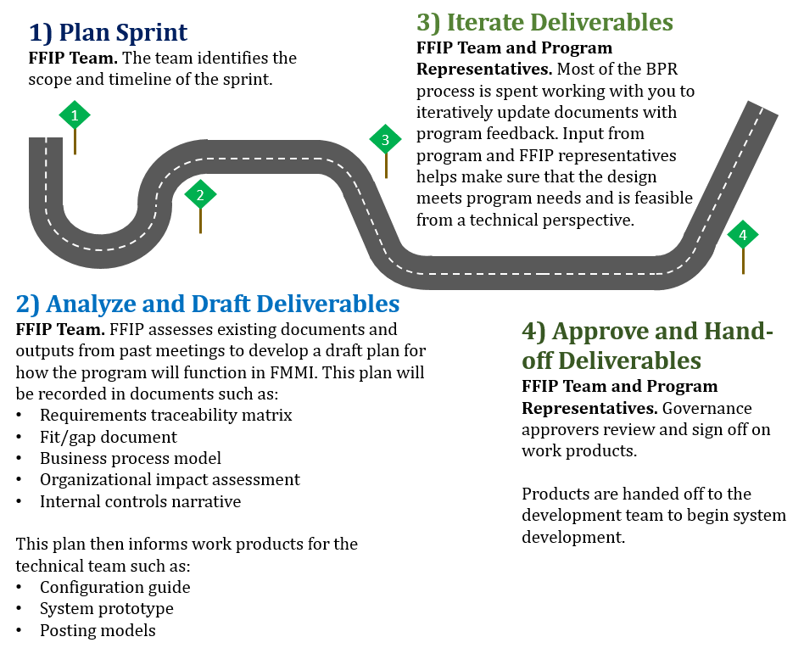
BPR Hybrid Agile Approach Overview
The FFIP team completes BPR for programs that will transition into FMMI through an iterative process involving representatives from the program and the technical team. This process is referred to as a “sprint” and follows the steps outlined below:

Slide 11
BPR Roles and Responsibilities
Provides expertise on business processes to help ensure that the new design will not interfere with program delivery. Expertise includes identifying business requirements. Program SMEs may also act as governance approvers
Program SME
Includes business process reengineering (BPR) and technical teams. The FFIP team identifies how the future solution will support business processes, in coordination with program SMEs, including identifying requirements
FFIP Team
Development Team
Develops the system based on the plan outlined in BPR documents. This team helps make sure that FMMI has functionality and interfaces to make the newly defined processes work
Signs off on deliverables at the end of a sprint. These approvers may be program SMEs or FFIP team members and provide key input during the process
Governance Approvers
Organizational Change Management Team
Assesses impacts to affected employees and provides communication and training. The OCM team also collects anonymous feedback on the program and can answer questions through FFIP-OCMTeam@fsa.usda.gov
Program Management Office Team
Coordinates program meetings and provides meeting support. The PMO team will help make sure you are on the correct meeting invitations and follow up with you if you have outstanding action items

Slide 12
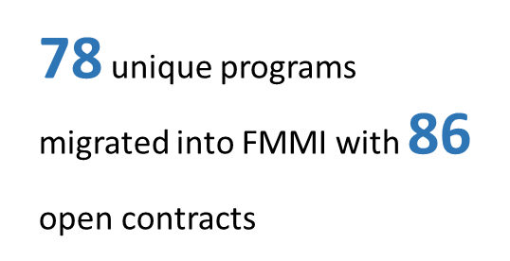
Phase 1a, 1, and 1.2 Highlights
$75,470,554
obligated in FMMI as of 3/31/2019 since migration
Status: Complete
Completed training sessions with 119 affected users
Closed out 15 fully executed programs

Slide 13
Phase 1a Summary
Phase overview: Unique Programs: 59
Disbursements: +29M
Disbursement Transactions: 233
Go Live 10/24/19)
Status (6/24/19) Complete
Critical Milestones:
BPR preparation, 5/21/18, Owner - FPAC
BPR, 7/12/18, Owner - Terathink
BPR Deliverables (draft), 8/30/18, Owner - Terathink/USDA
BPR deliverable Final, 9/27/18, Owner - Terathink/USDA
BPR handoff to developers, 9/28/18, Owner - Terathink/Deloitte
Configuration updates 10/12/18, Owner - Deloitte/USDA
QA Testing(USDA-OCFO), 10/19/18, Owner - OCFO
UAT Testing (USDA-FPAC), 10/26/18, Owner - FPAC
Migration/Go-live. 10/30/18, Owner - USDA
Training, 10/30/18, Owner - TeraThink/OCM
Achievements:
Demonstrated feasibility of the project
Interfaced CCC Funded Programs from IAS
Closed out 10 fully executed programs
identified an option for redesigned business processes for borrowing authority, eliminating the opportunity for negative cash - process is currently in policy review.
Identified opportunity for streamlined business processes, eliminating the need for manual, paper-based payment processing. White paper is currently in the governance approval process.
Researched and solved a long outstanding issue related to temporary sequestrations by working with OMB. Allows FSA to close many lingering account balances and move to FMMI much cleaner. Eliminates 6B balance

Slide 14
Phase 1 Summary
Phase Overview:
Phase 1 includes programs administered by the AMS and FAS covers FY18 obligations of $104K
Go-Live date - 4/29/19
Status (6/24/19) - Complete
Critical Milestones:
BPR, 8/22/18, 100% complete, owner FPAC
BPR Deliverables (Draft), 9/13/18), 100%complete, Terathink/BPR
BPR Deliverables (Final), 11/15/18, 100% complete, Owner Terathink/BPR
BPR Handoff to Developers; 11/15/18, 100% complete, TeraThink/Deloitte
Configuration and Coding, 12/14/18, 100% Complete. Deloitte/USDA
System Testing (FMMI/UES), 12/20/19, 100% complete, Owner Deloitte/USDA
QA testing (FMMI/UES), 2/8/19, 100% complete, Owner FPAC.
UAT Testing(FMMI/UES) 3/20/19, 100% complete, Owner FPAC
Review Master Data/Submit SF-132, 3/29/19, 100% complete, Owner FPAC
Conversion and Migration prep, 4/19/19, 100% complete, Owner FPAC/OCFO
Migration/Go-Live, 100% complete, 4/29/19, owners FPAC/OCFO
Training Planning, 3/15/19, 100% Complete, Owner TeraThink/OCM
Training Delivery, 5/10/19, 100% complete, Owners TeraThink/OCM
Post Migration, 6/10/19, 100% Complete, owner TeraThink/Deloitte
Upcoming Activities:
Task - Finalize Internal, FARM to review following testing) - Owner l Control Deliverables (on hold-TeraThink/BPR
Milestone Comments:
Task: Internal Controls Deliverables
Owner: FARM
Notes: Financial assistance and risk Management (FARM) is planning to begin review the internal controls Deliverables following completion of testing, the estimated completion for FARM's review is late July. While waiting for the FARM review, other Tier 4 reviewers are reviewing the document.

Slide 15
Phase 1.2 Summary
Phase 1.2 Summary: Critical Milestones
BPR And Related Tasks, 100% complete, owner FPAC
Submit Master data for QA/UAT & production, 4/3/19, 100% complete, owner FPAC
Shut down legacy payment codes, 5/23/19, 100% complete, owner FPAC
QA testing (If required), 5/31/19, 100% complete, owner OCFO
Conversion and Migration Prep, 6/7/19, 100% complete, Owner FPAC/OCFO
Migration/Go-Live, 6/17/19, 50%complete, Owner FPAC/OCFO
Training Planning, 3/15/19, 100% complete, Owner, Terathink/OCM
Training delivery. 5/10/19, 100%Complete, Owner, TeraThink/OCM
Post Migration Support, 7/3/19, 10% complete, Owner Terathink/Deloitte
Phase Overview:
Phase 1.2 includes Programs administered by FAS and covers FY18 disbursements of $41.3 million.
Go-Live 6/17/19
Status(6/24/19) - Ongoing
Accomplishments, and upcoming activities:
task - Continue to assess the readiness of Pima Cotton for migration, will not have a definitive answer until we close June (7/5-7/12)
Milestone Comments:
Task: Migration/Go-Live
Owner - FPAC/OCFO
Notes- G0-Live planned for Mid July

Slide 16
Phase 2 Export Credit Reform Summary
Critical Milestones:
BPR, 11/15/18, 100% complete, Owner, FPAC
BPR Sprint 1 master data 6/6/19, Owner Terathink/BPR
BPR Sprint 2, Master Data and Funds Mgmt, 6/27/19, Owner Terathink/BPR
BPR handoff to developers, 6/12/19, Owner, Terathink/BPR
Configuration and coding, 11/6/19, Owner , Deloitte/FAS IT
system Testing (Deloitte), 12/20/19, Owner, Deloitte/FAS IT
QA Testing (USDA/OCFO), 1/17/20, owner OCFO/FAS
UAT Testing (USDA/FPAC), 1/24/20, Owner FPAC/FAS
Review Master Data/Submit SF-132, 1/31/20, Owner FPAC
Conversion and Migration Prep, 2/12/20, owner FPAC/OCFO/FAS
Migration/Go-Live, 2/14/20, owner FPAC/OCFO/FAS
Training Planning 1/31/20, Owner TeraThink/OCM
Training Delivery, 2/28/20, Owner TeraThink/Deloitte
Post Migration Support, 3/30/20, Owner TeraThink/Deloitte
Internal Controls deliverables, 9/11/19. owner Terathink/BPR
      Phase Overview:
Phase 2 includes Programs administered by FAS and Commodity Programs executed through WBSCM. Phase 2 covers FY18 Obligations of $674 million.
Go-Live 2/14/20
Accomplishments:
Completed 3 iterations of performance smoke testing to measure per hour volume of transactions that can be posted in FMMI. Owner - FMS
Validated control activities within the collections, reconciliation, and rescheduling sub processes for pl480. Owner Terathink BPR/FPAC
Milestone Comments:
The FMMI team is evolving the approach for future deliverable development. an Agile development approach is being planned which will change the timing of deliverables.

Slide 17

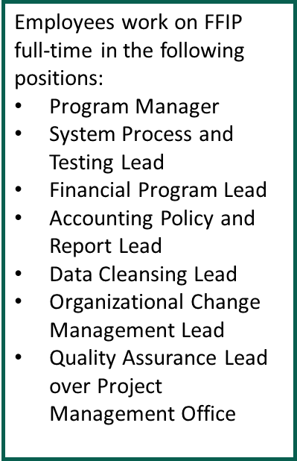
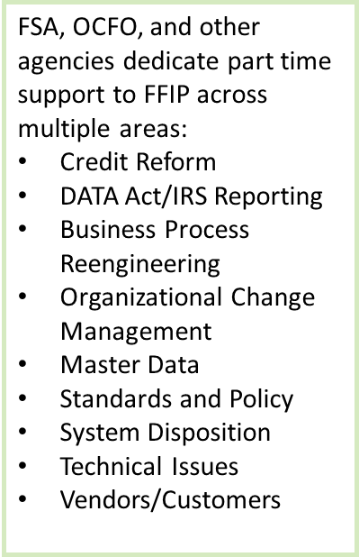
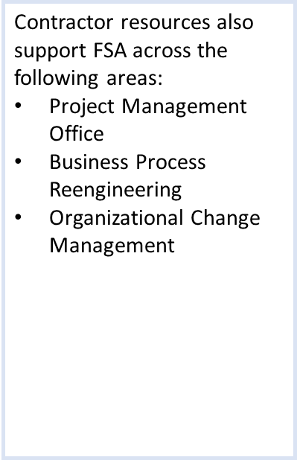
Project Staffing
FFIP is staffed by full-time, part-time, and contractor resources to provide representation across multiple functional areas:
Part Time Resources
Contractor Resources

Slide 18
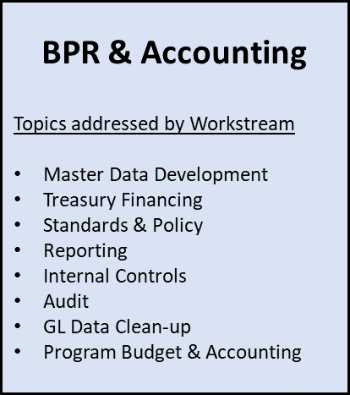
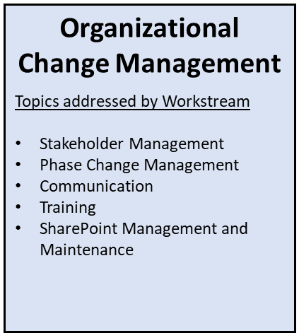
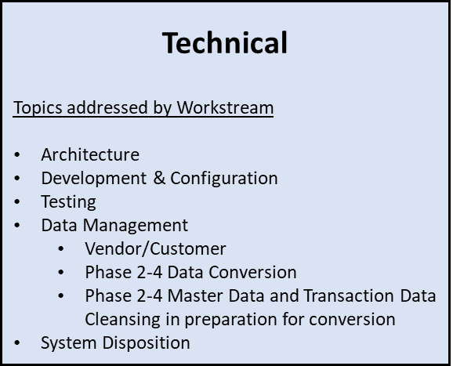
Project Structure (Proposed)
Business and Technical Resources Aligned Across Workstreams

Slide 19
Governance Structure
Governance Structure: Tier 1 ESC
Thomas Christensen/FPAC Business center/ESC chair
Margo E. Erny FPAC FMD
Richard Fordyce, FSA Administrator, Voting Member
Lynn Moaney. USDA Deputy CFO, Voting Member
Gary Washington, USDA, CIO, Voting Member
Darren Ash, FPAC, ACIO Voting Member
CJ Stanton, FPAC, Chief FOB, non voting member
Comment: Tier 2 will determine when Tier 1 Governance approvals are required
Tier 2 Executive Leadership:
CJ Stanton - chief FPAC-FMD-fob
Stan McMichael - Director OCFO, AMD
Bill Cobb-Deputy Administrator, Farm Loans Program
Bill Beam -Deputy Administrator, Farm Programs
Peggy Browne - Deputy Administrator, Field Operations
Jim Staiert - FPAC-BD
Jeff Machtly - Chief, FPAC-FMD-PARB
Chris Mechtly - RD-NFAOC Director
Clint Swett - FPAC-ISD

Slide 20
Governance Structure con’t
Tier 3 - Program Managers:
Angela Ackerly - FPAC-FMD
Loretta Burns - FPAC-ISD
Christine Vollmerhausen- OCFO
Trina Brake - FSA DAFO
Dana Richey - FSA DAFLP
Allson Groenwoldt - FSA DAFP
Clay Hamilton - FAS
Rhonda Knolhoff - NFAOC
Sean Rathman - FPAC-FMD-FOB-B&COS
Monty Tranbarger - FPAC-FMD-FOB-POS

Slide 21
Governance Structure Tier 4
Tier 4- Project Leads:
Denise Salanski - FPAC-FMD
Myduyen Le - FPAC-FMD
Adam Travis-FPAC-FMD
Kelly Holdman - FPAC-FMD
Colin Humphrey - FPAC-FMD
JoLynn Khan - FPAC-FMD
Carrie Jones - OCFO
Ron Gros - OCFO
Dan Muller - OCFO
Mike Fiene - FPAC-FMD
Kathleen Carroll -FPAC-FMD
Chris Claussen - FSA-DAFP
Curt Alt - FAS
Amy Slusher -FAS
Cindy Pawlikowski - DAFLP
Jennifer Nagler - FPAC-FMD-PARB-GLIS-SET
Eric Smith - FPAC-ISD

Slide 22
Risks Summary Overview
Near Term
Magnitude of CCC audit effort delayed some activities for future phases
Avoiding scope creep into the areas of loan programmatic accounting and grants management
General
High volume of payments (3 million+ transactions)
Significant program systems changes required to produce FMMI-compliant transactions
Multiple stakeholders from Agency headquarters, field, and Department
Large program user community (9,500)
Large volume of programs (60+)
Farm Bill program implementation competing for FFIP resources

Slide 23
System Architecture: Current Structure
Program Systems
(Farm Programs, Farm Loan Programs, Commodity Operations, Business Partner, Online Payments)
Obligations
Vendor/Customer Master Data
Payments
Collections
Due Receivables
G/L-only transactions
DLS/GLS Loan Obligations, Activity and General Ledger
IFM
COF
FSAFS
NPS
NRRS
eSCOAP
Request Obligation
Bankruptcy
Validate Funds
Create Receivable
Adjust Obligation
Other Agency Debt
Manual Handling
Query Receivables
Check Obligated Funds
Banking Info
Assignments
Cancel Receivable
Liquidate Obligation
Assignees
Joint Payments
Manage Receivables
Joint Payees
Req Ob Liquidation
TOP/CROSS Referral
Bank Routing Verification
Offsets
Validate CCID
Prompt Pay
Initial Notification and Demand letters
Date of Death
Certify & Sign
Withholdings
Rollup
Write-off
MIDAS Interface
Treasury Returns
Apply Collection
SAM interface
PAM to Treasury
Treasury Confirm
Public-facing UI
Disbursement Maintenance
FMS SCOAP
Collections
From NRRS
CORE
PFCS
PLAS
Fund Mgt
Fund Mgt

Slide 24
System Architecture: Recommended Future Structure
Program Systems
(Farm Programs, Farm Loan Programs, Commodity Operations, Business Partner, Online Payments)
Obligations
Vendor/Customer Master Data
Payments
Collections
Due Receivables
G/L-only transactions
DLS/GLS Loan Obligations, Activity and General Ledger
IFM
COF
FSAFS
NPS
NRRS
eSCOAP
Request Obligation
Bankruptcy
Validate Funds
Create Receivable
Adjust Obligation
Other Agency Debt
Manual Handling
Query Receivables
Check Obligated Funds
Banking Info
Assignments
Cancel Receivable
Liquidate Obligation
Assignees
Joint Payments
Manage Receivables
Joint Payees
Req Ob Liquidation
TOP/CROSS Referral
Bank Routing Verification
Offsets
Validate CCID
Prompt Pay
Initial Notification and Demand letters
Date of Death
Certify & Sign
Withholdings
Treasury Returns
Write-off
MIDAS Interface
Disbursement Maintenance
Apply Collection
SAM interface
Public-facing UI
FMMI
Fund Mgt
Rollup
PAM to Treasury
Treasury Confirm

Slide 25
Questions

