Slide 1
Farm Production and Conservation Business Center
Margo Erny, Chief Financial Officer
Wednesday, July 10, 2019 – Presented to the USDA Financial Management Training

Slide 2
Agenda
Introduction to Organizational Design
Benefits
Structure
Locations
Staffing
Optimization Activities
Service Portal
Business Process Reengineering (BPR)
Initiatives Process
Acquisitions Planning
Fleet Optimization
Optimally Productive Office
Integrated Investment Review Boards
Farmers.gov
Customer Experience
Farm Bill Engagement
Priority Communications
Internal Audit Steps
FFIP
What’s Next for FPAC Business Center
Optimization
Lessons Learned

Slide 3
Introduction
FPAC Business Center Organizational Design

Slide 4
Benefits of Mission Support Services Centralization
Former Decentralized Operating Model | Centralized Business Center Operations | Key Business Center Initiatives
Inconsistent processes and policies Impacts organizational efficiency, effectiveness, and compliance with regulation and policy. | Standardized policies, procedures, roles, and responsibilities Results in consistent customer service interactions. Standardization will also serve as basis for improved audit outcomes. | Business Process Improvement “ServiceNow” development to automate processes and drive standardization of roles and responsibilities
Fragmented oversight Common mission support capabilities were subject to agency silos, resulting in inconsistent procedures and performance measurements. | Direct line of sight The Chief Operating Officer has direct line of sight over mission support operations across FPAC. This provides for improved oversight and accountability, as well as consistent performance measures and resource focus on highest priorities. | Automating workflows in “ServiceNow” will create clear and accurate metrics Create standard performance measures for mission support employees
Organizational silos Can result in inefficient workload allocation and use of resources. | Deep bench strength Centralizing mission support operations results in a deeper bench (service back-ups) that improves capacity, ability to handle workload surges, and share expertise across the organization. | Centralized intake of service requests (“ServiceNow” platform) Leadership reports/dashboards that provide single view of all mission support activities Allows allocation of workload across organizational units, eliminating operational silos
Inconsistent levels of specialization The former organizational structures yielded different levels of specialization (e.g., HR generalist vs. specific expertise in hiring, employee relations, etc.). | Specialized staffing Allows employees to become experts in the specific regulations, policies, and procedures that govern work. This cuts down on errors, expedites processes, and improves compliance. Staff are also supervised by subject matter experts, providing critical technical guidance. | Develop core competencies across key service areas Consistent standards to measure technical expertise, evaluate performance, and develop workforce

Slide 5
Business Center Structure and Leadership Team
Bill Northey
Under Secretary,
Farm Production & Conservation
Legend
Position Officially Filled
Robert Stephenson
Chief Operating Officer (COO) and CCC Executive Vice President
Emily Su
Civil Rights and EEO
Acting Leadership
Tom Christensen
Deputy COO for
Business Services
Sarah Lynch
Deputy COO for Enterprise Services and CCC Secretary
Jim Staiert
Budget
Margo Erny
Financial Management
Ken Hill
Performance, Accountability, and Risk
Jack Welch
Appeals and Litigation
Robert Ibarra
Grants and Agreements
Darren Ash
Information Technology
Scott Linsky
Homeland Security
Sarah Campbell
Customer Experience
Melissa Drummond
Human Resources
Stephen Schaefer
Management Services
Joy Harwood
Economic and Policy Analysis
David Warner
External Affairs
Derek Beavers
Acquisitions
Nell Fuller
Environmental Activities

Slide 6
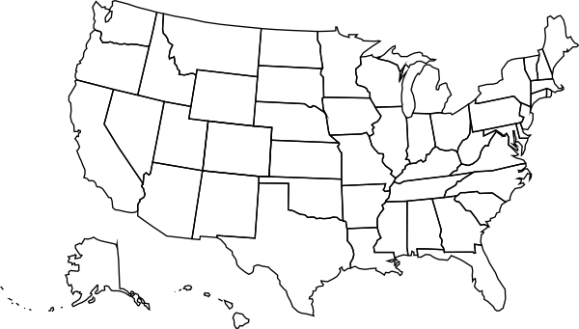
Service Delivery Locations & “Hubs”
The FPAC Business Center has critical mass in 3 primary locations – Washington, DC, Kansas City, and Raleigh. This enables improved collaboration through face-to-face interaction. Limited positions and specific capabilities will be located in Ft. Collins, Salt Lake City, and Ft. Worth.
Ft. Collins, CO
Over 30 Employees
Salt Lake City, UT
Over 60 Employees
Kansas City, MO*
Over 400 Employees
Washington, DC*
Over 500 Employees
Raleigh, NC*
Over 80 Employees
Ft. Worth, TX
Over 50 Employees
*Primary FPAC Hub Locations

Slide 7
Current FPAC Business Center Employees
As of June 6, 2019
Establishment of the Business Center did not increase the number of positions in FPAC. Business Center positions were transitioned from FSA, NRCS, and RMA to ensure “zero sum.”
1,918 total positions approved within the FPAC Business Center.
1,438 employees currently on board within the FPAC Business Center.
480 total vacancies within the FPAC Business Center
Optimized Span of Control to a 1:9 supervisor to employee ratio.
Leveraged OPM expertise to place 125 of 220+ supervisors in supervisory positions.
The Business Center is 75% Staffed

Slide 8
Farm Production and Conservation (FPAC) On-Board Strength
BUSINESS CENTER
MISSION AREA
1,918
Approved FY 2019 Position Ceiling
1,438
On-Board Positions
480
Vacant Positions
22,975
Approved FY 2019 Position Ceiling
20,037
On-Board Positions
2,938
Vacant Positions
On-Board Positions as Percentage of Position Ceiling
75%
On-Board Positions as Percentage of Position Ceiling
87%

Slide 9
Optimization Activities

Slide 10
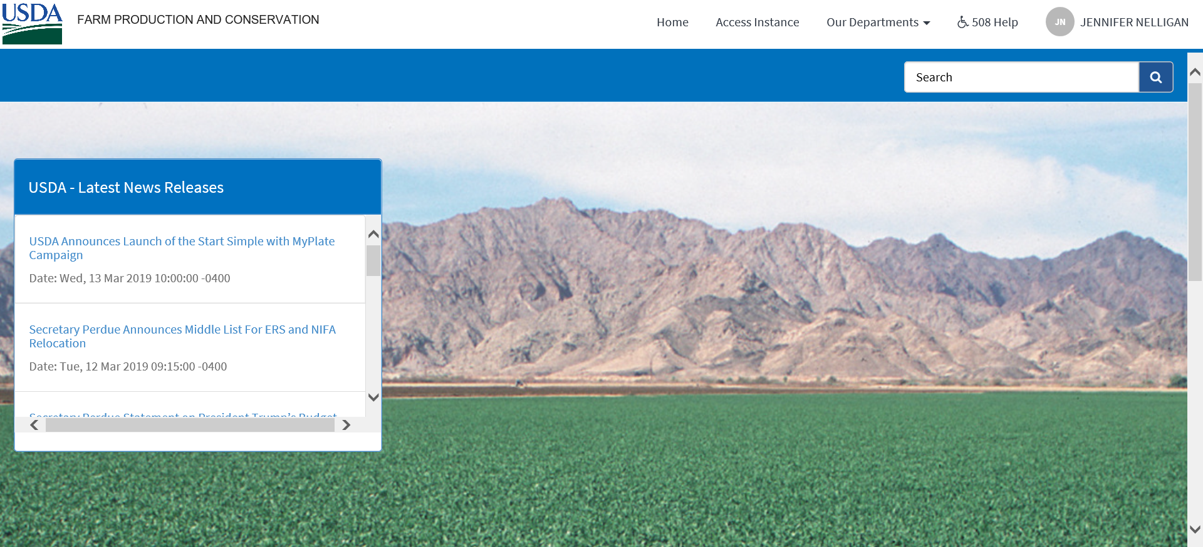
myFPAC Employee Service Portal
Prior to establishment of the Business Center in October 2018, mission support functions agencies engaged with partners via:
Individual points of contact
Unique inboxes (e.g., AskMSD@wdc.usda.gov)
SharePoint sites or shared drives
Manual workflows and hand-offs across stakeholders
This decentralized service delivery construct limits organizational agility, transparency, and the Business Center’s ability to efficiently assign workload across specialists.
myFPAC Services provides true one-stop-shopping for FPAC employees. The Business Center plans to expand FPAC’s employee portal to:
Simplify access to all service requests, policies, and procedures
Develop end-to-end workflows that automate manual processes and data entry and eliminate organizational silos
Improve individual and organizational accountability by developing clear roles and responsibilities, as well as automatic notifications and escalations
Develop user-friendly reports that improve transparency into workload volume, status of actions, and productivity metrics
Enable data-driven decision-making by integrating information across organizational units

Slide 11
Standardize, Integrate, and Automate Business Processes Across the FPAC Mission Area
The Business Center is undergoing a major business process improvement project, which will cover the below core value streams. The goal is to not only streamline and automate workflows where possible, but more clearly define roles and responsibilities across the parties.
Wave 1 Est. Completion: June 2019 | Federal Hiring Non-Federal Hiring (FSA Only) HR’s Employee Care Center Budget: Apportionments and Status of Funds Performance, Accountability, and Risk: Internal Audit Process
Wave 2 Est. Completion: October 2019 | Grants & Agreements: Advance Planning through Obligations Budget: Allocations, Unliquidated Obligations, Funds Control System, Section 4/11 Reimbursable Agreements (CCC) Real Property: Lease Acquisition and Payment Processes Fleet: Vehicle Optimization processes (establishing active management processes), Managing Incidents/Accidents for vehicles (including UTVs, ATVs, and snowmobiles) IT Investments and Acquisitions
Notes:
Approach to Modernizing Mission Delivery
Leverage FPAC’s Customer Experience initiatives to understand how USDA can best serve America’s farmers, ranchers, and forest stewards.
Simplify how customers do business across USDA agencies and programs by:
Improving access to and usability of tools and resources; and
Streamlining business practices and processes.
Continuously improve the quality of our technical and financial expertise and assistance by providing our employees and partners with impactful and integrated tools, information, and data.
Build upon past successes and lessons learned to integrate, modernize, and streamline how we deliver technical and financial assistance across the FPAC Mission Area.
Example: Do not build monolithic systems that attempt to be all things to all people.

Slide 12
FPAC Mission Support “Initiatives”
The Business Center is responsible for initiating and managing the process for funding FPAC’s common, shared, or unique mission support initiatives. This process allows the Business Center to help agencies identify, plan, and budget for these anticipated expenses and investments. The Initiatives Process provides for greater transparency and visibility into FPAC’s common, shared, or unique mission support expenses.
FPAC “Initiatives” Categories
Program Operations/Mission Delivery
Agency-specific needs for their specific mission outcomes; Business Center may provide support (e.g., budget support, award of a new contract or agreement).
FPAC Optimization
Other Mission Support Ops
Required Departmental Charges
Common charges (e.g., Working Capital Fund, Greenbook, e-Gov, Central Rent) that are required by the Department; may result in an intra-agency agreement or is paid via “direct cite.”
Essential Support Infrastructure
Essential tools and/or assets employees need to “keep the lights on and engine running.” Examples include lease costs, systems, platforms, or licenses and on-site infrastructure needs (e.g., mail room, janitorial services, facility needs, and physical security measures).
FPAC Optimization Projects
Initiatives that improve FPAC efficiency, effectiveness, and customer experience. Examples include the Optimally Productive Office Study, Technology Modernization Fund contracts, Customer Experience, Business Process Improvement projects, and others.
Business Center leadership estimates nearly $1 billion in mission support initiatives for the remainder of FY2019.
Other Mission Support Operations
All other FPAC mission support expenses or investments. Examples include USDA recruitment, diversity, and outreach events; development and delivery of FPAC training courses; essential travel to fulfill job duties; employee support services; and others.

Slide 13
Advanced Planning for Acquisitions, Grants, and Agreements
Objectives
Smooth out seasonal trends. The significant volume of Q3-Q4 actions increases risk to the agency. There is less time to exercise thorough due diligence. It is also one of many factors that result in high amounts of funding carried over into the next fiscal year.
Improve quality of service. The historical workload surge greatly limits the Acquisitions and Grants & Agreements Divisions’ ability to provide “high-touch” services. Advanced planning will allow much of the administrative work to be completed in earlier quarters (e.g., Q1 or Q2, when workload is historically low). The objective is to minimize mission support activities done by the agencies, improve the quality of service, and provide for better agreements that focus on performance and mission outcomes.
In-Progress Initiatives
Acquisition Program Review (APR): The Deputy Secretary requires that agencies submit and maintain APRs detailing their planned contract acquisitions.
Business Process Improvement: The Business Center is developing an advanced planning process for the Grants & Agreements Division, to shift planning and workload to earlier quarters.

Slide 14
FPAC Fleet Profile
 | By End of FY2017 | By End of FY2018 | Projected End of FY2019
Total Vehicles | 9,745 10% Sedans / 90% Trucks, SUVs, and Vans | 8,409 8% Sedans / 92% Trucks, SUVs, and Vans | 8,166 8% Sedans / 92% Trucks, SUVs, and Vans
Average Utilization | 5,908 miles/year | 7,330 miles/year | 8,000 miles/year
Utilization Rate* Note: Department-wide average is 38.1% underutilized | 53% Of vehicles are underutilized based on mileage (not days used) | 34% Of vehicles are underutilized based on mileage (not days used) | 25% Of vehicles are underutilized based on mileage (not days used)
Average Age | 5.5 years | 5.7 years | 6 years
*When the Vehicle Management Tool (ServiceNow) is implemented on a national level, the Business Center will be able to track days utilized. It is expected that tracking both mileage and days utilized will decrease the number of underutilized vehicles.

Slide 15
Optimally Productive Office (OPO) Framework
Staffing
Optimal levels of productivity (hours/output)
What are current levels of productivity?
How does this productivity vary across similar offices and programs?
What levels of productivity should be expected?
What variables drive performance improvements?
Expected demand / workload
How is demand expected to change?
How much customer demand is currently unmet due to capacity limitations?
How will technology change demand/workload across offices and among programs?
How can we best serve customers?
Optimal geographic footprint
Where should staff be geographically located to meet customer demand that requires physical presence?
Where can staff across FPAC agencies be co-located to optimize fixed costs and enhance collaboration?
1
::
Optimally Productive Office
How can FPAC deliver the best service to customers at the highest levels of productivity by optimally aligning its field presence (e.g., level of staffing, office locations)?
Geographic footprint
2

Slide 16
FPAC’s Investment Review Boards
FSA
FPAC Investment Review Board
Chair: Under Secretary, FPAC Mission Area
Participants: FPAC Chief of Staff, Agency Heads, Chief Operating Officer, Deputy Chief Operating Officers, FPAC Assistant CIO
NRCS
RMA
Business Center
Each FPAC entity has its own IRB. This ensures that agencies provide sufficient focus on the agency’s unique IT investments.
The FPAC Assistant CIO is the Executive Secretary for all IRBs within FPAC.
The FPAC IRB assesses Mission Area-wide initiatives, high risk or visibility projects, and major investments.
It also maintains awareness of agency unique portfolios, architecture activities, and project performance.

Slide 17
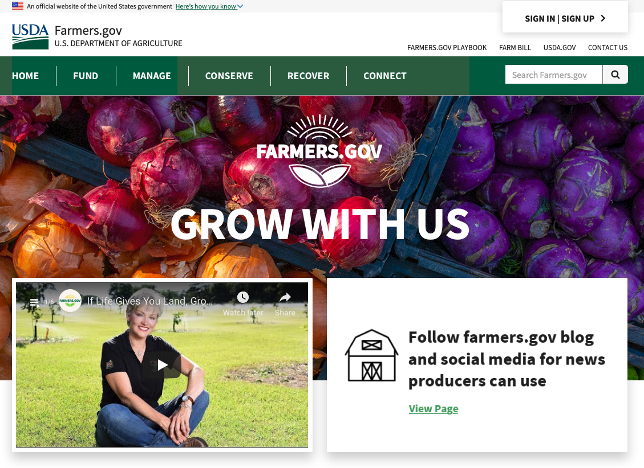
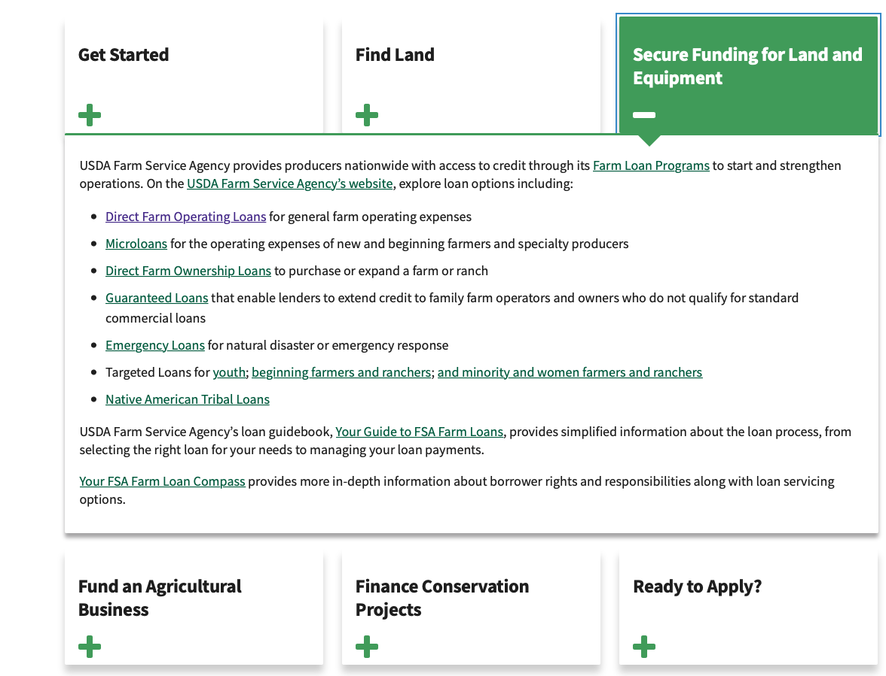
Farmers.gov A Digital Resource for Farmers, by Farmers
A “one-stop shop” where producers can easily:
Find information, tools, and applications
Engage with USDA, partners, and other producers
Access online self-service applications, educational materials, engagement opportunities, and business tools
… all while preserving and fostering long-held traditional relationships between local USDA offices and producers. Farmers.gov is a supplemental tool meant to enhance, not replace, interactions with local USDA offices and partners.

Slide 18
Customer Experience Division (CX) Deep Dive

Slide 19
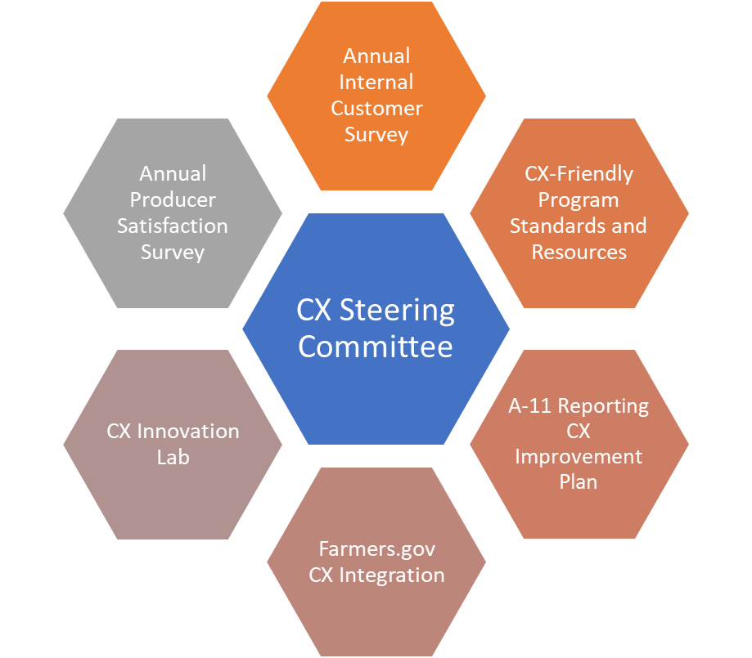
Key FPAC-wide CX Projects

Slide 20
Recent Farm Bill Priorities for Economic and Policy Analysis
Federal Register Rules to be published by the end of July:
Dairy Margin Coverage and Dairy Indemnity Payment Program
Emergency Conservation Program
Farm Loans and State Mediation
Crop Insurance Coverage and Associated Items
Other priorities:
Supplemental Disaster Assistance for 2018/2019
Market Facilitation Program (MFP2)
Agricultural Conservation Easement Program
Conservation Stewardship Program, Environmental Quality Incentives Program
Other items:
Setting data benchmarks for revised ARC/PLC program and working on re-designed website
ELS Cotton Competitiveness Program

Slide 21
Priority Communications Campaigns
Farm Bill: Highlights key changes and new programs for farmers, stakeholders, and staff.
Dairy: Drives sign-up for new Dairy Margin Coverage program as well as highlights broader suite of programs available to those in struggling industry.
Cover Crops: Demonstrates cross-agency collaboration on cover crops, which are a good farming practice for crop insurance purposes.
Farm Loan Discovery Tool: Part of a broader effort to highlight useful resources for producers on farmers.gov. Builds on the My Financial Information feature rolled out earlier this year as well as the efforts to provide farmer-facing information on USDA farm loans.

Slide 22
What is Next for FPAC Business Center?
Lessons Learned in the First Year

Slide 23
Optimization What's Next
RPA Robotics Process Automation
Currently identifying repeatable business processes to prepare processes for RPA
Data Analytics and Data Visualization
Expanding CXO Dashboards
Created a cross division working group (FMD and ISD)
Identifying tools to move reoccurring business processes out of email.
Managing the Audit and PBC requests through systems rather than email.
Updating and expanding ROOT across the FPAC
This Photo by Unknown Author is licensed under CC BY

Slide 24
Lessons Learned
Pay People – We did a great job on this.
Acquire Supplies – Perfect Storm of challenges
New Cards
Different Organization
Push to reduce the number of Card Holders
No Agency Code established for the Business Center
Process Inter Agency Agreements
New Funding Approval Forms few were Familiar with
New Processes Hindered Smooth Sign off and Approvals
Took Time to Establish Hand offs between Organizations
Shared Drive and Data Strategy
Systems Access Strategy

Slide 25
Questions?

