Slide 1
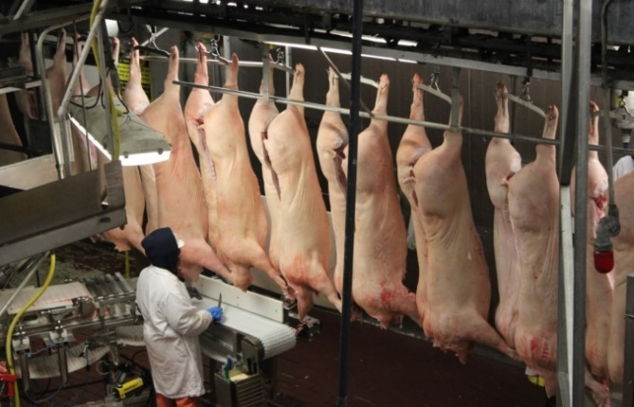
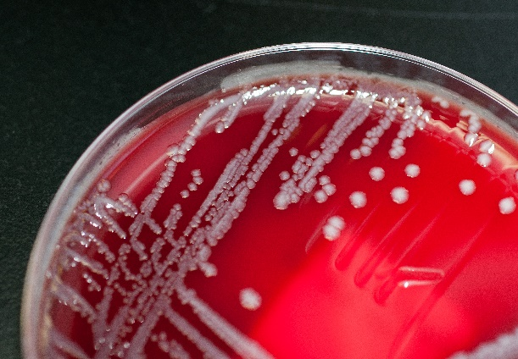
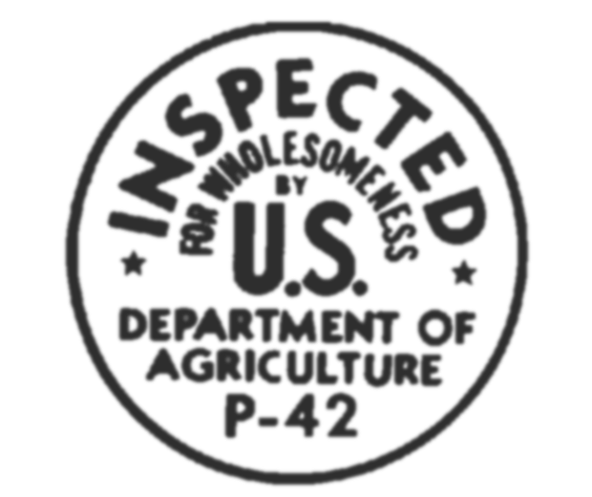
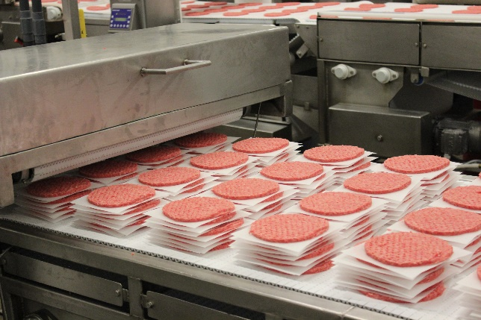
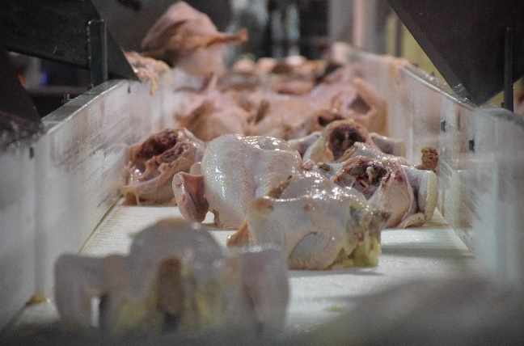
Food Safety and Inspection Service Protecting Public Health and Preventing Foodborne Illness

Slide 2
Food Safety an Inspection Service
Financial Management Training
Washington, D.C.
July 9, 2019
Cara LeConte, Chief Financial Officer
Food Safety and Inspection Service
U.S. Department of Agriculture

Slide 3
  Presentation Overview
Role of the Food Safety and Inspection Service within the US Food Safety System
FSIS History
Partnerships
Foodborne Illness
FSIS Modernization Efforts
Cell Cultured Food Products
Food Safety from Farm to Table
Consumer Education

Slide 4
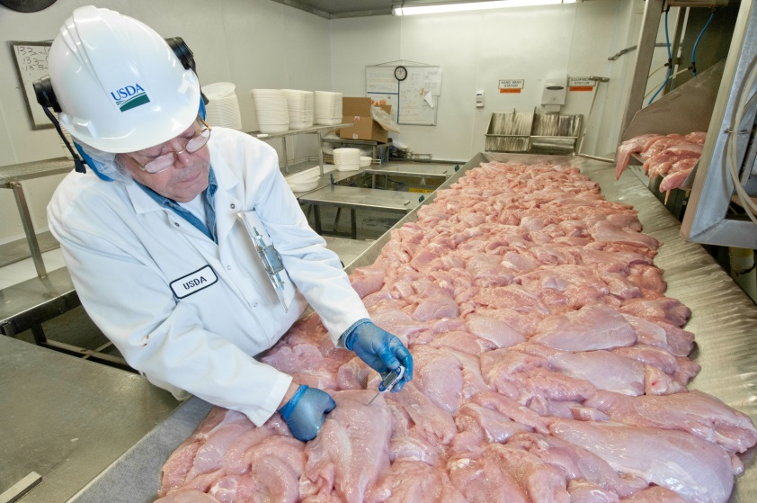
  FSIS’ Role within the US Food Safety System
We are the public health agency in the USDA and are responsible for ensuring that meat, poultry, and processed egg products are safe, wholesome, and accurately labeled.
Our Authority
Through a series of Acts, Congress empowers FSIS to inspect all meat, poultry, and processed egg products in interstate commerce.
Federal Meat Inspection Act (FMIA), 1906
Egg Products Inspection Act (EPIA), 1970
Humane Methods of Slaughter Act (HMSA), 1958
Poultry Products Inspection Act (PPIA), 1957
Agricultural Marketing Act (AMA), 1946
Notes:
FSIS is a public health and regulatory agency in the US Department of Agriculture that is responsible for ensuring the safety of meat, poultry and egg products. We get our regulatory authority from a number of acts established by the US Congress.

Slide 5
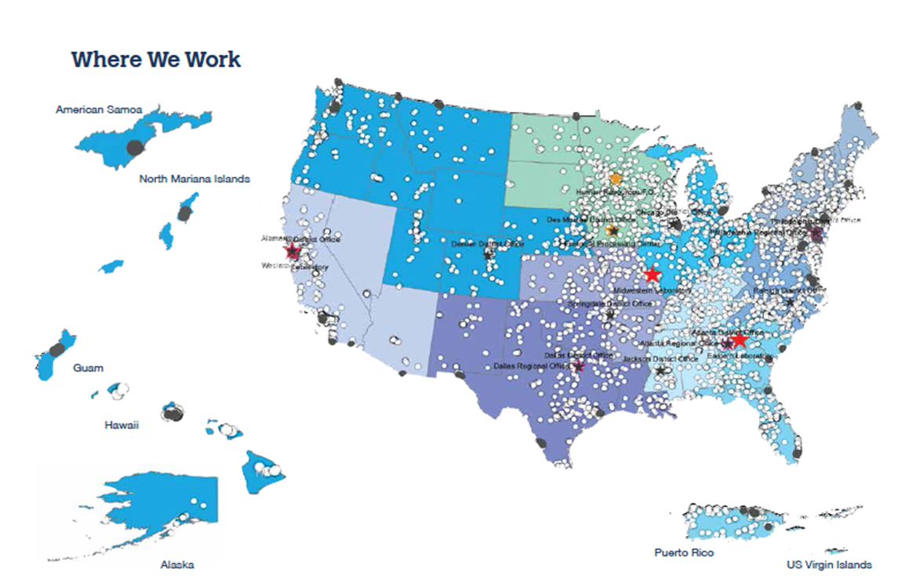
BY the Numbers
6,479 Establishments, 125 Ports of Entry, and
150,000 In-Commerce Facilities Nationwide

Slide 6
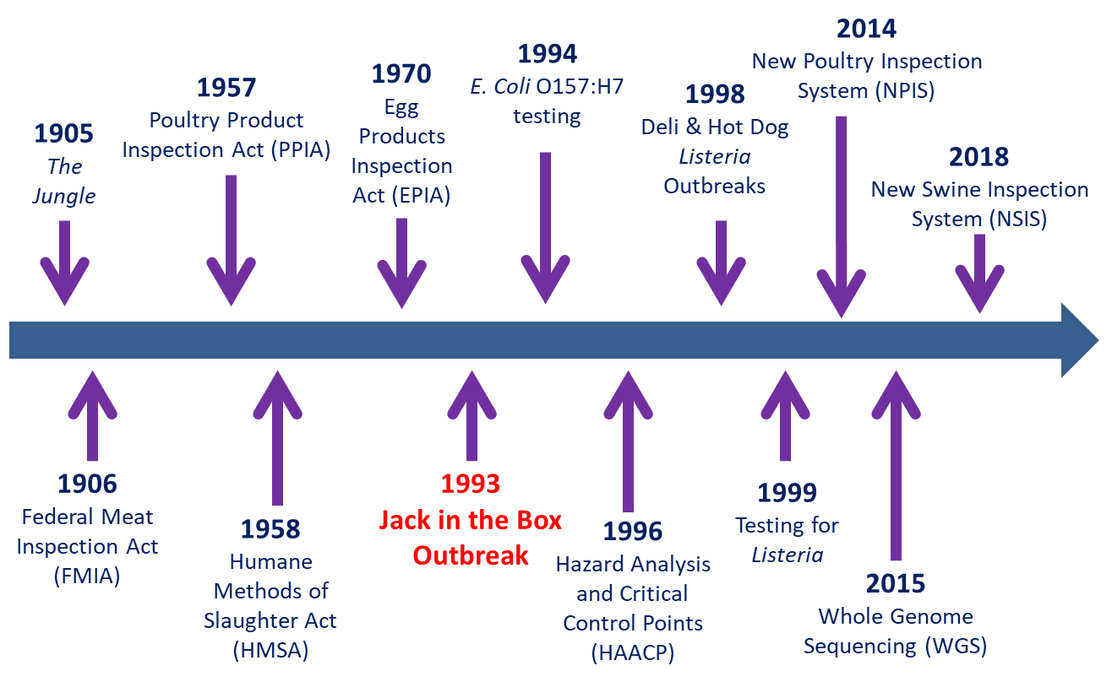
FFIS History

Slide 7
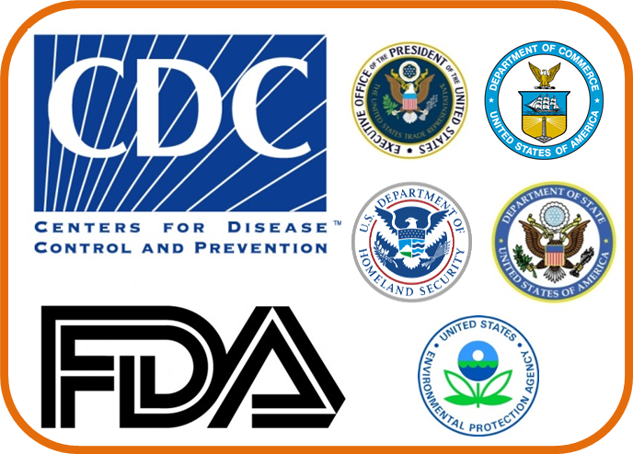
  Our Partnerships Make Us Stronger
To ensure the safety along
the farm-to-table continuum, FSIS collaborates with:
  Federal agencies
  States
  Tribal authorities
  Stakeholders
The public health community is more powerful
when it speaks with a single voice and shares
resources in service of a common mission.
Notes:
FSIS is one of a number of agencies with responsibilities related to food safety in the United States. It is important that the various agencies work together to be the most effective.
Products that USDA/FSIS oversees:
Domestic and imported meat and poultry (excluding game meat)
Products such as meat or poultry-containing stews, pizzas (such as a pepperoni pizza but NOT a cheese pizza), and frozen foods
Processed egg products, generally liquid, frozen, and dried pasteurized egg products (but NOT fresh shell eggs)
Siluriformes (which includes catfish)
Products that FDA oversees:
All domestic and imported food sold across state lines, including shell eggs, but NOT meat and poultry
Seafood, except siluriformes
Game meats
Shell eggs

Slide 8
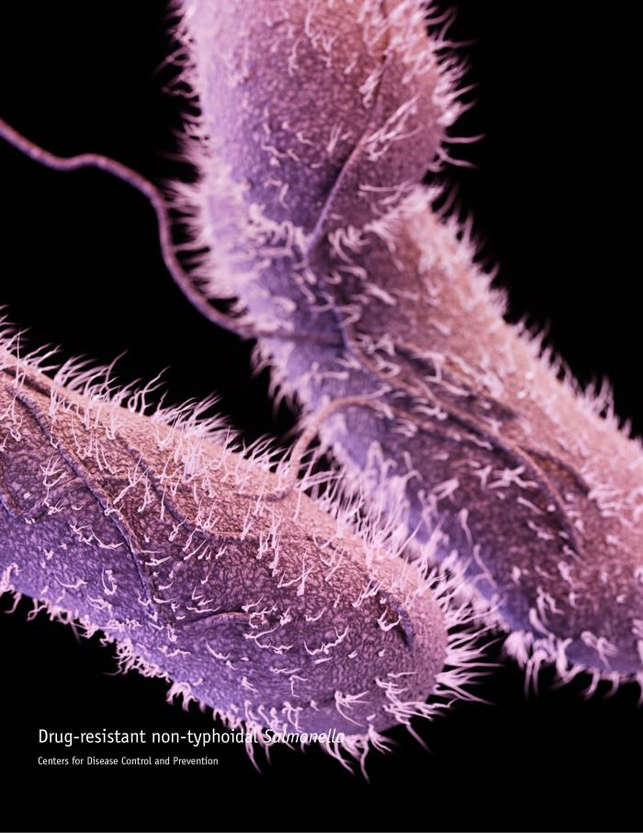
Foodborne Illness
Foodborne Illness:
Sickens more than 47 million Americans
Results in 128,000 hospitalizations
Causes 3,000 deaths
Many of those illnesses are from FSIS-regulated products
Notes:
Many of our policies and regulations focus on microbial hazards.
CDC estimates that foodborne illnesses sicken over 47 million Americans each year, with over 100,000 of those illnesses leading to hospitalization, and about 3,000 deaths.
Although not all of those illnesses are from FSIS-regulated products--many are--which is why preventing foodborne illnesses is one of FSIS’ main goals.
The four pathogens that most frequently affect our regulated products are: E.coli, Listeria, Salmonella, and Campylobacter.
FSIS ensures safety through a series of policies and regulations that define how establishments can operate to produce a safe and wholesome product. Through these efforts, FSIS has mandated that establishments have a Hazard Analysis and Critical Control Point (HACCP) plan. This process requires establishments to think about all of the hazards along the slaughter and production process to control and reduce risks and to ensure a safe product for consumers. FSIS verifies that these plans are in place and working effectively.
FSIS ensures that the infrastructure is in place to meet current and future challenges by developing, maintaining, and using innovative methodologies, processes, and tools to protect public health efficiently and effectively.
FSIS coordinates with food safety partners at the Food and Drug Administration (FDA), which regulates other food products sold in commerce such as leafy greens, bakery goods, and beverages, and at the CDC, which investigates and identifies causes of foodborne illnesses.

Slide 9
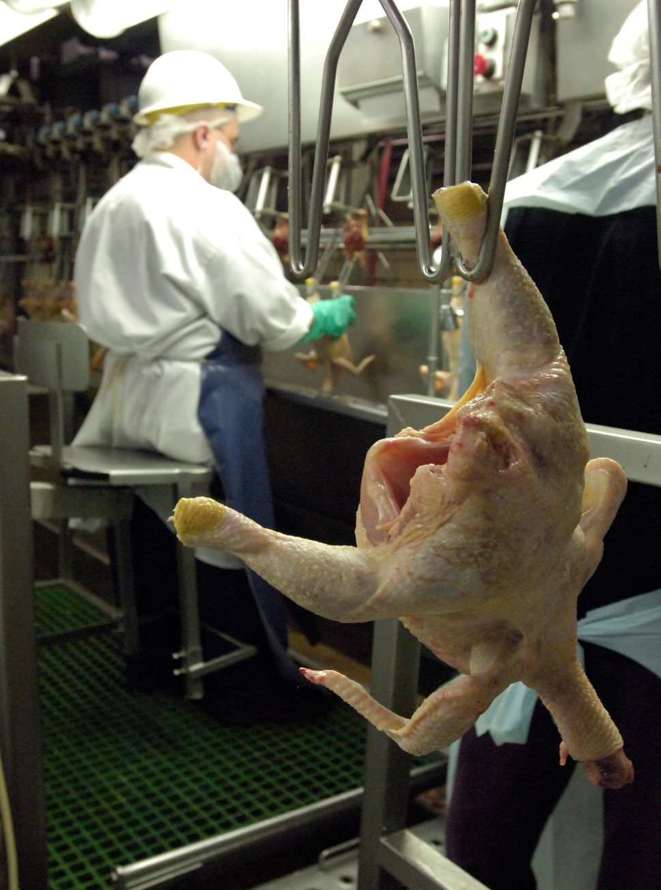
Poultry Modernization

Slide 10
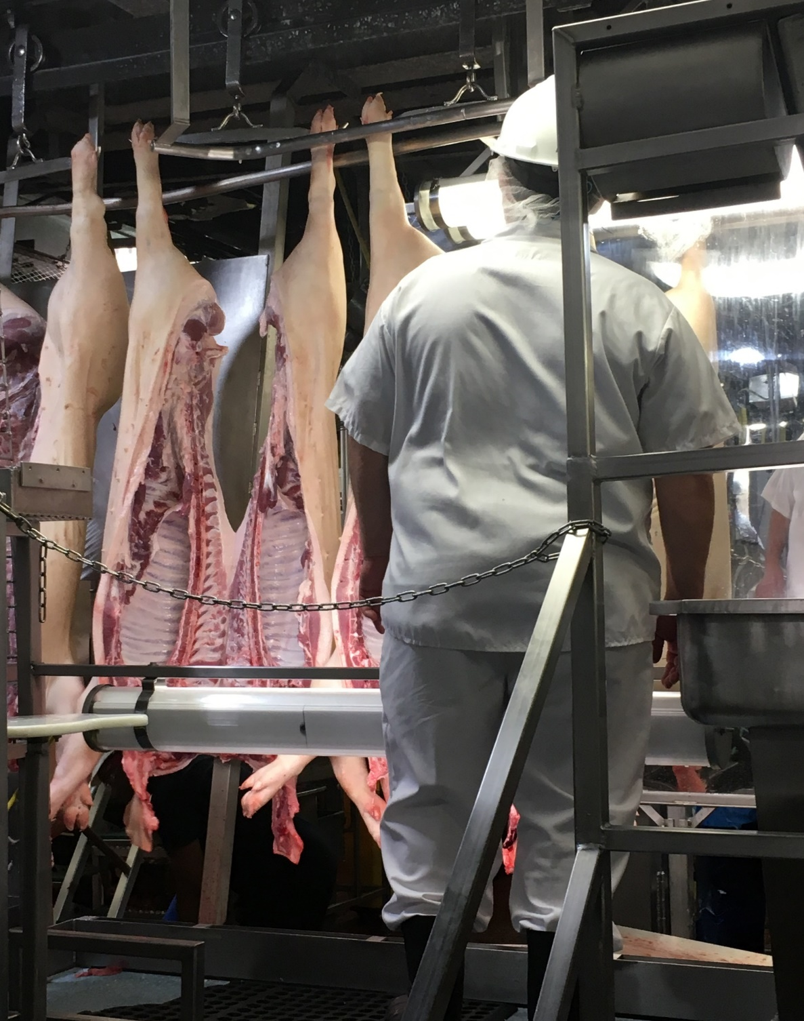
Modernization of Swine Slaughter Inspection
On February 1, 2018, the Food Safety and Inspection Service (FSIS) proposed to modernize how we inspect swine slaughter establishments with a goal of protecting public health while allowing for food safety innovations.

Slide 11
Egg Product Modernization
FSIS proposed to amend egg products inspection regulations by requiring official plants that process egg products to develop HACCP Systems and Sanitation Standard Operating Procedures and to meet other sanitation requirements consistent with the meat and poultry regulations.

Slide 12
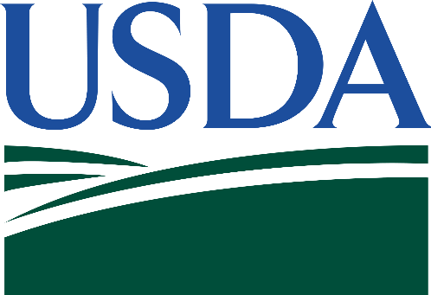
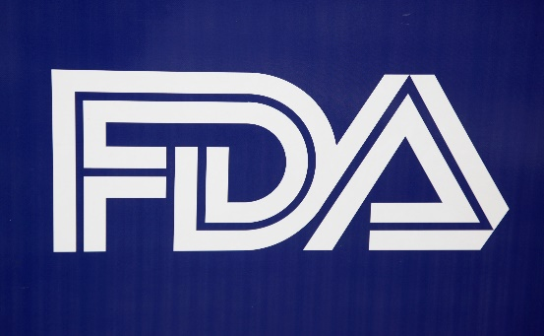
USDA-FDA Formal Agreement
Cell-Cultured Food Products
From Cell Lines of
Livestock and Poultry
Notes:
The food production industry continues to innovate and seek new ways to feed the world.
USDA and FDA signed a formal agreement recently that addresses the regulatory oversight of food products derived from the cells of animals.
Both agencies have important roles in the oversight of human food produced using this new technology.
This shared regulatory approach leads to the development, production, and labeling of a safe, wholesome and accurately labeled food products for consumers.
The formal agreement describes the oversight roles and responsibilities for both agencies and how the agencies will collaborate to regulate the development and entry of these products into commerce.
The joint regulation will ensure that meat and poultry products are produced safely and are accurately labeled.
Under the formal agreement, the agencies agreed upon a joint regulatory framework wherein FDA oversees cell collection, cell banks, and cell growth and differentiation.
A transition from FDA to FSIS oversight will occur during the cell harvest stage.
FSIS will also oversee the production and labeling of food products derived from the cells of livestock and poultry.
For these products to bear the USDA mark of inspection, establishments must meet all requirements of the Federal Meat Inspection Act (FMIA) and Poultry Products Inspection Act (PPIA).
One such requirement is to apply for and receive a USDA Grant of Inspection, which sets out the regulatory jurisdiction before the product can be sold in commerce.
There is a lot of interest in this new technology, which is still in the early stages of development.
There is a lot we still don’t know about the process and the safety of those processes, but we now have the regulatory structure defined.

Slide 13
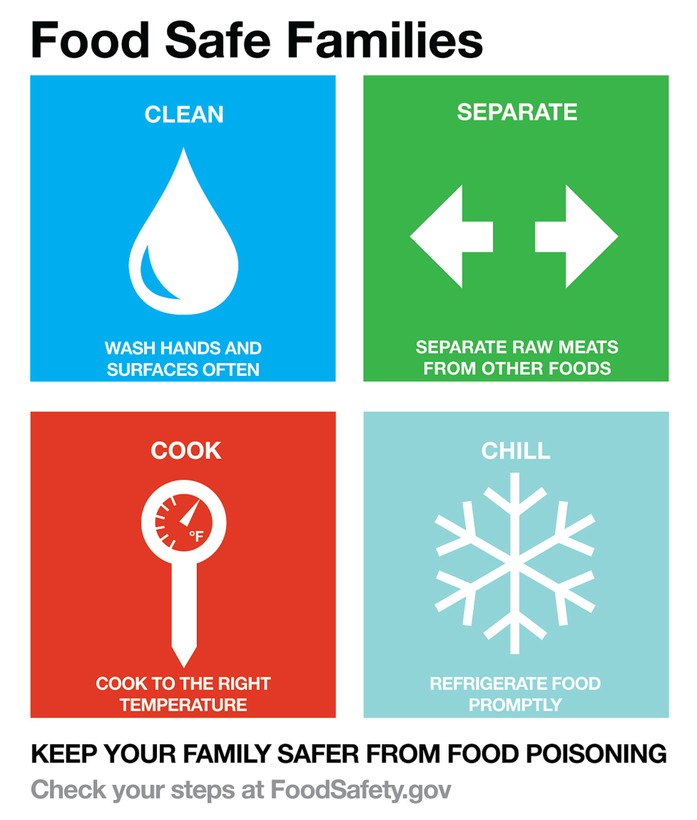

Food Safety from Farm to Table

Slide 14
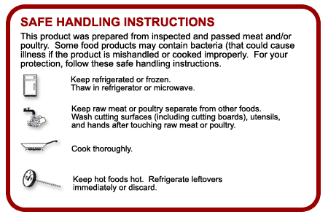
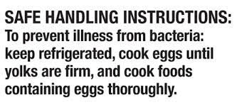
Consumer Education
Safe Handling Instructions
Notes:
As we continue to see advances in the pace of innovation, we also see an increased need for consumer education.
The Centers for Disease Control and Prevention (CDC) reports that every year an estimated 1 in 6 Americans (or 48 million people) get sick, 128,000 are hospitalized, and 3,000 die from eating contaminated food.
The Food Safety and Inspection Service (FSIS) has a mission to protect public health and prevent foodborne illness.
One of the ways that the agency accomplishes this mission is through consumer education.
In 1994, FSIS established the Safe Handling Instructions (SHI) label for raw and partially cooked meat and poultry products.
Since that time, the label has not been altered.
Recent research suggests that hygiene warning labels on meat and poultry products may help to improve consumer understanding and use of safe food-handling practices.
We are currently conducting research that will provide valuable data and insights on any potential SHI label revision.
I’m also a proponent of educating consumers themselves so they can make sure that the food on their dinner table is safe and wholesome.
Each of you in this room also has an important role as you share food safety information with consumers across the country.

Slide 15
Year-by-Year Integrated, Holistic Approach
Activity (Year) | Year 1 FY17 (Complete) | Year 2 FY18 (In Progress) | Year 3 FY19 | Year 4 FY20 | Year 5 FY21
Observational Experiment w/ Microsampling | “Cook” Messages: Food thermometer usage Pathogen transfer | “Clean” Messages: If wash/rinse raw chicken before cooking Pathogen transfer | “Cook” Messages: Prepare not-ready-to-eat (NRTE) frozen chicken product | “Clean, Separate, Cook, and Chill” Messages: Prepare hamburgers Prepare ready-to-eat (RTE) food | “Separate and Chill” Messages: Intact beef Leftovers
Focus Groups |  | Topics focused on consumption of raw/not fully cooked meat & poultry, if wash/rinse poultry before cooking, etc. |  | Investigate topics gleaned from previous research and any emerging food safety topics
Nationally Representative Web-based Survey |  |  | Questions re: recall/outbreak awareness, message fatigue, food safety info sources, food prep, etc. |  | Investigate topics gleaned from previous research and any emerging food safety topics
Notes:
In 2018, FSIS announced the results of a multi-year observational study research project investigating food handling by consumers.
The preliminary results of the observational study, conducted in collaboration with RTI International and North Carolina State University, show some concerning results.
The study showed that when it comes to handwashing before meals, consumers are failing to properly clean their hands 97% of the time.
The research team is conducting five separate iterations of a meal preparation study to address specific consumer behaviors and to determine the effectiveness of a behavior change intervention.
Consumer behaviors we are studying, include:
COOK: Properly cooking food and using a food thermometer;
CLEAN: Handling raw poultry correctly, not washing it, and preventing cross-contamination;
COOK/SHI: Following cooking and safe handling instructions on a product package to cook a frozen chicken product;
CLEAN, SEPARATE, COOK, and CHILL: Correctly prepare multiple dishes, prevent cross-contamination, cook according to instructions, and chill within food safe conditions.
SEPARATE AND CHILL: Correctly separating leftovers in small batches to chill them within food safe conditions; and
These meal preparation studies are part of a larger 5-year annual study that also includes two focus groups and two web surveys.
In this table you can see the activities that will be conducted each year of the contract and the associated behavior.
We have completed Year 1 and are currently conducting the Year 2 study.
The Year 3 observational study will begin in October 2019.
The focus group studies and web-based surveys will be conducted to focus on emerging food safety topics and behaviors, including those that we learn about from the ongoing research.
In particular, we are planning a focus group on addressing a common consumer behavior – washing raw poultry and a web survey on message fatigue and recall and outbreak awareness by consumers.
We will conduct a second focus group and web survey on other behaviors as we continue to gather information from the ongoing studies to refine emerging food concerns.

Slide 16
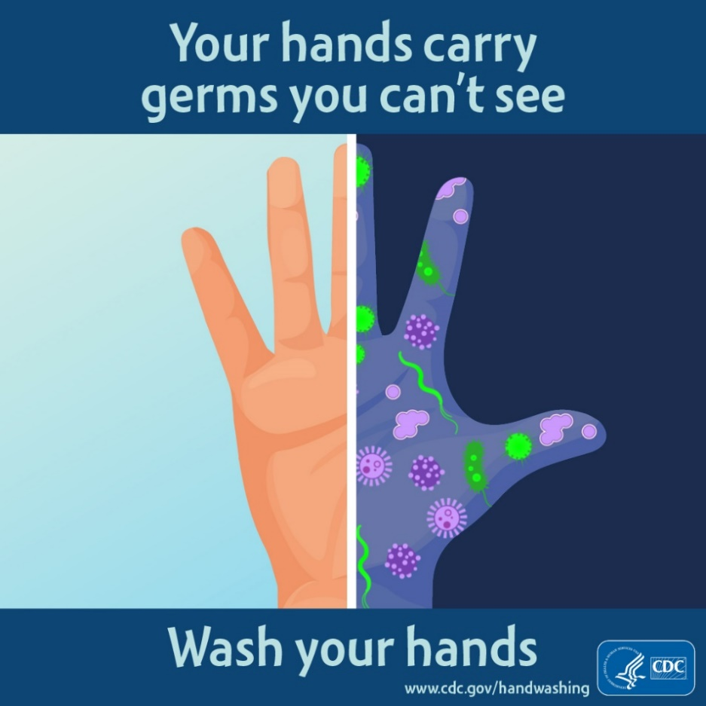
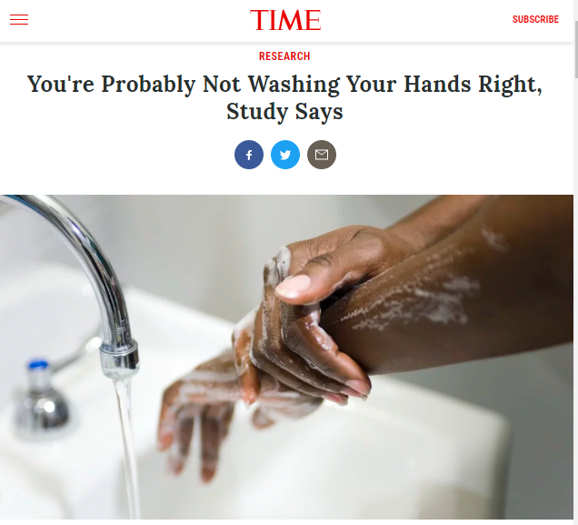
Year 1: Observational Study Handwashing Results
Handwashing
Turkey Burgers:
Unsafe below 165°F
Notes:
The truth is that rushed handwashing can lead to cross-contamination of food and other surfaces, resulting in foodborne illness.
The study shows that most consumers failed to wash their hands for the necessary 20 seconds, and that numerous participants did not dry their hands with a clean towel.
The study showed that when it comes to handwashing, consumers are failing to properly clean their hands 97% of the time.
The study showed participants spreading bacteria from raw poultry onto other surfaces and food items in the test kitchen.
48% of the time they contaminated spice containers used while preparing burgers;
11% of the time they spread bacteria to refrigerator handles; and
6% of the time they tainted salads destined for the dinner table due to cross-contamination.

Slide 17
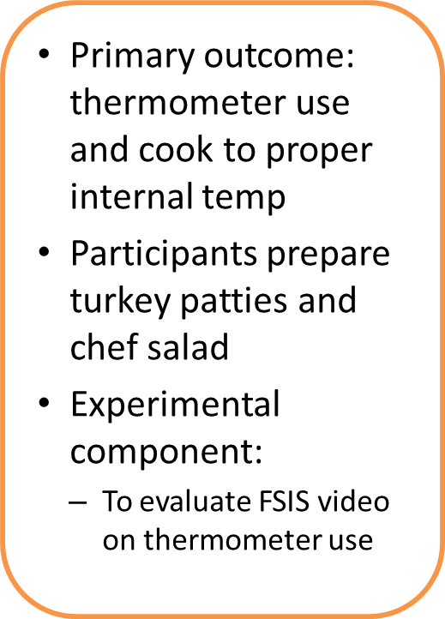
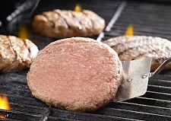
Year 1: Observational Cooking Study Results
Thermometer Use
Turkey Burgers:
Unsafe below 165°F
Notes:
We have completed our first observational study to evaluate if consumers can properly cook a turkey burger and test the internal temperature using a food thermometer.
We asked participants to prepare turkey patties and a chef salad while being videotaped in a test kitchen.
We had two groups of participants.
The treatment group watched an FSIS video on thermometer use before cooking.
The control group did not watch the FSIS video before cooking.
We also examined pathogen transfer in the test kitchen.
The burgers were inoculated with a harmless surrogate to trace and test for cross-contamination events by the participants.
We tested both ready-to-eat (RTE) foods and work surfaces for pathogen transfer.

Slide 18
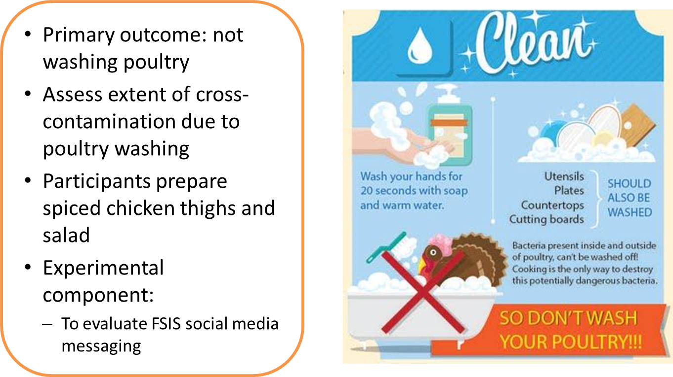
Year 2: Observational Cleaning Study (In Progress)
Notes:
For Year 2, which is currently in process, the focus is on CLEAN.
We are investigating consumer response to FSIS social media messaging on poultry washing.
We have over 300 participants in the study.
Study participants are being pre-screened so that only consumers who self-report washing their chicken before cooking are recruited.
Participants in the treatment group receive a series of 3 emails with information on the CLEAN message and why consumers shouldn’t wash their poultry before taking part in the study.
Participants prepare spiced chicken thighs and a salad while being videotaped in test kitchen.
The chicken is inoculated with harmless tracer bacteria and we are collecting microbiological samples before the participant cleans the kitchen.
Thus, this study will provide detailed data on the extent of cross-contamination in the kitchen environment due to poultry washing.
This study is so important because large-scale studies on chicken washing are not currently available.
We are also collecting information on handwashing, washing cutting boards, washing kitchen surfaces, and using a food thermometer.

Slide 19
Questions
Questions

