Slide 1
G-Invoicing
Program Update
Keith Jarboe
Bureau of the Fiscal Service
July 11, 2019

Slide 2
Executive Summary
Initiative Overview
Government Invoicing (G-Invoicing) is the long-term sustainable solution to improve the quality of Intragovernmental Transactions (IGT) - Buy/Sell data in support of more accurate financial management by Federal Trading Partners
G-Invoicing will implement a Federal Intragovernmental Data Standard (FIDS) and a platform through which Federal Trading Partners will broker IGT Buy/Sell transactions
A transparent IGT Buy/Sell data repository will support reconciliation, reduce adjustments, and drive proper Governmentwide IGT Buy/Sell eliminations
Governmentwide IGT Buy/Sell Facts – Fiscal Year 2018
IGT Buy/Sell transactions identified in GTAS totaled approximately $780 Billion
Elimination of differences between Trading Partners totaled $21 Billion
92 Federal Program Agencies actively engage in IGT Buy/Sell activity, leveraging approximately 700 Agency Location Codes (ALCs)

Slide 3
Program Update (System)
System Development
Release 2.3 – Performance Transaction Exchange Functionality (August 2019)
Future Program Increments targeted for early FY 2020 include:
  Performance Validation
  Settlement Generation
  GT&C Enhancements
Executive Touchpoints With ERP Vendors
Fiscal Service Executive Leadership conducted meetings with ERP Vendors in early 2019 to discuss timelines and costs to incorporate G-Invoicing into future offering(s)
  Emphasized need for this information for Federal Program Agencies (FPAs) to complete G-Invoicing Implementation Plans
  Plans have been communicated through the FMSC G-Invoicing Sub-groups and Vendor coordinated working sessions
  The G-Invoicing website will be updated with ERP Vendor points of contact and/or references to software upgrade approaches

Slide 4
Program Update (Policy)
Policy and Guidance
September 2018 - TFM Bulletin 2018-10 - Mandated that all FPAs who process IGT Buy/Sell transactions must implement G-Invoicing by June 30, 2021
May 2019 - TFM Chapter 4700 – Appendix 6 was published – (Incorporates Bulletin 2018-10)
G-Invoicing Implementation plans were due from all FPAs on June 28, 2019. Templates available on Fiscal Service G-Invoicing website https://www.fiscal.treasury.gov/g-invoice/
G-Invoicing Program Guide for Basic Accounting and Reporting – Provides guidance regarding proper accounting treatment for IGT Buy/Sell transactions processed through G-Invoicing. Published February 2019 https://www.fiscal.treasury.gov/ussgl/resources-g-invoicing-program-guide.html
G-Invoicing System Integration Guide – Details how FPAs may utilize automated data exchanges to communicate IGT Buy/Sell activities to/from G-Invoicing. https://www.fiscal.treasury.gov/files/g-invoice/G-InvoicingSystemIntegrationGuide1.0.pdf
Fiscal Service has published a new 7600 A & B Forms

Slide 5
Program Update (Data Standard)
Federal Intragovernmental Data Standard (FIDS)
Interface Specification for Performance Transactions and Remittance data updated in April 2019
Latest updates available on G-Invoicing Website
Continued refinement based collaborative feedback
OMB Data and Policy Alignment
Multiple discussions between OMB and Treasury to discuss IGT FAR alignment occurred in April.
Representatives from OMB (OFFM, OFPP), Treasury (G-Invoicing Program), GSA, DOT, DoD, DHS, VA, and NASA
Analyzing FIDS to Identify Potential Gaps, Adverse Effects of Potential Gaps, Remedies and Policy recommendations

Slide 6
Common Questions & Concerns
Implementation Plan Challenges
What if I don’t know what my Vendor or system upgrade timelines are?
  Stay engaged with the Financial Management Standards Committee (FMSC) Subgroups and any specific working groups sponsored by your Vendor
What if I don’t know the implementation timelines for my top trading partners?
  Engage in conversations with your key trading partners
  Focus on your Agency’s readiness and any internal Buy/Sell activity
  As plans are gathered and updated, Fiscal Service will work to share information
What if I know I won’t have all my transaction in G-Invoicing by June 30, 2021?
  Tell us what you will have in and what the dependencies are for other transactions
  Establish pilots with key trading partners and internally
Keep Us Informed: Ensure that you are leveraging all available avenues to gather information for your quarterly Implementation Plan update

Slide 7
Common Questions & Concerns
I’m Not Sure What Business Activity Is Required To Be Processed Through G-Invoicing
Will I need to process all of my IPAC activity in G-Invoicing?
  Only IGT Buy/Sell transactions should transition to G-Invoicing by June 30, 2021
  IPAC will remain available for non-Buy/Sell transactions
What exactly is “Buy/Sell”? I’m not sure which transactions are “In” or “Out”
Still have questions?
  Document your business scenarios. Contact us directly, work with your AIT representative, leverage ITWG and FMSC.

Slide 8
Common Questions & Concerns Cont.
We Process A LOT of IGT Buy/Sell Transactions
What should I do about my open Agreements and Orders on June 30, 2021?
  Assess your typical mid-year volume of in process orders and provide that information on your implementation plan
  Focus on your internal trading partners and work to establish new agreements and orders in G-Invoicing prior to June, 30, 2021
  Identify opportunities to transition by business line
  Fiscal Service is assessing API upload options for “in-flight” Buy/Sell activity
HELP! – This Is All New To Me. Where Do I Start?
Contact Fiscal Service
  An Agency Implementation Team representative will be assigned to assist you
Visit the G-Invoicing website
  Review the G-Invoicing Implementation Playbook, System Integration Guide, and other reference material
  Register for Training, Webinars, and Working Groups

Slide 9

Steps to Implementation and Onboarding
Onboarding Touchpoints
Demos
Training
Focus Group Meetings
FPA Work Sessions
Organize a Cross-Functional Team
Review Elements Against FIDS
Inventory Data
Design Plans for GT&C, Orders, Performance
Perform Change Management
Update Systems
Test Systems
Process Transactions
Implementation Playbook Checklist

Slide 10

We’re Here To Help
Agency Implementation Team (AIT)
Education
  Business Process Walkthroughs
  Application Demos
  User Training
Account Establishment
Enrollment Assistance
Production Support
  Engagement | Outreach | Support

Slide 11
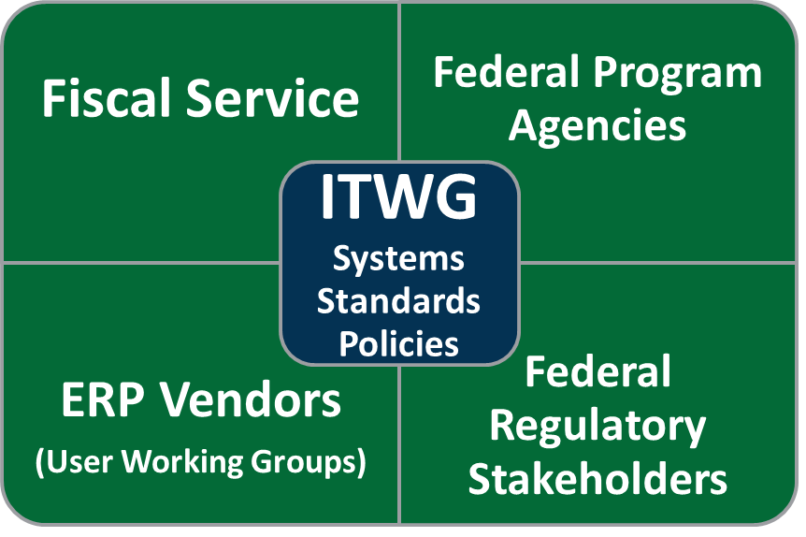

Collaboration Paves The Way
Intragovernmental Transactions Working Group (ITWG)
A venue for Federal Program Agencies to review, discuss and provide feedback on the requirements and functional/technical design of the G-Invoicing Solution
Leveraged to develop and refine the FIDS and related IGT Policy
https://www.fiscal.treasury.gov/g-invoice/
Financial Management Standards Committee (FMSC)
Forum that provides Federal Program Agencies an opportunity to collaborate on resolving Financial Management issues
To have a voice in developing FMLoB Financial Management Standard References
Engage with Federal FM software providers to convey requirements and promote standardized solutions
https://www.fiscal.treasury.gov/fit/financial-mgmt-standards-committee.html

Slide 12

The Road To Implementation
Continued Drive Towards a Longstanding Solution
G-Invoicing System – Common, long-term, sustainable solution where FPAs will exchange and store IGT Buy/Sell transaction data
Federal Intragovernmental Data Standard – Collaborative maintenance of a standard data structure in support of the IGT Buy/Sell business line
Intragovernmental Buy/Sell Policy – Leverage collaborative working groups to define/refine guidance
The Bumps In The Road
Accommodate Varying Business Processes and Missions
Support Federal ERP System Providers
Manage the immense scale of activity to be converted
The Destination
Improvements in Communication, Accountability, Transparency

Slide 13

Contacts & References
For IGT Program Management and Agency Outreach Support
Chris Beck
Manager, General Ledger and Advisory Branch
Bureau of the Fiscal Service
(304) 480-7122
christopher.beck@fiscal.treasury.gov
Keith Jarboe
IGT Agency Outreach – Engagement & Onboarding Staff
Bureau of the Fiscal Service – Fiscal Accounting
202-874-7818
keith.jarboe@fiscal.treasury.gov
For Intragovernmental Transactions Working Group Information
  IGT@fiscal.treasury.gov
  Alex Abshire (alexander.abshire@fiscal.treasury.gov)
  Wesley Vincent (wesley.vincent@fiscal.treasury.gov)
  https://www.fiscal.treasury.gov/g-invoice/

