Slide 1



Office of Inspector General Mission and Role in USDA

Slide 2
Overview
Background
Mission and Goals
Authorities
Organization
Offices
Financial Management Division (FMD)
Financial Management Activities
Key Links

Slide 3
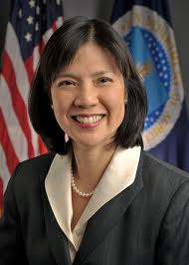
About USDA OIG
Administratively est. in 1962
Legislatively est. by the IG Act of 1978
Phyllis K. Fong, IG since Dec. 2, 2002
IG appointed by President and confirmed by the Senate
Member on the Council of the Inspectors General on Integrity and Efficiency
Notes:
USDA OIG was administratively established by the Secretary of Agriculture in 1962 following a major criminal fraud scandal affecting several agencies within USDA.
Legislatively established by Congress under the Inspector General Act of 1978 (Public Law [P.L.] 95-452), as amended.
IGs are nonpartisan and are selected without regard to political affiliations. Unlike other political appointees, IGs typically remain in office when Presidential Administrations change. This practice has been followed since the 1980s.
IG is a political appointee that serves at the leisure of the president. The president can remove the IG, but has to give Congress 30 days notice.
Since the 1980s, IGs do not change with change in the administration.
Maintain independence.

Slide 4
USDA OIG’s Mission, Vision, and Core Values
USDA OIG’s Mission
To promote economy, efficiency, and integrity in USDA programs and operations through the successful execution of audits, investigations, and reviews.
USDA OIG’s Vision
Our work advances the value, safety, and integrity of USDA programs and operations.
USDA OIG’s Core Values
Integrity – Objectivity - Diversity

Slide 5
USDA OIG’s Strategic Goals
USDA OIG’s Strategic Goal 1
Strengthen USDA’s ability to implement and improve safety and security measures to protect the public health, as well as agricultural and Departmental resources.
USDA OIG’s Strategic Goal 2
Detect and reduce USDA program vulnerabilities and deficiencies to strengthen the integrity of the Department’s programs.

Slide 6
USDA OIG’s Strategic Goals (con’t)
USDA OIG’s Strategic Goal 3
Provide USDA with oversight to help it achieve results-oriented performance.
USDA OIG’s Strategic Goal 4
Recruit, develop, and maintain a highly qualified and diverse workforce while fostering a work environment that promotes productivity, innovation, excellence, and employee satisfaction.

Slide 7
USDA OIG’s Authority
Where does it come from?
IG Act of 1978, as Amended
Requires the IG to independently and objectively
  Conduct and supervise audits and investigations of USDA’s programs and operations;
  Promote economy, efficiency and effectiveness
  Detect fraud and abuse within USDA and in non-Federal entities that receive USDA money; and
  Report to the Secretary and Congress semiannually.

Slide 8
IG Act of 1978
Provides Authority to OIGs
  Obtain access to information and documents within their agency in relation to any program or operations;
  Request information or assistance from any Federal, State, or local agency;
  Subpoena records and documents from any non-federal entity or individual;
  Take statements under oath; and
  Have direct and prompt access to the agency head for any purpose pertaining to the IG’s responsibilities.

Slide 9
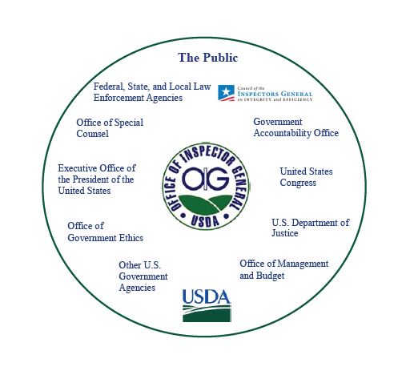
Who are our Stakeholders?
Notes:
Who gets our reports: Forest Service fall under other committees:
Senate Committee on Energy and Natural Resources
Senate Committee on Appropriations; Subcommittee on Interior, Environment, and Related Agencies
House Committee on Natural Resources;

Slide 10
Office of Audit
Responsible for:
Conducting independent and objective audits, inspections, and reviews of USDA programs and activities such as:
  food safety, nutrition, farm, research, and rural development programs;
  the security of information technology systems and applications; and
  financial statements and compliance with improper payment reporting requirements that must be performed annually.
Promoting economy, efficiency, and effectiveness.
Preventing and detecting fraud, waste, and abuse.
Reviewing pending legislation and regulation.
Keeping USDA officials and the Congress informed.

Slide 11
Office of Investigations
Responsible for:
Conducting and supervising criminal and civil investigations;
Obtaining and executing search warrants, and, when needed, making arrests;
Working in coordination with Federal, State, and local law enforcement agencies; and
Managing the OIG Hotline at:
https://www.usda.gov/oig/hotline.htm
Notes:
The types of investigations conducted by OIG’s Special Agents involve criminal activities such as fraud in subsidies, price support, benefits, and insurance programs; false statements, false claims, significant thefts of Government property or funds; bribery; extortion; smuggling; and assaults on employees;
OI investigates allegations of: Attendance matters, Using drugs/alcohol on the job, Failing to follow procedures, Neglect of duty, Misuse of govt. vehicles/assets, Workplace violence, Bribery, Gratuities, Assault,
Special Agents provide emergency law enforcement response to USDA declared emergencies and suspected incidents of terrorism affecting USDA regulated industries, as well as USDA programs, operations and personnel.

Slide 12
Office of Data Sciences
Responsible for:
Serving as a center for strategic analysis and policy review;
Applying data analytics to support OIG audits and investigations;
Conducting predictive data analysis, statistical sampling, modeling, data mining, and warehousing; and
Uncovering potential fraud patterns and identifies anomalies.

Slide 13
Office of Management
Responsible for:
Supporting OIG’s mission fulfillment through four divisions;
Delivering financial, human resources, procurement, and IT services; and
Providing valuable support to the other units for continuity of operations.

Slide 14
Other OIG Offices
Office of Counsel
Office of Compliance and Integrity
Office of Diversity and Inclusion

Slide 15
Financial Management Division
Responsible for all financial management activities related to OIG’s programs and operations;
Develops and maintains an integrated agency financial system including reporting controls which supports both accounting and budget transactions; and
Directs, manages, and provides policy guidance and oversight of agency financial personnel, that support financial activities.

Slide 16
FMD’s Mission
Complies with applicable laws, policies, directives and circulars, accounting principles, financial standards, and internal control standards;
Provides for complete, reliable, consistent, and timely financial information which is prepared based on a uniform basis; and
Ensures the development and reporting of budget and accounting information that is accurate, traceable to standards, and transparent.

Slide 17
USDA OIG-FMD Financial Activities
Develops Financial Management Operating Procedures that support OIG’s strategic goals and improve financial management activities;
Performs financial activities that help to ensure accuracy, integrity, and supports the reduction of improper payments;
Improves end-to-end business processes affecting OIG’s financial status;

Slide 18
USDA OIG-FMD Financial Activities Cont.
Coordinates the data needed for OIG’s budget and provides budget submission to the OIG for final approval before forwarding to OBPA;
Provides information needed to support any audits on OIG’s financial data in accordance with OMB Circular A-133; and
Ensures financial statements are timely, reliable ,and accurate.

Slide 19
FMD Team
Total of 8 Staff Members
Two Chiefs/Supervisors
    Accounting- Ms. Toris O’Neal
    Acting Budget- Ms. Rhonda Holder
3 Accountants
  Ms. Ebony Engram
  Ms. Andrea Drew
  Mr. Garri Azrelyvant
2 Budget Analysts
  Ms. Beverly Howard
  Ms. Patricia Gunderson

Slide 20
Key OIG Links
Home Page:
https://www.usda.gov/oig/
Annual Plan: https://www.usda.gov/oig/webdocs/2019_Annual_Plan.pdf
Audit Reports:
https://www.usda.gov/oig/rptsaudits.htm
Semiannual Reports to Congress:
https://www.usda.gov/oig/rptssarc.htm

Slide 21
Questions?
Robert Huttenlocker, OIG-OM
  Robert.Huttenlocker@oig.usda.gov
  (202) 720-6879
Kimberly Johnson-Miller, OIG-FMD
  Kim.Johnson-Miller@oig.usda.gov
  (202) 572-0268

