Slide 1
SAP Governance, Risk, and Compliance (GRC)10.1 and RMF Changes and Privacy
Tim Howell - Security Admin Lead SSCD
Scott Roy - Security Compliance Lead SSCD

Slide 2
GRC 10.1
New Features
New processes
Common Process issues
Job Aids

Slide 3
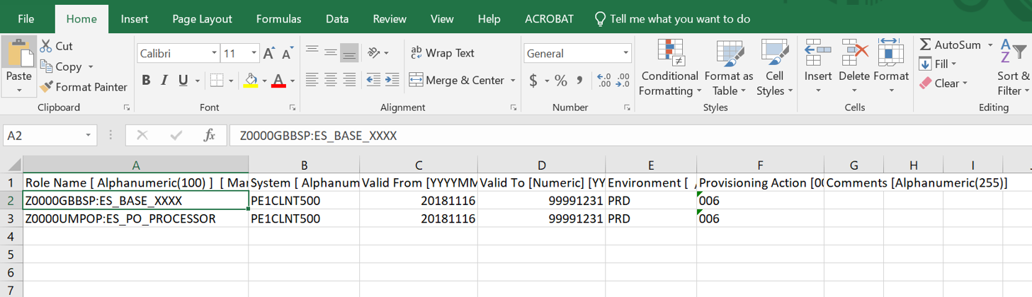
GRC 10.1 New Features
Role import
Copy Request

Slide 4
Role import
Problem : Adding roles to an access request can be tedious and error prone.

Slide 5
Role Import
How does Role Import address this.
Allows for the mass upload of roles from an excel spreadsheet
This spreadsheet can be used multiple times

Slide 6
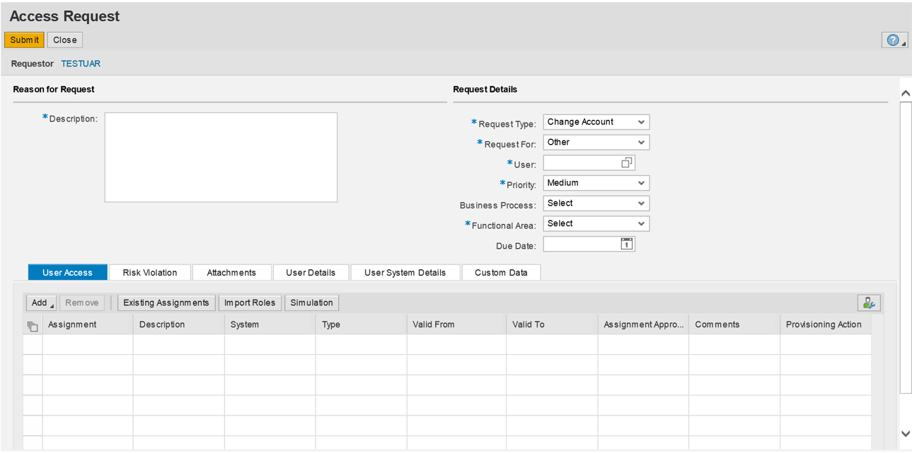

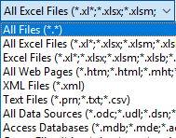
Role Import

Slide 7
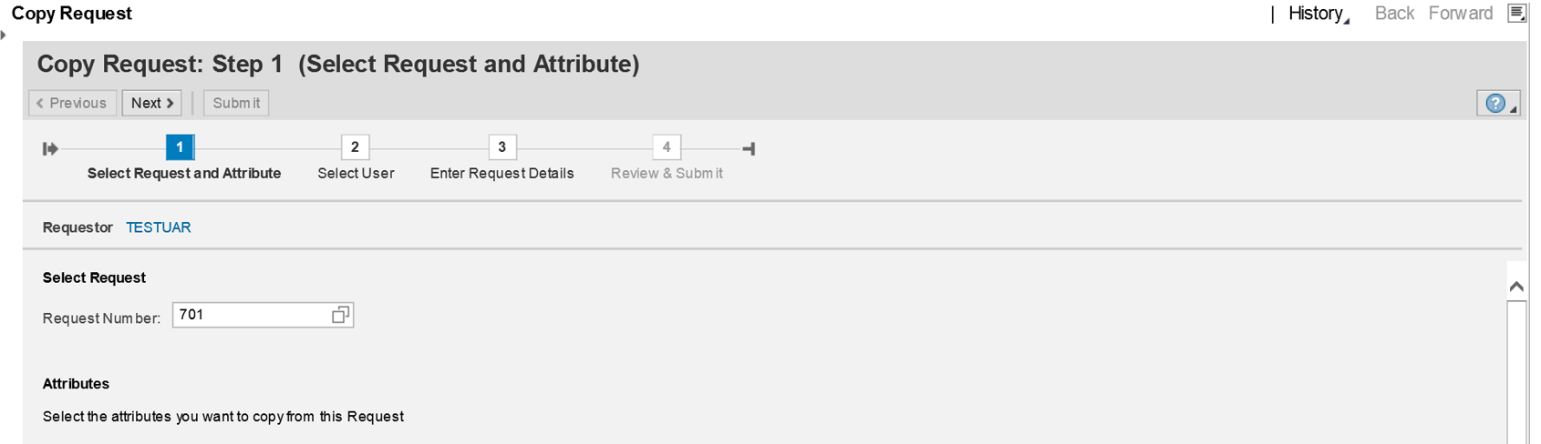
GRC 10.1 New Features
Role import
Copy Request

Slide 8
Copy Request
Problem : You have multiple similar requests that need to be replicated.

Slide 9
Copy Request
How does Copy Request address this.
It allows multiple parts of a previous request (User information, Roles, Request Details, etc…) to be copied into a new request.
* Draw back to using this method – You cannot change the request type of a copied request. ie: If the original request is a change request you will not be able create a new user request.

Slide 10
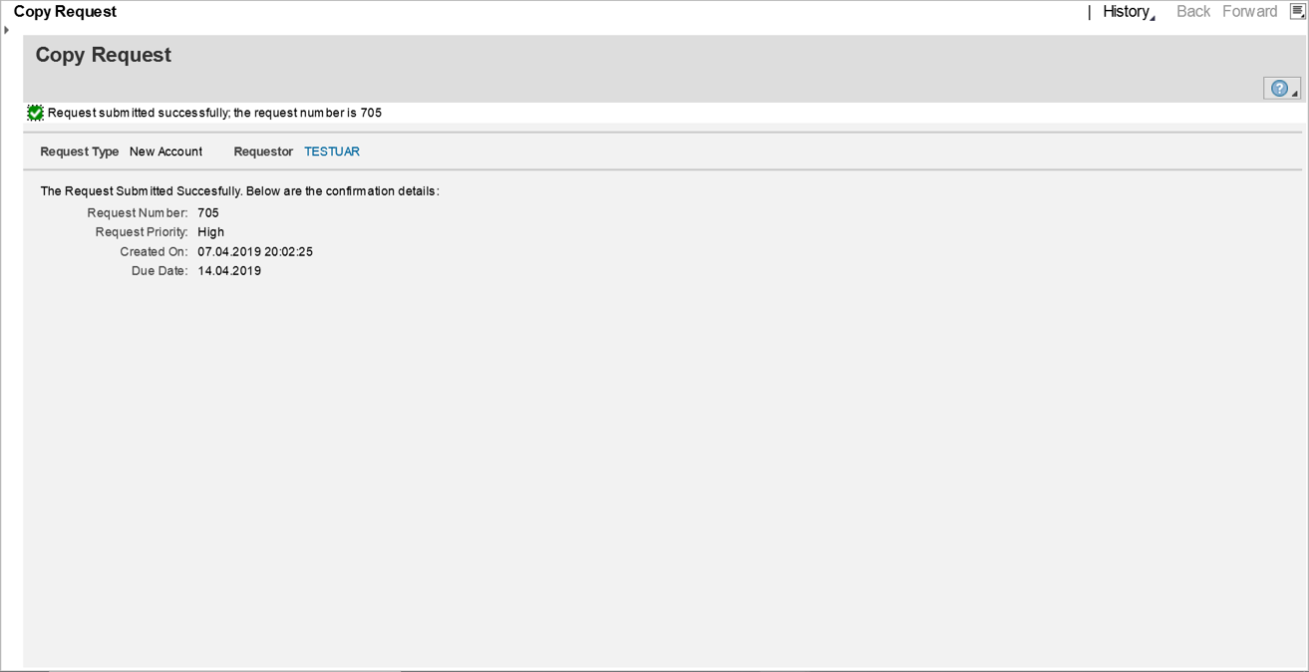
Copy Request

Slide 11
GRC 10.1 New Processes
  Update User Information via GRC request
    User’s Name
    Email
    Address
    Validity Dates
    Etc….

Slide 12
Update User Information
Why
  Not all users information was being updated in all systems.
  Portal information must be updated manually by a Central Security Administrator.
  It is difficult to track changes to user accounts during audits.

Slide 13
Update User Information
Use the “Existing Assignments” Button to select all of the systems the user has an account in.
Add all of the systems the user has an account in.
One role must be selected or else the request will not be processed.
If the user’s email, name, or company change this role will need to be the “Base Permission” Role. That way the Central Security Team can updated the Portal Account.
If the validity dates are changed select and agency role so that the Agency Security Admin can approve.

Slide 14
Process Issues
Transfers
  A GRC Remove request must be entered to ensure all previous roles are removed.
    Use the “Existing Assignments” button in the Access Request
  Please contact Central Security if a user’s roles have not been removed.

Slide 15
Process Issues
Role approver Setup
  2 Step Process
  1. Create a GRC request adding the “NHB: GRC ARM End User Role Approve” Role
    Z0000UCRLA:GR_AC_ROLE_APPRVR
  2. Create a Service Now ticket with the new Role Owner’s information
    Assign this ticket to the “SSCD_ISSP Security Admin GRC” group
Notes:
2. The Central Security team will be adding the Users to the specific roles in the backend of GRC. This will allow for the user to receive the appropriate tickets in the workflow.

Slide 16
Process Issues
Agency Security admin setup
  2 Step Process
  1. Create a GRC request adding the “GRC Agency Security Admin Approver” Role
    Z**00UCASA:GR_AC_AGENCYSEC_APP
  2. Create a Service Now ticket with the new ASA’s information
    Assign this ticket to the “SSCD_ISSP Security Admin GRC” group
Notes:
2. Central Security will need to add the user to the GRC ASA table so that the user can get the request a the final stage.

Slide 17
Job Aids
  All of the new 10.1 Job Aids are located in FMMI Help.
    02 - User Support by Material Type (e.g., User Procedures)
      04 - Job Aids

Slide 18
Risk Management Framework RMF Changes
To comply with requirements set forth in the Federal Information Security Modernization Act of 2014 (FISMA) and guidance provided in the National Institute of Standards and Technology (NIST) Special Publication (SP) 800-37, Revision 1, Guide for Applying the Risk Management Framework to Federal Information Systems: A Security Life Cycle Approach, the USDA assesses the security of its systems annually.
The policy guidance for this is provided by USDA Departmental Regulation (DR) 3540-003 Security Assessment & Authorization Policy and the process is fully documented in the USDA Six Step Risk Management Framework (RMF) Process Guide, CPB-SOP-004 (USDA RMF Guide)

Slide 19
FY19 Due Dates and New Requirements
Any USDA system whose Authority to Operate (ATO) expires will have 20 days from the date of expiration to complete the ATO process and be re-authorized to avoid the possibility of being shut down, as directed by the memo “Systems Without a Proper Authority to Operate (ATO)”.
.USDA is required to report the status of all IT components funded by the Department; all components are required to be documented as part of a system; and all systems must be documented in CSAM.

Slide 20
FY19 Due Dates and New Requirements (continued)
No agency shall establish a connection to any system/entity outside of USDA without first fully documenting the connection and submitting a request through the Change Advisory Board (CAB).​
OCIO may not approve Acquisition Approval Requests (AARs) for any system that does not complete the required annual A&A testing. New activities may not be funded until security weaknesses (such as incomplete A&A activities or POA&Ms) are addressed.

Slide 21
FY19 A&A Process and Requirements
Any systems which handles USDA data must be recorded in CSAM and must have an accurate Office of Management and Budget (OMB) 300 unique investment identifier (UII) code. This includes external, contractor, cloud, and partner systems and services.
.Child systems are not to be documented in CSAM.
Each system SSP in CSAM is to be associated with only one Privacy Threshold Assessment (PTA) and, if required, only one Privacy Impact Assessment (PIA).

Slide 22
FY19 A&A Process and Requirements
Binding Operational Directive (BOD) 19-02 Vulnerability Remediation Requirement for Internet-Accessible Systems to all federal agencies came out on April 29, 2019. Timelines are 15 days (Critical) and 30 days for (High).
On June 5, 2019, Information Security Center published DR 3530-006, Scanning and Remediation of Configuration and Patch Vulnerabilities. This policy provides security practices to maintain an information technology inventory, and to identify and remediate patch and configuration vulnerabilities and weaknesses.

Slide 23
Update: NIST 800-37 rev 2
Released in December 2018, Risk Management Framework for Information Systems and Organizations: A System Life Cycle Approach for Security and Privacy, https://csrc.nist.gov/publications/detail/sp/800-37/rev-2/final
Provide closer linkage and communication between the risk management processes and activities at the C-suite or governance level of the organization and the individuals, processes, and activities at the system and operational level of the organization.
• Institutionalize critical risk management preparatory activities at all risk management levels to facilitate a more effective, efficient, and cost-effective execution of RMF.
• Demonstrate how the NIST Cybersecurity Framework (NIST CSF) can be aligned with the RMF and implemented using established NIST risk management processes.

Slide 24
Update: NIST 800-37 rev 2
Integrate privacy risk management processes into the RMF to better support the privacy protection needs for which privacy programs are responsible.
Promote the development of trustworthy secure software and systems by aligning life cycle-based systems engineering processes in NIST Special Publication 800-160, Volume 1, with the relevant tasks in the RMF.
Integrate security-related, supply chain risk management (SCRM) concepts into the RMF to address untrustworthy suppliers, insertion of counterfeits, tampering, unauthorized production, theft, insertion of malicious code, and poor manufacturing and development practices throughout the SDLC.
Allow for an organization-generated control selection approach to complement the traditional baseline control selection approach and support the use of the consolidated control catalog in NIST Special Publication 800-53, Revision 5.

Slide 25
Privacy
What is PII? PII is information that can be used to uniquely identify an individual. The following data combined with an individual's name constitutes PII:
  Name , such as full name, maiden name, mother‘s maiden name, or alias
    Personal identification number, such as social security number (SSN), passport number, driver‘s license number, taxpayer identification number, or financial account or credit card number
    Address information, such as street address or email address
    Personal characteristics, including photographic image (especially of face or other identifying characteristic), fingerprints, handwriting, or other biometric data (e.g., retina scan, voice signature, facial geometry)

Slide 26
Privacy (Continued)
  NIST Guidance on PII, "NIST 800-122, Guide to Protecting the Confidentiality of Personally Identifiable Information PII, https://nvlpubs.nist.gov/nistpubs/Legacy/SP/nistspecialpublication800-122.pdf
Department Memorandum, dated November 2018, additional helpful privacy information:
  "Minimum Safeguards for Protecting Personally Identifiable Information (PII)".
Recent Privacy Policies
  (Un-named) Privacy Policy and Compliance for Personally Identifiable Information (PII)
  DR 3450-001Computer Matching Program Involving Personally Identifiable Information

Slide 27
Privacy (Continued)
Privacy controls are test as part of the USDA Six Step RMF Process:
Privacy Controls Rev4:
AP - Authority and Purpose
AP-1 - Authority to Collect
AP-2 - Purpose Specification
AR - Accountability, Audit, and Risk Management
AR-1 - Governance and Privacy Program
AR-2 - Privacy Impact and Risk Assessment
AR-3 - Privacy Requirements for Contractors and Service Providers
AR-4 - Privacy Monitoring and Auditing
AR-5 - Privacy Awareness and Training
AR-6 - Privacy Reporting
AR-7 - Privacy Enhanced System Design and development
AR- 8 - Accounting Disclosures
DI - Data Quality and Integrity
DI-1 - Data Quality
DI-2 - Data Integrity and Data Integrity Board

Slide 28
Privacy (Continued)
DM - Data Minimalization and Retention
DM-1 - Minimization of Personally Identifiable Information
DM-2 - Data Retention and Disposal
DM-3 - Minimization of PII Used in testing, Training, and Research
IP - Individual Participation and Redress
IP-1 - Consent
IP-2 - Individual Access
IP-3 - Redress
IP-4 - Complaint Management
SE - Security
SE-1 - Inventory of Personally Identifiable Information
SE-2 - Privacy Incident Response

Slide 29
Privacy (Continued)
Privacy Controls Rev4 (continued)
TR - Transparency
TR-1 - Privacy Notice
TR-2 - System of Records Notices and Privacy Act Statements
TR-3 - Dissemination of Privacy Information
UL - Use Limitation
UL-1 - Internal Use
UL-2 - Information Sharing with Third Parties

Slide 30
Privacy (Continued)
Privacy Controls which are the most important
  AR-2 Privacy Impact and Risk Assessment
  AR-5 Privacy Awareness and Training
  UL-2 Information Sharing with Third Parties
  DM-2 Data Retention and Disposal
  IP-1 Individual Participation and Redress
Recent incidents involving PII unencrypted SSN sent via email.
The department implemented Office 365 Data Loss Prevention (DLP) PII email scanning in June 2019. Procedures to encrypt and read encrypted emails were distributed.

Slide 31
Privacy Training
AgLearn PII Training for certain role-based or specialized users:
https://aglearn.usda.gov/plateau/user/deeplink.do?linkId=ITEM_DETAILS&componentID=USDA%2dPII&componentTypeID=Web+Based&revisionDate=1315517220000
AgLearn PII Lite for everyone including temporary employees, summer interns annually each fiscal year:
a) https://aglearn.usda.gov/learning/user/deeplink_redirect.jsp?linkId=ITEM_DETAILS&componentID=USDA-PII-Lite&componentTypeID=Web+Based&revisionDate=1382536500000.
b) PII “Lite” Training is available via mobile external/public link (Does not require eAuthentication): http://aglearn.usda.gov/customcontent/OCIO/USDA-PII-Lite-Web/index.html.

