Slide 1
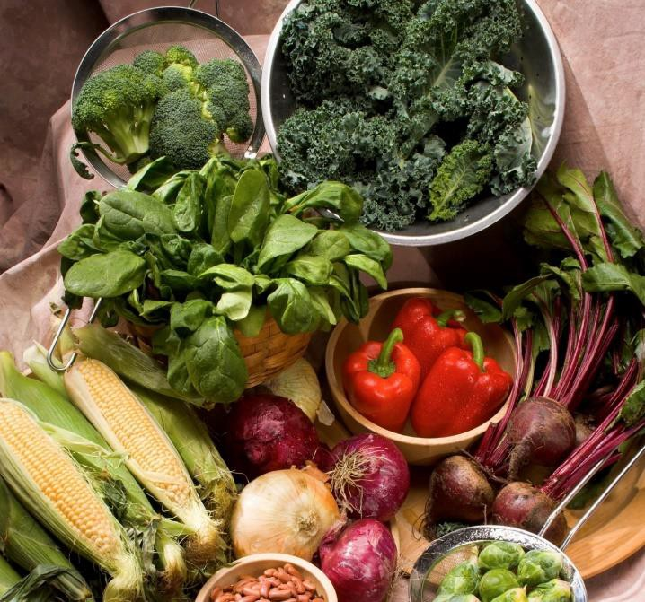
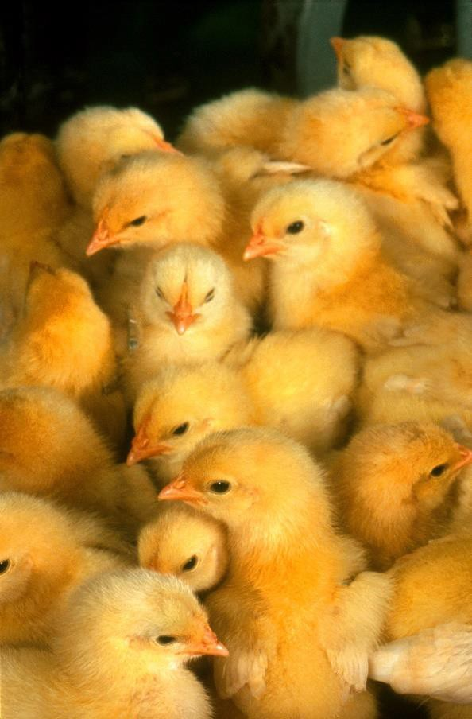

ARS Research
Jeff Silverstein
Deputy Administrator Animal Production & Protection
Office of National
Programs - ARS
USDA Financial Management Training 10 July 2019

Slide 2



USDA
and ARS
Sonny Perdue
USDA Secretary
Scott Hutchins
Deputy Under Secretary, Research,
Education, and Economics (REE)
Chavonda Jacobs-Young
Administrator Agricultural Research Service
Simon Liu
Associate Administrator Research Operations
Steven Kappes Associate Administrator National Programs

Slide 3
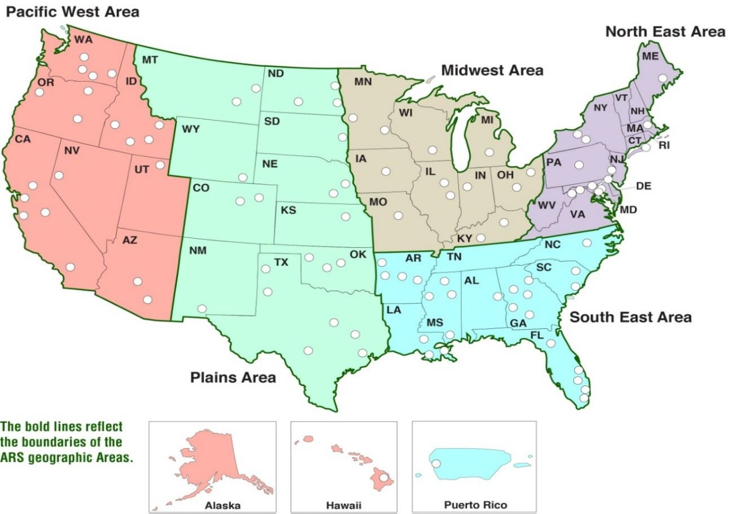

ARS Program
Implementation
research facilities in 90+ locations
7,000 total employees, 1,800 Ph.D. scientists
$1.3B annual budget
685 research projects - 15 National Programs
USDA AGRICULTURAL RESEARCH SERVICE

Slide 4
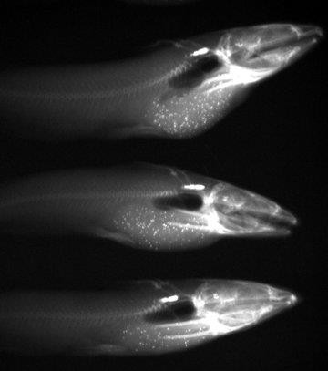
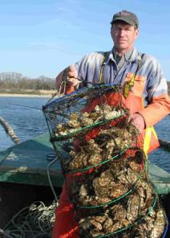
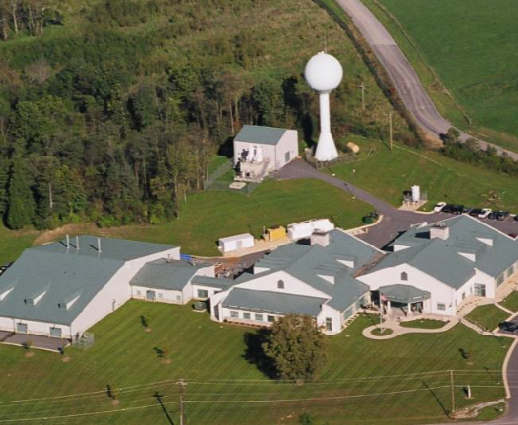
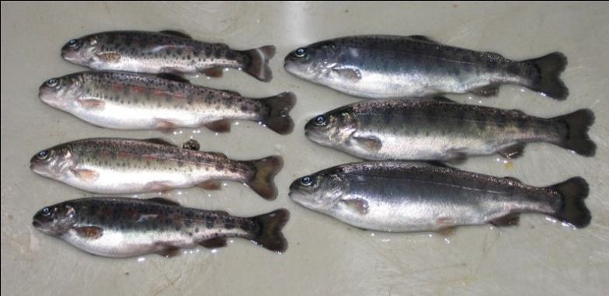

My path: Through aquaculture-fish farming
Gosnold Shellfish
Cuttyhunk, Massachusetts
USDA AGRICULTURAL RESEARCH SERVICE

Slide 5
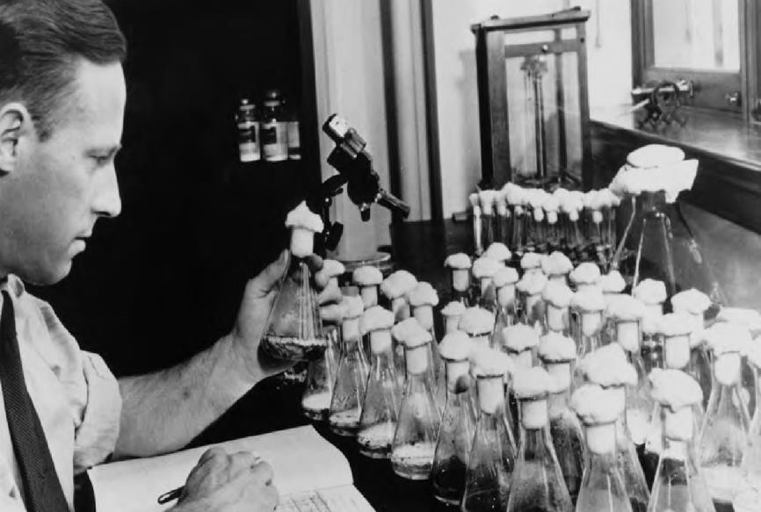
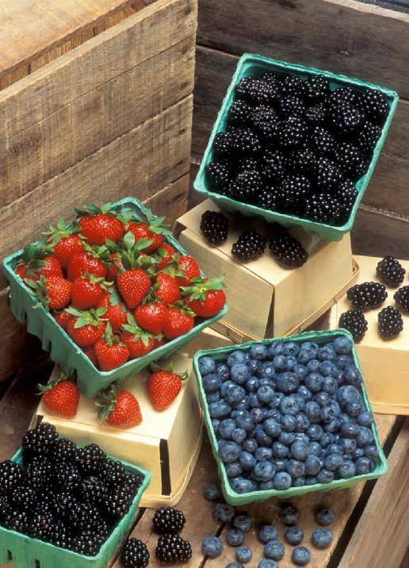
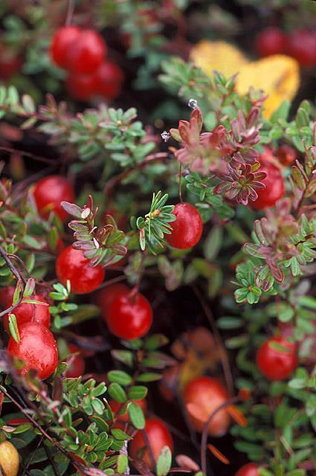
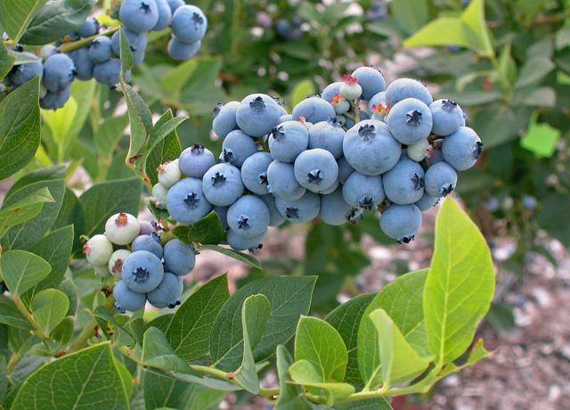

The Penicillin Story
Andrew Moyer, in his Peoria laboratory, discovered the process for mass producing penicillin.
It’s the Berries!
USDA AGRICULTURAL RESEARCH SERVICE

Slide 6
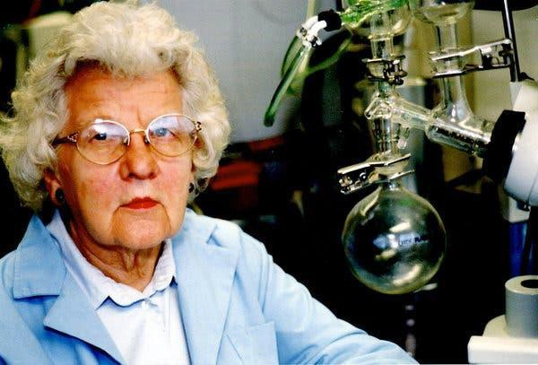
Permanent Press Cotton
Ruth Benerito is not a household name
But her chemistry is!
USDA AGRICULTURAL RESEARCH SERVICE

Slide 7
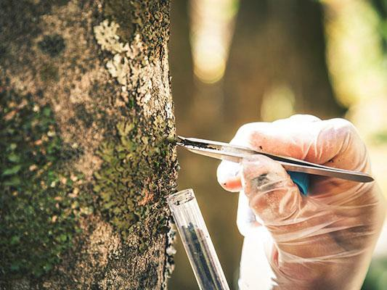
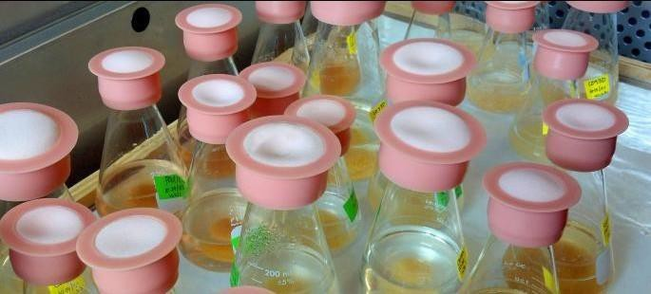
Anti-cancer drug development
Taxol originates from the bark of the Pacific Yew tree

Slide 8
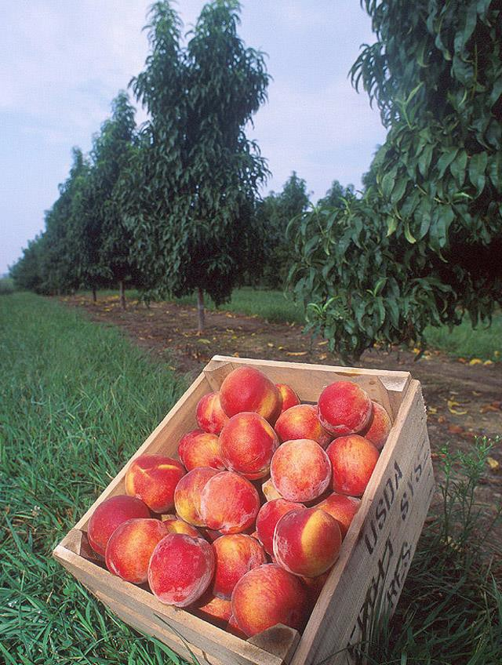
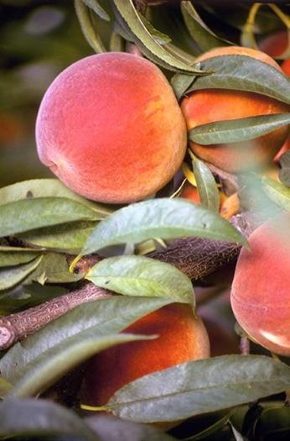
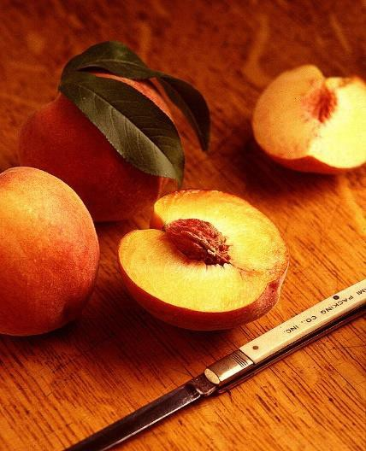



Peaches in Byron, Georgia
US National Arboretum: Flower Power
USDA AGRICULTURAL RESEARCH SERVICE

Slide 9
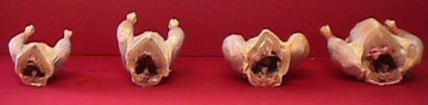
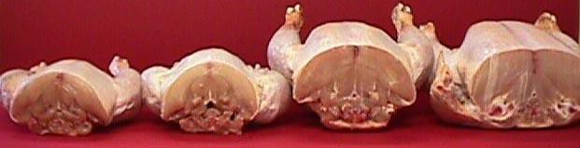
ACRBC (1957)Males – 2001 Feed
BROILERS
Havenstein and Qureshi, 2004
Ross Males (2001) – 2001 Feed
Day 43
Day 57
Day 71
Day 85

Slide 10

A Growing Concern- Demand for food
•By 2050 demand for food will increase by 50-100%
•Sustainable Intensification
USDA AGRICULTURAL RESEARCH SERVICE

Slide 11
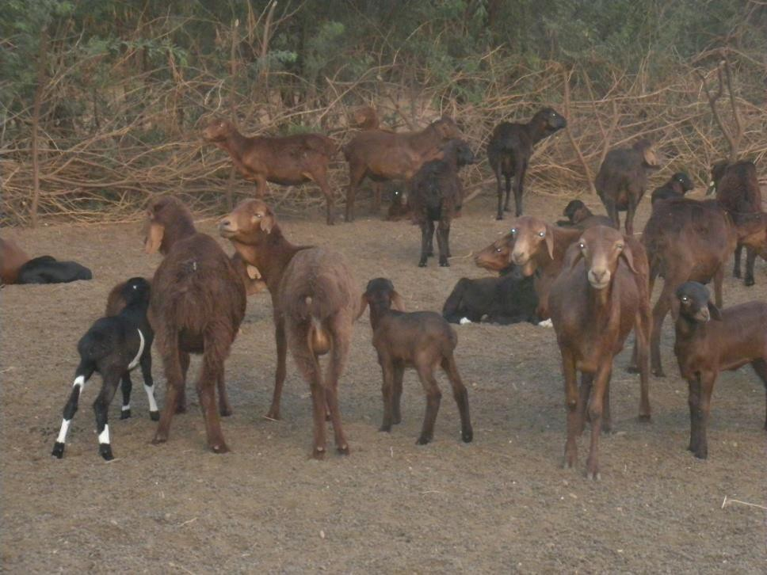
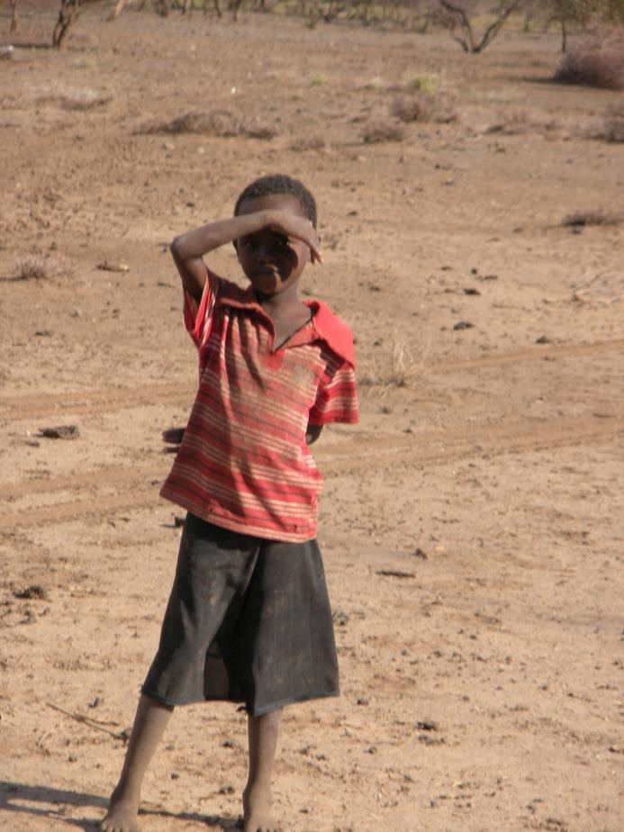
ARS and Feed the Future
Norman Borlaug Commemorative Research Initiative:
  Control and Prevention of UG99
  Enhanced Food Animal Production (Goat Improvement
  Enhanced Productivity of Grain Legumes (dried beans/pulses); and
  Enhanced Food Safety/Reduction of Post Harvest Losses (aflatoxin).
USDA AGRICULTURAL RESEARCH SERVICE

Slide 12


Can we feed the world in 2050?
Yes
  Requires a sustained investment in agriculture research today
  Requires collaborations across the animal and food industries, government and nonprofit groups
  There is no quick fix- but we have a track record that indicates
we are up to the task.
USDA AGRICULTURAL RESEARCH SERVICE

Slide 13
Travel Caps 2010-2016
Around 8,000 employees and 2,000 scientists
Travel is important
  Training
  Scientific meetings
  Conduct research
  Invited travel
Role of REE FM division in support of easing travel
calculations
Eventually funds from non-appropriated $ not
included
USDA AGRICULTURAL RESEARCH SERVICE

Slide 14
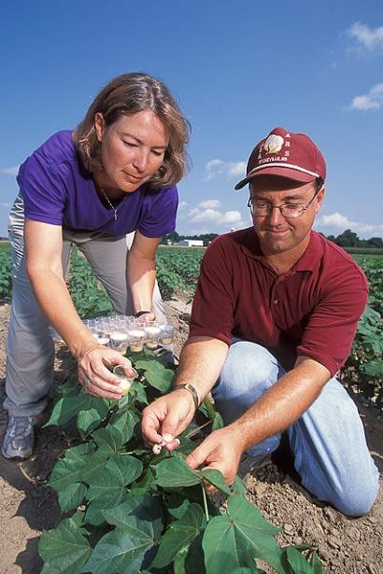
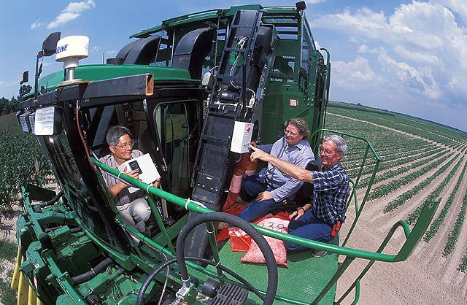
Electrolyte drinks
and the REE FM success!
OSHA has recognized the importance of electrolyte replenishing drinks to prevent heat exhaustion
Employees tend to keep better hydrated when electrolyte replenishing
drinks are available (people are buying their own for outdoor work)
We want to ensure safety and wellbeing of all of our employees and prevention is more critical than reactionary measures
USDA AGRICULTURAL RESEARCH SERVICE

Slide 15
Thank You!
ARS
www.ars.usda.gov

