Slide 1
FMMI Customer and Vendor Management
Chuck Ingraham
Derek Beloney

Slide 2
How to contact Vendor Customer Maintenance (VCM)
FMSC Help Desk between 7:30 a.m. – 4:00 p.m. Central
1-(800)-421-0323 option #3
Supervisor Chuck Ingraham 504-226-3507 charles.ingraham@usda.gov
VCM Analysts
Yolanda Wallace 504-226-3674 yolanda.wallace@usda.gov
Rhonda Lee 504-226-3594 rhonda.lee@usda.gov
Derek Beloney 504-226-3503 derek.beloney@usda.gov
VCM Technicians
Sheila Butler 504-226-3627 sheila.butler@usda.gov
Linda Davis 504-226-3636 linda.davis@usda.gov
Galvan Cutiyog 504-226-3502 galvan.cutiyog@usda.gov
Nathaniel Johnson 504-226-3597 nathaniel.johnson@usda.gov
Theresa Danner 504-226-3524 theresa.danner@usda.gov

Slide 3
OOH! OOH! OOH! OOH!

Slide 4
FMMI Vendors and Customers

Slide 5
Metro Map System

Slide 6
FMMI Vendors and Customers

Slide 7
Vendors and Customers
Vendors are entities we pay, Account Payable (A/P)
Customers are entities we bill or receive monies from, Accounts Receivable (A/R)
Vendors and Customers may come in pairs (linked) or as singles.
Not every Vendor has a Customer.
Not every Customer has a Vendor.
Vendors numbers are 10 digits in length.
Customer numbers are 7 digits in length.

Slide 8
Example of Customer with Linked Vendor Record
Located on Page 2 of the Customer Master is the Vendor Field

Slide 9
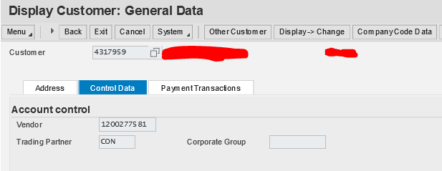
Example of Customer with Linked Vendor Record
Located on Page 2 of the Customer Master is the Vendor Field

Slide 10
FMMI Vendors and Customers Inbound

Slide 11
Conversion from FFIS (Foundation Financial Information System)
This can be considered a one time event that happened in phases.
FFIS was USDA’s Accounting System Prior to FMMI.
As we converted agencies from FFIS to FMMI we identified the vendors used within the last two years and converted them to FMMI.
Brought in both customer and vendors.
External Manuf. Field will show FFIS

Slide 12
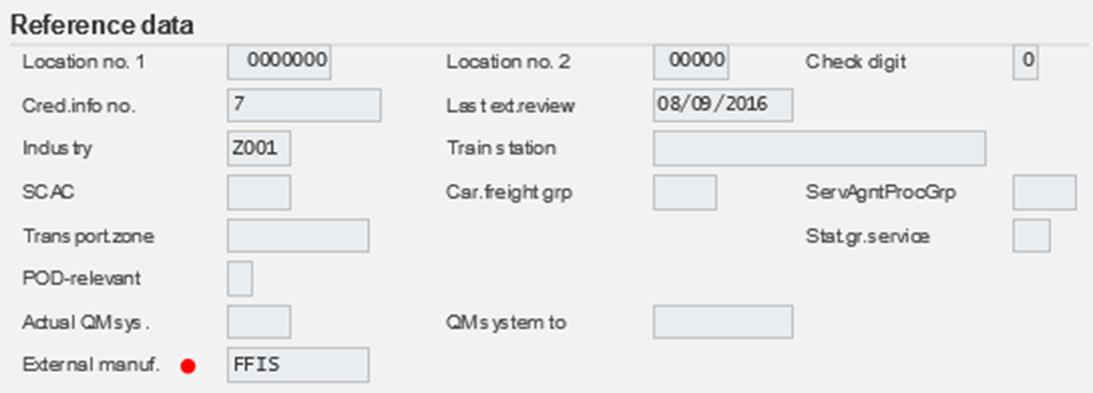
External Manuf.
External manuf. – is on the second page (tab) of the vendor master.

Slide 13
FMMI Vendors and Customers

Slide 14
NEMP Inbound
NEMP stands for Name EMPloyee. The source is payroll.
The records in FMMI are not the records used for your paychecks.
These records are used for:
Entries to the General Ledger
Miscellaneous payments to employees
Travel Payments to Employees
Billing Employees
The NEMP to FMMI Interface also builds the Pseudo Code (PSSN) used in the Travel System (Concur) to FMMI interface, covered in detail later.

Slide 15
External Manuf.

Slide 16
FMMI Vendors and Customers cont.

Slide 17
SAM to FMMI Interface
System for Award Management (SAM), formerly Central Contractor Registration(CCR). which was owned by the Department of Defense until July of 2012.
SAM is currently owned by GSA (General Services Administration)
Vendors register with SAM after obtaining a DUNS number from Dun and Bradstreet.
DUNS is a nine digit identifier - The Data Universal Numbering System, abbreviated as DUNS or D-U-N-S, is a proprietary system developed and regulated by Dun & Bradstreet that assigns a unique numeric identifier, referred to as a "DUNS number" to a single business entity. It was introduced in 1963 to support D&B's credit reporting practice. It is standard worldwide. DUNS users include the European Commission, the United Nations, and the United States government. More than 50 global industry and trade associations recognize, recommend, or require DUNS. The DUNS database contains over 300 million entries for businesses throughout the world.
PLUS4 – four digit number assigned within SAM to identify different EFT for a given DUNS
CAGE Code- stands for Commercial and Government Entity code. The Department of Defense’s Defense Logistics Agency ( DLA ) assigns the five-character ID; it is an alpha numeric identifier.

Slide 18
SAM to FMMI Interface
Three Names in SAM
Legal Business Name
Doing Business As (DBA) Name
Taxpayer Name (used as the FMMI vendor name)
In order to capture the three addresses in SAM, three vendors are created in FMMI
Mailing Record - only record with the DUNS PLUS4 and CAGE located on the Federal tab in FMMI
Remit-To Record
Physical Record
We do not import Federal Vendors from SAM into FMMI
Coming in December of 2020, the DUNS number will be replaced with a UEI (Unique Entity Identifier) This will be a 12 character alpha-numeric number issued by GSA. This will be a big change to all of our systems.
Our FMMI search for SAM vendor returns the Mailing Address record.
External Manuf. CCR

Slide 19
SAM to FMMI Interface Runs
SAM produces daily files Tuesday – Saturday just after midnight.
The SAM to FMMI interface runs close to 12:40 a.m. MT every Tuesday – Saturday.
The Wednesday file represents Tuesday SAM Business and so on. The Saturday file represents Friday SAM Business. The Tuesday file represents Saturday, Sunday and Monday SAM business.
A typical daily file from SAM contains 3,000 to 9,000 registrants.

Slide 20
RUN Times for the SAM to FMMI (All times are MT)

Slide 21
SAM-FMMI Interface Tracking Spreadsheet 1 of 2

Slide 22
SAM-FMMI Interface Tracking Spreadsheet 2 of 2

Slide 23
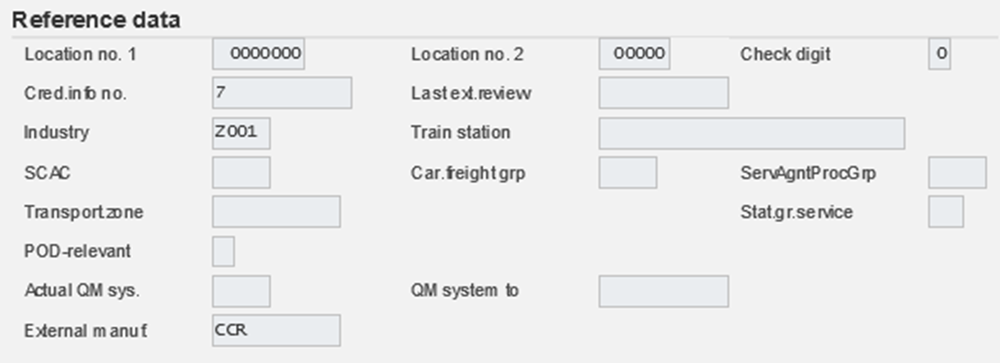
External manuf CCR on SAM Interface

Slide 24
Display Vendor: General Data

Slide 25
ACME

Slide 26
FMMI Inbound

Slide 27
ProTracts Interface
ProTracts (Project Contracts) is owned by NRCS (Natural Resource and Conservation Service)
Vendors are Bulk TIN matched by VCM prior to being fed through the ProTracts interface from NRCS to FMMI.
ProTract vendors cannot be changed using the PVND process.

Slide 28
External Manuf. – for ProTracts is PROTRACTS

Slide 29
PVND and Collections

Slide 30
PVND
PVND (Pre-Approval Vendor Request)
This is for both vendors and customer.
The name PVND is a carryover from our last accounting system, FFIS.
PVND is a custom module located within FMMI.
Authorized users make PVND requests.
PVND requests are made-up of an online two page form.
VCM section members review PVNDs, TIN match them, and either approve or reject the PVNDS.

Slide 31
PVND Lifecycle
All PVND begin as NEW requests
On Hold
Resubmit
Analyst Review
All PVNDs end as either Rejected or Approved requests

Slide 32
PVND – Request Process

Slide 33
PVND Vendor Request

Slide 34
PVND Supplemental Request

Slide 35
Additional Information

Slide 36
Outbound Payments and Billings

Slide 37
FMMI to IPP Outbound
The IPP Outbound is a manual process
When IPP Purchase Orders reject for a missing vendor, VCM extracts the vendors from FMMI and uploads them to the USDA IPP XMVL (vendor) table in IPP.
The XMVL vendor must then be matched to an IPP Supplier

Slide 38
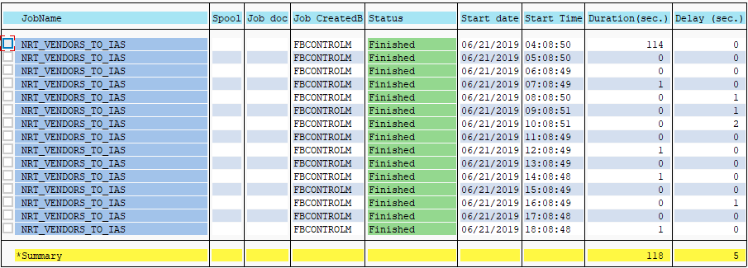
FMMI to IAS Outbound
The FMMI to IAS Outbound runs every hour throughout the day.
Times are in MT

Slide 39
FMMI to CRM Interface
CRM stands for Customer Relationship Module
An argument could be made to include CRM in the FMMI swim lane
VCM receives e-mail requests to mark vendors for replication from FMMI to CRM. In CRM the Business Partners are:
A FAS (Now X)
B FNS
C NRCS (Now X)
D AMS (Now X)
X Enterprise
We have moved to using X Enterprise for all agencies except FNS

Slide 40
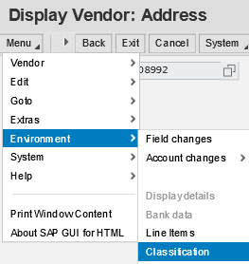
Replication to CRM
The setting for replication to CRM on the vendor master is under Menu \ Environment \ Classification

Slide 41
Vendor Classification

Slide 42
CRM Replication
The vendors that are marked for replication to CRM are replicated around 20:40 (08:40 p.m. MT).
After the initial replication, changes to the FMMI vendors are kept synchronized almost instantaneously with CRM.

Slide 43
ProTracts and Other Outbounds
ProTracts Interface Outbound Runs Nightly
There are other Outbounds for the Vendor and Customer table not depicted on the flow chart.

Slide 44
FMMI Inbound and Outbound Process

Slide 45
TIN Matching
What is a TIN?
A Taxpayer Identification Number (TIN) is an identification number used by the Internal Revenue Service (IRS) in the administration of tax laws. It is issued either by the Social Security Administration (SSA) or by the IRS. A Social Security number (SSN) is issued by the SSA whereas all other TINs are issued by the IRS.
We are only concerned with two types of TINS
EINs (Employee Identification Numbers) **-*******
SSNs (Social Security Numbers) ***-**-****

Slide 46
How TIN matching is accomplished
The IRS maintains a web site for TIN matching against both the IRS and SSA databases.
The VCM (Vendor and Customer Maintenance) Section and FMS’ 1099 Section have access to TIN match.
TINs (EIN or SSN) and Names are submitted to the IRS.
Manually, 25 maximum
Bulk match, 100,000 maximum
A resulting code is returned for each submission indicating a TIN match or non-TIN match.

Slide 47
IRS Interactive TIN Session

Slide 48
IRS

Slide 49
IRS Interactive Results

Slide 50
TIN Matching
TIN numbers cannot be submitted multiple times or access will be temporarily suspended, sometime for days.
Names cannot be submitted multiple times or access will be temporarily suspended, sometime for days.
The IRS only accepts as valid characters
A-Z (case doesn’t matter)
Integers 0-9
Special characters
Ampersand &
Dash –

Slide 51
TIN Matching
Entities incorporate with their Legal Business Name. It is often not the name they file their taxes under.
Many times the name is completely different
Sometimes the TIN match names are close to their Legal Business Names. However because of the restrictions the IRS places on the names, such as the special characters it disallows, a Legal Business Name of Initech’s Consulting would not TIN match because of the apostrophe. It would most likely match under Initechs Consulting.

Slide 52
TIN Matching
Sole proprietors are very tricky as well. For example if Michael Bolton has a lawn service called “Bob & Bob Making Cuts”
Depending on how Michael has registered his company
It might match as a “6” under Michael Bolton
It might match as a “6” under Bob & Bob Making Cuts
It might match as a “7” under Michael Bolton
It might match as a “7” under Bob & Bob Making Cuts
It might match as an “8” under Michael Bolton
It might match as an “8” under Bob & Bob Making Cuts

Slide 53
TIN Matching
The Debt Collection Improvement Act of 1996, also known as the DCIA regulates the collection of bad debts owed to the U.S. government. It controls the whole debt recovery procedure and collection tools used for collection of non-tax US federal debts.
Required to help prevent improper payments.
Required for proper 1099 reporting.
Required to ensure proper Treasury Offset Program (TOPS). TOPS is a centralized offset program, administered by the Bureau of the Fiscal Service's Debt Management Services (DMS), to collect delinquent debts owed to federal agencies and states (including past-due child support), in accordance with 26 U.S.C. § 6402(d) (collection of debts owed to federal agencies).

Slide 54
Pseudo Codes Are Used For Interfacing Transactional Data between Concur And FMMI
What is a Pseudo Code (PSSN)? It is a unique identifier that does not contain PII (Personally Identifiable Information).
Based on PII concerns, social security numbers of USDA employees and USDA invitational travelers do not reside in the Concur Government Edition (CGE) Travel System.

Slide 55
Pseudo Code Construct
The pseudo code is 11 characters long consisting of:
Example - Al E Gator SSN 123456789, his PSSN would be AEGATOR6789
When alpha characters are missing the number “9” will be substituted for the missing alpha. If Mr. Gator is missing a middle name his pseudo would be A9GATOR6789
Position | Pseudo Code Construct
1 | First initial of the first name
2 | First initial of the middle name
3-7 | First five positions of the last name
8-11 | Last four of the SSN

Slide 56
PSSN
The PSSN is built independently in CGE and FMMI following the construct.
What could go wrong?
The most common issue is a difference in the middle name. Many times is not known on one side or the other.
If, while following the PSSN construct, a duplicate is achieved on the PSSN to FMMI cross walk table the NEMP to FMMI interface replaces the last character of the name with 0-9 until uniqueness is achieved. For example, if AEGATOR6789 were a duplicate AEGATO06789 would be the PSSN.
We normally adjust FMMI to agree with the PSSN CGE.

Slide 57
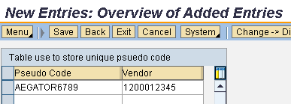
PSSN
When a transaction is received in FMMI from CGE the FMMI Pseudo code cross walk table is used to find the FMMI vendor code.
Users cannot see the PSSN table. A special search tool is available to show the PSSN. We will go over that search further on in this presentation.

Slide 58
PVND Vendor Request (Modify)

Slide 59
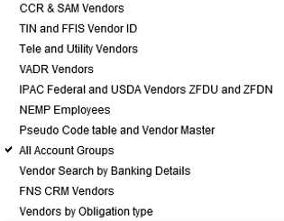
Searching for Vendors in FMMI

Slide 60
Using the CCR & SAM Vendors Search
This search will only return SAM vendors, and is limited to Vendors with “CCR” in the External Manuf.
It will only return the Mailing Record.
Once you know the Mailing Record FMMI vendor number you can find the Physical and Remit-To vendor records on the Partner Tab of the Mailing Record.

Slide 61
SAM Search

Slide 62
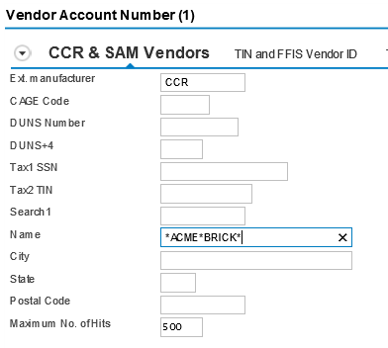
SAM Search

Slide 63
SAM Search Criteria

Slide 64
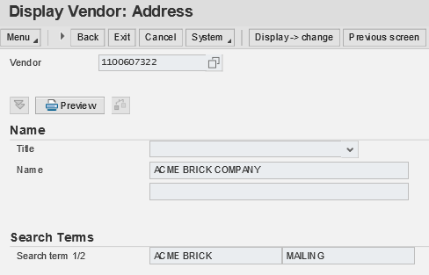
SAM Search

Slide 65
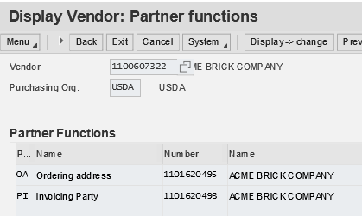
SAM Search
Navigate to the Partner Function Screen to see the
Physical Address Vendor – OA Ordering address
Remit-To Address Vendor – PI Invoicing Party

Slide 66
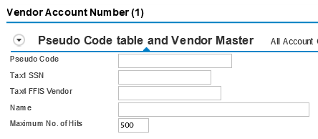
PSSN Search
FMMI users cannot see the FMMI PSSN x-walk table
The FMMI PSSN x-walk table is not very user friendly
We have developed a Search that uses a “join” to search the FMMI vendor table and x-walk table at the same time.

Slide 67
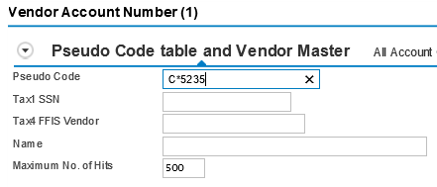
PSSN Search
This is a very helpful search for doing PSSN maintenance.
Remember the construct AEGATOR6789.
Most times the issue is with the second character.
So searching by the first character, wildcard (*), and the last four characters brings back the PSSN or PSSNs you are looking for (i.e., A*6789)

Slide 68
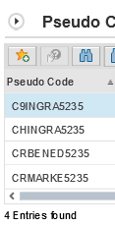
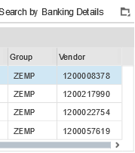
PSSN Search
These are the results
This is the very best way to find the correct Pseudo code.
One caveat is, if the vendor doesn’t have a PSSN it will not be found by this search. Usually this is only an issue with ZINT, Invitational Travelers.

Slide 69
QUESTIONS?

