Slide 1
Agenda
Centralized Receivable System (CRS) Overview
eBill
USDA-OCFO’s Implementation of CRS
  “FMMI-CRS” Interface
Implementation of CRS for other USDA Program Billings, using the FMMI to CRS Interface

Slide 2
CRS Overview
CRS is a service provided by Treasury, at no charge to federal agencies to assist in the management of current, non-tax receivables
Agencies send receivables to CRS
CRS issues bills and handles debt management
CRS is operated by US Bank
US Bank call center handles inquires and follow up on delinquent debt
Collections go directly to Agency – Both CRS and agency receive collection data from the Treasury’s Collection Information Repository (CIR)
CRS performs no accounting services, but handles debt management services - CRS is not an accounting system

Slide 3
CRS Services Provided
Invoice automation including demand letter and due process notice
Offers electronic and conventional remittance options
Active debtor location through skip tracing and outbound calls
Call center servicing
Installment agreements
Automated referral (transfer of debt) to Treasury for delinquent servicing (TOPS, CSNG)
Standardization and DATA Act compliance
On-line system – agencies can query on debts, upload proof of debt documents, and modify if necessary

Slide 4


CRS Services and Functionality
Functionality Offered
Collections Information Repository (CIR), Cross Servicing, and agency interfaces
User-friendly reports
Case file with complete case history
Configurable collection parameters
Variety of payment collection options
Portal (online) and batch transmission for case referrals
Batch adjustments and batch attachments to update case information
Master case (multiple cases under one case)
Joint and several debtors (2 or more debtors each 100 percent liable for the same debt)
Services Offered
Implementation support
Business process modeling
Agency training
Invoicing
Installment agreements
Account resolution for death, bankruptcy, and entity out of business
Full service call center / inbound and outbound
Returned mail processing and skip tracing
Payment collections
Case history management
Transfer of delinquent debt to DMS Cross-Servicing

Slide 5
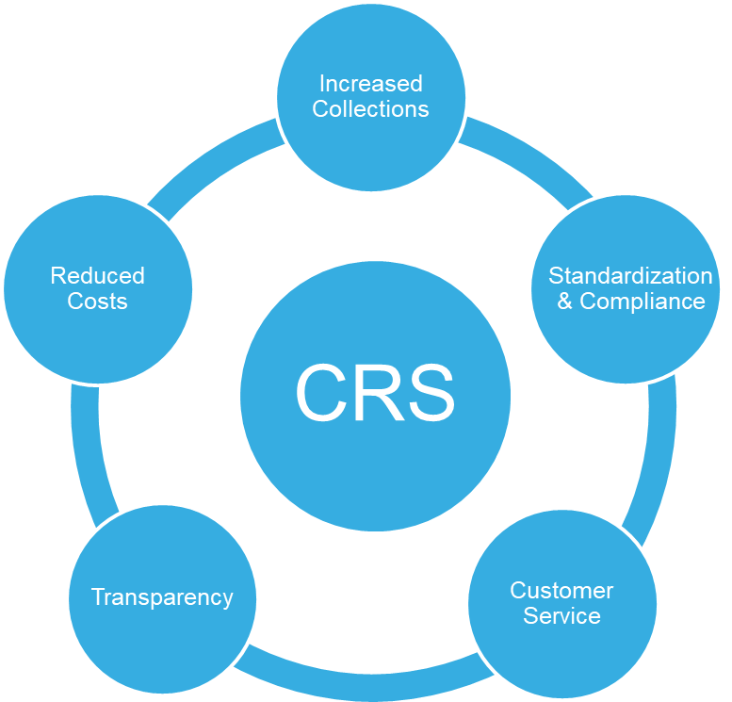
CRS Benefits - Cheaper, Faster, Better…
Increases collectability and decreases delinquencies through prompt servicing and invoicing
Ensures quality and compliance with Debt Collection Improvement Act (DCIA), the Data Act of 2014, Federal Claims Collections Standards (FCCS) and the government-wide all electronic initiative
Offers state-of-the-art receivables management with customizable options in an automated and paperless environment that delivers exceptional customer service
Provides full access to case management, history and reports
Reduces costs through economies of scale in an automated business environment. No cost to agencies in short term and planned legislation for long term to keep CRS at no cost to agencies

Slide 6
CRS Performance Results
Current Receivable Portfolio: over 918,000 cases
Collections: over $200,000,000
Collection Rate: 65%
Pre-Delinquent Collections: 67%
99% of inbound calls answered in 2 minutes
Agencies: 16
Programs:74

Slide 7
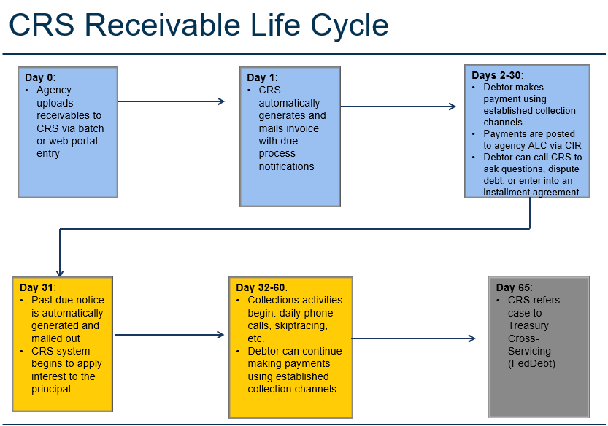
CRS Receivable Life Cycle

Slide 8
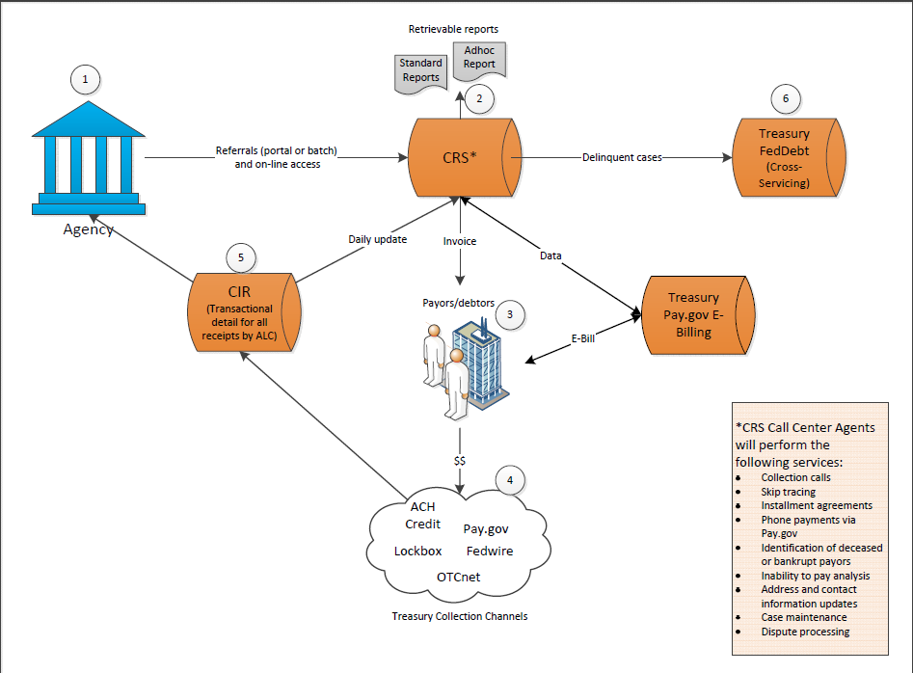
CRS Process Flow

Slide 9
CRS - Collection Options
Agency chooses collection options to use
  Lockbox, OTCnet, Pay.gov Fedwire, ebill, etc.
Choose one or more options
Collection options specific to each application
For USDA Travel Relocation – eBill chosen as sole option

Slide 10
eBill’s
eBill
“The way to eliminate unapplied collections!”

Slide 11
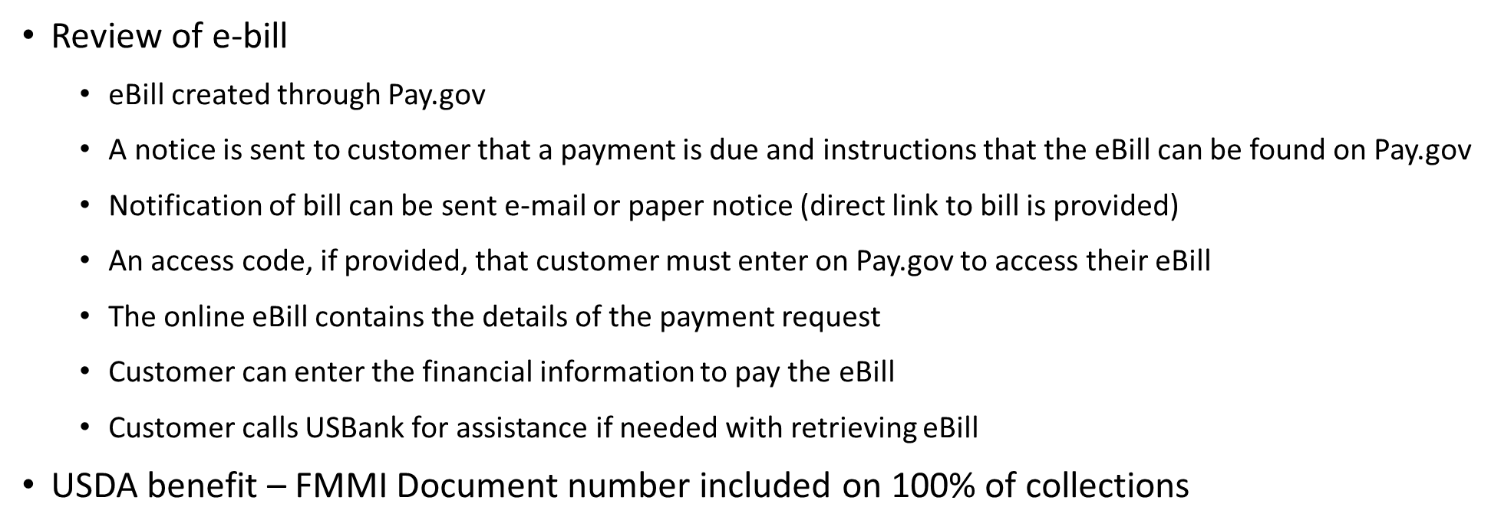
Using eBill

Slide 12
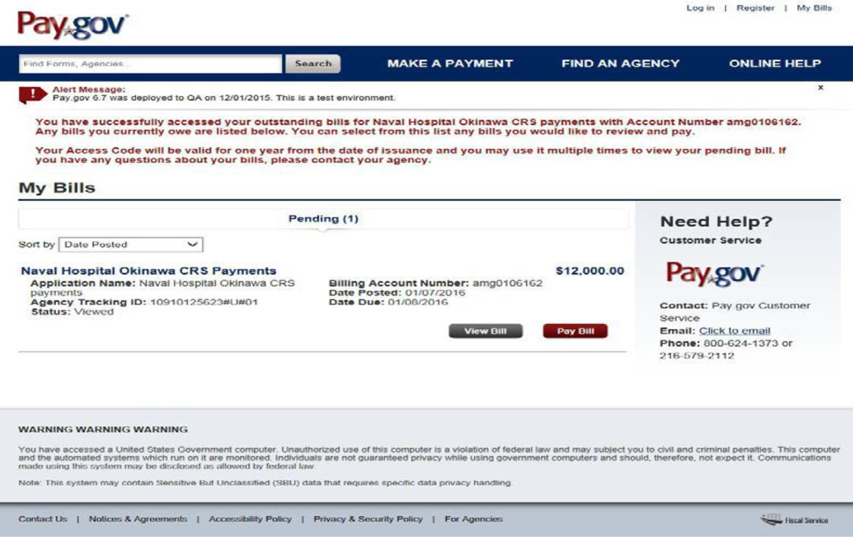


eBill Example

Slide 13
The
FMMI-CRS Interface

Slide 14

FMMI – CRS
“Billing through Collection”
FMMI AR Invoice
CRS issues Bill
(using FMMI AR Invoice Doc No.)
Debtor Receives eBill Notice
Debtor goes to Pay.gov
Pays (eBill)
FMMI Doc No. Referenced
FMMI-CRS Interface
CRS
Cash Posted
Collection Posted in the CIR
FMMI AR Invoice match
FMMI Collection
Re-processor
CIR
Extract File

Slide 15
FMMI-CRS Interface
“Plug and Play”
Interface is parameter driven – Selects specific AR invoices
Interface Parameters are established for a specific “CRS Application”
Selected AR invoices are modified to reflect being sent to CRS for debt management; 3 fields are updated on all AR invoice documents selected by the interface and sent to CRS
  Reason Code changed to “TRD” (Treasury Receivable Debt)
  Assignment field – updated to “CRS mm/dd/yy”
  Baseline Date – updated to “mm/dd/yy” (date sent to CRS)
Parameters for Receivable Selection are numerous
  Document type - Reason code - Document header text - Reference Document number - Business area - Item text - Assignment Payment method - Payment block - WBS element - Commitment

Slide 16
FMMI-CRS Interface
  Parameters allow for standard verbiage to be contained on demand letters, specific for the program/application for which interface is being run
Important FMMI Reference Numbers flow through to CRS, and contained on debt notices issued by CRS
Currently running for Travel Relocation Debts established through the “moveLINQ-FMMI Interface”
See example on following page

Slide 17
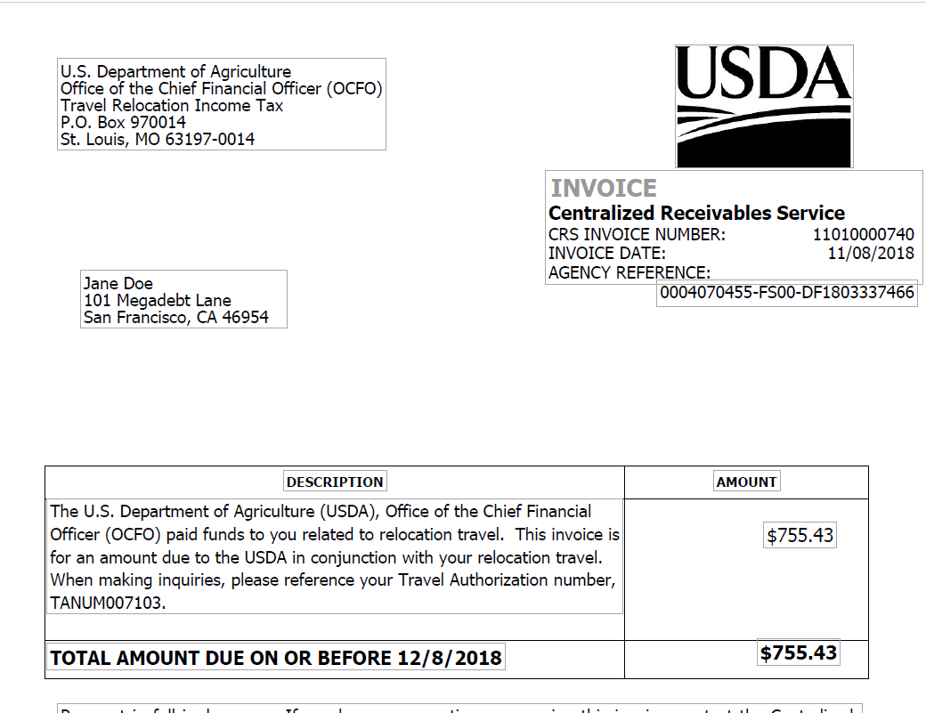
CRS Produced Bill
CRS Produced bill has USDA Logo and address
Agency defined reference sent thru interface contains FMMI Customer Number and AR invoice document number
Specific narrative for all bills for Travel relocation debt have a variable data field where input the Tanum Number – specific to the travel relocation case
Bill also issued electronically, where debtor clicks on a link and views bill.
eBill option of payment assures FMMI Document number flows though on remittance information and immediately applied in FMMI upon receipt

Slide 18

Questions
Next Implementation . . .
Forest Service

Slide 19


Central Receivables Service (CRS)
Matthews Smith
July 2019
Caring for the Land and Serving People.

Slide 20
CFO Financial Policy
Responsible for formulating and prescribing Agency-wide financial management policies and procedures, accounting standards and controls, and for providing assistance in their implementation and use.

Slide 21
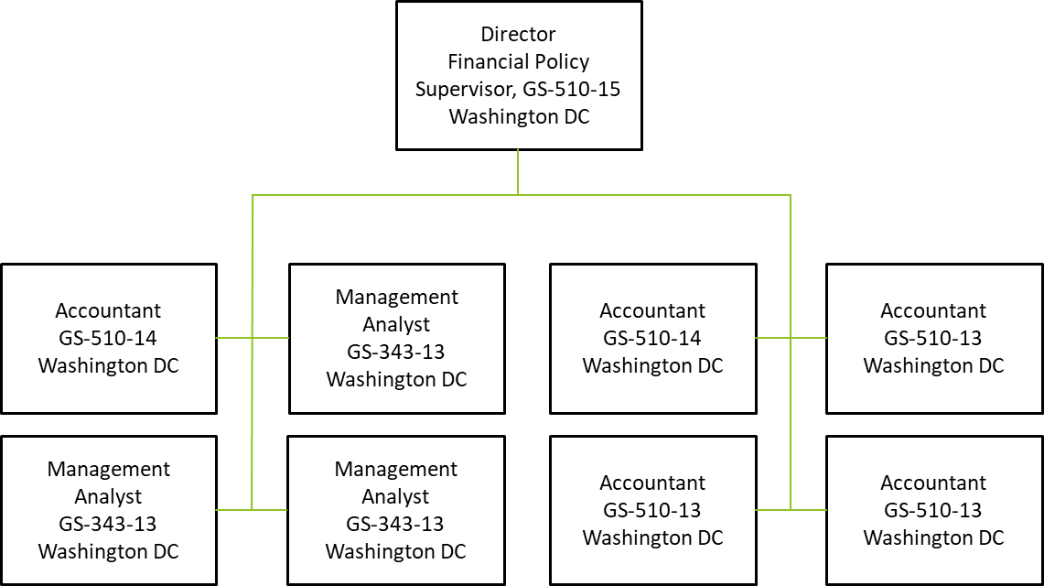
Organization Chart

Slide 22
Storyline
FY2017: Systematic Issues
FY2018: Strategic Working Group
FY2019: CRS Discussions w/FMS & Treasury
FY2020: CRS Implementation Phase I
FY2021: CRS Implementation Phase II

Slide 23
Process
Feeder Systems → FMMI
FMMI (Batch) → CRS
Pay.Gov & OTCnet (POSS)
Automation* → FMMI

Slide 24
Misc. Bills
Individual & Commercial
50 Receivables ($100K)
Approx. $30K Delinquent Debt

Slide 25
Special Uses
Individual, Commercial, Government
48K Receivables ($135MM)
Approx. $7MM Delinquent Debt
Notes:
$1MM of DD are retention fees/cost recovery

Slide 26
Phase I
Executive Buy-in June 7, 2019
Kickoff Meeting June 27, 2019
Technical Meetings July-October 2019
Technical Release November 16, 2019*
Notes:
*US Bank/CRS tentatively scheduled release date.

Slide 27
Phase II
Kickoff Meeting Spring 2019
Technical Meetings Summer 2019
Technical Release Fall 2019
Targeted Programs: Agreements & Timber

Slide 28
Questions?
Notes:
B&F Help Solutions Library

