Slide 1
FMMI Roadmap
Linda Connolly
Mike Brashear
Afnan Chawla

Slide 2

A Look In The Rear View Mirror

Slide 3
FMMI Cloud Migration Project
Scope:
Conversion – Oracle Database to SAP HANA
Upgrade – Enhancement Pack 7
Cloud Migration / Re-platform
Benefits:
Increase in Stability
Increase in Performance
Cost Savings

Slide 4
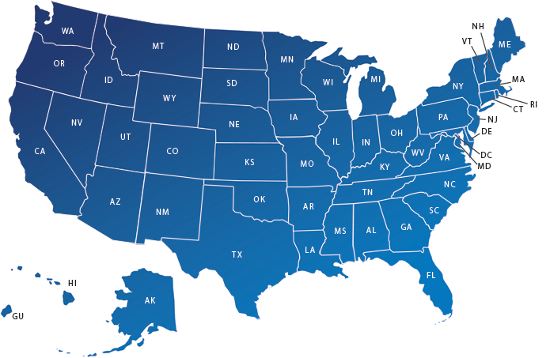


Datacenter Locations
San Francisco
Vienna, VA
Quality Assurance
PRODUCTION
Disaster Recovery
O&M SYS TEST
O&M DEVELOPMENT
O&M SANDBOX
CUSTOMER DEMOBOX

Slide 5

First Level
Dell
EMC
Virtustream

Slide 6
Datacenter Migration
Vienna, VA (VFC1)
Sterling, VA (VFC3)
PRODUCTION
Quality Assurance
System Test
Development
Sandbox
Customer Demo
PRODUCTION
System Test
Development
Sandbox
Customer Demo
San Francisco, CA (VFC2)
Boyers, PA (VFC4)
Quality Assurance
Disaster Recovery
Disaster Recovery

Slide 7
Datacenter Migration and Consolidation of QA
August 5, 2018 – Migrated Development, Test, Sandbox, and Demo Landscapes.
March 9, 2019 – Migrated Production Landscape to VFC3.
March 30, 2019 – Migrated Quality Assurance to VFC3.
Benefits of Consolidation
Reduced Storage costs
Removed datacenter to datacenter network costs
Reduced overall server count
Improved maintenance activities
Quality Assurance testing can continue during a DR drill

Slide 8
Network Connection
1. End-user connects to USDA Universal Telecommunications Network (UTN)
2. Connection is routed to NFC datacenter in Denver
3. Travels over a 1Gbps Level 3 circuit to VFC3 in Vienna, VA
4. Virtustream routes connection to VFC3 in Dulles, VA
USDA Backbone
(UTN)
End-User
Denver Datacenter
Vienna Datacenter
Sterling Datacenter
Level 3 Circuit
1Gbps

Slide 9
Network Connection
1. End-user connects to UTN
2. The UTN has two 10Gbps connections to the Cloud datacenter
  Directly connected to the USDA Network
  Less hops
  Bigger pipes
  Redundant connections
AT&T Circuits
Sterling Datacenter
USDA Backbone
(UTN)
10Gbps
10Gbps

Slide 10
Recent and Ongoing Upgrades
ECC – Enhancement Pack 8 CRM – Enhancement Pack 4
BW – Version 7.5 GRC – Version 10.1
BOBJ – Version 4.2 PI – Version 7.5
PEGA – Version 8.1 HANA – Version 2.0
Enhance services to add value and drive efficiency and effectiveness of internal operations
Reduce risk to the business and customers through consistent and stable business processes and systems performance
Drive efficiency in resource allocation to promote scalability
Increase the Quality to the Customer

Slide 11
S/4HANA
What is S/4HANA?
Main Drivers to Upgrade
Changes and Benefits
S/4HANA Preview
Next Steps

Slide 12
What is S/4HANA?
SAP Business Suite 4 SAP HANA
Optimized for SAP’s in-memory database SAP HANA
Two editions
  SAP S/4HANA On-Premise
  SAP S/4HANA Cloud
Legacy software sunsetting at the end of 2025

Slide 13
Changes and Benefits
New look and feel
Simplified data model
Business Suite integration

Slide 14
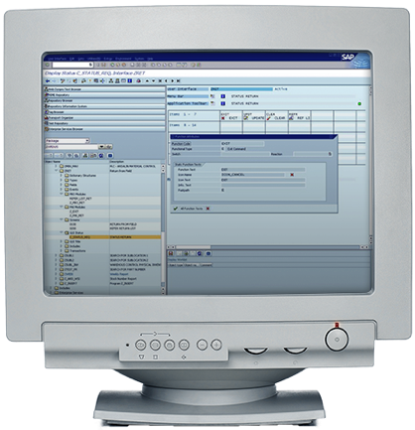
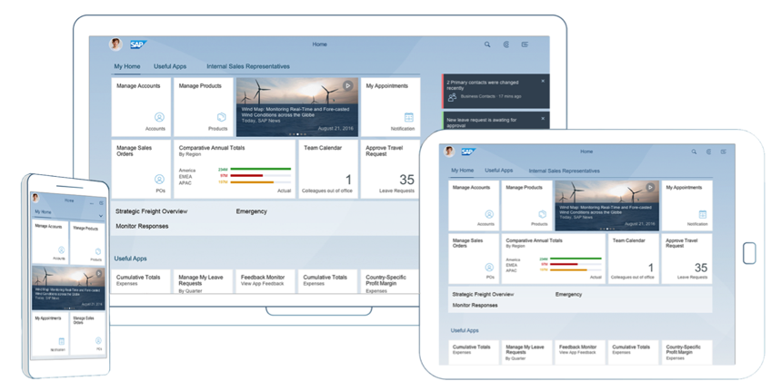
New Look and Feel
From the Past…
…To the Present

Slide 15
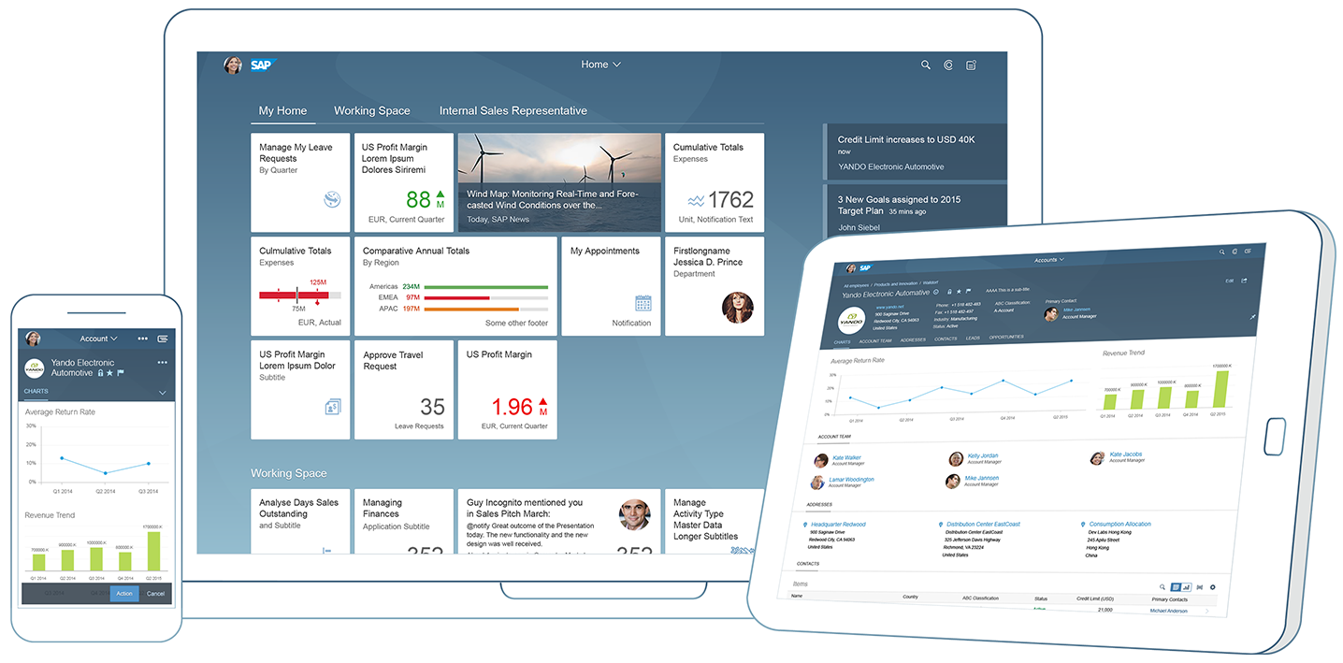
New Look and Feel
Changes:
New user experience
Fiori launchpad
  Provides role-specific access to relevant apps and tasks
  Can be personalized
  Tiles can launch Fiori apps and classic transactions
Works on other devices
Digital assistance with voice recognition
Intuitive search capability

Slide 16
New Look and Feel
Benefits:
Easier to use
Gain flexibility to use on other devices
Improved user productivity
Decreased training time with intuitive screens
Enhanced user satisfaction

Slide 17
Simplified Data Model
Changes:
Takes advantage of HANA technology
Changes to the database structure
  Tables combined/deleted
  Redundant data eliminated
  No indices or aggregates (summary tables)
Universal Journal
  Single source of the truth

Slide 18
Simplified Data Model
Benefits:
Data retrieval will be done very fast
Calculations done on the fly
Processing time reduced
Performance Improved
Smaller database size will be more cost effective

Slide 19
Business Suite Integration
Changes:
Re-integrates portions of SAP Business Suite products
CRM / Grantor module
Embedded Analytics
  Collection of all analytics features integrated in SAP S/4HANA
  Real-time analysis on the transactional system
  Many pre-built models and reports
  Brings transaction data and analytics into one platform
  Can be reported through various reporting tools

Slide 20
Business Suite Integration
Benefits:
May eliminate the need to have a separate data warehousing system and the need to replicate data - where the data is usually one day old
Simplifies the environment
  Fewer servers
  Reduces system maintenance/support time and effort
  More cost effective

Slide 21
Next Steps
Contract for FMMI Assessment
  Initialization
    System Scans (STAR+, Business Scenario Recommendations, Readiness Check)
    Identify project team
    Benchmarking
  Discovery Workshops
    Pain Point Identification / Validation
    Analytics Assessment
  Roadmap Development
    Implementation approach

Slide 22
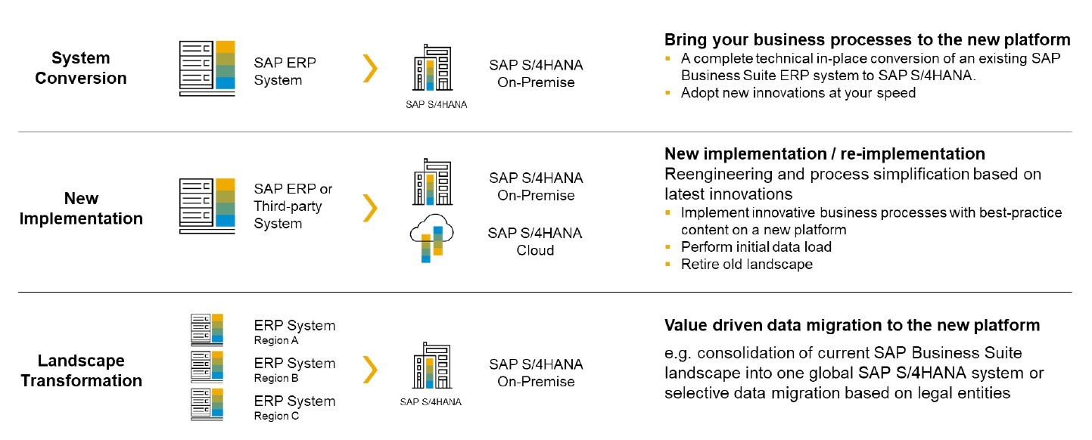
Implementation Approaches

Slide 23
Deployment Options
On-Premise
In the Cloud
Hybrid Model

Slide 24

Any Questions?

Slide 25

In Closing…

