Slide 1
SAP Budget and Planning (SBP)
Proof-of-Concept Presentation and Demonstration
Shawn C. Williams and Charles Collins
July 2019

Slide 2
Topics
Introduction
Why SBP?
USDA Applications
  Budget Status and Forecasting (BSF)
  Allotment Planning and Management (APM)
  Budget and Performance Management Service (BPMS)
The SBP Solution
How USDA Applications Compare to SBP
Changes Users Could Expect

Slide 3
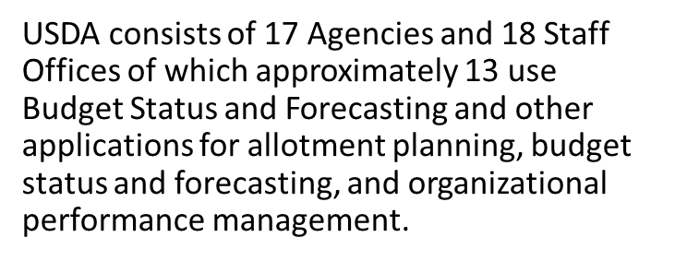
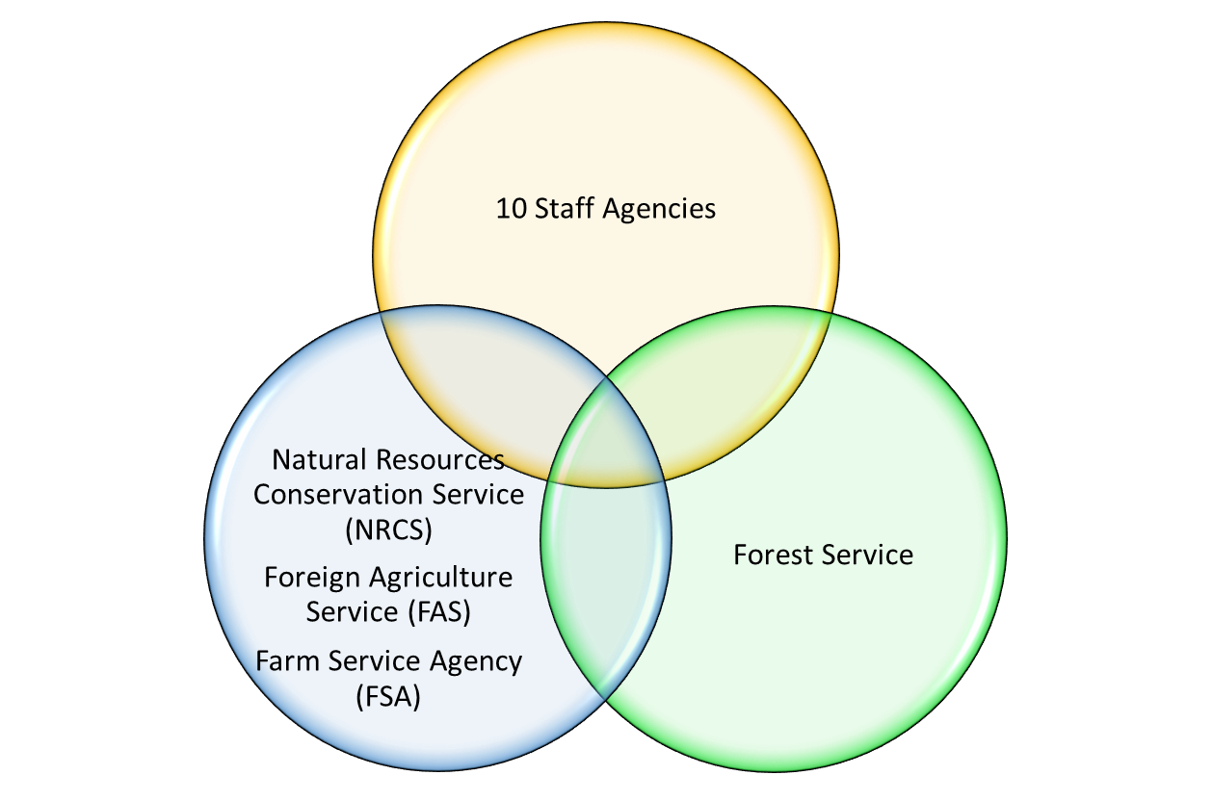
Introduction

Slide 4

Why SBP?
Commercial Off the Shelf (COTS)
VENDOR SUPPORT
  Ability to leverage enhancements from other SAP SBP customers
  Continuous support of SBP by SAP (4 upgrades in 10 years)
Consistent User Experience
  Familiar layout and user-friendly design
  Enhanced user interface for input layouts (form-based for complete record creation to report-based for multiple entries)
Additional Available Functionality
  Workflow (optional)
  Narrative Text Entry and Reporting (optional)
  Broader use of Business Objects reporting suite
Continued Flexibility for USDA-Specific Enhancements
  Configurable enhancements such as Travel Planning, Contract Tracking, and potential future planning and monitoring requirements
GREATER EFFICIENCY THROUGH STANDARD AUTOMATED FEATURES
  Standard reports and workflows reduce manual spreadsheet work
Faster Scalability for New Agencies
  Using the standard SBP form framework enables rapid adaptation by new agencies

Slide 5
  USDA Applications
Budget Status and Forecasting (BSF)
Creation of initial operating plans, salary and benefit forecasting
Adjustments to actuals, operating plans, and forecasts
Application administration functions are built-in.
Allotment Planning and Management (APM)
Creation of initial allotments and adjustments to allotments resulting from continuing resolutions
Includes a workflow function to enable multi-stage review, adjustment, and approval
Application administration functions are built-in.
Budget Performance Management Service (BPMS)
BSF functionality
Includes functions to create, manage, and utilize organization performance measure data for operational and financial forecasting purposes
Application administration functions are built-in.
BSF
APM
BPMS
Reports are built into the BSF, APM, and BPMS applications and operate like the input forms.
Reports are built into the BSF, APM, and BPMS applications and operate like the input forms.

Slide 6
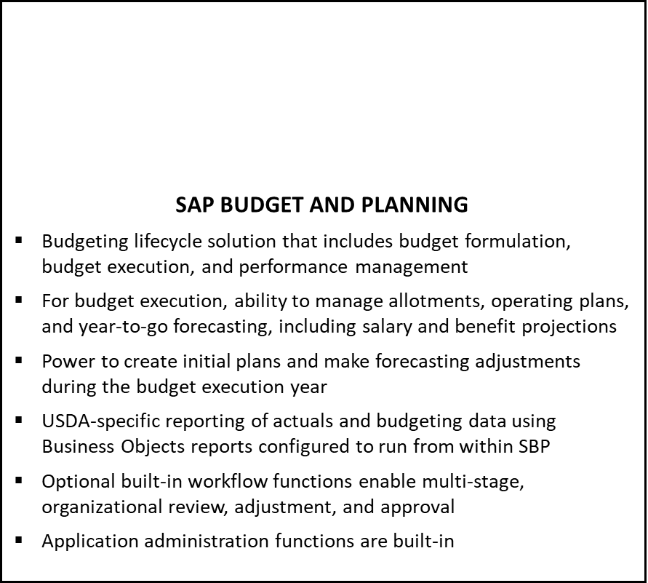
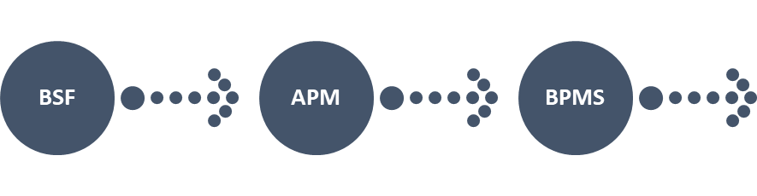
  The SBP Solution
SBP

Slide 7
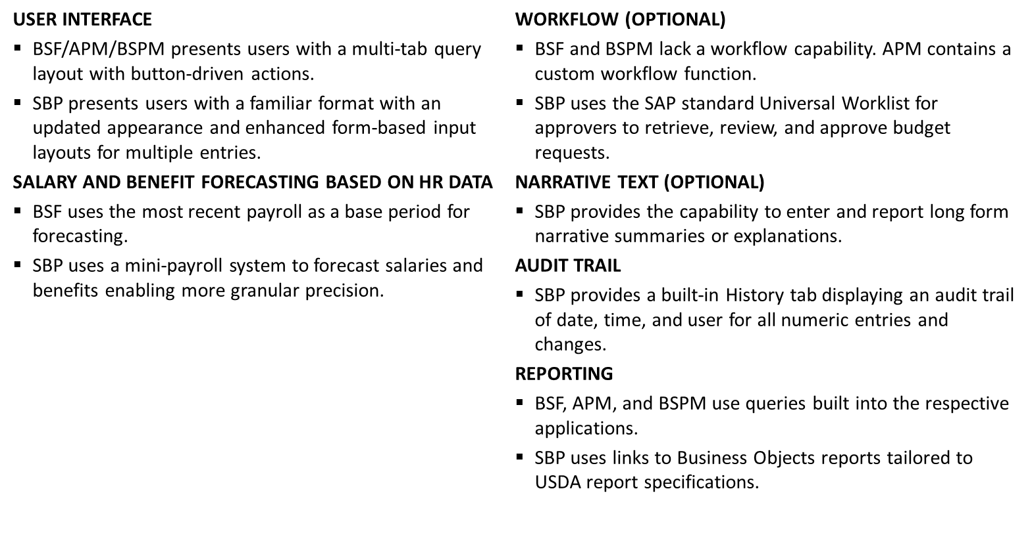

  Changes Users Could Expect

