Slide 1
FINANCIAL TRAINING FORUM
JULY 2024

Slide 2
Welcome from the FMS Deputy Director
Welcome to the Financial Management Services’ 2024 Financial Training Forum (FTF). We are excited to offer another training opportunity, continuing to meet our customers’ needs while leveraging the flexibilities associated with virtual training. The trainers are subject matter experts in various areas of financial management-related processes and FMMI Intelligent Enterprise Transformation (FIET). We look forward to your interaction and feedback throughout the next two weeks so we can continue to serve you in achieving the USDA mission.
- Linda Connolly, Deputy Director
FINANCIAL TRAINING FORUM JULY 2024

Slide 3
Fiori App Demo:
Manage Journal Entries, Post Incoming Payment, and Reverse Items
FINANCIAL TRAINING FORUM JULY 2024
Notes:
We will be doing a live demonstration of multiple Fiori apps today. The transactions used in the demonstration may not match the transactions shown in the slide deck. Due to the testing environment that we will be using I will not be showing the actual path that may be used when this upgrade goes live.

Slide 4
Housekeeping
This training session is being recorded.
In the event of an audio interruption, please turn on captioning. (More > Language and Speech > Turn on Live Captioning)
Presenters will address questions at the end of their presentation. You may submit questions in the Chat at any time during the presentation.
Please keep your microphone muted unless you are recognized to ask a question.
If possible, use a headset with microphone when speaking to reduce echoes and feedback.
The AgLearn survey is NOT available until after the class has completed.

Slide 5
NASBA CPE Credit Guidelines
The Directives and Training Branch will be using MS Teams’ polling feature to capture engagement metrics during each training session. Four polls will be launched at random intervals within each hour of the class. Each poll will remain open for 60 seconds and, per NASBA requirements, attendees must respond to at least three of the four polls to receive CPE credit for that hour. Partial credit will not be issued. Two-hour training sessions are not designed to include breaks, therefore, please plan accordingly.
Polls will appear in either the Chat box or the main presentation area of your screen.

Slide 6
Presenter
Timothy “Tim” Ross
Tim is the Treasury Services Branch Chief and a Certified Government Financial Manager. The four sections in the Treasury Services Branch process the collections and disbursements for most USDA agencies and its federal and non-federal customers and vendors. Tim started with USDA in June 2015 and brought 25 years of accounting experience working for publicly traded and privately held companies.

Slide 7
Training Objectives
Upon completion of this training, participants will be familiar with the following web-based Fiori applications:
Vendor Line-Item Display
Create & Park a Vendor Invoice
Post Parked Documents
Create & Park a Vendor Credit Memo
Post Incoming Payment
Reset Cleared Items
Reverse FI Document
Clear Vendor Items
Notes:
Today’s presentation will show how similar these transactions look and process transactions in the new FMMI portal environment.

Slide 8
Vendor Line-Item Display
Using the Vendor Line-Item Display Fiori App

Slide 9
Vendor Line-Item Display
Users may search for a vendor item using any of the following criteria:
Vendor Account number
Posting date
Select Type: Parked Items
Then click Execute (button is at the bottom right of the screen)
Notes:
FBL1N
Execute button at the bottom of the screen

Slide 10
Vendor Line-Item Display (cont’d)
Vendor item search results are displayed
Notes:
FBL1N

Slide 11
Create & Park a Vendor Invoice
Using the Park Vendor Invoice Fiori App

Slide 12
KR Document – Park Vendor Invoice
To search for an invoice, enter the following:
Supplier number
Invoice receipt date
Document Type: KR (Vendor Invoice)
Amount
FAIN: Agency specific
Notes:
Menu > Edit > Account Assignment Templates > Select Account Assignment Template (Ctrl+F7)

Slide 13
KR Document – Park Vendor Invoice (cont’d.)
The Financial Transaction Library dialog box will appear. Select Transaction model, then Continue.

Slide 14
KR Document – Park Vendor Invoice Results
Invoice search results are displayed

Slide 15
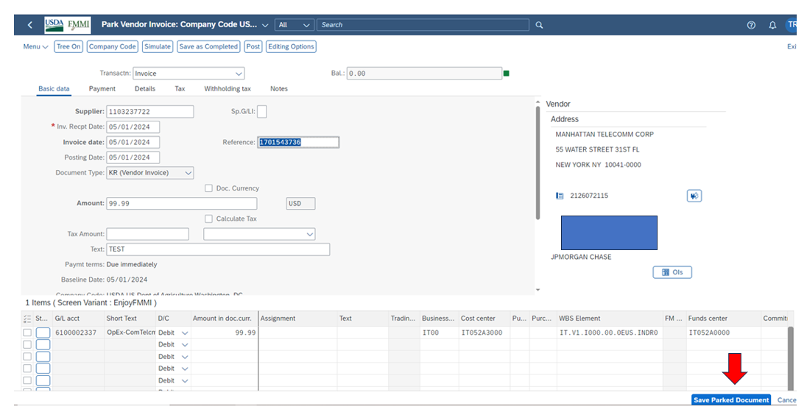
KR Document – Saving Parked Documents
Click the Save Parked Document button (bottom right)
Notes:
Save Parked Document is at the bottom

Slide 16
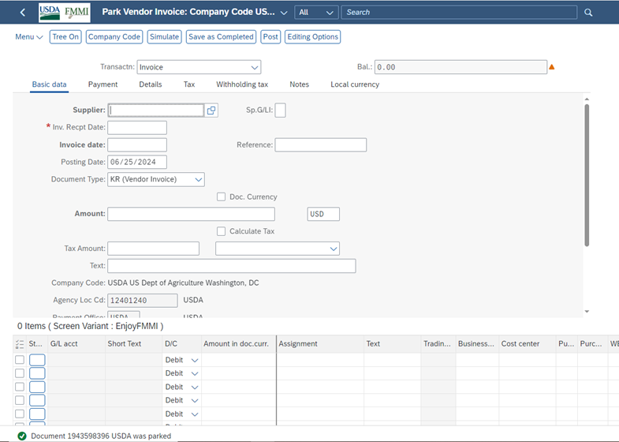
KR Document – Successfully Parked Vendor Invoice
The invoice is successfully parked, as indicated by the message below.

Slide 17
Post Parked Documents
Using the Post Parked Document Fiori App

Slide 18
Post Parked Document
To search for a parked document, enter the Document Number
Or….
Notes:
FBV0 – You can enter a single document

Slide 19
Post Parked Document (cont’d.)
Or to get a list of parked documents, enter a Reference number, then click Execute.
Notes:
Or you can query to get list of parked documents , click the “Execute” button

Slide 20
Post Parked Document Results
Parked document search results are displayed.
Notes:
Clicked on the Select button

Slide 21
Post Parked Document Process
Select the document, then click Post to complete the process. Or…
Notes:
With the document selected use the “Post” button to complete the process

Slide 22
Post Parked Document Process (Cont’d)
Or double click the Document Number to post the document.
Notes:
Or you can double click the document #

Slide 23
Post Parked Document Edit
Click Post to edit a parked vendor invoice document.
Notes:
Click the “Post” button

Slide 24
Post Parked Document Edit (cont’d)
The Information dialog box indicates the company code in which the document was posted. Select Continue.
Notes:
Click the “Post” button

Slide 25
Create & Park a Vendor Credit Memo
Using the Park Vendor Credit Memo Fiori App

Slide 26
Park Vendor Credit Memo
To create a vendor credit memo, enter the following:
Supplier number
Document date
Amount
Notes:
FV65

Slide 27
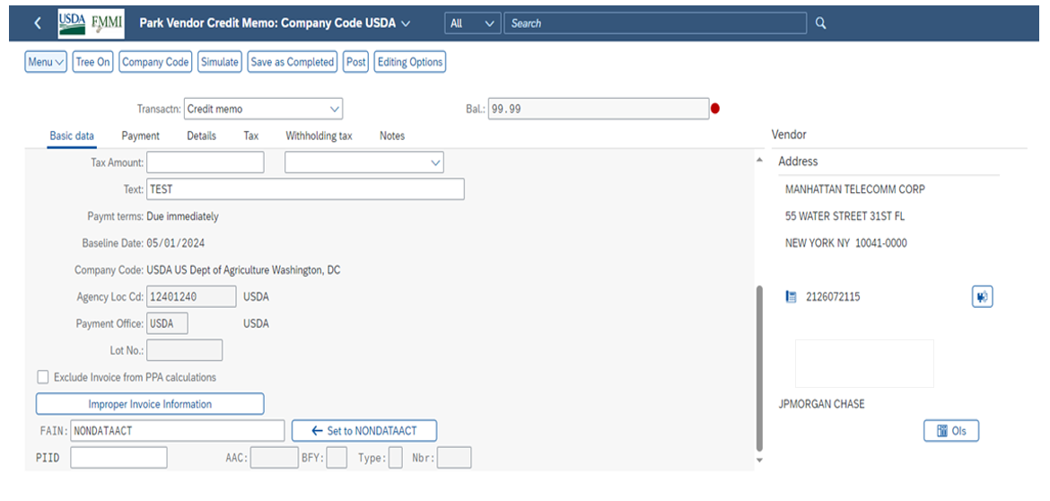
Park Vendor Credit Memo (Cont’d)
In FAIN, enter appropriate agency information.
Notes:
Menu > Edit > Account Assignment Templates > Select Account Assignment Template (Ctrl+F7)

Slide 28
Park Vendor Credit Memo: Select Transaction Model
The Financial Transaction Library dialog box will appear. Select Transaction model, then Continue.

Slide 29
Park Vendor Credit Memo – Derived Accounting Elements
Once the minimum accounting elements are entered, press the Enter key to auto-populate derived accounting elements (Description and Funds Center), then click Append.
Notes:
Once the minimum accounting elements are entered; Hit the “Enter” key to auto-populate derived accounting elements; Click on the “Append” button

Slide 30
Park Vendor Credit Memo – Save Parked Document
Note that the balance is 0.00 and a credit is being posted to expense GL 6100. Click Save Parked Document.
Notes:
Review data points ie Bal = 0.00 and a credit is being post to the expense GL 6100 ; Click on the “Save Parked Document” button

Slide 31
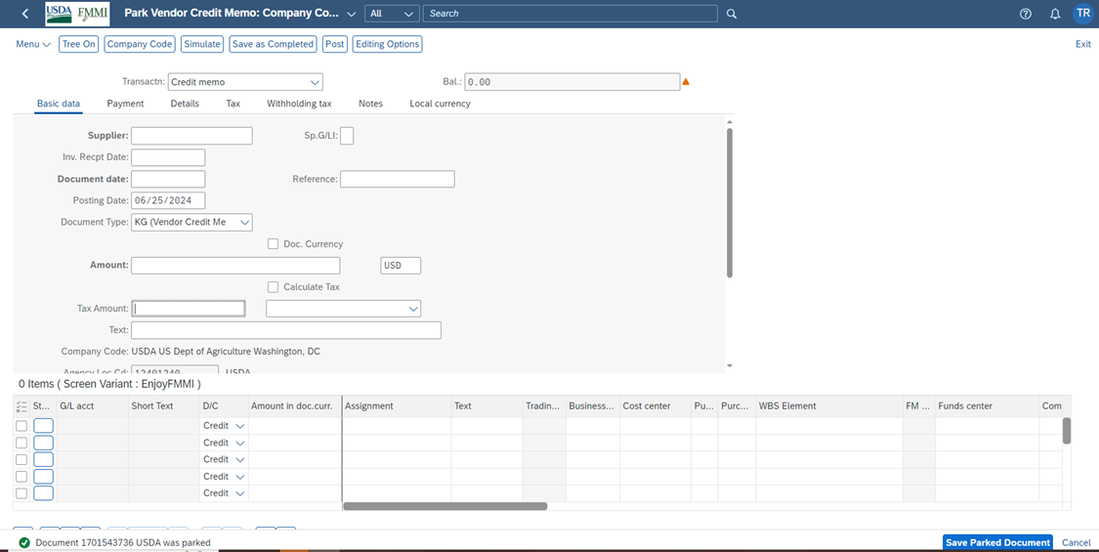
Parked Vendor Credit Memo
The document successfully parked, as indicated by the message below.

Slide 32
Post Incoming Payments
Using the Post Incoming Payments Fiori App

Slide 33
Post Incoming Payment
To post an incoming payment, enter the following:
Document date
Posting Date
Bank data: Account
Bank data: Amount
Open item selection: Account
Open item selection: Account type
Select “Document Number” from the Additional selections section then click Process Open Items.
Notes:
F-52 (F1345) - Standard Application. After the required data is entered. Click the “Process Open Items”

Slide 34
Post Incoming Payment (cont’d)
Enter the Document Number in the From column.

Slide 35
Post Incoming Payment – Process Open Item
View of Process Open Item screen showing to which billing document that collection is being applied. There is no remaining amount in the Not Assigned field.
Notes:
F-52 (F1345) - Standard Application

Slide 36
Posting Incoming Payment
Press the Enter key to accept any warnings at the bottom of the screen.
Notes:
F-52 (F1345) - Standard Application

Slide 37
Posting Incoming Payment (cont’d)
The document has been posted successfully.
Notes:
F-52 (F1345) - Standard Application

Slide 38
Clearing Document
The Vendor Line Item Display screen shows the payment has been successfully applied and becomes the Clearing Document for the KG Document.
Notes:
F-52 (F1345) - Standard Application

Slide 39
Reset Cleared Items
Using the Reset Cleared Items Fiori App

Slide 40
Reset Cleared Items – Step One
To reset cleared items, enter the document number in Clearing Journal Entry*, then click the > arrow.
*Note that the Clearing Document field has been renamed to Clearing Journal Entry in the upgraded version of FMMI.
Notes:
Click on the arrow on the far right of the line

Slide 41
Reset Cleared Items (Cont’d)
The query results are displayed. Click Reset and Reverse.
Notes:
Click on “Reset and Reverse”

Slide 42
Reset Cleared Items – Reverse Journal Entry
In the Reverse Journal Entry dialog box, enter Reversal Reason and Posting Date according to agency procedure then click OK.
Notes:
Enter Reversal Reason and Date per agency procedure then Click on the “OK” button

Slide 43
Reset Cleared Items Sucessfully
The Success dialog box appears. Click OK.
Notes:
Enter Reversal Reason and Date per agency procedure then Click on the “OK” button

Slide 44
Reset Cleared Items Display
The successfully reset cleared item is displayed, as indicated here.
Notes:
Enter Reversal Reason and Date per agency procedure then Click on the “OK” button

Slide 45
Reverse FI Document
Using the Manage Journal Entries Fiori App

Slide 46
Reverse Document
Notice that the Reverse button is unavailable unless a document is selected. Select a document by checking the box to the left of the document number or by double-clicking the document number.
Notes:
FB08 Reverse Document – Path: AP > Invoice Approval > Manage Journal Entry – FI. NOTICE the “Reverse” is greyed out. Must select document or double click the document #

Slide 47
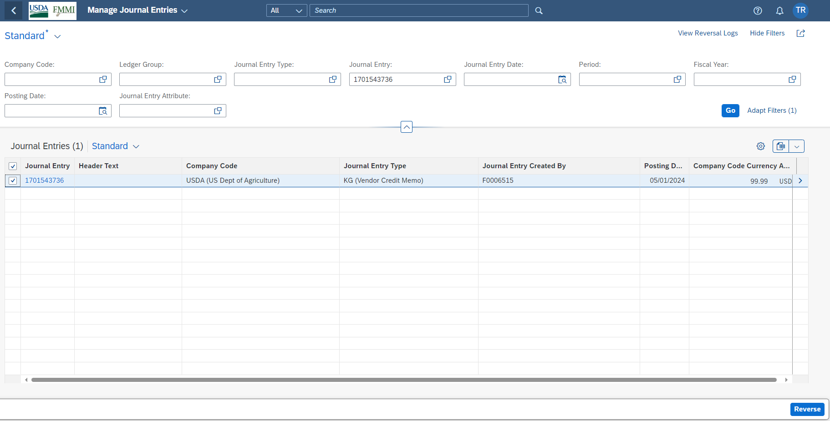
Document Reversed
Once a document is selected, the Reverse button is available. Upon clicking Reverse, a quick message appears to indicate the document has been reversed.
Notes:
A quick message pops up saying your document is reversed. The message does not stay.

Slide 48
Document Reversed (Cont’d)
Click the gear icon to add the Reversed With field.
Notes:
Go to the gear icon to add the “Reversed With” field or you can double click on the document # or click the arrow at the end of the row to get document details.

Slide 49
Reversed Document
The document now shows as reversed, as indicated here.
Notes:
Go to the gear icon to add the “Reversed With” field or you can double click on the document # or click the arrow at the end of the row to get document details.

Slide 50
Reversed Document (cont’d)
Display of the original document and the reversed document from the Vendor Line Item view.
Notes:
Viewing the documents from the Vendor Line Item view

Slide 51
Clear Vendor Items
Using the Vendor Line Item Display Fiori App

Slide 52
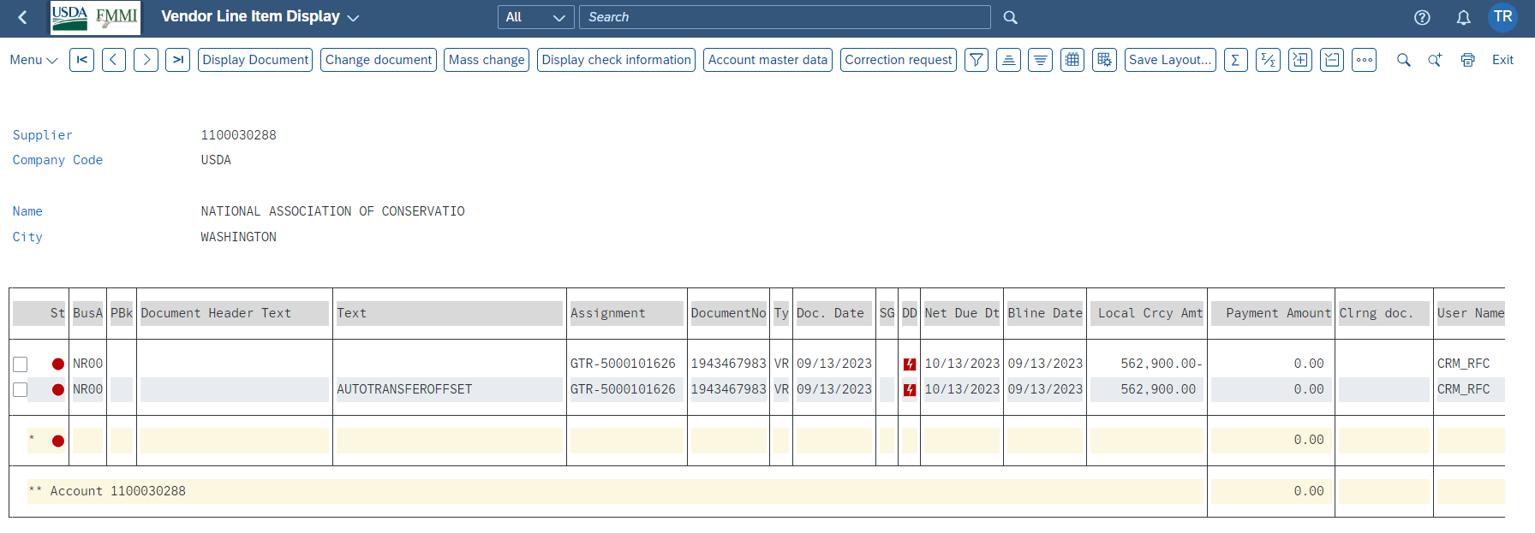
Clear Vendor Items – Multiple Documents
Clear multiple documents that are open and net to zero.
Notes:
F-44

Slide 53
Search for Vendor Item to Clear
To search for a vendor item to clear, enter the following:
Account number
Special G/L Indicator: frat
Select Document Number from the Additional Selections section.
Then click Post.
Notes:
F-44

Slide 54
Clear Vendor Items – Document Number
Next enter the document number to be cleared in the From column. Then click Post again.
Notes:
F-44

Slide 55
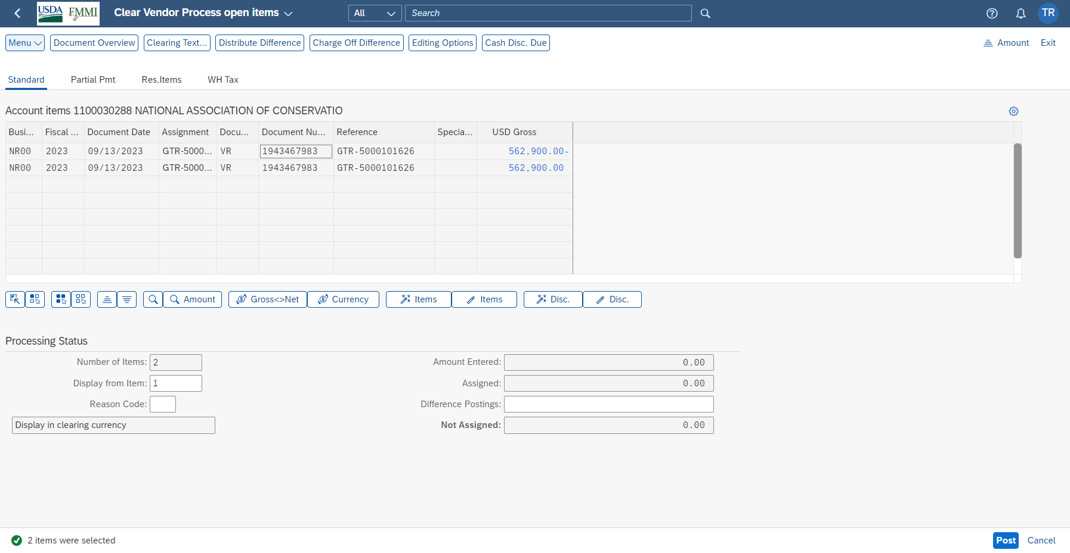
Clear Vendor Items – Process Open Item Screen
View of Process Open Item screen showing to which billing document that collection is being applied. There is no remaining amount in the Not Assigned field.
Notes:
F-44

Slide 56
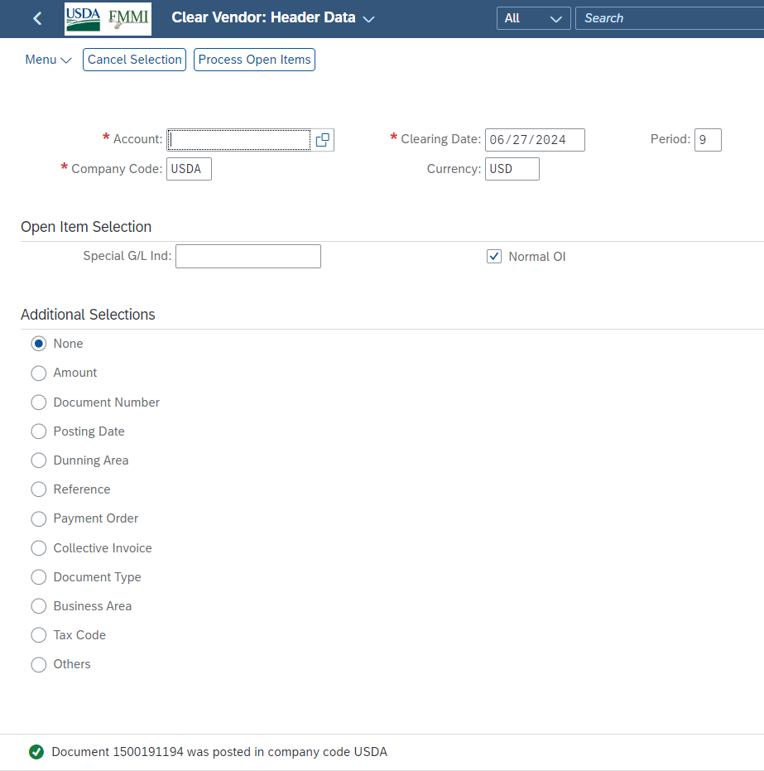
Clear Vendor Items – Posted Sucessfully
The document has been posted successfully.
Notes:
F-44

Slide 57
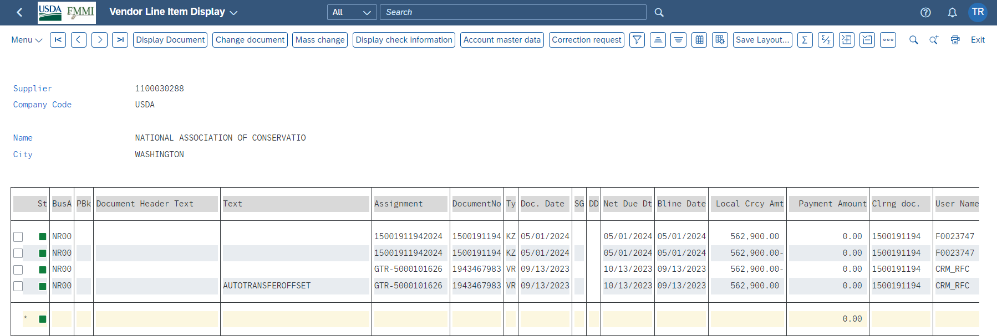
Clear Vendor Items – Cleared Document
Display of the original document and the cleared document.
Notes:
F-44

Slide 58
FINANCIAL TRAINING FORUM JULY 2024

