Slide 1
FINANCIAL TRAINING FORUM
JULY 2024

Slide 2
Welcome from the FMS Deputy Director
Welcome to the Financial Management Services’ 2024 Financial Training Forum (FTF). We are excited to offer another training opportunity, continuing to meet our customers’ needs while leveraging the flexibilities associated with virtual training. The trainers are subject matter experts in various areas of financial management-related processes and FMMI Intelligent Enterprise Transformation (FIET). We look forward to your interaction and feedback throughout the next two weeks so we can continue to serve you in achieving the USDA mission.
- Linda Connolly, Deputy Director
FINANCIAL TRAINING FORUM JULY 2024

Slide 3
FINANCIAL TRAINING FORUM JULY 2024
Fiori App Demo:
Parked Documents Report

Slide 4
Housekeeping
This training session is being recorded.
In the event of an audio interruption, please turn on captioning. (More > Language and Speech > Turn on Live Captioning)
Presenters will address questions at the end of their presentation. You may submit questions in the Chat at any time during the presentation.
Please keep your microphone muted unless you are recognized to ask a question.
If possible, use a headset with microphone when speaking to reduce echoes and feedback.
The AgLearn survey is NOT available until after the class has completed.

Slide 5
NASBA CPE Credit Guidelines
The Directives and Training Branch will be using MS Teams’ polling feature to capture engagement metrics during each training session. Four polls will be launched at random intervals within each hour of the class. Each poll will remain open for 60 seconds and, per NASBA requirements, attendees must respond to at least three of the four polls to receive CPE credit for that hour. Partial credit will not be issued. Two-hour training sessions are not designed to include breaks, therefore, please plan accordingly.
Polls will appear in either the Chat box or the main presentation area of your screen.

Slide 6
Presenters
Barbara Frye, CPA, CGFM - USDA FIET Functional Lead
Barbara is the USDA Functional Lead for the FIET project. She is a Certified Public Accountant and Certified Governmental Financial Manager with 27 years of experience in a public accounting firm, the banking industry and with USDA. Barbara’s 16 years with USDA has been in the Cash Reconciliation Branch and the FMS Customer Support Branch.
Donna Raymond, CGFM - Customer Service Branch Chief
Donna has 25 years of experience in government accounting. This includes State of Arizona’s GAO Functional System Manager, the USDA FMS Treasury Services Branch, and the USDA FMS Customer Services Branch. Donna is a Certified Government Financial Manager and an SAP FI Certified Associate.

Slide 7
Training Objectives
In this session, you will learn:
Key information and Policy Directive updates for Parked Documents
The definition of Parked Documents
How to identify the new Fiori app for Parked Documents
The types of Parked Documents available in S/4HANA
How to Display a Parked Document
Different Statuses for Parked Documents
Data Actions (Change, Delete, Approve)

Slide 8
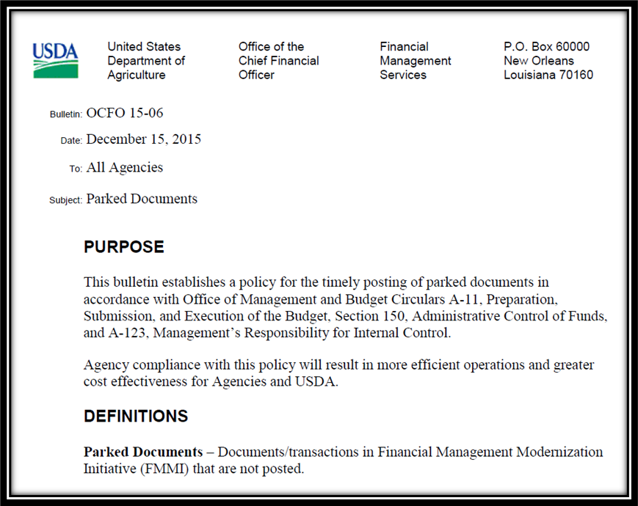
Current Directive
Current Bulletin OCFO 15-06: Parked Documents

Slide 9
Background
USDA is responsible for establishing and maintaining internal controls to achieve the objectives of effective and efficient operations, reliable financial reporting, and compliance with applicable laws and regulations.
Throughout the year, the net and absolute dollar value of parked transactions not timely posted in FMMI is material.
As such, the financial reports and statements may not be reliable because timely information cannot be obtained, reported, and used for decision-making.
Therefore, corporately, USDA agencies and staff offices cannot have the reasonable assurance required to certify that:
Programs achieve their intended results
Resources used are consistent with agencies’ missions
Programs and resources are protected from waste, fraud, and mismanagement
In addition, when transactions are not recorded timely, the effectiveness of FMMI’s administrative control of funds is compromised, and financial statements could be overstated or understated. A proactive measure must be implemented to improve the agencies’ ability to rely on the completeness of their financial information.

Slide 10
Updated Directive
What about all other types of documents?
i.e., PO, Funds Commitments, etc.
Should also be included in directive to clear by 10 days. Therefore, the following is being done:
Revised Directive is in process of being reviewed and moving forward with Senior Exec approval. We anticipate that it will be released by end of August.
New OLPH for to manually running these reports in FMMI
Gov Delivery to communicate with Directive and OLPH are completed
Developed Fiori Parked Document App

Slide 11
What Are Parked Documents?
The timely posting of financial documents helps ensure up-to-date, accurate financial reports and statements for decision-making. USDA departments and agencies must complete documents in accordance with the Office of Management and Budget’s Circular A-11:
Regular Finance (FI) Document: “Parked”
LIV Financial (Logistics Invoice Verification): “Parked”
Materials Management: “Park,” “Hold,” and “In External Approval”
Exclude those that have been Trash Canned and Line Locked
PO – Purchase Orders
PR – Purchase Requisitions
Funds Management Entry status on Hold with no Completion Date
Fund Obligations: “On Hold”
FC – Funds Commitments
FP – Funds Pre-Commitments
FR – Funds Reservations
FMBD – Budget Documents “PrePosted”

Slide 12
Problems Solved/Gaps Addressed
To comply with the new directive, FMS created 6 new procedures.
Executing 6 procedures can be time-consuming.
To simplify the process, the upgrade to S4/HANA provides a great enhancement through SAP’s User Experience of Fiori.
This customized application has its own Fiori tile to execute for all document types.
The objective of this application is to combine parked documents across FI, MM, and FM modules and display them in a single report with the ability to change/approve/reject each of the documents.

Slide 13
Security
Fiori Parked Document app security will always be based on your existing FMMI security:
Security Roles
AP, AR, GL etc.
View only or change/approve
Business Area
Select by 1 or more Business Areas (Agency)
*All Business Areas that user has access to.
Example FPAC: If user has access to all their Business Areas, they could enter: Business Area for RMA (RM00), NRCS (NR00), Farm Services (FA00), and FPAC Business Office (FB00)
Only 1 (NR00)
List 2+ (FA00 and NR00)
* (All)

Slide 14
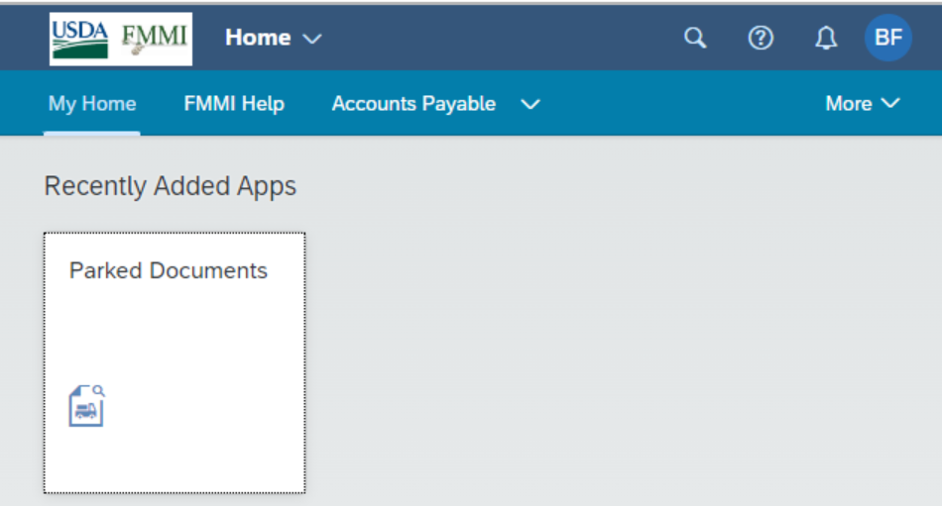
Fiori Tile (New)
The production environment will have the Parked Document tile available within the applicable business process areas such as Funds Management.
NOTE: Screen shots are from the Development environment and will vary from Production depending on a user’s roles. Therefore, information shown in the demo may appear differently than what you will experience after go-live.

Slide 15
Parked Documents View (Fiori App)
One screen is used to execute all eight reports:
A) Filters for specific criteria - Top Section
B) Displays - Bottom Section
Use the dropdown menu, to display relevant parked documents.

Slide 16
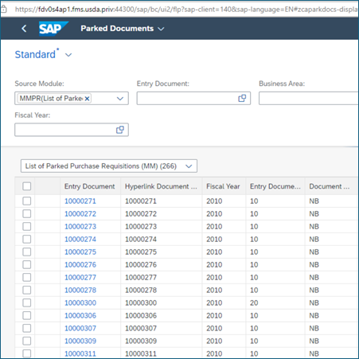
Parked Documents View (Fiori App), cont’d.
Use this dropdown menu to display relevant parked documents.

Slide 17
Demonstration

Slide 18
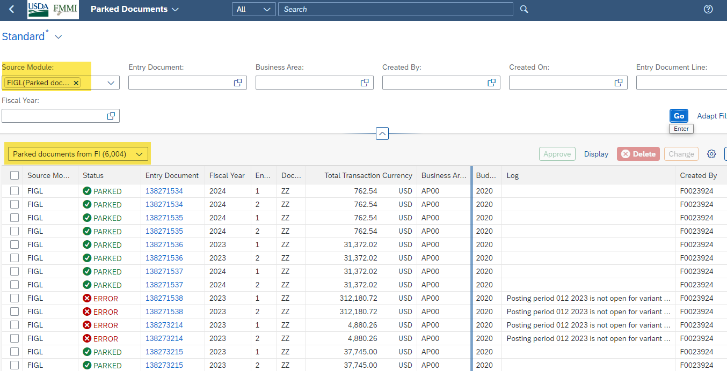
FI Example

Slide 19
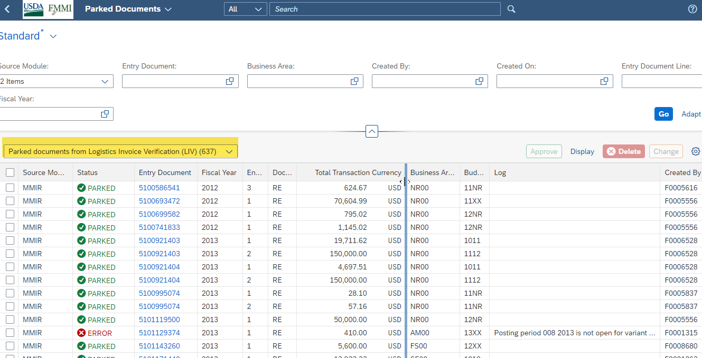
LIV Example

Slide 20
Purchase Order (PO) Example

Slide 21
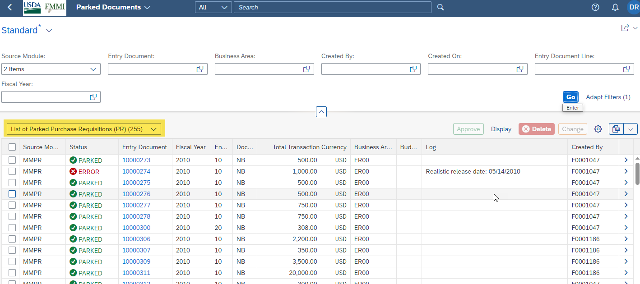
Purchase Requisition (PR) Example

Slide 22
Funds Pre-Commitment (FPC) Example

Slide 23
Funds Reservation (FR) Example

Slide 24
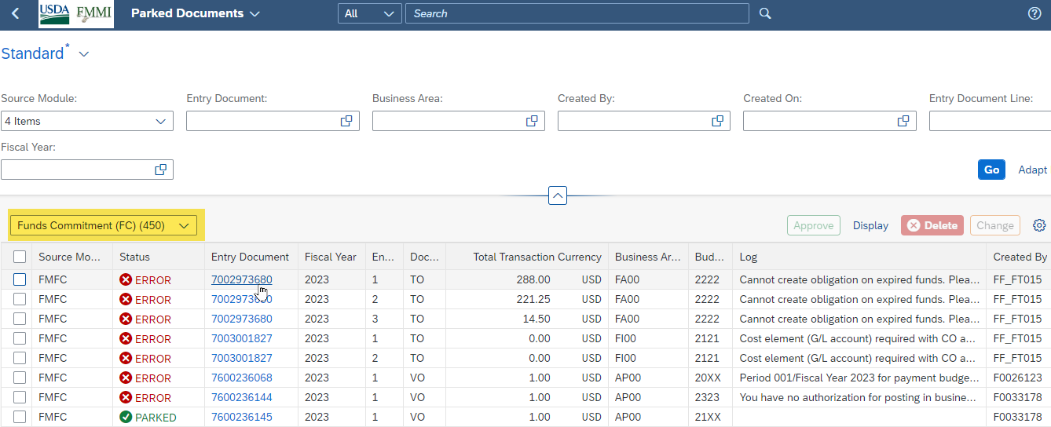
Funds Commitment (FC) Example

Slide 25
Budget (FMBB) - Example

Slide 26
Filters and Sort
Input filters:
Type of Documents
Entry Document Number (slide 27)
Business Area
Fiscal Year
Created By – User ID
Created On – Date
Entry Document Line (slide 28)
Sort – by all fields (slide 29)
Output Filters (slide 30)

Slide 27
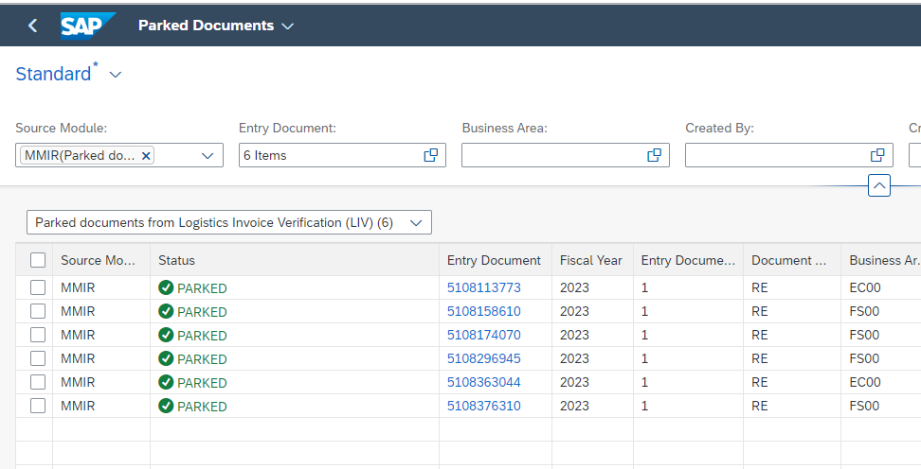
Input Filter: Entry Document Number
To view specific document numbers, copy and paste into the Entry Document:
Examples:
5108113773
5108174070
5108376310
5108363044
5108158610
5108296945

Slide 28
Input Filter: Entry Document Line = 1
1

Slide 29
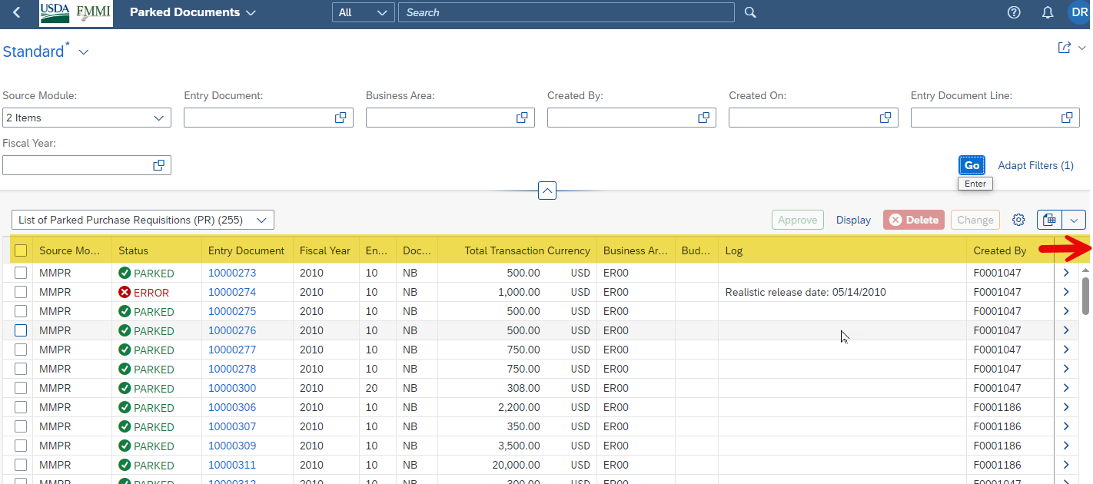
Sort
Sorting can be done on ANY field

Slide 30
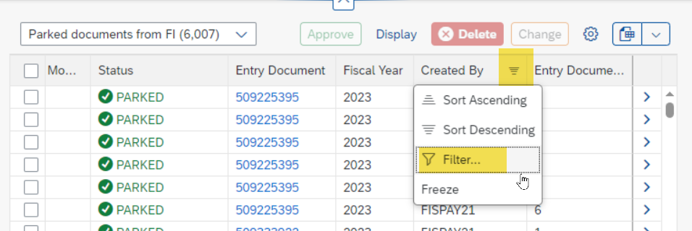
Output Filters
Filter can be done on ANY field: Example by Created By

Slide 31
Perform Data Actions
One Document or Many
Display
Change
Delete
Post/Approve

Slide 32
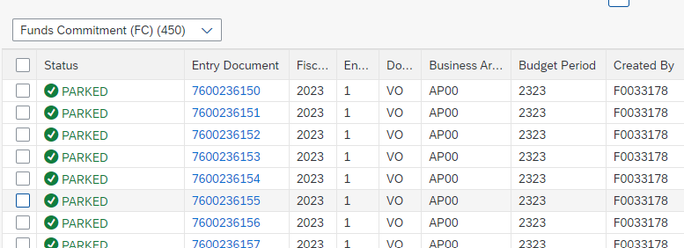
Status: PARKED
PARKED – initial view when documents are first selected and displayed.
Example: Funds Commitment that is on “HOLD” with no Completion Date

Slide 33
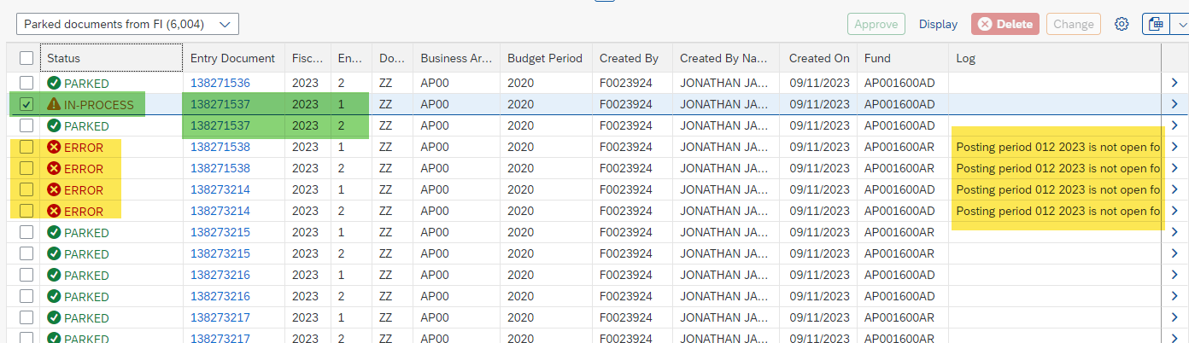
Executing and Results
After executing by clicking GO, Fiori will provide a status of “IN PROCESS” or “ERROR.”

Slide 34
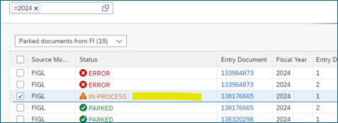
Status: IN-PROCESS
This shows when the user submitted the document for approval, change or delete, and it’s IN-PROCESS, thereby keeping it from being modified.

Slide 35
Status: ERROR
ERROR – user tried to approve, change or delete the document, and it resulted in an error.
To see the error:
Scroll to the far right,
Move the Log (Error Message) to main screen
Click on the “>” symbol on right of screen to see details (slide 36)

Slide 36
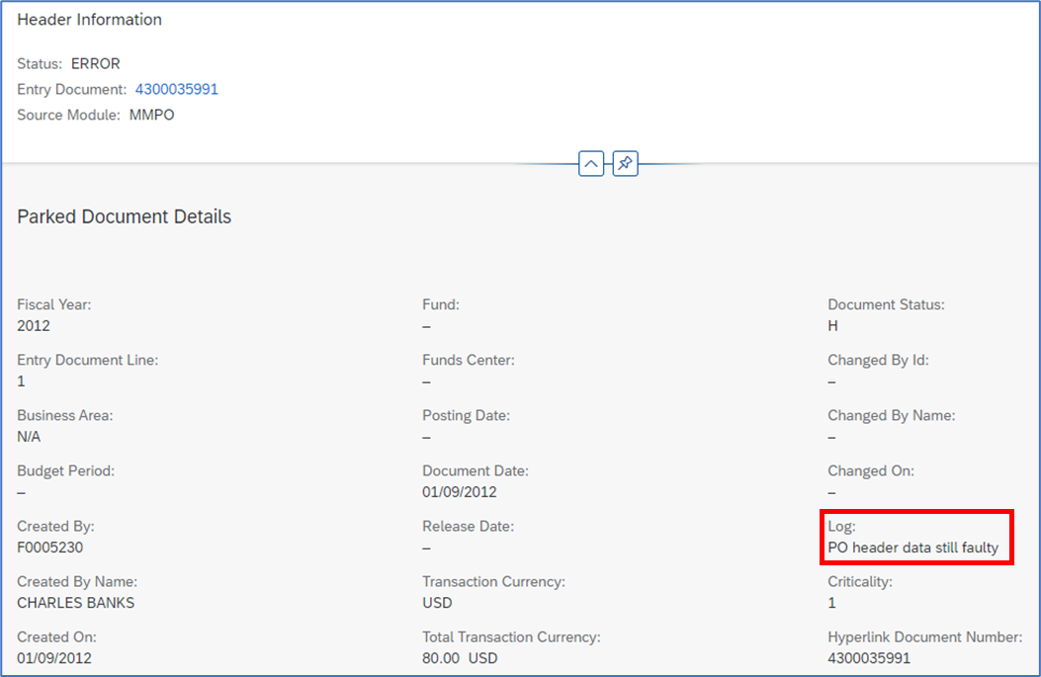
Document Details
After clicking on the “>” symbol, the Parked Document Details screen is displayed:
Log Error: “PO header data still faulty.”

Slide 37
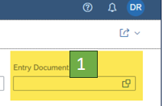
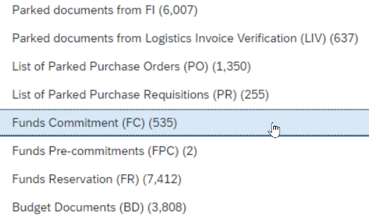
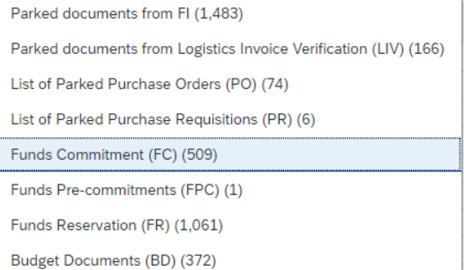
Displays
Use the down arrow to see available documents. You MUST specify what type of document you want to review based on the Filtered Data:
Example: Funds Commitments
Filter:
Entry Doc = 1
Total 509 records
If No filters - Total 535 records

Slide 38
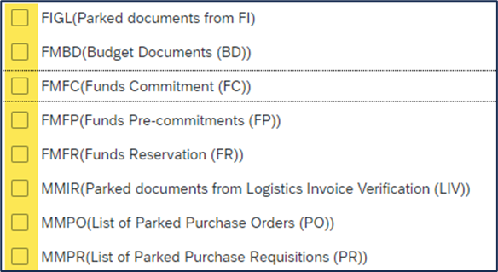
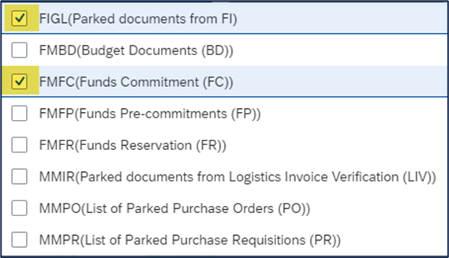
Is a Filter Required?
No Filters Needed
When executing without any filters,
you will receive all data you have
access to, all agencies, and all doc types:
Many options: Example -
If you only want 2 types:

Slide 39
Important Reminders
Select a filter - Source Module
Must change the Display Type
The Display Type does not change automatically
(keeps the last one used)

Slide 40
Data Actions
One Document or Many
Display
Change
Delete
Post/Approve

Slide 41
Display – reorganize columns
Reorganize your columns by clicking and dragging columns (like in Excel)

Slide 42
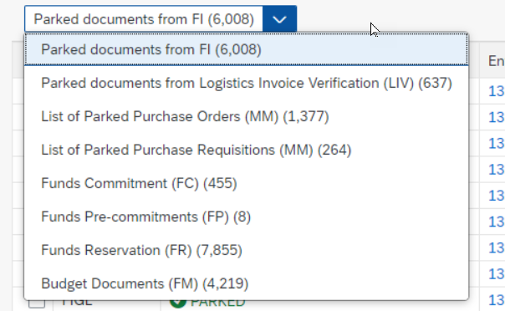
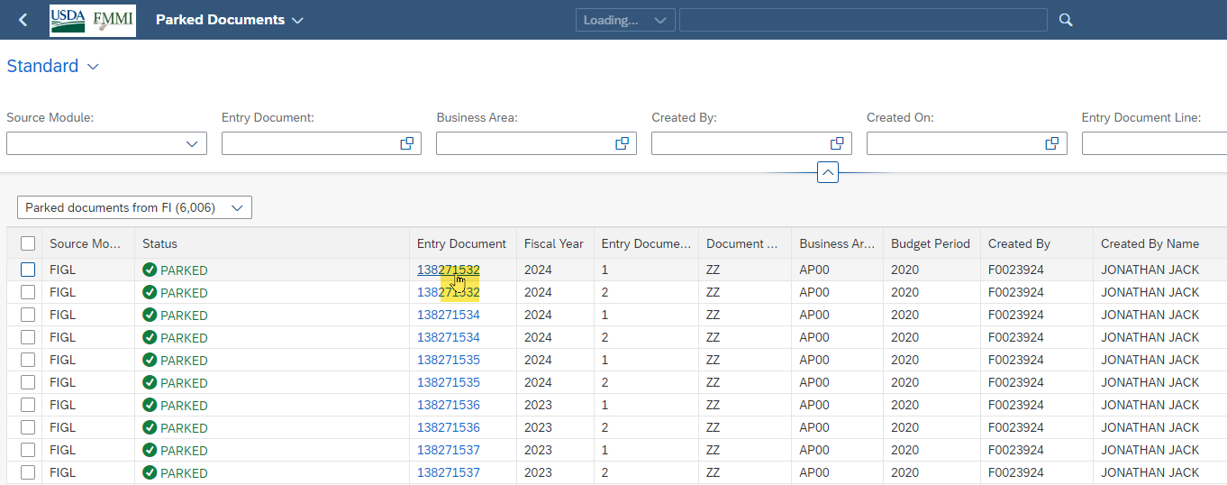
Display one document
1) Must always display first based on the filters and criteria we just talked about.
2) Drill into document (hand icon) to see details.

Slide 43
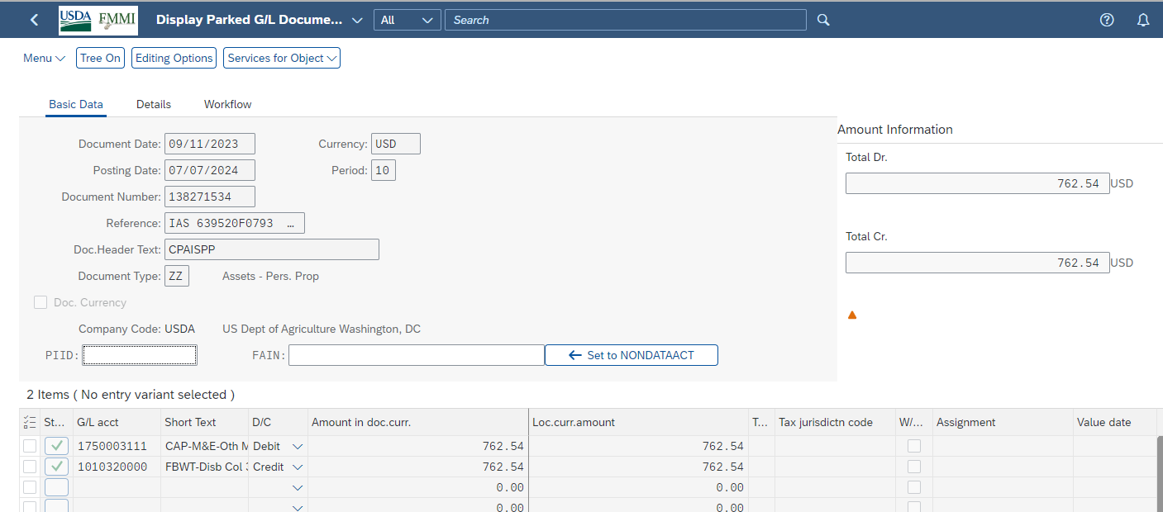
Drilldown Details
Drill into the document to see the details.

Slide 44
Export
Export the list to EXCEL or PDF for review.

Slide 45
Change
Display list > hyperlink into the document >
Get into Change Mode and change just like normal.
Example (PO):

Slide 46
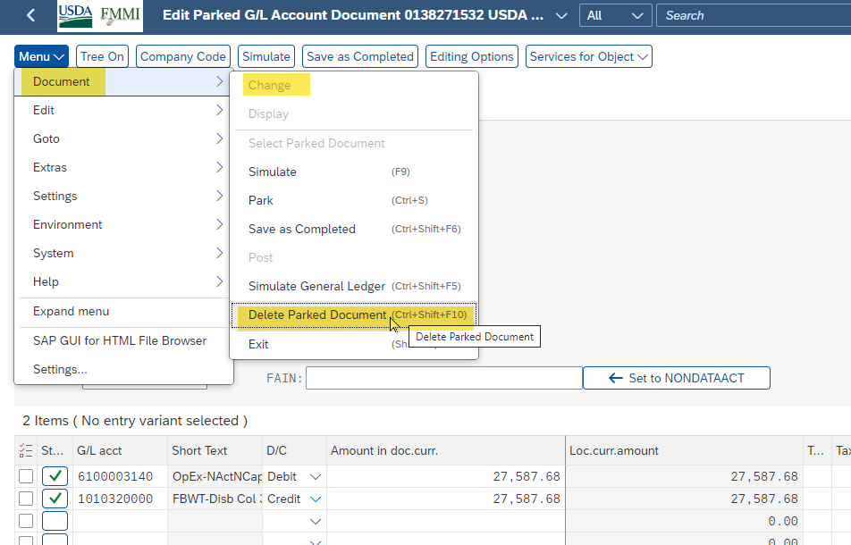
Delete
Display list > hyperlink into the document >
Get into Change Mode and delete like normal, if applicable

Slide 47
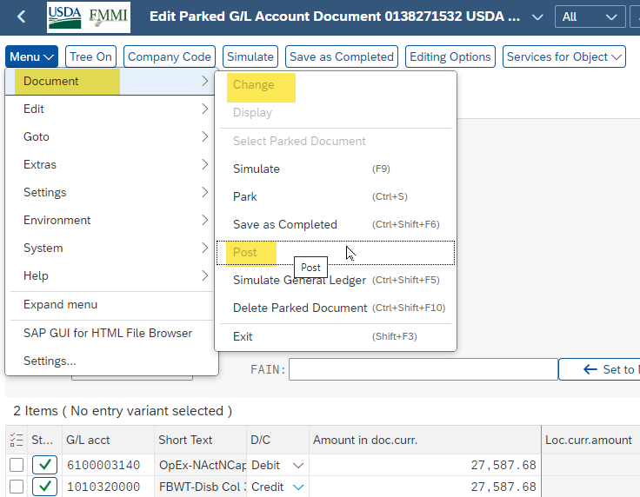
Approve
Display list > hyperlink into the document >
Get into Change Mode and Post like normal, if applicable

Slide 48
Mass Change, Approve, or Delete
More than one document at a time!
Mass Change
Mass Approve
Mass Delete
Risk – may impact documents that you didn’t intend to.
Therefore, we are limiting the ability to do this.
NEW SECURITY will be needed!
Maybe only 1 or 2 people at each agency to receive this new role.

Slide 49
Mass Change
Mass Change – Dates only
Posting Date (FI, BD, FC, FP, FR)
Document Date (PO)
Release Date (PR)
FI - Posting Date
LIV - Posting Date
FC, FR, FPC - Posting Date
Budget - Posting Date
PR - Release Date
PO - Document Date

Slide 50
Mass Delete
Mass Delete – will delete all lines to a document (even POs)

Slide 51
Another Warning
Once you delete FI Documents,
you cannot undo!

Slide 52
What Can’t I Do to Interface Documents?
Mass Functions are greyed out
Cannot Mass Change
Cannot Delete or Mass Delete
You can ONLY Display interface documents, e.g., Payroll, IAS Purchases Orders, SmartPay, etc.

Slide 53
Unique Info
Business Area – not all records display a Business Area.
We are deriving Business Area from the following criteria:
If Business Area is blank, Fiori will:
Funds Center: 1st two characters + “00”
Cost Center: 1st two characters + “00”
Fund <> ‘AG”: 1st two characters + “00”
“N/A”: FMS will manage

Slide 54
Future
FMS will continue to test the app during
the future FIET Test Cycles.
Eventually, agency testing will be available, and FMS will be open for discussions of any concerns regarding security or functionality.

Slide 55
FINANCIAL TRAINING FORUM 2024

