Slide 1



FINANCIAL TRAINING FORUM
JULY 2024

Slide 2

Welcome from the FMS Deputy Director
Welcome to the Financial Management Services’ 2024 Financial Training Forum (FTF). We are excited to offer another training opportunity, continuing to meet our customers’ needs while leveraging the flexibilities associated with virtual training. The trainers are subject matter experts in various areas of financial management-related processes and FMMI Intelligent Enterprise Transformation (FIET). We look forward to your interaction and feedback throughout the next two weeks so we can continue to serve you in achieving the USDA mission.
- Linda Connolly, Deputy Director
FINANCIAL TRAINING FORUM JULY 2024

Slide 3

Introduction to FIET
FMMI Intelligent Enterprise Transformation
FINANCIAL TRAINING FORUM JULY 2024

Slide 4
Housekeeping
This training session is being recorded.
Presenters will address questions at the end of their presentation. Please keep your microphone muted unless you are recognized to ask a question.
You may submit questions in the Chat at any time during the presentation.
If possible, use a headset with microphone when speaking to reduce echoes and feedback.
The AgLearn survey is NOT available until after the class has completed.

Slide 5
Presenters
Mike Brashear
Mike is the Technical Architect for FMS with 34+ years of experience, beginning as a Developer for the Thrift Savings Plan and continuing as a Systems Engineer at NFC where he built the first SAN and led the first datacenter replication Project. Mike received the President’s Council medal for the Year 2000 Conversion and recovered systems in the aftermath of Hurricane Katrina. Joining FMS in 2012, he led the FMMI migration to a cloud-based system, as well as several datacenter migration efforts. He is the TAMACO for OCFO.
Arianne Edward
Arianne is the Program Manager of the Financial Management Modernization Initiative (FMMI) Intelligent Enterprise Transformation (FIET) Program. She started her government career in 2015 and joined OCFO’s Program Management Office in 2020. Arianne earned a Bachelor of Science degree in Accounting as well as a Federal Acquisition Certification for Program and Program Managers, Certified at the Mid-Level.

Slide 6
Agenda
What is FIET?
Why modernize FMMI?
What will be the key changes for end users?
How will end users be involved?
Where are FIET Resources?

Slide 7
What is FIET?

Slide 8
The FIET Program
FIET (FMMI Intelligent Enterprise Transformation) is the program in which we are migrating the existing FMMI system from SAP ECC to SAP S/4HANA. This program represents a key milestone in USDA’s journey towards digital transformation and enhanced efficiency.
FMMI
SAP ECC version
FMMI
SAP S/4HANA version
FIET Program
Current financial system
Future financial system
Notes:
Ari
What is FIET?
Well let's start with what we know first. FMMI,
FMMI is our current Financial System, and we are in the process of migrating all FMMI's data into S4/HANA.
This Program is called FIET, Which stands for FMMI Intelligent Enterprise Transformation
It is our roadmap to our new Financial system.
So, FMMI 2.0 in a sense, but more accurately our FMMI SAP S/4 HANA version
The FIET program is our initiative to get us to our upgraded financial home.
Originally, we said that the new system will be called FIET but after some, analysis we decided to keep the System name as FMMI

Slide 9

FIET Program Objectives
Objectives
Data Quality & Information Lifecycle Management
Develop and implement a comprehensive data management strategy to optimize system performance and reduce costs​
Program Management, Organizational Change Management, & Training
Institute processes and oversee transformative changes to minimize user
impact and maximize successful outcomes for all FMMI workflows and end users
Grants Solution Integration
Integrate ezFedGrants grantor functionality from SAP CRM to SAP S/4HANA; integrate existing Pega portal interface
Selective Data Transition
Transform FMMI ERP system to S/4HANA providing enhanced financial functionalities and user experience
Notes:
This is a list of some FIET Program objectives
You all, as the agencies that we service have been heavily involved in the Data Quality and the ILM archiving workshops.
The cleaning the old house purging the things you no longer need or want before moving into our brand-new house
The movement into this new house would be our Selective Data Transformation
Everything we decided to keep and deemed worthy of moving it into the updated house.
We are going to ensure that we keep supporting our Grants Solution
And keep you all abreast every step of way.
We will provide Production Readiness Testing which is basically UAT and training to ensure we maximize successful outcomes for all FIET workflows and end users

Slide 10




Our Journey
Future
Present
FMMI
SAP S/4HANA
Past
FMMI
SAP ERP
FFIS
Mainframe
S/4HANA is like a new car with a more powerful engine, slick interior, and all the latest cool features. Even so, there will still be an adjustment period as you get the driver’s seat right where you want it, set your radio presets, and perfect parking in your garage.
Notes:
Our journey goes from legacy to leading-edge.
FFIS was a legacy system running in the days of big mainframes. Eventually the maintenance and licensing became very expensive, and it was difficult to integrate emerging modern technologies being developed at that time like Electronic Travel Service, E-Payroll and Grants.gov.
We knew it was time to replace that horse and buggy and start looking for a better solution to support USDA’s financial line of business.
In 2008 we started the process of migrating from the legacy system to a modern client/server technology based on SAP’s ERP business software This was called a COTS solution which is a Commercial-Off-The-Shelf software. The Program was called the Financial Management Modernization Initiative which became known to everyone as FMMI.
The primary objective of the FMMI is to improve financial management performance by efficiently providing USDA agencies with a modern core financial management system that both complies with Federal accounting and systems standards, while providing maximum support to the Agencies’ mission.
FMMI went live in 2009 and we cruised along in this hatchback for about six years. As the system grew, we started experiencing performance issues, especially around reporting. we installed appliances to help improve speed, we also saw issues with the virtualization, storage and networking layers. FMMI, like any old car was due for an overhaul. Technology was rapidly changing, and new innovations were developing. We found it challenging to implement innovation and functionality in the on-premises datacenter.
In 2015, we chose to move FMMI from on-prem to a HANA Enterprise Cloud hosted at Virtustream. This was a major overhaul, Not only was it a cloud migration, but we also performed an Enhancement pack upgrade and moved to Suit on HANA and converted the large Oracle database to HANA which allows the entire database to reside in memory
Now here we are in 2024. In today’s fast-paced, increasingly digital world, planning and delivering the optimal modernization journey is of critical importance. That hatchback is getting a little worn out and it is time to trade it in on a cutting-edge, high-performance convertible.
We’re calling this jump to the future the FMMI Intelligent Enterprise Transformation or FIET as Ari mentioned earlier.

Slide 11
Why modernize FMMI?
Notes:
Migrating from FMMI on ECC to the next generation SAP Business Suite (S/4HANA) will allow for a scalable growth platform for FMMI and its integrated systems .

Slide 12





Why Upgrade FMMI?
Simplification
Supportability
Ease of Use
Innovation
Improved
Performance
S/4HANA centralizes hardware and network resources and serves as the digital core for business process simplification.
Maintenance and support for core SAP ERP and SAP ECC release will end in 2027. S/4HANA will be supported long-term.
SAP Fiori’s UI is designed to be intuitive, personalized, responsive, and simple. It allows users to ask questions and access required details.
SAP S/4HANA sets the stage for innovation. S/4HANA applications leverage speed, context, and data accessibility allowing an enterprise to make decisions that are future ready.
S/4HANA improves performance by allowing users to develop and generate reports using real-time data. This improves service for customer-centric applications.
Notes:
Why are we upgrading now?
Let’s look at a few of the main drivers.
Simplification: SAP S/4HANA brings about immense simplification to the management and administration of the IT landscape – in fact, simplicity is one of the key features SAP has brought into its business application structure. SAP S/4HANA enables the centralizing of hardware and network resources and serves as the digital core for business process simplification, by harnessing the power of its HANA in-memory database.
Supportability: SAP is committed to provide mainstream maintenance support for Business Suite 7 through the end of 2027. There is an option to delay upgrading until 2030 but SAP will impose a higher maintenance fees after 2027. When we stated looking into this a few years ago, we understood this is a huge undertaking and realized the earlier we started, the better. We began planning a roadmap back in 2019, then the pandemic slowed us down a bit, but we officially started the migration last September and now we are about halfway into the Program with a target go-live in February of 2025.
Ease Of Use
The Fiori user interface is designed to be intuitive, personalized and responsive. The user interface brings innovative features like a more responsive home page and new collaboration capabilities which will facilitate improvements in user productivity.
Innovation : S/4HANA sets the stage for innovation. With every release of S/4HANA the ERP capabilities get refined. There are significant improvements in data management, Security, Database features, Integration features as well as automation possibilities. These improvements help to achieve better data governance and robust cybersecurity measures. SAP S/4HANA also sets the stage for future innovation.
Improved performance and speed: S/4HANA facilitates improved performance by allowing you to plan, execute, generate reports and analytics based on real-time data.
New and improved analytical apps provide more advanced operational and management reporting, which will help aid users with quicker and more efficient decision-making

Slide 13
















SAP ECC vs. SAP S/4HANA
SAP ECC | Feature | SAP S/4HANA
Not available | Intelligent Technologies | All available – embedded machine learning, advanced analytics, and digital assistants with voice recognition
HANA database | Database | SAP S/4HANA in-memory database with optimized code set; real-time Online Analytical Processing and Online Transaction Processing from one data model
Complex data model – redundant tables for analysis means blocking and maintenance issues | Data Model | Simple data model – combined analytics and transactions, reduced reconciliation, blocking, and maintenance
Traditional processes constrained by the legacy database | Business Process | Intelligent processes powered by new technology and SAP HANA
Legacy Portal | User Interface | SAP Fiori – modern, customizable, and intuitive User Interface
Notes:
This slide highlights some differences between FMMI running on ECC and the future state on S/4HANA.
Intelligent Technologies - S/4HANA is future-ready, it brings in the possibility of Intelligent Technologies like predictive analysis, machine learning, artificial intelligence, chatbots and Blockchain. None of these features are available with FMMI on the current Business suite.
Database – When we look at the differences between the database, essentially both are running with HANA as the underlying database but in S/4hana, SAP re-developed the code that was written back in the seventies and optimized it to take advantage of the power of the in-memory database.
The Data-model – In S/4 they consolidated and removed redundant tables into a simpler data model. They call this simplification. Thanks to SAP HANA’s columnar data structure, by removing the duplicate or non-mission critical information this can shrink the database size by a factor of 12. This means a smaller data footprint and a lower TCO.
Business Processes – The business processes in S/4HANA can simplify automation with drag-and-drop capabilities, allows seamless integration for developing faster workflows, bots, test automations and SAP connectors for non-SAP systems.
User Interface – and finally, with S/4HANA we are enabling the Fiori interface. For ECC the entry point into FMMI is through the enterprise portal. SAPGUI is used by a small set of super-users. With S/4 we are enabling the Fiori launchpad for a new user experience
new Fiori interface. There is more information on this later in the presentation.

Slide 14
What are the key changes for end users?

Slide 15
Key Changes
1
2
3
4
The most notable changes to FMMI can be grouped into four categories:
1. Fiori
2. Simplified Data Model
The fresh, new user interface with a modern look and feel.
Data tables will be combined to improve performance and data accuracy.
3. Business Partner Records
4. Reporting
Business Partner records will serve as an umbrella that captures data for related Customer and Vendor records.
A few fields in reports will be adjusted while the overall process will remain largely the same.

Slide 16
Degree of Change
FMMI users will face varying degrees of change in the transition based on their individual role and usage of FMMI.
Degree of change by category:
MODERATE
MODERATE
1
Fiori
3
Business Partner Records
LOW
HIGH
LOW
HIGH
Degree of Change
Degree of Change
MODERATE
MODERATE
2
Simplified Data Model
4
Reporting
LOW
HIGH
LOW
HIGH
Degree of Change
Degree of Change
Notes:
As you can see Fiori will be our highest degree of change
It will be a new look and feel for you all. A modern, app-based user interface that will serve as the new primary FMMI interface and will be accessed via the Portal.
For the Simplified data model, the Data tables will be combined to improve performance and data accuracy. So, this is a moderate change
Business Partner records will also be a moderate change and will serve as an umbrella that captures data for related Customer and Vendor records.
Our reporting will be our lowest degree of change. A few fields in reports will be adjusted while the overall process will remain largely the same.

Slide 17
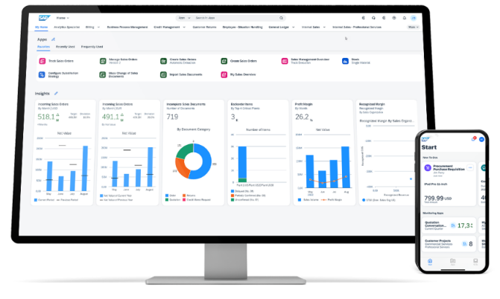
Fiori – New Look and Feel
Fiori will be the most notable for FMMI users while also providing the most benefit.
1
2
3
4
Fiori will serve as the new User Interface (UI) for transactions and will be accessed via the existing FMMI Portal. All transactions will move to Fiori, but only a small percentage will work differently than they do today.
Key benefits of Fiori include:
  Modern, intuitive interface
  Personalization options
  Improved productivity
  Operational metrics, enabling
  data-driven decision-making
  Embedded analytics
Fiori will launch in February 2025.
Notes:
Mike
Let's take a deeper dive into FIORI
You are all familiar with the enterprise Portal. Currently the portal acts as the gateway to other systems like CRM, GRC, and the Business warehouse. To eliminate the portal completely will take some major changes to the security architecture across the enterprise. As you know, FMMI was built before we all had PIV-cards and while implementing SAP Analytics Cloud, we are seeing disconnects between the Long-ID or our certificates and the FMMI F-ID. Due to these challenges we have decided to keep the Portal as the entry-point and will have a link to launch the Fiori launchpad, but the tabs will still be available for users needing the other systems.
Fiori is SAP's modern and user-friendly interface design, built with a focus on simplicity, responsiveness, and enhanced functionality, including embedded reporting. Some of the key changes and benefits users will experience with Fiori are
1.Personalization - Users can customize their Fiori launchpad layout, organizing apps in a way that makes sense for their role. Additional customization options include preset filters and color schemes.
2.Ease of use - Fiori employs the app-based design that users have come to know and love in their smart phones. Each transaction has its own clearly labeled app that users will click ion to initiate a transaction. The Most frequently used apps as well as most recently used are easily accessible to users for quick navigation.
3.Tile-based display - Users will only see apps and transactions relevant to their role, minimizing visual clutter. The interface is overall more visually appealing, harnessing clean lines, and high-contrast elements like tiles seen on your smart-phone.
4.Searchability - The search bar has increased functionality, allowing users to search for transactions, data records, and more. Within transactions, additional search fields allow users to find records more easily.
5.Data analytics - Key operational metrics appear directly on Fiori apps, and users can click into operational reports to drill down and make decisions using real-time data.
The user interface of S/4HANA is intuitive and user-friendly. It embraces a consumer-grade experience that enhances user adoption and reduces the learning curve for employees, leading to higher productivity.

Slide 18
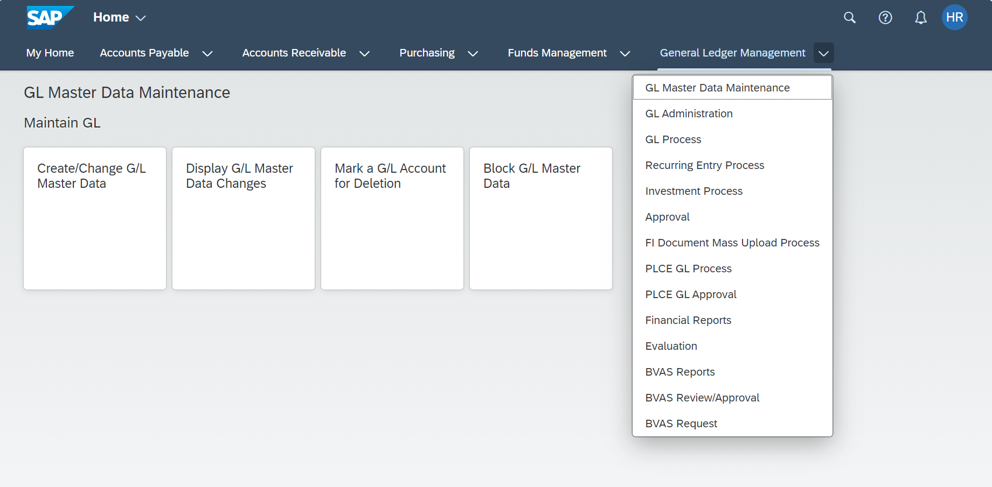
Fiori – Launchpad
The Fiori Launchpad is the first page users see after signing in.
The Launchpad is organized into spaces, pages, sections, and apps or tiles.
The terms app and tile are used interchangeably.
Space
Page
Section
App / Tile
*Note: The visual example provided above is illustrative only. Your Launchpad may appear differently based on your role and can be customized individually.
Notes:
This image gives you a sneak peek of what Fiori will look like. It’s organized around spaces and pages.
Each of the spaces across the top of the screen are organized to reflect the same business areas that you see in Portal today (ex. Accounts Payable, Accounts Receivable, etc.)
Then as you click on each space, you can click into a specific transaction that you’d like to complete.

Slide 19
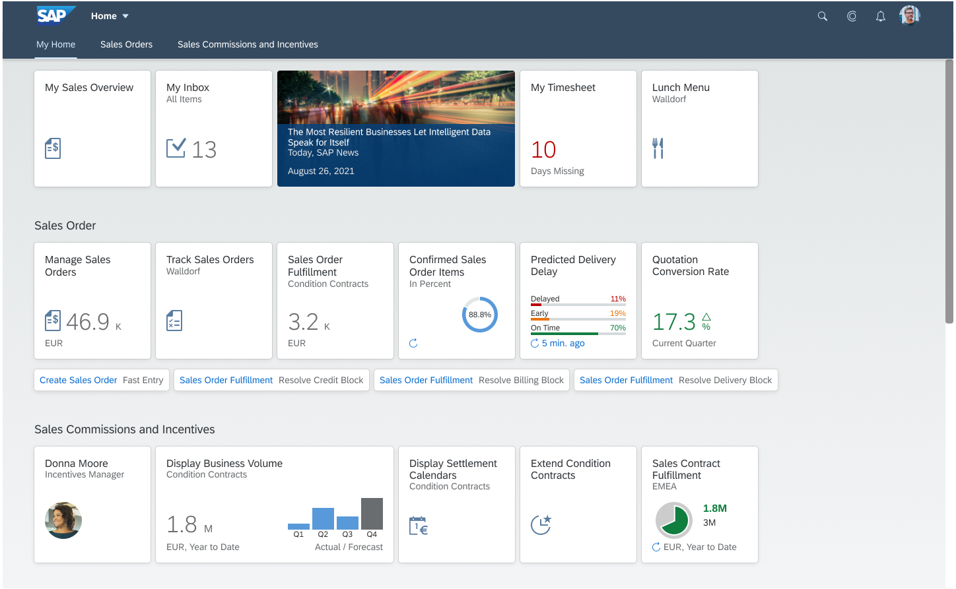
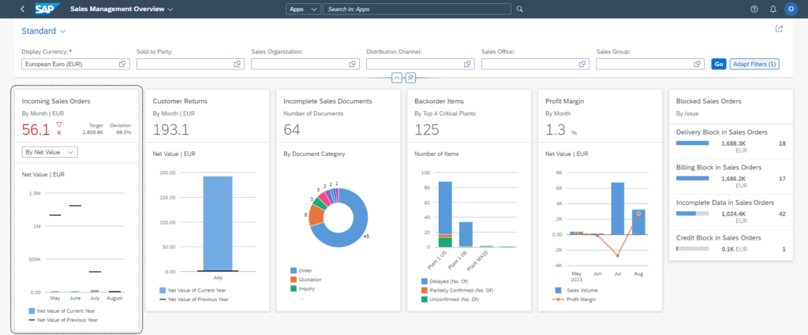
Fiori – Embedded Analytics
Key operational metrics appear directly on Fiori tiles, and users can click into operational reports to drill down and make decisions using real-time data.
1
2
3
4
To learn more about Fiori, watch this video.
Notes:
Embedded Analytics is one of the key innovations of S/4HANA. It will Provide USDA with new reporting and analytics features and lay a platform for future innovations.
We are developing and deploying the embedded analytics as well as out of the box, standard Fiori apps for selected functional areas.
The CDS View introduces new Fiori analytics apps and new core data service (CDS) views for existing reporting requirements. These type of apps will be expanded as USDA grows into this new landscape in the coming years.
Essentially embedded analytics can give us a real-time view of financial reports. These analytics can be generated instantaneously and will allow users to make decisions based on the most up-to-date information.

Slide 20
Simplified Data Model
The upgrade to S/4HANA will combine data tables into a single Universal Journal to improve performance and data accuracy.
1
2
3
4
This will also combine ledgers, thus simplifying the data model and improving system performance and data accuracy.
Benefits of this change include:
Eliminating redundant data
Reducing database size, improving performance
Introducing a single source of information in the Universal Journal
SAP ECC
SAP S/4HANA
Universal Journal
General Ledger
General Ledger
Controlling
Controlling
Notes:
Traditional ERP systems often use complex, multi-layered table structures to manage transactional and historical data. S/4HANA simplifies these structures, reducing the number of tables and using advanced columnar storage techniques for faster access and processing.
One of the standout features of SAP S/4HANA's data model is the Universal Journal, which consolidates financial and managerial accounting data into a single table (ACDOCA). This is a central component within S/4HANA, designed to simplify financial reporting, improve data consistency, and provide real-time insights into an organization's financial performance. The Universal Journal will maintain many of the same benefits that users enjoy in ECC:
The new Universal Journal integrates financial and accounting elements, such as federal ledger, accounts payable, accounts receivable, asset accounting into a single, unified data structure. This consolidation eliminates the need for separate tables and aggregates financial data in one place, providing a single source of truth for all financial transactions.
This simplified data model reduces main memory consumption, eliminates efforts in the maintenance of indices which in turn speeds up the overall query throughput. Overall, we should see better performance and lower infrastructure costs.

Slide 21
Business Partner Records
The launch of S/4HANA will introduce Business Partner (BP) records to FMMI. Business Partner records will serve as an umbrella that captures data for all customers and vendors.
1
2
3
4
Users will now view Business Partner records for information on customers and vendors and may experience minor changes to what they are familiar with today.
Business Partner Records
Customer Records
Vendor Records
Notes:
The third bucket of change that we want to discuss today is business partner records, which are introduced in S/4HANA. This is a new type of record that does not exist in ECC.
A business partner can refer to either a customer or a vendor. And a Business Partner Record will sit on top of each customer record and each vendor record.
With the introduction of this new record type, changes to customer and vendor data will be made at the business partner level. I won’t get into the details of this change, but I will use this as an opportunity to highlight the Introduction to Business Partner Records presentation being put on by Yolanda Wallace and Theresa Danner next week. If you are interested in learning more about business partner records, be sure to attend that presentation.
Otherwise here are a few fast facts that you should know about business partner records:
Chuck Ingraham’s Customer & Vendor Master Data Team will continue to maintain customer and vendor records, as well as business partner records
There will be no change to BPs in CRM. BPs will be created and updated in S/4HANA, similar to the current process in ECC.
The interfaces inbound to FMMI that create/change customer and vendor data will now create/change BP data instead. The BP data syncs to the customers and vendors. Interfaces that send customer and vendor data to agency systems will be unchanged.
And finally, users will be able to search for customers and vendors using Business Partner transaction.
Again, for more information about Business Partner Records, be sure to attend the Introduction to Business Partner Records presentation being put on by Yolanda Wallace and Theresa Danner next week.

Slide 22
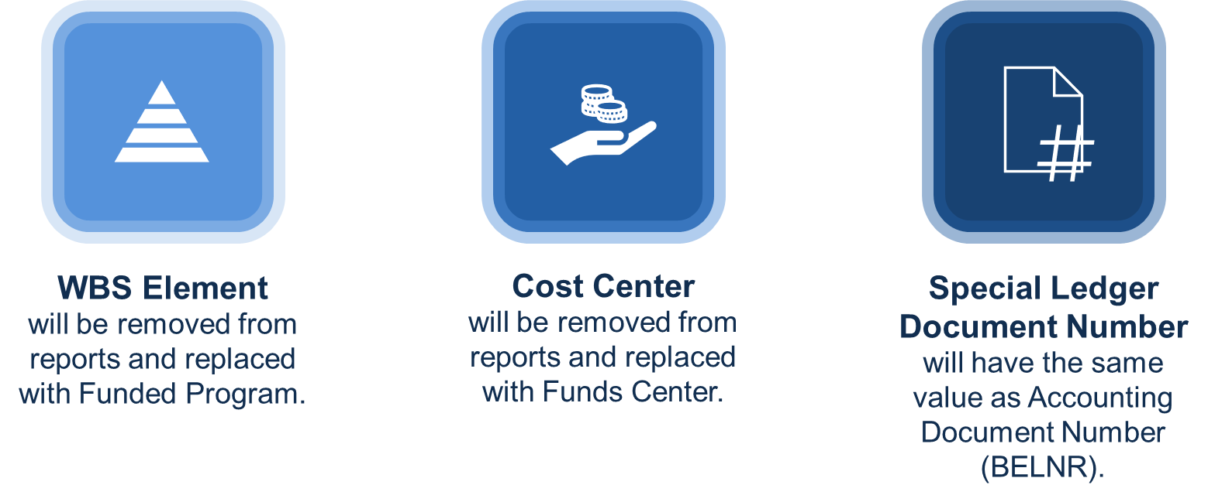
Reporting
Reporting will be minimally impacted in the FMMI upgrade. S/4HANA will not support WBS Element, Cost Center, or Special Ledger Document Number (DOCNR) features.
1
2
3
4
Notes:
The fourth and last bucket of change is related to reporting.
As we mentioned earlier, FIET will introduce embedded analytics capabilities. For more information on that, be sure to sign up for Tiffany Wimberly’s Embedded Analytics FTF presentation next week.
But otherwise, one of the guiding criteria for the FIET program is to minimize disruption to end users’ current reporting environment. We are retrofitting existing HANA models and Business Objects reports to validate and confirm that the existing reports will function as-is, and we are testing these retrofits as part of our Integration Test Cycles.
There will be minor changes to the WBS, Cost Center, and Special Ledger Documents, and those specific changes can be found in the Report section in the What's Changing Guide available on the FIET webpage. But overall, we are working to minimize the changes that end users will experience from a reporting experience.
Again, for more information on reporting and embedded analytics, be sure to join Tiffany Wimberly’s Embedded Analytics FTF presentation next week.

Slide 23
How will end users be involved?

Slide 24
What is a Change Champion and a Super User?
Change Champions and Super Users are agency representatives who provide support to the FIET Program by:
 | Change Champion | Super User
Communicating key FIET Program updates to their agency | YES
Collecting questions and feedback from end users to share with the FIET Program team | YES
Gauging the effectiveness of FIET communications | YES
Advising on how processes are used by agencies |  | YES
Ensuring processes align with business needs |  | YES
Participating in functional workshops, data validation, system integration testing, etc. |  | YES
Notes:
As part of the FIET Initiative, back in December, we asked for volunteers from each agency for Change Champions and Super Users.
Hopefully, you’ve heard from your Change Champions and Super Users already, as we have been partnering closely with them to share key FIET messages and updates, and they help us cascade those messages across USDA.
Change Champions are People who :
Are well connected to the agency users and end users.
Have knowledge of their agency needs
Have a baseline understanding of FMMI
Have knowledge of agency functions and processes
Attends weekly O&M meetings to receive FIET Program key messages and share questions from their perspective agencies
As for Super Users
These are people who
Have expertise in at least one FMMI functional area
Is knowledgeable of agency functions and business processes
They will support test scripts review
Will support training delivery by answering questions and coaching colleagues during the training sessions which will take place (Nov 2024 – Feb 2025)
They will also provide ongoing support to impacted users after go live, so Feb 2025 and beyond

Slide 25





How will Customers be Involved?
System Integration Testing 2 (SIT 2)
Aug. – Sept. 2024
FMS will invite some Agency Super Users to participate in this phase of testing by performing system validations.
Production Readiness Testing
Nov. 2024 – Dec. 2024
FMS QA Team will coordinate with select agency end users to conduct end-to-end validation testing.
End User
Training
Nov. 2024 – Feb. 2025
Agency users will be trained on the new Fiori user interface and any minor application function changes.
Deployment
Cutover & Go Live
Feb. 2025
Agency participation in post go-live validation as required.
  Hypercare Post Go Live Support
  90 Days Post Go-Live
  Our vendor partners will monitor the customer service, data integrity, and smooth operation of the implemented S/4HANA solution. Agency interaction may be required to troubleshoot agency-specific issues.
*Dates are tentative and will be updated as needed as the Program progresses.
Notes:
This is a timeline for customer involvement.
We will engage super users to start testing as early as September where they will perform system validations. Note that this is contingent upon testing by the QA team to ensure the environment is stable. Worst case scenario, we will have Super Users engage in testing during PRT.
During PRT, we will be coordinating with select agency users to do end to end testing which is usually called UAT User Acceptance Testing. We highly encourage one or two testers in every section of your organization that works with FMMI to participate in Production Readiness Testing. This will be used as a rubber stamp of ensuring the system is working as expected and as needed to complete business processes. Be on the lookout for a communication closer to September with details for how to get involved in PRT.
We will have training starting in November 2024 to ensure agency users are familiar with the changes that we have made to the FMMI system
The big bang is happening in February pf 2025 we will definitely need agency participation in post go live validation to ensure everything is working correctly.
Our vendor partners will stick around for a while after go live to fix any defects they may pop up and ensure will troubleshoot any issues that arise.

Slide 26







What are Customer Impacts?
FMMI Code Brownout (July 2023 – May 31, 2024)
Major Program code freeze. Only minor enhancements (<100 Hours) and break fixes that can be retrofitted in S/4HANA will be addressed.
FMMI Code Blackout (June 1, 2024 – Jan. 2025)​
Emergency system changes only. No other system changes will be planned or implemented.
'Big Bang’ Implementation (Feb. 2025)
All customers will go-live concurrently in the new version of FMMI. Current ECC will be depreciated at go-live and will not run in parallel with the S/4HANA system.
Notes:
Here are the impacts that you all have been experiencing thus far.
The brownout started last July. Even though we have been a little lacks on the brownout to ensure we get everything that our agencies needed in. In June 2024, we implemented our last FMMI release until we actually go live
To be sure everything works in S4, from now on only emergencies will go through. Emergencies are classified as work stoppage for agencies. It is imperative that we stick to this because we must retrofit anything that goes in the current FMMI system to ensure it works in S/4. Any unnecessary changes could delay our progress and impact the go live date. So other than those emergency changes, there will not be any other system changes being planned or implemented.
In Feb 2025 it will be our Big Bang of our implementation to FIET. We will be moving all agencies transactions at one time vs in a phased approach like we did with FSIS.
We are doing this to ensure everything is retrofitted into S/4 correctly and working properly after go live.
We are going to do what we can to make this transition easy and risk-free. With that in mind, we are going to continue to maintain Portal for a little while beyond February 2025, so if you find yourself in a pinch and unable to complete a transaction in Fiori, you will be able to do it in Portal for at least a little while, while you navigate the learning curve of moving to Fiori.

Slide 27
What to Expect?
Preparing for Upcoming Changes

Slide 28

FIET Program Roadmap
INITIATE
CONFIRM
DESIGN & BUILD
INTEGRATE
DEPLOY
SUPPORT
SEP 23 | OCT 23 | NOV 23 | DEC 23 | JAN 24 | FEB 24 | MAR 24 | APR 24 | MAY 24 | JUN 24 | JUL 24 | AUG 24 | SEP 24 | OCT 24 | NOV 24 | DEC 24 | JAN 25 | FEB 25 | MAR 25 | APR 25 | MAY 25
FIET Program Kickoff
9-5-23
Process Analysis
We are here
Planning & Operationalizing
Blueprinting
What’s Changing Guide
Publication June 2024
System Conversion
Financial Training Forum
Beginning 7-22-24
Design and Build
End-to-End Testing
Data Migration and Verification
Training
GO LIVE
Targeted 2-17-25
Post Go-Live Support
Notes:
This is a Roadmap of FMMI from beginning to end.
We started this Program in the beginning of Sept 2023
Since then, we have completed the impact analysis of the S/4HANA migration to include the FIT GAP analysis with the Functional Workstream. Key agency end users have participated in working sessions with the FIET functional team to determine impact on business processes. These results will also factor into the training plan.
We are currently in the middle of End-to-End testing but to be more specific right now we are currently in system Test. Once System Test is completed, we will move into Quality Assurance Testing where, mentioned before, the agency super users will get involved as early as September—contingent on the stabilization of the environment.
Then we will move into production readiness testing when more of you will get involved in testing. Then we will move into training.
Then we WILL go live in February of 2025!!!

Slide 29
Coming Soon
Survey – The second Stakeholder Survey will hit your inbox this fall
Training – Process-specific demonstrations for changing areas and roles are coming this winter. Be on the lookout for an announcement with more detail.
Job aids – Additional resources preparing you for the migration are coming this winter
Notes:
This is a list of things that will be coming your way this fall.
There will be another iteration of the survey that was sent out in April to check sentiment around FIET and how comfortable our end users are feeling with the changes that are coming.
The Financial Training Forum sessions this week and next week are intended as a helpful sneak peek into what is coming, but more robust training will be provided in the fall. We are currently preparing your training material (including courses, simulations, and job aids) now. Training will take place in this fall and will start by November.

Slide 30






FIET Training Plan
We will identify who needs to be trained, what they need to be trained on, and how they will be trained.
Create a Learning Strategy
Perform Learning Needs Assessment
Design Learning Curriculum and Plan
Develop the Learning Materials
Deliver and Deploy Learning
Evaluate the Learning Program
  Identify learning challenges, opportunities, and vision to develop an effective S/4HANA learning strategy. Identify the major areas of upcoming change where end users will most benefit from training support.
  Perform Learning Needs Analysis for insights, analyzing learning needs for end users as a result of S/4HANA deployment and ensuring that the learning program addresses the specific needs of the learners and improves user adoption.
  Design a Learning Curriculum and Plan that aligns with Program goals and meets learners' needs. Map business roles to ensure learning materials are aligned with their role in the system.
  Develop EnableNow simulations and Quick Reference Guides to support end user just-in-time learning models.
  Deliver Train-the-Trainer sessions to USDA trainers to prepare them to deliver training to end users. Schedule training just-in-time, shortly before go-live, to ensure that learning is fresh in users’ minds before go-live.
  Determine the learning program effectiveness and identify any areas for improvement. Gather feedback from the workforce, assess the adoption rates of the new S/4HANA technologies, and/or measure the impact of the learning program on business outcomes.
Notes:
We are identifying who needs to be trained, what they need to be trained on, and how and when they will be trained.
We will be designing training for end users that will ensure they are prepared to do their jobs in the upgraded system at go-live.
Training is tailored around the specific changes that end users will experience when they move from ECC to S/4HANA.
Since the time frame for

Slide 31
Where are FIET Resources?

Slide 32
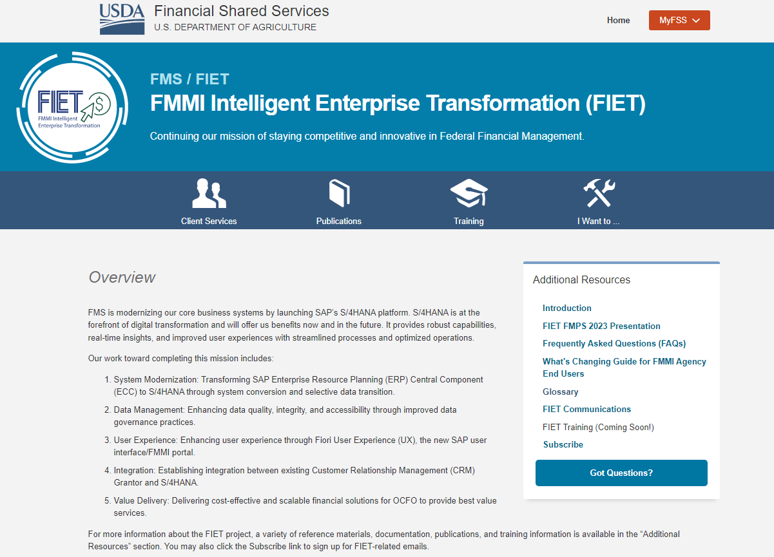


FIET Webpage
The FIET Webpage serves as a central location for all FIET resources and communications. Visit regularly for the latest updates on Program progress, training materials, upcoming end user impacts, and more.
Bookmark now for easy access!
Use the Got Questions button to ask questions
Notes:
Ari
A great source to key changes is the FIET webpage. The FIET OCM team, which I like to call the programs voice and cheerleaders because they so chipper and excited to share all the great things that we are doing,
They have put together a webpage that is dedicated to all things FIET. It is where you can find all the information that we have shared thus far with our end users, well you.
You can access the FIET webpage through the FMS website. To the right of your screen, you will see FMS Financial Solutions. The link to the FIET webpage is right under FMS Financial solutions. I am currently displaying a screen shot of how the FIET webpage looks today. It is a great source for you to get and stay connected to all FIET information and the changes coming your way.

Slide 33
What’s Changing Guide
The purpose of the What’s Changing Guide is to provide early education and awareness of the upcoming impacts to FMMI by:
Providing an overview of the FIET Program
Highlighting key changes to FMMI
Understanding how to prepare for these upcoming changes
Table of Contents
FIET Overview
The overall FMMI transformation
What’s Changing
  Fiori
  Simplified Data Model
  Business Partner Records
  Reporting
What to Expect
Preparing for upcoming changes
Notes:
What's Changing Guide which provides a detail presentation on what changes you can expect to see. The What Changing Guide or WCG outlines what you have today, what you will have after the FIET initiative in comparison to what you have today, what does that change mean for you and exactly which group is impacted by that change. The OCM team, in collaboration with the other FIET workstreams, worked really hard to put this presentation together to take out the guessing work for you
So, I encourage you all to go to the FIET webpage. You can access the FIET webpage through the FMS website.

Slide 34
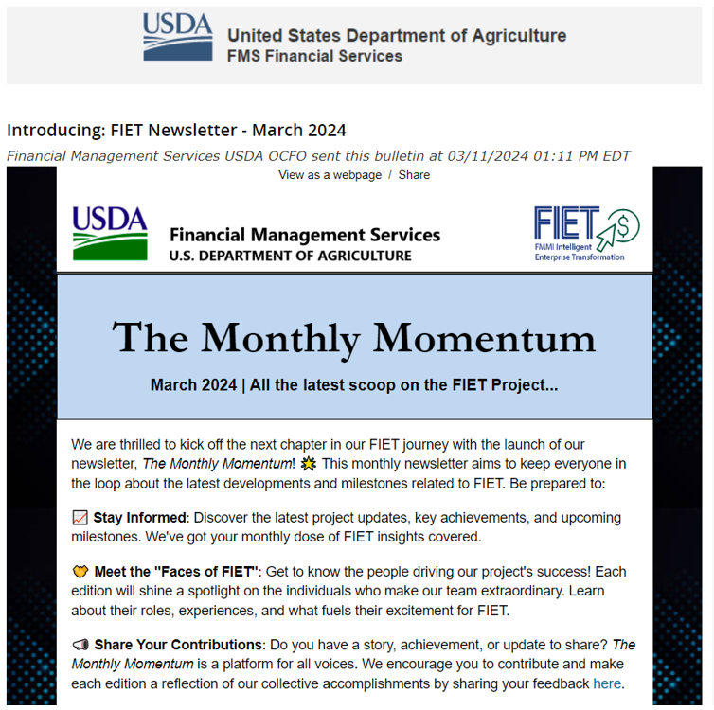

Monthly Bulletin
Read the FIET newsletter series, The Monthly Momentum!
Subscribe to the newsletter here
Notes:
Our OCM team is so proud of their monthly newsletter, called the Monthly Momentum. This is a great email bulletin resource that shares key updates on FIET progress and what’s coming. Be sure to subscribe if you haven’t already and read about how FIET is going.
Also, at the end of every newsletter is a fun series called Faces of FIET where you can get to know the leaders on the FIET program on a professional and personal level.
Stay informed about the FIET program's progress and know where you can go to ask questions.

Slide 35
FIET Frequently Asked Questions
What is FIET?
How are SAP, FMMI, FIET, Portal, and Fiori
related to each other?
Why upgrade FMMI?
What is the Program timeline?
What is my role as a stakeholder?
How will customers be involved?
What is a code blackout vs. a code brownout?
What are the key changes for end users?
What degree of change will end users will experience?
Will the upgrade impact agency-level security?
Will support be available to end users to
prepare them for the change?
Does USDA have a training plan?
What will the conversion process be?
Will there be fit gap analysis performed with processes and interfaces?
Will impacts to agency-specific interfaces be identified and reconciled?
What is a Change Champion and a Super User?
Will reports still be accessible?
How will missing Cost Center and WBS Element impact reporting?
How will missing Special Purpose Ledger impact reporting?
Will ECC layouts and variants be migrated to the Fiori apps?
What are the next steps?
Where can I ask additional questions?
Click here for answers!
Notes:
The next slide is the question slide, but before we get there, I want to show you some of the Frequently Asked Questions that we have received thus far for the FIET Program. We have the answers to these questions on the webpage.

Slide 36

How to ENGAGE
Things you can do to get ready for the migration to S/4HANA:
Read our newsletter series – The Monthly Momentum
Read our What’s Changing Guide – WCG
Read our Frequently Asked Questions – FAQ
Ask questions through the channels listed below
Resources for Success:
FIET Webpage
Change Champions
Help Desk
Agency CAM
Subscribe to email updates
Notes:
We will share regular, iterative updates in the O&M calls, emailed bulletins, and on our web page to ensure that end users receive frequent updates on Program progress, upcoming change impacts, and more.
Our goal is to over-communicate rather than under-communicate, to ensure that all end users are familiar with the FIET Program, are not caught by surprise, and are able to do their jobs in the upgraded system.
Please use all the links in this presentation as resources to get and stay connected to all things FIET.
Are there any questions?

Slide 37

FINANCIAL TRAINING FORUM JULY 2024

