Slide 1
FINANCIAL TRAINING FORUM
JULY 2024

Slide 2
Welcome from the FMS Deputy Director
Welcome to the Financial Management Services’ 2024 Financial Training Forum (FTF). We are excited to offer another training opportunity, continuing to meet our customers’ needs while leveraging the flexibilities associated with virtual training. The trainers are subject matter experts in various areas of financial management-related processes and FMMI Intelligent Enterprise Transformation (FIET). We look forward to your interaction and feedback throughout the next two weeks so we can continue to serve you in achieving the USDA mission.
- Linda Connolly, Deputy Director
FINANCIAL TRAINING FORUM JULY 2024

Slide 3
Introduction to Fiori Launchpad
FINANCIAL TRAINING FORUM JULY 2024

Slide 4
Housekeeping
This training session is being recorded.
In the event of an audio interruption, please turn on captioning. (More > Language and Speech > Turn on Live Captioning)
Presenters will address questions at the end of their presentation. You may submit questions in the Chat at any time during the presentation.
Please keep your microphone muted unless you are recognized to ask a question.
If possible, use a headset with microphone when speaking to reduce echoes and feedback.
The AgLearn survey is NOT available until after the class has completed.

Slide 5
NASBA CPE Credit Guidelines
The Directives and Training Branch will be using MS Teams’ polling feature to capture engagement metrics during each training session. Four polls will be launched at random intervals within each hour of the class. Each poll will remain open for 60 seconds and, per NASBA requirements, attendees must respond to at least three of the four polls to receive CPE credit for that hour. Partial credit will not be issued. Two-hour training sessions are not designed to include breaks, therefore, please plan accordingly.
Polls will appear in either the Chat box or the main presentation area of your screen.

Slide 6
Presenters
Barbara Frye, CPA, CGFM
Barbara is the USDA Functional Lead for the FIET project. She is a Certified Public Accountant and Certified Governmental Financial Manager with 27 years of experience in a public accounting firm, the banking industry and with USDA. Barbara’s 16 years with USDA has been in the Cash Reconciliation Branch and the FMS Customer Support Branch.

Slide 7
Training Objectives
After completing this training session, you will be able to:
Define Fiori
Navigate to the Fiori Launchpad
Understand the mapping of business processes and transactions
Understand how Fiori is organized
Fiori functionality – high level navigation
Navigate to a transaction
Learn how to personalize your Fiori Launchpad

Slide 8
Define Fiori
SAP Fiori is the new user experience (UX) for SAP software and applications. It is a web-based user interface with a Launchpad where users will access business processes and transactions.

Slide 9
FMMI Portal and Fiori Launchpad
Users will log into the FMMI Portal with Single Sign-On (SSO)
Navigate to the Launchpad by clicking the Fiori button
BOBJ, Grantor and GRC access remains on the FMMI Portal
Notes:
Your single sign-on credentials carry over to the Fiori launchpad

Slide 10
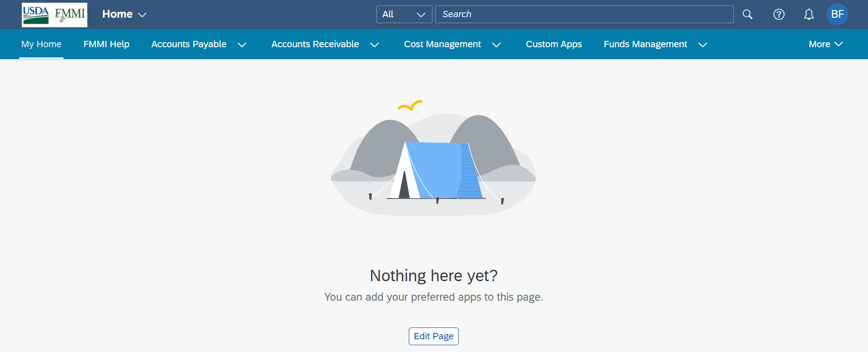
Fiori Launchpad
The Fiori Launchpad is the landing page for FMMI users and the central access point for the Fiori apps
Initially, the home page is empty showing the tent graphic
The My Home space can be customized by each user

Slide 11
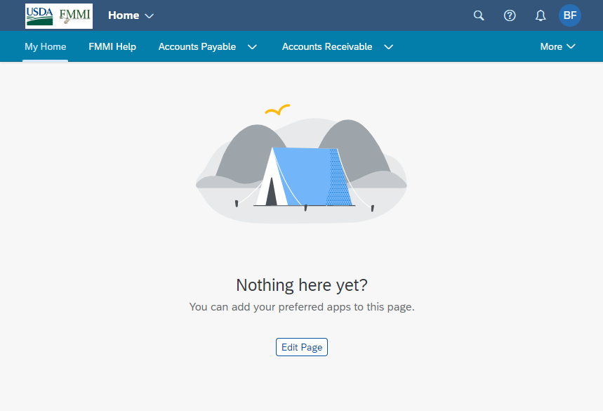
My Home Edit Page
The My Home space is blank when users sign in for the first time
The Edit Page link allows users to add Sections and Tiles

Slide 12
USDA vs SAP Terminology
USDA Process Areas (SAP Spaces)
SAP Pages
USDA Business Processes and Subprocesses (SAP Sections)
USDA Transactions (SAP Tiles)
Launchpad Shell/Header Bar

Slide 13
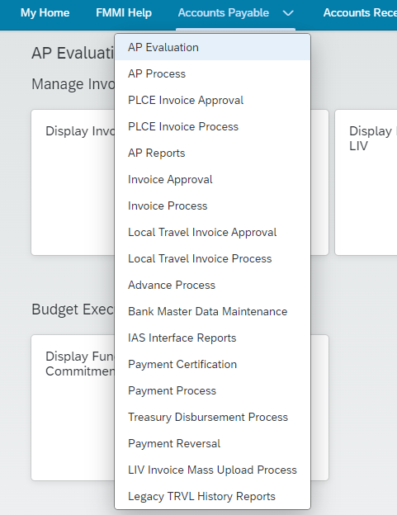
Business Process & Transaction Mapping
The business processes and transactions are located with a similar breadcrumb path as in Portal
Just as a user would go to Accounts Payable > AP Evaluation to display an invoice in Portal yesterday, they will do the same in Fiori tomorrow
Users’ security roles will carry over to Fiori apps, enabling users to process transactions as they do currently in Portal

Slide 14
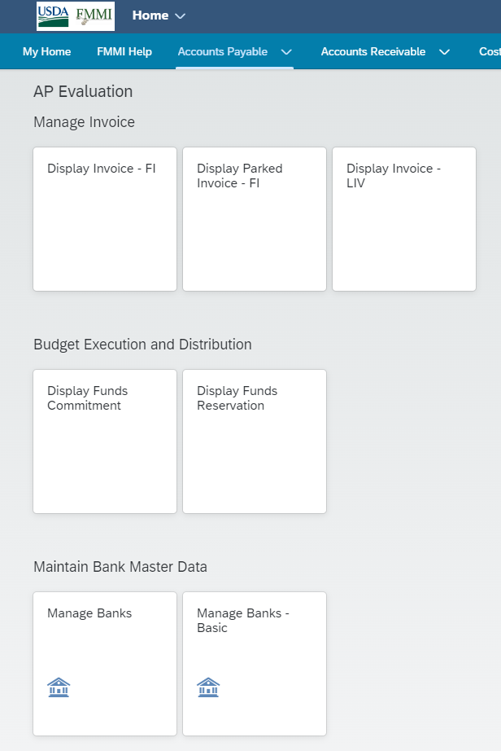
Business Subprocess & Transaction Mapping
Subprocesses and transactions are also mapped similarly to Portal: AP Evaluation > Manage Invoice > Display Invoice – FI

Slide 15
Launchpad Shell/Header Bar
The Launchpad Shell/Header Bar is always visible as the top banner on the page and is the default header that provides the following functions:
Global Search (magnifying glass) – searches across apps and business processes
Help (question mark) - when opened, provides context-sensitive help depending on where you are in the system
Notifications (bell icon) – displays system-generated notifications organized by date, by type, and by priority, which can contain workflow items
User Actions Menu (Profile photo or User initials) – offers multiple functions for each user to personalize and establish their preferred settings

Slide 16
Launchpad Shell Bar: Global Fiori Search
Users can search business processes and apps in multiple ways:
Search All categories (results are based on your security access)
Search Apps
Search specific categories
Ex: Document Numbers, Text, Vend/Cust Number or Names, Apps
Wildcard (*), “Exact phrase”, One term OR other, ...
Search results include links to other transactions or documents

Slide 17
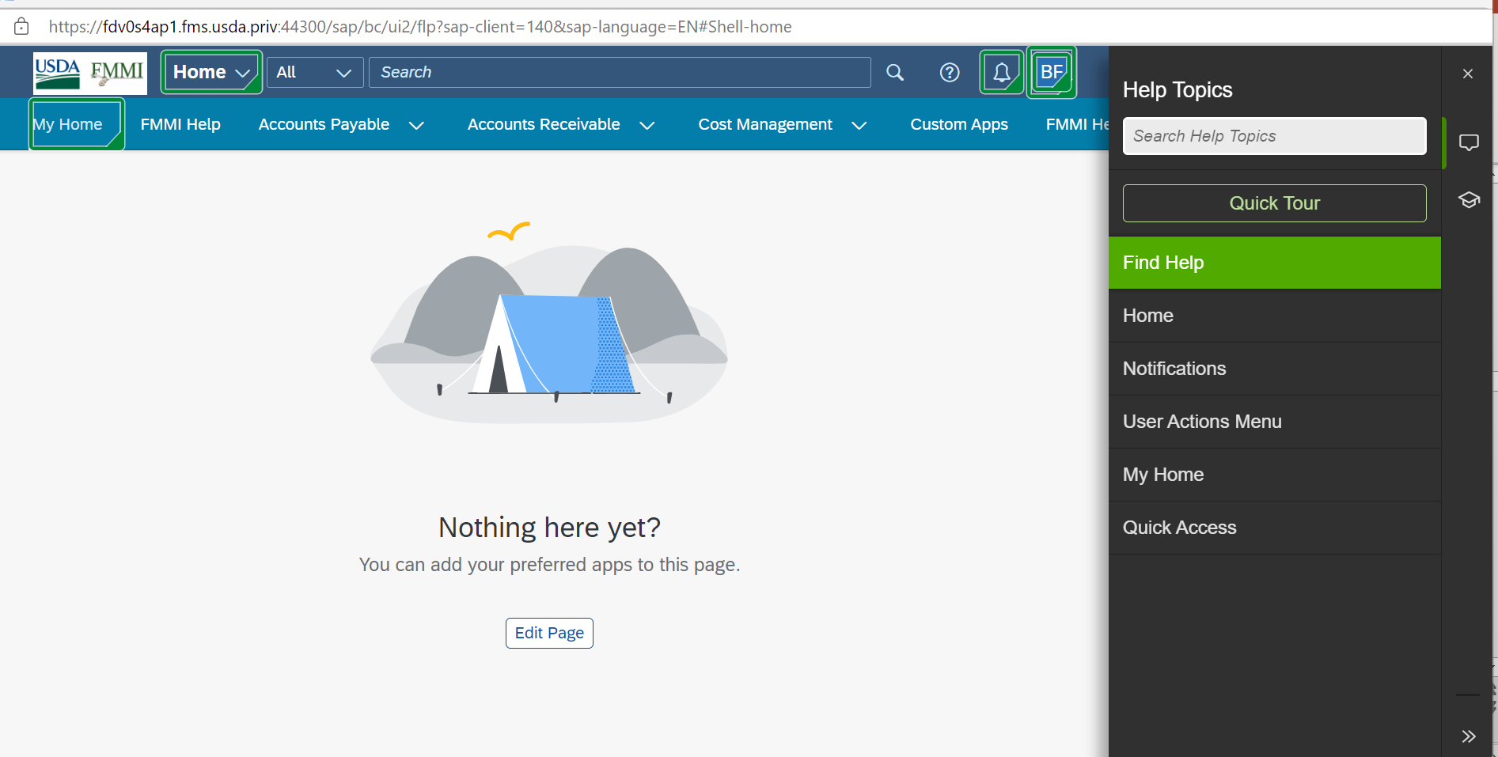
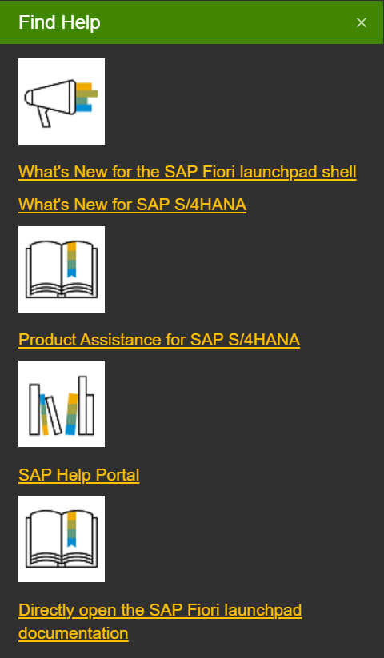
Help Topics: Find Help
The Find Help option in the Help Topics menu provides links to additional SAP documentation
Notes:
Documentation provided in the Find Help section is the generic SAP material and does not contain any USDA-specific information. Upcoming slides will show you where to access the USDA-specific information.

Slide 18
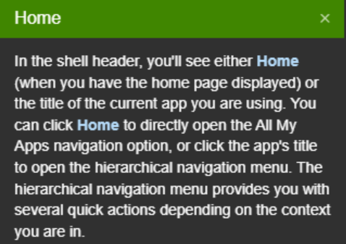
Help Topics: Home
The Home option in the Help Topics menu provides a description of the Home feature.

Slide 19
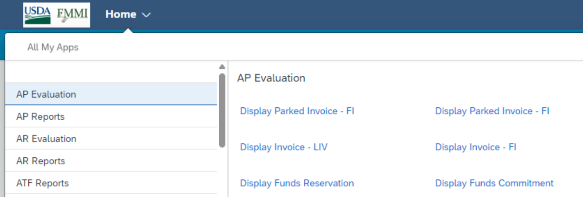
Home Functionality
Home shows the All My Apps options where apps can be opened/activated
Clicking the USDA FMMI logo brings users back to My Home

Slide 20
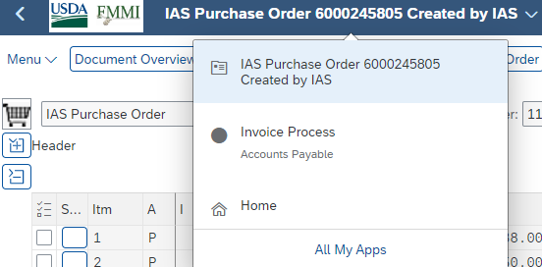
App Title & Hierarchical Navigation Menu
When in a specific app, the launchpad shell updates to the app title.
Clicking the app title displays a hierarchical navigation menu.
Example: From “IAS Purchase Order 6000245805”, you can jump to Invoice Process, Home, or All My Apps
Clicking the left arrow takes users back one step in navigation

Slide 21
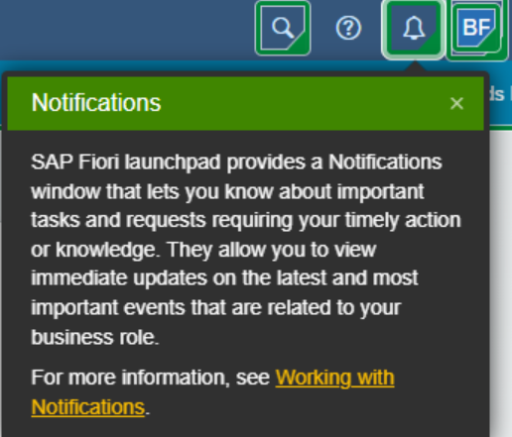
Help Topics: Notifications
Notifications can be viewed from the bell icon:
By Date
By Type
By Priority
Notes:
Important tasks or requests requiring actions based on role and specific S4 applications, such as Workflow Items

Slide 22
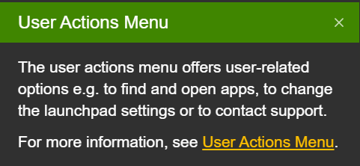
Help Topics: User Actions Menu
The User Actions Menu in the profile icon allows users to open apps, change settings, and contact support.

Slide 23
Help Topics: My Home
On My Home, users can customize the page for frequently used apps which allows for quick access to transactions.

Slide 24
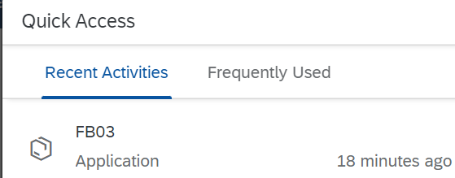
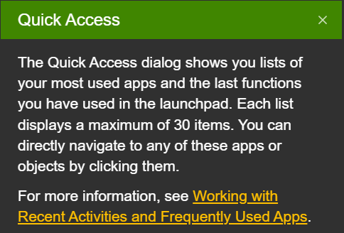
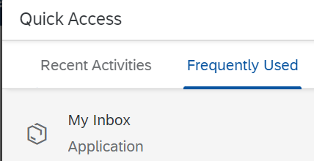
Help Topics: Quick Access
The Quick Access option in the profile icon shows a list of your Recent Activities and your Frequently Used apps.

Slide 25
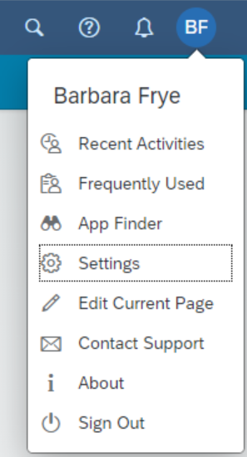
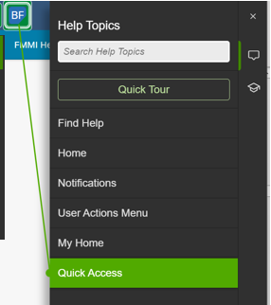
User Actions Menu and Quick Access
The profile icon contains functions described in User Actions Menu and Quick Access
The profile icon dynamically changes depending on location in Launchpad (see Inbox slides)
User Actions:
App Finder
Settings
Edit Current Page
Contact Support
About
Sign Out
Quick Access (in previous slide):
Recent Activity
Frequently Used

Slide 26
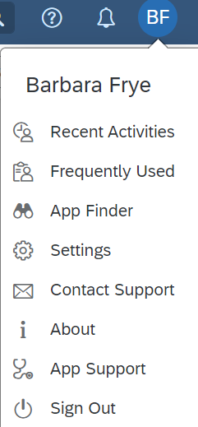
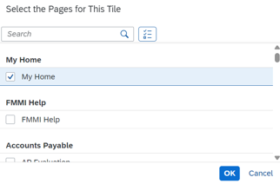
User Actions: App Finder
All apps included in user’s security role
Open Apps in App Finder
= Edit tile, = Add tile to pages, including the My Home space

Slide 27
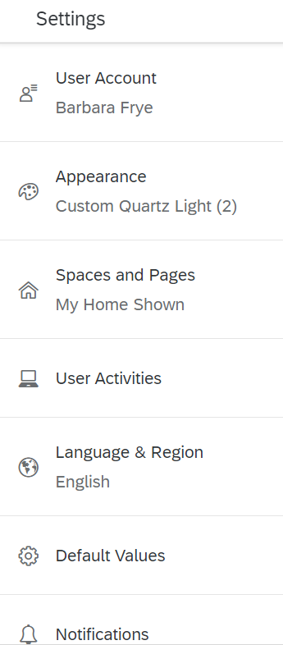
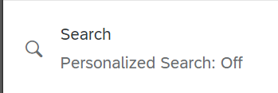
User Actions: Settings
User Account: Name, Email, and Server
Appearance: Color Theme and Display Settings
Spaces and Pages: Allows for selecting your My Home as first space
User Activities: Allows for tracking recent activity and frequently used apps, with the option to clear history
Language & Region: Date, Time, Dollar Values
Default Values
Notifications: Displayed by Date, Type, and Priority
Personalized Search: Track Search Activities, Delete Search Options
My Default Search Scope: Allowing users to narrow search options

Slide 28
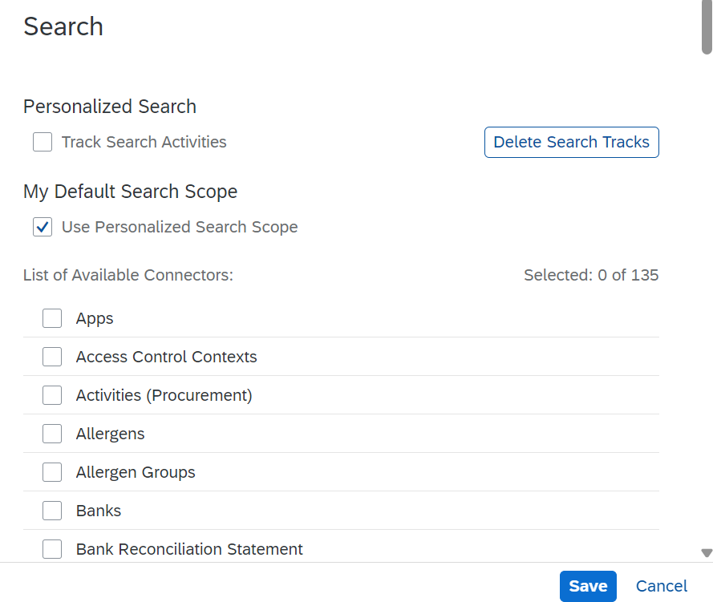
Settings: Personalized Search
Turn on Track Search Activities
Delete Search Tracks button
Personalize Search Scope
Opens list of connectors
Options will be based on security

Slide 29
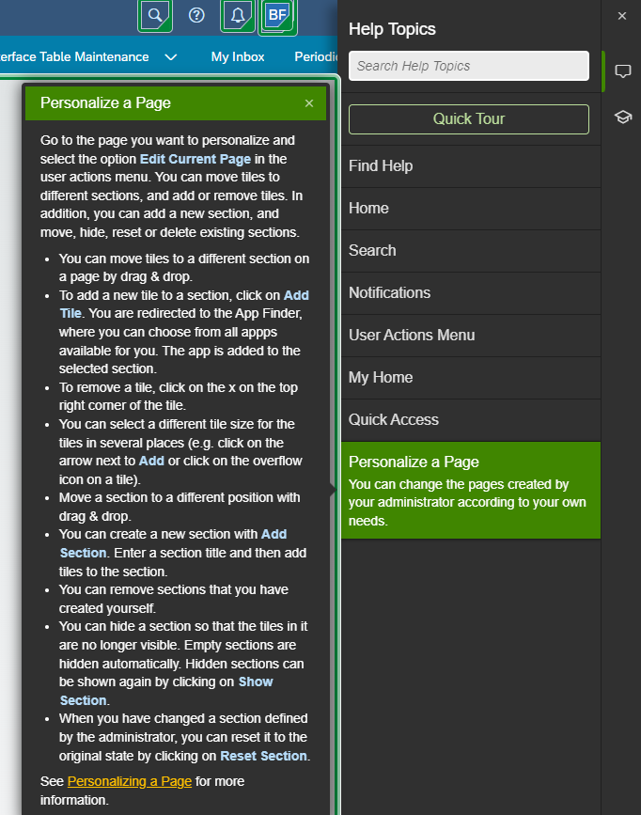
Personalize a Page
There are multiple ways to personalize a page. Users may:
Edit the current page within the Profile icon
Move tiles to different sections
Remove a tile
Drag and drop tiles within a page
Resize a tile

Slide 30
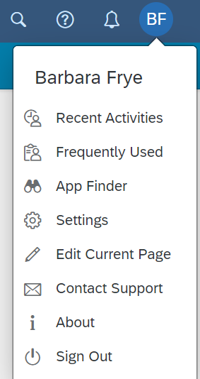
User Actions: Edit Current Page
Users can customize apps on the My Home page of the launchpad
Select your User Profile at the top right of the screen, then select Edit Current Page
Edit Current Page allows users to:
Add or remove a tile or section, rename a section, drag a tile between or within sections

Slide 31
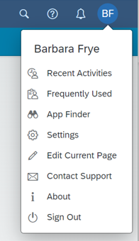
Edit Current Page: Customizing
Tiles added via App Finder are cataloged into Recently Added Apps
You can drag and drop recently added apps to other sections from Edit Current Page

Slide 32
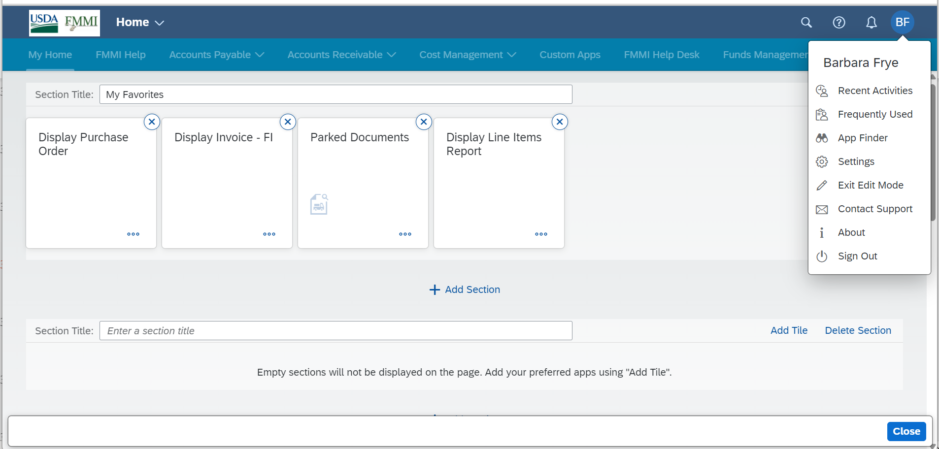
Edit Current Page: Exit and Close
Edit Current Page allows users to:
Drag and drop recently added apps to other sections
Use profile menu option Exit Edit Mode or the Close button to save changes
Remove a tile by clicking the “X” at the top right corner of the tile

Slide 33
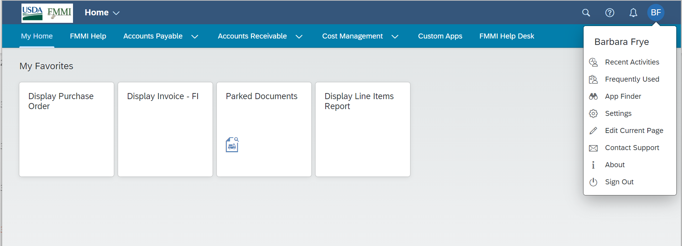
Edit Current Page: Customized Results
Moved from Recently Added to My Home and saved with My Favorites

Slide 34
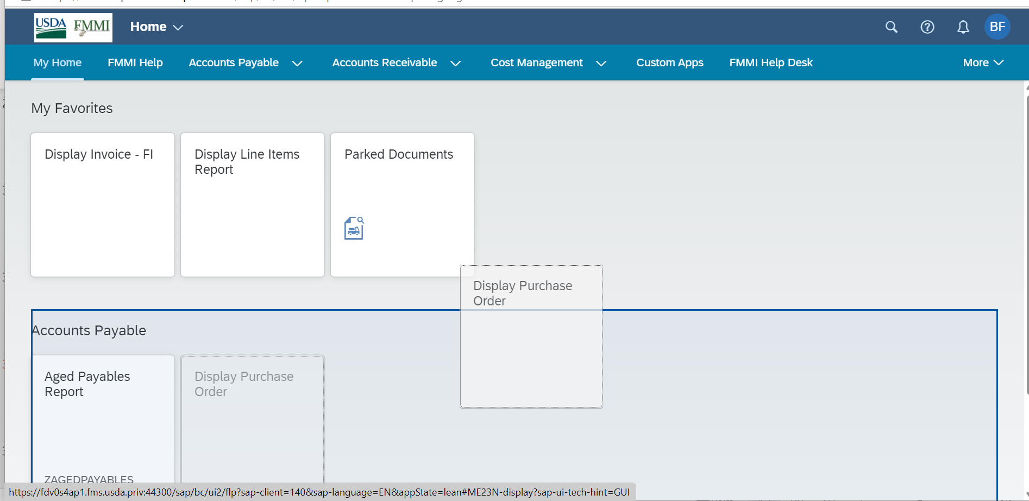
Edit Current Page: Drop and Drag
A new Accounts Payable section was added with Edit Current Page
Drag and drop between sections from My Home without using Edit Current Page

Slide 35
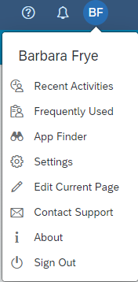
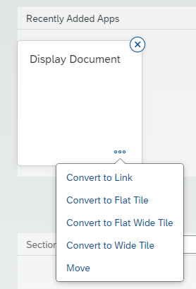
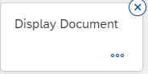
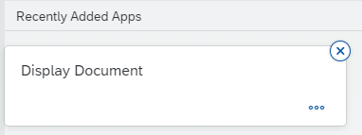
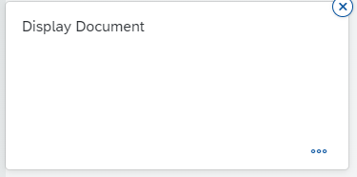
Edit Current Page: Tile Size
Tile size is managed in Edit Current Page
Options include:
Convert to Link
Convert to Flat Tile
Convert to Flat Wide Tile
Convert to Wide Tile

Slide 36
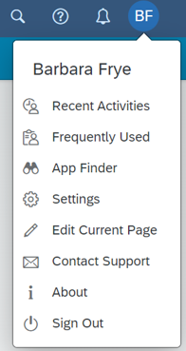
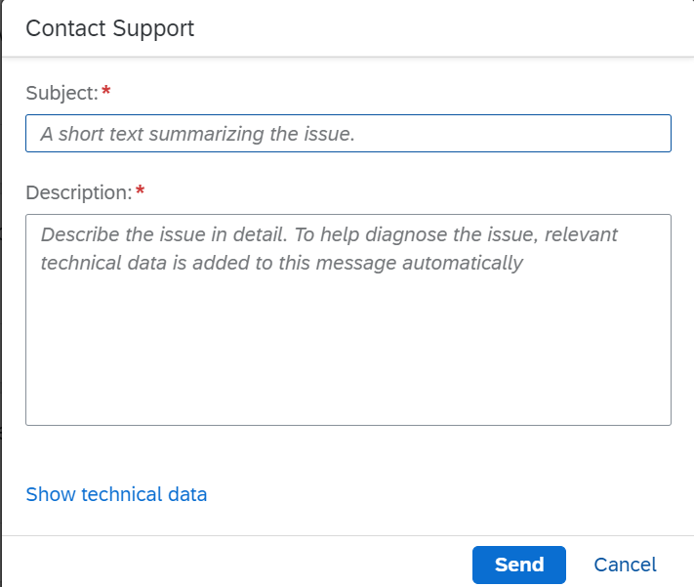
User Actions: Contact Support
Contact Support emails are routed to the FMS Help Desk for review and a possible ServiceNow ticket.

Slide 37
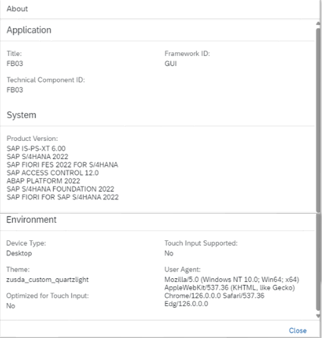
About
The About menu option displays tile and/or technical information, depending on where you are in the Launchpad.
Types of Tiles:
Most apps are based on ECC technology and will function the same way that they currently do.
Several apps are based on web-based technology. (Fiori App Demo: Manage Journal Entries, Post Incoming Payments, and Reverse Items)
A few apps are based on web-based technology with USDA customizations. (Fiori App Demo: Parked Documents Report)

Slide 38
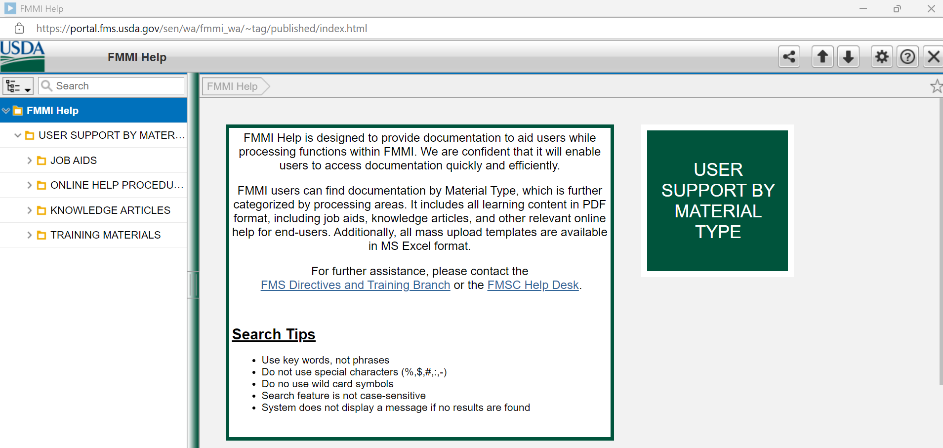
FMMI Help Tile
The FMMI Help tile links to the current FMS documentation and training library. All new Fiori training courses and simulations (online help procedures) will be added here.
Notes:
Notes test

Slide 39
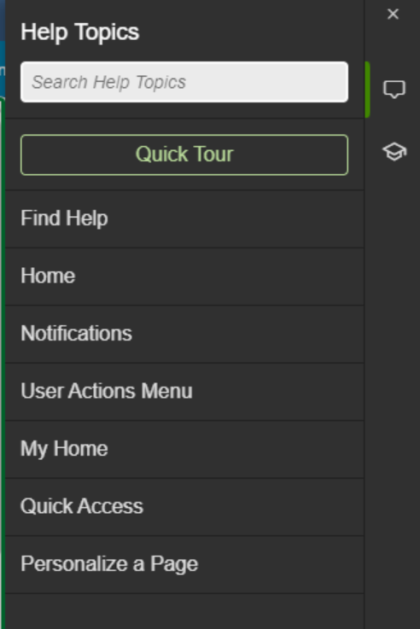
Help Topics – Quick Tour
Click the help icon (question mark) in the Launchpad Shell Header Bar to open Help Topics
Users may click the Quick Tour button for additional information. Note: all features may not be available and/or applicable to federal end-users

Slide 40
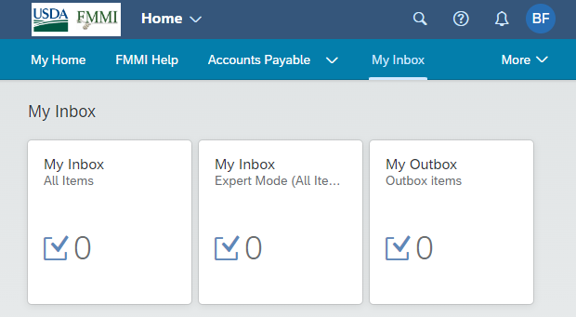
My Inbox Space
The My Inbox space contains three tiles:
My Inbox (All Items)
My Inbox (Expert Mode)
My Outbox (Outbox items)

Slide 41
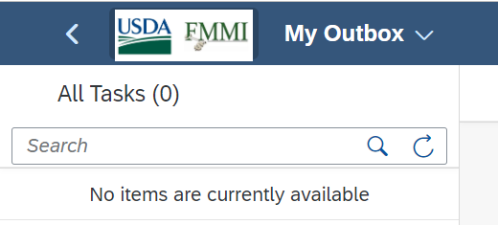
My Inbox Tiles
My Inbox is used to manage workflow tasks
My Inbox Expert Mode can be filtered by Title, Status, Priority, etc.
My Outbox is used to view your completed and suspended tasks

Slide 42
My Inbox: Manage My Substitutes
Manage My Substitutes allows for planned and unplanned delegates in your absence
Allows users to assign a designee to workflow items
Allows for an unplanned designee to retrieve workflow items

Slide 43
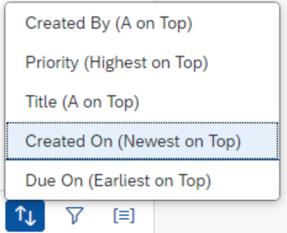
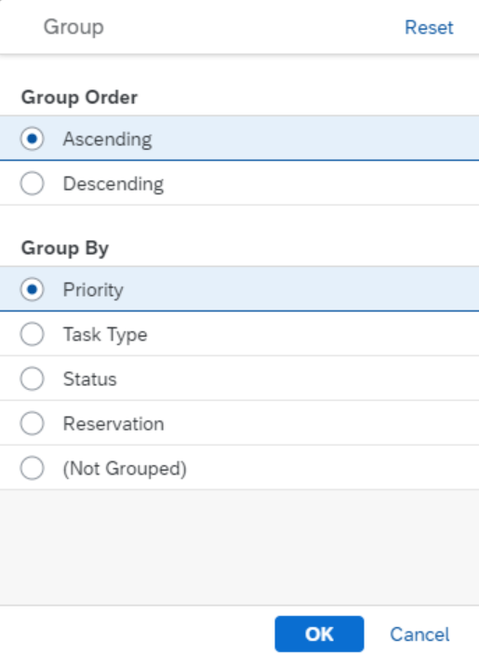
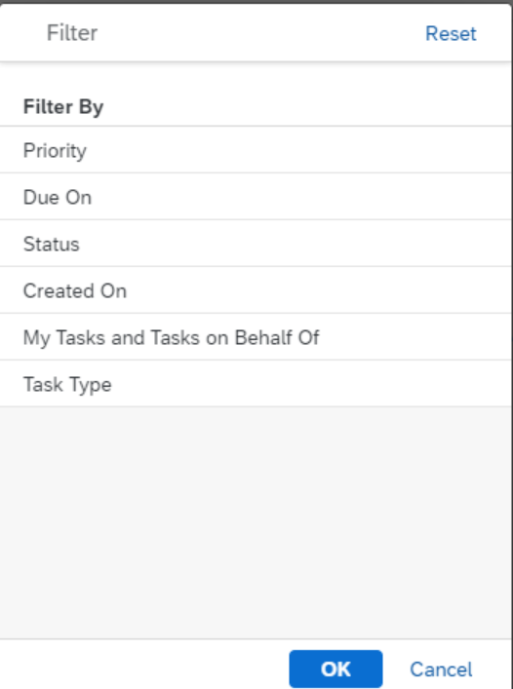
My Inbox: Sort, Filter, Group
Sort
Filter
Group
My Inbox items can be sorted, filtered, or grouped

Slide 44
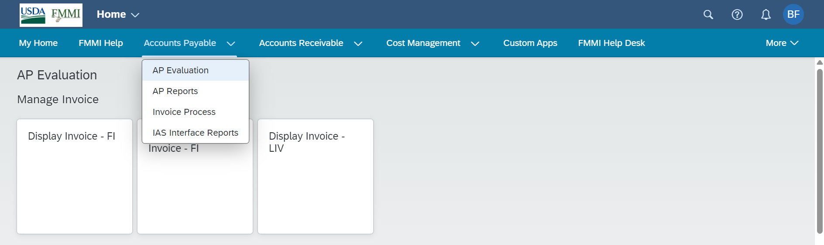
Navigating to a Transaction: Breadcrumbs
Users have three options for finding a transaction
Option 1 is to select the relevant Process Area/Business Process (Spaces/Sections), and then select the transaction they want to complete

Slide 45
Navigating to a Transaction – Global Search
Option 2 is to utilize the search function: Select the magnifying glass, then type in the name of the transaction, then (optionally) select Apps to narrow the search
Reminder: “app,” “tile,” and “transaction” are used interchangeably in Fiori

Slide 46
Navigating to a Transaction: App Finder
Option 3 is to search for an App in App Finder. Type the app title into the Search in Catalog box and press enter.
Click on the tile to open the transaction.

Slide 47
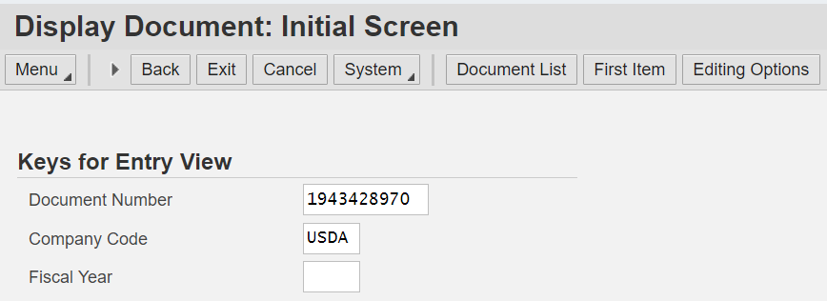
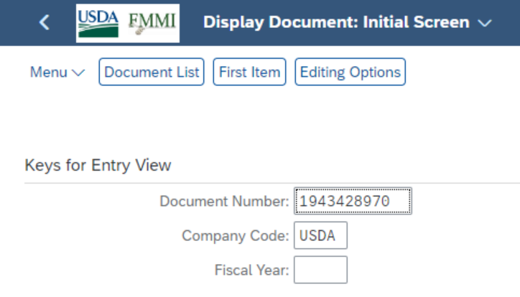
Display Document
Once the user opens the tile, the process of completing the transaction will be the same as it was in Portal for most transactions.
Training sessions and documentation will be provided for transactions that have changed.
Example: Display Document
Portal
Fiori

Slide 48
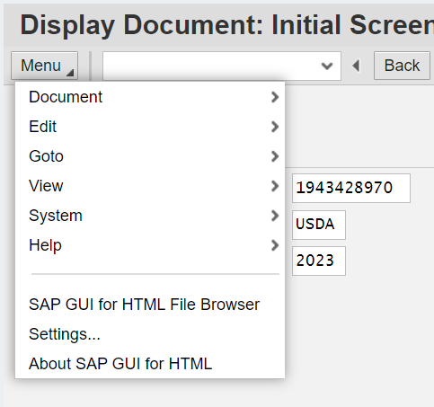
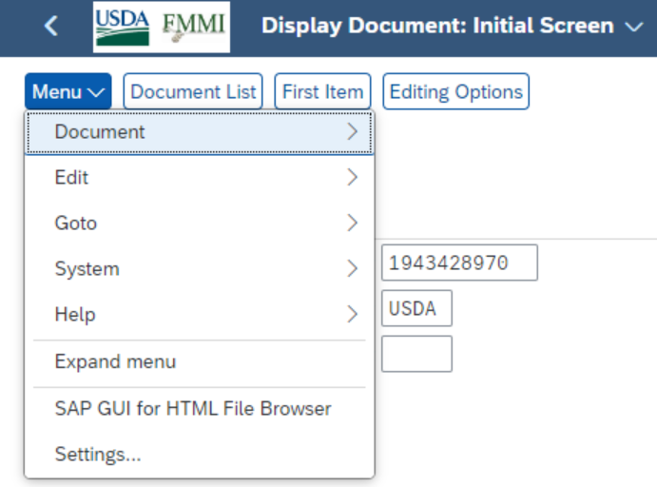
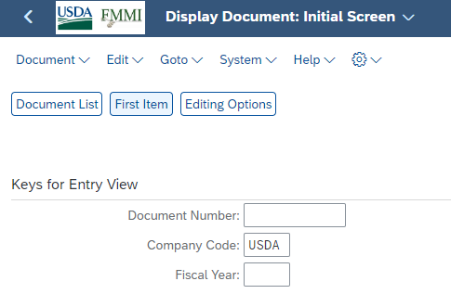
Display Document: Menu
Portal
Fiori
Menu options are the same in Portal and Fiori
Expand menu will show Menu options

Slide 49
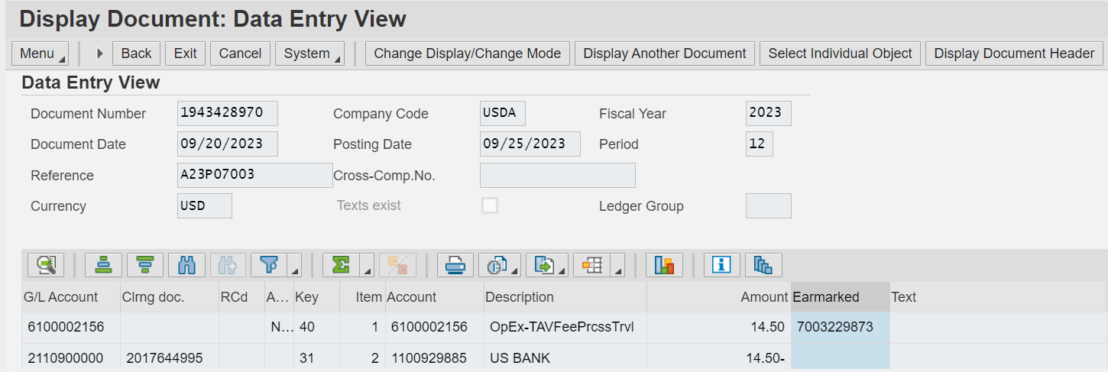
Display Document: Header & Line
Portal
The header and line fields of the document are the same in Portal and Fiori
Fiori

Slide 50
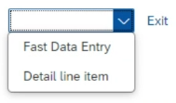
Display Funds Commitment
Portal
Funds commitment: Display screens are the same in Portal and Fiori
Menu can be expanded/collapsed
Fiori

Slide 51
Portal Funds Commitment Display
Funds Commitment Display header and line items are the same in Portal and Fiori

Slide 52
Fiori Funds Commitment Display
Funds Commitment Display header and line items are the same in Portal and Fiori
Consumption History in drop-down menu

Slide 53
Portal Funds Consumption History
Funds Consumption History is the same in Portal and Fiori

Slide 54
Fiori Funds Consumption History
Funds Consumption History is the same in Portal and Fiori

Slide 55
Questions
FINANCIAL TRAINING FORUM JULY 2024

