Slide 1
FINANCIAL TRAINING FORUM
JULY 2024

Slide 2
Welcome from the FMS Deputy Director
Welcome to the Financial Management Services’ 2024 Financial Training Forum (FTF). We are excited to offer another training opportunity, continuing to meet our customers’ needs while leveraging the flexibilities associated with virtual training. The trainers are subject matter experts in various areas of financial management-related processes and FMMI Intelligent Enterprise Transformation (FIET). We look forward to your interaction and feedback throughout the next two weeks so we can continue to serve you in achieving the USDA mission.
- Linda Connolly, Deputy Director
FINANCIAL TRAINING FORUM JULY 2024

Slide 3
S/4 Embedded Analytics: Document Chain, Accounts Payable, Sales Orders, Trial Balance
FINANCIAL TRAINING FORUM JULY 2024

Slide 4
Housekeeping
This training session is being recorded.
In the event of an audio interruption, please turn on captioning. (More > Language and Speech > Turn on Live Captioning)
Presenters will address questions at the end of their presentation. You may submit questions in the Chat at any time during the presentation.
Please keep your microphone muted unless you are recognized to ask a question.
If possible, use a headset with microphone when speaking to reduce echoes and feedback.
The AgLearn survey is NOT available until after the class has completed.

Slide 5
NASBA CPE Credit Guidelines
The Directives and Training Branch will be using MS Teams’ polling feature to capture engagement metrics during each training session. Four polls will be launched at random intervals within each hour of the class. Each poll will remain open for 60 seconds and, per NASBA requirements, attendees must respond to at least three of the four polls to receive CPE credit for that hour. Partial credit will not be issued. Two-hour training sessions are not designed to include breaks, therefore, please plan accordingly.
Polls will appear in either the Chat box or the main presentation area of your screen.

Slide 6
Presenters
Tiffany Wimberly
Tiffany is an Information Technology Specialist with over 30 years of experience in IT development and business intelligence. She has dedicated most of her career to working with USDA customers on various business intelligence and reporting initiatives.

Slide 7
Agenda
Introduction to S/4HANA Embedded Analytics
Key Features and Benefits
Searching for Analytics Data
Launching Analytics Applications
Navigating Embedded Analytics
Customizing Analytics for USDA Financials
Practical Examples: Document Chain, Sales Order, Accounts Payable, and Trial Balance
Q&A

Slide 8
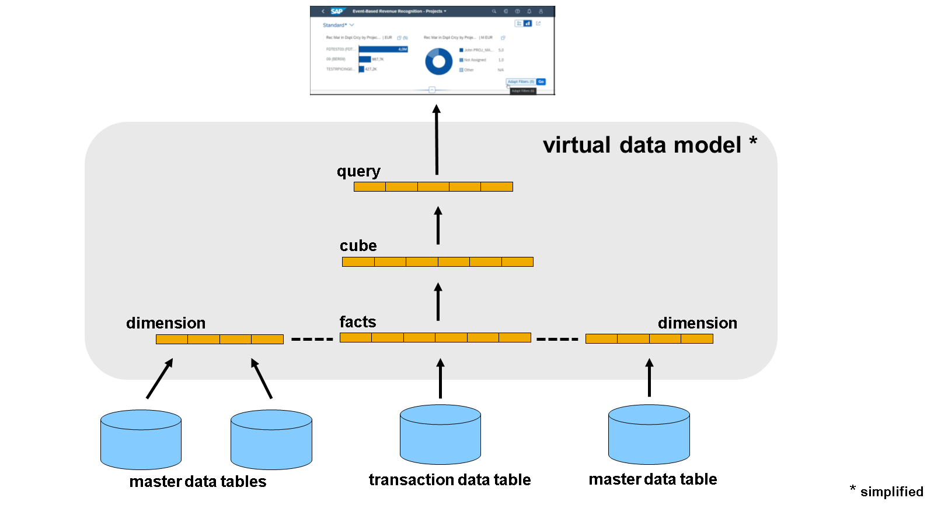
Introduction to Embedded Analytics
Overview of S/4HANA Embedded Analytics
Importance of Embedded Analytics
Benefits of Operational Analytics for USDA

Slide 9
Key Features and Benefits
Real-time data processing
Integrated with core business processes
User-friendly interface
Customizable dashboards and reports

Slide 10
Searching for Analytics Data
Step-by-step guide:
Accessing the S/4HANA system
Using the search bar to find specific analytics reports
Filtering search results for relevant data

Slide 11
Launching Analytics Applications
Step-by-step guide:
Navigating to the Analytics Launchpad
Selecting and launching predefined analytics applications
Accessing relevant financial data for USDA

Slide 12
Navigating Embedded Analytics
Step-by-step guide:
Understanding the user interface
Exploring different views and charts
Utilizing drill-down functionalities for deeper insights

Slide 13
Customizing Analytics for USDA Financials
Step-by-step guide:
Customizing dashboards and reports
Adding new Key Performance Indicators (KPIs) and metrics
Setting up alerts and notifications

Slide 14
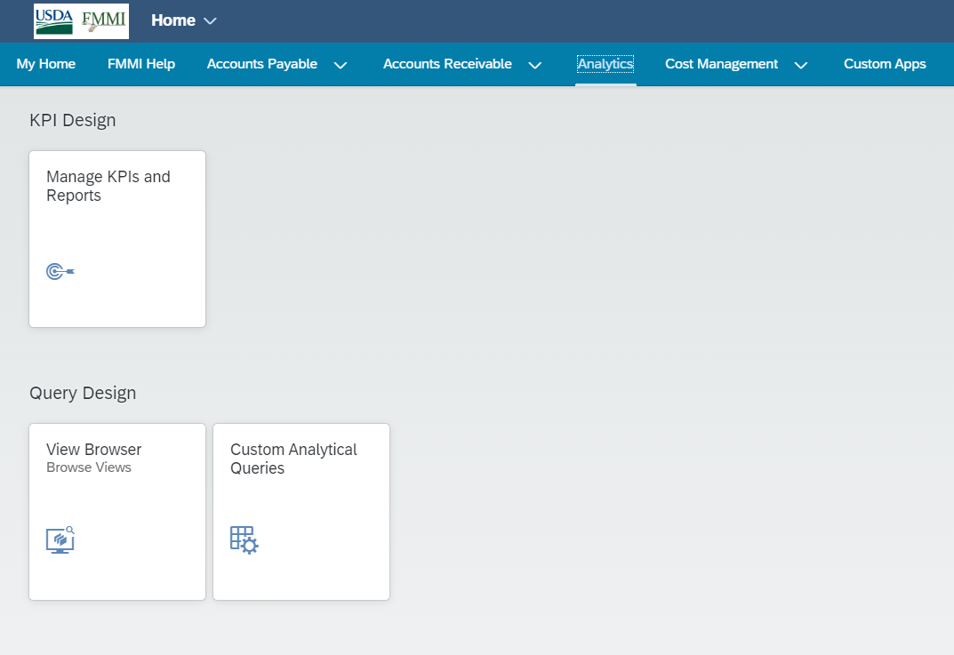
Practical Examples: View Browser
Step-by-step guide:
Analytics
Query Design
View Browser:

Slide 15
Overview Pages: Insight-to-Action
An Overview Page is a special type of SAP Fiori Application that provides an entry-level view of all the key information for a line of business, such as procurement or finance. The objective is to quickly provide USDA customers with the big picture relating to its performance. There is enough information on this page to get an overview of performance without drowning in the details.
From each Overview Page, there is an option to drill down for deeper investigation and even the possibility to act on any individual issue found. This is how Overview Pages support the insight-to-action approach of SAP S/4HANA embedded analytics. SAP provides many ready-made Overview Pages.

Slide 16
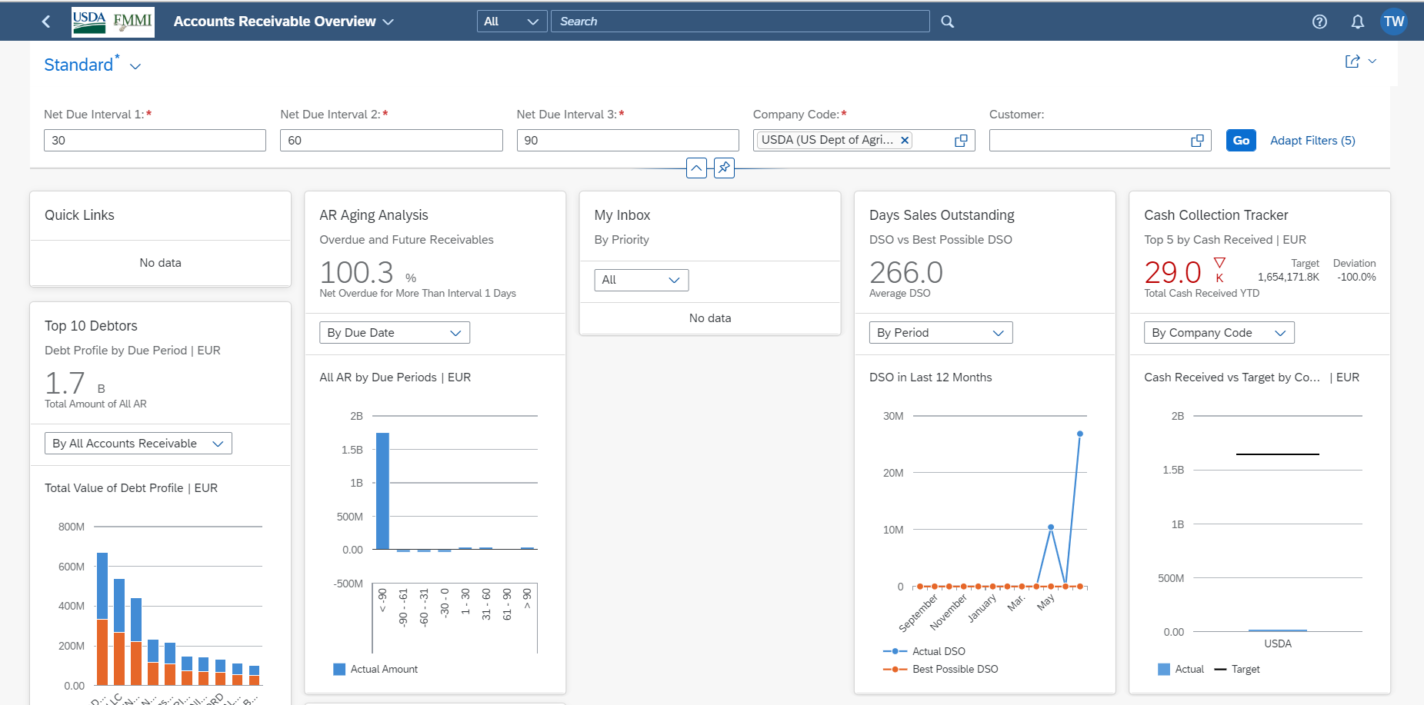
Overview Pages: Insight-to-Action (cont’d)
Accounts Receivable Overview Page

Slide 17
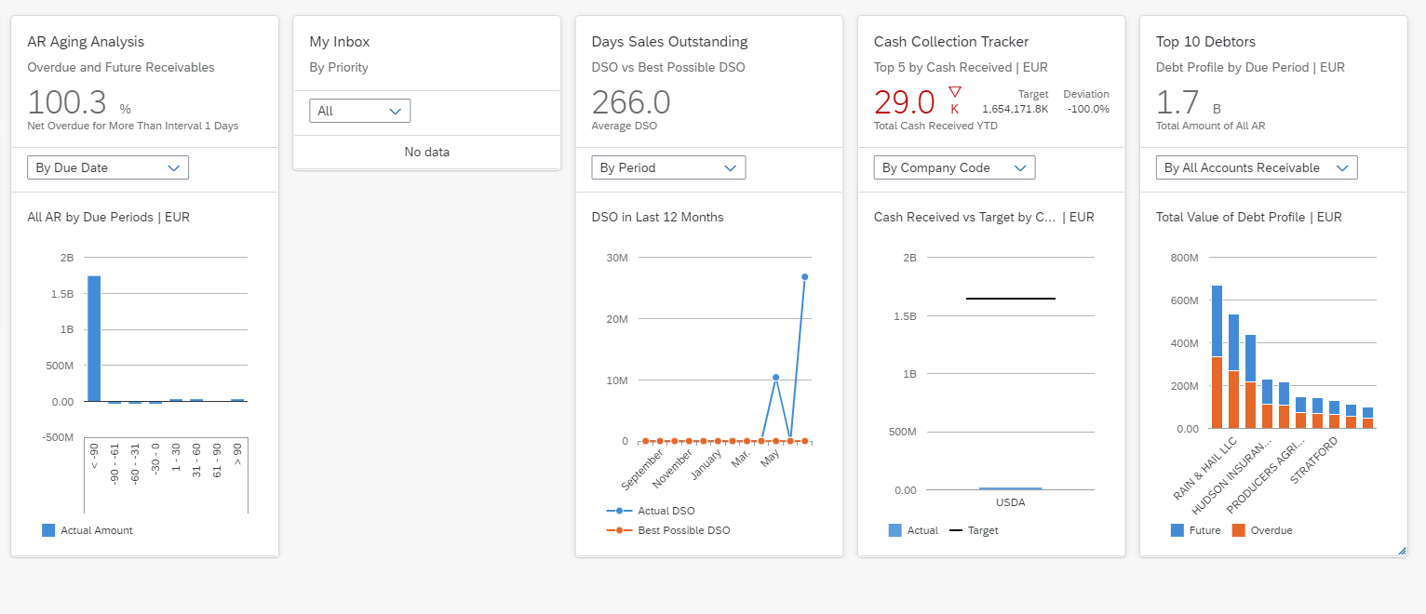
Overview Page - Cards
An Overview Page presents the KPIs that relate to a line of business using cards. On each card, a KPI is presented using a chart or list.
The business user can hide cards that are not applicable, adjust the position of the cards, or reset the cards to the original view.

Slide 18
Overview Pages – Filtering
Each Overview Page comes with a filter tool bar.
Each business user can have predefined filters set.
Filters are not applied until you click Go.
Filters are applied to all the cards in the Overview Page.
You can also save your filters as a variant.

Slide 19
Overview Pages – Filtering (cont’d)
The Adapt Filters option is used to remove unnecessary filters, providing for a cleaner workspace.
Clicking the Adapt Filters link opens a separate menu where business users may choose which filters to remove.

Slide 20
Overview Pages – Drilling
You can also drill into the details presented on cards of an Overview Page.
To drill down to the details on a card, you can either click the card header (the details are less granular) or you can click on a detail within the card. Clicking a detail within the card, such as a single bar in a bar chart, allows the user to focus on a particular value, i.e., a Fiscal Month or Fund.
You can also navigate to any related analytical or transactional app directly from the cards. For example, from a card that lists a 6-month Unliquidated Travel Obligation. Each Overview Page provides a set of jump targets.

Slide 21
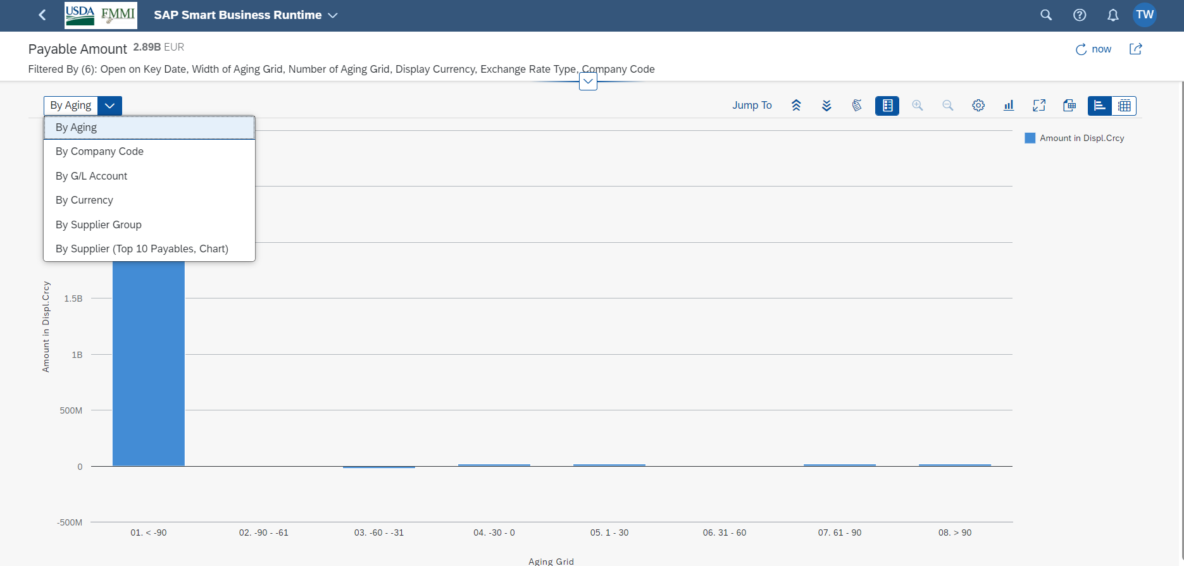
Overview Pages – Drilling (cont’d)

Slide 22
Overview Pages – Header Level

Slide 23
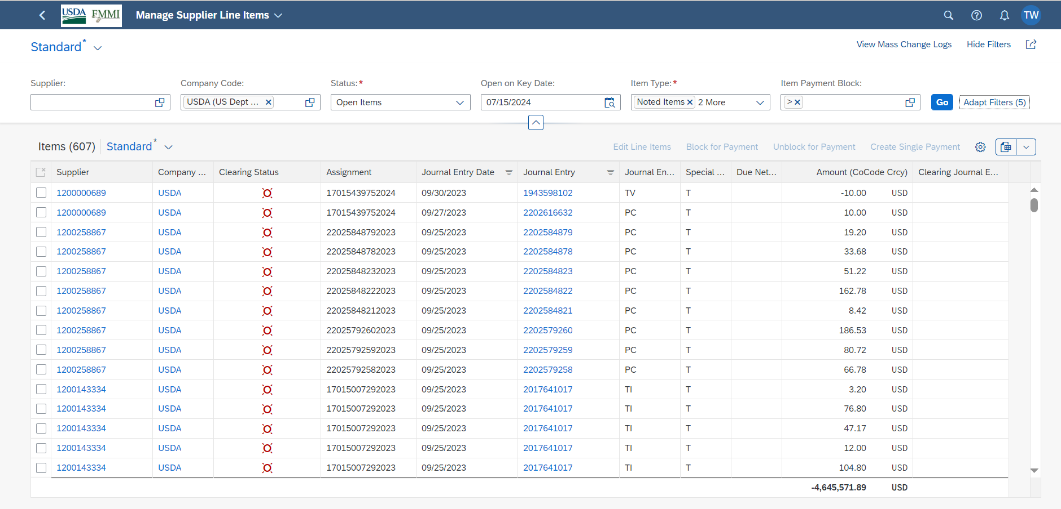
Overview Pages – Header Level (cont’d)

Slide 24
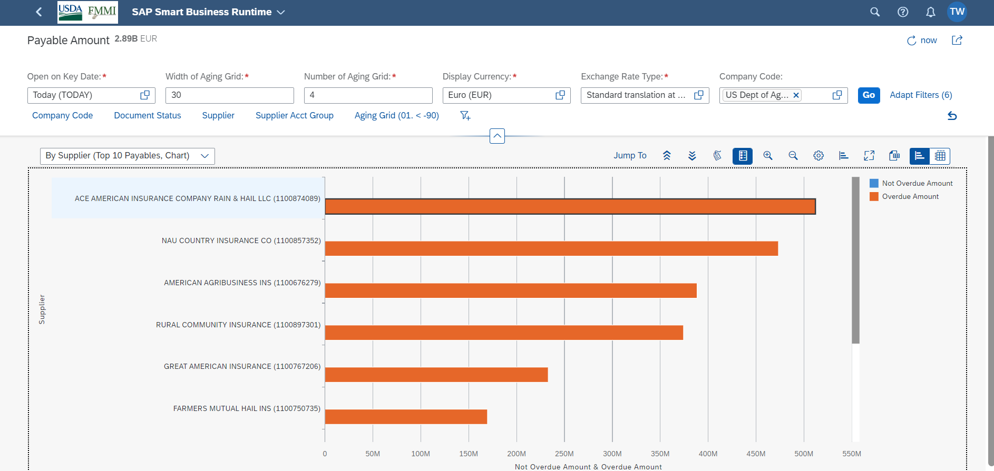
Overview Pages – Drilling (cont’d)

Slide 25
Closing Remarks
Thank you for attending
S/4 HANA Embedded Analytics!
Contact Information:
Tiffany B. Wimberly
Tiffany.wimberly@usda.gov

Slide 26
FINANCIAL TRAINING FORUM JULY 2024

