Slide 1
Friends of FIET Kickoff
FMMI Intelligent Enterprise Transformation (FIET) Project

Slide 2
Friends of FIET Defined
“Friends of FIET” encompasses our Change Champions and Super Users.
Friends of FIET
Change Champions
Super
Users

Slide 3
Welcome!
Bob Magill
Chief Financial Officer for ARS, ERS, NASS, and NIFA

Slide 4
Agenda
FIET Organizational Change Management (OCM) Team Introductions
Change Champion & Super User Roles
Overview of FIET
Our Ask of You Today
What’s Coming Next

Slide 5





Meet the FIET OCM Team
Organizational Change Management (OCM) Team members
Heidi Rees
Accenture Change Lead
Kourtney Peters
USDA Change Lead
Cheryl Jones
Accenture Training Lead
Julie Bradford
USDA Change Co-Lead
Nina Anthony
Change & Comms Specialist
USDA resource
Accenture resource

Slide 6
The Change Champion & Super User Roles

Slide 7
The Change Champion Role
Change Champion defined
Responsibilities | Qualifications | What’s in it for You
Communicates FIET project updates and high-level system changes to end users Sets positive tone for FIET and encourages users to embrace change Collects questions and feedback from end users to share with FIET project team Attends weekly O&M meetings to receive FIET project key messages and share questions from agencies | Well-connected to agency end users Knowledge of agency needs Baseline understanding of FMMI Knowledge of agency functions and processes | Be a voice for your agency as part of the FIET Project Be the first to know what is changing with FMMI Opportunity to work with colleagues across USDA Opportunity to make a meaningful impact on the organization

Slide 8
The Super User Role
Super User defined
Responsibilities | Qualifications | What’s in it for You
Supports test script review (May 2024) Participates in System Integration Testing and Production Readiness Testing (May 2024, Aug 2024, Nov 2024) Supports training delivery by answering questions and coaching colleagues during the training sessions (Dec 2024 – Feb 2025) Provides ongoing support to impacted users (Feb 2025 and beyond) | Experience designing and managing business processes Expertise in at least one FMMI functional area Knowledge of agency functions and processes | Be a voice for your agency as part of the FIET Project Be the first to know what is changing with FMMI Opportunity to work with colleagues from across USDA Opportunity to make a meaningful impact on the organization

Slide 9
Overview of FIET

Slide 10
What is FIET?
FIET (FMMI Intelligent Enterprise Transformation) is the project in which we are migrating the existing FMMI system from SAP ECC to SAP S/4HANA. This project represents a key milestone in USDA’s journey towards digital transformation and enhanced efficiency.
FMMI
SAP ECC version
FMMI
SAP S/4HANA version
FIET Project
Current financial system
Future financial system

Slide 11




The FIET journey
Future
Present
FMMI
SAP S/4HANA
Past
FMMI
SAP ERP
FFIS
Mainframe
S/4HANA is like a new car with a more powerful engine, slick interior, and all the latest cool features. Even so, there will still be an adjustment period as you get the driver’s seat right where you want it, set your radio presets, and perfect parking in your garage.

Slide 12






Why Upgrade FMMI?
Simplification
Supportability
Ease of Use
Cost Savings
Innovation
Improved
Performance
S/4HANA centralizes hardware and network resources and serves as the digital core for financial processes.
Maintenance and support for core SAP ERP and SAP ECC release will end in 2027. S/4HANA will be supported long-term.
SAP Fiori’s UI is designed to be intuitive, personalized, responsive, and simple. It allows users to ask questions and access required details.
S/4HANA brings together analytical and transactional capabilities of a variety of systems into one location. This enables better decision making and cost efficiency.
SAP S/4HANA sets the stage for innovation. S/4HANA applications leverage speed, context, and data accessibility allowing an enterprise to make decisions that are future ready.
S/4HANA improves performance by allowing users to develop and generate reports using real-time data. This improves service for customer-centric applications.

Slide 13
Our Ask of You Today

Slide 14

FIET Project Roadmap
INITIATE
CONFIRM
DESIGN & BUILD
INTEGRATE
DEPLOY
SUPPORT
SEP 23 | OCT 23 | NOV 23 | DEC 23 | JAN 24 | FEB 24 | MAR 24 | APR 24 | MAY 24 | JUN 24 | JUL 24 | AUG 24 | SEP 24 | OCT 24 | NOV 24 | DEC 24 | JAN 25 | FEB 25 | MAR 25 | APR 25 | MAY 25
FIET Project Kickoff
9-5-23
Process Analysis
Planning & Operationalizing
Blueprinting
System Conversion
Design and Build
End-to-End Testing
Data Migration and Verification
Training
GO LIVE
Targeted 2-17-25
We are here
Post Go-Live Support

Slide 15
The Ask
Available Now
Bookmark the FIET webpage
Review key materials on the web page:
        Introduction – Describes the FIET Project and the benefits of upgrading FMMI
        Frequently Asked Questions (FAQ) – Answers common questions about the FIET Project and the S/4HANA system
        Glossary – Defines FIET-related terms and acronyms
        The Monthly Momentum – First edition of the monthly FIET newsletter
Cascade these resources to other FMMI end users and stakeholders within your agencies
Encourage members of your agency to subscribe to FIET updates
Share questions using the Got Questions button on the FIET web page
If you do not have the weekly FMS Operations and Maintenance (O&M) Meeting (on Thursdays sent from Carolyn Small) on your calendar, put your name in the chat now

Slide 16
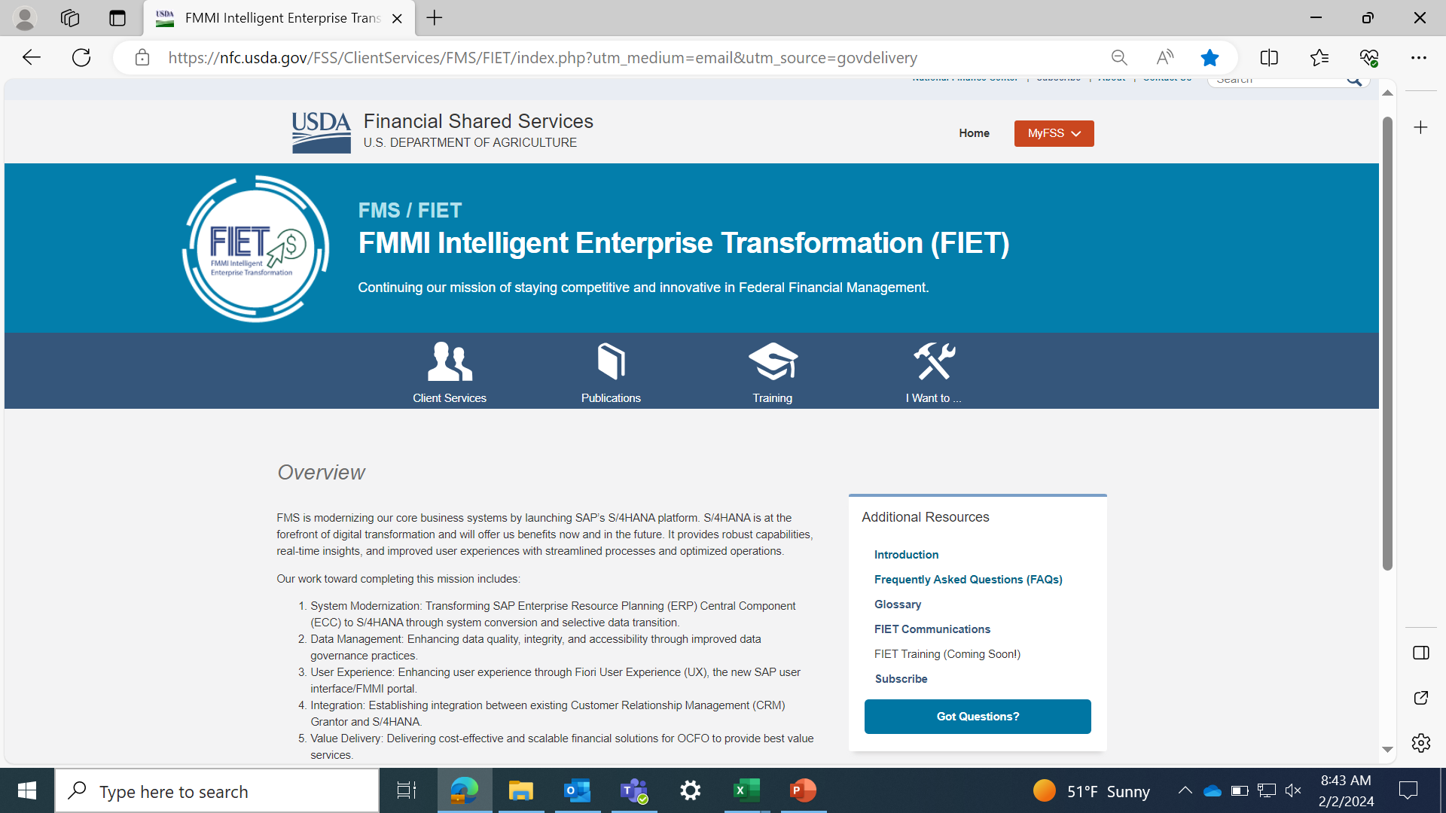



FIET Webpage
The FIET Webpage serves as a central location for all FIET resources and communications. Visit regularly for the latest updates on project progress, training materials, upcoming end user impacts, and more.
Bookmark now for easy access!
Use the Got Questions button to ask questions
Notes:
Kourtney

Slide 17
What’s Coming Next

Slide 18
WHAT’S NEXT
Next Friends of FIET Meeting
Agenda items for our next Friends of FIET Meeting (4/16):
Overview of change impacts for end users
Fiori demonstration
Other Resources
New resources coming soon:
Pulse Survey – Captures baseline stakeholder understanding of FIET; targeted April 2024
What’s Changing Guide – Details key system changes and how they impact end users; targeted for an April 2024 release
Training and job aids – Offers process-specific demonstrations for changing areas and roles; targeted Winter 2024

Slide 19


Questions?
Ask away!
Submit questions at any time:
Help Desk
Agency CAM

