Slide 1
What’s Changing Guide for FMMI Agency End Users
FMMI Intelligent Enterprise Transformation (FIET) Project

Slide 2
PURPOSE
The purpose of this What’s Changing Guide is to provide early education and awareness of the upcoming impacts to FMMI by:
Providing an overview of the FIET Project
Highlighting key changes to FMMI
Understanding how to prepare for these upcoming changes
Table of Contents
FIET Overview
The overall FMMI transformation
What’s Changing
  Fiori
  Simplified Data Model
  Business Partner Records
  Reporting
What to Expect
Preparing for upcoming changes

Slide 3
FIET Overview
The Overall FMMI Transformation

Slide 4
What is FIET?
FIET (FMMI Intelligent Enterprise Transformation) is the project in which we are migrating the existing FMMI system from SAP ECC to SAP S/4HANA. This project represents a key milestone in USDA’s journey towards digital transformation and enhanced efficiency.
FMMI
SAP ECC version
FMMI
SAP S/4HANA version
FIET Project
Current financial system
Future financial system

Slide 5
Key FIET Terms
FMMI
(Financial Management Modernization Initiative)
USDA’s financial management system and department-wide instance of SAP
Fiori
A modern, app-based user interface that will serve as the new primary FMMI interface and will be accessed via the Portal
SAP ECC
The current enterprise software version that FMMI runs on
FIET
(FMMI Intelligent Enterprise Transformation)
The project by which the existing FMMI system is being upgraded from SAP ECC to SAP S/4HANA
Fiori Launchpad
The homepage of Fiori and entry point to apps and transactions
SAP S/4HANA
The more advanced enterprise software version that FMMI is being upgraded to, with the go-live date in February 2025

Slide 6
















SAP ECC vs. SAP S/4HANA
SAP ECC | Feature | SAP S/4HANA
HANA database | Database | SAP S/4HANA in-memory database with optimized code set; real-time Online Analytical Processing and Online Transaction Processing from one data model
Complex data model – redundant tables for analysis means blocking and maintenance issues | Data Model | Simple data model – combined analytics and transactions, reduced reconciliation, blocking, and maintenance
Traditional processes constrained by the legacy database | Business Process | Intelligent processes powered by new technology and SAP HANA
Legacy Portal | User Interface | SAP Fiori – modern, customizable, and intuitive User Interface
On premise | Deployment | Complete choice of on premise, cloud, or hybrid

Slide 7
PROJECT TIMELINE
INITIATE
CONFIRM
DESIGN & BUILD
INTEGRATE
DEPLOY
SUPPORT
SEP 23 | OCT 23 | NOV 23 | DEC 23 | JAN 24 | FEB 24 | MAR 24 | APR 24 | MAY 24 | JUN 24 | JUL 24 | AUG 24 | SEP 24 | OCT 24 | NOV 24 | DEC 24 | JAN 25 | FEB 25 | MAR 25 | APR 25 | MAY 25
FIET Project Kickoff
9-5-23
Process Analysis
Planning & Operationalizing
Blueprinting
System Conversion
Design and Build
End-to-End Testing
Data Migration and Verification
Training
GO LIVE
Targeted 2-17-25
Post Go-Live Support

Slide 8
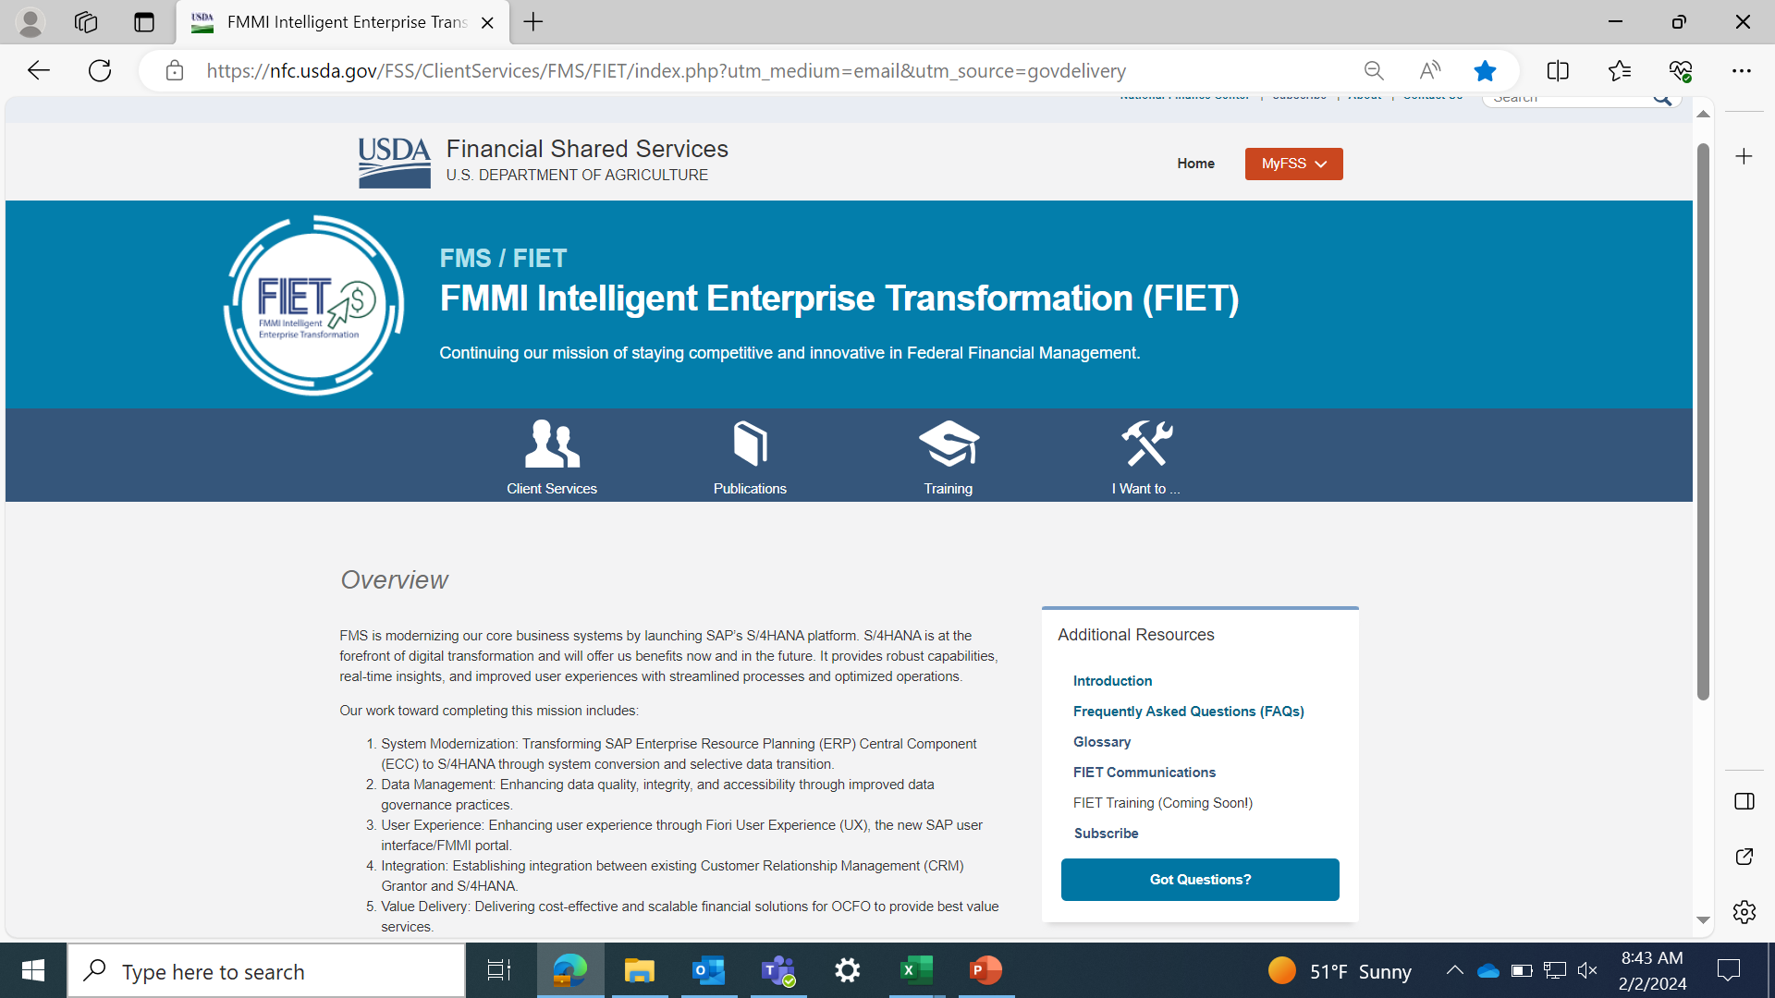



FIET Webpage
The FIET Webpage serves as a central location for all FIET resources and communications. Visit regularly for the latest updates on project progress, training materials, upcoming end user impacts, and more.
Bookmark now for easy access!
Use the
Got Questions button to ask questions
Notes:
Kourtney

Slide 9
What’s Changing
Key Changes that FMMI Users will Experience

Slide 10
What are the key changes USERS will experience?
1
2
3
4
The most notable changes to FMMI can be grouped into four categories:
Interactive menu!
Click numbers
to navigate
1. Fiori
2. Simplified Data Model
The fresh, new user interface with a modern look and feel.
Data tables will be combined to improve performance and data accuracy.
3. Business Partner Records
4. Reporting
Business Partner records will serve as an umbrella that captures data for related Customer and Vendor records.
A few fields in reports will be adjusted while the overall process will remain largely the same.

Slide 11
Degree of Change
FMMI users will face varying degrees of change in the transition based on their individual role and usage of FMMI.
Degree of change by category:
MODERATE
MODERATE
1
Fiori
3
Business Partner Records
LOW
HIGH
LOW
HIGH
Degree of Change
Degree of Change
MODERATE
MODERATE
2
Simplified Data Model
4
Reporting
LOW
HIGH
LOW
HIGH
Degree of Change
Degree of Change

Slide 12
Fiori
The New FMMI User Interface (UI)
MODERATE
LOW
HIGH
Degree of Change

Slide 13
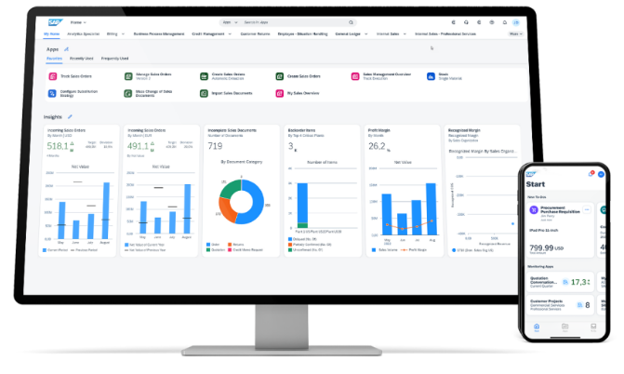
Fiori – new look and feel
Fiori will be the most notable for FMMI users while also providing the most benefit.
1
2
3
4
Fiori will serve as the new User Interface (UI) for transactions and will be accessed via the existing FMMI Portal. All transactions will move to Fiori, but only a small percentage will work differently than they do today. Only those that will function differently are detailed in this What’s Changing Guide.
Key benefits of Fiori include:
  Modern, intuitive interface
  Personalization options
  Improved productivity
  Operational metrics, enabling data-driven
  decision-making
  Embedded analytics
Fiori will launch in February 2025.

Slide 14
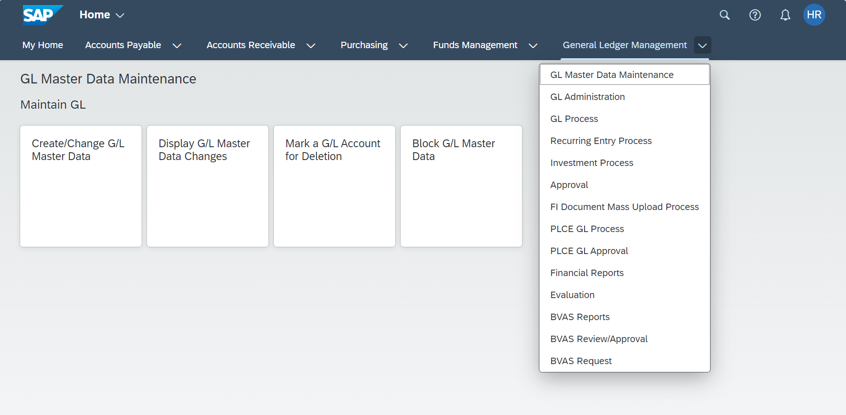
Fiori – Launchpad
The Fiori Launchpad is the first page users see after signing in.
The Launchpad is organized into spaces, pages, sections, and apps or tiles.
The terms app and tile are used interchangeably.
Space
Page
Section
App / Tile
*Please note: The visual example provided above is illustrative only. Your Launchpad may appear differently based on your role and can be customized individually.

Slide 15
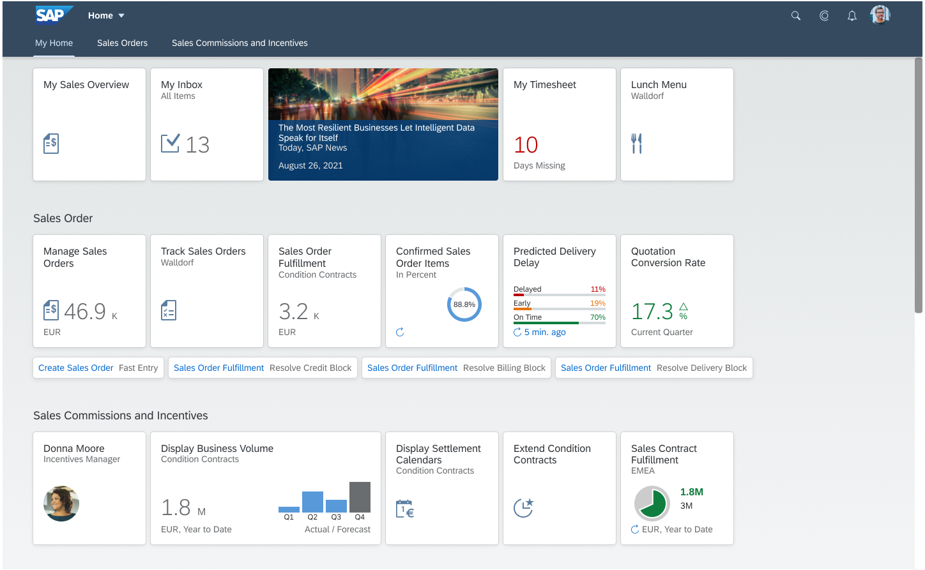
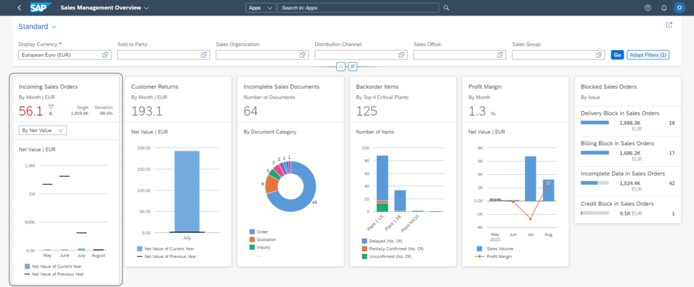
Fiori – Embedded Analytics
Key operational metrics appear directly on Fiori tiles. Users can click into operational reports to drill down and make decisions using real-time data.
1
2
3
4
To learn more about Fiori, watch this video.

Slide 16
Fiori Details (General Changes) 1 of 1
Review the information below to understand how Fiori may impact day-to-day activities. Remember, only transactions with changes are detailed here. Most transactions will remain the same as they are today. View these changes in spreadsheet format here.
Today | Tomorrow | What does this mean for you? | Groups Impacted
In ECC, users are familiar with the Portal as their primary user interface. | In S/4HANA, Fiori will be the primary user interface. | Transactions will move from Portal to Fiori. Fiori is SAP's modern and user-friendly interface design, built with a focus on simplicity, responsiveness, and enhanced functionality, including embedded reporting. Here are some of the key changes and benefits users will experience with Fiori: Personalization - Users can customize their Fiori launchpad layout, organizing apps in a way that makes sense for their role. Additional customization options include preset filters and color scheme. Ease of use - Fiori employs the app-based design users have come to know and love in smart phones. Each transaction has its own clearly labeled app that users will click into to initiate a transaction. Most frequently used apps as well as most recently used apps are easily accessible to users for quick navigation. Neat and tidy display - Users will only see apps and transactions relevant to their role, minimizing visual clutter. The interface is overall more visually appealing, harnessing clean lines, sans serif font, and high-contrast elements. Searchability - The search bar has increased functionality, allowing users to search for transactions, data records, and more. Within transactions, additional search fields allow users to find records more easily. Data analytics - Key operational metrics appear directly on Fiori apps, and users can click into operational reports to drill down and make decisions using real-time data. | All FMMI users

Slide 17
Fiori Details (app-level Changes) 1 of 6
Today | Tomorrow | What does this mean for you? | Groups Impacted
In ECC, users access transactions Reverse Clearing and Reset/Reverse Cleared Items via Portal. | In S/4HANA, users will access transaction Reset Cleared Items via Fiori app. | The Clearing Document field will be renamed to Clearing Journal Entry. Results from a search can also be utilized as a report. Users will be able to see details of a document prior to reversal. | All FMMI users
In ECC, users access transactions Change AR Reversal Document and Change Header G/L Account Document via Portal. | In S/4HANA, users will access transaction Manage Journal Entries via Fiori app. | Document Number will be renamed to Journal Entry. Document Date will be renamed to Journal Entry Date. Documents will be listed out so that users do not have to enter a document number. Users will get an error message when attempting to edit a document that is already being edited by another user. Authorization/security level will determine what functionality users have. | All FMMI users
In ECC, users access transaction General Evaluations Report via Portal. | In S/4HANA, users will access transaction Purchase Order Value and Scheduling Agreement Value via Fiori app. | Users can toggle between graph view and list view. | All FMMI users

Slide 18
Fiori Details (app-level Changes) 2 of 6
Today | Tomorrow | What does this mean for you? | Groups Impacted
In ECC, users access the following transactions via Portal: Reverse Invoice, Create AR Reversal Document, and Reverse G/L Account Document. | In S/4HANA, users will access transaction Manage Journal Entries via Fiori app. | There are no significant functional changes to this transaction, but user navigation through the transaction will be different. | All FMMI users
In ECC, users access transaction Vendor Address List Report via Portal. | In S/4HANA, users will access transaction Display Supplier List via Fiori app. | There are no significant functional changes to this transaction, but user navigation through the transaction will be different. | All FMMI users, specifically those involved in Master Data
In ECC, users access the following transactions via Portal: Add Shorthand Code and Modify Shorthand Code. | In S/4HANA, users will access transaction Add or Modify Shorthand Code via Fiori app. | Shorthand code add and modify functions will be combined into one transaction for efficiency. | Shorthand Code Adders and Modifiers
In ECC, users access transaction View Shorthand Code via Portal. | In S/4HANA, users will access transaction View Shorthand Code via Fiori app. | Users will click "Go" instead of "Execute" to run reports. | Shorthand Code Viewers
In ECC, users access transaction Down Payment Request via Portal. | In S/4HANA, users will access transaction Manage Supplier Down Payment Requests via Fiori app. | The Account field will be renamed to Supplier. | AP Processors that advance against funds commitments

Slide 19
Fiori Details (app-level Changes) 3 of 6
Today | Tomorrow | What does this mean for you? | Groups Impacted
In ECC, users access transaction Due Date Analysis for Open Items via Portal. | In S/4HANA, users will access transaction Aging Analysis via Fiori app. | Aging Analysis in Fiori includes additional graphing functionality. | AP & FB
In ECC, users access transaction Enter and Park LIV Document via Portal. | In S/4HANA, users will access transaction Manage Supplier Invoices via Fiori app. | There are no significant functional changes to this transaction, but user navigation through the transaction will be different. | AP
In ECC, users access transaction View TAS/BETC Data Records via Portal. | In S/4HANA, users will access transaction View TAS/BETC Data Records via Fiori app. | Users will click "Go" instead of "Execute" to run reports. | TAS/BETC Data Record users
In ECC, users access the following transactions via Portal: Create Vendor/Customer Master Data Request and View Vendor/Customer Master Data Request. | In S/4HANA, users will access transaction PVND - Create or View Vendor/Customer Master Data Request via Fiori app. | Instead of requesting creation of a customer or vendor record, users will request creation of a Business Partner record, specifying whether the Business Partner is a customer or vendor. FMS CVMDM will review and approve Business Partner creation requests. | Customer and Vendor Requestors and Viewers

Slide 20
Fiori Details (app-level Changes) 4 of 6
Today | Tomorrow | What does this mean for you? | Groups Impacted
In ECC, users access the following transactions via Portal: Display Parked Document, Display List of Invoice Documents, List Purchase Orders, Purchase Requisition List Display Report, Display Funds Commitment, and Drilldown for Budget Entry Documents. | In S/4HANA, users will access transaction Parked Documents via Fiori app. | Authorized users will be able to mass delete parked documents and make mass date changes themselves using one transaction instead of submitting a ticket to FMS. Only users with the appropriate role will have access to mass delete/date change. | Parked Document Deletion Requesters
In ECC, users access transaction Block Invoice via Portal. | In S/4HANA, users will access transaction Supplier Invoices List via Fiori app. | Users will navigate to invoices using a list to edit, delete, or post invoices. | PO Processors and Invoicers
In ECC, users access transaction Display List of Invoice Documents via Portal. | In S/4HANA, users will access transaction Supplier Invoices List via Fiori app. | There are no significant functional changes to this transaction, but user navigation through the transaction will be different. | PO Processors and Invoicers
In ECC, users access transaction Cancel Invoice Document via Portal. | In S/4HANA, users will access transaction Manage Supplier Invoices via Fiori app. | There are no significant functional changes to this transaction, but user navigation through the transaction will be different. | PO Invoice Processors
In ECC, users access transaction Display Invoice - LIV via Portal. | In S/4HANA, users will access transaction Supplier Invoices List via Fiori app. | There are no significant functional changes to this transaction, but user navigation through the transaction will be different. | PO Processors and Invoicers

Slide 21
Fiori Details (app-level Changes) 5 of 6
Today | Tomorrow | What does this mean for you? | Groups Impacted
In ECC, users access transaction Display Parked Invoice via Portal. | In S/4HANA, users will access transaction Supplier Invoices List via Fiori app. | There are no significant functional changes to this transaction, but user navigation through the transaction will be different. | PO Processors and Invoicers
In ECC, users access the following transactions via Portal: Record Goods Receipt, Return Goods Receipt, and Cancel Goods Receipt. | In S/4HANA, users will access transaction Material Document Overview via Fiori app. | There are no significant functional changes to this transaction, but user navigation through the transaction will be different. | IAS Processors
In ECC, users access transaction Display Material Documents via Portal. | In S/4HANA, users will access transaction Display Material Documents via Fiori app. | There are no significant functional changes to this transaction, but user navigation through the transaction will be different. | PO Handlers, especially IAS or Procurement POs; PO Processors, Reporters, Evaluators, and Approvers
In ECC, users access transaction Post LIV Document via Portal. | In S/4HANA, users will access transaction Supplier Invoices List via Fiori app. | There are no significant functional changes to this transaction, but user navigation through the transaction will be different. | PO Processors and Invoicers
In ECC, users access transaction Incoming Payments via Portal. | In S/4HANA, users will access transaction Post Incoming Payments via Fiori app. | There are no significant functional changes to this transaction, but user navigation through the transaction will be different. | Collection Processors

Slide 22
Fiori Details (app-level Changes) 6 of 6
Today | Tomorrow | What does this mean for you? | Groups Impacted
In ECC, users access transaction Material Document List Report via Portal. | In S/4HANA, users will access transaction Material Documents Overview via Fiori app. | There are no significant functional changes to this transaction, but user navigation through the transaction will be different. | IAS Purchase Order users

Slide 23
Simplified Data Model
Universal Journal
MODERATE
LOW
HIGH
Degree of Change

Slide 24
What is the Simplified Data Model?
The upgrade to S/4HANA will combine data tables into a single Universal Journal to improve performance and data accuracy.
1
2
3
4
This will also combine ledgers, thus simplifying the data model and improving system performance and data accuracy.
Benefits of this change include:
Eliminating redundant data
Reducing database size, improving performance
Introducing a single source of information in the Universal Journal
SAP ECC
SAP S/4HANA
Universal Journal
General Ledger
General Ledger
Controlling
Controlling

Slide 25
Simplified Data Model Details 1 of 5
Review the information below to understand how the Simplified Data Model will impact day-to-day activities. View these changes in spreadsheet format here.
Today | Tomorrow | What does this mean for you? | Groups Impacted
In ECC, users are using data from SAP Financials data model. | In S/4HANA, all financial data will be migrated into a single ledger called the Universal Journal. The Universal Journal will offer the same benefits that users enjoy today in ECC. | The SAP Universal Journal is a central component within SAP S/4HANA designed to simplify financial reporting, improve data consistency, and provide real-time insights into an organization's financial performance. The Universal Journal will maintain many of the same benefits that users enjoy in ECC: Single Source of Truth - The Universal Journal integrates various financial and accounting elements, such as general ledger, federal ledger, accounts payable, accounts receivable, asset accounting, and more into a single, unified data structure. This consolidation eliminates the need for separate tables and aggregates financial data in one place, providing a single source of truth for all financial transactions. Real-Time Data - The Universal Journal is built on in-memory database technology, which enables real-time processing of financial data. This means that financial reports and analytics can be generated instantaneously, and users can make decisions based on the most up-to-date information. Flexible Reporting - The Universal Journal allows for flexible and dynamic financial reporting. Users can create multidimensional financial reports and analyze data based on various attributes and dimensions, such as cost centers, business units, and more. Simplified Data Structure - The Universal Journal reduces the complexity of financial data structures, making it easier for users to access, analyze, and understand financial information. Instead, all data will be stored in the Universal Journal. Financial Transparency - The Simplified Data Model will help USDA continue to achieve the greater transparency, efficiency, and accuracy in their financial processes and reporting that they first began to see with FMMI/ECC. | All FMMI users

Slide 26
Simplified Data Model Details 2 of 5
Today | Tomorrow | What does this mean for you? | Groups Impacted
In ECC, Special Purpose Ledger (SPL) Document Number (DOCNR) exists. | In S/4HANA, “List of Documents in Accounting” will not show the SPL documents because they will not be supported in the transition to the Universal Journal. Converted transactions will not retain their ECC SPL document number. | Users will use the Universal Journal instead of SPL documents. | All FMMI users
In ECC, Secondary Cost Elements exist only within the CO module. | In S/4HANA, Secondary Cost Elements (9* series accounts) will appear on Trial Balances. | Due to implementation of the new Universal Journal, Secondary Cost Elements have been established within the General Ledger. As such, activity to these accounts will appear on trial balance reports. | All FMMI users, specifically Trial Balance users
In ECC, users may have custom reports that combine data from Financial Accounting and Controlling. | In S/4HANA, users will be able to access reports with combined data from Financial Accounting and Controlling in Fiori. | Financial Accounting and Controlling Reports from ECC will continue to show as they have historically. Reports with combined data from both Financial Accounting and Controlling will be available in Fiori. | Custom Report users

Slide 27
Simplified Data Model Details 3 of 5
Today | Tomorrow | What does this mean for you? | Groups Impacted
In ECC, users can view US federal attributes through the Special Ledger View. | In S/4HANA, users will be able to view US federal attributes using the General Ledger View. | The Special Purpose Ledger will no longer be available. Users will now view US federal attributes by selecting General Ledger View. | Financial Data Posters, Financial Data Viewers, and Financial Reporters
In ECC, cost element master data is maintained using the following transactions via Portal: Create Primary Cost Element, Change Primary Cost Element, Display Primary Cost Element, and Create Secondary Cost Element. | In S/4HANA, all primary and secondary cost elements will be created as G/L accounts. Cost elements will be managed using transaction Edit G/L Account - Central View via Fiori app. G/L Master Data Maintainers will also be able to update cost element relevant fields using transaction Edit G/L Account - Central View. | Authorized users will be able to create and change cost element master data to maintain Primary Costs or Revenue accounts. Authorized users will also be able to create or change G/L accounts to maintain Secondary Cost accounts. | G/L Master Data Maintainers, Cost Management Master Data Maintainers

Slide 28
Simplified Data Model Details 4 of 5
Today | Tomorrow | What does this mean for you? | Groups Impacted
In ECC, Secondary Cost Elements are created manually and are not linked to a G/L account. | In S/4HANA, Secondary Cost Elements will be integrated into G/L master data and be managed within the G/L account master. Secondary Cost Elements will have a corresponding G/L account. | The following transactions will be redirected to transaction Create or Change G/L Master Data in S/4HANA: Create Primary Cost Element, Change Cost Element, Display Cost Element, and Create Secondary Cost Element. In G/L Master, G/L Account Type field for Secondary Costs or Revenues update the CSK* and SK* tables. There will be a Cost Element Category field in the Control Data Tab of the GL Master. This field will specify cost element type and determine how the cost element is used in transactions and reporting. Secondary Cost Elements will now be included in the profit and loss structure of Financial Statement Version (FSV) in FI for reporting. | G/L Master Data Maintainers
In ECC, debits and credits shown as "D" and "C." | In S/4HANA, debits and credits will be shown as "+" and "-." | Debit and credit indicators will be updated from "D" and "C" to "+" and "-" to comply with the latest accounting guidelines. | G/L Processors, Invoice Processors, FI Document Viewers, FI Document Enterers

Slide 29
Simplified Data Model Details 5 of 5
Today | Tomorrow | What does this mean for you? | Groups Impacted
In ECC, users have the option to view WBS hierarchies graphically. | In S/4HANA, the graphic view of WBS elements will no longer be available. | Users will no longer have the option to view hierarchies on WBS elements or project codes graphically. Users will continue to be able to see hierarchies as a list, and all information will still be available. | Master data viewers, especially those who maintain projects and WBS elements

Slide 30
Business Partner Records
An Umbrella Over Customer & Vendor Records
MODERATE
LOW
HIGH
Degree of Change

Slide 31
What is A Business Partner Record?
The launch of FIET will introduce Business Partner (BP) records to FMMI. Business Partner records will serve as an umbrella that captures data for all customers and vendors.
1
2
3
4
Users will now view Business Partner records for information on customers and vendors and may experience minor changes to what they are familiar with today.
Business Partner Records
Customer Records
Vendor Records

Slide 32
BP Record Details 1 of 2
Review the information below to understand how Business Partner Records will impact day-to-day activities. View these changes in spreadsheet format here.
Today | Tomorrow | What does this mean for you? | Groups Impacted
In ECC, customer data and vendor data are maintained on customer and vendor records. | In S/4HANA, each customer record and vendor record will have a Business Partner record that sits on top of it. | S/4HANA introduces Business Partner Records. A single Business Partner Record will sit on top of each customer record and each vendor record. With the introduction of the Business Partner Record, changes to customer or vendor data will need to be made at the Business Partner level. Key things to know related to this change include: Business Partner – A Business Partner (BP) can be a customer or a vendor. For customers, the BP number and customer number will be different; the BP number will be within the vendor number range. For vendors, the BP number and vendor number will be the same. PVND Process Change – The Customer & Vendor Master Data Team will maintain the PVND process so that data flows down from the BP level to customers and vendors. Business Relationships – BPs provide a more coherent view of business relationships, as a single entity can play both customer and vendor roles. No CRM Impact – There will be no change to BPs in CRM. BPs will be created and updated in S/4HANA, similar to the current process in ECC. Interfaces – The interfaces inbound to FMMI that create/change customer and vendor data will now create/change BP data instead. The BP data syncs to the customers and vendors. Interfaces that send customer and vendor data to agency systems will be unchanged. Search – Users will still be able to search for customers and vendors using transaction Business Partner. | Interface Teams, Customer and Vendor Requesters, Travel Reimbursements and Relocation Teams

Slide 33
BP Record Details 2 of 2
Today | Tomorrow | What does this mean for you? | Groups Impacted
In ECC, all users encounter personal identifiable information (PII) masking on key fields, such as tax and banking information. Masking is either active or non-active based on user authorization and enforced on customer and vendor master records. Unauthorized users see stars masking PII fields. | In S/4HANA, all users will still encounter PII masking on key fields, such as tax and banking information. Masking will be either active or non-active based on user authorization and enforced on Business Partner master records. Unauthorized users will see stars masking PII fields. | Users will continue to encounter PII masking on key fields of Business Partner master records, just the same as they currently experience PII masking in customer and vendor records today. | All FMMI users, especially those authorized to view PII
In ECC, users create a request to create/change customer or vendor data such as name, address, and more using the following transactions: View Customer Master Data and Display Vendor Master. | In S/4HANA, users will create a PVND request to create/change customer or vendor data through transaction Business Partner. | Users will continue to request changes to customer and vendor data through PVND. The system will then execute those changes through the BP. The process will remain largely the same as it is today, but with layout and stylistic improvements. | Customer Vendor Master Data Creation and Modification Requesters

Slide 34
Reporting
WBS Element, Cost Center, and Special Ledger Document Number Adjustments
MODERATE
LOW
HIGH
Degree of Change

Slide 35
Reporting Details 1 of 5
Review the information below to understand how Reporting will be impacted by the migration to S/4HANA. View these changes in spreadsheet format here.
Today | Tomorrow | What does this mean for you? | Groups Impacted
In ECC, Special Ledger Document Number (DOCNR) appears in report Data Act Quality Review – NONDATAACT NDA. | In S/4HANA, Special Ledger Document Number (DOCNR) will have the same value as Accounting Document Number (BELNR). | There are no significant changes to this report. | Report users
In ECC, Special Ledger Document Number (DOCNR) appears in report HANA - Vendor Account Activity. | In S/4HANA, Special Ledger Document Number (DOCNR) will have the same value as Accounting Document Number (BELNR). | There are no significant changes to this report. | Report users
In ECC, WBS Element and Cost Center fields appear in report HANA - Shorthand Code. | In S/4HANA, WBS Element and Cost Center will still be displayed but will appear blank in this report. Replacement fields, Funded Program and Fund Center, will be added to the report query and exposed in the display of the report. WBS Element and Cost Center fields will be removed from this report's prompts. | Funded Program will replace WBS Element, and Fund Center will replace Cost Center in this report. Although WBS Element and Cost Center field names will appear in this report but will not return results. | Report users
In ECC, WBS Element and Cost Center fields appear in report HANA - Budget Fund Review Report. | In S/4HANA, WBS Element and Cost Center fields will be removed from display in this report. Replacement fields, Funded Program and Fund Center, will be made available in this report. | Funded Program will replace WBS Element, and Fund Center will replace Cost Center in this report. | Report users

Slide 36
Reporting Details 2 of 5
Today | Tomorrow | What does this mean for you? | Groups Impacted
In ECC, WBS Element and Cost Center fields appear in report HANA - Federal Transaction Register. | In S/4HANA, WBS Element and Cost Center fields will be removed from display in this report. Replacement fields, Funded Program and Fund Center, will be added to the report query and exposed in the display of the report. | Funded Program will replace WBS Element, and Fund Center will replace Cost Center in this report. | Report users
In ECC, WBS Element and Cost Center fields appear in report HDM Amendment Item. | In S/4HANA, WBS Element and Cost Center fields will be removed from display in this report. Replacement fields, Funded Program and Fund Center, will be added to the report query and exposed in the display of the report. | Funded Program will replace WBS Element, and Fund Center will replace Cost Center in this report. | Report users
In ECC, WBS Element and Cost Center fields appear in report HDM Claims BRI Item. | In S/4HANA, WBS Element and Cost Center fields will be removed from display in this report. Replacement fields, Funded Program and Fund Center, will be added to the report query and exposed in the display of the report. | Funded Program will replace WBS Element, and Fund Center will replace Cost Center in this report. | Report users
In ECC, WBS Element and Cost Center fields appear in report HDM Claims Item. | In S/4HANA, WBS Element and Cost Center fields will be removed from display in this report. Replacement fields, Funded Program and Fund Center, will be added to the report query and exposed in the display of the report. | Funded Program will replace WBS Element, and Fund Center will replace Cost Center in this report. | Report users

Slide 37
Reporting Details 3 of 5
Today | Tomorrow | What does this mean for you? | Groups Impacted
In ECC, WBS Element and Cost Center fields appear in report HDM Closeout WBS Total. | In S/4HANA, WBS Element and Cost Center fields will be removed from display in this report. Replacement fields, Funded Program and Fund Center, will be added to the report query and exposed in the display of the report. | Funded Program will replace WBS Element, and Fund Center will replace Cost Center in this report. | Report users
In ECC, WBS Element and Cost Center fields appear in report HDM Funds Pre Commitments Item. | In S/4HANA, WBS Element and Cost Center fields will be removed from display in this report. Replacement fields, Funded Program and Fund Center, will be added to the report query and exposed in the display of the report. | Funded Program will replace WBS Element, and Fund Center will replace Cost Center in this report. | Report users
In ECC, WBS Element and Cost Center fields appear in report Webi - Delta HDM Agreement Item. | In S/4HANA, WBS Element and Cost Center fields will be removed from display in this report. Replacement fields, Funded Program and Fund Center, will be added to the report query and exposed in the display of the report. | Funded Program will replace WBS Element, and Fund Center will replace Cost Center in this report. | Report users
In ECC, WBS Element and Cost Center fields appear in report Webi - Delta HDM Amendment Item. | In S/4HANA, WBS Element and Cost Center fields will be removed from display in this report. Replacement fields, Funded Program and Fund Center, will be added to the report query and exposed in the display of the report. | Funded Program will replace WBS Element, and Fund Center will replace Cost Center in this report. | Report users

Slide 38
Reporting Details 4 of 5
Today | Tomorrow | What does this mean for you? | Groups Impacted
In ECC, WBS Element and Cost Center fields appear in report Webi - HDM Accounting Item (BOBJ Report). | WBS element and cost center will be removed from display in this report. Replacement fields, Funded Program and Fund Center, are already available in this report. | Funded Program will replace WBS Element, and Fund Center will replace Cost Center in this report. | Report users
In ECC, WBS Element and Cost Center fields appear in report Webi - HDM Agreement Item (BOBJ Report). | In S/4HANA, WBS Element and Cost Center fields will be removed from display in this report. Replacement fields, Funded Program and Fund Center, will be added to the report query and exposed in the display of the report. | Funded Program will replace WBS Element, and Fund Center will replace Cost Center in this report. | Report users
In ECC, WBS Element appears in report HANA - INTR Agreement SO Report (BOBJ Report). | In S/4HANA, WBS Element and Cost Center fields will be removed from display in this report. Replacement field Funded Program will be added to the report query and exposed in the display of the report. | Funded Program will replace WBS Element in this report. | Report users
In ECC, WBS Element appears in report HDM Closeout Item. | In S/4HANA, WBS Element and Cost Center fields will be removed from display in this report. Replacement field Funded Program will be added to the report query and exposed in the display of the report. | Funded Program will replace WBS Element in this report. | Report users

Slide 39
Reporting Details 5 of 5
Today | Tomorrow | What does this mean for you? | Groups Impacted
In ECC, WBS Element appears in the prompt and the results of report Webi - ASAP Disbursement Report (ezFedGrants Enterprise HANA Reports). | In S/4HANA, WBS Element will be removed from the display in this report and Funded Program will be displayed instead. Report prompts will also be updated to remove WBS Element and show Funded Program instead. | Funded Program will replace WBS Element in this report. | Report users
In ECC, Cost Center appears in report Webi - HANA Employee Level Payroll Detail Report (BOBJ Report). | In S/4HANA, Cost Center will not appear in this report. Replacement field Fund Center will be added to the report query and exposed in the display of the report. | Fund Center will replace Cost Center in this report. | Report users
In ECC, Cost Center is a prompt in report Spending Detail (General Ledger). | In S/4HANA, Cost Center will be removed from the report prompt options. Replacement field Funds Center is already available in the prompts. | Funds Center will replace Cost Center in this report. | Report users

Slide 40
What to Expect
Preparing for Upcoming Changes

Slide 41
What’s Next?
Prepare for the migration to S/4HANA by completing key actions and utilizing the resources listed below.
Key Actions:
Attend the Financial Training Forum
Read our newsletter series – The Monthly Momentum
Ask questions through the channels listed
Resources for Success:
FIET Webpage
Change Champions
Help Desk
Agency CAM
USDA FIET What's Changing excel version
Subscribe to email updates
Coming Soon:
Survey – The second Stakeholder Survey will hit your inbox this fall
Training – Process-specific demonstrations for changing areas and roles are coming this winter. Be on the lookout for an announcement with more detail.
Job aids – Additional resources preparing you for the migration are coming this winter

