Slide 1

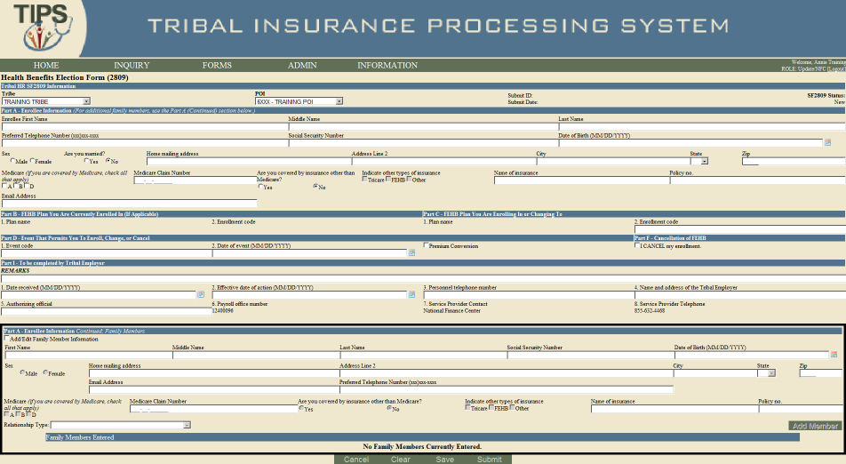
Pg. 1
TIPS SF 2809 Guide
Introduction – SF 2809 in TIPS
This guide is intended to help users understand how to complete key fields in the SF 2809 form. In order to submit the SF 2809, users are also required to complete basic mailing address and demographic fields not covered in this guide. TIPS will prompt users to enter any missing information upon submission of the SF 2809.
Tribal HR SF 2809 Information
Part A – Enrollee Information
Part B – FEHB Plan You Are Currently Enrolled In (If Applicable)
Part C – FEHB Plan You Are Enrolling In or Changing To
Part D – Event That Permits You To Enroll, Change, or Cancel
Part F – Cancellation
Part I – To be completed by Tribal Employer
Part A – Enrollee Information Continued; Family Members
Finalizing a form
Holding a form (only available after submission of the SF2809)
1
6
2
7
3
8
4
9
5
10
1
2
3
4
5
6
7
8
9

Slide 2
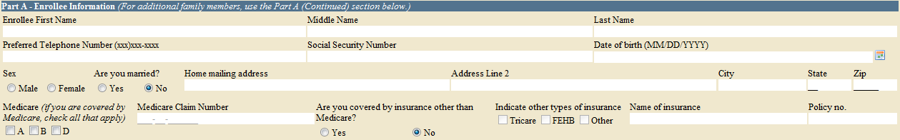
Pg. 2
1. Tribal HR SF 2809 Information
A
B
C
Tribe: TIPS will automatically select the user’s Tribe when creating a new SF 2809
POI: A Billing Unit / POI must be selected on all SF 2809s
SF 2809 Status: The status of the form is indicated in the top right. The status will update once the form has been saved or submitted
2. Part A – Enrollee Information
A
B
C
D
Enrollee First Name, Middle Name, and Last Name: Only first and last name are required. Employees are not required to enter a middle name
Preferred Telephone Number: A valid telephone number is required for all new enrollments. This field can be found in Part H on the paper SF 2809
Social Security Number: A valid Social Security Number is required for all new enrollments
Name of Insurance and Policy no.: Enter Name of Insurance and Policy no. if covered by an additional type of insurance other than Tricare or FEHB
3. Part B – FEHB Plan You Are Currently Enrolled In (If Applicable) 4. Part C – FEHB Plan You Are Enrolling In or Changing To
A
B
2. Enrollment Code: Field is available once an enrollment is processed in FEHB. Used to enter current plan for enrollment changes and cancellations
2. Enrollment Code: All enrollment codes are three-digit alphanumeric codes. A full list of enrollment codes can be found on the OPM website: http://www.opm.gov/insure/health/search/plansearch.aspx. If a Self Only enrollment code has been selected, the user will be unable to add family members in the form. In order to add family members, the user must select a Self & Family enrollment code
5. Part D – Event That Permits You To Enroll, Change, or Cancel 6. Part F – Cancellation
A
B
C
D
1. Event Code: A valid event code is required on SF 2809s. Event codes contain a number then a letter. A list of event codes is available in the paper SF 2809 at: http://www.opm.gov/Forms/pdf_fill/SF2809.pdf. For initial enrollments, enter 1A or 5A depending on participation in premium conversion. The Premium Conversion box must be checked for Series 1 codes. Series 5 codes are used for employees not participating in premium conversion
2. Date of Event: The date an employee becomes eligible for enrollment, change of coverage, or cancellation as defined by the event code. Must occur after March 1, 2012
Premium Conversion: If employee enters a Series 1 code, the Premium Conversion box must be checked. Some POIs do not participate in premium conversion. If an employee’s POI does not participate in premium conversion, the employee will be unable to check the Premium Conversion box
I CANCEL my enrollment: Check this box in order to cancel an employee’s enrollment

Slide 3
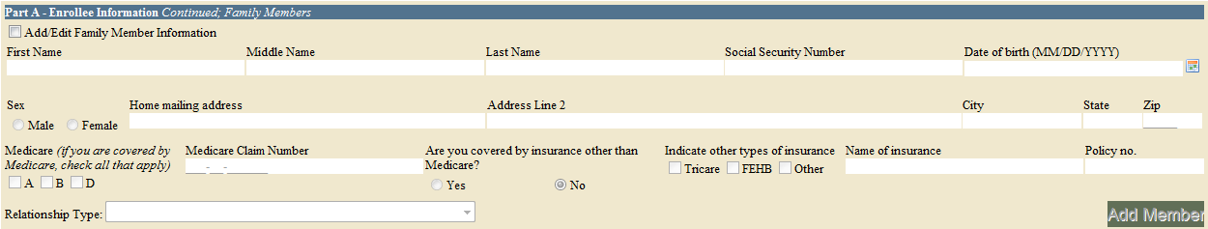
Pg. 3
7. Part I – To be completed by Tribal Employer
A
B
C
D
E
Remarks: Used by the Tribal Employer to include notes. These notes are stored in TIPS, but will not be seen by anyone outside of the Tribal Employer
1. Date Received: The date the Tribal Employer received the SF 2809 form from the employee
2. Effective Date of Action: The date that any enrollment, change in coverage, or cancellation takes effect. Must occur on or after May 1, 2012
3. Personnel telephone number: The telephone number for the HR contact responsible for the employee or Tribal Employer benefits
5. Authorizing Official: The name of the Tribal Employer official authorizing the submission of this form
8. Part A – Enrollee Information Continued; Family Members
A
B
C
Add/Edit Family Member Information: In order to add an additional family member, first check this box before filling out the rest of this section
Relationship Type: A Relationship Type must be specified for all family members
Add Member: Click the Add Member button after completing all required fields. Please note, all required fields must be completed to successfully add a family member. Users will not be able to save family members’ information if it has not been attached to the form via the “Add Member” button
9. Finalizing a Form
A
B
C
D
E
Mark for Deletion: Deletes the non-processed and non-billed records
Cancel: Exits form and returns the user to the homepage
Clear: Deletes all data from the fields allowing the user to start the form again
Save: Saves the form for future edits. To save this form, the following fields are required: POI, First Name, Last Name, and Social Security Number
Submit: Validates the form and releases it to TIPS
10. Holding a Form
A
Hold: After the form is submitted, but before it is processed, users can select “Hold” to edit all fields on the form except Social Security Numbers (of employee and family members), POI, and Tribe. Once edits have been made, select “Submit” to release the form to TIPS. A form may only be held in the “Submitted and Released” status. Once the form status reads “Processed,” all edits must be made using a new SF 2809 or SF 2810

